Slide 1





Towards Multi-Modal DBMSs
for Seamless Querying of Texts and Tables
AMS 691.03 - Data Management
Instructor: Prof. Weihao Wang
Vishnu Sangadala
Eshwar Chaitanya Sarampati
Jaya Chandra Dadi
Harsha Vardhan Reddy Vummadi
1

Slide 2
Structured vs Unstructured Data – The Gap in Databases
Traditional databases are designed for structured, tabular data.
Real-world applications (healthcare, business, journalism) involve unstructured data like text, images, and audio.
SQL, the standard query language, does not support querying free-form text directly.
Extracting insights from text usually requires external tools or custom pipelines that are slow, expensive, and inflexible.

Slide 3
Why Current Systems Fall Short
SQL handles tables, not documents.
Text handling is limited to basic full-text search or regular expressions.
Complex operations like joins between text and tables require manual extraction and preprocessing.
No built-in reasoning capabilities over text meaning or semantics.
Lack of integration between structured and unstructured data types.

Slide 4
Bridging Structured and Unstructured Worlds
A Multi-Modal DBMS (MMDB) allows seamless SQL querying across both tables and text.
It uses Multi-Modal Operators (MMOps) to extract, join, and aggregate data from different modalities.
Text is treated as if it were a virtual table — no need for manual conversion.
Powered by large pre-trained language models (e.g., GPT-3) for intelligent extraction.
Enables unified data analysis across tables and unstructured sources, directly within the database system.

Slide 5
How MMDB is different from others Existing Methods
MMDB is pre-trained with a task-specific strategy designed for table extraction, while traditional methods(text-to-table and Stable) rely on generic pre-trained language models like BART without tailoring to the task.
MMDB adapts to new text domains with just a few examples, whereas traditional models require full retraining for each new dataset.
MMDB avoids hallucination by strictly grounding outputs in the source text, while traditional models can generate fabricated values learned during training.
MMDB enables faster inference by avoiding token-by-token autoregressive decoding, unlike traditional methods which are computationally expensive due to sequential output generation.
MMDB supports complex operations like joins, unions, and aggregations natively, while traditional models are limited to basic table generation and lack built-in support for such MMOps.

Slide 6
MMDB Methdology
Multi-modal Database Storage :
MMDB extends traditional databases by treating text collections as tables, requiring only schema definitions without manual extraction. Unlike others, it supports multimodal data and uses an MMDB-Model to extract structured data via zero-shot or few-shot learning.
Multi-modal Query Execution :
The MMDB-Model uses an encoder to map both the input text and the specified attributes (like diagnosis) into a shared latent space, and a decoder then extracts relevant text spans as values for those attributes.
This extractive mechanism avoids hallucination by pulling exact spans from the input documents instead of generating new content.

Slide 7
The approach supports complex multi-modal scans, including extracting multiple rows per document in a consistent and scalable manner.
Users can perform ad-hoc queries on text collections without pre-building large tables, while also having the option to use materialized views for faster repeated queries.
MMDB Optimizations :
MMDB minimizes the need to run large language models during query execution, reducing computational overhead
It processes and stores expensive multi-modal data transformations offline using materialized views to speed up runtime performance.
It uses multi-modal secondary indexes to enable fast access to only the necessary parts of the text, avoiding full dataset scans.

Slide 8
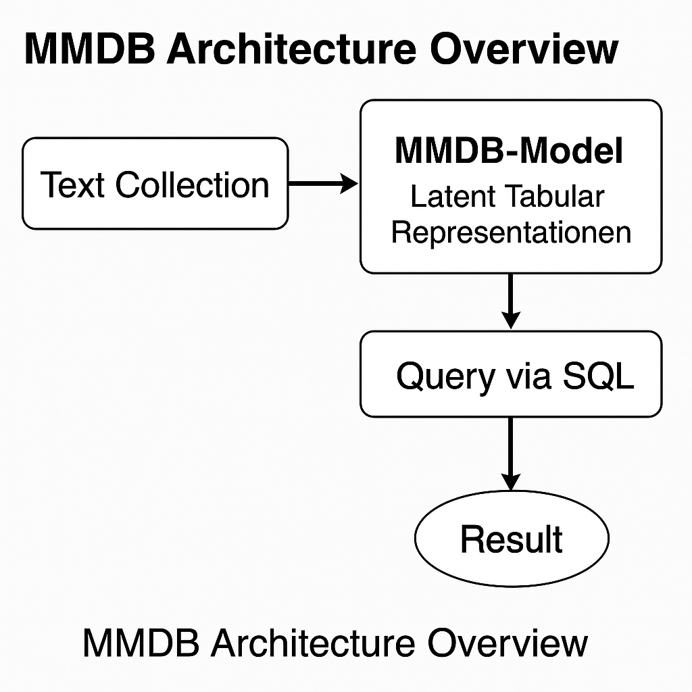
FLOW / Design
Register text as a table
Model transforms text to structured rows
SQL queries use MMOps to extract insights
Results returned as if querying normal tables
Input: Start with free-text documents (e.g., “Alice was diagnosed with fever…”).
Register: Declare a virtual table with desired fields using SQL.
Extract: MMDB’s language model extracts values like diagnosis = fever, treatment = aspirin.
Query: Use standard SQL (e.g., JOIN, WHERE) on the extracted fields.
Result: Get structured output as if querying normal database tables.
Safe & Reliable: MMDB extracts only from the text — no hallucination, no fabrication.

Slide 9
Example: Querying Patient Reports with MMDB
A hospital stores:
Structured data in a patients table (name, age, gender)
Unstructured diagnosis notes in free-text documents
With MMDB:
You can write a single SQL query to:
Join patients with diagnosis text
Extract fields like diagnosis directly from reports
Filter by age or gender and get real-time results
No need to manually extract tables from reports — the MMDB does it automatically using MMOps.

Slide 10
What are Multi-Modal Operators?
Traditional SQL uses operators like JOIN, FILTER, PROJECT.
MMOps extend SQL to handle unstructured data like text.
Examples of MMOps:
Multi-Modal Scan,Multi-Modal Join,Multi-Modal Union and Aggregation
These operators integrate seamlessly into SQL queries and query plans.

Slide 11





How MMOps work?, How Text Can be Transformed into tables without creating one in actual,The Multi-Modal Scan
The multi-modal scan transforms a collection of texts into structured tables using the MMDB-Model, enabling downstream database-style operations.
In basic scans, each text maps to a single row, while complex scans support multiple rows or even multiple tables from one input text.
For simple row generation, the model takes a text and query attributes with MASK tokens, then extracts values using token representations.
The encoder, based on TaBERT, converts input tokens and query attributes into latent representations aware of table structure.
The decoder uses a span-detect head with I-O-B (Inside, Outside, Beginning) tags to identify full-value spans for each attribute.

Slide 12
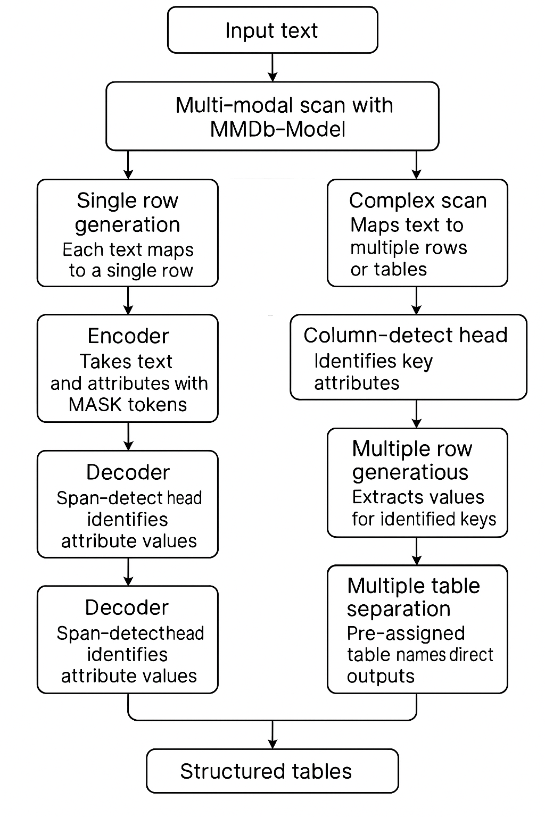
Multi-Modal Scan
For texts with multiple rows (e.g., several diagnoses in a medical report), the scan first identifies all values of a key attribute like "diagnosis."
The column-detect head, separate from the span-detect head, is responsible for finding all instances of the identifying attribute.
The model then iteratively uses the span-detect head to extract related values (e.g., treatments) for each identified key in a second pass.
When rows are uniquely defined by multiple keys (e.g., diagnosis and date), the model extracts all combinations before extracting associated values.
If a text contains information relevant to multiple tables, the model uses prepended table names to separate and direct data into appropriate outputs

Slide 13
OTHER MULTI-MODAL OPERATORS
Multi-modal Join : Combines structured table data (T) with unstructured text documents (D), using linked tuples as context to extract relevant information from text.
Contextual Extraction: The model uses fields from a tuple (e.g., name, date of birth) to guide attribute extraction from text, ensuring relevance and accuracy.
Multi-modal Union: Appends rows extracted from text to an existing table by using sampled rows as examples, enriching the model’s understanding of what to extract.
Multi-modal Aggregation: Operates on text collections without using table data, grouping extracted values across documents for aggregate analysis (e.g., counting diagnoses).

Slide 14
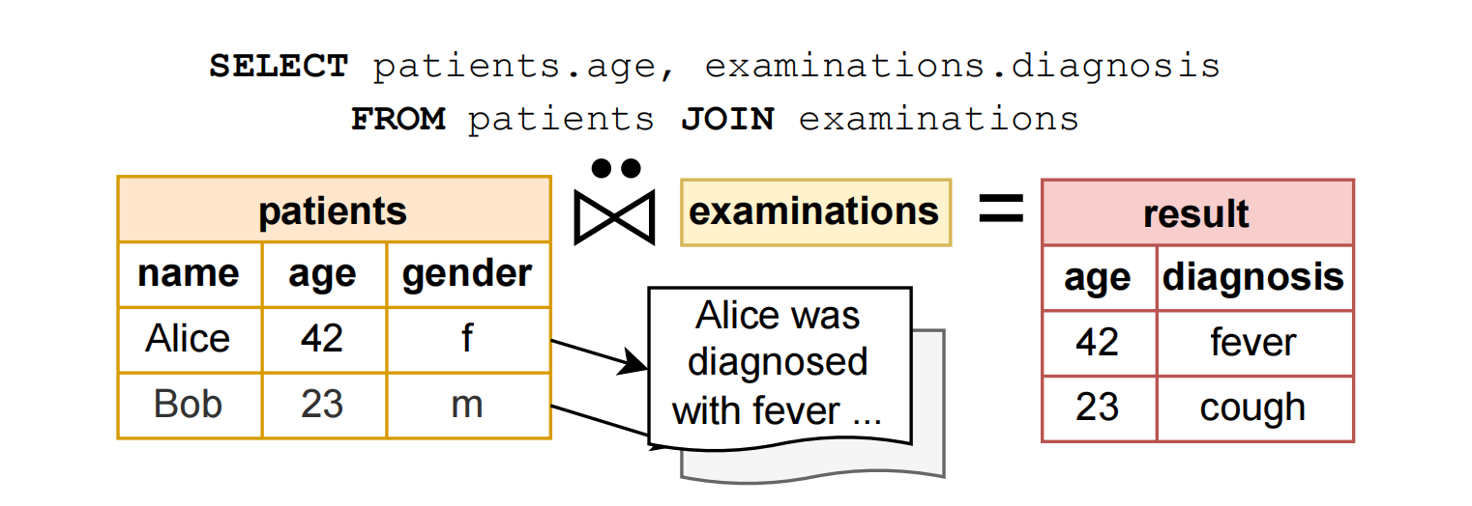
Multi-Modal Join
What Happens:
examinations is registered as a virtual table over text.
The MMDB-Model extracts diagnosis = fever from the document.
A Join is performed using name = Alice between structured and unstructured sources.

Slide 15
MMDB Model Architecture
The MMDB-Model allows table extraction from text with zero- or few-shot learning, meaning it doesn't require retraining for each new set of documents—making it highly adaptable.
It is pre-trained with custom objectives that focus on teaching generalizable extraction skills, rather than memorizing document-specific data.
The model is trained using three key pre-training tasks: Column-Text-Alignment (CTA) to link text to table columns, Masked Cell Reconstruction (MCR) to align rows, and Duplicate Detection (DD) to identify repeated or synonymous content.
A transformer-based text encoder is paired with a multi-head table decoder where each head specializes in a different task—detecting spans, aligning columns, or detecting duplicates.
The table encoder incorporates vertical self-attention, allowing it to model interactions between rows and better understand the structure of tables.
A combined weighted loss function is used to train all components together, with hyperparameters optimized for performance across tasks.

Slide 16
The model includes the Masked Language Modeling (MLM) loss from BERT to reinforce natural language understanding alongside table-specific objectives
A new parallel pre-training corpus was constructed using T-REx alignments of Wikipedia abstracts and Wikidata triples, providing the necessary link between text and structured table data.
To enrich the training data, the dataset generation process includes column name randomization, combining abstracts to simulate multiple entities, and grouping entities into coherent relational tables.

Slide 17
Powering MMDB with Language Models
MMDB builds on Large Pre-trained Language Models (like GPT, BERT, TaBERT).
These models can understand and extract structured meaning from text.
MMDB uses these models as a base for its MMOps, such as scans and joins.
Pretrained models reduce the need for massive custom training.

Slide 18
Accurate and Reliable Extraction
Avoiding Hallucination
Unlike generative models, MMDB uses extractive decoders.
Values must exist in the text — no “made-up” values.
Reduces risks in critical applications (like healthcare).
Detecting Duplicates
Same info may appear with different phrasing (e.g., fever vs high body temperature).
MMDB uses a duplicate-detection head to merge semantically similar entries.

Slide 19
Experimental Evaluation
The evaluation compares the proposed MMDB and MMDB-Model against the text-to-table [43] baseline, showing better computational efficiency and extraction quality with limited training data.
The primary dataset used is the Rotowire dataset, which includes basketball game reports and corresponding tables for team and player statistics, enriched with general information from Wikipedia to support join operations.
The experiments involve multi-modal operations such as scan, join, and union, demonstrating the system's ability to integrate text and table data seamlessly. An additional dataset is constructed using T-REx from three unseen Wikipedia domains—Nobel Prize winners, skyscrapers, and countries—to test generalization.
The setup includes comparisons against strong baselines and utilizes a DGX A100 server, with 4 GPUs used for pre-training and 2 GPUs for fine-tuning and inference.

Slide 20
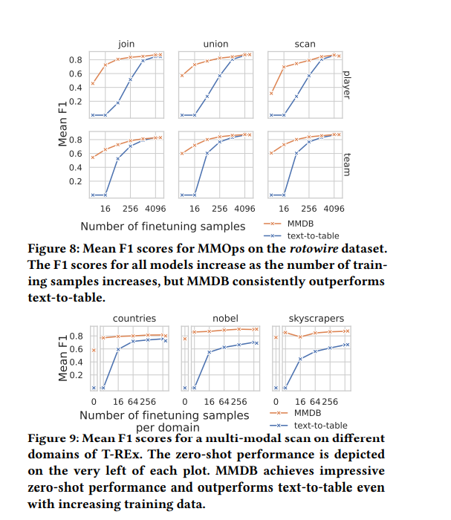
Exp. 1: Accuracy of Multi-Modal Queries
Accuracy with Limited Training Data: MMDB consistently outperforms text-to-table in terms of extraction accuracy (measured by mean F1 score) across both the Rotowire and T-REx datasets, even with very few training samples. MMDB achieves up to 60% F1 on Rotowire with just four samples per table and demonstrates strong zero-shot performance (up to 80% F1) on unseen T-REx domains.
Generalization and Efficiency: MMDB shows strong generalization to new domains (like basketball reports or unseen Wikipedia categories) without hyperparameter tuning. It performs well across multi-modal operations (scan, join, union) and maintains an edge over text-to-table even with increasing data.
Runtime Performance: MMDB is significantly faster than text-to-table, especially for join queries on the Rotowire dataset, with runtimes in the range of seconds compared to several minutes for text-to-table, as shown on a log-scale Y-axis.

Slide 21
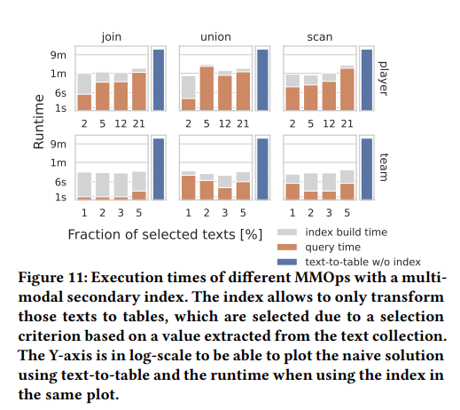
MMDB significantly reduces runtime in selective multi-modal join queries by generating only rows with join partners, avoiding the inefficiency of the text-to-table approach which processes all data regardless of join relevance.
Using multi-modal secondary indexes, MMDB speeds up selective queries by transforming only relevant texts, achieving much faster execution times even when including the cost of index creation.
For materialized view creation, MMDB is far more efficient than text-to-table due to its shallow decoder, which processes entire rows in a single pass, completing view construction in under a minute compared to over 15 minutes.
Exp. 2: Runtime of Multi-modal Operators

Slide 22
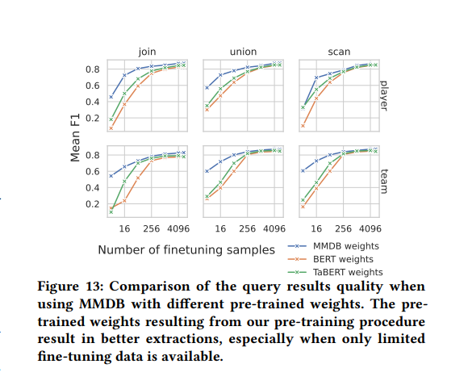
Exp. 3: Ablation Study for Pre-Training
Accuracy with Limited Training Data: MMDB consistently outperforms text-to-table in terms of extraction accuracy (measured by mean F1 score) across both the Rotowire and T-REx datasets, even with very few training samples. MMDB achieves up to 60% F1 on Rotowire with just four samples per table and demonstrates strong zero-shot performance (up to 80% F1) on unseen T-REx domains.
Generalization and Efficiency: MMDB shows strong generalization to new domains (like basketball reports or unseen Wikipedia categories) without hyperparameter tuning. It performs well across multi-modal operations (scan, join, union) and maintains an edge over text-to-table even with increasing data.
Runtime Performance: MMDB is significantly faster than text-to-table, especially for join queries on the Rotowire dataset, with runtimes in the range of seconds compared to several minutes for text-to-table, as shown on a log-scale Y-axis.

Slide 23
Drawbacks & Conclusion
Drawbacks of MMDB
Relies on large language models, which can be resource-intensive.
Extraction accuracy depends on model quality — may need fine-tuning
Initial setup may be complex, especially for defining virtual tables and schema mapping.
Conclusion
MMDB enables seamless SQL querying over both structured tables and unstructured text, eliminating the need for preprocessing or manual pipelines.
It uses language models to extract exact, structured values directly from text, avoiding hallucinated or fabricated outputs.
Unlike vector databases, which retrieve similar text based on embeddings, MMDB supports precise SQL operations like joins, filters, and aggregations.

Slide 24
Thank you

