Slide 1

Risk Assessment Model for Diabetic Patient Readmissions.
Gowtham Venkata Sai Ram Maddala: gowthamvenkata.maddala@stonybrook.edu
Raghu Varma Kosuri: raghuvarma.kosuri@stonybrook.edu
Raghuram Kotaru: raghuram.kotaru@stonybrook.edu
Vishnu Sangadala: vishnu.sangadala@stonybrook.edu
Venkata Shanmukh Reddy Atluru: venkatashanmuk.atluru@stonybrook.edu
1

Slide 2
Problem Statement
Hospital readmissions pose a significant threat to health providers, particularly with diabetic patients. Not only do hospital readmissions equate to added economic costs to the health care system, but they also have negative effects on patients' outcomes.
Research has proven that most of these readmissions can be avoided when there is early identification of risk factors. But the majority of hospitals are still using reactive care instead of proactive methods.
Our Goal:
Predict whether a diabetic patient will be readmitted within 30 days after discharge.
Help healthcare professionals identify high-risk patients using data-driven insights.
2

Slide 3
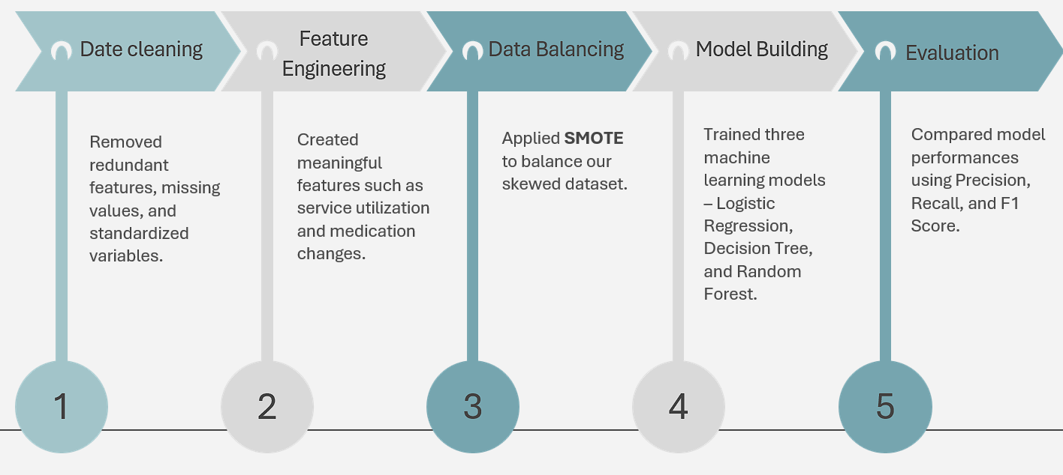
Our Methodology
3

Slide 4
Data Overview
We employed the Diabetes 130-US Hospitals dataset on the UCI ML Repository. It has 10 years of hospital stays for more than 130 US hospitals and includes:
100,000+ patient visits
50+ features in demographics, diagnoses, medications, procedures, and lab tests
Target variable: readmitted (Yes/No within 30 days)
Challenges in the Data:
A large number of missing entries (weight, payer_code, etc.)
A heavy concentration of categorical and string-based columns
Target classes are imbalanced (~11% positive class)
4

Slide 5
Data Preprocessing
Step | Before | After
Total Columns | 50+ | ~40
Missing Values | “?” in multiple fields | NA handled or removed
Diagnosis Codes | RAW ICD-9 (eg., 250.01) | Grouped (e.g.; Endocrine)
Gender Entries | Male, Female, Unknown | Male = 1, Female = 0
Sparse Fields | Weight, payer_code, med_specialty | Dropped
Dropped non-informational or null columns like weight, payer_code, and medical_specialty.
Handled missing values by removing rows with NAs (e.g., for gender or race).
Encoded categorical variables (e.g., Male = 1, Female = 0).
Mapped ICD-9 diagnosis codes to high-level diagnosis categories (e.g., circulatory, endocrine).
Standardized numerical values to ensure models treated variables equally.
5

Slide 6
Feature Engineering
To enhance model predictability, we created a few insightful features:
numchange – Number of changes in medications between 23 drugs
nummed – Number of drugs prescribed for the stay
service_utilization – Sum of inpatient, outpatient, and emergency visits
Diagnosis Mapping – ICD-9 coded at Level 1 categories such as Respiratory, Circulatory, etc.
One-hot encoding – Transformed race, gender, and drug features into binary features
These developed dimensions reflected treatment intensity and complexity, which helped improve model learning.
6

Slide 7
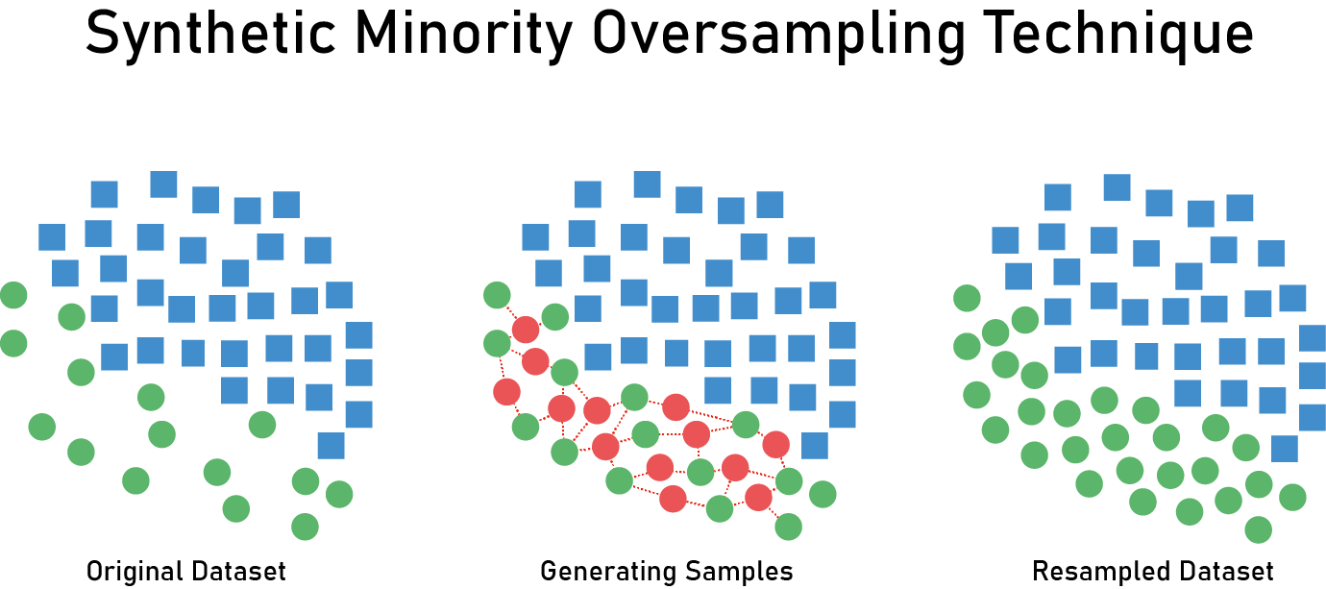
Dealing with Imbalanced Dataset
The first dataset was imbalanced — only 11% of the patients were readmitted within 30 days. This would lead to models predicting the majority class alone.
We overcame this by using SMOTE (Synthetic Minority Oversampling Technique), which:
Creates synthetic minority class samples
Preserves the distribution of data
Substantially improves recall for the minority class.
7

Slide 8
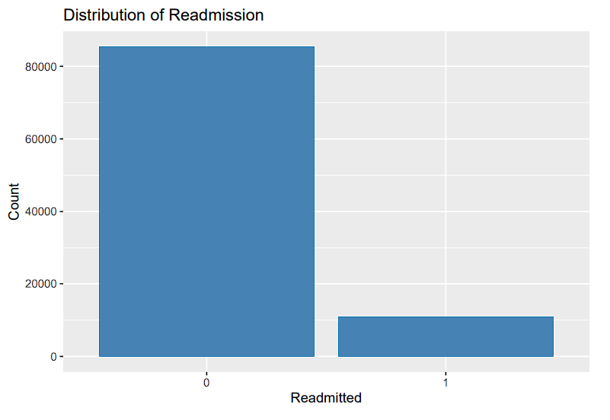
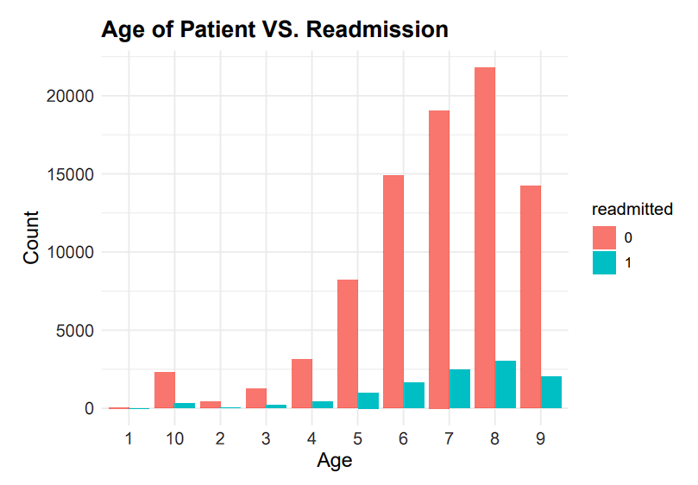
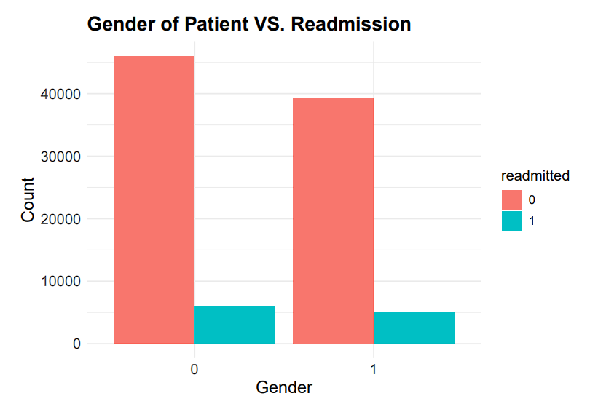
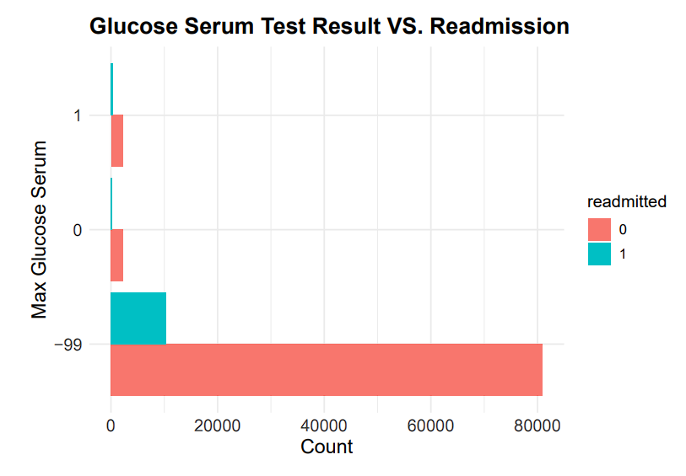
Data Visualization and Analysis
7

Slide 9
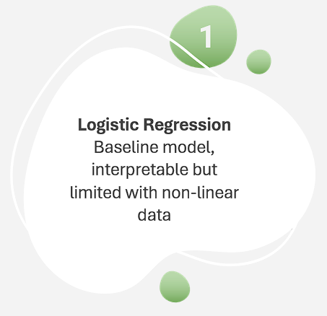
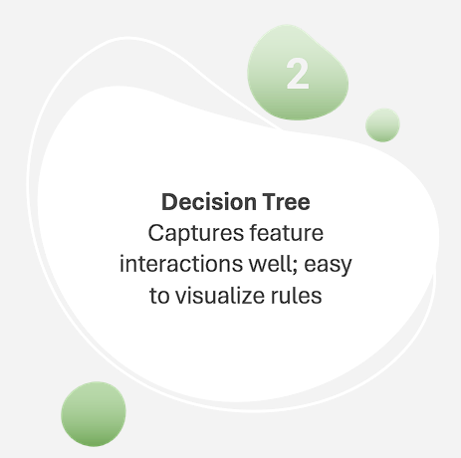
Models Used
A statistical model used for binary classification that models the probability of a class using a sigmoid function.
Key Hyperparameters:
Family = “binomial” – Specifies Logistic Regression
Data = Training dataset
Formula = Response ~ predictors
A non-parametric model that splits the data based on feature thresholds to create a tree of decisions.
Key Hyperparameters:
cp: Complexity parameter (like pruning)
minsplit: Minimum number of observations before a split
maxdepth: Maximum tree depth
minbucket: Minimum number of observations in terminal node
8

Slide 10
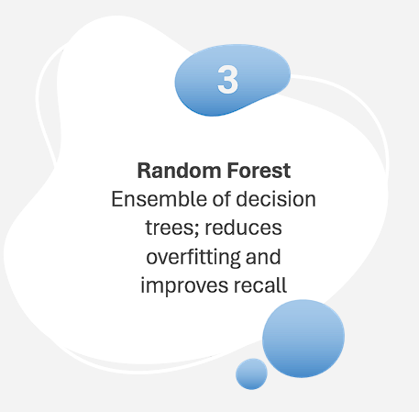
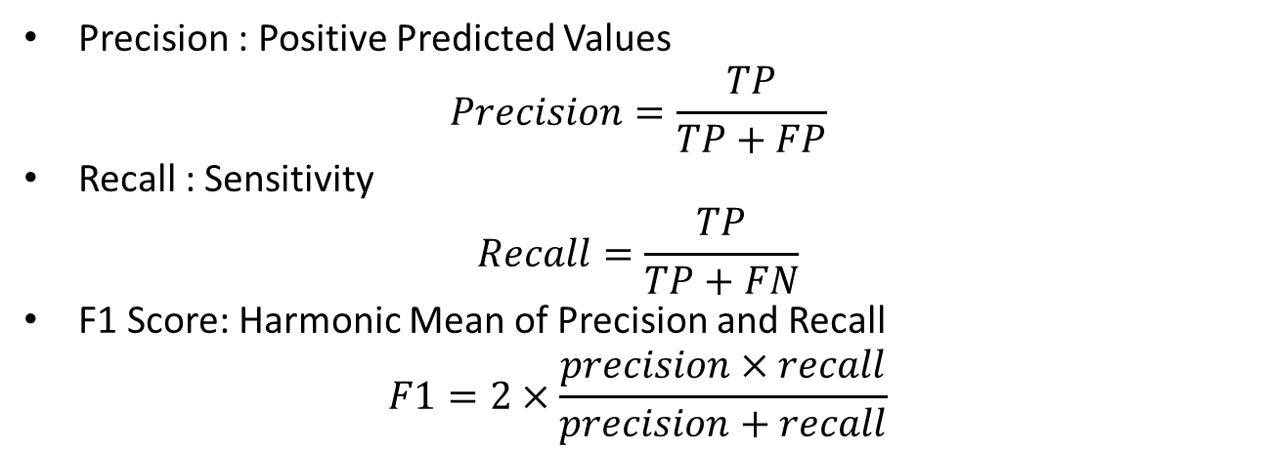
Models Used
An ensemble method that builds multiple decision trees and averages their results for more robust predictions.
Key Hyperparameters:
Ntree: Number of tress(e.g., 100)
Mtry: Number of features to consider per split
Nodesize: Minimum size of terminal nodes
Maxnodes: Max number of terminal nodes.
Model Evaluation
Precision : Positive Predicted Values
$$Precision=\frac{TP}{TP+FP}$$
Recall : Sensitivity
$$Recall=\frac{TP}{TP+FN}$$
F1 Score: Harmonic Mean of Precision and Recall
$$F1=2×\frac{precision×recall}{precision+recall}$$
8

Slide 11





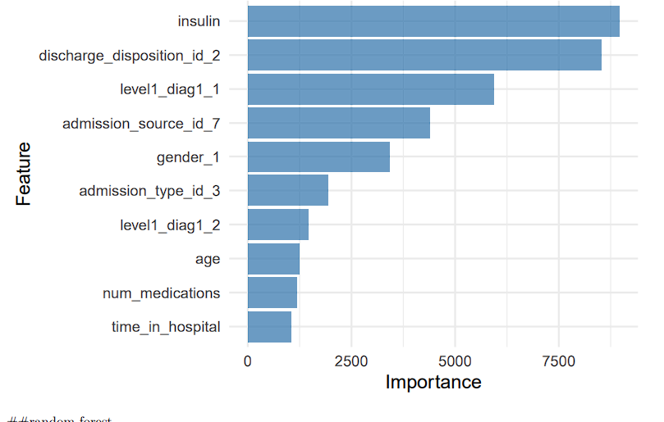
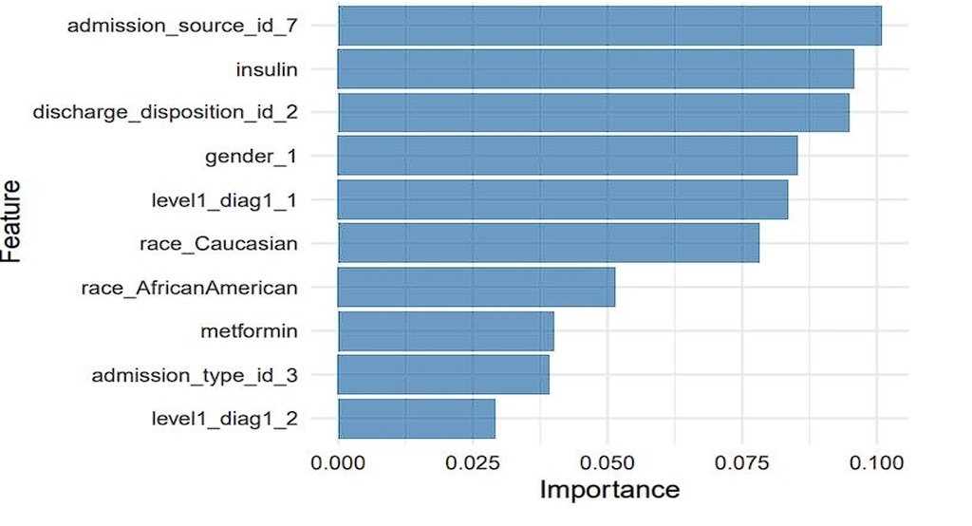
Key Findings
admission_source_id_7
Insulin
Discharge_disposition_id_2
Num_procedures
Number_inpatient
Indicates emergency room referrals. Patients coming from emergencies are more unstable and at higher risk of readmission
Usage and change in insulin dosage were strong indicators of diabetes management complexity
Patients discharged to other healthcare facilities tend to have more severe conditions
A higher number of procedures during admission often signals complications.
Indicates past inpatient history, showing a trend of frequent readmissions.
Most Important Features – Decision Tree
Most Important Features – Random Forest
10

Slide 12
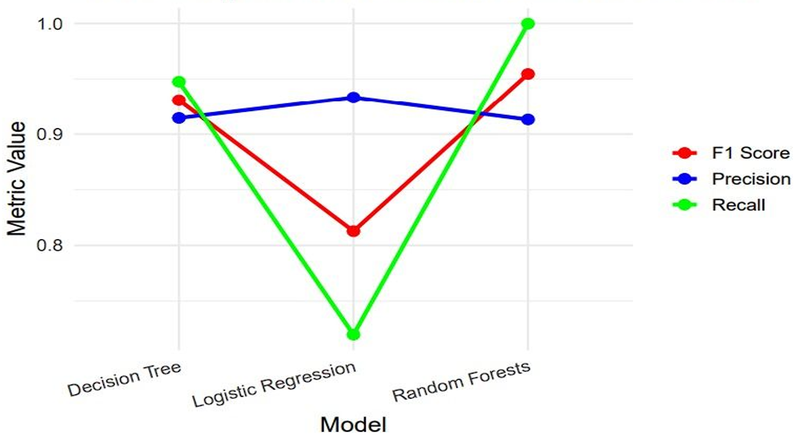
Model Comparison : F1 Score, Precision, Recall
F1 Score, Precision, Recall for all the 3 models:
 | Logistic Regression | Decision Tree | Random Forest
F1 Score | 0.8128 | 0.9307 | 0.9545
Precision | 0.9332 | 0.9145 | 0.9132
Recall | 0.7198 | 0.9476 | 0.9998
9

Slide 13
Future Scope
While the current study provides a strong foundation, there are several areas for improvement:
Data Enrichment: Features like weight, which had over 98% missing values, could be highly predictive if collected reliably. Incorporating such attributes could further enhance model accuracy.
Generalization Across Diseases: This model was trained specifically on diabetic patients. Future work can involve training a generalized model for hospital readmission across various diseases.
Model Optimization: Performance can be further improved through hyperparameter tuning, ensemble stacking, or deep learning approaches.
Explainability: Incorporating SHAP or LIME for model explainability can help clinicians better trust and adopt the model in practice.
16

Slide 14
Conclusion
In this project, we developed a predictive model to identify the likelihood of hospital readmission among diabetic patients.
The dataset underwent thorough preprocessing involving feature encoding, handling of missing values, standardization, and transformation of skewed variables.
We engineered new features such as service_utilization, numchange, and several interaction terms to capture deeper relationships within the data.
To address the inherent class imbalance in the target variable, we employed the Synthetic Minority Oversampling Technique (SMOTE), ensuring more balanced model training.
We trained and evaluated multiple machine learning models — Logistic Regression, Decision Tree, and Random Forest. Among these, Random Forest performed the best with an F1-score of 0.9545.
Demonstrating its effectiveness in handling imbalanced classification and capturing complex patterns in the dataset.
To interpret model predictions, we extracted feature importances using Decision Tree and Random Forest classifiers.
The most influential features contributing to readmission included:
Time in Hospital
Discharge Disposition ID
Number of Diagnoses
Number of Medications
Number of Procedures
Level 1 Diagnosis Code
Age
Gender
Insulin Usage
Metformin Usage
These findings offer actionable insights into factors influencing patient readmission and can support clinical decision-making.
16

Slide 15
THANK YOU ☺
17

