Slide 1
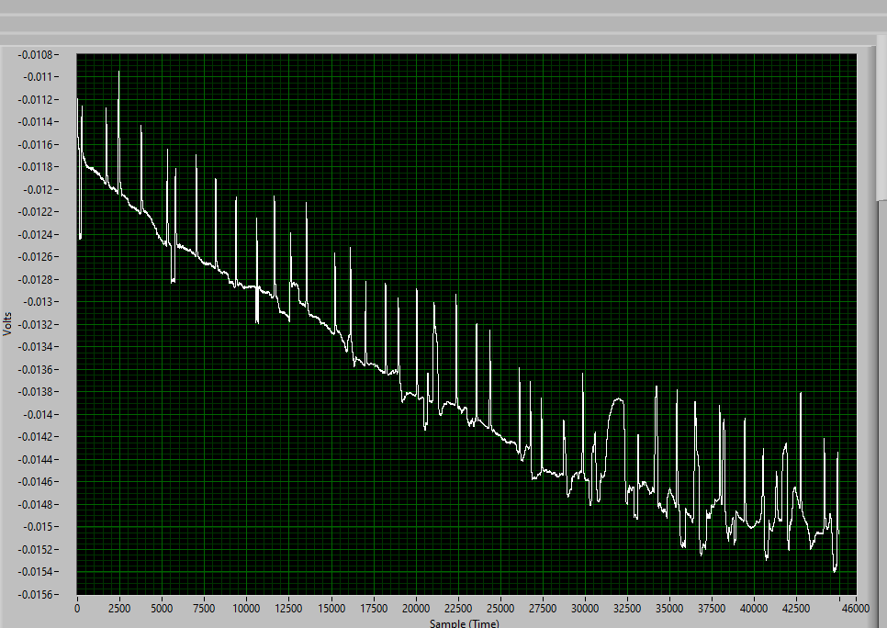
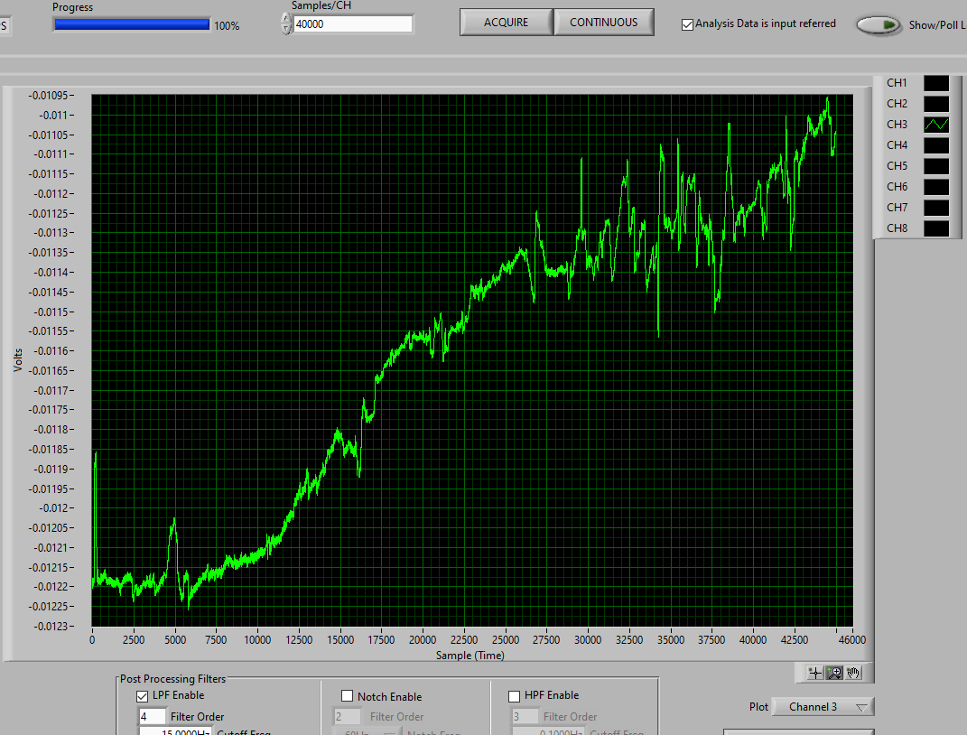
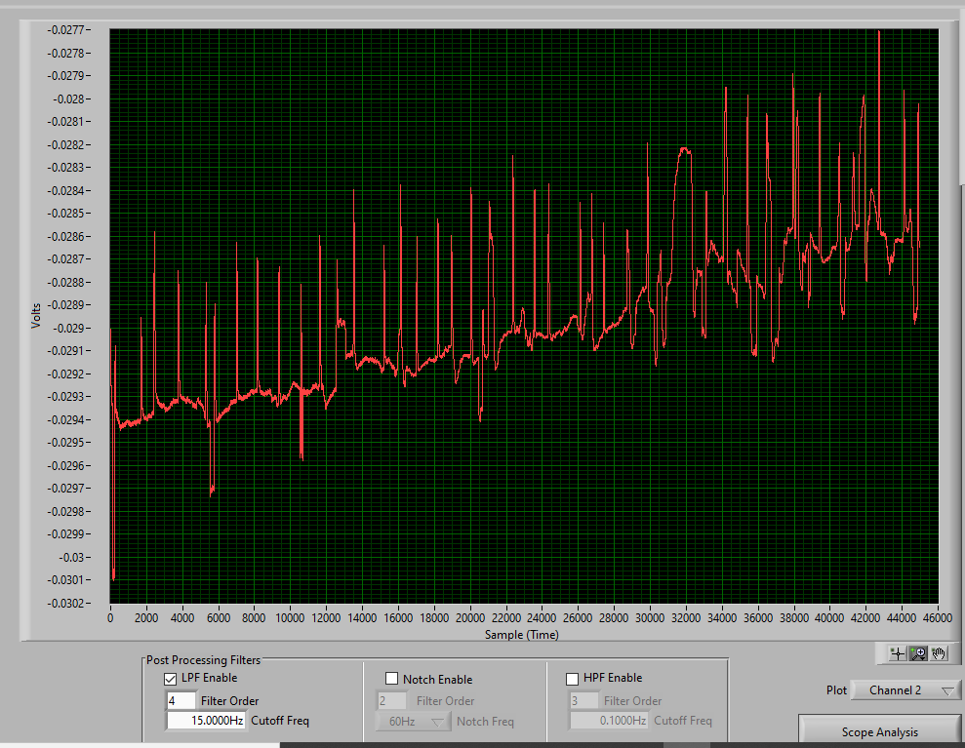
Ch1
Ch3
Ch2
Trial # 1
Sirisha – 39 – F, Normal,
Spontaneous blinks ~ 3 mins
Electrode placement: 1
Ch1, Ch2- vertical channel, Ch3-Hrzontal (L- positive, R – negative)
LPF: order= 4, Cut-off:15 Hz
Only one common reference for Ch-A and Ch-B
SPS:256

Slide 2
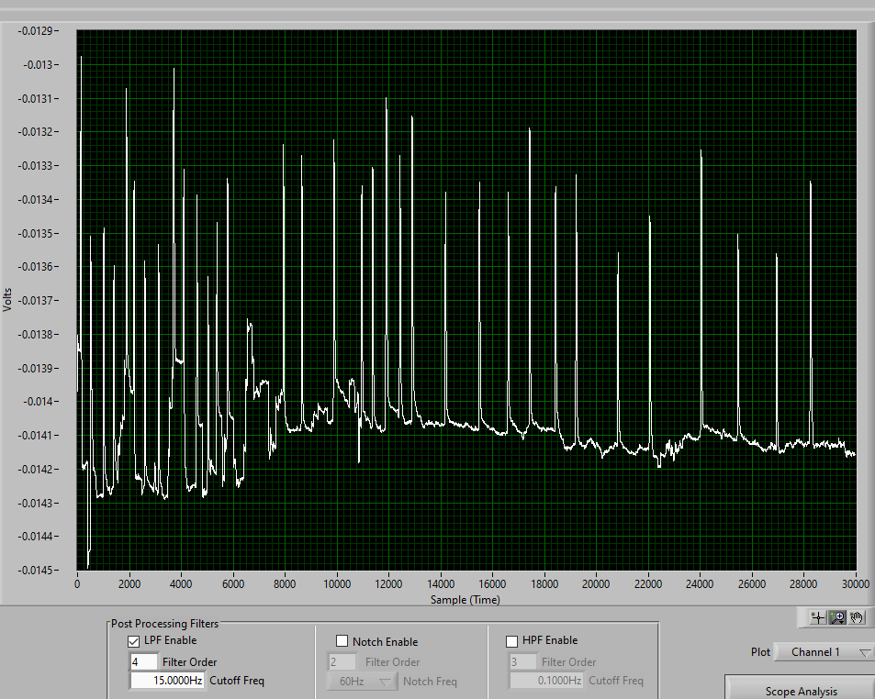
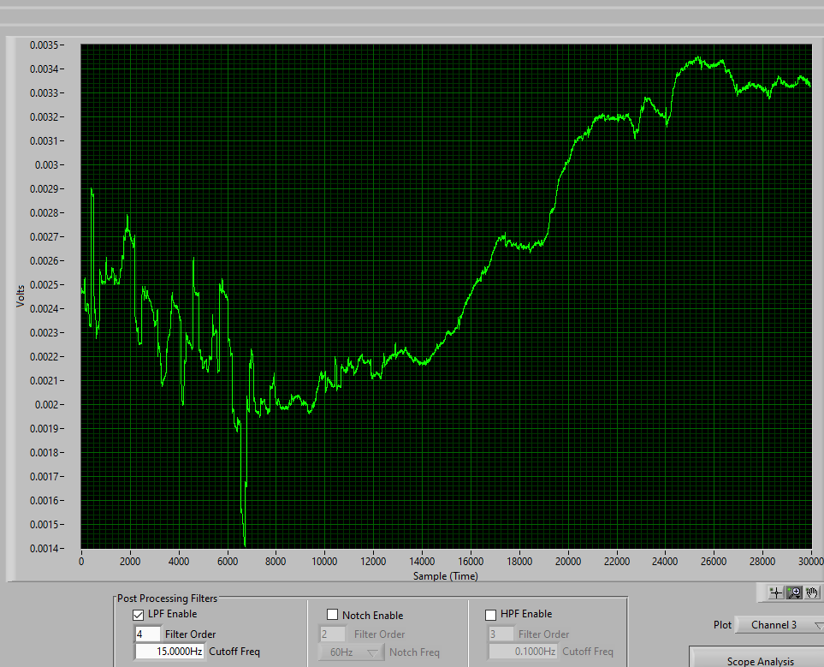
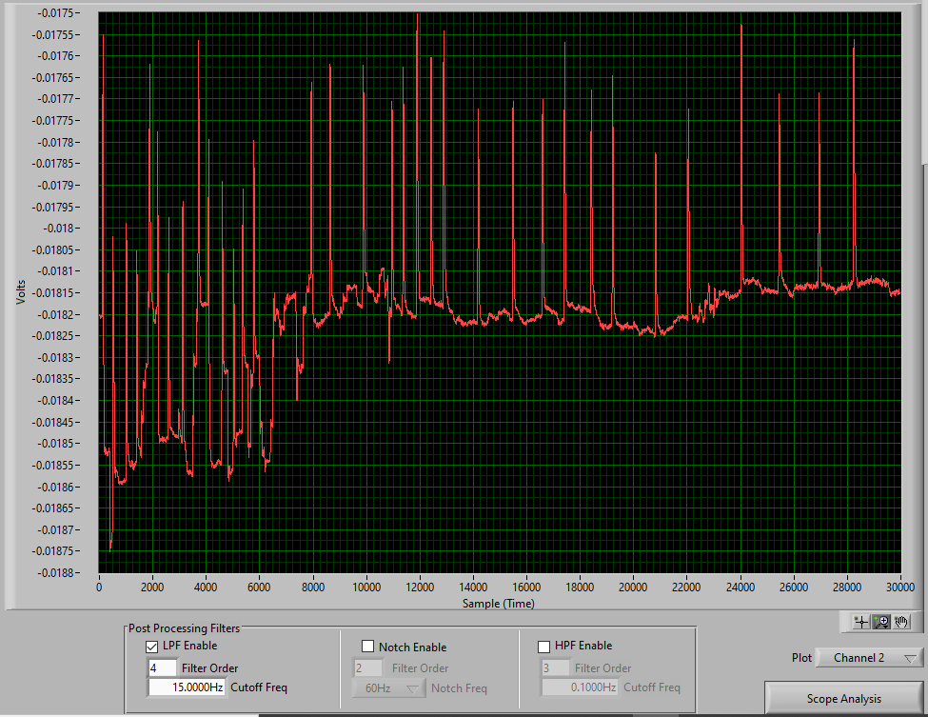
Ch1
Ch3
Ch2
Trial # 2
Sirisha – 39 – F, Normal,
Spontaneous blinks ~ 3 mins
Electrode placement: 1
Ch1, Ch2- vertical channel, Ch3-Hrzontal (L- positive, R – negative)
LPF: order= 4, Cut-off:15 Hz
Only one common reference for Ch-A and Ch-B
SPS:256

Slide 3
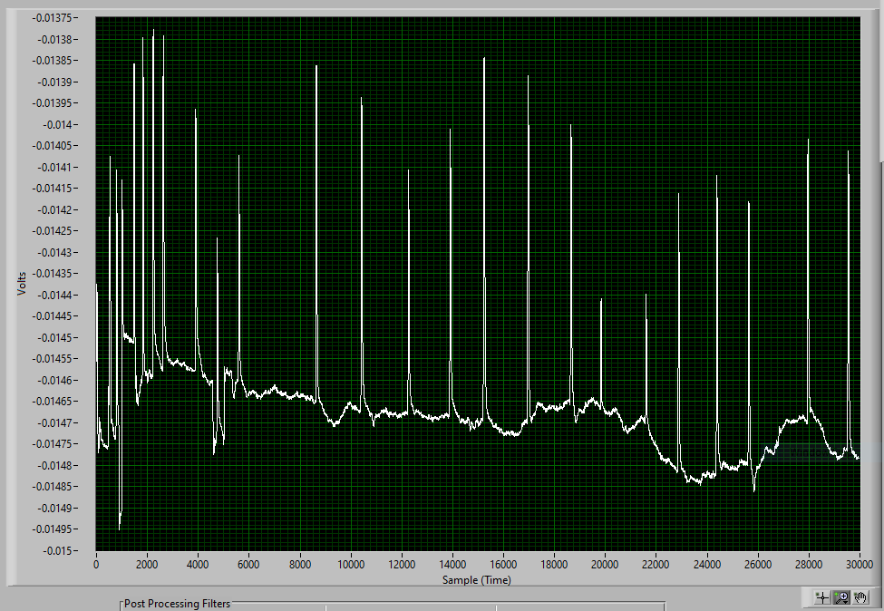
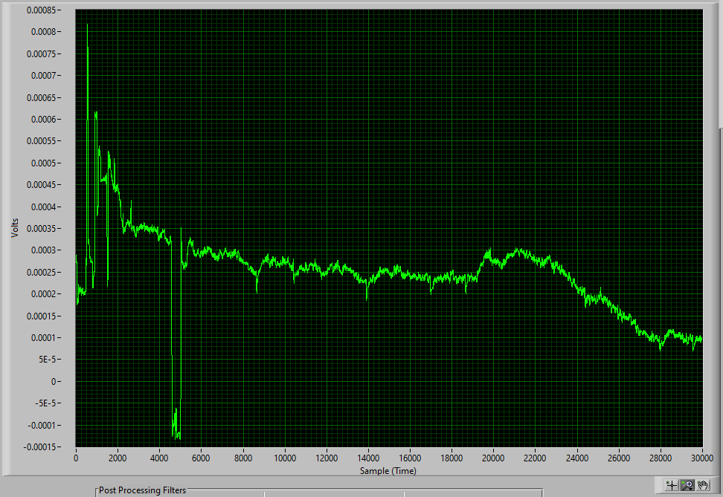
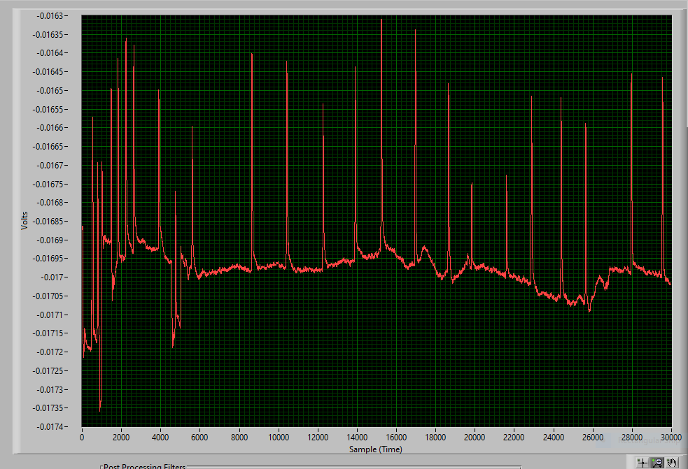
Ch1
Ch3
Ch2
Trial # 3
Sirisha – 39 – F, Normal,
Spontaneous blinks ~ 3 mins
Electrode placement: 1
Ch1, Ch2- vertical channel, Ch3-Hrzontal (L- positive, R – negative)
LPF: order= 4, Cut-off:15 Hz
Only one common reference for Ch-A and Ch-B
SPS:256

Slide 4
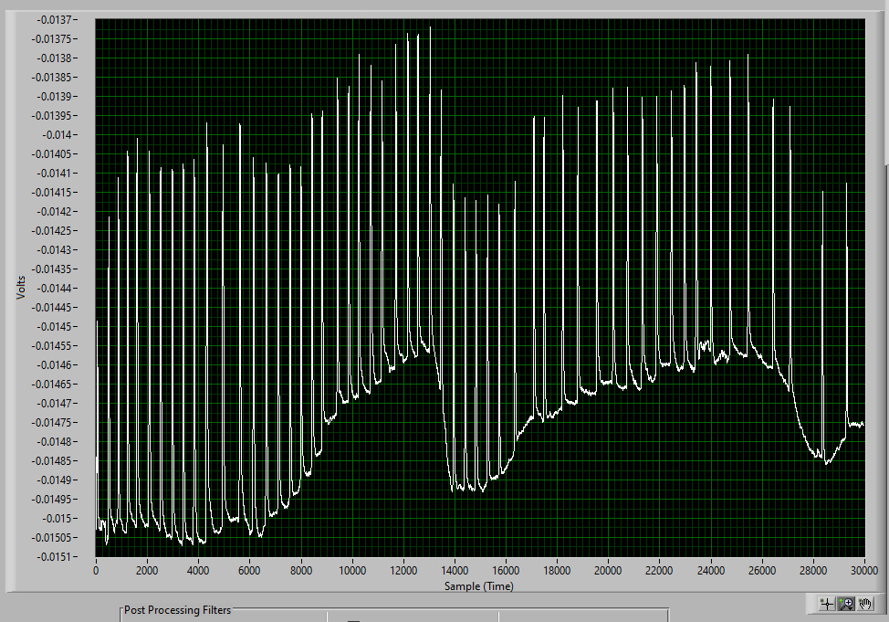
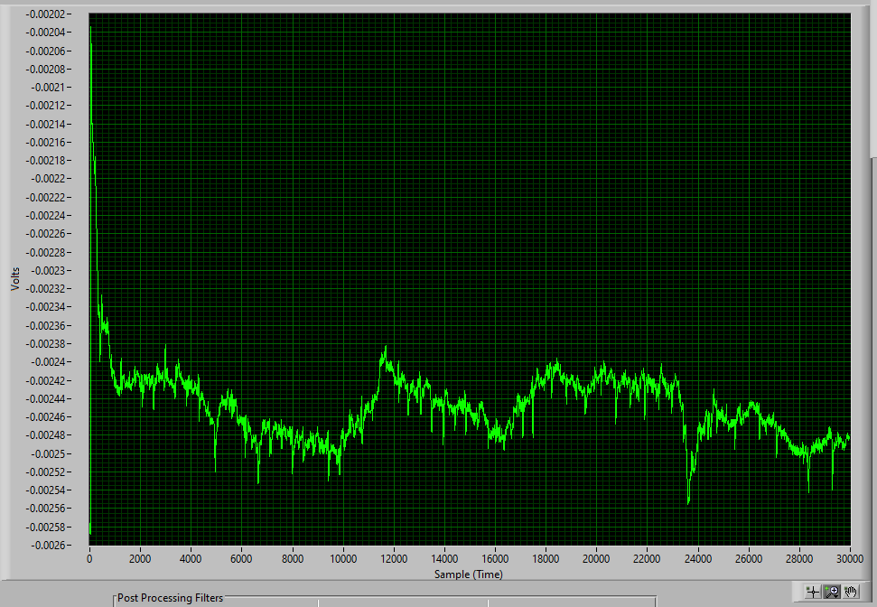
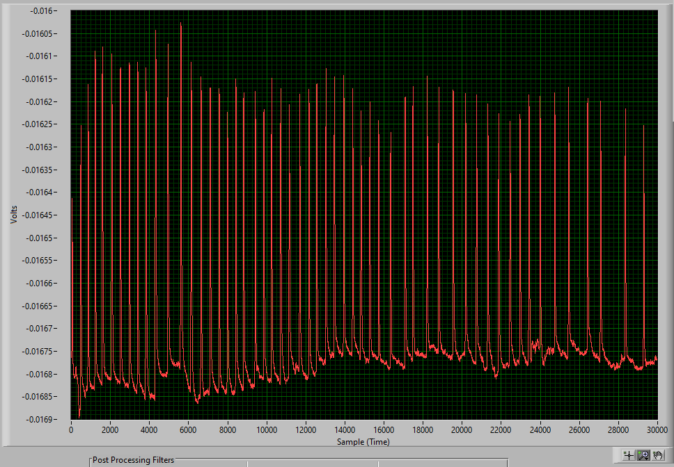
Ch1
Ch3
Ch2
Trial # 1
Sirisha – 39 – F, Normal,
Forced blinks ~ 3 mins
Electrode placement: 1
Ch1, Ch2- vertical channel, Ch3-Hrzontal (L- positive, R – negative)
LPF: order= 4, Cut-off:15 Hz
Only one common reference for Ch-A and Ch-B
SPS:256

Slide 5
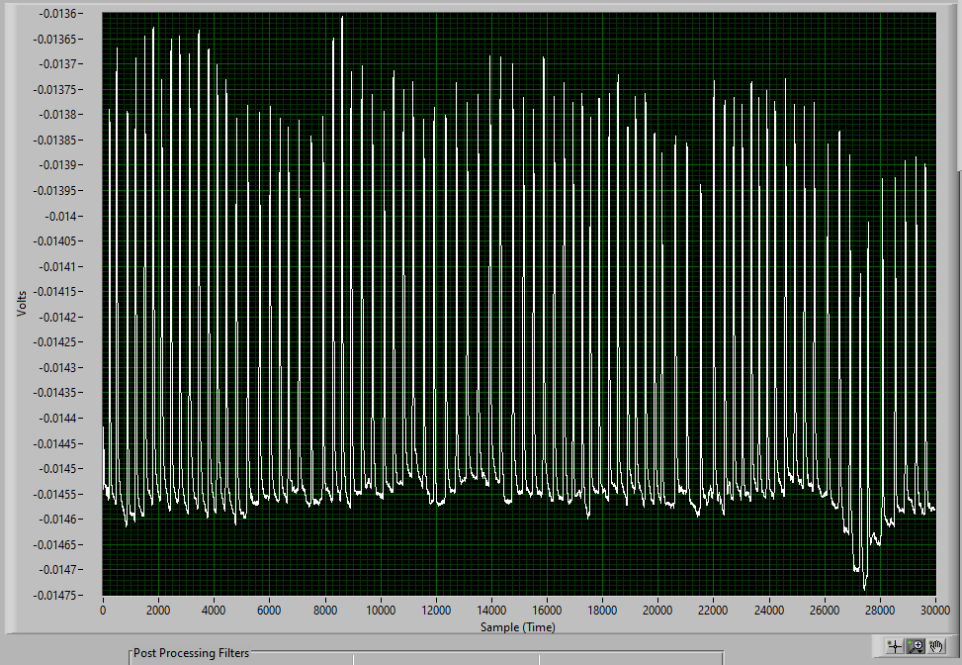
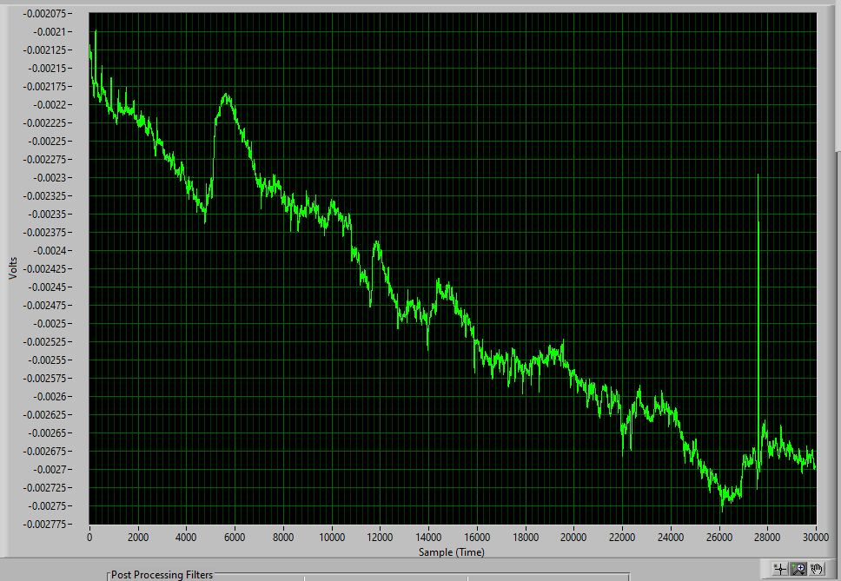
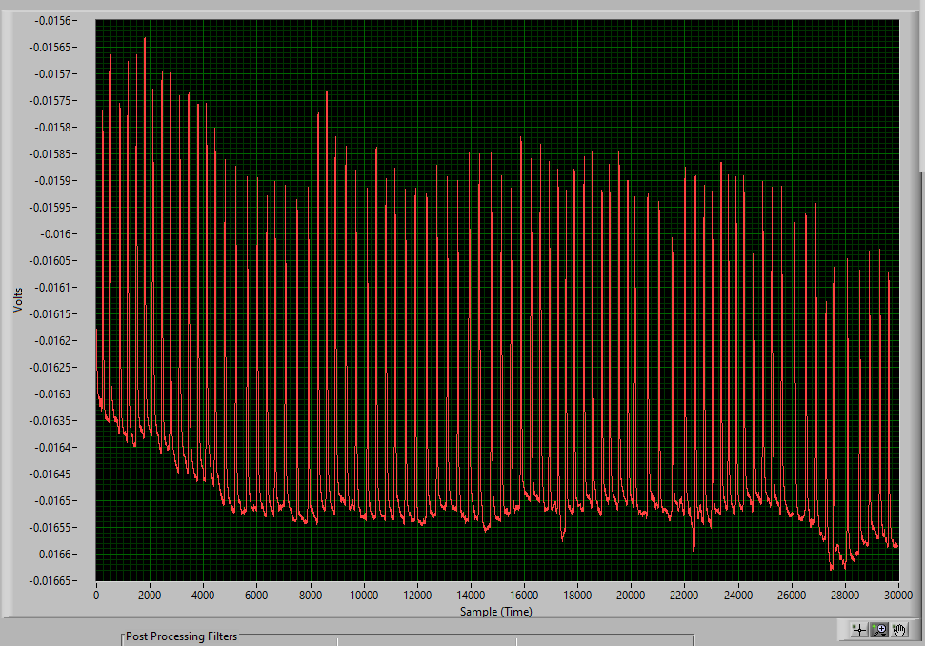
Ch1
Ch3
Ch2
Trial # 2
Sirisha – 39 – F, Normal,
Forced blinks ~ 3 mins
Electrode placement: 1
Ch1, Ch2- vertical channel, Ch3-Hrzontal (L- positive, R – negative)
LPF: order= 4, Cut-off:15 Hz
Only one common reference for Ch-A and Ch-B
SPS:256

Slide 6
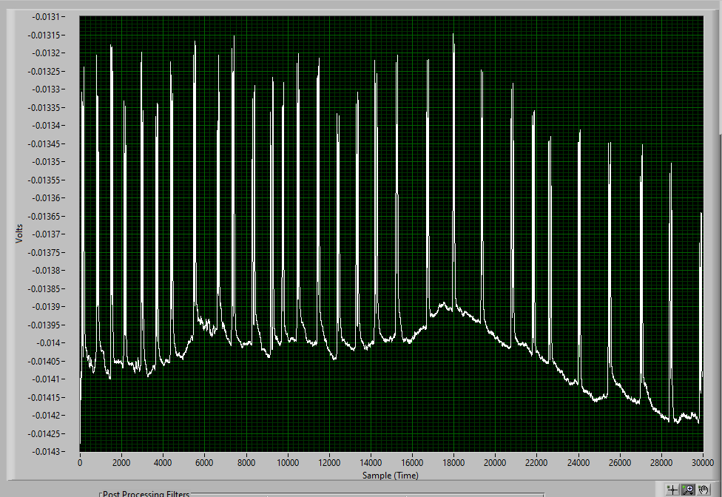
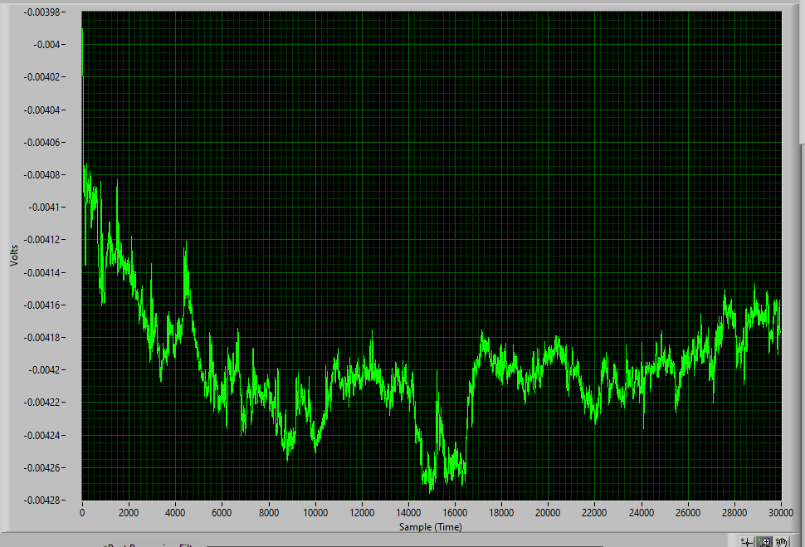
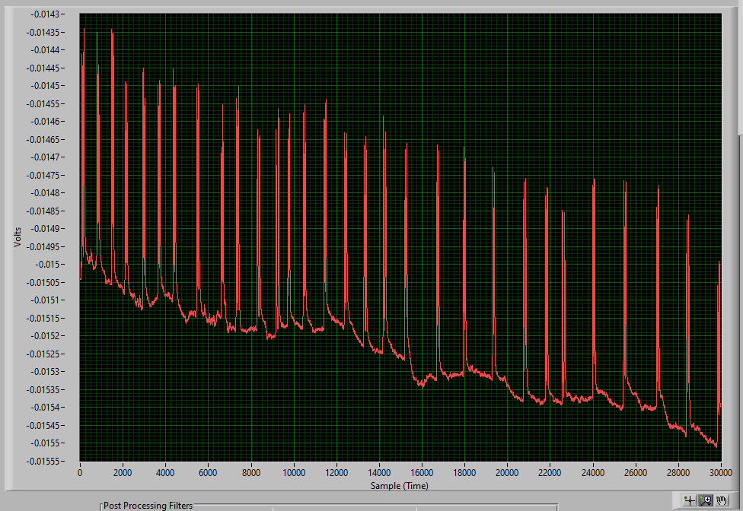
Ch1
Ch3
Ch2
Trial # 1
Sirisha – 39 – F, Normal,
Double blinks ~ 3 mins
Electrode placement: 1
Ch1, Ch2- vertical channel, Ch3-Hrzontal (L- positive, R – negative)
LPF: order= 4, Cut-off:15 Hz
Only one common reference for Ch-A and Ch-B
SPS:256

Slide 7
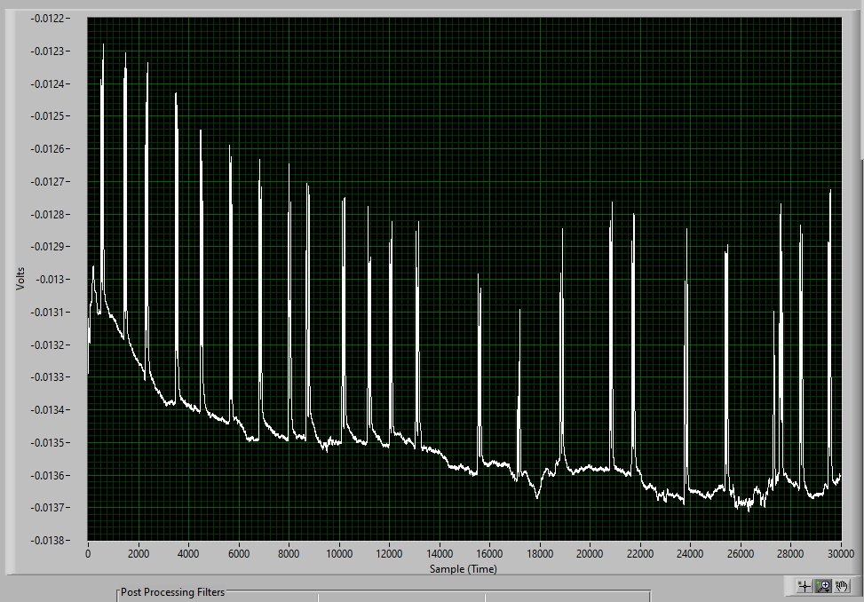
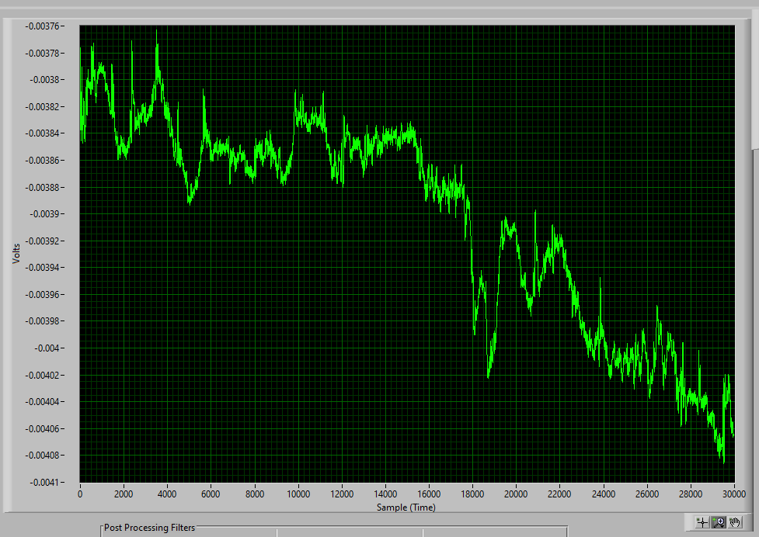
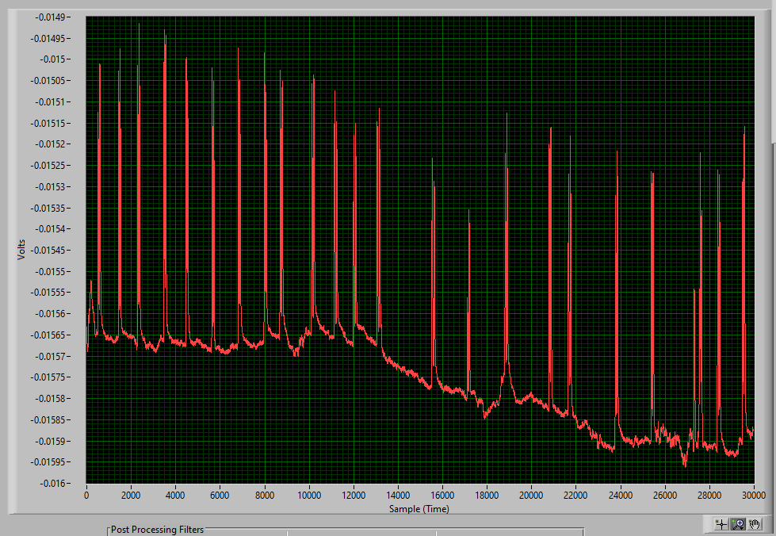
Ch1
Ch3
Ch2
Trial # 2
Sirisha – 39 – F, Normal,
Double blinks ~ 3 mins
Electrode placement: 1
Ch1, Ch2- vertical channel, Ch3-Hrzontal (L- positive, R – negative)
LPF: order= 4, Cut-off:15 Hz
Only one common reference for Ch-A and Ch-B
SPS:256

Slide 8
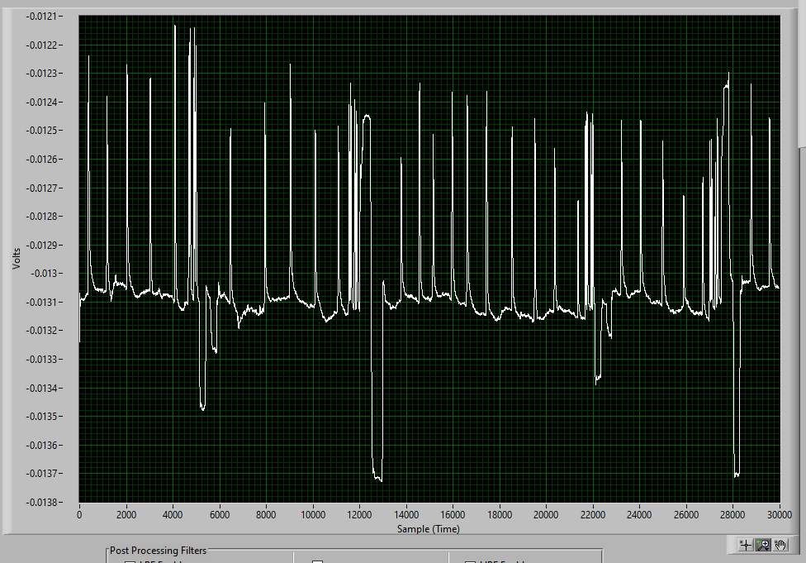
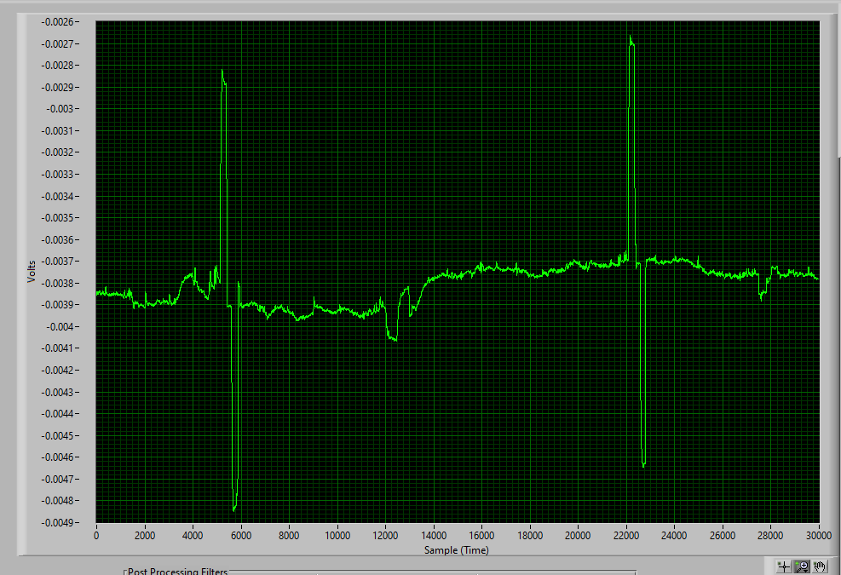
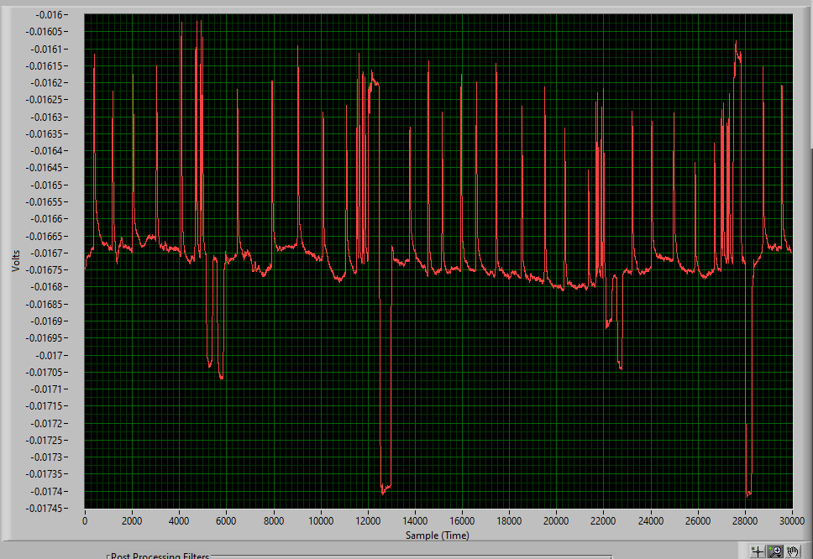
Ch1
Ch3
Ch2
Trial # 1
Sirisha – 39 – F, Normal,
Eyeball movements(left, right, up, down) ~ 3 mins
Electrode placement: 1
Ch1, Ch2- vertical channel, Ch3-Hrzontal (L- positive, R – negative)
LPF: order= 4, Cut-off:15 Hz
Only one common reference for Ch-A and Ch-B
SPS:256
Sequence: blink, double blink, left and right, blink, double blink, up and down

Slide 9
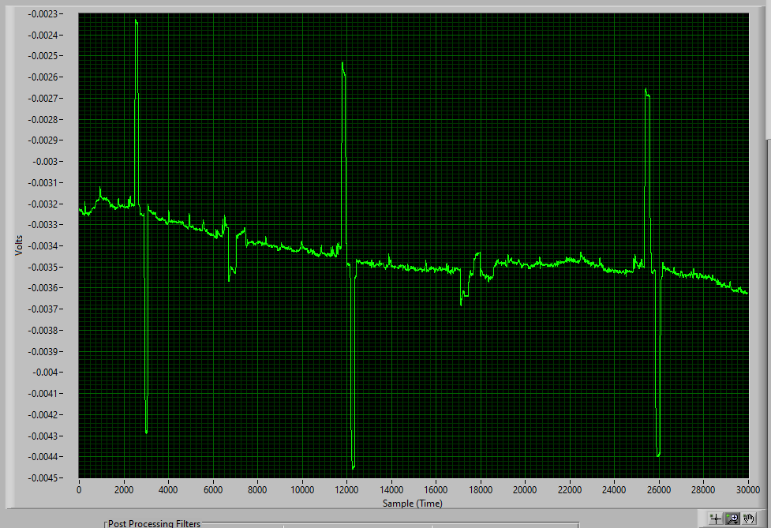
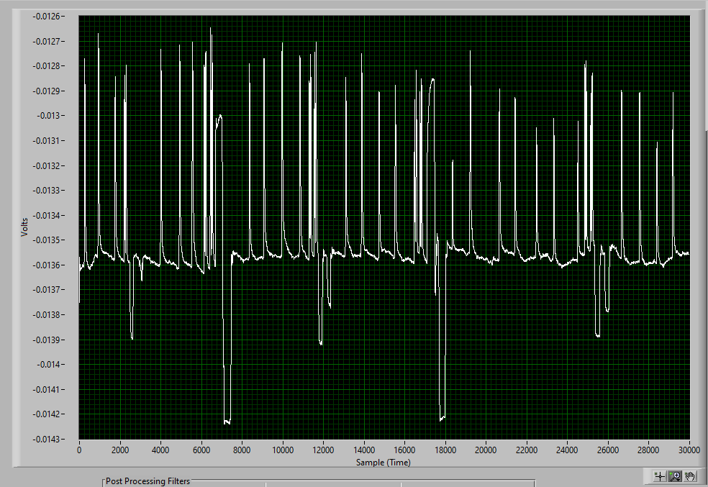
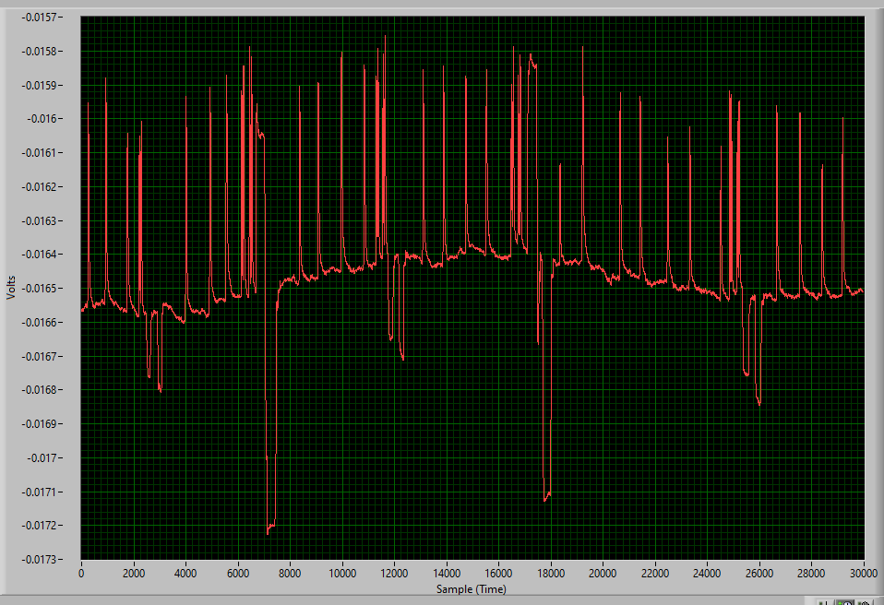
Ch1
Ch3
Ch2
Trial # 2
Sirisha – 39 – F, Normal,
Eyeball movements(left, right, up, down) ~ 3 mins
Electrode placement: 1
Ch1, Ch2- vertical channel, Ch3-Hrzontal (L- positive, R – negative)
LPF: order= 4, Cut-off:15 Hz
Only one common reference for Ch-A and Ch-B
SPS:256
Sequence: blink, double blink, left and right, blink, double blink, up and down

