Slide 1
Vishnu Sankar M
Final Project
3/21/2024 Annual Review

Slide 2
PROJECT TITLE
Cancer Prediction
3/21/2024 Annual Review

Slide 3


AGENDA
Problem Statement
Project Overview
Who are the end users?
Solutions and value of propositions
WOW factor in the solution
Modelling
Results
3/21/2024 Annual Review

Slide 4

PROBLEM STATEMENT
Develop a machine learning model to predict the likelihood of cancer in patients based on relevant medical features. Utilize a dataset containing patient information including demographics, medical history, and test results. The model should accurately classify patients into cancer and non-cancer groups, aiding in early detection and timely intervention. The aim is to create a reliable predictive tool to assist healthcare professionals in diagnosing cancer at an early stage, thereby improving patient outcomes and survival rates. Evaluation metrics such as accuracy, precision, recall, and F1-score will be used to assess the model's performance.
3/21/2024 Annual Review

Slide 5

PROJECT OVERVIEW
1. Objective: The project aims to develop a predictive model for cancer detection using machine learning techniques.
2. Dataset: Utilizing a comprehensive dataset containing patient demographics, medical history, and diagnostic test results.
3. Methodology: Employing feature engineering, model training, and evaluation to build an accurate predictive model.
4. Outcome:The project seeks to provide a valuable tool for early cancer detection, aiding healthcare professionals in timely intervention and improving patient outcomes.
5. Evaluation: Performance will be assessed using metrics such as accuracy, precision, recall, and F1-score, ensuring the reliability and effectiveness of the developed model.
3/21/2024 Annual Review

Slide 6

WHO ARE THE END USERS?
The end users of the cancer prediction model could include:
Medical Professionals: Oncologists, radiologists, and other healthcare providers who utilize the model as a decision support tool for diagnosing cancer in patients.
Patients: Individuals who may benefit from early detection and treatment of cancer, improving their prognosis and overall health outcomes.
Healthcare Institutions: Hospitals, clinics, and medical centers incorporating the model into their diagnostic protocols to enhance the accuracy and efficiency of cancer diagnosis.
Researchers: Scientists and researchers in the field of oncology and public health who may use the model for further analysis, validation, and improvement of cancer detection methods.
Policy Makers: Government health agencies and policymakers who may use insights from the model to develop public health policies aimed at promoting early cancer screening and prevention initiatives.
3/21/2024 Annual Review

Slide 7

YOUR SOLUTION AND ITS VALUE PROPOSITION
My solution offers a sophisticated predictive model for cancer detection, leveraging machine learning algorithms to analyze patient data with precision and efficiency. Its value proposition lies in providing early detection of cancer, enabling timely intervention and improving patient outcomes. By offering customizable risk assessment and treatment planning, our solution empowers healthcare professionals to make informed decisions tailored to individual patients. With scalability and continuous improvement capabilities, it ensures adaptability to evolving medical knowledge and datasets, ultimately enhancing the quality of cancer care and saving lives.
3/21/2024 Annual Review

Slide 8

THE WOW IN YOUR SOLUTION
The "wow" factor in the solution lies in its potential to revolutionize cancer detection and diagnosis by leveraging cutting-edge machine learning techniques. Here are some key aspects that contribute to the "wow" factor:
Early Detection: By accurately predicting the likelihood of cancer in patients based on their medical data, the model can enable early detection of cancer, significantly improving prognosis and survival rates.
Precision and Efficiency: The model utilizes advanced algorithms to analyze complex medical datasets, providing precise and efficient predictions, which can assist healthcare professionals in making informed decisions quickly.
Customization: The solution can be tailored to different types of cancer and patient populations, allowing for personalized risk assessment and treatment planning.
Scalability: As machine learning models are scalable, the solution can handle large volumes of data, making it suitable for application in various healthcare settings, from small clinics to large hospitals.
Continuous Improvement: With the ability to continuously learn from new data, the model can adapt and improve over time, staying up-to-date with the latest advancements in cancer research and diagnosis.
3/21/2024 Annual Review

Slide 9
MODELLING
Modeling in the context of your cancer prediction project involves several steps:
Data Preprocessing: Cleaning the data, handling missing values, encoding categorical variables, and scaling features if necessary to prepare the dataset for modeling.
Feature Selection/Engineering: Identifying relevant features that contribute most to the prediction task. This may involve techniques like feature importance analysis, dimensionality reduction, or creating new features from existing ones.
Model Selection: Choosing an appropriate machine learning algorithm(s) based on the nature of the problem (classification in this case), dataset size, and desired performance metrics. Random Forest, Support Vector Machines, or Logistic Regression are common choices for binary classification tasks like cancer prediction.
Model Training: Training the selected model on the training dataset to learn the patterns and relationships between features and the target variable (cancer/no cancer).
Model Evaluation: Assessing the performance of the trained model using evaluation metrics such as accuracy, precision, recall, F1-score, and ROC-AUC score on the test dataset.
Hyperparameter Tuning: Fine-tuning the parameters of the chosen model(s) to optimize performance further. Techniques like grid search or random search can be used for this purpose.
Cross-validation: Assessing the generalization performance of the model(s) using techniques like k-fold cross-validation to ensure the model's robustness.
Deployment: Once a satisfactory model is obtained, deploying it into production for real-world use, where it can make predictions on new, unseen data.
3/21/2024 Annual Review

Slide 10
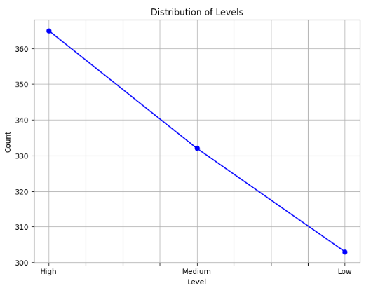
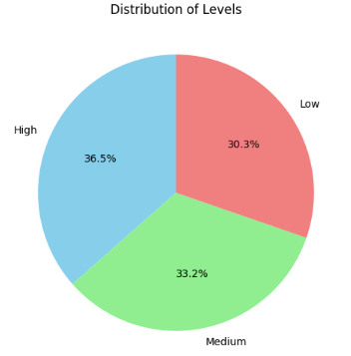
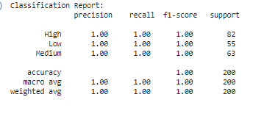
RESULTS
3/21/2024 Annual Review

