Slide 1


Enterprise AI Governance & Intelligence Layer for PMWeb
Governed AI Orchestration — Not Direct AI-to-Database Connectivity
Executive Proposal for DAMAC Leadership & Technology Stakeholders
Prepared for DAMAC | May 2026
Enterprise AI Governance & Intelligence Layer for PMWeb | CMCS
CONFIDENTIAL

Slide 2
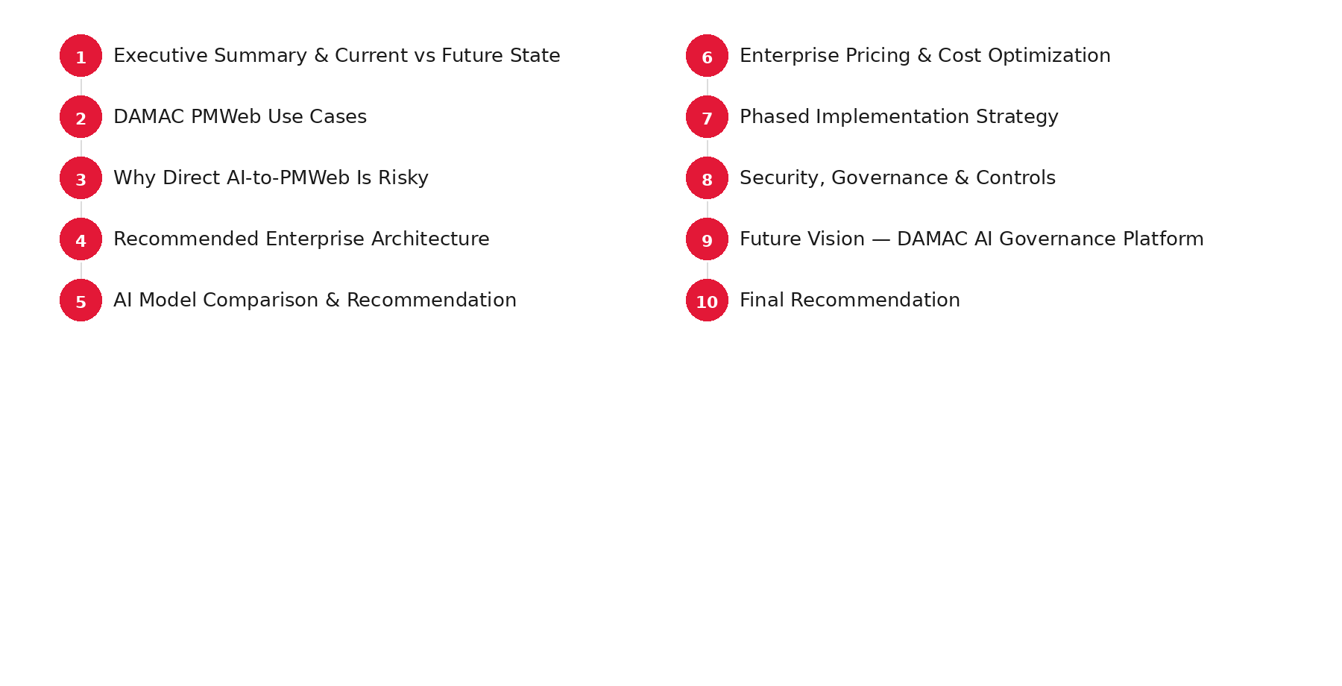
OVERVIEW
Agenda
Boardroom executive briefing structure
Enterprise AI Governance & Intelligence Layer for PMWeb | CMCS
CONFIDENTIAL

Slide 3
01
Executive Summary
Challenges, opportunity, and transformation
Enterprise AI Governance & Intelligence Layer for PMWeb | CMCS
CONFIDENTIAL

Slide 4

SECTION 01
Executive Summary
Governed enterprise AI over PMWeb — not uncontrolled connectivity
• Procurement and commercial workflows on PMWeb generate high-value data trapped in documents and contracts.
• Manual summarization and tender analysis create bottlenecks and visibility gaps for leadership.
• AI accelerates decisions only when deployed as a governed intelligence layer over enterprise truth.
• Recommended AI platform: Claude Enterprise behind an Enterprise Orchestration Layer.
• Deliver full scoped program in 2–3 months: POC → tender engine → chatbot → governance platform.
Strategic Thesis
"AI should explain enterprise truth, not derive uncontrolled truth."
Enterprise AI Governance & Intelligence Layer for PMWeb | CMCS
CONFIDENTIAL

Slide 5
SECTION 01
Current Challenges
Operational friction across procurement & commercial management
Manual Effort
No Executive Summaries
Slow Tender Cycles
• Heavy manual work in bid packs, BAFO comparisons, and CO approvals.
• Leadership lacks trusted summaries of tenders and contracts.
• Decisions delayed by document review and deviation analysis.
Limited Visibility
Governance Gap
• No on-demand access to project status, unit mix, or vendor insights.
• Risk of shadow AI and ungoverned database access.
Enterprise AI Governance & Intelligence Layer for PMWeb | CMCS
CONFIDENTIAL

Slide 6
SECTION 01
Current State vs Future State
Transformation narrative for boardroom stakeholders
CURRENT STATE
FUTURE STATE
• Manual contract & tender summarization
• Fragmented document repositories
• Reactive management reporting
• Siloed PMWeb data access
• No AI audit trail or governance
• AI-assisted governance & summarization
• Enterprise Knowledge Layer + RAG
• Executive AI chatbot with citations
• Governed API orchestration to PMWeb
• DAMAC AI Governance Platform
→
Opportunity: AI-assisted governance — not ungoverned AI connectivity
Enterprise AI Governance & Intelligence Layer for PMWeb | CMCS
CONFIDENTIAL

Slide 7
02
DAMAC PMWeb Use Cases
Commitment, contracts, management chatbot
Enterprise AI Governance & Intelligence Layer for PMWeb | CMCS
CONFIDENTIAL

Slide 8



SECTION 02
DAMAC PMWeb Use Cases
Procurement, commercial & management scenarios
Commitment / CO Approval
Contract Intelligence
Management AI Chatbot
• Bid summarization & BAFO comparison
• Technical recommendations & benchmarking
• Deviations, exclusions & T&C summaries
• AI clause extraction & summarization
• Auto-population of PMWeb fields
• Contract intelligence repository
• Project & package status queries
• Building config, unit mix, awards
• Vendor & subcontractor insights
Enterprise AI Governance & Intelligence Layer for PMWeb | CMCS
CONFIDENTIAL

Slide 9
SECTION 02
Use Case 1 — Commitment / CO Approval
Accelerate procurement decisions with governed AI
Bid Summarization
BAFO Comparison
Technical Recommendations
• Executive summaries from tender submissions
• Commercial & technical comparison matrices
• Evaluation summaries with citations
Historical Benchmarking
Deviations / Exclusions
Contract T&Cs Summary
• Compare against prior awards
• Highlight material deviations
• Condensed terms for approval committees
PMWeb → Ingestion → RAG → Claude Summarization → Human Approval → PMWeb API
Enterprise AI Governance & Intelligence Layer for PMWeb | CMCS
CONFIDENTIAL

Slide 10
SECTION 02
Use Case 2 — AI-Assisted Contract Summarization
Reduce manual effort with enterprise control
AI Clause Extraction
Contract Intelligence Workflow
• Payment, LDs, warranties, termination clauses
• Mapped to PMWeb contract schema fields
• 1. Secure contract PDF ingestion
• 2. OCR, chunking, vector indexing
• 3. Claude Enterprise extracts clauses & summaries
• 4. Orchestration validates schema + RBAC
• 5. Analyst reviews with citations
• 6. Approved data synced via PMWeb API
• Outcome: 60–80% reduction in manual effort
Auto-Population of PMWeb Fields
• Governed API writes only — never AI-to-database
• Human-in-the-loop before record updates
Enterprise AI Governance & Intelligence Layer for PMWeb | CMCS
CONFIDENTIAL

Slide 11
SECTION 02
Use Case 3 — Management AI Chatbot
Conversational access to governed PMWeb intelligence
Project / Package Status
Building Configuration
Unit Mix
• Pipeline view across developments
• Typology, floors, areas, specifications
• Inventory by type, size, price band
Design Parameters
Awarded Values
Vendor Insights
• Design criteria and approval status
• Contract values, variations, commitments
• Performance, awards, risk flags
RBAC-filtered • Citation-linked • Audit-logged • No direct database inference
Enterprise AI Governance & Intelligence Layer for PMWeb | CMCS
CONFIDENTIAL

Slide 12
03
Why Direct AI-to-PMWeb Is Risky
Governed truth, not uncontrolled inference
Enterprise AI Governance & Intelligence Layer for PMWeb | CMCS
CONFIDENTIAL

Slide 13
SECTION 03
Why Direct AI-to-PMWeb Is Risky
Ungoverned connectivity threatens data and decision integrity
Direct DB Access
Hallucinations
Security Breach
• SQL/DB credentials create exposure and injection risk.
• Fabricated figures or clauses are catastrophic in procurement.
• Uncontrolled prompts may leak PII and commercial terms.
No Governance
No Traceability
Inaccurate Answers
• Shadow AI bypasses DAMAC policies and data residency.
• Leadership cannot explain how answers were produced.
• Stale embeddings and wrong document versions.
"AI should explain enterprise truth, not derive uncontrolled truth."
Enterprise AI Governance & Intelligence Layer for PMWeb | CMCS
CONFIDENTIAL

Slide 14
SECTION 03
Anti-Pattern vs Recommended Pattern
Architecture decision with enterprise consequences
✕ ANTI-PATTERN
✓ RECOMMENDED
Claude / OpenAI
Management Experience
▼
AI Orchestration + Governance
Direct DB / SQL
Enterprise Knowledge Layer
▼
PMWeb Database
API / Integration Layer
▼
PMWeb
No RBAC • No citations • No audit
Enterprise AI Governance & Intelligence Layer for PMWeb | CMCS
CONFIDENTIAL

Slide 15
04
Recommended Enterprise Architecture
API-first orchestration and RAG
Enterprise AI Governance & Intelligence Layer for PMWeb | CMCS
CONFIDENTIAL

Slide 16
SECTION 04
Recommended Enterprise Architecture
Governed intelligence layer — API-first, auditable, cloud-native
Management Experience Layer
Dashboards · Chatbot · Approvals · Citations
Claude Enterprise
Document intelligence · Reasoning · Summarization
AI Orchestration Layer
Guardrails · Human-in-loop · Audit · Cost control
Enterprise Knowledge Layer
Vector DB · RAG · Ingestion · Versioning
API / Integration Layer
PMWeb APIs · ETL · Schema validation
PMWeb
System of record — contracts, tenders, projects
RBAC · Audit Logs · Prompt Logging · Citations · Vector DB · RAG
Enterprise AI Governance & Intelligence Layer for PMWeb | CMCS
CONFIDENTIAL

Slide 17
SECTION 04
RAG & Knowledge Architecture
Retrieval-augmented generation with enterprise controls
PMWeb Docs
Ingestion
Embedding
Vector DB
RAG
Claude
Response
Document Ingestion
Orchestration Engine
• PDF, Word, PMWeb exports — OCR and classification
• Policy routing, fallbacks, evaluation hooks
AI Governance Layer
PMWeb APIs
• PII redaction, output validation, kill switch
• Read via APIs; write only after human approval
Enterprise AI Governance & Intelligence Layer for PMWeb | CMCS
CONFIDENTIAL

Slide 18
05
AI Model Comparison
Single recommendation: Claude Enterprise
Enterprise AI Governance & Intelligence Layer for PMWeb | CMCS
CONFIDENTIAL

Slide 19
SECTION 05
AI Model Comparison
Enterprise evaluation — single recommended platform
Capability | Claude Enterprise | OpenAI GPT-5/4.1 | Azure OpenAI | Gemini
Document Summarization | ★★★★★ | ★★★★☆ | ★★★★☆ | ★★★★☆
Contract Analysis | ★★★★★ | ★★★★☆ | ★★★★☆ | ★★★☆☆
Hallucination Control | ★★★★★ | ★★★★☆ | ★★★★☆ | ★★★☆☆
Governance Capability | ★★★★★ | ★★★★☆ | ★★★★★ | ★★★★☆
Context Window | 200K–1M | 128K–1M | 128K | 1M–2M
Enterprise Readiness | ★★★★★ | ★★★★★ | ★★★★★ | ★★★★☆
PMWeb Fit (DAMAC) | ★★★★★ | ★★★★☆ | ★★★★☆ | ★★★☆☆
Recommendation: Claude Enterprise — best fit for contract, tender & document intelligence
Enterprise AI Governance & Intelligence Layer for PMWeb | CMCS
CONFIDENTIAL

Slide 20
SECTION 05
Recommended Platform
Single enterprise AI standard for DAMAC PMWeb intelligence
RECOMMENDED
Claude Enterprise
• Primary enterprise AI for DAMAC PMWeb governance layer
• Industry-leading document & contract summarization with long context
• Lowest hallucination risk for legal, commercial, and procurement text
• Strong enterprise governance: RBAC integration, audit, data controls
• Consistent model family (Haiku / Sonnet / Opus) for cost-tiered workloads
• Unified vendor relationship simplifies security review and DPAs
One platform. One governance model. Orchestration layer routes Haiku → Sonnet → Opus by task complexity.
Enterprise AI Governance & Intelligence Layer for PMWeb | CMCS
CONFIDENTIAL

Slide 21
06
Enterprise Pricing
Claude-centric cost model and scenarios
Enterprise AI Governance & Intelligence Layer for PMWeb | CMCS
CONFIDENTIAL

Slide 22
SECTION 06
Claude Enterprise API Pricing
Per-million-token rates — primary cost model for DAMAC
Claude Model | Input ($/1M) | Output ($/1M) | DAMAC Use Case
Haiku 4.5 | $0.80 | $4.00 | Retrieval, classification, chatbot triage
Sonnet 4.5 | $3.00 | $15.00 | Contract & tender summarization
Opus 4.5 | $15.00 | $75.00 | Complex contracts, executive summaries
Reference pricing (May 2026 indicative). Competitors shown for context only.
Provider | Comparable Tier | Input | Output
OpenAI | GPT-4.1 | $2.00 | $8.00
Azure OpenAI | GPT-4.1 | $2.20 | $8.80
Gemini | Enterprise | $1.50 | $6.00
• DAMAC standardizes on Claude — no multi-vendor routing complexity
• Prompt caching: up to 90% savings on repeated contract templates
• RAG reduces tokens sent to Sonnet/Opus by pre-filtering relevant chunks
Enterprise AI Governance & Intelligence Layer for PMWeb | CMCS
CONFIDENTIAL

Slide 23
SECTION 06
Monthly Enterprise Cost Scenarios
Realistic DAMAC workloads — Claude Enterprise
Scenario | Volume | Claude Tier | Est. Monthly (USD)
Contract Summaries | 1,000 / month | Sonnet + Haiku | $8,500 – $14,000
Tender Summarizations | 200 / month | Sonnet (long docs) | $4,200 – $7,500
Management Chatbot | 500 users × 20 queries/day | Haiku + Sonnet | $5,500 – $10,500
Combined (Phase 3) | All workloads + caching | Tiered routing | $16,000 – $28,000
Full Platform (Phase 4) | All + governance infra | Full stack | $30,000 – $48,000
Cost Optimization Strategies
• Prompt caching for repeated tender and contract templates
• Haiku for retrieval and chatbot triage; Sonnet for synthesis; Opus for complex packs only
• RAG architecture limits context sent to premium models
• Batch off-peak processing for non-urgent summarization
Enterprise AI Governance & Intelligence Layer for PMWeb | CMCS
CONFIDENTIAL

Slide 24
SECTION 06
Per-Use-Case Cost Breakdown
Business case validation — Claude Enterprise only
Use Case | Token Assumption | Model | Cost / Unit | Monthly Est.
Contract summary | ~80K in / 4K out | Sonnet | $0.28 | $12,000
Tender BAFO pack | ~200K in / 8K out | Sonnet | $0.82 | $6,400
Chatbot query | ~2K in / 500 out | Haiku | $0.003 | $6,500
Executive summary | ~120K in / 6K out | Opus | $2.10 | $1,800
Scenarios: 1,000 contracts + 200 tenders + 500 chatbot users ≈ $22,000 – $26,000 / month at scale
Enterprise AI Governance & Intelligence Layer for PMWeb | CMCS
CONFIDENTIAL

Slide 25
07
Implementation Strategy
2–3 month delivery | slope, phases & timeline
Enterprise AI Governance & Intelligence Layer for PMWeb | CMCS
CONFIDENTIAL

Slide 26
SECTION 07
Phased Implementation Strategy
Full program scope delivered in 2–3 months — parallel workstreams where possible
PHASE 1
PHASE 2
PHASE 3
PHASE 4
Contract Summarization POC
Tender Recommendation Engine
Executive AI Chatbot
AI Governance Platform
Weeks 1–3
Weeks 4–6
Weeks 7–9
Weeks 10–12
• PMWeb API integration
• RAG MVP
• Claude extraction
• Approval UI
• BAFO automation
• Deviation detection
• Benchmarking
• PMWeb workflows
• Management queries
• RBAC + citations
• 500-user pilot
• PMWeb sync
• Full audit & compliance
• Governance control plane
• DAMAC AI standards
Enterprise AI Governance & Intelligence Layer for PMWeb | CMCS
CONFIDENTIAL

Slide 27
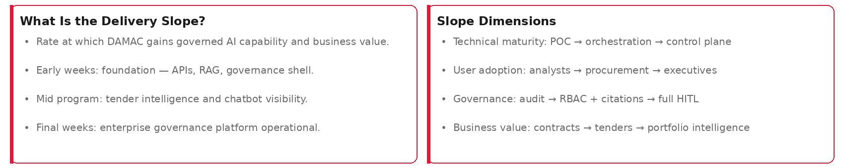
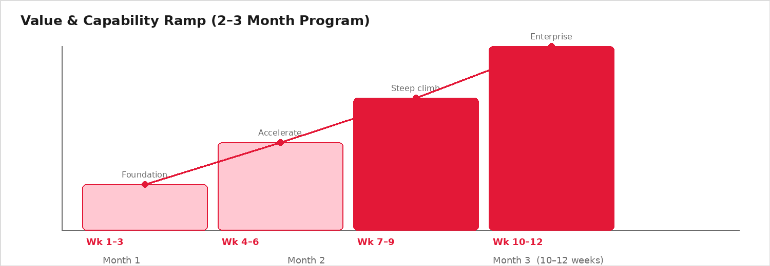
SECTION 07
Delivery Slope Definition
How capability, effort, and business value accelerate across the program
Target: complete Phases 1–4 in 2–3 months | Accelerated track: ~8–10 weeks with parallel squads
Enterprise AI Governance & Intelligence Layer for PMWeb | CMCS
CONFIDENTIAL

Slide 28
SECTION 07
Implementation Timeline
Total program duration: 2–3 months (10–12 weeks)
Weeks 1–3
Weeks 4–6
Weeks 7–9
Weeks 10–12
Phase 1
Phase 2
Phase 3
Phase 4
Contract POC
Tender Engine
Chatbot
Governance Platform
Full scope (contract POC + tender engine + chatbot + governance platform) within 2–3 months
Enterprise AI Governance & Intelligence Layer for PMWeb | CMCS
CONFIDENTIAL

Slide 29
08
Security & Governance
RBAC, audit, human-in-the-loop
Enterprise AI Governance & Intelligence Layer for PMWeb | CMCS
CONFIDENTIAL

Slide 30
SECTION 08
Security & Governance Framework
Enterprise controls aligned to DAMAC policies
RBAC
Audit Logging
Prompt Logging
AI Governance
• Aligned to PMWeb permissions — procurement, commercial, executive.
• Who asked, which documents, which model, which output.
• Full capture for compliance and incident review.
• Approved models, data rules, output validation gates.
Human-in-the-Loop
Data Privacy
DAMAC Controls
Secure APIs
• Mandatory approval before PMWeb writes.
• PII redaction, encryption, UAE residency options.
• SSO, retention policies, vendor DPAs, SOC2 providers.
• API gateway, mTLS, vault — zero DB credentials to AI.
Enterprise AI Governance & Intelligence Layer for PMWeb | CMCS
CONFIDENTIAL

Slide 31
SECTION 08
AI Governance Control Plane
Centralized policy enforcement across all workloads
RBAC & SSO
Audit & Compliance
AI Governance Control Plane
Prompt Management
Model Allowlist
Human Approval
Data Classification
Enterprise AI Governance & Intelligence Layer for PMWeb | CMCS
CONFIDENTIAL

Slide 32
09
Future Vision
DAMAC AI Governance Platform
Enterprise AI Governance & Intelligence Layer for PMWeb | CMCS
CONFIDENTIAL

Slide 33
SECTION 09
Future Vision — DAMAC AI Governance Platform
Enterprise-wide procurement and project intelligence
Predictive Procurement
AI Risk Scoring
Vendor Performance
• Pricing trends, bid competitiveness, award outcomes
• Vendor and subcontractor risk across portfolio
• SLA compliance and anomaly patterns
Anomaly Detection
Project Intelligence
Executive Copilots
• Unusual pricing, scope gaps, compliance deviations
• Cross-project cost, schedule, design insights
• AI advisors for CEO, CFO, procurement leadership
Vision: DAMAC AI Governance Platform — trusted intelligence for all enterprise decisions
Enterprise AI Governance & Intelligence Layer for PMWeb | CMCS
CONFIDENTIAL

Slide 34
10
Final Recommendation
Decision ask and next steps
Enterprise AI Governance & Intelligence Layer for PMWeb | CMCS
CONFIDENTIAL

Slide 35
SECTION 10
Final Recommendation
Consulting conclusion — governed enterprise AI for DAMAC
• Build the Enterprise AI Orchestration Layer first — before production AI workloads.
• Avoid direct AI-to-database architecture — API-first governed PMWeb connectivity only.
• Standardize on Claude Enterprise as the enterprise AI platform for PMWeb intelligence.
• Deploy AI as a governed layer that explains enterprise truth with citations.
• Start with Contract Intelligence POC (Phase 1) — demonstrable value by Week 3.
• Complete full program scope in 2–3 months (Phases 1–4).
Decision Ask
• Approve Phase 1 POC budget & team
• Nominate DAMAC executive sponsor
• Confirm PMWeb API access scope
• Approve Claude Enterprise as AI standard
• Establish AI governance steering committee
Build the intelligence layer that governs how AI serves DAMAC — not ungoverned connectivity.
Enterprise AI Governance & Intelligence Layer for PMWeb | CMCS
CONFIDENTIAL

Slide 36
Thank You
Enterprise AI Governance & Intelligence Layer for PMWeb
CMCS | Confidential
Enterprise AI Governance & Intelligence Layer for PMWeb | CMCS
CONFIDENTIAL

