Slide 1
LIFE EXPECTANCY PREDICTION
PROJECT MENTOR
Prof. Arnab chakraborty
TEAM MEMBERS
SHEELA BHATTACHARJEE
BIPLAB GORAIN
BISHNU SHARMA
PRIYANSHU BURMAN

Slide 2
Project Objective
Data Description
Methodology
Data Preprocessing
Models Used
Accuracy and Comparison
Future Scope of Improvements
CONTENTS

Slide 3
Project OBJECTIVE
The term “life expectancy” refers to the number of years a person can expect to live. The purpose of this project is to predict the life expectancy of a person considering the various factors.
Developing a model that can accurately predict life expectancy based on historical data and trends.
Identifying the key factors that contribute to life expectancy, such as lifestyle choices, medical history, and environmental factors.
Building a tool that can be used by healthcare providers to identify patients who are at risk of developing life-threatening diseases.
Creating a model that can be used by insurance companies to develop more accurate pricing models and reduce the risk of losses due to unexpected deaths.
Informing public policy decisions related to healthcare, retirement, and social security.

Slide 4
Data description
Column | Type | Description | Target attribute
Country | Categorical | Country names(193 unique countries name) | No
Year | Categorical | Year(2000-2013) | No
Status | Categorical | Developed or Developing status | No
Life Expectancy | Non-Categorical | Life expectancy in age | Yes
Adult Mortality | Non-Categorical | Adult mortality rates for both sexes(probability of dying between 15 and 60 years per 1000 population) | No
Infant Deaths | Non-Categorical | Number of infant death per 1000 population | No
Alcohol | Non-Categorical | Alcohol recorded per capita(15+) consumptions(in liters of pure alcohol) | No

Slide 5
Data description
Column | Type | Description | Target attribute
Percentage expenditure | Non-Categorical | Expenditure on health as a percentage of Gross Domestic Product per capita(%) | No
Hepatitis-B | Non-Categorical | Hepatitis-B(Hep-B) immunization coverage among 1-year-olds(%) | No
Measles | Non-Categorical | Measles number of reported cases per 1000 population | No
BMI | Non-Categorical | Average Body Mass Index of entire population | No
Under-5 deaths | Non-Categorical | Number of under-5 deaths per 1000 population | No
Polio | Non-Categorical | Polio(Pol3) immunization coverage among 1-year-olds(%) | No
Total expenditure | Non-Categorical | General Government expenditure on health as a percentage of total government expenditure(%) | No

Slide 6
Data description
Column | Type | Description | Target attribute
Diphtheria | Non-Categorical | Diphtheria tetanus toxoid and pertussis(DTP3) immunization coverage among 1-years-olds(%) | No
HIV/AIDS | Non-Categorical | Deaths per 1000 live births HIV/AIDS(0-4 years) | No
GDP | Non-Categorical | Gross Domestic Product per capita(in USD) | No
Population | Non-Categorical | Population of the country | No
Thinness 1-19 years and Thinness 5-9 years | Non-Categorical | Prevalence of thinness among children and adolescent from age 10-19 and Prevalence of thinness among children for age 5-9(%) | No
Income composition of resources | Non-Categorical | Human development index in terms of income composition of resources(index ranging from 0 to 1) | No
Schooling | Non-Categorical | Numbers of years of schooling(years) | No

Slide 7
METHODOLOGY
Collecting data
Data analysis
Data Pre-processing
Selection of principal attributes
Trains models
Test models
Implements models on dataset
End

Slide 8
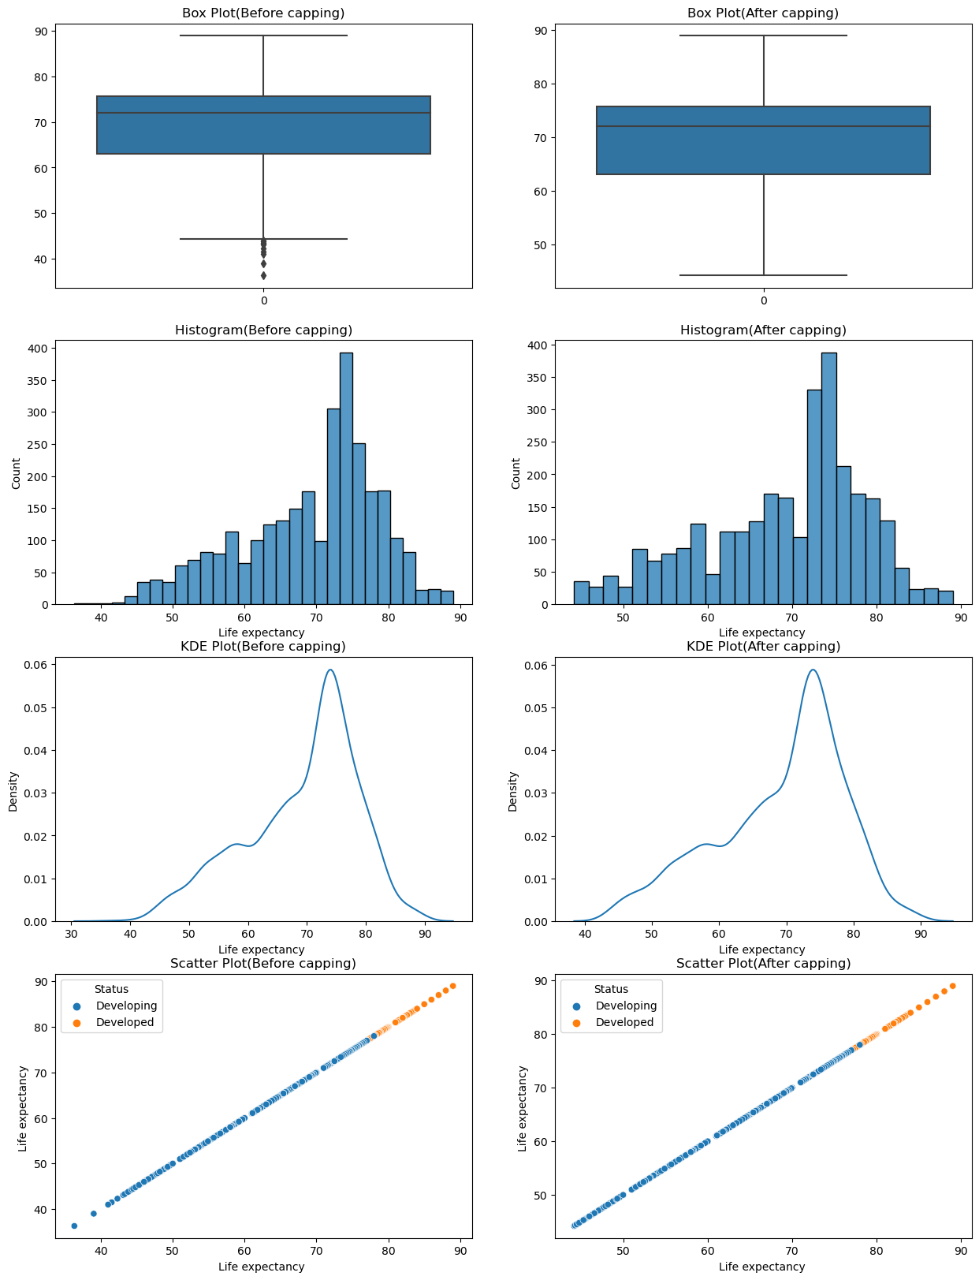
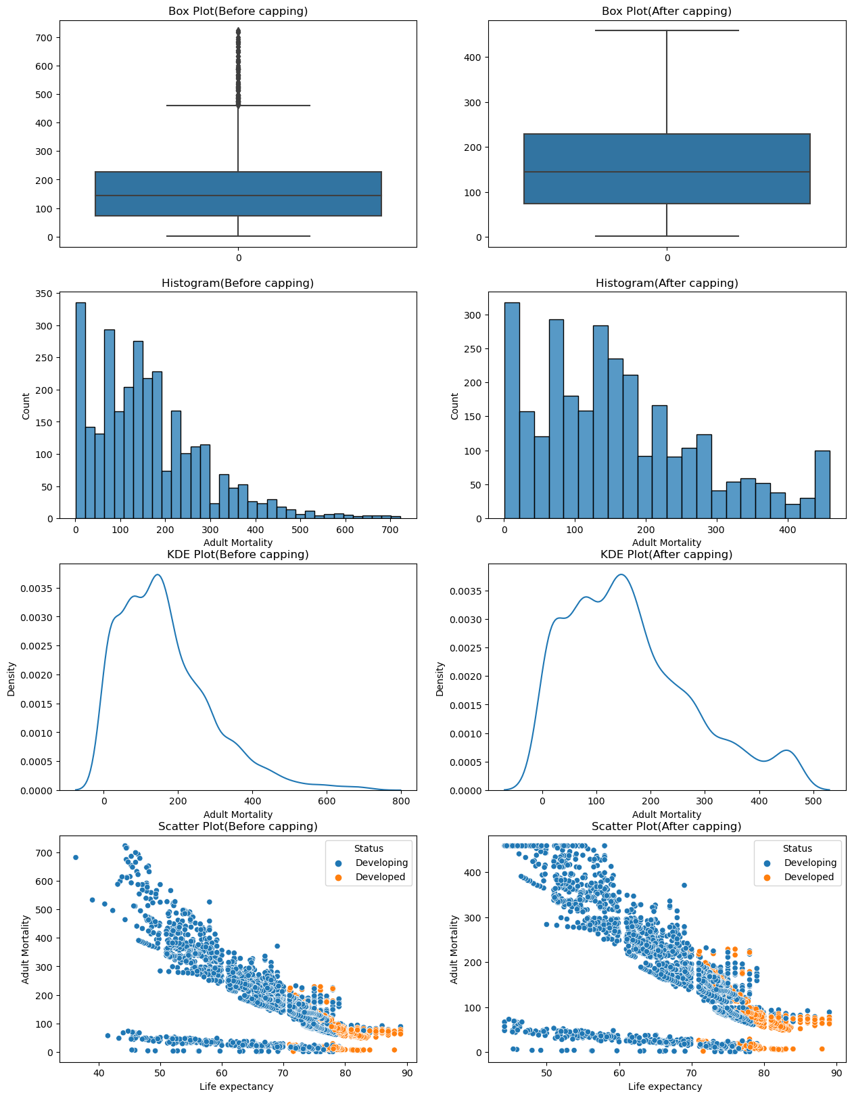
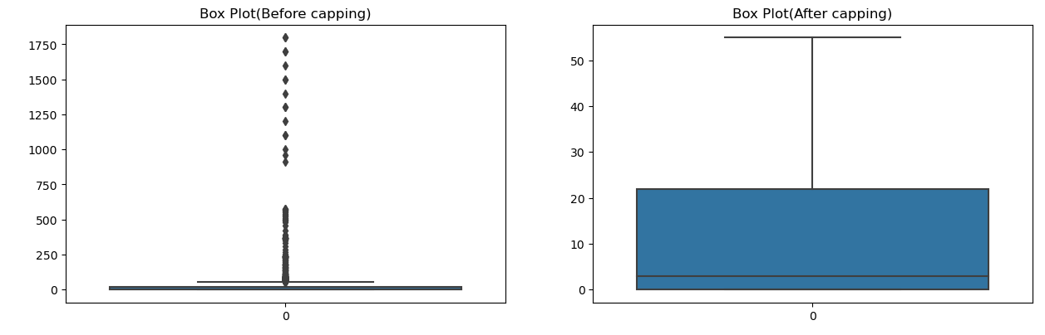
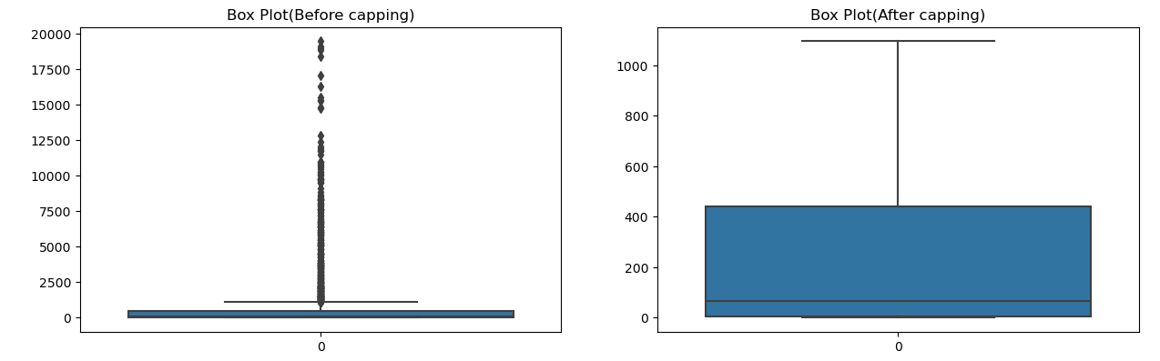
Data pre-processing
Changed the categorical values into numerical values
Handle outliners using IQR method

Slide 9
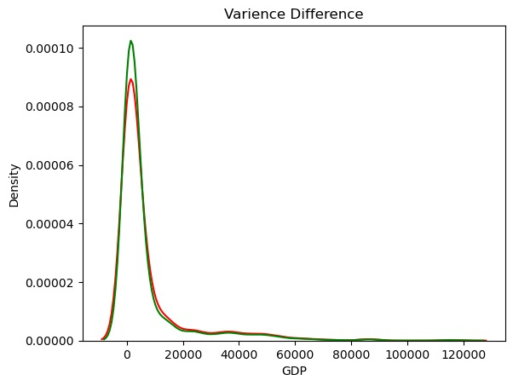
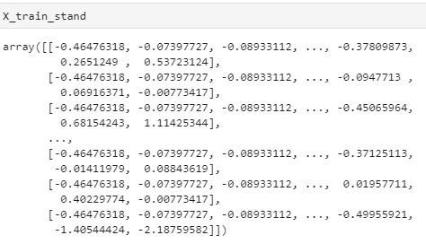
Filled null value and removed
Scaled by standardization

Slide 10
MODEL USED
We have used 3 models here viz.
Linear Regression Model
Random Forest Regression
Decision Tree Regression Model

Slide 11
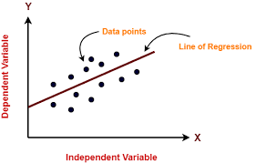
Linear regression
Used to predict the value of a variable based on the value of another value.
Fits a straight line or surface that minimizes the discrepancies between predicted and actual output.
Variable you want to predict is dependent variable.
Variable you’re using to predict another variable’s values is independent variable
Formula for calculating linear regression:
Y = m(X) + b
where Y=dependent variable
X= independent variable
m= estimated slope
b= estimated intercept

Slide 12
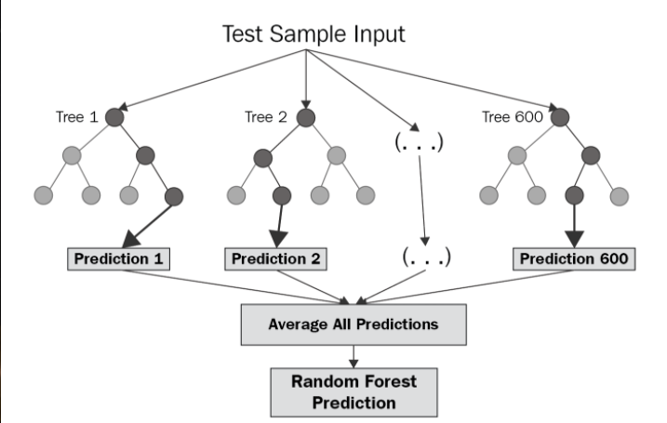
Random forest regression
Used an ensemble of decision trees to predict continuous numerical values
Multiple decision trees are constructed and combined to form a "forest." Each tree in the forest is trained on a different subset of the data, using a random sample of the features at each node.

Slide 13
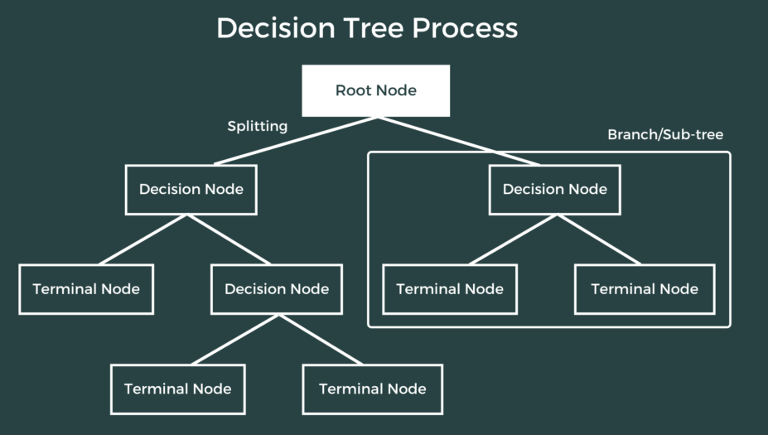
DECISION TREe
Observes features of an object and trains a model in the structure of a tree to predict data in the future to produce meaningful continuous output.
Works by splitting the data up in a tree-like pattern into smaller and smaller subsets. Then, when predicting the output value of a set of features, it will predict the output based on the subset that the set of features falls into.

Slide 14
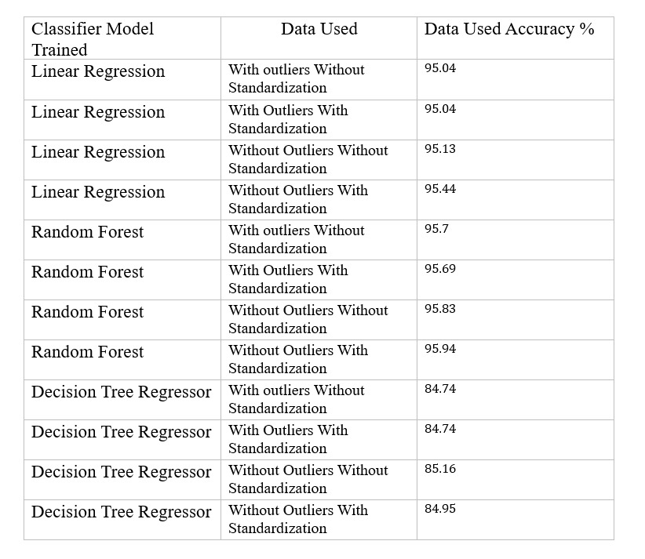
Accuracy comparison

Slide 15
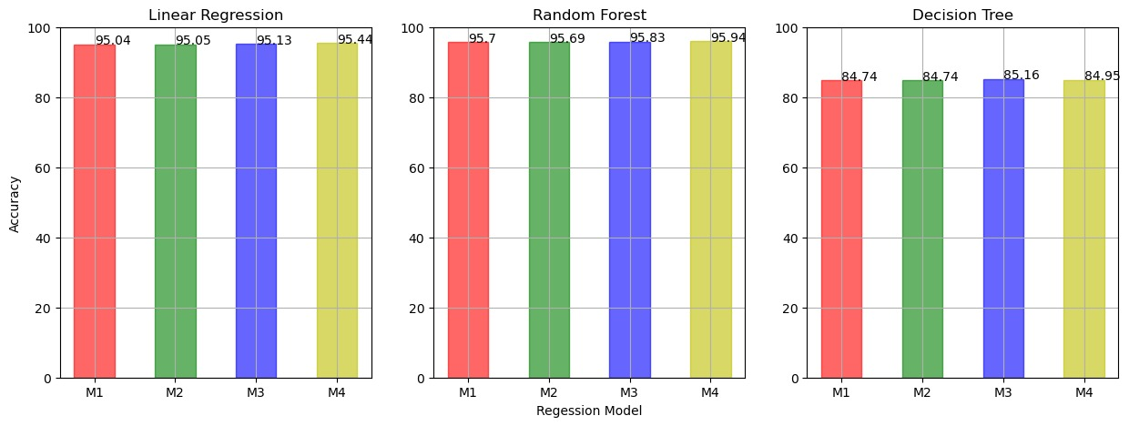
Accuracy graph analysis
Data shown above is extracted from the average of multiple tests.
From above data we can clearly see that highest accuracy for dataset is in RANDOM FOREST REGRESSION Without outliers With standardization which is 95.94 %

Slide 16
Future scopes of improvement
Incorporating more data: As more data becomes available, a life expectancy prediction model could be improved by incorporating new sources of data. This could include environmental data, genetic data, and data from wearable devices.
Improving accuracy: While current ML models for life expectancy prediction are accurate, there is always room for improvement. Future models could be refined to provide even more accurate predictions.
Increasing interpretability: The ability to explain how an ML model makes predictions is becoming increasingly important. Future life expectancy prediction models could be developed with more transparent algorithms that allow for greater interpretability.

Slide 17
Thank you
Asansol Engineering College
SHEELA BHATTACHARJEE (sheeladhn2024@gmail.com)
BIPLAB GORAIN (biplabgorain2018@gmailcom)
BISHNU SHARMA (vs510514@gmail.com)
PRIYANSHU BURMAN (priyanshu887887@gmail.com)

