Slide 1
ImpactGuard
Business regressions, traced to code
Shopify seller demo and banking reconciliation
LOCAL PROTOTYPE / 10 OCTOBER 2026
Notes:
0:00–0:20. Introduce ImpactGuard. This is a local working prototype. All business figures come from the deterministic local simulator and engine in this project. Seller projection assumes 120 checkout starts/day and $82 average order value. No external customer, cloud, bank or Shopify account is connected.

Slide 2
An independent seller needs a business safety net
Luma Goods
Shopify website, custom checkout changes, frequent promotions
120
$82
$690
checkout starts per day
assumed order value
daily exposure after regression
Synthetic scenario projection. Exposure is not measured loss or guaranteed savings.
Notes:
0:20–0:50. Luma Goods is a fictional independent SME seller running its own Shopify website. It has a developer or agency maintaining checkout and promotions. The buyer needs fewer lost orders and a faster explanation of what changed. All business figures come from the deterministic local simulator and engine in this project. Seller projection assumes 120 checkout starts/day and $82 average order value. No external customer, cloud, bank or Shopify account is connected.

Slide 3
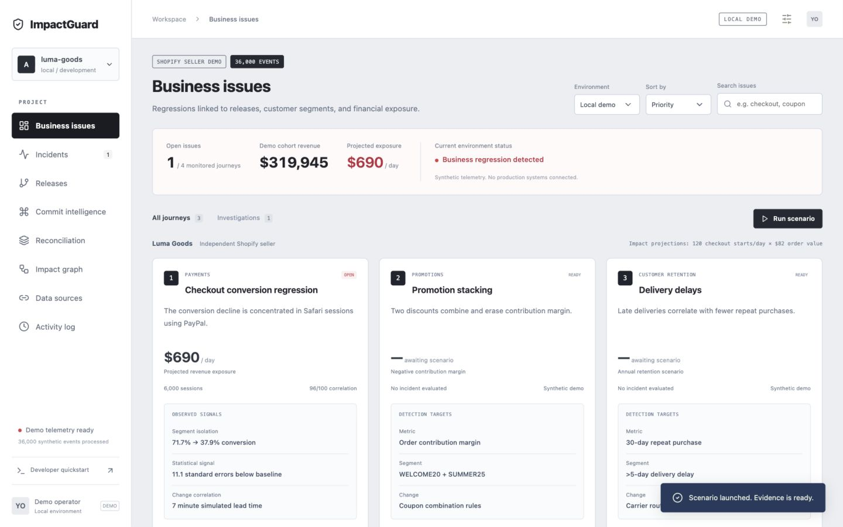
A developer workspace for business issues
Working local dashboard. Every financial projection shows its assumptions in the investigation.
Notes:
0:50–1:15. Switch to the local app if presenting live. Reset to healthy, then run Checkout regression. Red marks an active issue. Healthy and recovered states are green. The source cohort is synthetic and intentionally larger than the seller volume used in exposure estimates. All business figures come from the deterministic local simulator and engine in this project. Seller projection assumes 120 checkout starts/day and $82 average order value. No external customer, cloud, bank or Shopify account is connected.

Slide 4
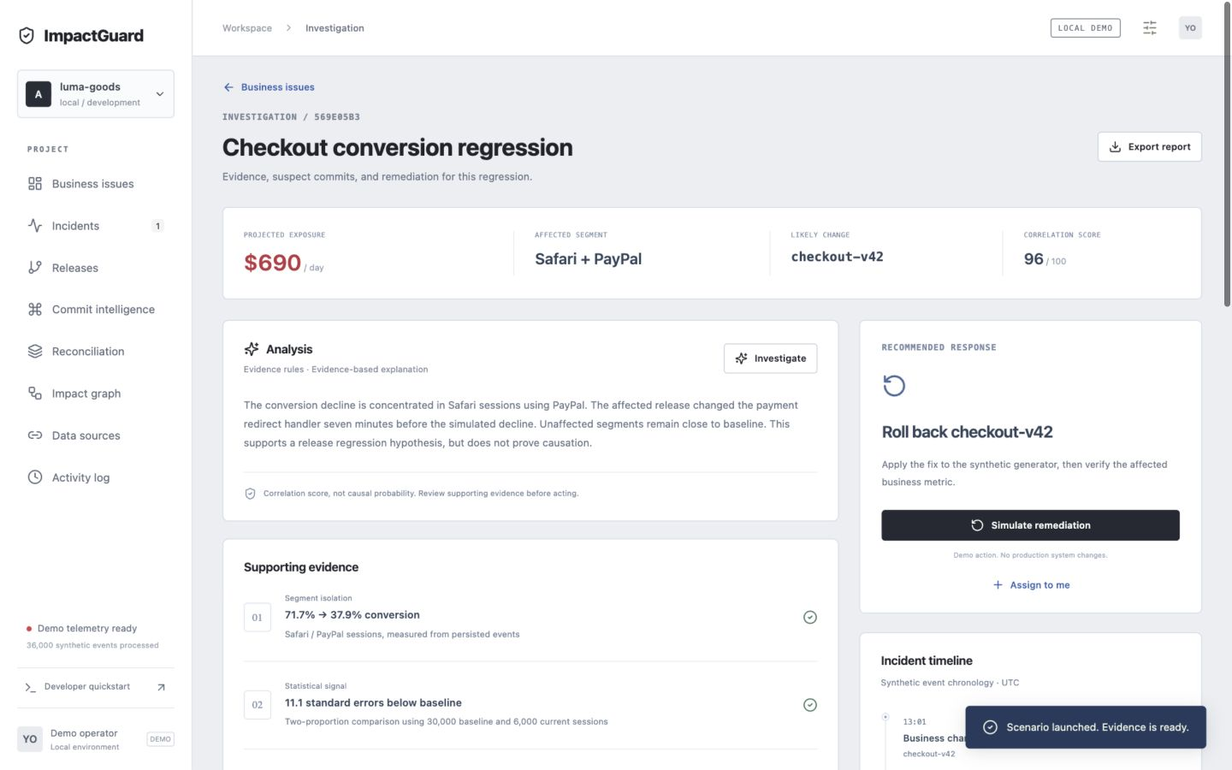
The regression is concentrated in Safari and PayPal
71.7%
baseline completion
37.9%
current Safari / PayPal
Other segments remain
close to baseline
Segment evidence supports a release-regression hypothesis. It does not establish causation.
Notes:
1:15–1:50. Open the checkout issue. Explain affected segment and control segments. These rates are measured from 30,000 historical and 6,000 current synthetic sessions. No production observations are represented. All business figures come from the deterministic local simulator and engine in this project. Seller projection assumes 120 checkout starts/day and $82 average order value. No external customer, cloud, bank or Shopify account is connected.

Slide 5
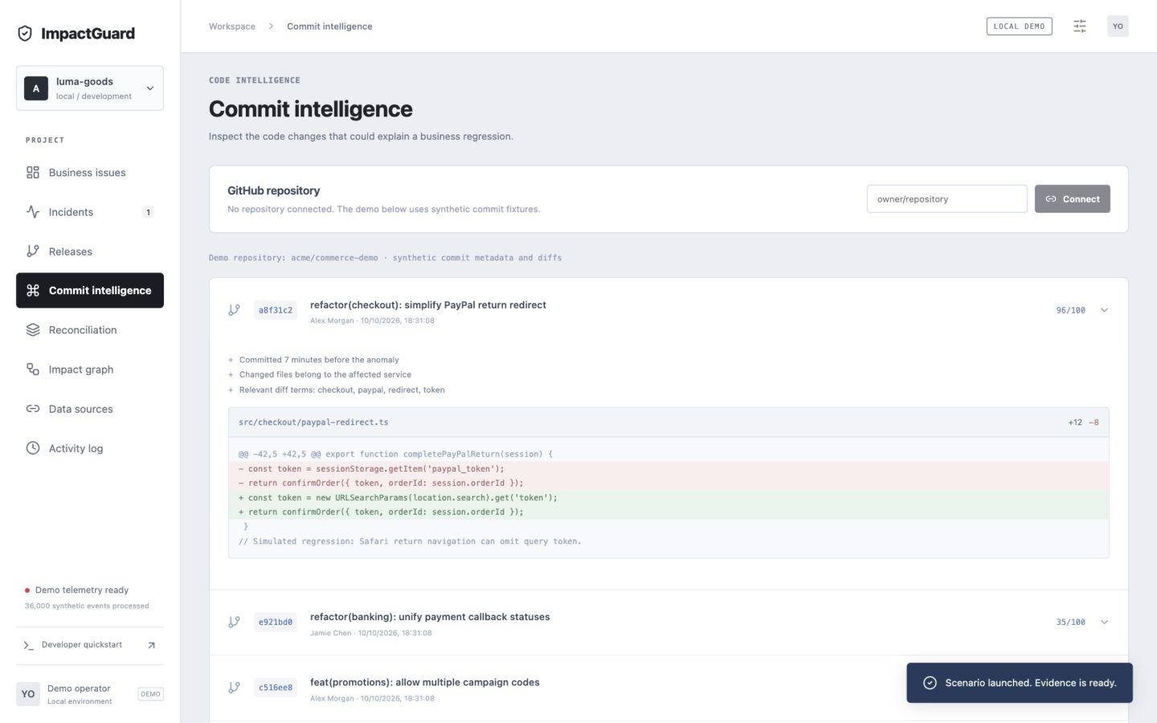
The relevant commit is visible with its diff
a8f31c2
Payment redirect
token handling
7 minutes before
the simulated anomaly
96 / 100
Heuristic association score. Production attribution needs a verified deployment-to-commit mapping.
Notes:
1:50–2:25. Show Commit intelligence or scroll to Suspect commits in the investigation. The top candidate changes PayPal token retrieval. Ranking weights timing 30%, service 30%, diff association 25%, segment signal 15%. Candidate SHA and diff are synthetic fixtures. The GitHub adapter can ingest real repository commits once explicitly connected. All business figures come from the deterministic local simulator and engine in this project. Seller projection assumes 120 checkout starts/day and $82 average order value. No external customer, cloud, bank or Shopify account is connected.

Slide 6
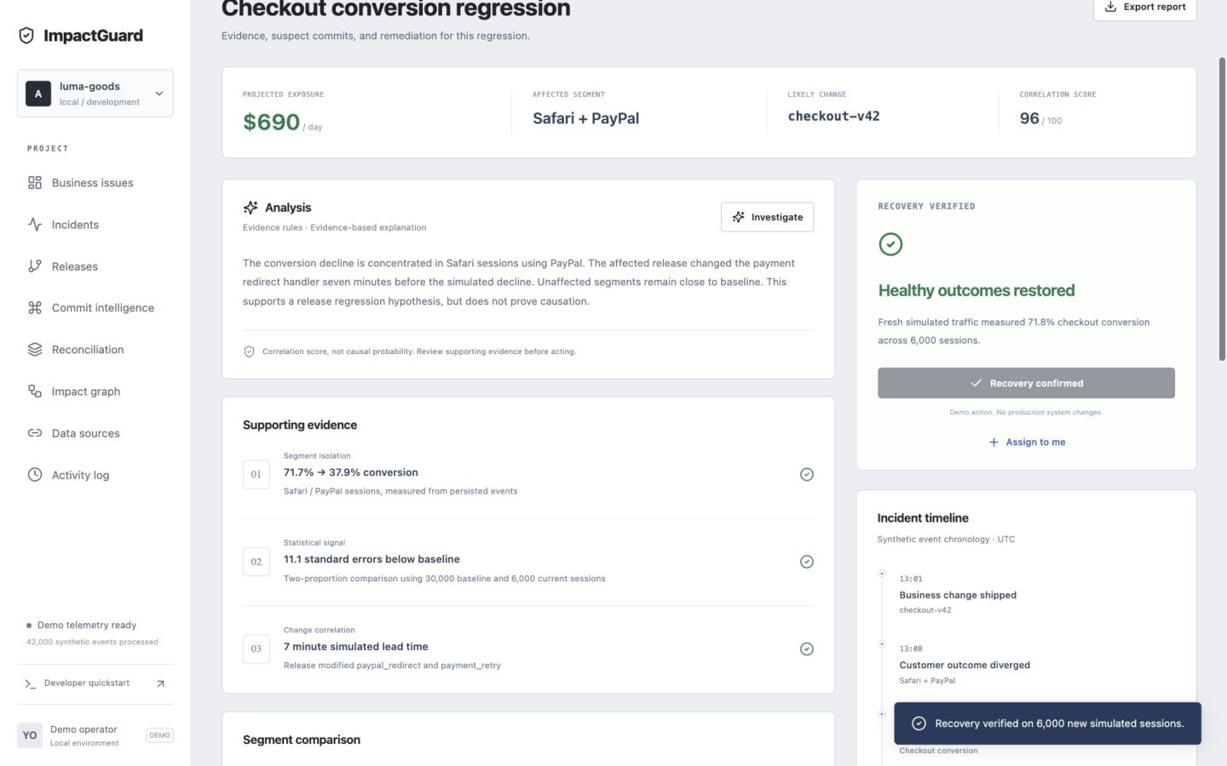
Recovery follows measured customer outcomes
71.8%
recovered checkout completion
6,000 fresh sessions
Green after verification
Functional simulator remediation. No production action occurs.
Notes:
2:25–2:55. Click Simulate remediation in the checkout investigation. The simulator restores healthy behavior and generates fresh sessions. The measured result is 71.75%, rounded to 71.8%. It does not roll back real infrastructure or claim realized savings. All business figures come from the deterministic local simulator and engine in this project. Seller projection assumes 120 checkout starts/day and $82 average order value. No external customer, cloud, bank or Shopify account is connected.

Slide 7
Profit and retention matter beyond checkout uptime
Stacked coupon discounts
Delayed delivery
$1,235 / week
41.7% vs 14.1%
on-time vs delayed
customer repurchase
45% combined discount against
64% assumed product cost
$126,165 / year scenario
Independent scenarios. Units differ. Do not add daily, weekly and annual exposure totals.
Notes:
2:55–3:30. After resolving checkout, run Promotion stacking. Highlight negative-margin orders and the discount-combiner diff. Delivery is a second, mature synthetic cohort scenario. Treat its result as an association and annual projection. All business figures come from the deterministic local simulator and engine in this project. Seller projection assumes 120 checkout starts/day and $82 average order value. No external customer, cloud, bank or Shopify account is connected.

Slide 8
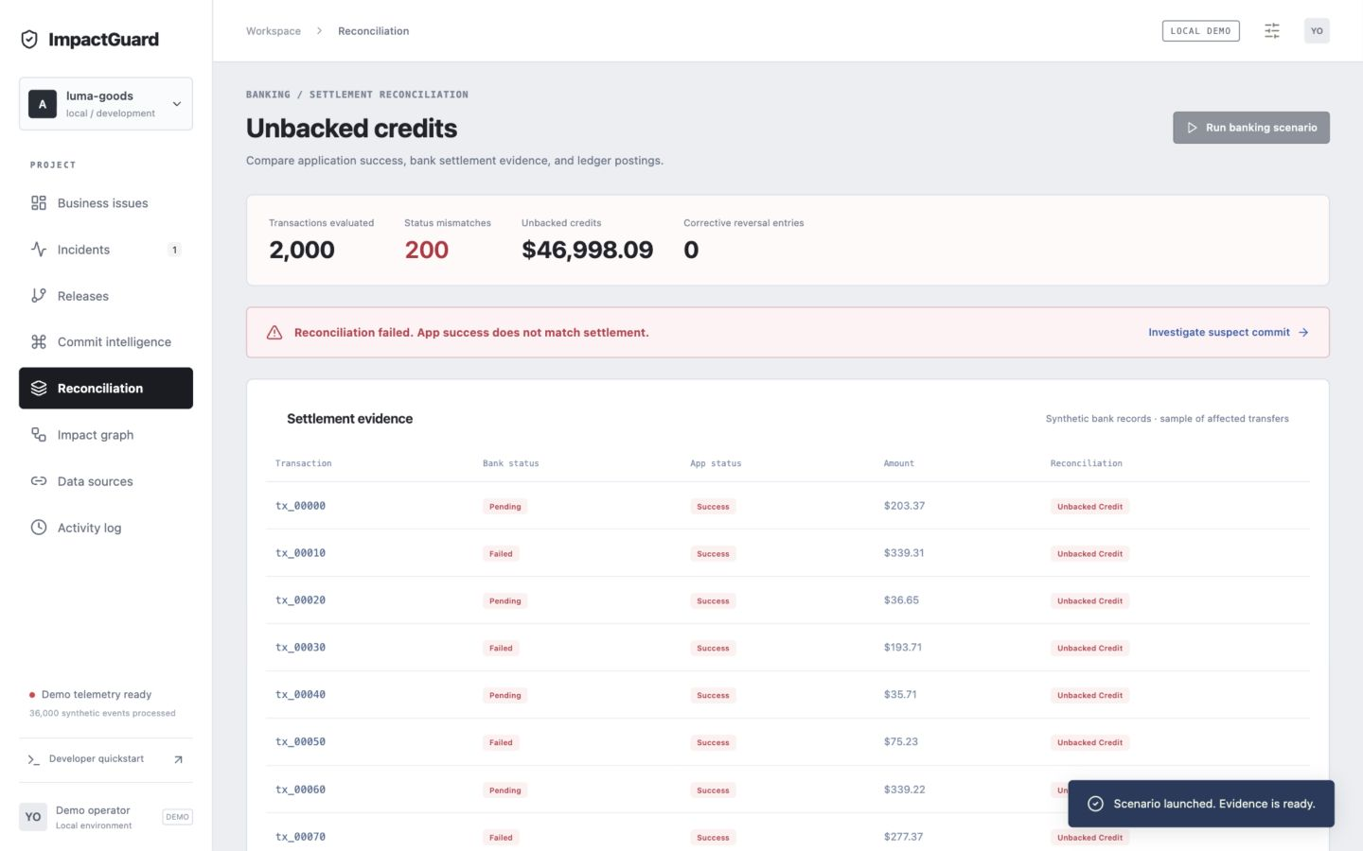
Banking: a success flag can hide unbacked credits
200
status mismatches
in 2,000 transfers
$46,998.09
unbacked ledger credits
Bank records are synthetic. Accounting postings use integer cents.
Notes:
3:30–4:10. Run the banking scenario. The status mapper reports success even when the authoritative simulated bank status is failed or pending. Reconciliation compares transaction status with actual ledger postings. The amount is an observed synthetic accounting discrepancy, not a revenue forecast. All business figures come from the deterministic local simulator and engine in this project. Seller projection assumes 120 checkout starts/day and $82 average order value. No external customer, cloud, bank or Shopify account is connected.

Slide 9
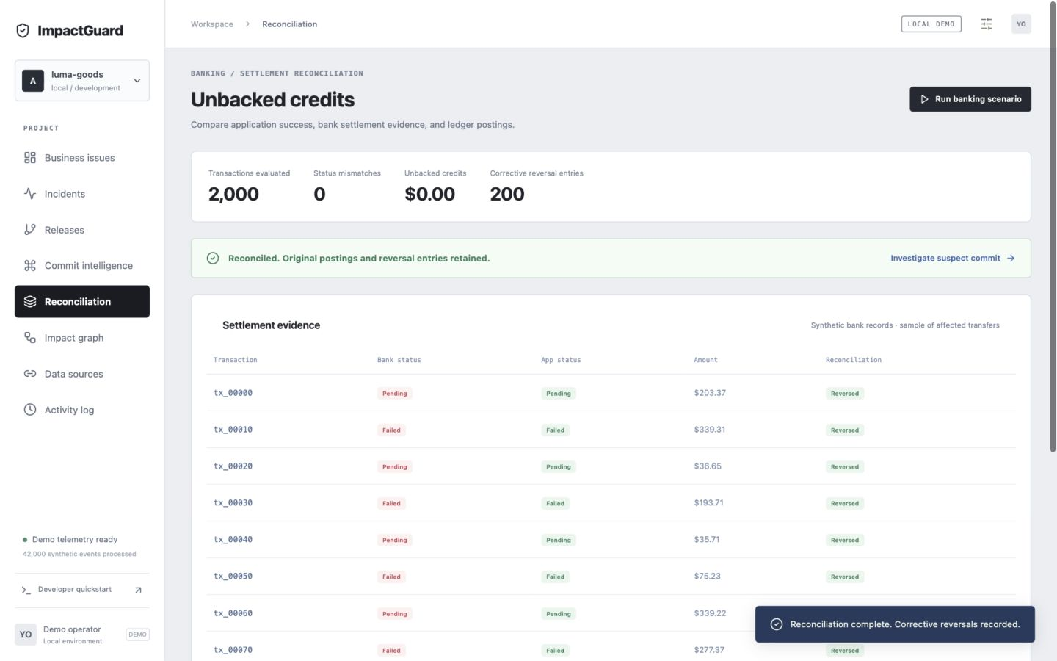
Reconciliation preserves the original postings
200 reversals
0 mismatches
Original credits retained
Corrections recorded in the audit trail
No bank connection or real financial transfer. Recovery is verified against persisted demo records.
Notes:
4:10–4:40. Show the bank status-mapper diff, then simulate remediation. The demo writes 200 reversal entries and keeps 2,000 original credit postings. The reconciliation engine also checks duplicate and missing ledger postings. Production operation would need verified external settlement evidence and approved accounting controls. All business figures come from the deterministic local simulator and engine in this project. Seller projection assumes 120 checkout starts/day and $82 average order value. No external customer, cloud, bank or Shopify account is connected.

Slide 10
A pilot should prove investigation value
First buyer hypothesis
Pilot measures
A growing Shopify seller
with custom checkout code
and frequent campaign changes
Useful alerts vs false positives
Time to identify a candidate change
Measured recovery after a response
Working locally today
Next connected milestone
Persisted events, detection, commit diffs,
impact calculations and reconciliation
One personal GCP project, one repository,
and one verified business event stream
Notes:
4:40–5:10. Buyer hypothesis, not customer traction. Target an SME seller with a custom Shopify storefront and access to an agency or developer, then validate alert precision and investigation speed. Banking is a separate vertical with a distinct reconciliation control model. All business figures come from the deterministic local simulator and engine in this project. Seller projection assumes 120 checkout starts/day and $82 average order value. No external customer, cloud, bank or Shopify account is connected.

