Slide 1
SUPERSTORE SALES PREDICTION
USING MACHINE LEARNING
M. VISHNU SRIKAR
12112382
LOVELY PROFESSIONAL UNIVERSITY
K21UW

Slide 2

AGENDA:
Problem Statement
Introduction
Literature Review
Data Preprocessing
Methodology
Dataset Description
Result and Analysis
Reference

Slide 3
PROBLEM STATEMENT:
Develop a machine learning model to predict future sales for a superstore based on historical data, considering factors accordingly. The goal is to enhance inventory management and optimize business strategies to maximize their sales.

Slide 4
INTRODUCTION:
This project focuses on predicting how much a superstore will sell in the future using data from its sales. We carefully clean up the data, fixing any missing or unclear data, and analyze various features such as item categories and numbers to determine how they impact sales. Then, to predict sales in the future, we employ machine learning models like Decision Trees, XG-Boost, Random Forest, Support Vector, and K-Nearest Neighbors. We evaluate these models’ effectiveness using evaluation metrics such as R-squared, Mean Absolute Error, and Mean Squared Error. The results show that our models perform well at forecasting sales, which can help the superstore to better handle its inventory and make better business choices based on data. Overall, using these prediction models can help the superstore become more efficient and responsive to market changes.

Slide 5
LITERATURE REVIEW:
Sales Prediction System Using Machine Techniques | Ms. M. Anitha et al | Linear regression, K-nearest neighbors (KNN), Support vector machines (SVM), Random forest | Sales prediction systems can help retailers to improve the accuracy of their sales forecasts, which can lead to increased profits and improved customer satisfaction.
Analysis on the Prediction of Sales using Various Machine Learning Testing Algorithms | Dr. J.Sasi Kiran et al | Linear regression, K-nearest neighbors (KNN), Support vector machines (SVM), Random forest, XGBoost | Traditional sales forecasting methods are often inaccurate, especially for businesses with complex or dynamic sales patterns. Machine learning algorithms, such as XGBoost, can be used to build more accurate sales forecasting models, even for businesses with data sparsity.
Quotidian Sales Forecasting using Machine Learning | Spuritha M et al | Linear regression, K-nearest neighbors (KNN), XGBoost, Random forest | Traditional forecasting methods are often not accurate enough to predict daily sales. ML based daily sales forecasting system that is easy to use and does not require any prior knowledge of machine learning.

Slide 6
A survey of machine learning techniques for food sales prediction | Grigorios Tsoumakas | support vector machines, decision trees, random forests | The issue addresses the adoption of machine learning techniques to enhance food sales forecasting, emphasizing their potential to improve accuracy, adaptability, and overall decision-making in the retail industry.
E-Commerce System for Sale Prediction using Machine Learning Technique | Karandeep Singh et al | Linear regression, K-nearest neighbors (KNN), Support vector machines (SVM), Random forest | The issue addressed is the performance of the proposed system on a real-world e-commerce dataset and finds that the system outperforms traditional forecasting methods in terms of accuracy. The paper also shows that the system can generate accurate sales forecasts even for products with sparse data. quality control in wine production.
Sales Prediction System Using Machine Learning | Mansi Panjwani et al | Linear regression, K-nearest neighbors (KNN), Support vector machines (SVM), Random forest | Traditional methods like time series that can’t provide accurate sales can be overcome by Machine learning can enhance accuracy by considering more factors.
Sales Prediction based on Machine Learning | Zixuan Huo | Linear regression, K-nearest neighbors (KNN), XGBoost, Random forest, convolutional neural networks (CNNs), recurrent neural networks (RNNs) | Inaccurate sales forecasting in businesses can lead to missed opportunities, lost revenue, and increased costs. Machine learning can be used to build more accurate sales prediction models, which can help businesses to make better decisions and improve their profitability.

Slide 7
Walmart Sales Prediction Using Machine Learning Algorithms | Dr. C. Shyamala et al | Linear regression, K-nearest neighbors (KNN), XGBoost, Random forest | Traditional forecasting methods are often not accurate enough for Walmart to make informed decisions about inventory management, pricing, and marketing. Machine learning algorithms can be used to build more accurate sales prediction models for Walmart, which can help the company to improve its efficiency and profitability.
Sales Prediction System Using Machine Techniques | Ms. M. Anitha et al | Linear regression, K-nearest neighbors (KNN), Support vector machines (SVM), Random forest | Sales prediction systems can help retailers to improve the accuracy of their sales forecasts, which can lead to increased profits and improved customer satisfaction.
Analysis on the Prediction of Sales using Various Machine Learning Testing Algorithms | Dr. J.Sasi Kiran et al | Linear regression, K-nearest neighbors (KNN), Support vector machines (SVM), Random forest, XGBoost | Traditional sales forecasting methods are often inaccurate, especially for businesses with complex or dynamic sales patterns. Machine learning algorithms, such as XGBoost, can be used to build more accurate sales forecasting models, even for businesses with data sparsity.
Quotidian Sales Forecasting using Machine Learning | Spuritha M et al | Linear regression, K-nearest neighbors (KNN), XGBoost, Random forest | Traditional forecasting methods are often not accurate enough to predict daily sales. ML based daily sales forecasting system that is easy to use and does not require any prior knowledge of machine learning.

Slide 8
DATA PREPROCESSING:
Data Preprocessing Steps :
The data is checked for null values and the null values were filled by mean for numerical data and by mode for categorical data.
We have constructed different graphs using Box plot and Histogram plot representing all the numerical columns and categorical columns to see how the data is set in each feature.
The column “Item_Fat_Content” was found to be inconsistent, so we replaced few values in that column.
We have converted the categorical values (if any in the column) into numerical values for machine learning model training.

Slide 9
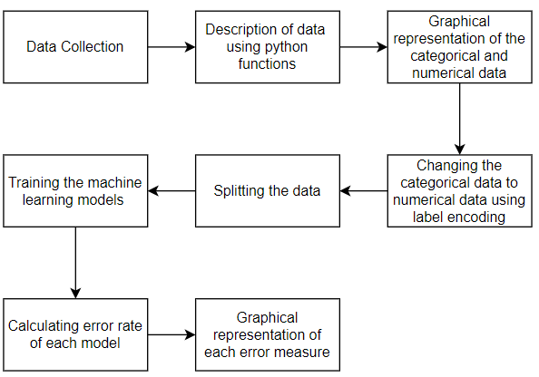
METHODOLOGY ARCHITECTURE:

Slide 10
METHODOLOGY:
XG-Boost Regressor:
XG-Boost (Extreme Gradient Boosting) is an ensemble learning algorithm that combines the predictions of multiple decision tree models to improve accuracy and is particularly effective for regression tasks.
K-Nearest Neighbors Regressor:
K-Nearest Neighbors is an algorithm that predicts the target variable by averaging the values of its k-nearest neighbors.
Decision Tree Regressor:
Decision Tree builds a predictive model in the form of a tree structure, where each node represents a decision based on a feature, and each leaf node represents the predicted output.
Random Forest Regressor:
Random Forest is collection of decision trees, where multiple trees are trained independently, and their predictions are averaged to improve accuracy and handle overfitting.
Support Vector Regressor:
Support Vector Regression uses support vector machines to find a hyperplane that best represents the relationship between features and the target variable.
Linear Regression:
Linear Regression models the relationship between the independent variables and the target variable as a linear.

Slide 11
DATASET DESCRIPTION:
8523 instances and 12 features are included in the dataset.
The dataset contains different features which clearly tells all the details about the product or the item in the supermarket.
The Dataset contain various null values in the features.
The dataset contains different features for items such as Item_Identifier, Item_Weight, Item_Fat_Content, Item_Visibility, Item_Type, Item_MRP.

Slide 12
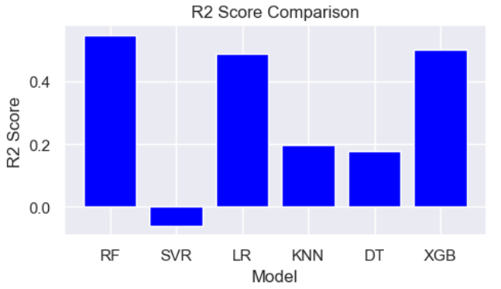
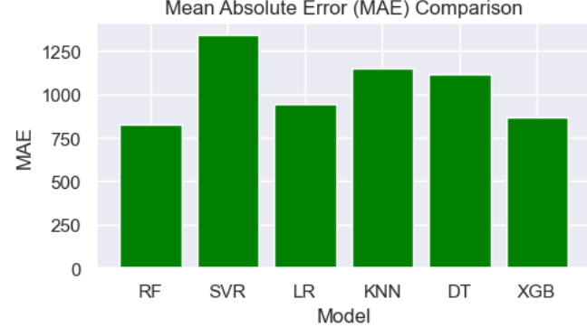
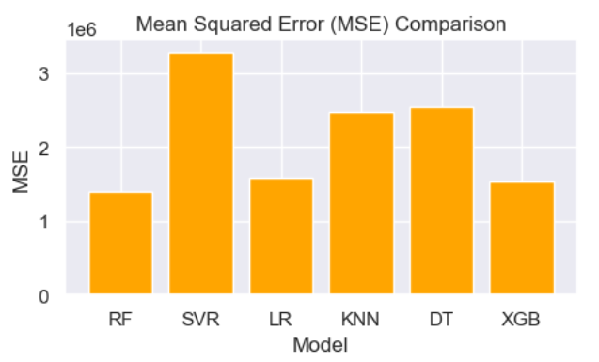
RESULT AND ANALYSIS:
The result or conclusion for the regressor model is based on the fact that the value for R2-Score should be high and the MAE and the MSE should be relatively low.
After plotting all the graphs for R2,MSE,MAE measures. The below are the plots:
We can thus conclude that Random Forest Regressor has given the best result considering all the error measures.

Slide 13
REFERENCES:
[1] Bajaj, P., Ray, R., Shedge, S., Vidhate, S., & Prof. Dr. N. K. Shardoor. (2020). Sales Prediction using Machine Learning Algorithms.
[2] Odegua, R. (2020). Applied Machine Learning for Supermarket Sales Prediction.
[3] Tsoumakas, G. (2019). A survey of machine learning techniques for food sales prediction.
[4] Singh, K., M., B. P., & Eaganathan, U. (2020). E-Commerce System for Sale Prediction using Machine Learning Technique.
[5] Panjwani, M., Ramrakhianil, R., Jumnani, H., Zanwar, K., & Prof. R. Hande. (2020). Sales Prediction System Using Machine Learning.
[6] Huo, Z. (2021). Sales Prediction based on Machine Learning.
[7] Dr. Shyamala, C., Sabarish, P., Vignesh, T., & Yogeendran, S. (2021). Walmart Sales Prediction Using Machine Learning Algorithms.

Slide 14
[8] Anitha, M., Nagaraju, E., & Geetha, D. (2023). Sales Prediction using Machine Techniques.
[9] Dr. Kiran, J. S., Dr. Srinivasa Rao, P. S. V., Dr. Prasada Rao, P. V. R. D., Dr. Babu, B. S., & Divya, N. (2022). Analysis on the Prediction of Sales using Various Machine Learning Testing Algorithms.
[10] M., S., Kashyap, C. S., Nambiar, T. R., Kiran, D. R., Rao, N. S., & Reddy, G. P. (2021). Quotidian Sales Forecasting using Machine Learning.

Slide 15

Thank you !!!!!

