Slide 1
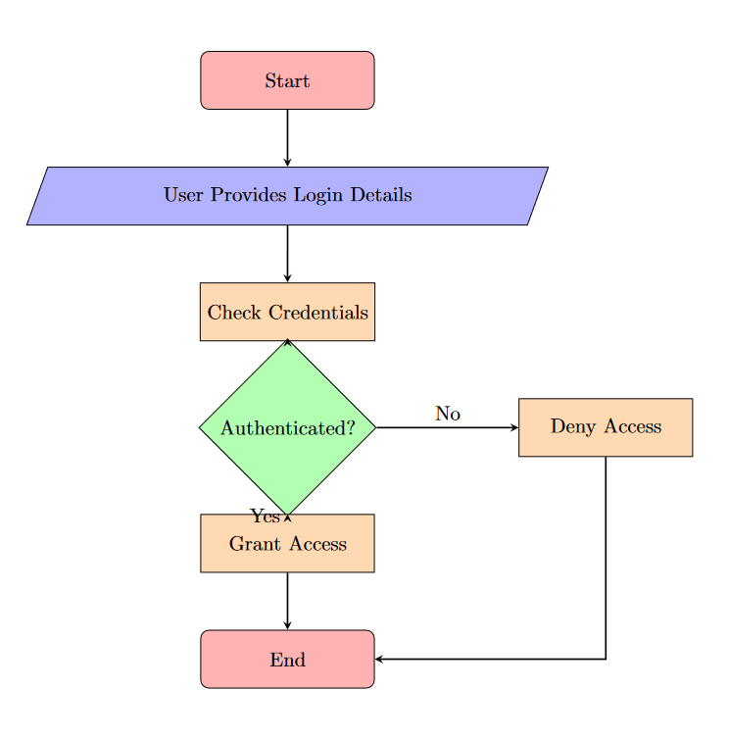
LOGIN PAGE

Slide 2
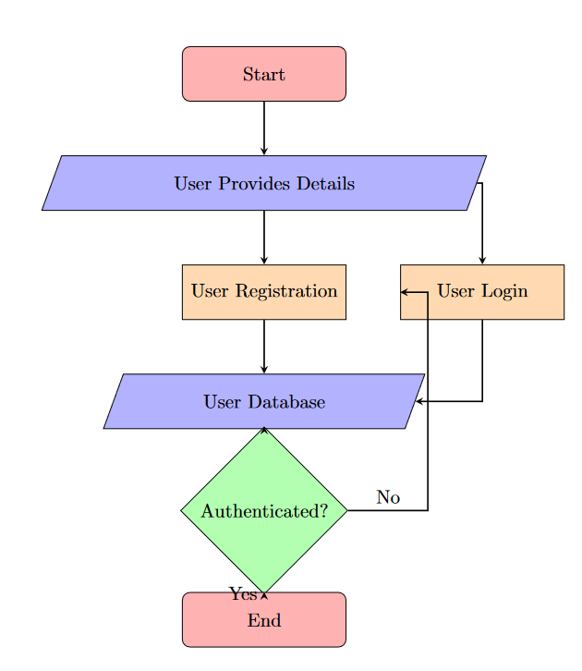
USER REGISTRATION

Slide 3
USER TABLE
User ID (Primary Key) | Name | Email | Password

