Slide 1
E-BOOK READER
K Krishna Chaitanya 1211A020
M Siddarth 1211A023
T Ramakanth 1211A051
T Vishnu Teja 1211A056

Slide 2
AGENDA
Scope of the project
Technical specifications
Design method
Iterations
Future Enhancements
Screenshots

Slide 3
SCOPE
This project is aimed at the development of a application used to read content from “.pdf” file with various functionalities provided for the user.
Provides flexibility to user to navigate through the e-books

Slide 4
Technical Specifications
Java JDK 1.7
Multi purpose programming language
Net Beans IDE
Tool to develop robust application
Itext
This jar files are used to work with pdf formatted files.

Slide 5
Design method (RUP)
IBM Rational Unified Process(RUP) is a comprehensive process framework that provides industry-tested practices for software and systems delivery and implementation and for effective project management.
It is one of many processes contained within the Rational Process Library, which offers best practices guidance suited to your particular development or project need.

Slide 6
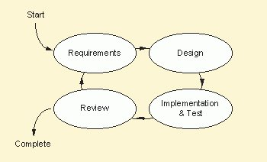
Rational Unified Process

Slide 7
1. Requirements analysis and use cases
Stand alone application
One- click access for easy navigation
Sequential access for the book
Display the list
Personalize reading preferences
Delete
Search book
Installation guide, documentation

Slide 8
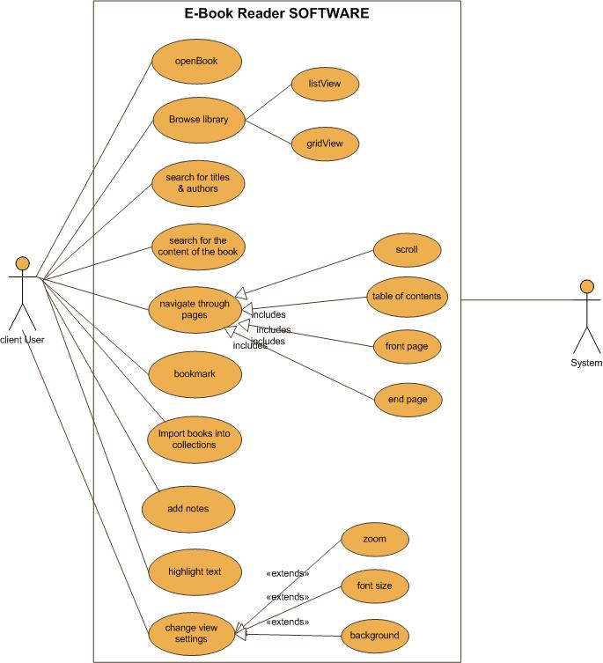
Use case

Slide 9
Design Model (sequence diagram)

Slide 10
Domain Model

Slide 11
Class Diagram

Slide 12
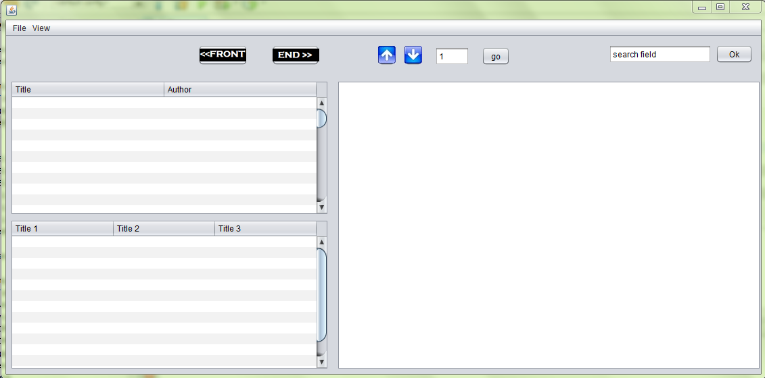

Slide 13
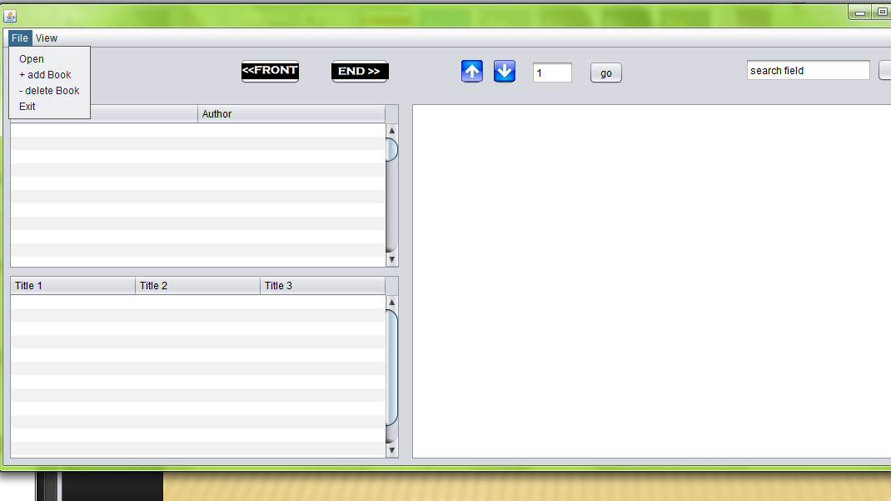

Slide 14
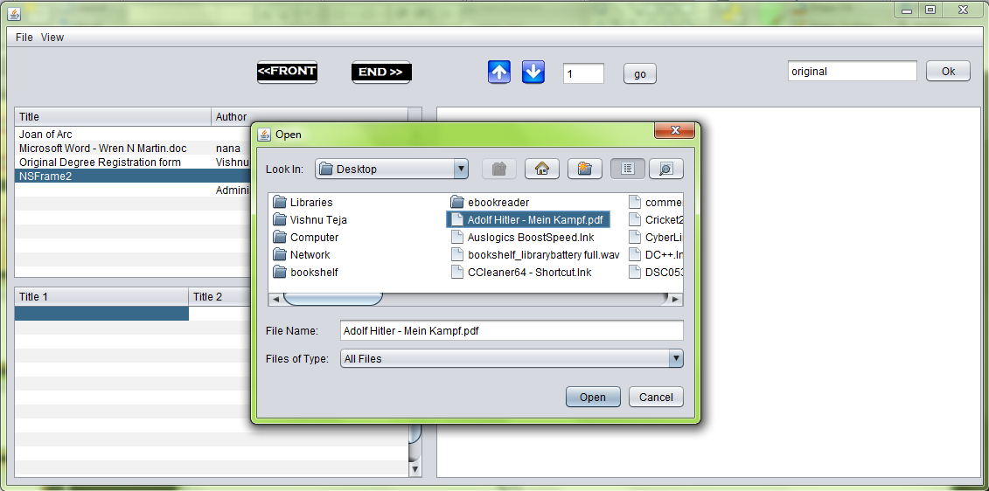

Slide 15
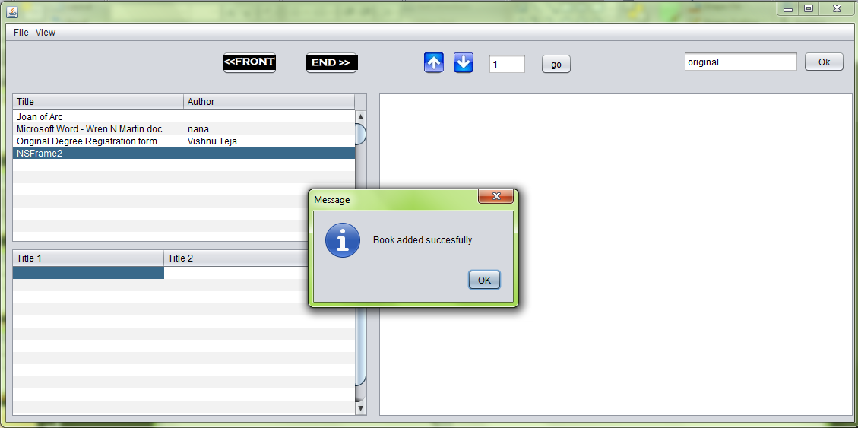

Slide 16
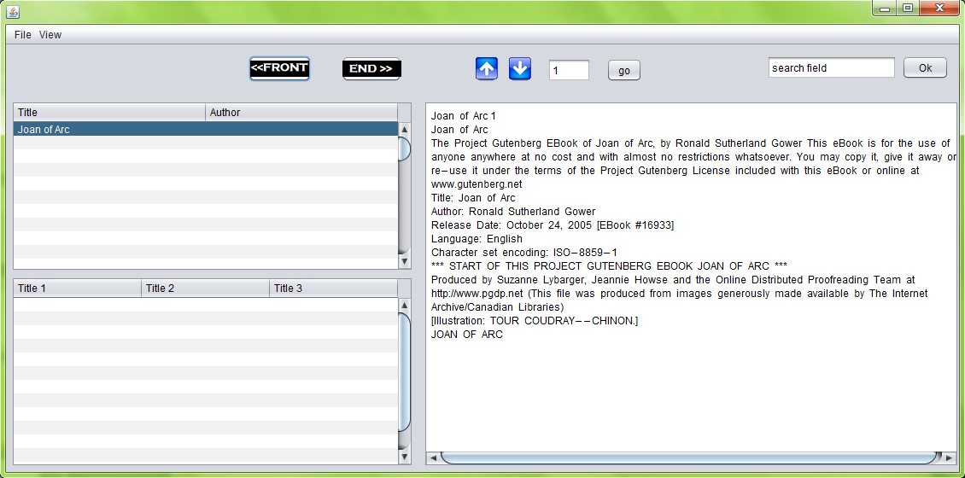

Slide 17
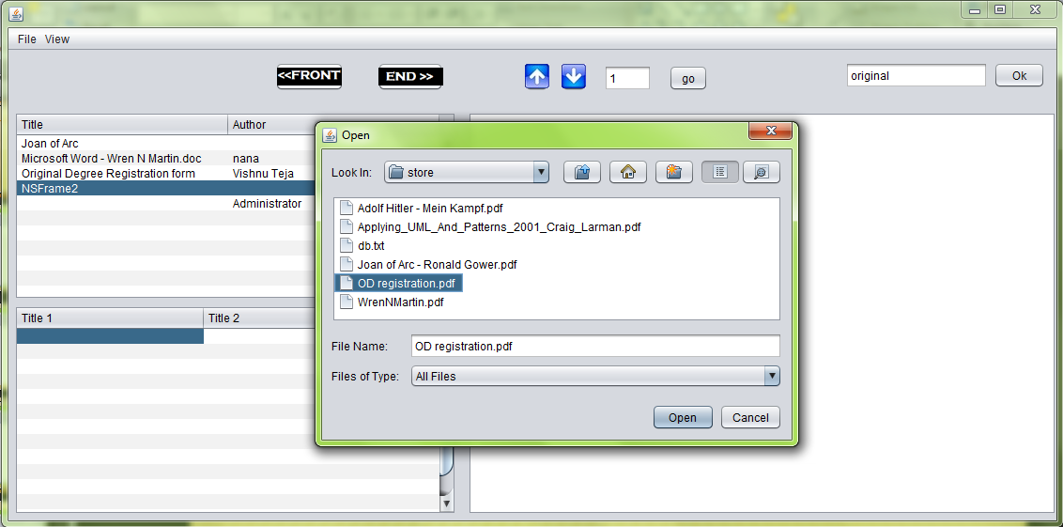

Slide 18
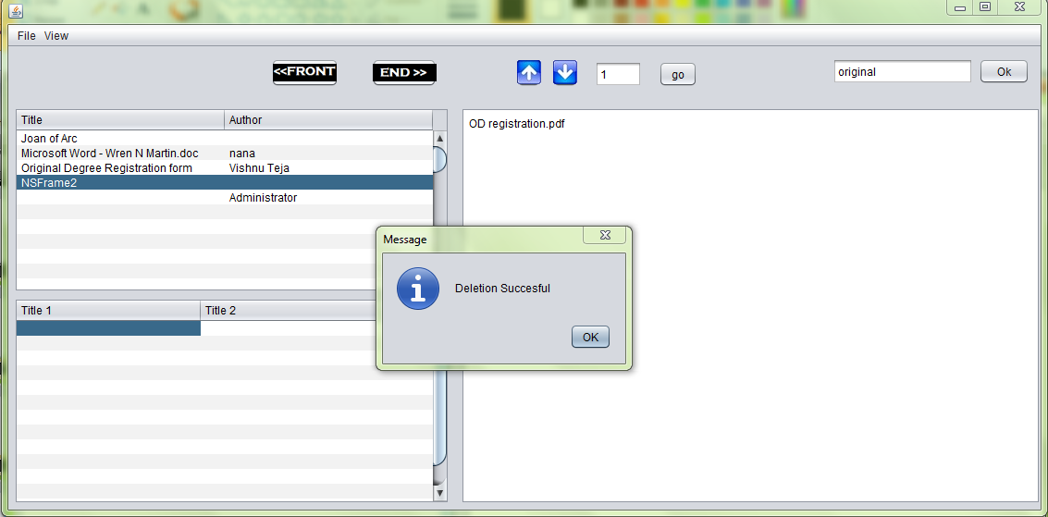

Slide 19
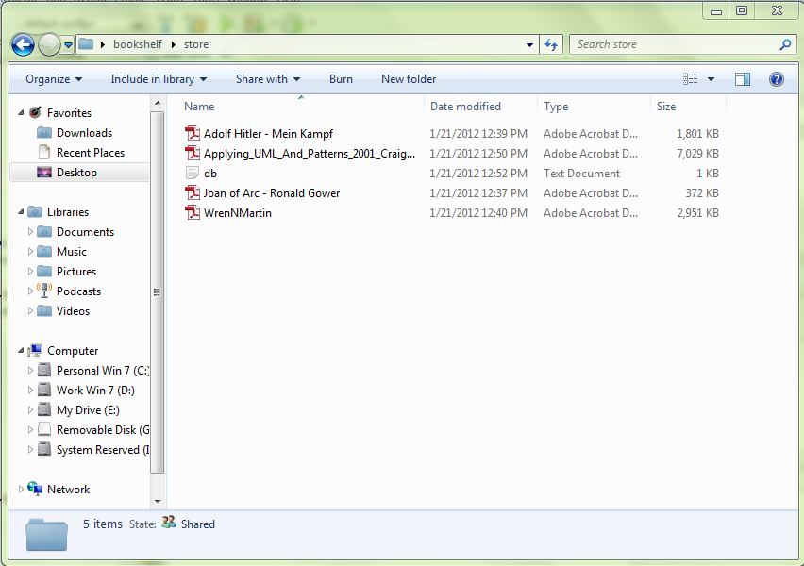

Slide 20
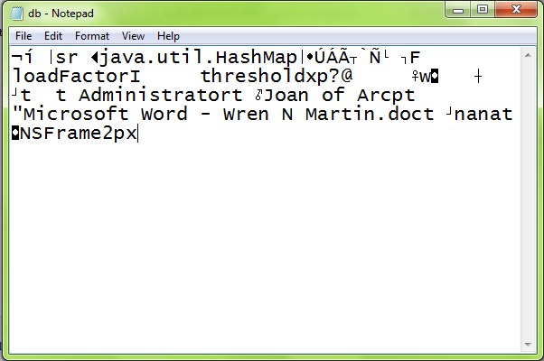

Slide 21
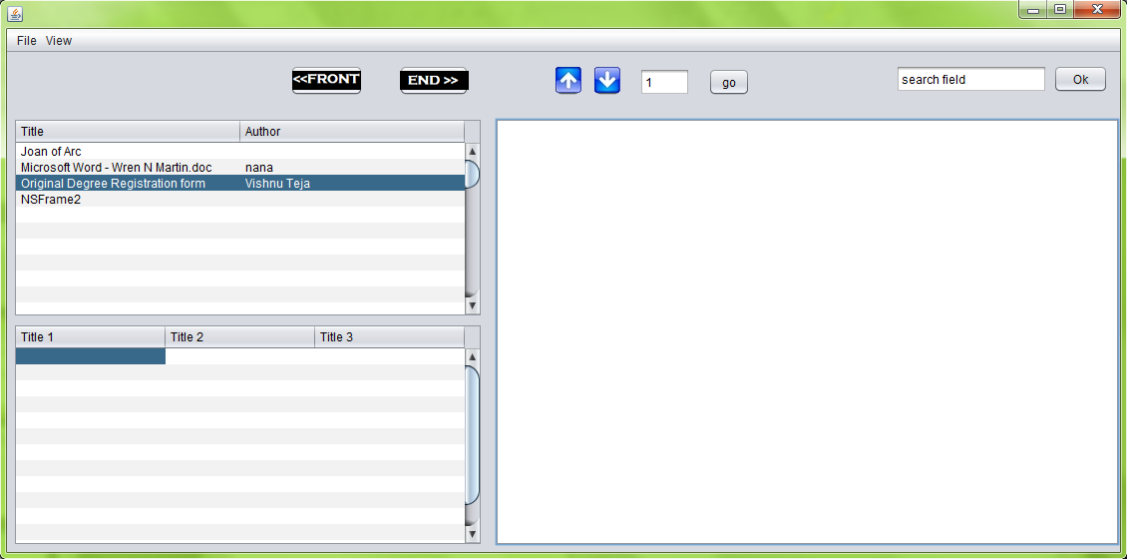

Slide 22
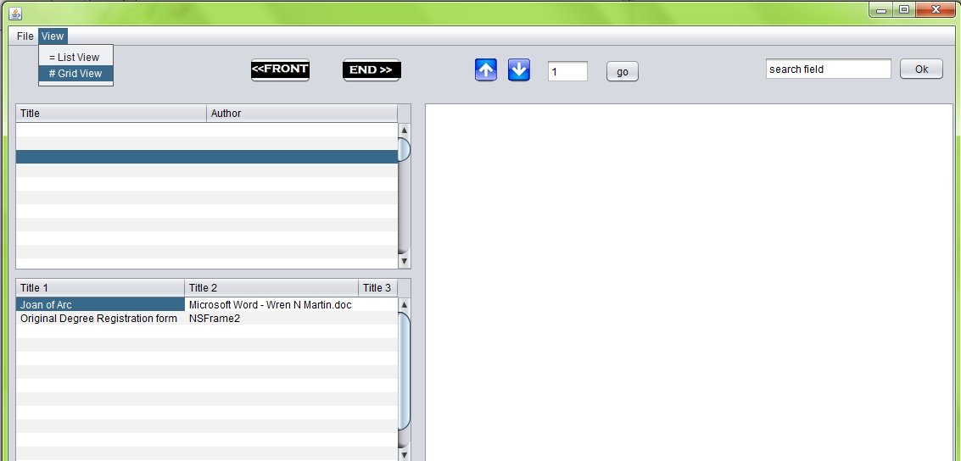

Slide 23
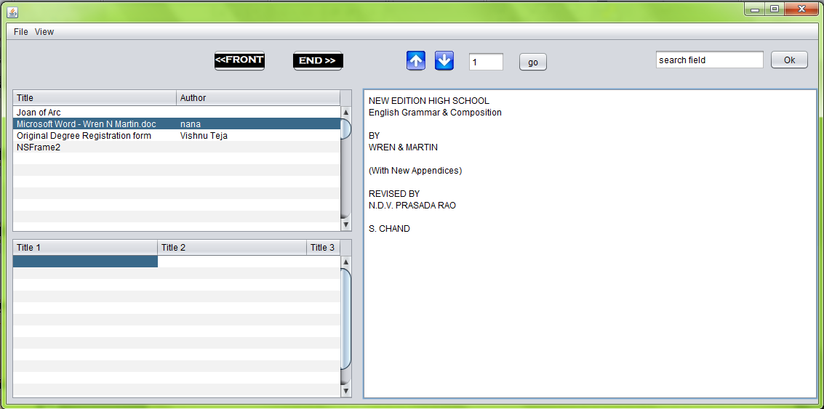

Slide 24
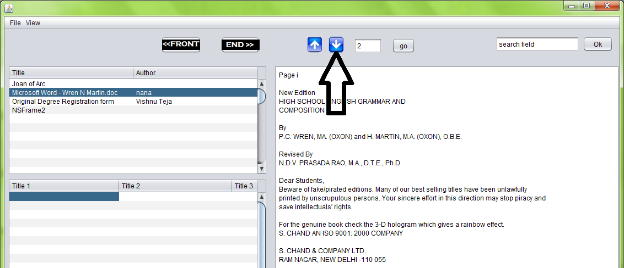

Slide 25
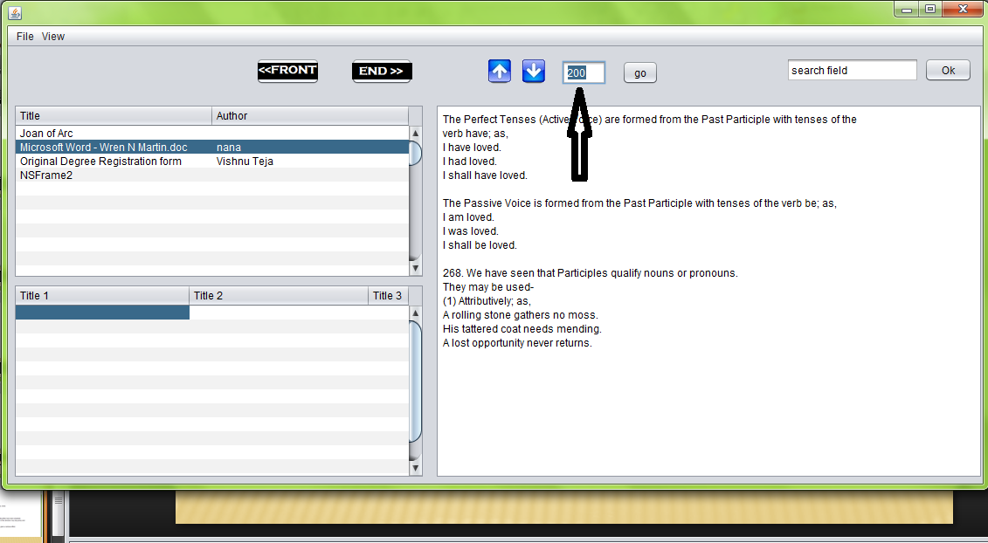

Slide 26
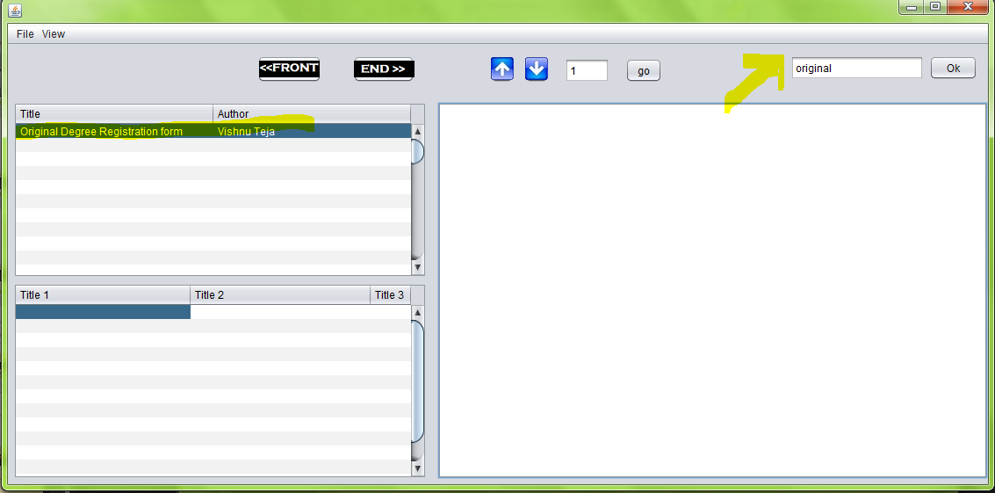

Slide 27
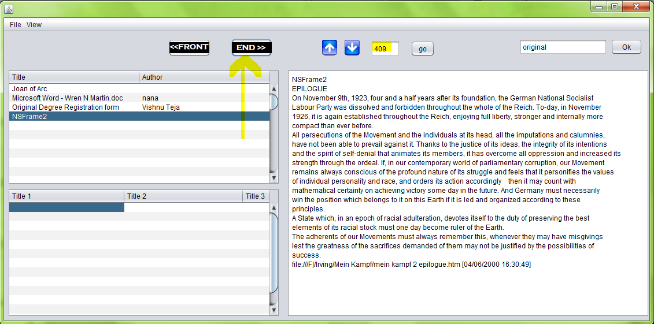

Slide 28
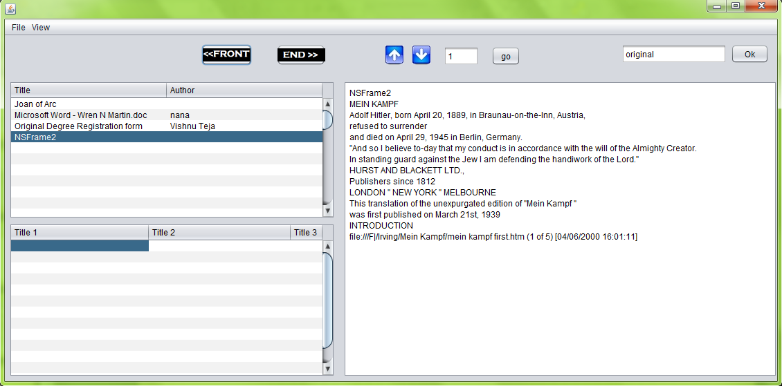

Slide 29
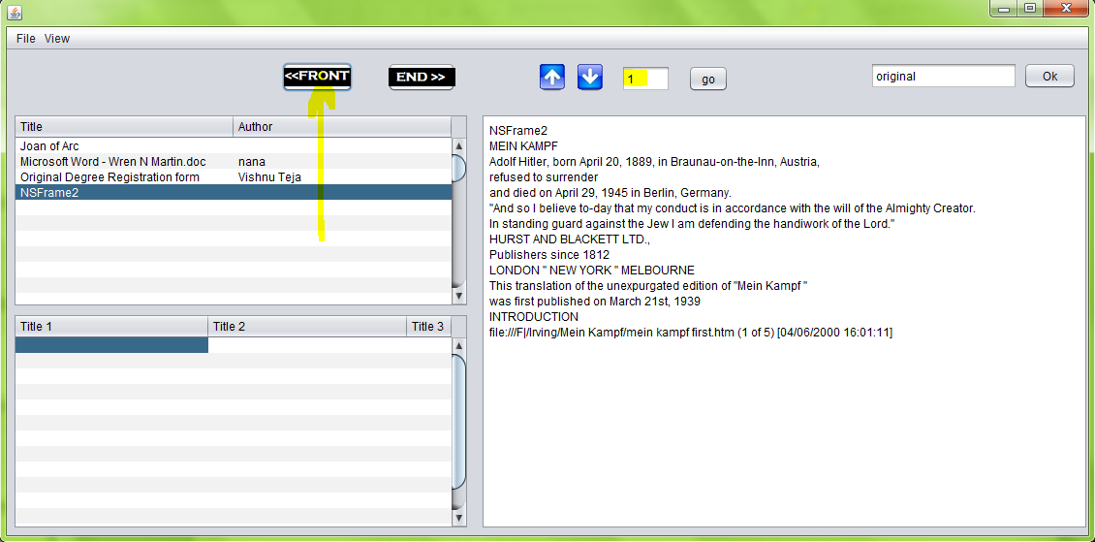

Slide 30
Future Enhancements
Tagging of content
Bookmarking
Create a common tool for opening even documents( .doc)
Advanced grid view
Download from internet

Slide 31
THANK YOU

