Slide 1
HOTELS IN HYDERABADD
CAPSTONE PROJECT

Slide 2
OUTLINE
Introduction
Data
Data Cleaning
New Dataset
Clustering
Visualization
Conclusion and Future Direction

Slide 3
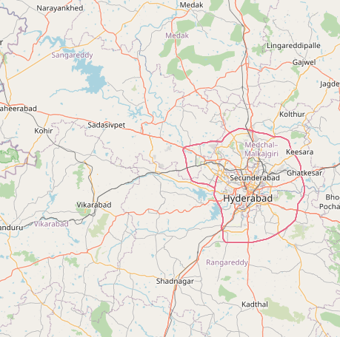
introduction
Main moto of this project is to help the new person in Hyderabad to select a hotel to stay or eat
As a new person in a city people tend to get confused to select a good place which is good and also affordable
This project provide you a map of hotels clustered on the basis of ratings and price
By using this application , one can select their preferred hotel in his surrounding using the map

Slide 4
DATA COLLECTING
Foursquare API: Here we have fetched data of hotels in Hyderabad.
From foursquare API we got following columns of data which we have to clean
'categories', 'hasPerk', 'id', 'location.address', 'location.cc','location.city', 'location.country', 'location.crossStreet','location.distance', 'location.formattedAddress','location.labeledLatLngs', 'location.lat', 'location.lng','location.postalCode', 'location.state', 'name', 'referralId’
Zomato API: From this we fetch useful information like ratings, price etc.

Slide 5
DATA CLEANING
Data collected from foursquare API includes some unwanted and incomplete data
I have dropped some unwanted columns from the API data
After cleaning the data , merged the both dataset and made a new data set for further process
Now some venues are dropped whose latitude and longitude aren’t matched in foursquare data and Zomato data
There are some mismatched data between Zomato and foursquare data which I have dropped manually.
Now we got our cleaned dataset which contains 22 venues

Slide 6
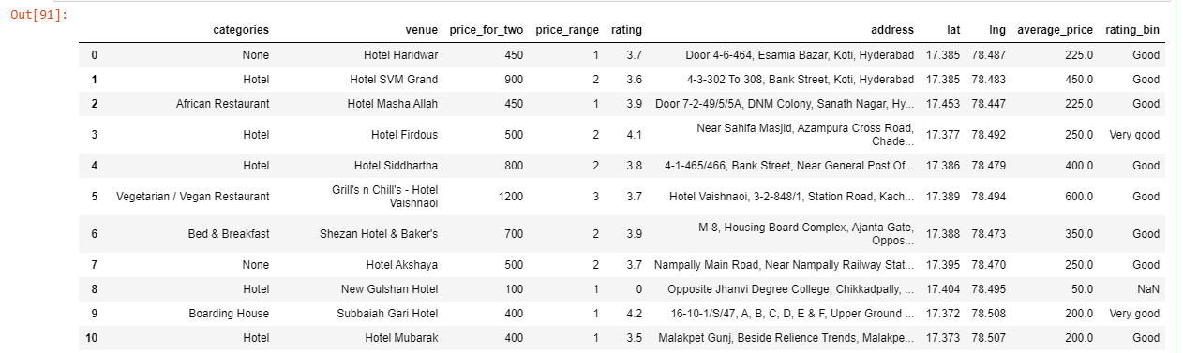
New Dataset
Now from the cleaned dataset we select some particular columns for further clustering. The first 10 elements of new dataset is

Slide 7
CLUSTERING
We Cluster the data into 3 clusters on the basis of ratings and average price
CLUSTER_0 - 1st cluster contains 6 venues whose average price was very low when compared to other hotels .Mostly it’s in between 50- 200
CLUSTER_1 - 2nd cluster contains 6 hotels whose average price was very high when compared other hotels. Mostly it’s in between 200 to 300
CLUSTER_2 - 3rd cluster contains 12 hotels whose average price was moderate Mostly it’s more than 300
BLACK MARKED HOTELS – CLUSTER_0
RED MARKED HOTELS – CLUSTER_1
BLUE MARKED HOTELS – CLUSTER_1

Slide 8
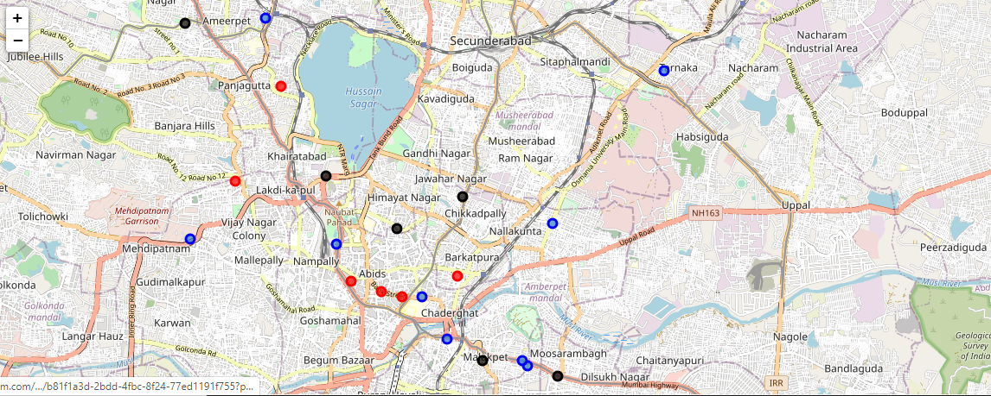
CLUSTER VISUALIZING

Slide 9
Conclusion and future direction
So the whole process was to collect data from both API’s, merge them and clean data just by keeping the required data. After cleaning, clustering the data such that we cluster the similar hotels on the basis of their ratings and average price. This application will help people who are in Hyderabad and want to go to a hotel and who wants to check whether the hotel is good and affordable or not.
Further Improvisations: Instead of giving the Hyderabad location details, we can use geocoder to find the live location and calculate the hospitals nearby, this was this application is not restricted to Hyderabad and can be used anywhere in this world
THANK YOU.

