Slide 1
METHODOLOGY
How the System Was Designed, Simulated, Built, and Validated
Wearable Wrist Rehabilitation Using Dual-Channel FES

Slide 2





01 · OVERVIEW OF APPROACH
A Five-Stage Methodology
1
2
3
4
5
Compare options
Select FES
Simulate
Implement
Validate
Evaluate motor, SEA, pneumatic, and FES against weight, cost, complexity.
Chosen for being lightweight, low-cost, no mechanical actuator.
Model grip-then-rotate logic in MATLAB as a finite-state machine.
Port validated logic to ESP32 firmware; integrate sensors & FES.
Structured self-wear testing across defined movement scenarios.
Actuator comparison ran in parallel with system planning; simulation preceded hardware to reduce debugging risk.

Slide 3
02 · ACTUATOR COMPARISON METHODOLOGY
Four Alternatives Evaluated Against FES
Actuator | Weight | Cost | Complexity | Verdict
Electric motor / servo | High | Moderate | Moderate | Rejected — adds mass
Pneumatic (PAM) | Moderate | Moderate | High (compressor) | Rejected — needs air supply
Series elastic actuator | Moderate–High | High | High | Rejected — costly
Hydraulic | High | High | High | Rejected — impractical
FES (proposed) | Minimal | Low | Low–Moderate | Selected — no actuator needed
FES eliminates the need for any mechanical actuator — stimulation is delivered directly to the patient's own muscle tissue.

Slide 4
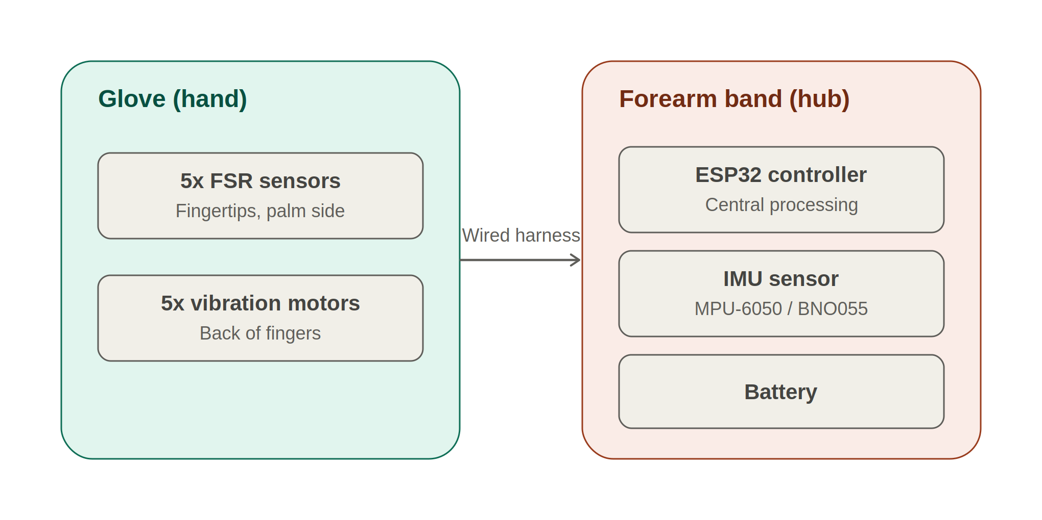
03 · SYSTEM DESIGN METHODOLOGY
Two Physical Units, Connected by a Wired Harness

Slide 5


04 · SIMULATION METHODOLOGY
Two Functions Drive the Simulated Behaviour
Exponential Approach (Motion)
Bang-Bang Trigger (Stimulation)
Grip and rotation move toward target by closing a fixed % of the remaining gap each time step — a smooth, settling curve approximating real muscle response.
FES switches fully ON when a sensor reading falls below threshold, and OFF the instant threshold is crossed — closed-loop, but not proportional.
IF grip_force < grip_threshold:
activate FES Channel 1 (close hand)
IF grip_force ≥ grip_threshold AND rotation_angle < angle_target:
activate FES Channel 2 (rotate forearm)
ELSE IF rotation_angle ≥ angle_target: hold state → LED green (success)

Slide 6



05 · HARDWARE IMPLEMENTATION METHODOLOGY
Five-Step Build Order
1
Sensor integration
Wire and calibrate the 5 FSR grip sensors and the IMU rotation sensor.
2
Driver & feedback
Connect ULN2803A to drive vibration motors; wire the RGB LED.
3
Firmware logic
Implement the validated finite-state machine on ESP32 firmware.
4
FES integration
Connect the medical-grade, isolated dual-channel stimulator to Ch.1 & Ch.2 pads.
5
System assembly
Integrate all components into the glove and forearm-band housings.

Slide 7


06 · VALIDATION METHODOLOGY
Structured Self-Wear Testing Across Five Scenarios
Grip only
Rotation only
Combined sequence
Range of motion
Repeated trials
Confirms FES Ch.1 triggers correctly on low FSR readings.
Confirms FES Ch.2 triggers correctly on low IMU readings.
Confirms correct grip-then-rotate phase ordering.
Tested at 15°, 30°, 45°, 60° rotation targets.
5–10 repetitions per team member for consistency.
Recorded per trial: FES activation success, comfort, electrode adhesion, and feedback accuracy.

