Slide 1
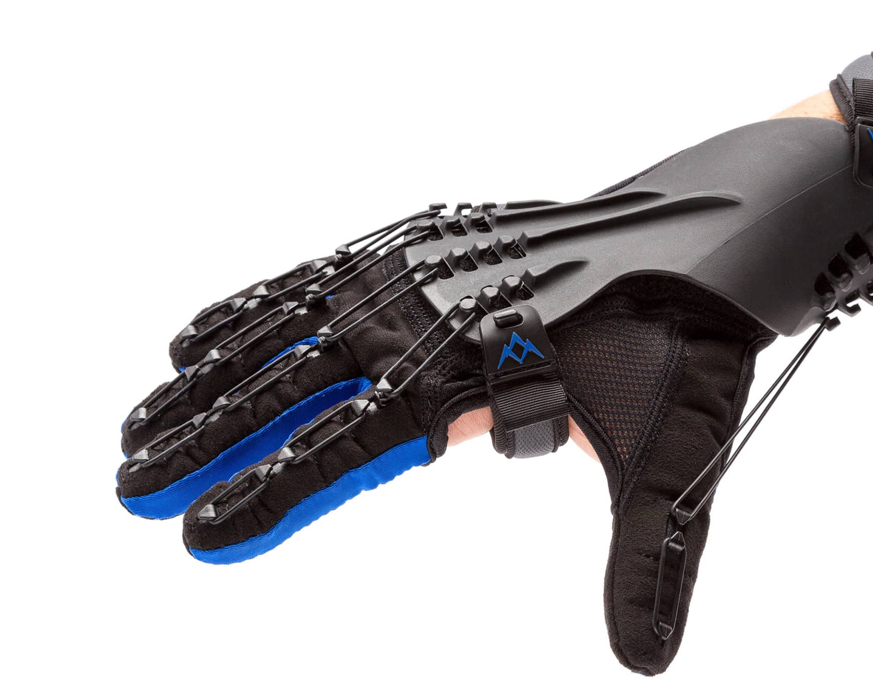
Haptic Glove used for Rehabilitation
Vishnu Thaimachedath Nandakumar
(12405702)
Jeethu Thambi (12500149)

Slide 2
Introduction
Hand rehab is slow after injury or stroke
Patients need feedback to improve finger movement
Haptic gloves give force and vibration cues
Wearable devices let patients practice at home

Slide 3
Aim
To develop a wearable haptic glove for interactive hand rehabilitation that provides real-time force and vibrotactile feedback, tracks finger motion and grip strength, and ensures safe, portable, and effective therapy for patients.

Slide 4
Expected Outcomes
Patients can feel resistance and guidance in finger movement
Measure finger motion and grip force automatically
Improve therapy effectiveness and engagement

Slide 5
Haptic Concept
Force feedback: tendon-driven servo system
Vibrotactile feedback: small motors on fingertips
Closed-loop control: sensors → MCU → actuators → user → sensors

Slide 6
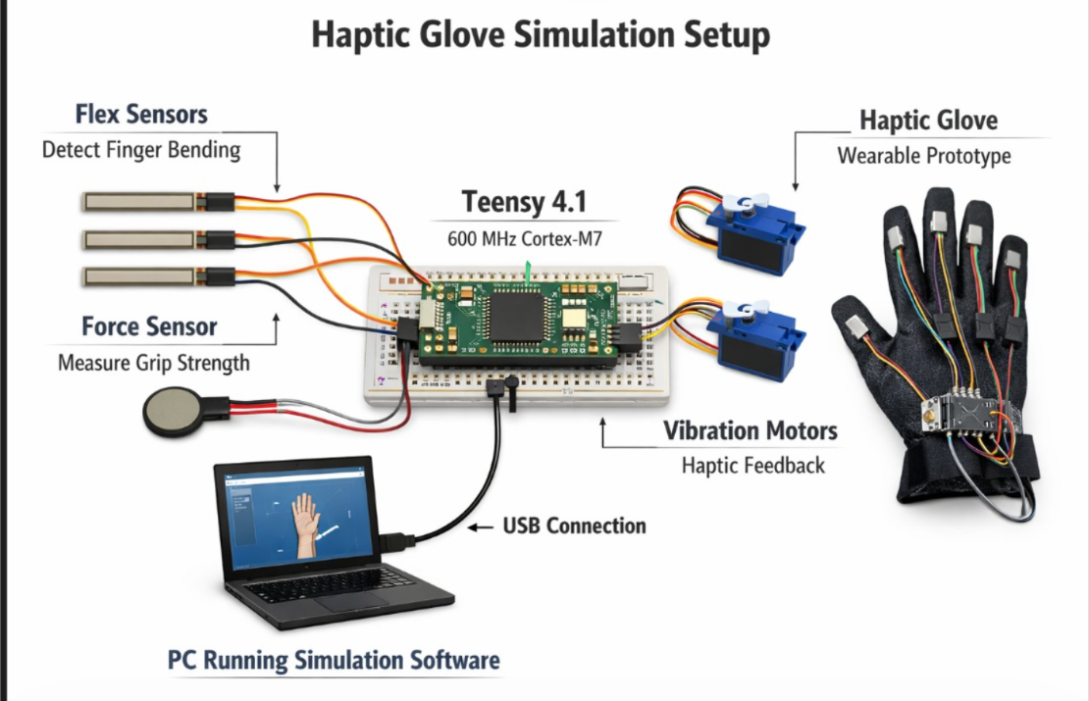
Components
Servo Motors
Flex Sensors
Force sensors
Teensy 4.1
Vibration Motors
Battery
Voltage Regulator

Slide 7
Safety Measures
Limit servo torque to safe levels
Restrict finger joint motion to anatomical limits
Use soft glove material to prevent pinching
Low-voltage regulated power Emergency disconnect

Slide 8
Future Scope
Extend to 5-finger full-hand glove
Adaptive haptic feedback for personalized therapy
Integration with rehabilitation software
Home-based patient monitoring

Slide 9
Reference
Fernández-Vázquez, D., Cano-de-la-Cuerda, R., Navarro-López, V. (2022). Haptic glove systems in stroke rehabilitation. Int. J. Environ. Res. Public Health, 19, 10378.
Placidi, G., Di Matteo, A., Lozzi, D., Polsinelli, M., Theodoridou, E. (2023). Patient–Therapist Cooperative Hand Telerehabilitation. Sensors, 23, 3463.
Li, F., Chen, J., Ye, G., et al. (2023). Soft robotic glove with sensing and force feedback for VR rehabilitation. Biomimetics, 8, 83.

Slide 10
Thank You

