Slide 1
RESEARCH PROPOSAL
Wearable Wrist Rehabilitation Using Dual-Channel Functional Electrical Stimulation (FES)
A lightweight, low-cost alternative to mechanical wrist-rehabilitation actuators
Vishnu Thaimachedath Nandakumar · Jeethu Thambi · Thadepalli Nikitha
Technische Hochschule Deggendorf

Slide 2



01 · THE PROBLEM
Wrist Rehabilitation Still Depends on Heavy, Costly Hardware
Widespread need
Stroke and other neurological or musculoskeletal conditions frequently impair hand and upper-limb function, limiting daily activities.
150 g+
typical added mass of a motor- or pneumatic-driven wrist exoskeleton
Heavy hardware
Existing rotation-assist devices rely on motors, pneumatics, or series elastic actuators — adding significant weight and mechanical complexity.
Grip assistance via FES is well studied — but assisted forearm rotation remains rare in lightweight wearables.
Limited access
Cost and bulk keep many of these systems confined to clinics, out of reach for consistent home-based rehabilitation.

Slide 3


02 · RESEARCH GAP
Grip Is Well Studied. Rotation Is Not.
Grip / Flexion — Well Studied
Wrist Rotation — Underexplored
FES-driven grip restoration widely reported in literature
Assistance typically mechanical (motor / SEA / pneumatic)
Multiple validated haptic + sensing designs exist
Few lightweight, FES-only rotation systems reported
Sensor fusion (EMG, FSR, IMU) well characterized
Anchoring a rotation device without hindering hand use is difficult
Research Gap: no lightweight wearable combines FES-driven grip AND rotation assistance in a single device.

Slide 4



03 · PROPOSED SOLUTION
Dual-Channel FES — Grip and Rotation, No Mechanical Actuator
FES-driven movement
Wearable glove + band
Small electrical pulses make the patient's own weak or paralyzed muscles contract and move the limb.
Senses grip via FSRs and forearm rotation via IMU, worn as a fabric glove and forearm-mounted band.
Visual + haptic feedback
Two independent channels
RGB LED (visual) and vibration motors (haptic) keep the user informed of system state in real time.
Channel 1 closes the hand; Channel 2 rotates the forearm — sequenced grip-then-rotate.
Total system mass targeted under 150 g — no mechanical actuator required.

Slide 5
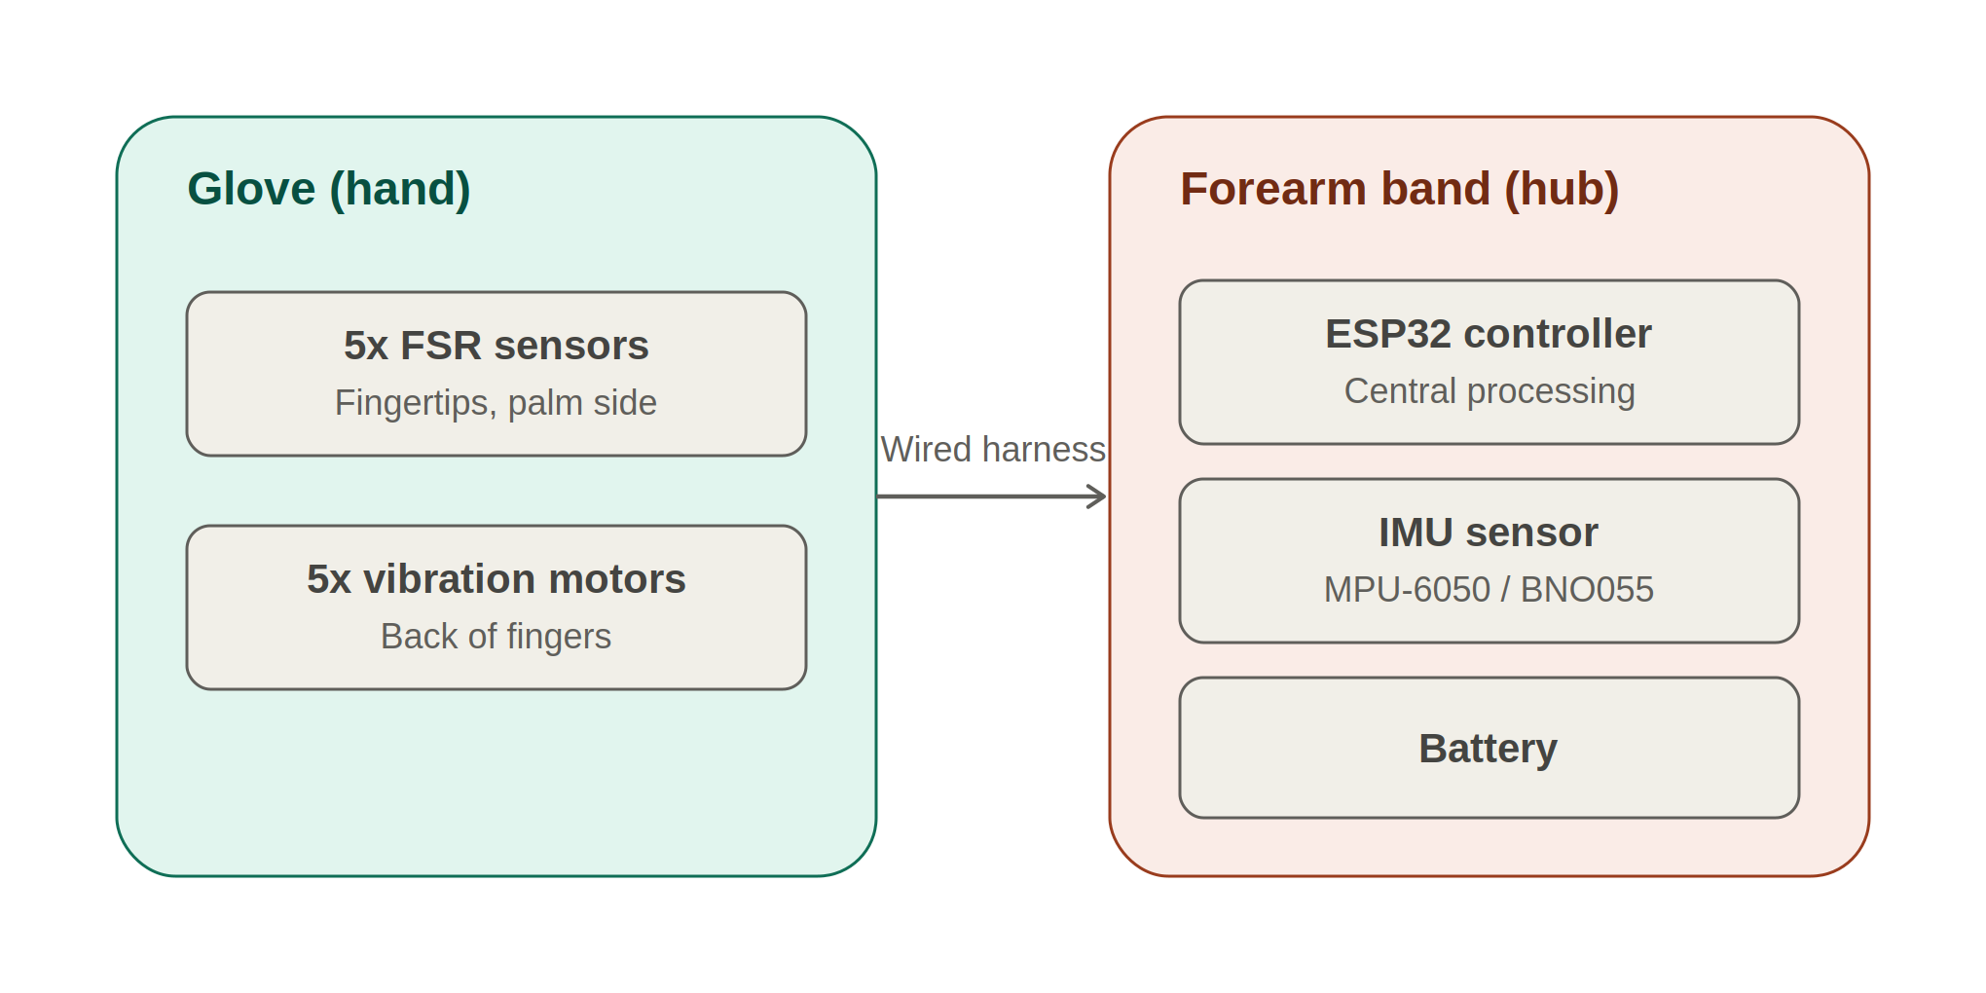
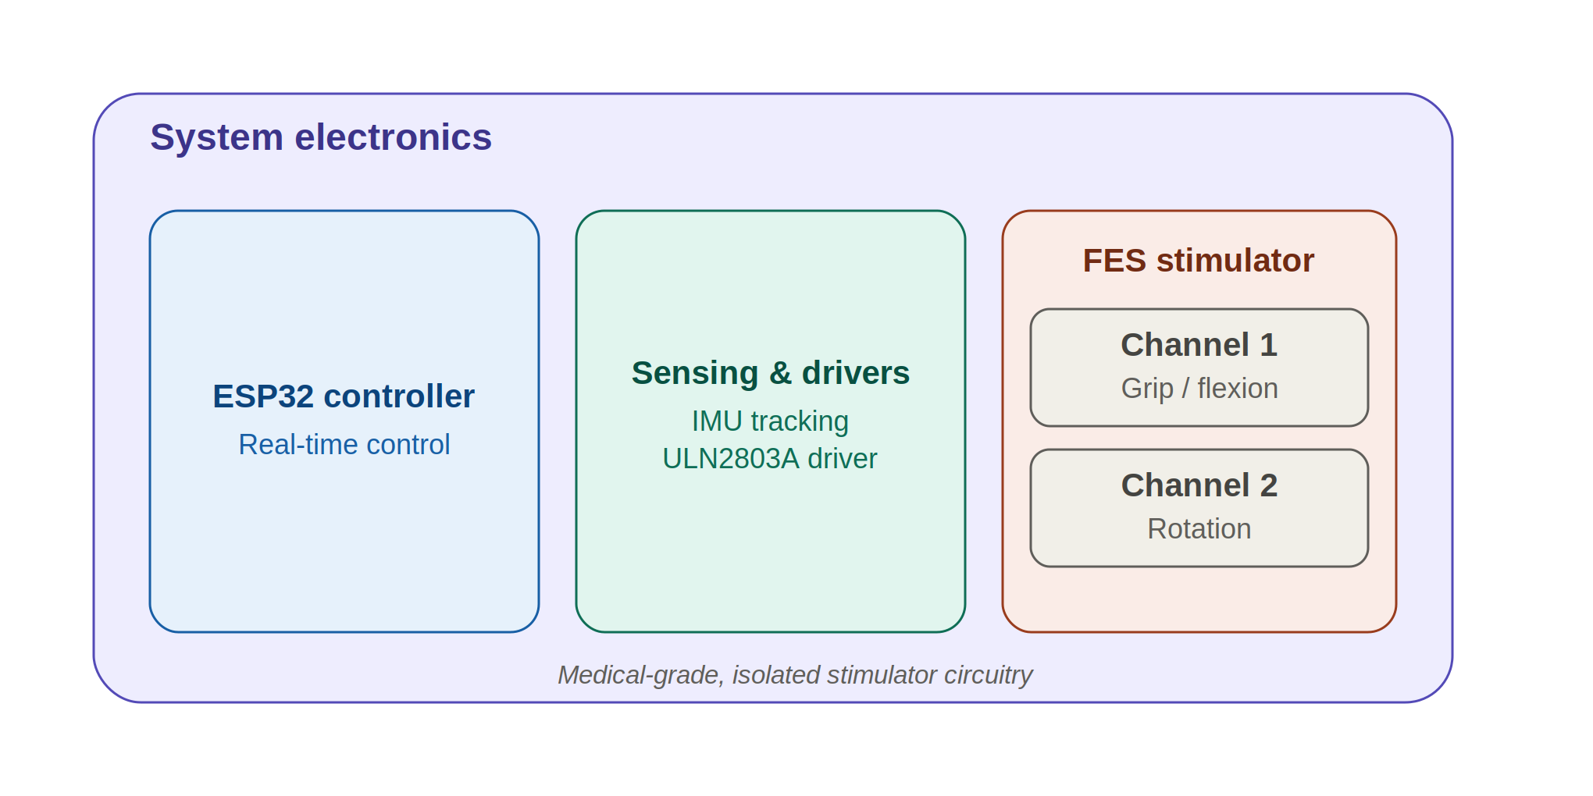

04 · SYSTEM ARCHITECTURE
From Wearable Layout to Electronics Stack
ESP32 controller
reads FSR + IMU sensors, runs the grip-then-rotate decision logic, and drives the FES stimulator and feedback outputs — all housed in the forearm band.

Slide 6



05 · ROADMAP
Two Stages: Sense & Feedback, Then Full Dual-FES Assistance
Stage 1 — Current Build
Stage 2 — Full Vision
Sense + Feedback (No FES)
Dual FES Assistance (Grip + Rotation)
FSR grip sensing (5x fingertip)
Add 2-channel FES stimulator
IMU rotation sensing
FES pads for grip (Channel 1)
LED + vibration feedback
FES pads for rotation (Channel 2)
Logging & progression tracking
Sequenced, closed-loop assistance
Status: In Development
Status: Roadmap Goal

