Slide 1
FINAL RECOMMENDATION DASHBOARD
AI-Powered Digital Operations Cockpit
ServiceNow 2025 | Matplotlib Analytics + FastAPI Services + Grafana Visualization
Recommended direction
Build an operations-centric dashboard focused on cycle time, hotspots, risk signals and automation candidates — not only SLA reporting.
39,973
2025 records
21,488
Service Requests
17,122
Inquiries
493
Incidents
870
Changes
Prepared from masked ServiceNow yearly dump and sample dashboard direction

Slide 2
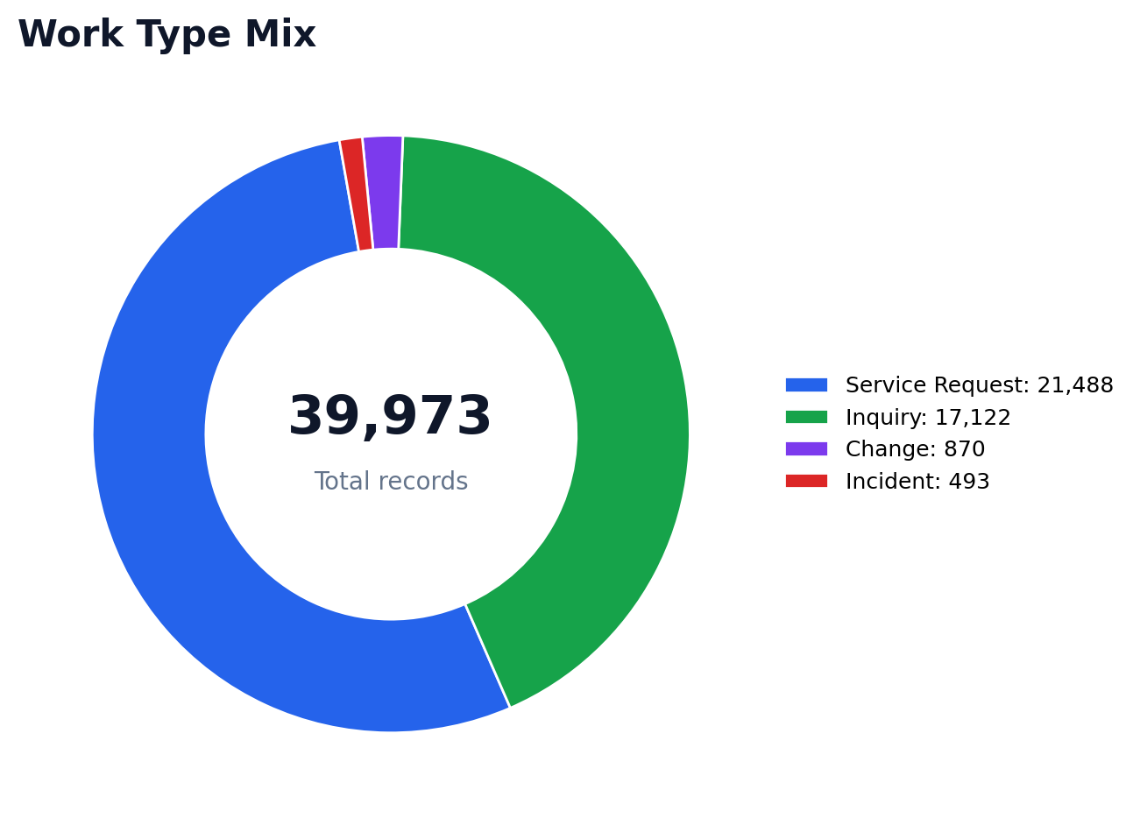
EXECUTIVE RECOMMENDATION
Why this dashboard: the data says “operate & optimize”
Core design principle
Use ServiceNow data to expose operational demand, service bottlenecks, application hotspots, change risk and automation opportunities.
4.58d
Avg SR cycle
12.47d
Avg Inquiry cycle
135h
Avg Incident MTTR
38.45d
Avg Change cycle
Important finding
The SLA field is uniformly positive across the major sheets, so SLA alone will not drive performance improvement. The meaningful signals are cycle time, P90 ageing, assignment-group concentration, application hotspots and emergency-change load.
AI-Powered Digital Operations Cockpit | ServiceNow 2025
Data source: NTBI-SNOW Yearly Dump 2025 (masked)

Slide 3
DASHBOARD BLUEPRINT
Final dashboard design: ITSM 360 operating model
1. Executive Operations Cockpit
Leadership view of workload, cycle time and risk
Grafana page
2. Incident Command Center
MTTR, P50/P90, app hotspots and support performance
Grafana page
3. SR & Inquiry Performance
Demand trend, request ageing and fulfilment bottlenecks
Grafana page
4. Change & Release Risk
Emergency changes, validation results and release health
Grafana page
5. Automation Opportunity
Repetitive demand clusters and GenAI / agent backlog
Grafana page
Recommended first release: Executive Cockpit + Incident Command Center + Change Risk, then add automation candidate mining.
AI-Powered Digital Operations Cockpit | ServiceNow 2025
Data source: NTBI-SNOW Yearly Dump 2025 (masked)

Slide 4
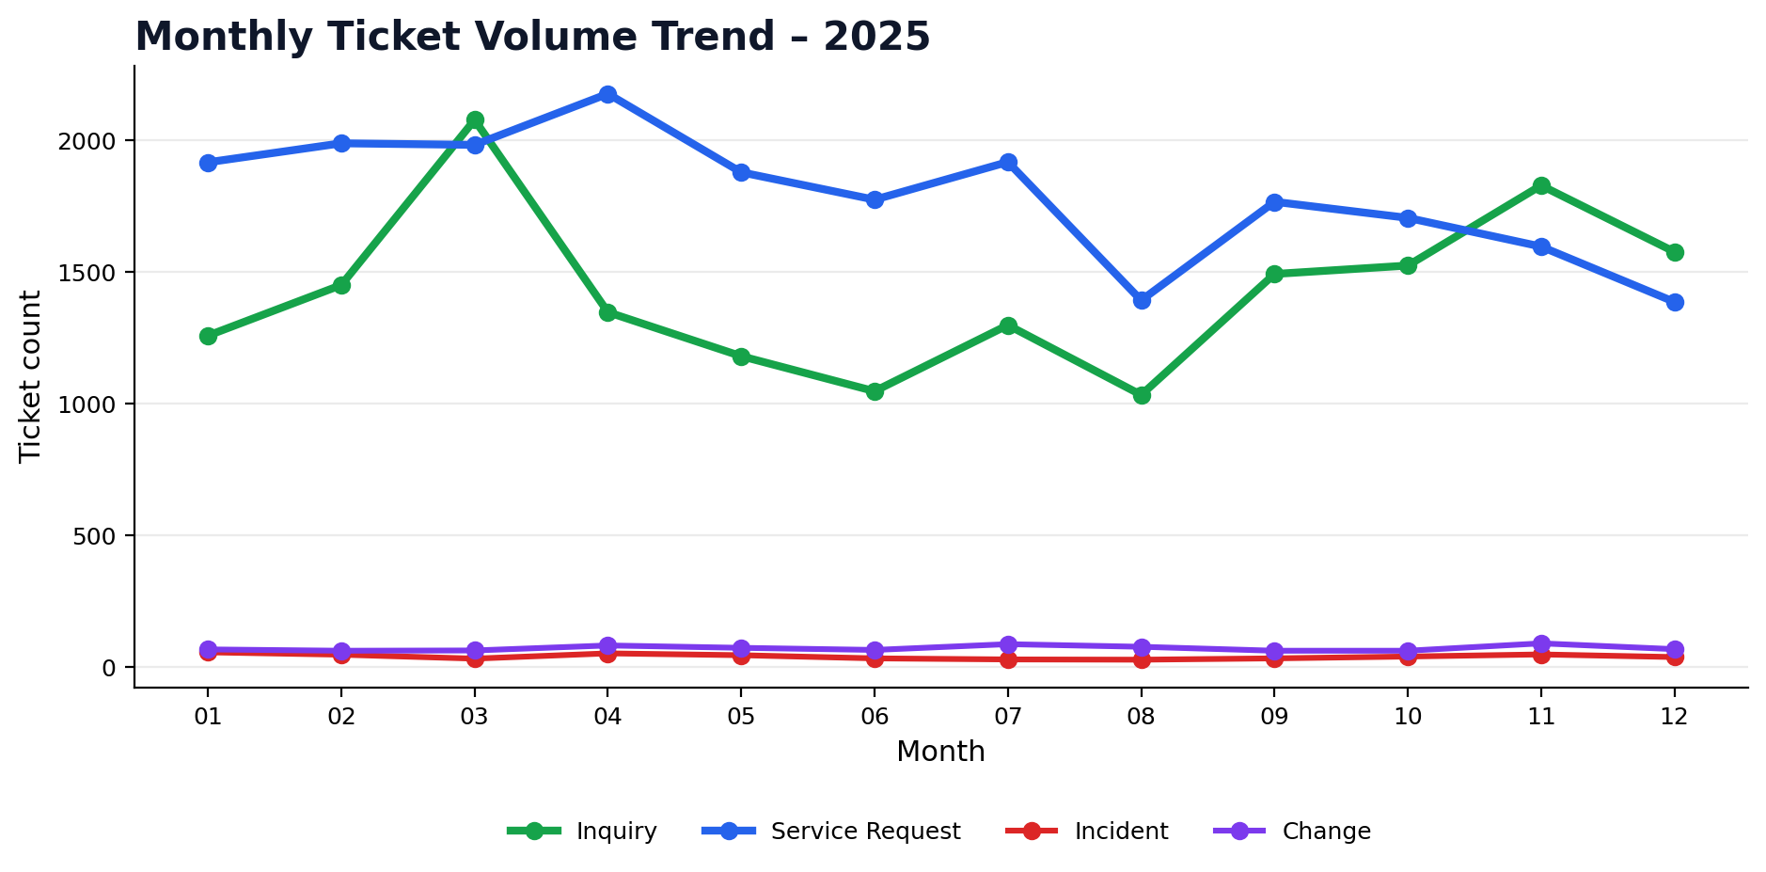
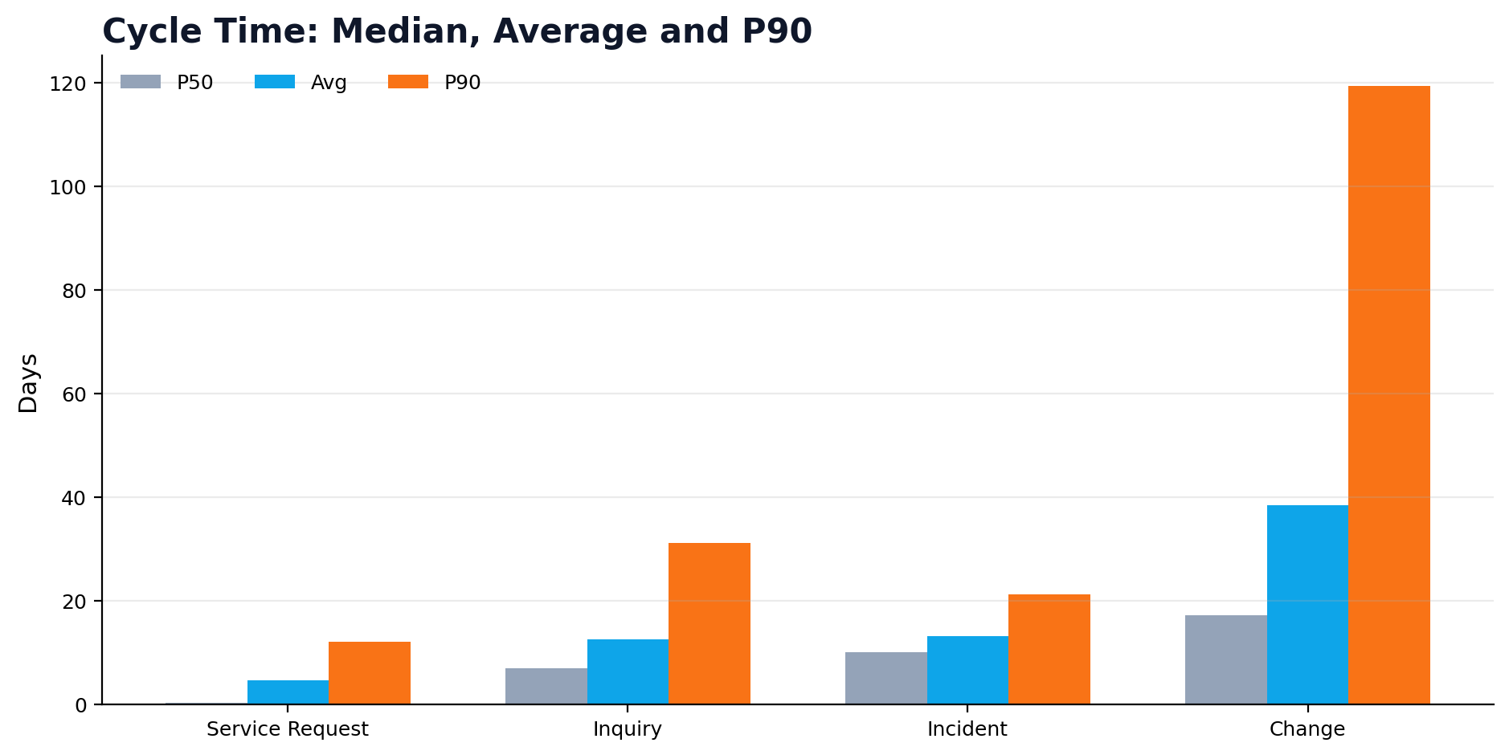
RECOMMENDED DASHBOARD PAGE 1
Executive Operations Cockpit: management dashboard view
39,973
Total tickets
21,488
Service requests
17,122
Inquiries
493
Incidents
870
Changes
100%
SLA flag*
4 pages
Grafana MVP
* SLA is not a differentiator in this dump because the flag is uniformly true; treat it as a control metric, not the main performance driver.
AI-Powered Digital Operations Cockpit | ServiceNow 2025
Data source: NTBI-SNOW Yearly Dump 2025 (masked)

Slide 5
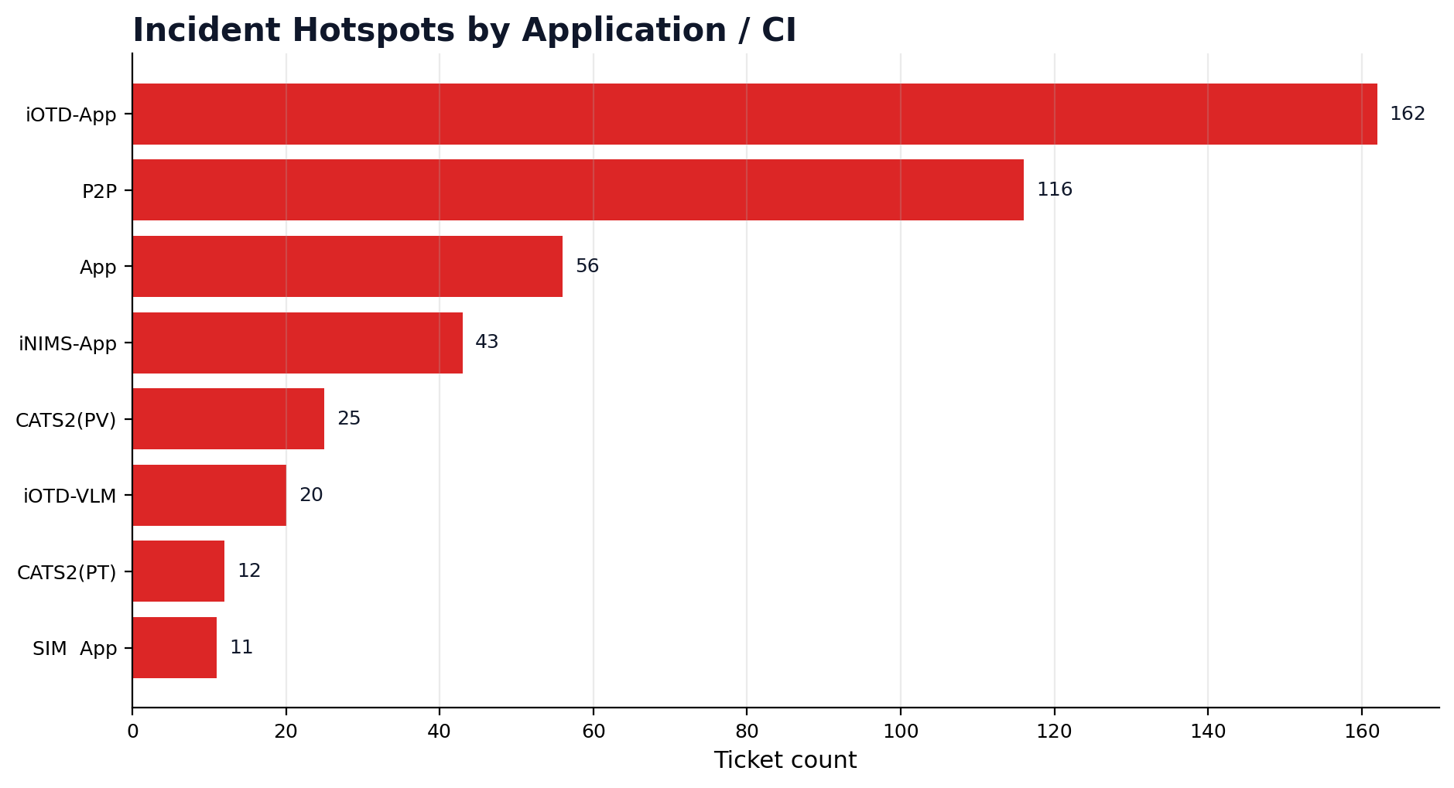
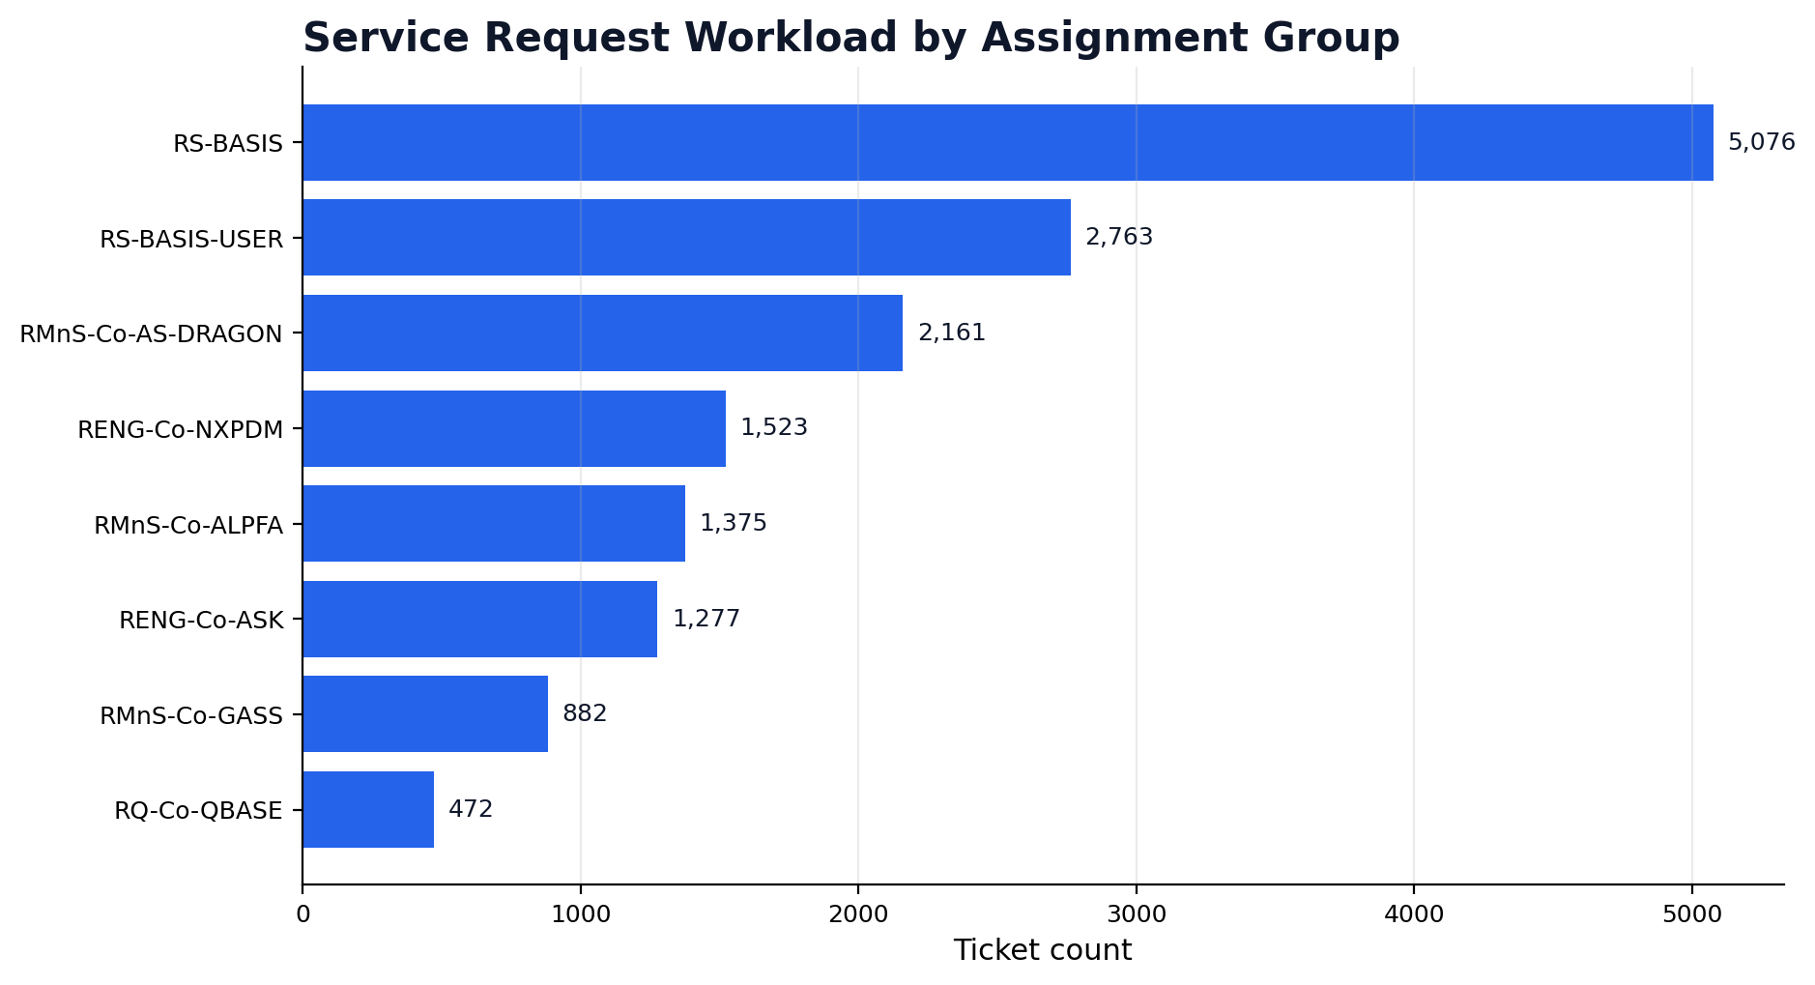
RECOMMENDED DASHBOARD PAGE 2
Incident Command Center: MTTR, hotspots and operational stability
493 Incidents in 2025
Mean time to resolve: 135h | P90: 329h
Primary hotspots
iOTD-App and P2P dominate incident load, suggesting focused problem management and runbook automation.
Grafana panels
MTTR trend • P50/P90 resolve time • application + assignment-group hotspots
AI-Powered Digital Operations Cockpit | ServiceNow 2025
Data source: NTBI-SNOW Yearly Dump 2025 (masked)

Slide 6
RECOMMENDED DASHBOARD PAGE 3
Service Request & Inquiry Performance: demand and fulfilment view
Demand concentration
Service Requests and Inquiries represent 96.6% of total volume; this is the biggest productivity and automation opportunity.
Operating focus
Track monthly demand pulse by channel / application / assignment group. Use P90 ageing to identify hidden backlog even when SLA remains green.
AI-Powered Digital Operations Cockpit | ServiceNow 2025
Data source: NTBI-SNOW Yearly Dump 2025 (masked)

Slide 7
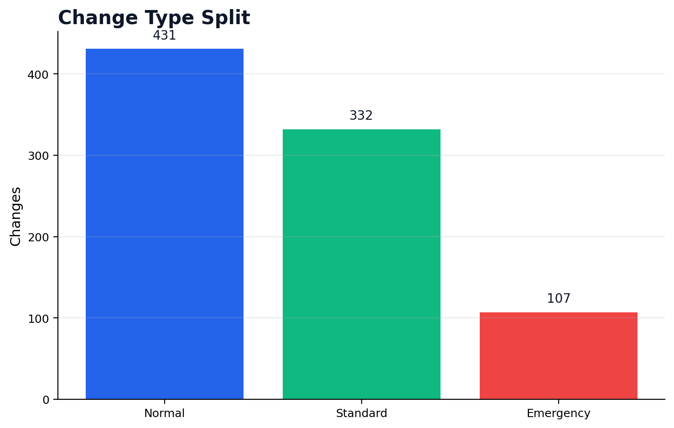
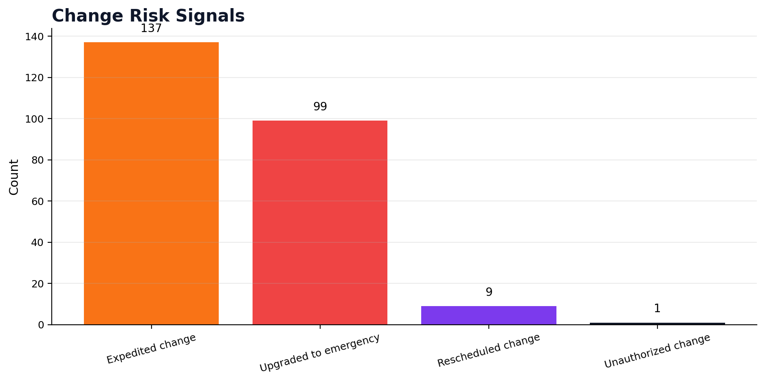
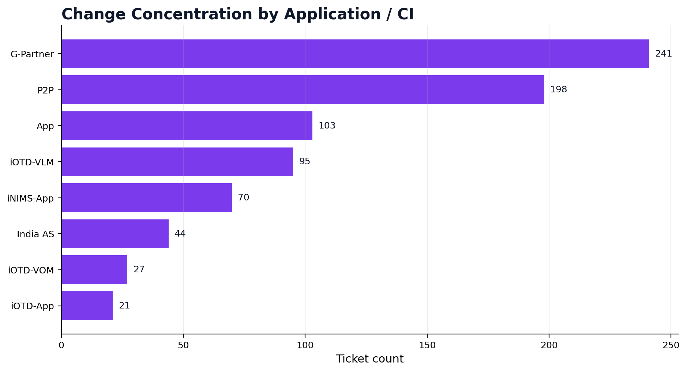
RECOMMENDED DASHBOARD PAGE 4
Change & Release Risk: emergency load, release stability and validation
870
Total changes
107
Emergency
137
Expedited
99
Upgraded to emergency
843
As planned
841
Validated OK
AI-Powered Digital Operations Cockpit | ServiceNow 2025
Data source: NTBI-SNOW Yearly Dump 2025 (masked)

Slide 8
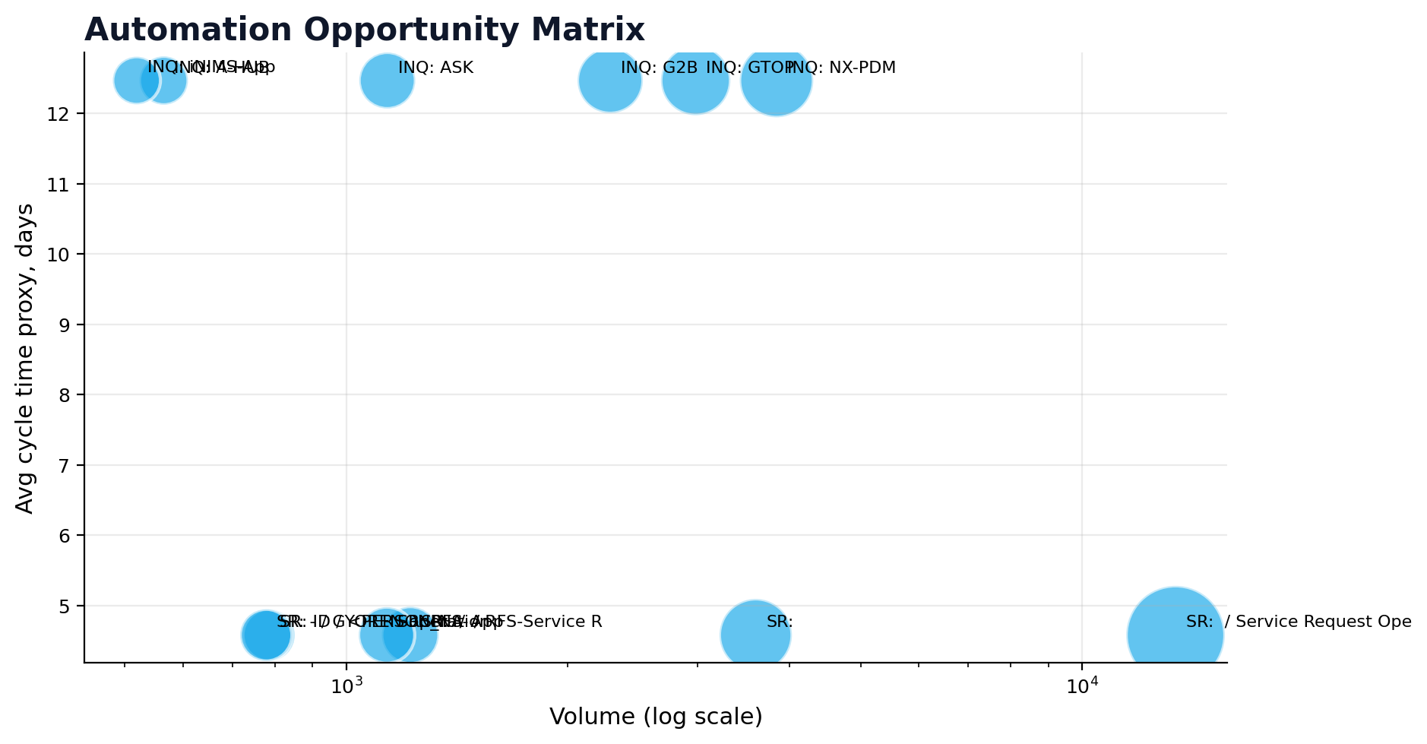
RECOMMENDED DASHBOARD PAGE 5
AI automation opportunity: convert repetitive demand into action backlog
Automation scoring model
Volume × repetition × cycle time × assignment-group load × low-complexity classification
Priority candidates
• Password reset and access / user ID workflows
• Printer setup and repetitive request operations
• P2P and NX-PDM request routing automation
• Inquiry deflection through GenAI knowledge assistant
• Problem remediation runbooks for incident-heavy apps
Output: ranked backlog for AI agents, knowledge articles and runbook automation.
AI-Powered Digital Operations Cockpit | ServiceNow 2025
Data source: NTBI-SNOW Yearly Dump 2025 (masked)

Slide 9
TECHNICAL ARCHITECTURE
Matplotlib + FastAPI + Grafana: service exposure pattern
Endpoint design
Expose both metric APIs and Matplotlib-rendered PNG panels so Grafana can combine native interactivity with custom analytics visuals.
Preferred Grafana usage
JSON API / Infinity for metrics; Prometheus for KPIs; Image / HTML panels for Matplotlib PNGs.
XLSX Dump
ServiceNow export
Python ETL
Normalize + aggregate
Metric Store
DB / JSON / Parquet
FastAPI
JSON + PNG + metrics
Grafana
Native + image panels
Recommended service endpoints
/api/kpis
/api/monthly-volume
/api/cycle-time
/api/assignment-hotspots
/api/application-hotspots
/api/incidents
/api/changes
/api/automation-candidates
/render/{panel}.png
/metrics
AI-Powered Digital Operations Cockpit | ServiceNow 2025
Data source: NTBI-SNOW Yearly Dump 2025 (masked)

Slide 10
EXECUTION ROADMAP
MVP implementation plan: build once, reuse across Grafana pages
Week 1
Data profiling & metric model
Validate date fields, duration rules, SLA caveat and app/group mappings.
Build
Week 2
Matplotlib panel library
Create reusable chart functions for trend, Pareto, heatmap, risk and automation matrix.
Build
Week 3
FastAPI service layer
Publish JSON metrics, PNG render endpoints and Prometheus-compatible /metrics.
Build
Week 4
Grafana dashboard build
Configure pages, variables, native panels, image panels and role-based views.
Operationalize
Week 5–6
Hardening & adoption
Automated refresh, data quality checks, documentation and stakeholder walkthrough.
Operationalize
Decision ask: Approve MVP as the standard ITSM operations cockpit and reuse the same service layer for future predictive / preventive analytics.
AI-Powered Digital Operations Cockpit | ServiceNow 2025
Data source: NTBI-SNOW Yearly Dump 2025 (masked)

