Slide 1
CONTENTS
BUSINESS PROBLEM
DATA AGGREGATION
DATA EXPLORATION
MODELS
LINEAR REGRESSION
NEURAL NETWORK
CLUSTERING OF CUSTOMERS
RESULTS & INSIGHTS
RECOMMENDATIONS
APPENDIX

Slide 2
Problem Statement
What does our customer base look like?
How much money are our customers going to spend?
Which customer segments do we want target for advertising ?

Slide 3
Aggregation of Three Datasets
Customer Attributes | Customer Transactions | Customer Visits
CustomerID | TransactionID | CustomerID
Age | Spends | Visits
CustomerSince | CustomerID
Gender | TransactionDate
Region

Slide 4
Aggregation of Three Datasets
FINAL AGGREGATED TABLE
Customer Data
CustomerID | Age | CustomerSince | Gender | Region
AvgSpent | TotalSpent | MaxSpent | MinSpent | TotalTransactions
FirstTransaction | LatestTransaction | Visits | NextSpends | RFM Scores

Slide 5
Data Exploration
No missing values
Before or after aggregation
Only 1 outlier
Average transaction amount of $94, but only had one transaction
Excluded Variables From Modeling
Latest Transaction and Recency Days because of their correlation with Recency Score (a derived attribute)
Total Spend because of its correlation with AvgSpend
Frequency Score (a derived attribute) because of its correlation with Total Transactions

Slide 6
Linear Regression
Model 1
Standard Least Squares
Model 2
Standard Least Squares
Exclude insignificant predictors
Model 3
Exhaustive search
--All possible models
Model 4
Stepwise
--Forward selection
Model 5
Stepwise
--Backward elimination
Model 6
Mixed stepwise

Slide 7
Linear Regression
 | Num of predictors | R^2 (Validation) | RASE (Validation) | R^2 (Test) | RASE (Test)
Model 1 | 11 | 0.6219 | 5.8190 | 0.6262 | 5.8083
Model 2 | 8 | 0.6219 | 5.8189 | 0.6263 | 5.8081
Model3 | 7 | 0.6219 | 5.8189 | 0.6262 | 5.8084
Model 4 | 8 | 0.6219 | 5.8189 | 0.6263 | 5.8084
Model 5 | 8 | 0.6219 | 5.8191 | 0.6263 | 5.8083
Model 6 | 8 | 0.6219 | 5.8189 | 0.6262 | 5.8084

Slide 8
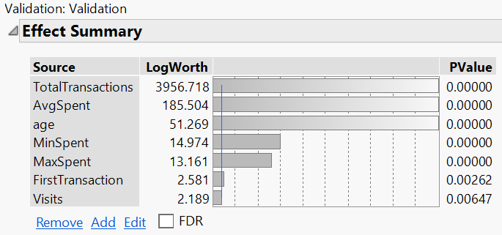
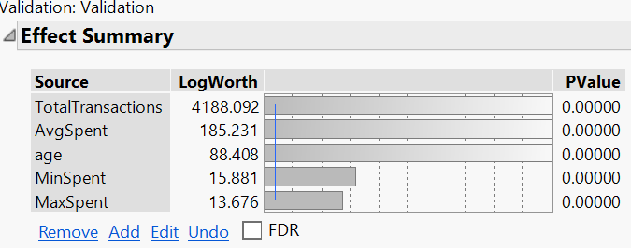
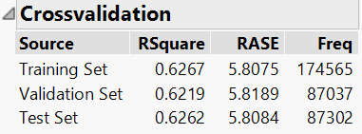
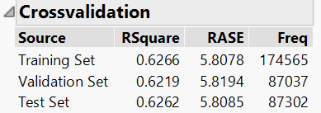
Linear Regression
Model 3
Model 7

Slide 9
Linear Regression
Model 7
Model 8 -- Best Model
TotalTransaction
AvgSpent
Age
MinSpent
MaxSpent
TotalTransaction
AvgSpent
Age
Recency Score
Visits

Slide 10
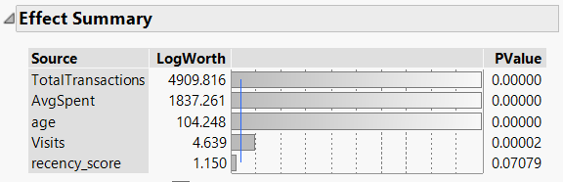
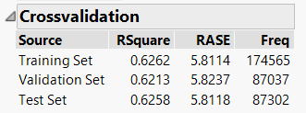
Linear Regression
Model 8 -- Best Model

Slide 11
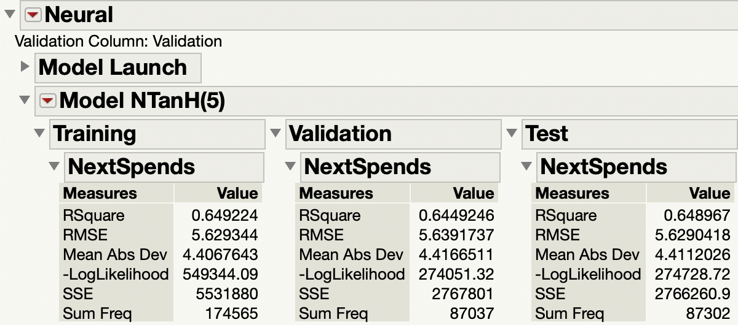
Neural Model
Top five variables - Recency score, Total Transactions, Average Spent, Age, Visits.
R-square - 64.5%
RMSE - 5.64
Notes:
We tried different iterations of the neural model to pick the best one. For example, we tried a model with all the variables and a default setting of 3 TanH nodes, then another model with all the variables and one node each of TanH, Linear and Gaussian. Another variation that we tried was with all the variables and 17 TanH nodes because we were using a total of 17 variables to predict the Next Spends. After that, we tried a model with the five most influential variables that we picked earlier and ran the neural model with the default setting of 3 TanH nodes. Another variation we tried was with the five variables and 1 node each of TanH, Linear and Gaussian. Finally, the model that we picked as the best neural model was with the 5 variables and it gave us a R-square of 64.5%

Slide 12
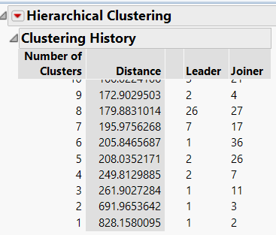
Hierarchical Clustering

Slide 13
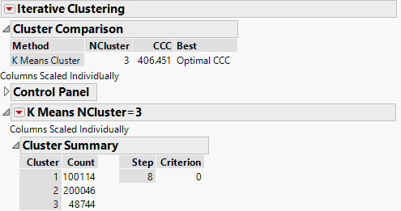
K-Means Clustering

Slide 14
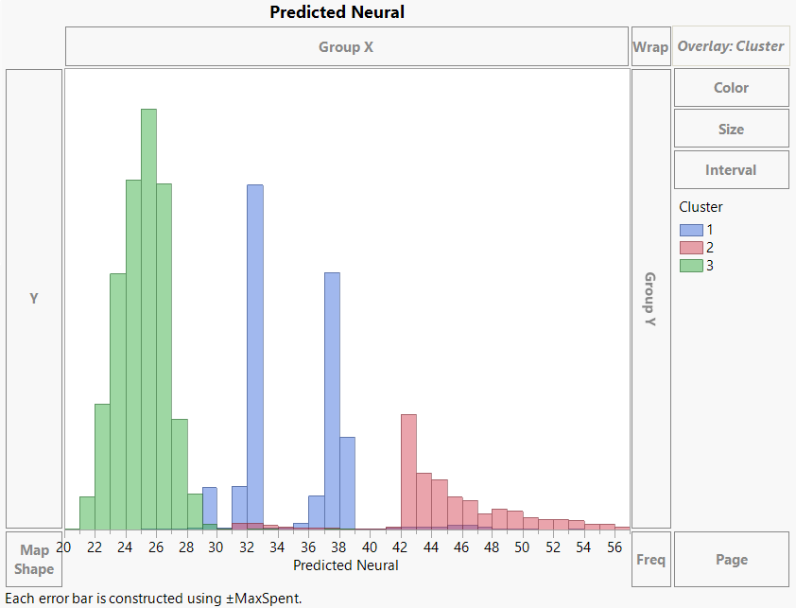
High Spending Customers In Cluster 2

Slide 15
BUT WHAT ARE WE MISSING?

Slide 16
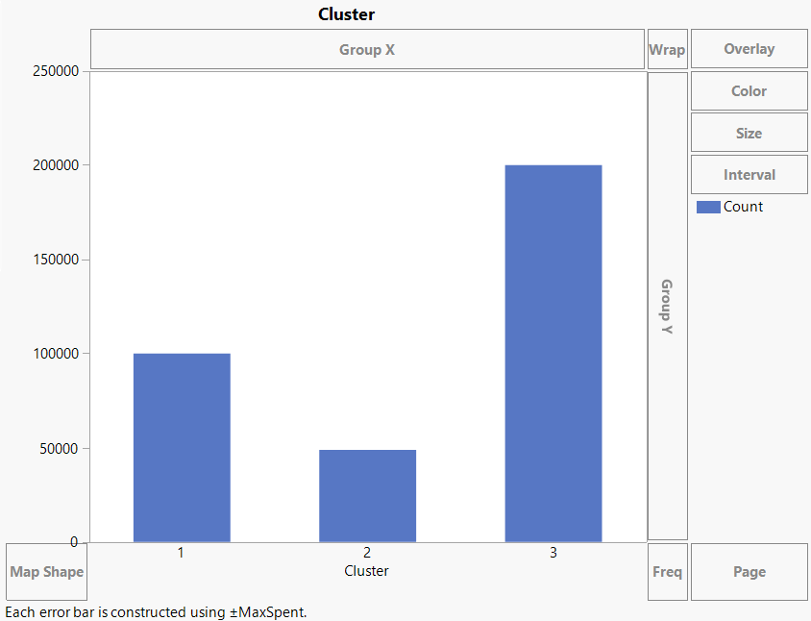
Cluster Size

Slide 17
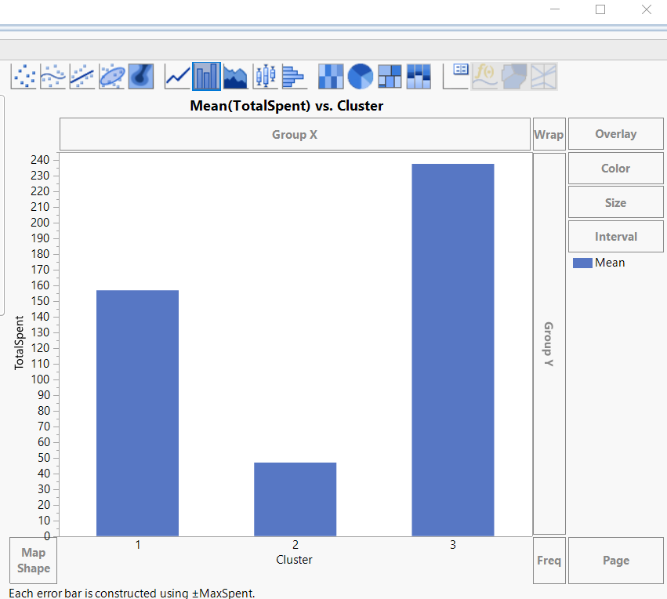

Slide 18
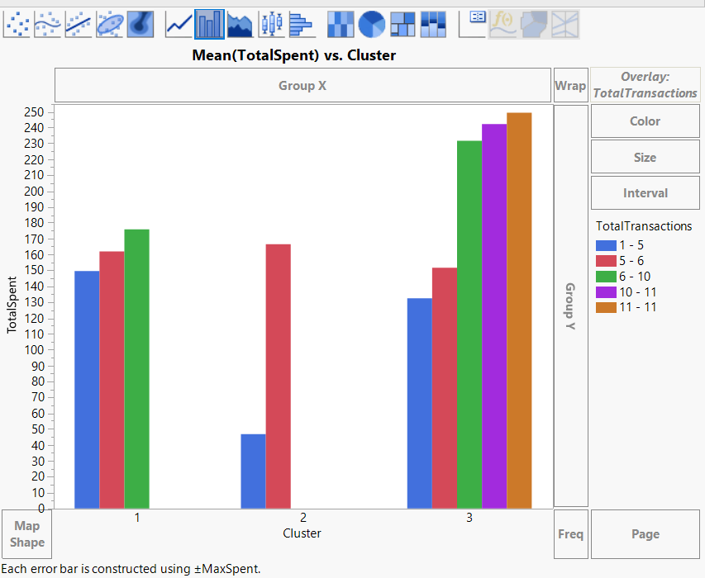

Slide 19
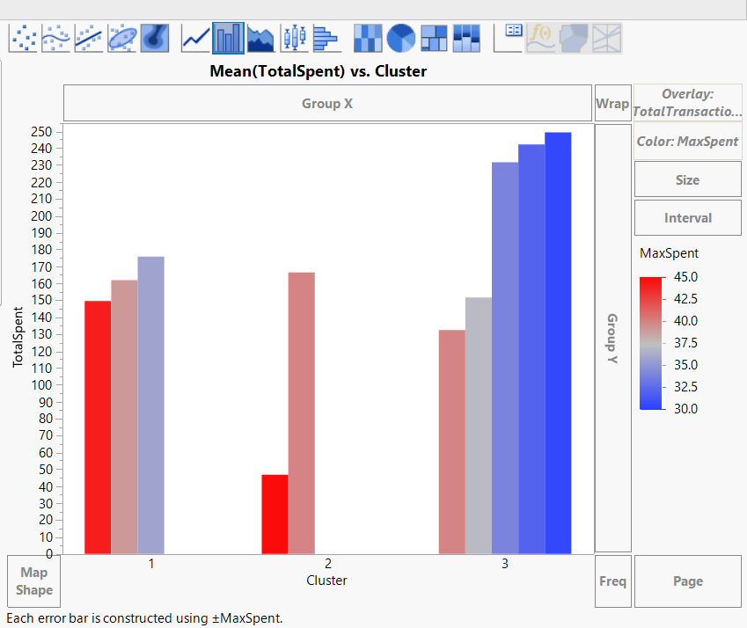

Slide 20
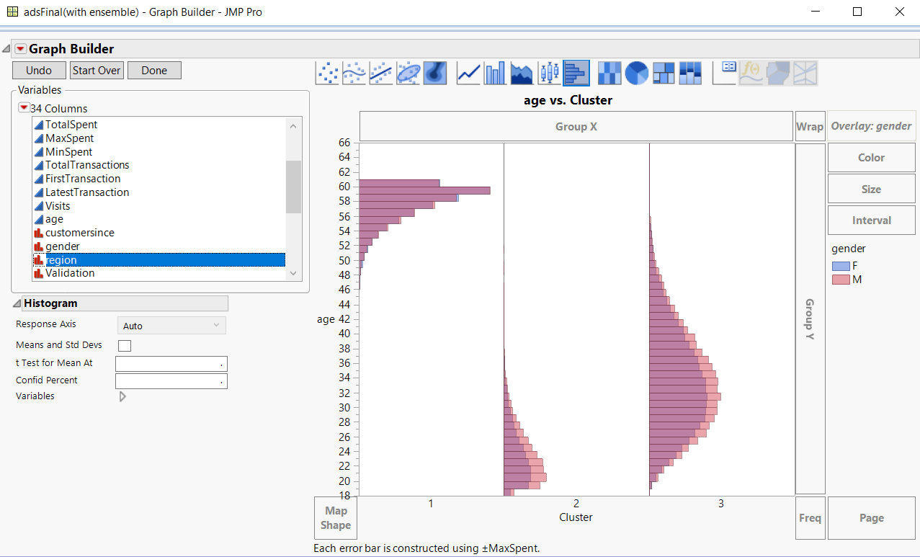

Slide 21
200,046 Loyal Customers
100,114 Aging Customers
48,744 Young Customers
RECOMMENDATIONS

Slide 22
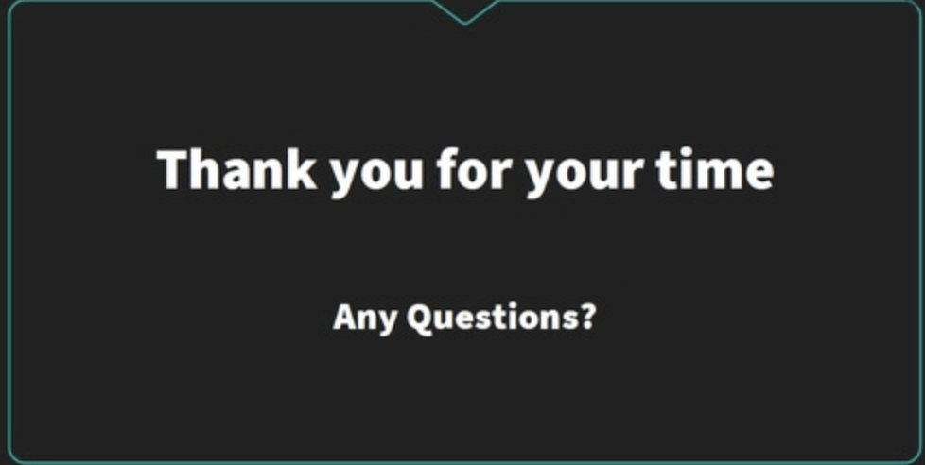

Slide 23
Appendix

Slide 24
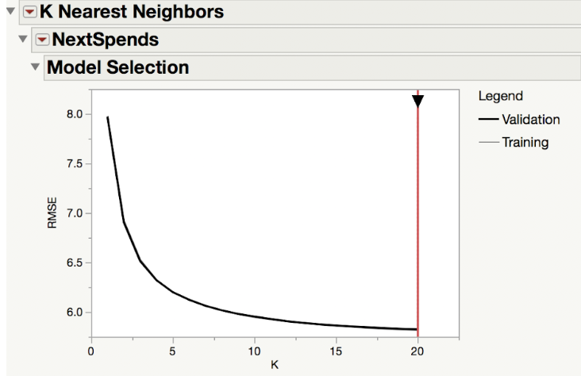
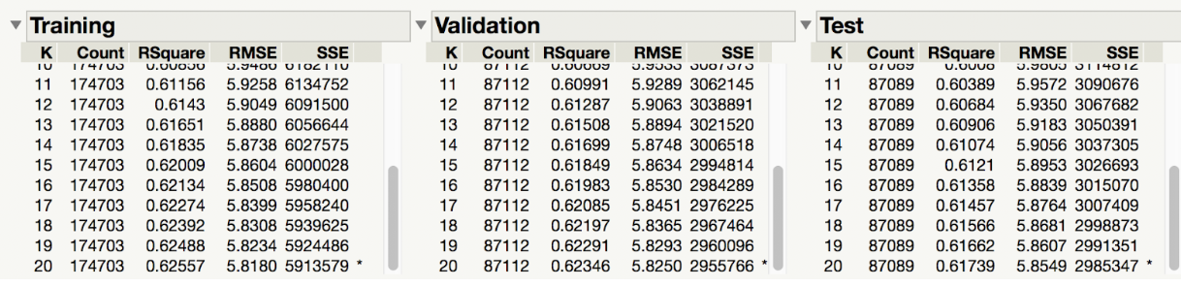
K-Nearest-Neighbor
Set K is 20
R square - 62.3% RMSE - 5.82

Slide 25
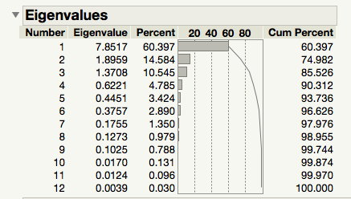
Linear Regression with
Principal Components Analysis (PCA)
Creating Principal Components
Retained 5 Principal Components that account for 93% of the information
Number of PC >5 resulted in better variance but increased complexity
Number of PC < 5 improved dimensionality but decreased the amount of information captured

Slide 26
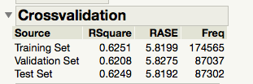
Linear Regression with
Principal Components Analysis (PCA)
Building Linear Regression Models
Ran a Standard Least Squares Regression Model on dataset with 5 PCs and the Target Variable
R Square value of 0.62 (Validation)
RASE of 5.83 (Validation)
Decision on number of PCAs to include in the Regression Model is based on judgment that balances accuracy and explainability

Slide 27
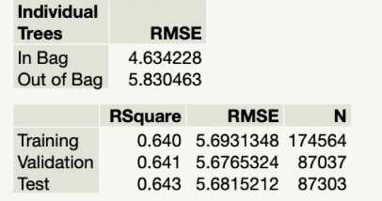
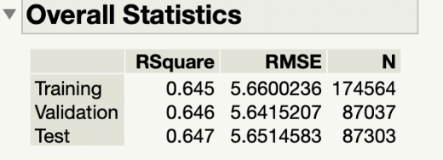
Decision Trees
Bootstrap Forest-
R-square - 64.1%
Trees were too big and incomprehensible
Boosted Trees -
All variables
R-square - 64.6%
Top five variables but it did not change the R-square

Slide 28
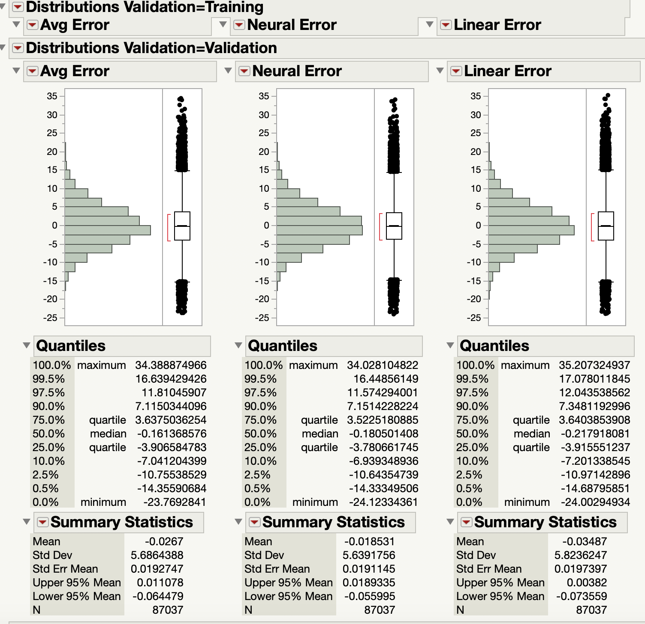
Ensemble model
Average of the top two models
Calculated the errors of the two best
models and the ensemble model
Neural was the best

