Slide 1
Model Checking an Avionics Voter System
Vishnuvardhan Prem
IIT Palakkad

Slide 2
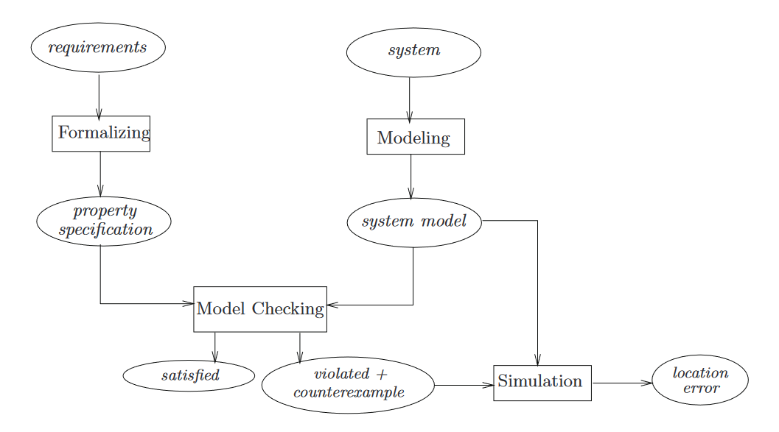
Model Checking
Model checking is an automated technique that given a model of a system and a formal property, systematically checks whether this property holds for that model.
A standard method of representing models for hardware and software systems are finite state transition systems.
An example of a popular model checker is NuSMV

Slide 3
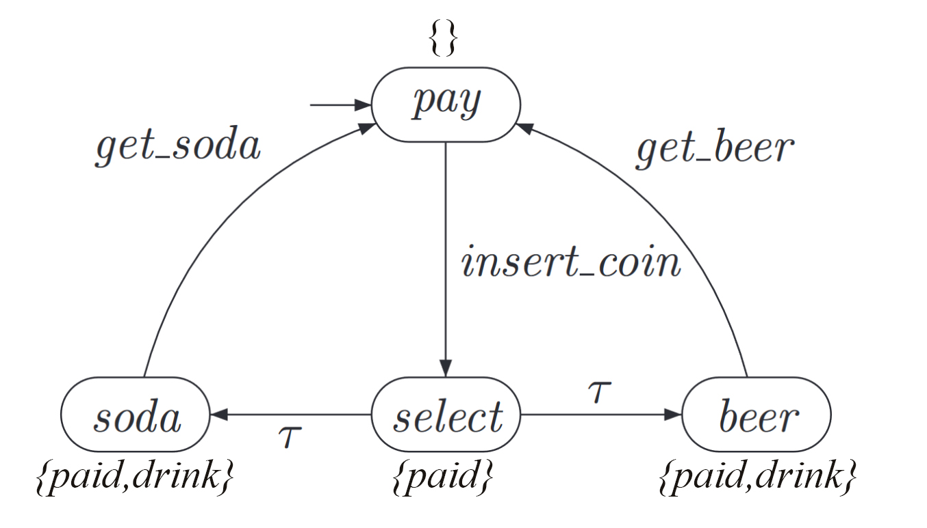
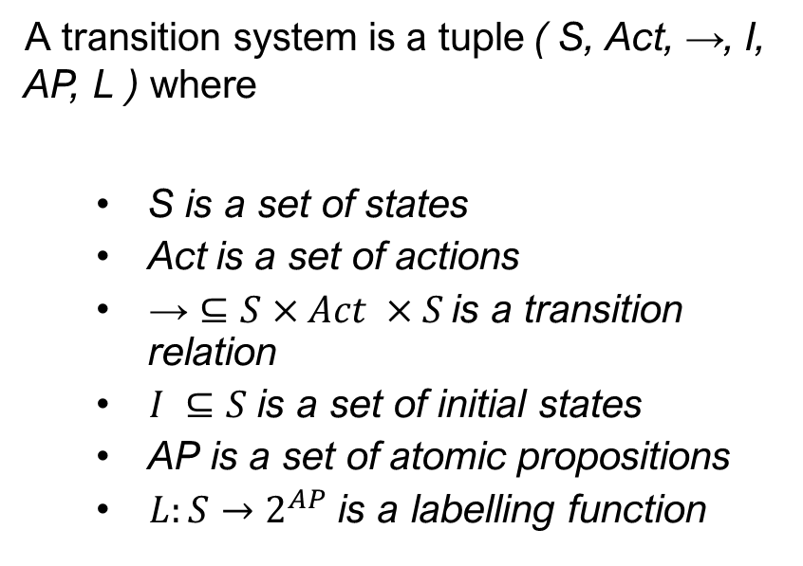
Transition System
A transition system is a tuple ( S, Act, →, I, AP, L ) where
S is a set of states
Act is a set of actions
$\text{→}⊆S×Act ×S$is a transition relation
$I ⊆S$ is a set of initial states
AP is a set of atomic propositions
$L:S→2^{AP}$ is a labelling function

Slide 4
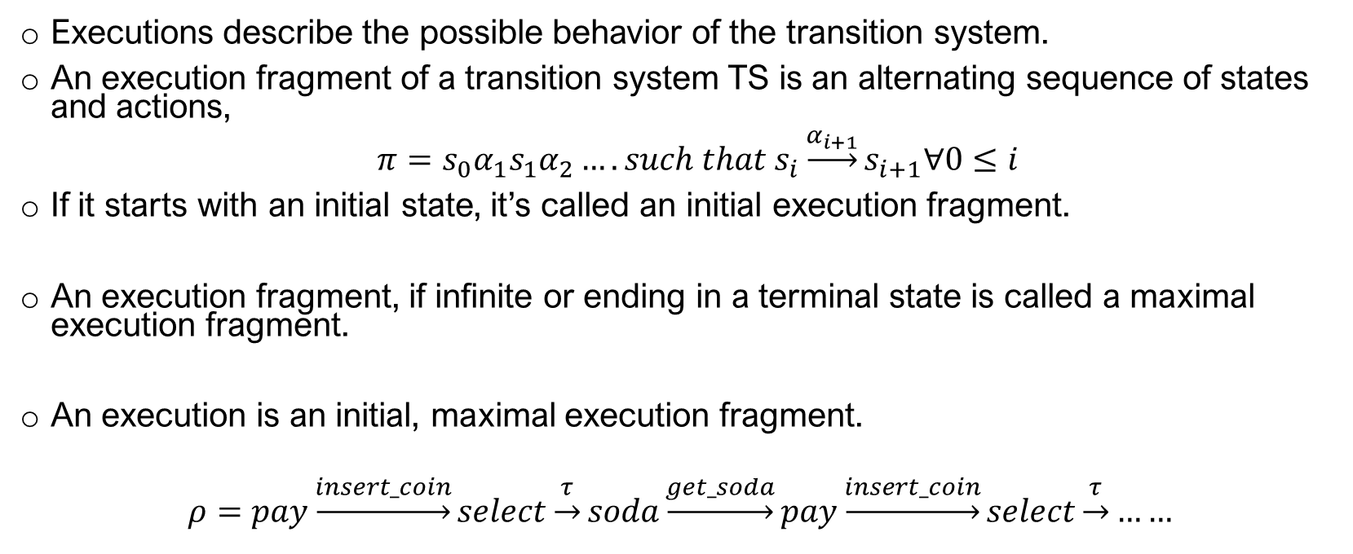
Executions
Executions describe the possible behavior of the transition system.
An execution fragment of a transition system TS is an alternating sequence of states and actions,
$π=s_{0}α_{1}s_{1}α_{2}…. such that s_{i}\underset{→}{α_{i+1}}s_{i+1}∀0≤i$
If it starts with an initial state, it’s called an initial execution fragment.
An execution fragment, if infinite or ending in a terminal state is called a maximal execution fragment.
An execution is an initial, maximal execution fragment.
$$ρ=pay\underset{→}{insert_coin}select\underset{→}{τ}soda\underset{→}{get_soda}pay\underset{→}{insert_coin}select\underset{→}{τ}……$$

Slide 5
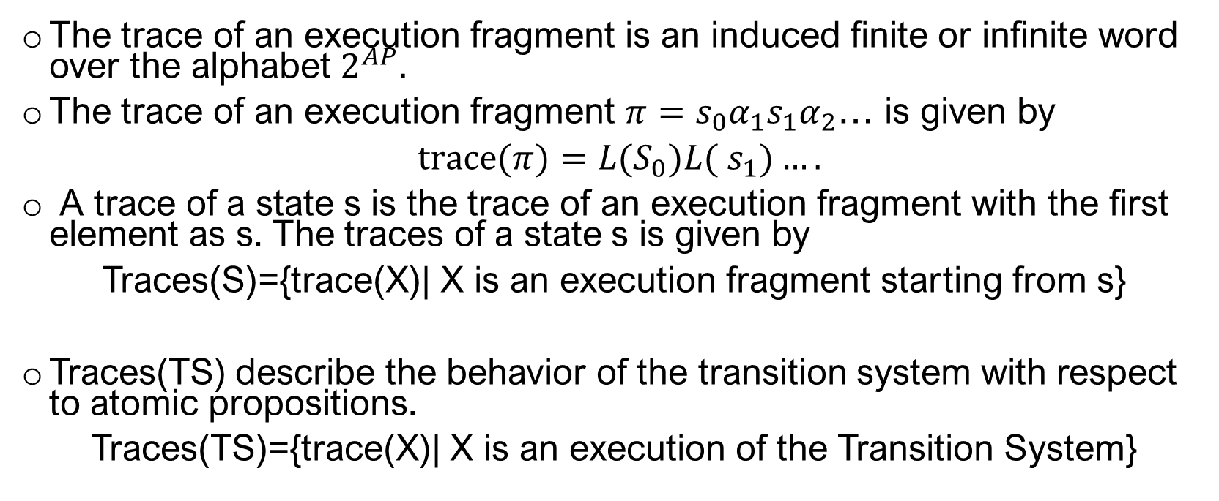
Traces
The trace of an execution fragment is an induced finite or infinite word over the alphabet $2^{AP}.$
The trace of an execution fragment $π=s_{0}α_{1}s_{1}α_{2}$… is given by
$trace(π)={L(S}_{0})L( s_{1})….$
A trace of a state s is the trace of an execution fragment with the first element as s. The traces of a state s is given by
Traces(S)={trace(X)| X is an execution fragment starting from s}
Traces(TS) describe the behavior of the transition system with respect to atomic propositions.
Traces(TS)={trace(X)| X is an execution of the Transition System}

Slide 6
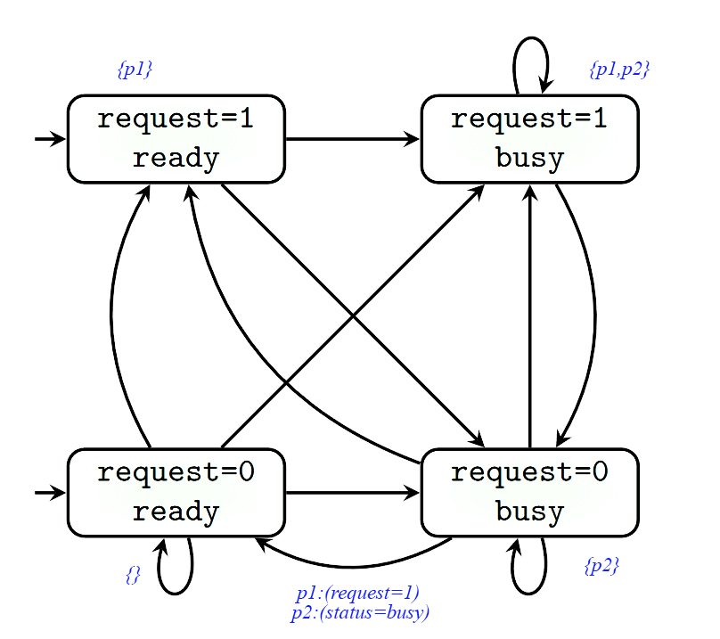
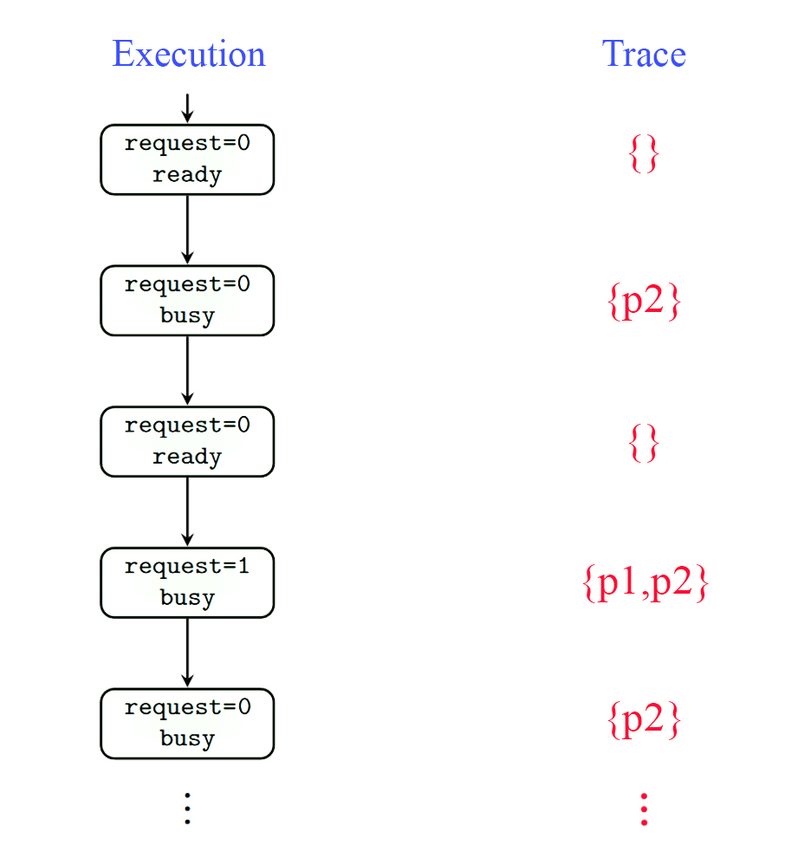
Example

Slide 7
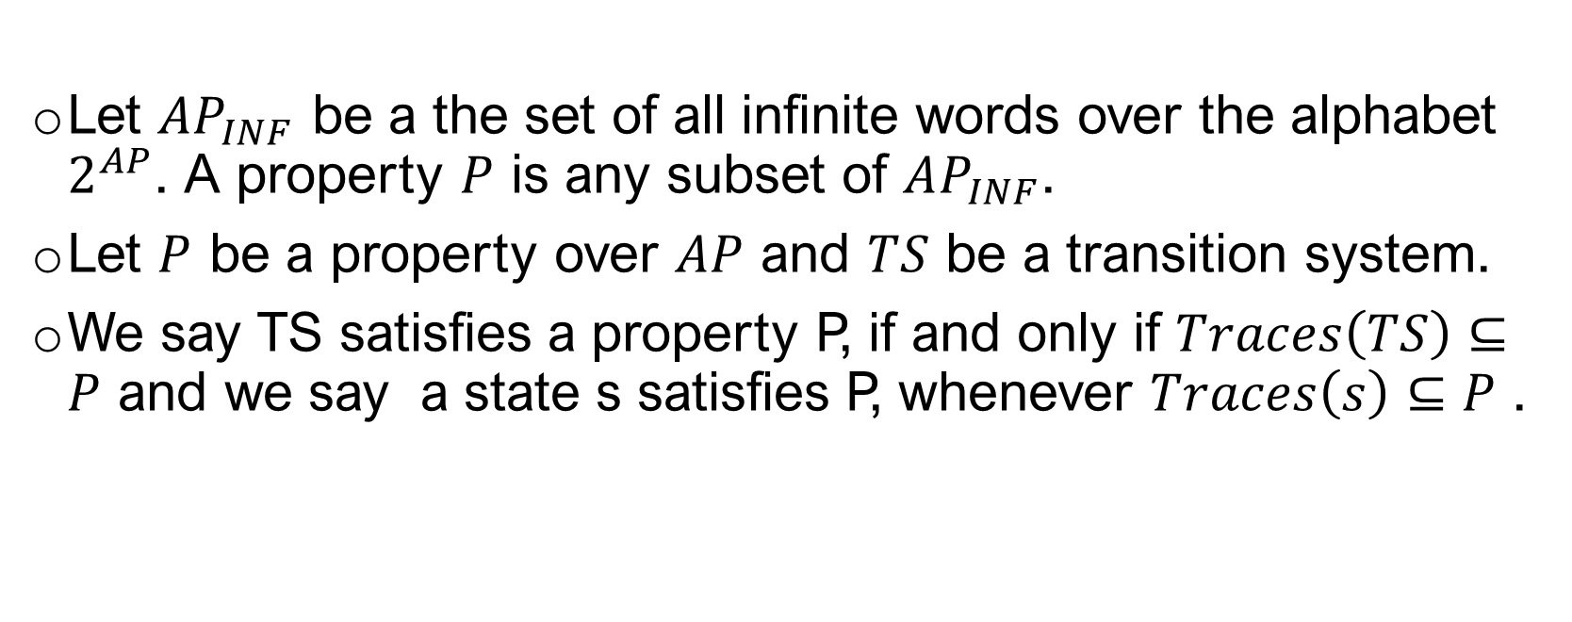
Properties
Let $AP_{INF}$ be a the set of all infinite words over the alphabet $2^{AP}$. A property $P$ is any subset of $AP_{INF}$.
Let $P$ be a property over $AP$ and $TS$ be a transition system.
We say TS satisfies a property P, if and only if $Traces\left(TS\right)⊆P$ and we say a state s satisfies P, whenever $Traces\left(s\right)⊆P$ .

Slide 8
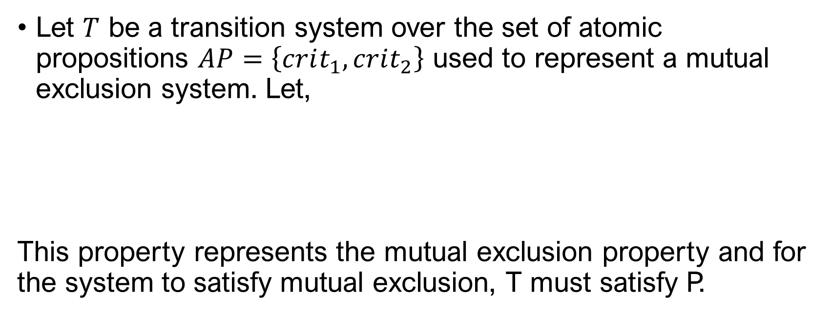
An example of a property
Let $T$ be a transition system over the set of atomic propositions $AP=\left\{crit_{1},crit_{2}\right\}$ used to represent a mutual exclusion system. Let,
This property represents the mutual exclusion property and for the system to satisfy mutual exclusion, T must satisfy P.

Slide 9
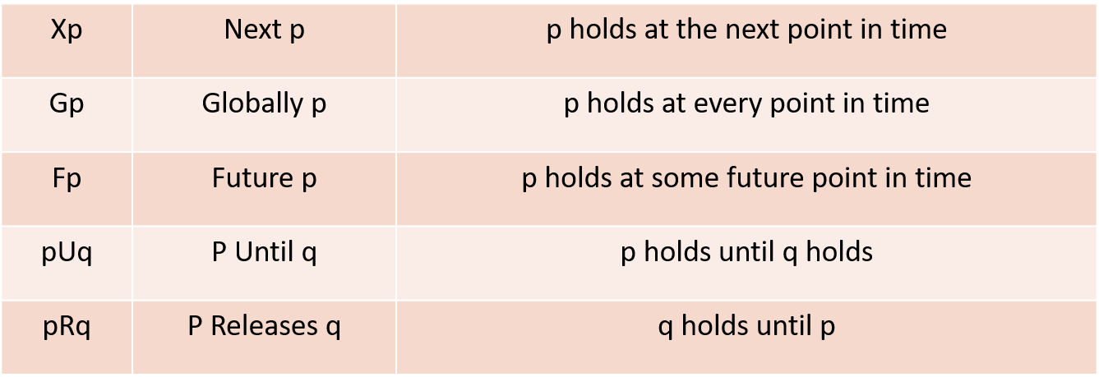
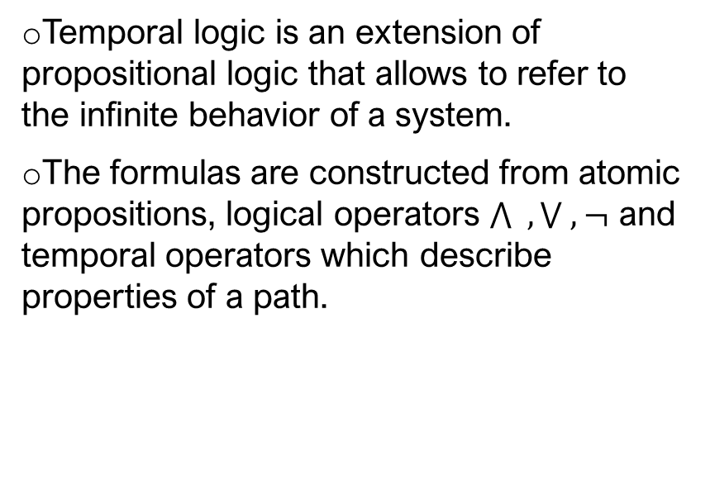
Temporal Logic
Temporal logic is an extension of propositional logic that allows to refer to the infinite behavior of a system.
The formulas are constructed from atomic propositions, logical operators $\bigwedge{ ,}\bigvee{ ,}¬$ and temporal operators which describe properties of a path.

Slide 10
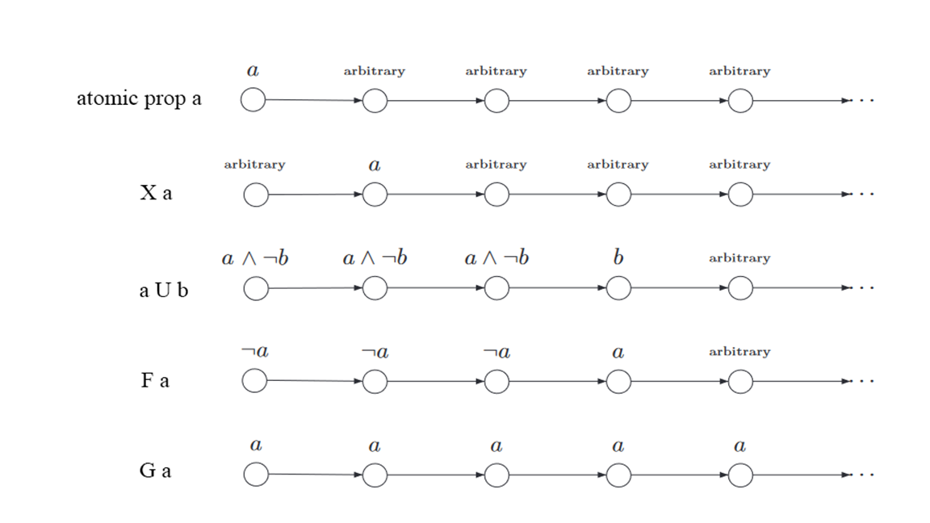
Temporal Operators

Slide 11
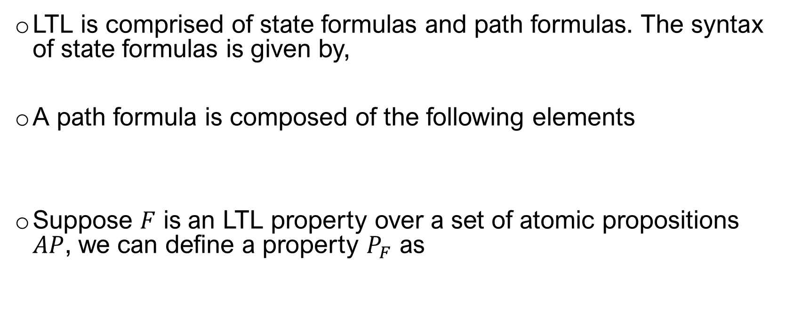
Linear Temporal Logic
LTL is comprised of state formulas and path formulas. The syntax of state formulas is given by,
A path formula is composed of the following elements
Suppose $F$ is an LTL property over a set of atomic propositions $AP$, we can define a property $P_{F}$ as

Slide 12

Computation Tree Logic
CTL is used to describe branching-time properties
In addition to the temporal operators mentioned in LTL, CTL also introduces path quantifiers.
We need to introduce the following path quantifiers

Slide 13
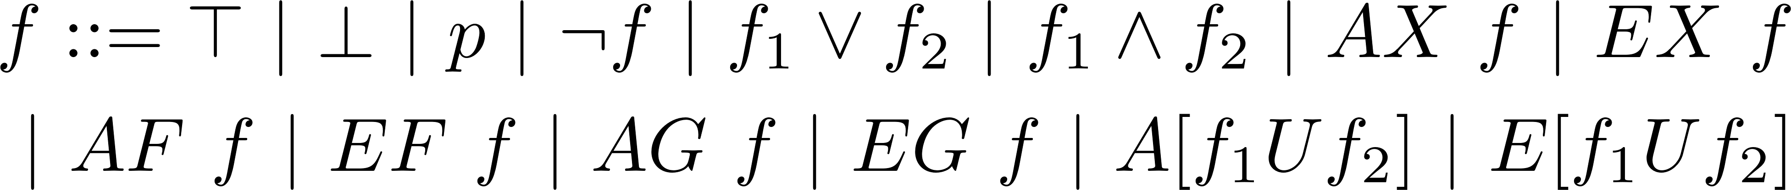
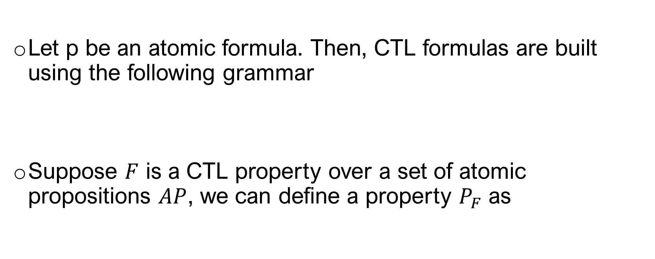
Computation Tree Logic(cont.)
Let p be an atomic formula. Then, CTL formulas are built using the following grammar
Suppose $F$ is a CTL property over a set of atomic propositions $AP$, we can define a property $P_{F}$ as

Slide 14
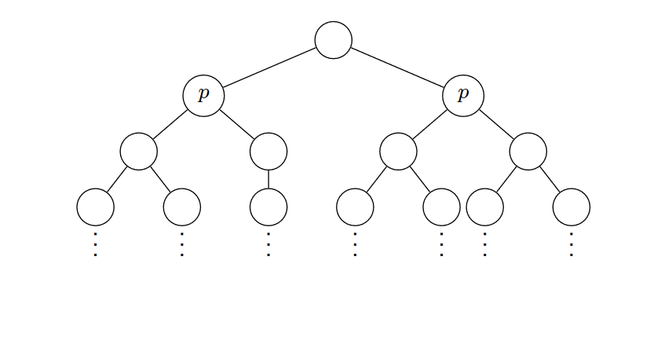
AXp
Across all paths from the current state, the next state satisfies the property p.

Slide 15
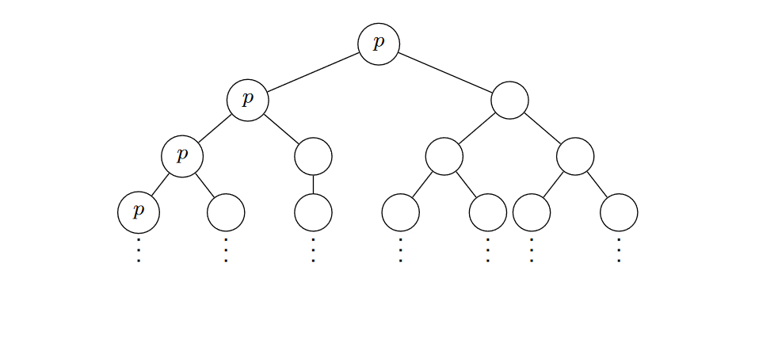
EGp
There exists a path from the current state across which every state satisfies the property p.

Slide 16
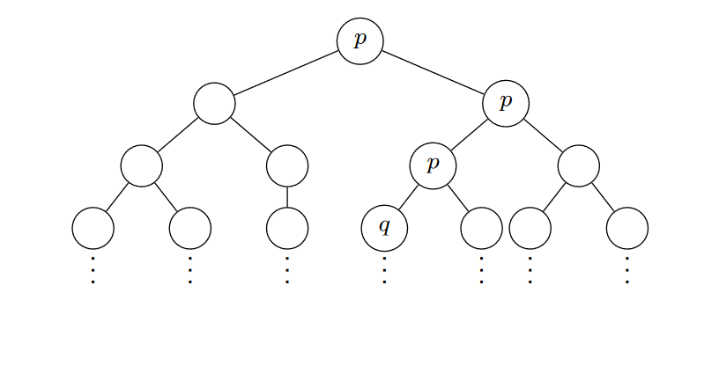
E[pUq]
There exists a path from the current state along which every state satisfies the property p until the property q is satisfied.

Slide 17
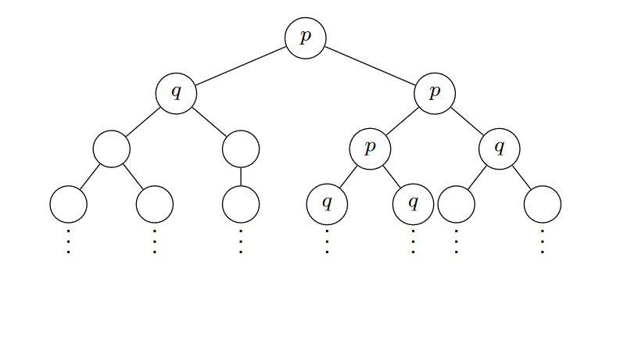
A[pUq]
Across all paths from the current state, every state satisfies the property p until the property q is satisfied.

Slide 18
NuSMV
NuSMV is an open source, automatic model checker and allows to check finite state systems against specifications in temporal logics such as Linear Temporal Logic(LTL) and Computation Tree Logic(CTL).
The input language of NuSMV is SMV.
It allows the description of finite state systems that range from completely synchronous to completely asynchronous.
Allows for modular hierarchical descriptions which are reusable.

Slide 19
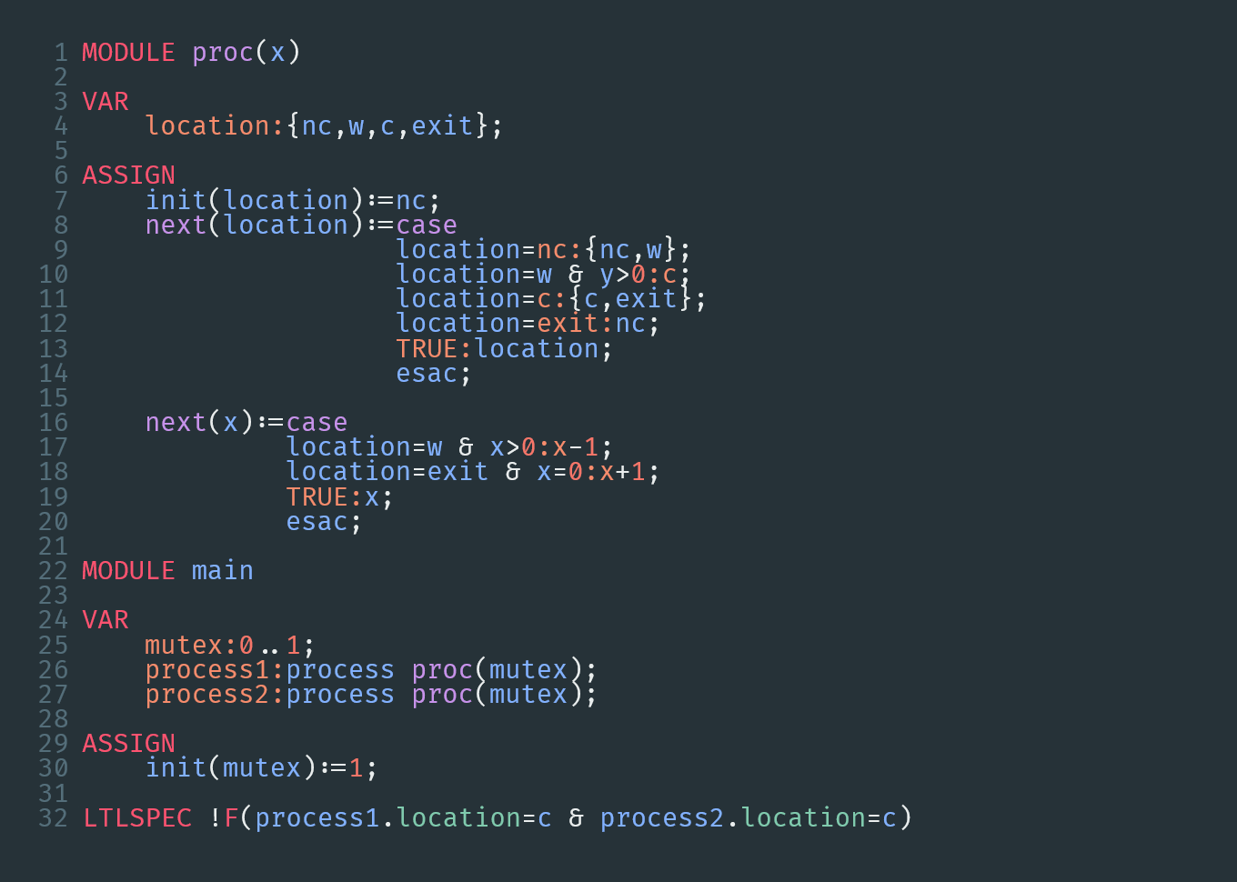
Modules in NuSMV
VAR: Identifies a portion of code where variables are defined
ASSIGN: Identifies a portion of code where variables are initialized and evolution is described
SPEC: Defines properties to be verified

Slide 20
Redundancy in Systems
A core principle in the design of flights and avionics systems is that reliability is increased through redundancy.
When sensor redundancy is introduced, we must use a voter algorithm which would allow us to provide an output for as long as possible.
The system we are currently basing the model on has triple modular redundancy.

Slide 21
Our requirements
We aimed to model a generic voter which would take inputs from multiple sensors and produce a reliable output.
The system is to provide a valid output for as long as possible.
We generally measure the performance of sensor management systems by extensive simulations on the system.
By applying formal methods instead, we hope to obtain a cheaper and more exhaustive approach to it’s verification.

Slide 22
The Voter Algorithm
The functionality of the voter is as follows:
Sample the signals of each sensor measurement at a fixed rate. The hardware flag of the sensor is also sampled at the same rate.
Use the hardware flag and compare the redundant sensor values to detect and isolate failed sensors.
Provide the output at a specified sample rate by taking a composite average of the signals of the non faulty sensors.
Tolerate false alarms. Sensors are not marked failed if they are operating within acceptable tolerances.
Maximize the availability of valid output.

Slide 23
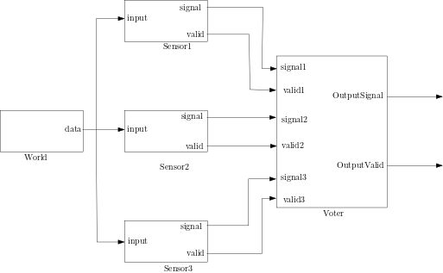
Modules in the System Model

Slide 24
Computing the output
Our aim is to provide a valid output for as long as possible.
In the case of 3 sensors, when there is no miscompare among them, the output is a simple average. If there is a miscompare between 2 pairs of the sensors, the output is a weighted average. If all 3 pairs miscompare, the output is calculated as a simple average but it is deemed invalid.
In the case of 2 sensors, the output is valid only when there is no miscompare between them. It is the simple average of the 2 sensor values.
In the case of only one valid sensor, the output is always considered valid and is simply the sensor output.

Slide 25
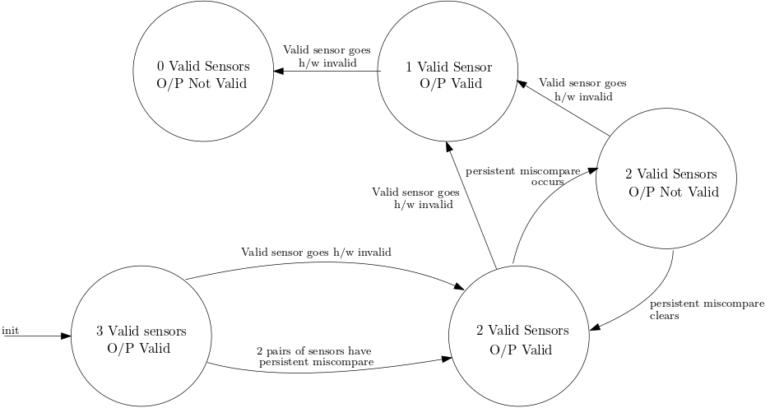
Fault States in the our initial Model

Slide 26
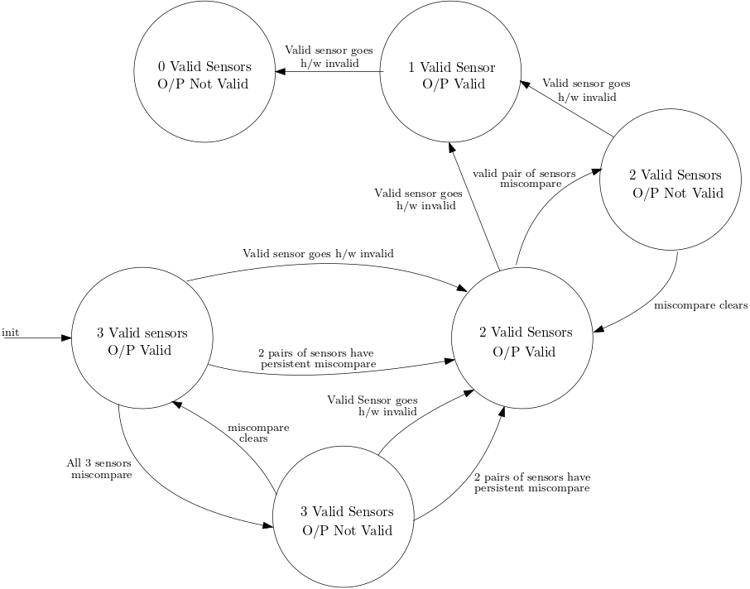
Fault states in our improved model

Slide 27
Verifying Properties
AG(votermodule.num_sensor_valid=2 -> !(EF(votermodule.num_sensor_valid=3)))
AG(votermodule.num_sensor_valid=1 -> !(EF(votermodule.num_sensor_valid=2)))
AG(votermodule.num_sensor_valid=0 -> !(EF(votermodule.num_sensor_valid=1)))
These properties verify that once a sensor has failed, there is no possible path of recovery for the failed sensor.

Slide 28
Verifying Properties
EF(A[(votermodule.num_sensor_valid=2 & votermodule.outputvalid=TRUE)
U(votermodule.num_sensor_valid=2 & votermodule.outputvalid=FALSE)])
& EF(A[(votermodule.num_sensor_valid=2 & votermodule.outputvalid=FALSE)
U(votermodule.num_sensor_valid=2 & votermodule.outputvalid=TRUE)])
These properties verify that in the case of 2 valid sensors, the sensors remain in service when a miscompare occurs. The output is declared to be invalid until the sensors come to an agreement.

Slide 29
Verifying Properties
EF(A[(votermodule.num_sensor_valid=2 & votermodule.outputvalid=TRUE)
U(votermodule.num_sensor_valid=2 & votermodule.outputvalid=FALSE)])
& EF(A[(votermodule.num_sensor_valid=2 & votermodule.outputvalid=FALSE)
U(votermodule.num_sensor_valid=2 & votermodule.outputvalid=TRUE)])
These properties verify that in the case of 2 valid sensors, the sensors remain in service when a miscompare occurs. The output is declared to be invalid until the sensors come to an agreement.

Slide 30
Verifying Properties
AG((votermodule.num_sensor_valid=2 & votermodule.outputvalid=FALSE)-> EF(votermodule.num_sensor_valid=1 & votermodule.outputvalid= TRUE))
From all states where there are 2 valid sensors and the output is invalid, it is possible to reach a state where there is a single valid sensor with a valid output.

Slide 31
Verifying Properties
AG(!(votermodule.op_value=worldreading)->AF(A[!(votermodule.op_value=worldreading)
U((votermodule.op_value=worldreading) & votermodule.outputvalid)] | !(votermodule.op_value=worldreading)))
From all states for which the computed output is not equal to the world reading, across all paths in the future, the output remains invalid as long as it remains unequal or the output becomes valid once the output and world reading agrees.

Slide 32
References
[1] C. Baier and J.-P. Katoen, Principles of Model Checking. The MIT Press, 2008.
[2] A. Cimatti, E. Clarke, F. Giunchiglia, and M. Roveri, “NuSMV: a new Symbolic Model Verifier,” in Proceedings Eleventh Conference on Computer-Aided Verification (CAV’99), ser. Lecture Notes in Computer Science, N. Halbwachs and D. Peled, Eds., no. 1633. Trento, Italy: Springer, July 1999, pp. 495–499.
[3] B. Srivathsan, “Model checking and system verification,” 2015. [Online]. Available: https://www.cmi.ac.in/∼sri/Courses/MC2015/
[4] S. Dajani-Brown, D. Cofer, G. Hartmann, and S. Pratt, “Formal modeling and analysis of an avionics triplex sensor voter,” in Model Checking Software, T. Ball and S. K.Rajamani, Eds. Berlin, Heidelberg: Springer Berlin Heidelberg, 2003, pp. 34–48.
[5] M. Fredrikson, “Automated program verification and testing 15414,” 2016. [Online].Available: https://www.cs.cmu.edu/∼mfredrik/15414/lectures/
[6] W.-P. de Roever, F. de Boer, U. Hanneman, J. Hooman, Y. Lakhneche, M. Poel, and J. Zwiers, Concurrency Verification: Introduction to Compositional and Noncompositional Methods, ser. Cambridge Tracts in Theoretical Computer Science. United Kingdom: Cambridge University Press, 2001.
[7] H. Hyman, “Comments on a problem in concurrent programming control,”Commun. ACM, vol. 9, no. 1, p. 45, Jan. 1966. [Online]. Available: https://doi.org/10.1145/365153.365167
[8] S. Osder, “Practical view of redundancy management application and theory,” Journal of Guidance Control and Dynamics, vol. 22, pp. 12–21, 1999.
[9] S. Documentation, “Simulation and model-based design,” 2020. [Online]. Available: https://www.mathworks.com/products/simulink.html

Slide 33
Thank you.

