Slide 1
15I711-Distributed Component Laboratory
Presented by
D.Dharani
Assistant Professor
Department of IT
Date:04/08/2020

Slide 2
CO-PO-PSO
CO | Course Outcomes | Programme Outcomes (PO’s) | Programme Specific Outcomes (PSO)
CO1 | Study of development of distributed applications using recent middleware technologies | a, d, e | PSO 1, PSO 2
CO2 | Design and Develop distributed applications using Procedure and Object oriented middleware technologies | b, c, d, e, g, l | PSO 1, PSO 2

Slide 3
List of Exercises
IPC with Socket Programming (C Language)
RPC Programming with SUN-RPC and Microsoft RPC
Distributed Object Computing with Java RMI
Distributed Programming with EJB
Distributed Object Computing with Microsoft COM and DCOM
Mini Project

Slide 4
Software requirements
Ubuntu (to run Socket Program in C/C++ )
Netbeans (to run client server programs using distributed components such as RPC,RMI, EJB, COM,DCOM in Java)

Slide 5
Objective
To learn the protocols and implement distributed applications

Slide 6
Fundamentals
Different Computing Paradigms: Parallel, centralized, Distributed
Distributed system types: Client/server, Peer to Peer
Middleware
Distributed Computing Environments and Distributed Components

Slide 7
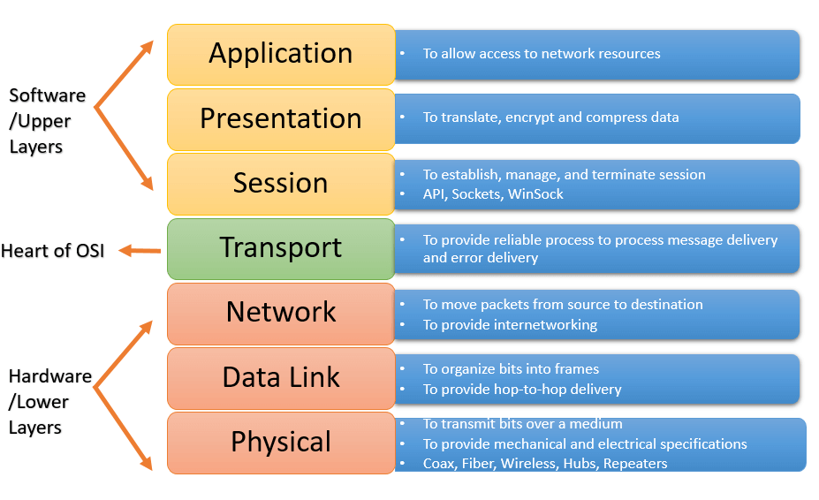
Network layers
Reference: guru99.com

Slide 8
Network to network communication
Network A
Network B
DNS
Host X
Host Y
P1….Pn
P1….Pn

Slide 9
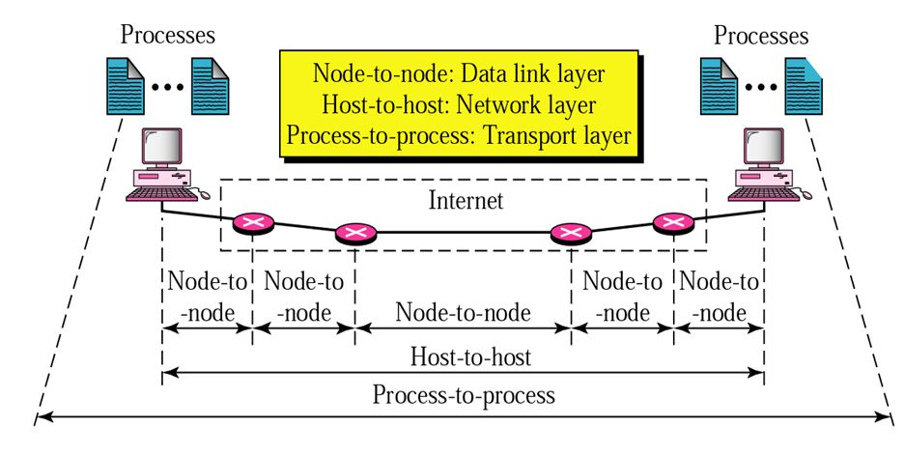
Process to Process Communication
https://slideplayer.com/slide/5024938/

Slide 10
IPC-Inter Process Communication
Inter process communication (IPC) is a mechanism which allows processes to communicate with each other and synchronize their actions.
The communication between these processes can be seen as a method of co-operation between them.
Processes can communicate with each other through both: Shared Memory. Message passing.

Slide 11
Exercise 1 – Implementation of Socket Programming
Socket programs are used to communicate between various processes usually running on different systems. It is mostly used to create a client-server environment.
A socket is a communication mechanism. A socket is normally identified by a small integer which may be called the socket descriptor.

Slide 12
Socket Programming-steps
The steps involved in establishing a socket on the client side are as follows:
Create a socket with the socket() system call
Connect the socket to the address of the server using the connect() system call
Send and receive data. There are a number of ways to do this, but the simplest is to use the read() and write() system calls.
The steps involved in establishing a socket on the server side are as follows:
Create a socket with the socket() system call
Bind the socket to an address using the bind() system call. For a server socket on the Internet, an address consists of a port number on the host machine.
Listen for connections with the listen() system call
Accept a connection with the accept() system call. This call typically blocks until a client connects with the server.
Send and receive data

Slide 13
Pre Lab Questions for Exercise 1
Prelab Questions: to be submitted before 4th August 2020-6pm
What are the various methods of Inter Process Communication?
Execute any command line argument program in C
What are sockets? Explain Types of sockets
List out the client and server side system calls used in socket programming along with explanations
Explain TCP and UDP
What is called as socket descriptor?
Give detailed explanations on
Multiple clients involved in socket Programming
Socket programming where client and server running in same and different systems
To be completed while coming to the next Lab:
Implement simple socket program for message passing system in C

Slide 14
Socket Programming
Socket Types:
Stream sockets: It uses TCP (Transmission Control Protocol), which is a reliable, stream oriented protocol.
Datagram sockets. It uses UDP (Unix Datagram Protocol), which is unreliable and message oriented.

Slide 15
Cont.,
When a socket is created, the program has to specify the address domain and the socket type and each socket needs a port number on that host.
There are two widely used address domains:
Unix domain: Two processes can share a common file system
Internet domain: Two processes running on any two hosts on the Internet. The address of a socket in the Internet domain consists of the Internet address (IP) of the host machine.

Slide 16
sock = socket(AF_INET , SOCK_STREAM , 0);

Slide 17
Core Functions in socket programming
socket()
bind()
listen()
accept()
read()
write()
connect()
close()
send()
recv()
recvfrom()
sendto()
recvfrom()
shutdown()
select()

Slide 18
Iterative and concurrent servers
The server can be iterative, i.e. it iterates through each client and serves one request at a time.
Alternatively, a server can handle multiple clients at the same time in parallel, and this type of a server is called a concurrent server.

Slide 19
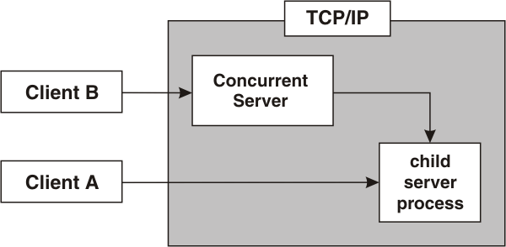
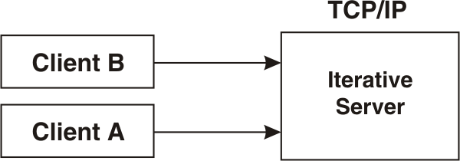
Cont.,

Slide 20
Multi client and single server

Slide 21
Select function
int select(int maxfd, fd_set *readsset, fd_set *writeset, fd_set *exceptset, const struct timeval *timeout);
Returns: positive count of descriptors ready, 0 on timeout
Select command allows to monitor multiple file descriptors, waiting until one of the file descriptors become active.
For example, if there is some data to be read on one of the sockets select will provide that information.
Select works like an interrupt handler, which gets activated as soon as any file descriptor sends any data.

Slide 22
Arguments
maxfd: maximum number of descriptor ready.
timeout: How long to wait for select to return.
readset: Descriptor set that we want kernel to test for reading.
writeset: Descriptor set that we want kernel to test for writing.
exceptset: Descriptor set that we want kernel to test for exception conditions.

Slide 23
Multi client and multi server

Slide 24
Can a client connect to multiple servers?
Ans: Indeed, one client can connect to only one server at a time. To connect a client to multiple servers you would need to create multiple clients and initiate the requests to different servers.

Slide 25
Multi threaded server
A multithreaded server is any server that has more than one thread. Because a transport requires its own thread, multithreaded servers also have multiple transports. The number of thread-transport pairs that a server contains defines the number of requests that the server can handle in parallel.

Slide 26
Post lab questions: Deadline 9th sep 2020
Describe the following core socket functions (with syntax, data type, parameters and return value) required to write a complete client and server program in C.
socket()
bind()
listen()
accept()
read()
write()
connect()
close()
send()
recv()
recvfrom()
sendto()
recvfrom()
shutdown()
select()

Slide 27
Procedure calls
Procedure is an important and frequently used programming construct for a compiler.

Slide 28
Remote Procedure Call
Remote procedure calls, however, run procedures on other machines or devices connected to a network.
Once the instructions have been run, the results of the procedure are usually returned to the local computer.
RPC is a protocol that one program can use to request a service from a program located in another computer on a network without having to understand the network’s detail.

Slide 29
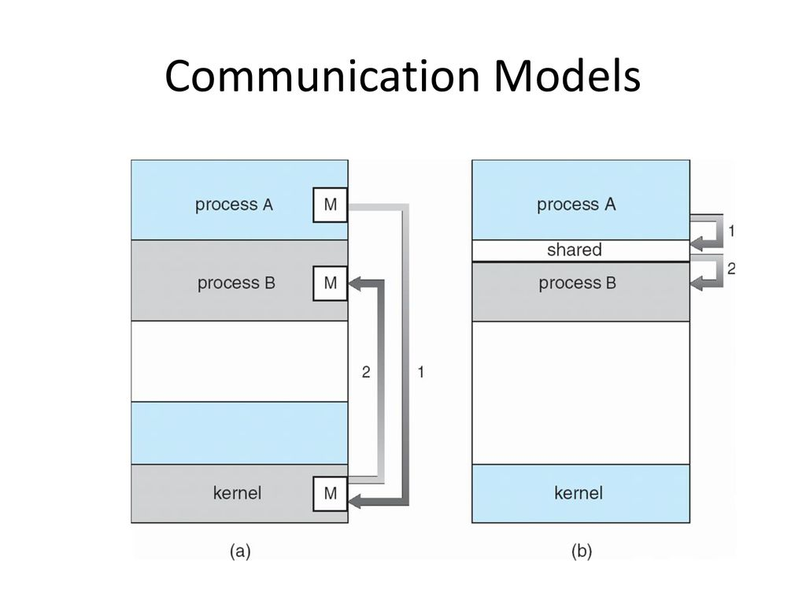
IPC- runs at same machine

Slide 30
IPC vs RPC
In contrast to the IPC facility, the messages exchanged in RPC communication are well structured and are thus no longer just packets of data
Each message is addressed to an RPC daemon listening to a port on the remote system and each contains an identifier of the function to execute and the parameters to pass to that function
The function is then executed as requested and any output is sent back to the requester in a separate message

Slide 31
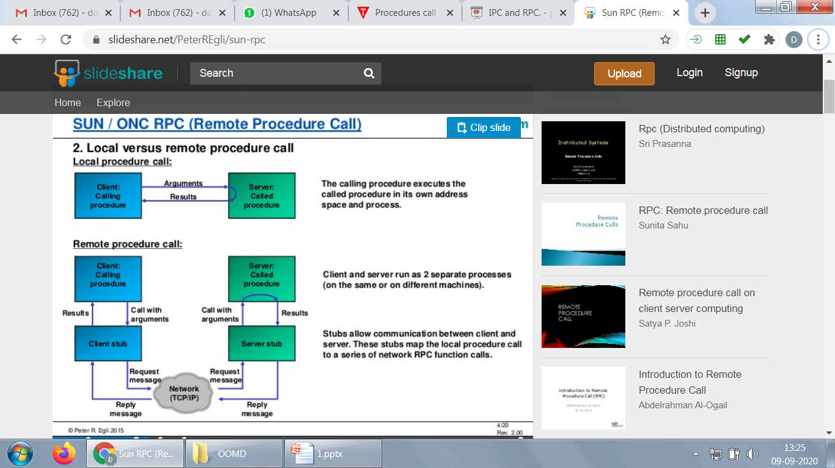
Local Procedure calls

Slide 32
Components of RPC
Client
Client stub
Server
Server stub
RPC interface

Slide 33
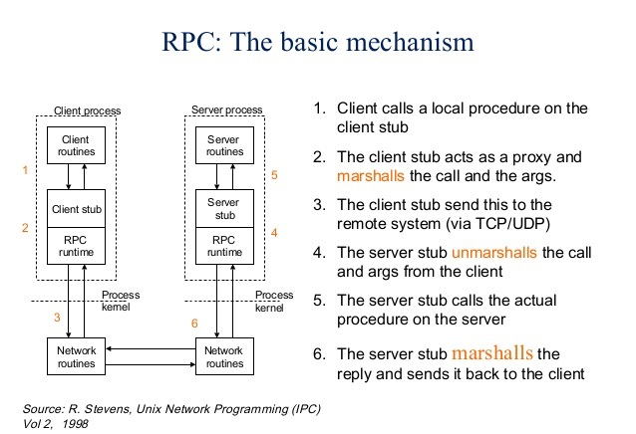

Slide 34
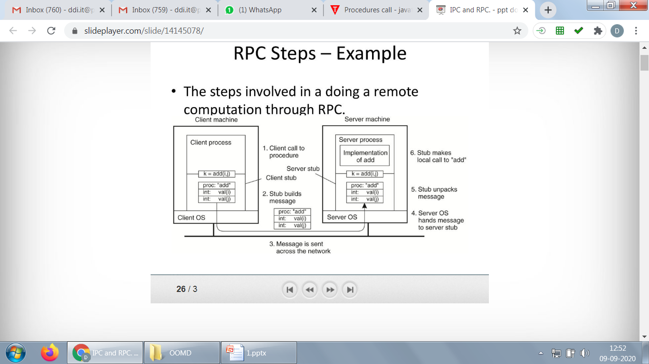

Slide 35
Marshalling/Unmarshalling
Implementing RPC involves the transfer of arguments and results between client-server processes.
These arguments and results are language-level data structures which are transferred in the form of message data.
Transfer of message data between two computers requires encoding of the message data, which is known as marshalling.
The decoding of the message data is known as unmarshalling which reverses the steps of marshalling.

Slide 36
The following steps take place during a RPC
A client invokes a client stub procedure, passing parameters in the usual way. The client stub resides within the client’s own address space.
The client stub marshalls(pack) the parameters into a message. Marshalling includes converting the representation of the parameters into a standard format, and copying each parameter into the message.
The client stub passes the message to the transport layer, which sends it to the remote server machine.
On the server, the transport layer passes the message to a server stub, which demarshalls(unpack) the parameters and calls the desired server routine using the regular procedure call mechanism.
When the server procedure completes, it returns to the server stub (e.g., via a normal procedure call return), which marshalls the return values into a message. The server stub then hands the message to the transport layer.
The transport layer sends the result message back to the client transport layer, which hands the message back to the client stub.
The client stub demarshalls the return parameters and execution returns to the caller.

Slide 37
Issues in RPC and how resolved
Differences in data representation on the client and server machines(i.e big endian or little endian) -> machine independent representation of data(marshalling)
How does client know the port numbers on the server? -> 1) fixed port number or 2) randezvous/ matchmaker mechanism

Slide 38
Different flavors of RPC
SUN RPC: Open Network Computing RPC- An RPC technology for Unix based systems
DCE/RPC: Distributed Computing Environment RPC by OSF(Open Software Foundation)
MS RPC: Microsoft’s extension of DCE/RPC

Slide 39
Execution steps- SUN RPC using rpcgen for addition of two numbers
rpcinfo – whether rpcbind is installed
If not, sudo apt –get install rpcbind
Create folder and open a doc into it named ‘add.x’
Define add.x // RPC Protocol Specification File
Compile it using rpcgen
Rpcgen –a –C add.x
Shows result in folder
Execute the command: make –f Makefile.add
Edit the auto generated add_server.c add_client.c //write the code
Execute server: sudo ./add_server
Execute client: sudo ./add_client localhost 5 8
https://freetechorb.wordpress.com/2019/04/28/adding-two-integers-using-rpcgen/

Slide 40
Prelab Questions-2
1. RPC is not suitable to pass pointers to remote procedure. Justify
2. Differentiate between SUN RPC and MS-RPC
3. Differentiate between Socket and RPC
4. Write down the functionalities of Stub
5. How does the procedure oriented middle ware differ from Object oriented middleware? Give an example
6. List out all the issues in RPC and also mention how it is resolved
7. What is marshalling/ Unmarshalling
8. Execute a simple Calculator program using rpcgen

Slide 41
Exercise 2
Implement a factorial procedure
Develop a distributed application that implements dictionary lookup operation.
Server should maintain a dictionary of words and client interface should keep a cache of recently referenced words and searches the cache before making a remote procedure call.The dictionary may be maintained using string arrays
When the client submits a word, it is checked in the client cache and if it is not found, a request is made to the server to fetch the meaning. Cache may be implemented using string array in the client side.
3. Online Test
4. Secure Chat (Encryption and Decryption)

Slide 42
Post Lab for Exercise 2-Quiz
https://docs.google.com/forms/d/1RR5DY2cQwreuNHdUIKlpFAAVLpZSoK1QrvgXNyRV1o8/edit

Slide 43
Java RMI
RMI stands for Remote Method Invocation. It is a mechanism that allows an object residing in one system (JVM) to access/invoke an object running on another JVM.
RMI is used to build distributed applications; it provides remote communication between Java programs. It is provided in the package java.rmi.

Slide 44
Cont..,
In an RMI application, we write two programs, a server program (resides on the server) and a client program (resides on the client).
Inside the server program, a remote object is created and reference of that object is made available for the client (using the registry).
The client program requests the remote objects on the server and tries to invoke its methods.

Slide 45
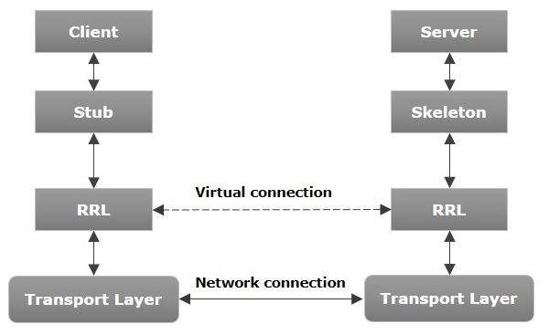
Architecture of an RMI Application

Slide 46
Components
Transport Layer − This layer connects the client and the server. It manages the existing connection and also sets up new connections.
Stub − A stub is a representation (proxy) of the remote object at client. It resides in the client system; it acts as a gateway for the client program.
Skeleton − This is the object which resides on the server side. stub communicates with this skeleton to pass request to the remote object.
RRL(Remote Reference Layer) − It is the layer which manages the references made by the client to the remote object.

Slide 47
Working of RMI
The following points summarize how an RMI application works −
When the client makes a call to the remote object, it is received by the stub which eventually passes this request to the RRL.
When the client-side RRL receives the request, it invokes a method called invoke() of the object remoteRef. It passes the request to the RRL on the server side.
The RRL on the server side passes the request to the Skeleton (proxy on the server) which finally invokes the required object on the server.
The result is passed all the way back to the client.

Slide 48
RMI Registry
RMI registry is a namespace on which all server objects are placed. Each time the server creates an object, it registers this object with the RMIregistry (using bind() or reBind() methods). These are registered using a unique name known as bind name.
To invoke a remote object, the client needs a reference of that object. At that time, the client fetches the object from the registry using its bind name (using lookup() method).

Slide 49
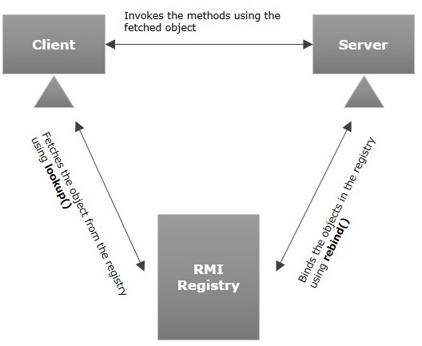
RMI Registry

Slide 50
Steps
To write an RMI Java application, you would have to follow the steps given below
Define the remote interface
Develop the implementation class (remote object)
Develop the server program
Develop the client program
Compile the application
Execute the application

Slide 51
Remote interface
A remote interface provides the description of all the methods of a particular remote object. The client communicates with this remote interface.
To create a remote interface −
Create an interface that extends the predefined interface Remote which belongs to the package.
Declare all the business methods that can be invoked by the client in this interface.
Since there is a chance of network issues during remote calls, an exception named RemoteException may occur; throw it.

Slide 52
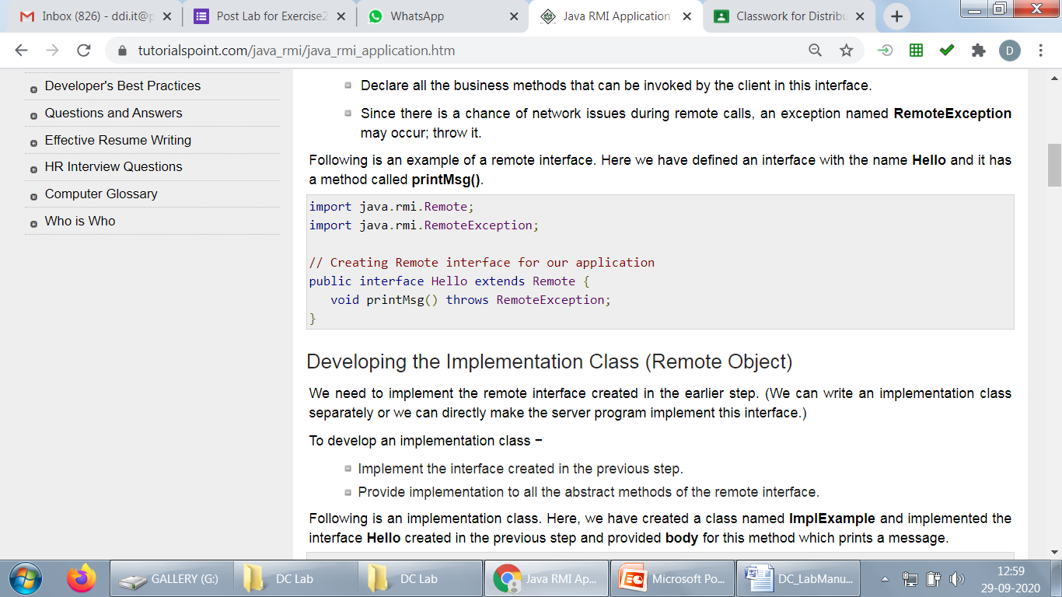
Example- Remote Interface

Slide 53
Developing the Implementation Class (Remote Object)
We need to implement the remote interface created in the earlier step. (We can write an implementation class separately or we can directly make the server program implement this interface.)
To develop an implementation class
Implement the interface created in the previous step.
Provide implementation to all the abstract methods of the remote interface.
Following is an implementation class. Here, we have created a class named ImplExample and implemented the interface Hello created in the previous step and provided body for this method which prints a message.

Slide 54
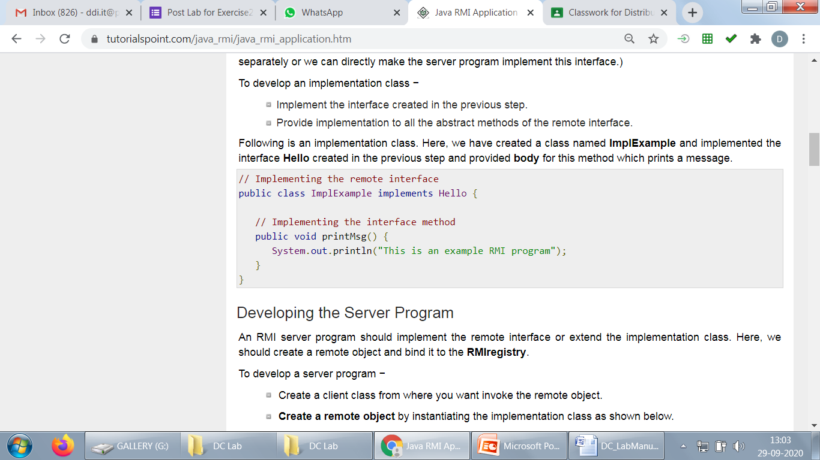
Implementation class-Example

Slide 55
Developing the Server Program
An RMI server program should implement the remote interface or extend the implementation class. Here, we should create a remote object and bind it to the RMIregistry.
To develop a server program −
Create a client class from where you want invoke the remote object.
Create a remote object by instantiating the implementation class as shown below.
Export the remote object using the method exportObject() of the class named UnicastRemoteObject which belongs to the package java.rmi.server.
Get the RMI registry using the getRegistry() method of the LocateRegistry class which belongs to the package java.rmi.registry.
Bind the remote object created to the registry using the bind() method of the class named Registry. To this method, pass a string representing the bind name and the object exported, as parameters.

Slide 56
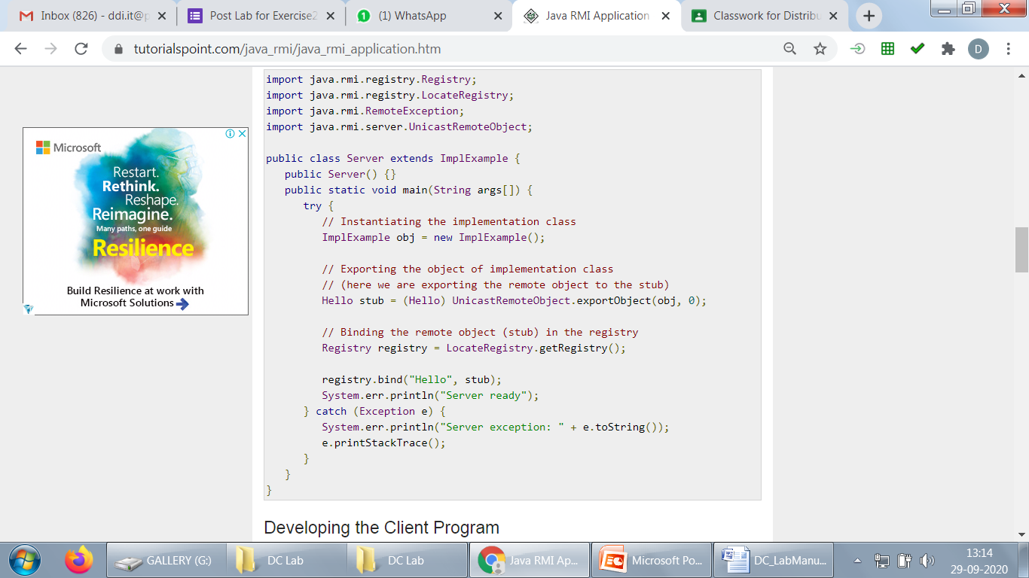
Example Server Program

Slide 57
Developing the Client Program
Write a client program in it, fetch the remote object and invoke the required method using this object.
To develop a client program −
Create a client class from where your intended to invoke the remote object.
Get the RMI registry using the getRegistry() method of the LocateRegistry class which belongs to the package java.rmi.registry.
Fetch the object from the registry using the method lookup() of the class Registry which belongs to the package java.rmi.registry.
To this method, you need to pass a string value representing the bind name as a parameter. This will return you the remote object.
The lookup() returns an object of type remote, down cast it to the type Hello.
Finally invoke the required method using the obtained remote object.

Slide 58
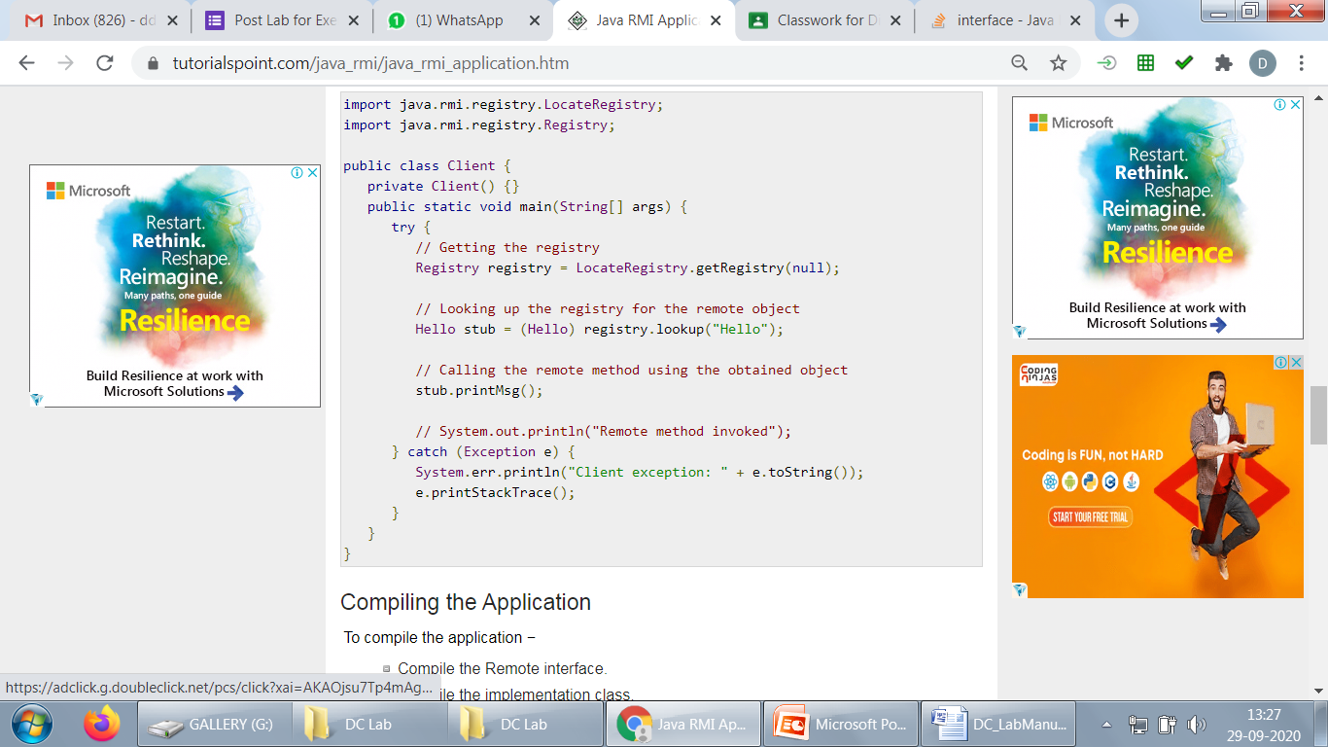
Example-Client Program

Slide 59
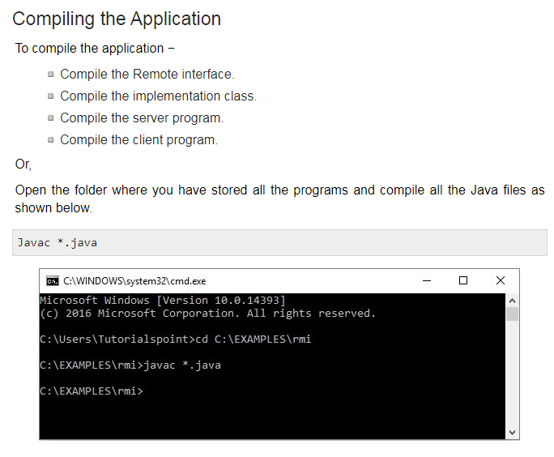
Compilation

Slide 60
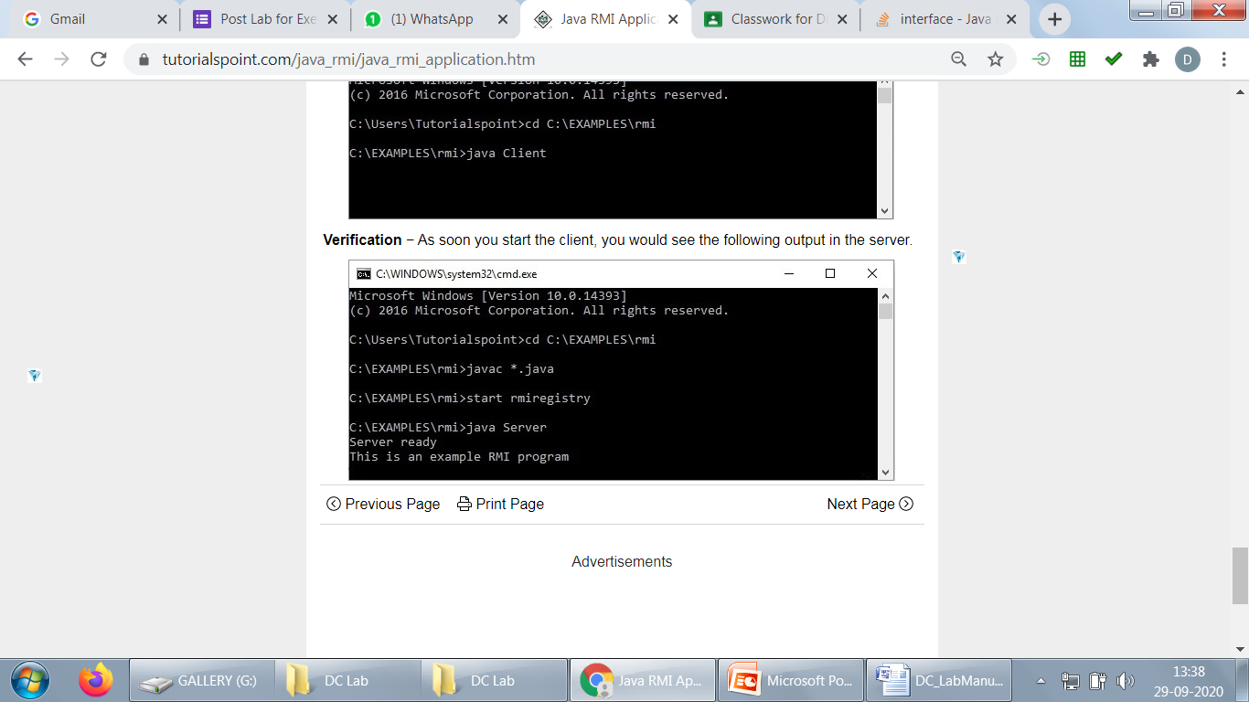
Execution
start rmiregistry
Java Server
java Client

Slide 61
Pre Lab Question for Exercise 3
How does the Java RMI differ from CORBA?
List out the differences between RPC and RMI.
What does the following statement indicate?
Naming.rebind ("//rmi:3000/ HelloRegistry ", object1);
What is the default port number used by RMI Registry?
What is the difference between bind () and rebind() methods of Naming Class?
Implement Print Hello Program using Java RMI

Slide 62
Exercise 3
Develop a simple client/server banking service application using Java RMI. Whenever a user logins, the user is allowed to perform the following operations:
Deposit operation: one can deposit some amount to an existing account
Withdraw operation: one can withdraw some amount from an existing account. While withdrawing, it should check for minimum balance. The minimum balance for an account is 500.
Balance Enquiry: one can check the balance of an account
Transfer operation: one can transfer some amount to another existing account. While Transferring check for Minimum balance.
If there isn't sufficient money in the account, then an error message should be returned. Check the existence of the account(s) in all the operations and return an error message if it doesn’t exist.
2. Develop a Patient Information system using Java RMI. This information system keeps track of the patient’s information and treatment details in a hospital or clinic. The Patient Information system offers following operations:
Register patient details
Search for Patient details by name
Use java swing or frames for the user interface.

Slide 63
EJB (Enterprise Java Bean)
The EJB enumeration aims to provide a standard way to implement the server-side business software typically found in enterprise applications.

Slide 64
Cont.,
To run EJB application we need an application server (EJB Container) such as Jboss, Glassfish, Weblogic, Websphere etc. It performs:
1. Life cycle management 2. Security 3. Transaction management 4. Object pooling

Slide 65
Types
Session Bean
Entity Bean
Message driven Bean

Slide 66
https://www.infoworld.com/article/2071724/ejb-fundamentals-and-session-beans.html

Slide 67
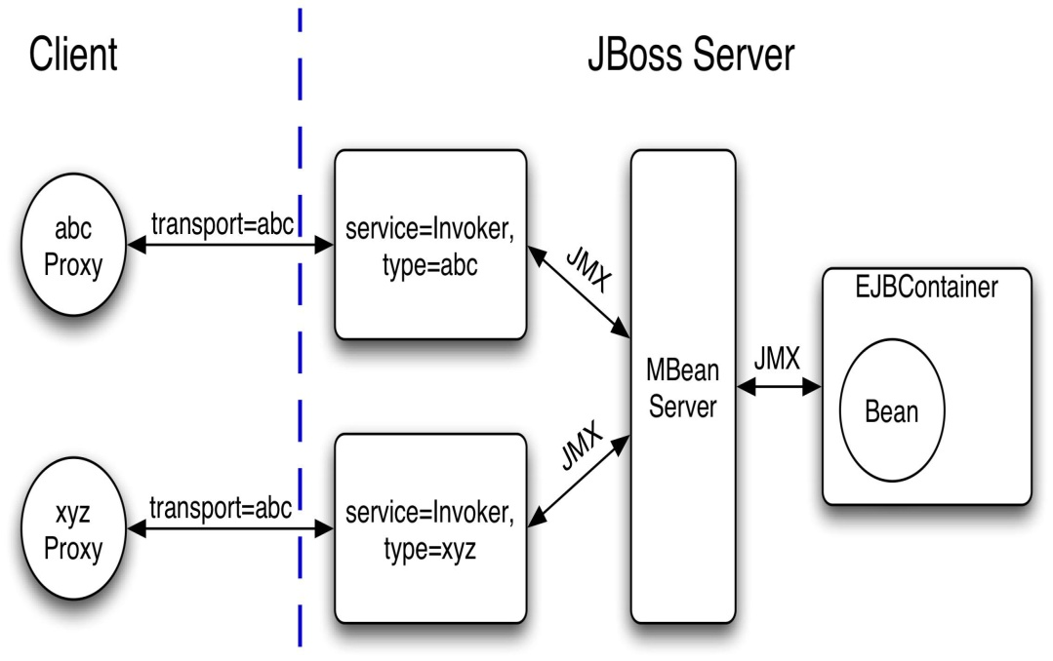
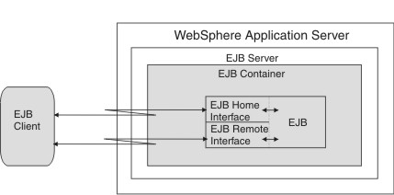
Example

Slide 68
PreLab Questions
Comparison of EJB versions with examples
Explain EJB Types and its need
Stateful vs stateless sessions
Explain EJB annotations. What does EJB annotations do?
Implement a simple session bean to print Hello World

Slide 69
Exercise 4
A cart bean represents a shopping cart in an online bookstore. The bean’s client can add a book to the cart or remove a book. Cart bean keeps track of the customer and the items chosen by the client application. Once the client application is ready to execute a sale, the Cart bean manages the interactions of the customer, product, credit card, and order beans in a workflow that results in a charge against the customer’s credit card and the creation of a shipping order. Hint: DisplayBook bean should send the book names along with cost to the client when the client invokes bookdetails.Cart bean should add or remove a book with cost when the client invokes addbook or removebook. It will send a bill to the client when the client invokes Finalbill. This bean should ask a credit card number when the client invokes order. Creditcardverification bean should validate the number against the database. If its valid then send the “successfully completed” message to the client and store the order in the database else send an error message.

Slide 70
Study- Exercise 5 COM and DCOM
Component object model was introduced by Microsoft in the year 1993. It is an interface standard designed for software components. It helps for the inter process communication irrespective of the programming language to be used. COM is termed as a software architecture that allows systems to be built from the different software vendors. It is also called as a set of binary standards which helps in the creation of a dynamic object. COM can also be termed as the standard for the effective communication between the components.
The benefits of using COM are it can be used with any programming language which is capable of creating objects and pointer.

Slide 71
DCOM
The distributed component object model is specifically designed for distributed applications. Before DCOM was known as “Network OLE”. The applications designed with COM was not able to serve the need of distributed computing as a result DCOM came into the picture. This supports the need in which the component needs to communicate across networked supported computers.
The benefits of using are it provides distributed computing, it has a distributed garbage collector that enhances the CPU utilization.

Slide 72
Steps
When a COM Server is installed on a Windows operating system, it needs to register a class identifier in the registry (CLSID). The COM client can start the server using the CLSID.

Slide 73
Link
http://active-undelete.com/understanding-dcom.htm#:~:text=The%20Distributed%20Component%20Object%20Model,Internet%20protocols%20such%20as%20HTTP.

Slide 74
Thank You

