Slide 1
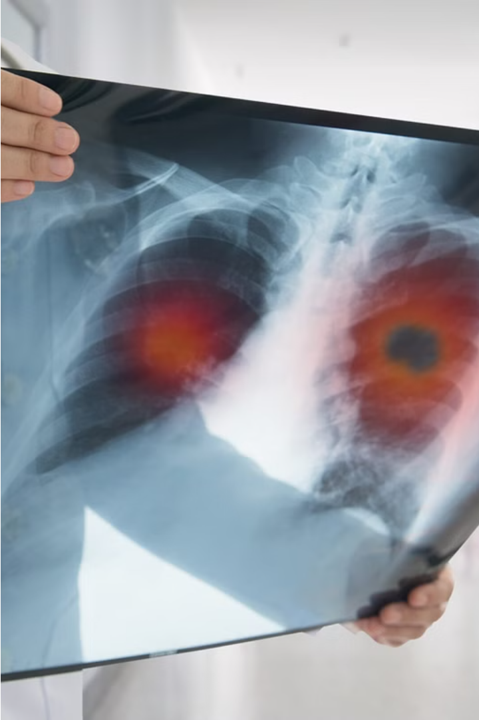
Introduction to Lung Cancer Prediction
Lung cancer is one of the deadliest forms of cancer, but early detection can greatly improve outcomes. This presentation will explore the latest advancements in machine learning-based lung cancer prediction models that can analyze medical imaging data to identify signs of the disease at an early stage.

Slide 2
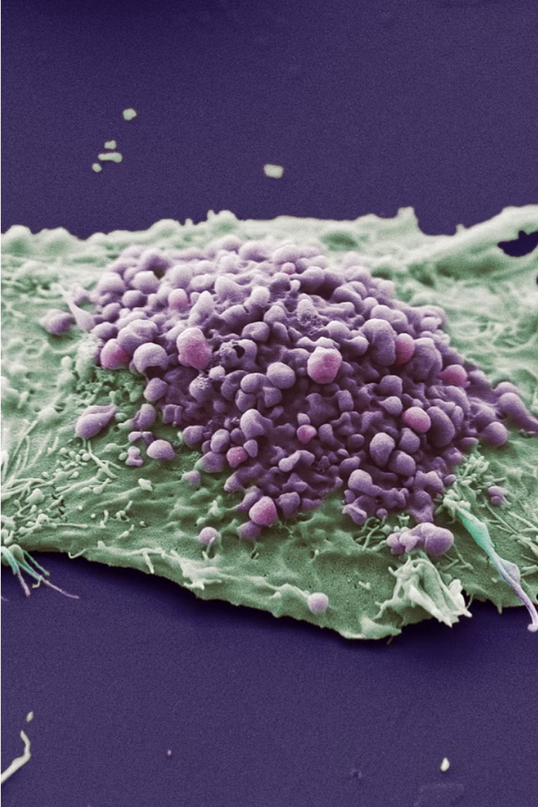
Understanding Lung Cancer
Lung cancer is a complex and devastating disease that affects the respiratory system. It is characterized by the uncontrolled growth of abnormal cells in the lungs, which can lead to the development of tumors and the disruption of normal lung function. Understanding the underlying causes, risk factors, and disease progression is crucial for effective prevention, early detection, and treatment.

Slide 3
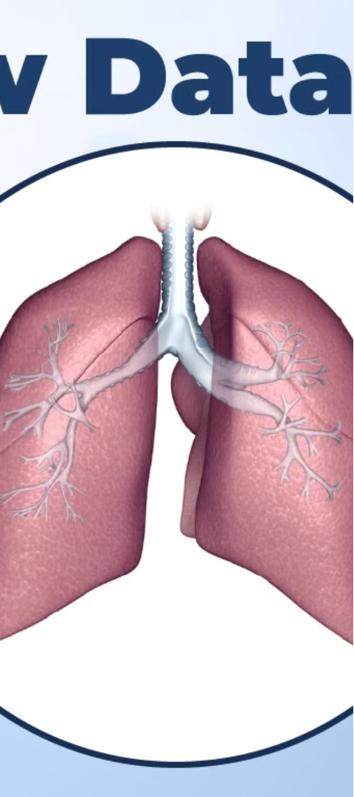
Data Collection and Preprocessing
1
Data Sources
Collect lung cancer data from reputable medical databases, electronic health records, and clinical studies. Ensure the data is comprehensive, covering patient demographics, medical history, and diagnostic information.
2
Data Cleaning
Preprocess the data by handling missing values, removing duplicates, and addressing any inconsistencies or errors. Implement robust data cleaning techniques to ensure data integrity and reliability.
3
Feature Extraction
Extract relevant features from the data, such as patient age, smoking history, biomarkers, and imaging data. Transform the data into a format suitable for machine learning analysis.

Slide 4
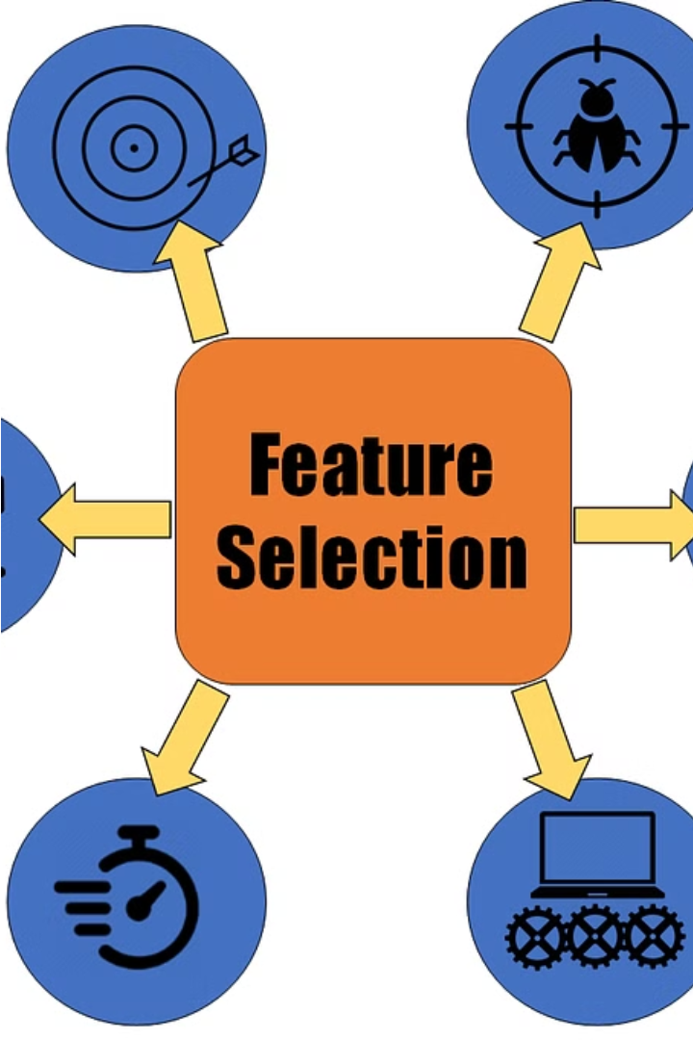
Feature Engineering and Selection
Feature engineering is the process of transforming raw data into meaningful features that can improve the performance of machine learning models. Feature selection identifies the most relevant features, reducing the dimensionality of the data and improving model accuracy.
Techniques like Principal Component Analysis, Recursive Feature Elimination, and Sequential Feature Selection can be used to identify the optimal set of features for lung cancer prediction.

Slide 5

Machine Learning Models for Prediction
Logistic Regression: A robust and interpretable model for binary classification of lung cancer risk.
Random Forest: An ensemble method that handles complex, nonlinear relationships in the data.
Linear regression :Linear regression is a statistical method used to model the relationship between a dependent variable and one or more independent variables. It assumes a linear relationship between the independent variables (predictors) and the dependent variable (outcome)

Slide 6



Model Evaluation and Comparison
Model Performance Metrics
Cross-Validation
Comparative Analysis
Employ cross-validation techniques to ensure robust and unbiased model assessment, accounting for dataset variability.
Compare the performance of different machine learning models, such as logistic regression, decision trees, and random forests, to determine the optimal model for lung cancer prediction.
Evaluate model performance using metrics like accuracy, precision, recall, and F1-score to identify the most effective approach.

Slide 7
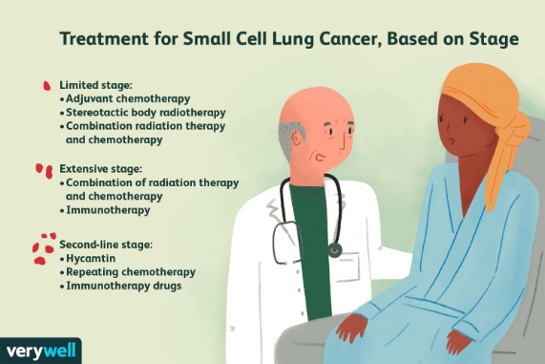
Clinical Implications of Lung Cancer Prediction
Accurate lung cancer prediction models can have significant clinical implications. Early detection enables timely interventions, improving treatment outcomes and patient prognosis. Predictive tools can also guide personalized screening strategies, optimizing resource allocation and minimizing unnecessary procedures.
Furthermore, risk prediction models can inform shared decision-making between patients and clinicians, empowering individuals to make more informed choices about their healthcare. Integrating these models into clinical practice has the potential to transform lung cancer management and enhance patient-centered care.

Slide 8





Proposed Workflow
Gather Data
1
Collect comprehensive lung cancer patient data from multiple sources.
Preprocess Data
2
Clean, integrate, and transform the data into a format suitable for analysis.
Feature Engineering
3
Identify and extract the most relevant features from the data to drive predictive accuracy.
Model Development
4
Train and optimize machine learning models to predict lung cancer risk and outcomes.
5
Deployment
Integrate the model into a clinical decision support system for real-world application.
.

Slide 9




Implementation
Coding the Solution
Deployment
Testing and Validation
User Interface
Package the solution for easy deployment in clinical settings, ensuring seamless integration with existing healthcare infrastructure.
Design an intuitive and user-friendly interface that allows clinicians to easily input patient data and interpret the lung cancer prediction results.
Translate the machine learning models into functional code, integrating them into a comprehensive lung cancer prediction system.
Rigorously test the system using diverse datasets to validate its performance and ensure it meets clinical standards.

Slide 10
Conclusion and Future Directions
Improved Accuracy and Early Detection
Integration with Clinical Workflows
Ongoing research and development will focus on enhancing the predictive accuracy of lung cancer models, enabling earlier diagnosis and intervention for patients.
Seamless integration of lung cancer prediction tools into clinical practice will be crucial, allowing healthcare providers to make informed decisions and improve patient outcomes.
Personalized Risk Assessments
Collaborative Research Efforts
Advancements in machine learning and data analytics will enable the creation of personalized risk profiles, tailoring lung cancer prevention and screening strategies to individual patient needs.
Fostering interdisciplinary collaboration between clinicians, data scientists, and researchers will drive continuous improvements and innovations in lung cancer prediction models.

