Slide 1

Group C9
Security System with Autonomous Anomaly Detection and Response Robot
I Charuhas Reddy CB.SC.U4AIE23233
CB Harshavardhan CB.SC.U4AIE23220
C Vishnuvardhan Chowdary CB.SC.U4AIE23219
Y Bhasith Sai CB.SC.U4AIE23264

Slide 2
Problem Statement
Monitoring public spaces using multiple camera feeds is inefficient, prone to errors, and time-consuming, especially in crowded or high-risk areas.
Identifying suspicious individuals or intruders in real-time is difficult without advanced AI systems to distinguish normal behavior from anomalies.
Enabling a robot to autonomously navigate crowded or obstacle-filled environments toward a specific target is complex and requires advanced algorithms.
There is no seamless mechanism to connect surveillance systems with response units, leading to delayed or ineffective responses.

Slide 3
Objectives
To develop an autonomous security system for real-time anomaly detection using static cameras.
To deploy a robot capable of navigating to detected locations and interacting with individuals.
To analyze facial emotions for identifying suspicious behavior and triggering alerts.
To assist genuine individuals through interactive NLP-based guidance.
To integrate pathfinding and SLAM algorithms for precise robot navigation.

Slide 4
Literature Review
S.NO | Title | Description | Techniques Used | Draw Backs
1 | AI on the Road: NVIDIA Jetson Nano-Powered Computer Vision-Based System for Real-Time Pedestrian and Priority Sign Detection | The paper talks about a smart system that helps drivers by detecting pedestrians and important road signs in real time. It uses an NVIDIA Jetson Nano (a small, low-power AI device) along with two cameras and a screen to warn drivers when they need to stop or give way. | NVIDIA Jetson Nano B01 – A small AI computer used for running deep learning models. Two Cameras (CSI Cameras) – One for daytime, one for nighttime vision. YOLO for the Object detection | Low resolution (300×300) led to difficulties detecting small objects from a distance. It does not detect traffic lights, lane markings, moving vehicles, or other road signs.
2 | Smart Night Patrolling Robot using YOLOv8 | Night patrolling robot with YOLOv8 achieving 92% accuracy for "person" detection. Equipped with sound, ultrasonic, GPS, and IR sensors for activity detection. Sends alerts to security personnel via Telegram API. Offers remote monitoring through VNC connectors. | Object Detection: YOLOv8 for real-time object detection. GPS for location tracking, sound sensors for hazard detection, and IR/ultrasonic sensors for obstacle avoidance. Emergency Alerts: Sends real-time notifications via Telegram API. Navigation: Uses sensor-based obstacle avoidance and pathfinding. | Reliance on Internet Connectivity: Failure of Telegram API or Wi-Fi results in notification breakdown. Environmental Limitations: Primarily suitable for low-light indoor environments. Moderate Recall Performance: Precision is 60.7%, but recall is only 24.7%, limiting the reliability of detection.

Slide 5
3. | The Design and Fabrication of Smart Surveillance Robot" | This project discusses the fabrication of a smart surveillance robot with IoT capabilities. It uses a Raspberry Pi 4 for processing and incorporates motion detection, object tracking with Kalman filters. Motion detection is implemented via PIR sensors, and the robot is designed for rough terrains using a rugged chassis. | Motion Detection: Background subtraction and PIR sensors. Face Recognition: Dlib library with pre-trained face recognition models. Object Tracking: Kalman filter for tracking moving objects in video frames. Storage and Alerts: Images and videos stored on an FTP server, with email alerts for intrusions. | Internet Dependency: Requires stable internet for remote monitoring and alerts. Environmental Constraints: Although rugged, it’s limited in dynamic outdoor applications.
4. | A Raspberry Pi Based Smart Security Patrol Robot | This paper discusses a mobile patrolling robot designed for security applications. It is equipped with sound sensors to detect disturbances, a Pi Camera for live video streaming, and a GPS module for location tracking. The robot operates autonomously, using Raspberry Pi as the main processor and Python for coding. It alerts users via email with live footage and GPS coordinates. | Motion Detection: Triggered using four sound sensors Path Planning: A predefined algorithm is implemented to navigate toward the source of sound using Raspberry Pi and L293D motor drivers. GPS Tracking: The Neo-6 AGPS Receiver provides precise location coordinates. | Limited detection capabilities (relying solely on sound sensors). Navigation is limited to predefined paths, leading to potential blind spots.

Slide 6
5. | An Anomaly Detection System via Moving Surveillance Robots with Human Collaboration | This presents an autonomous anomaly detection system that utilizes mobile surveillance robots to monitor target areas. The system aims to overcome the limitations of stationary CCTV cameras, which require a large number of installations to cover wide areas. | Siamese Neural Network (SiamNet) for Anomaly Detection Geo-tagging for Efficient Image Retrieval Human Collaboration for Continual Learning | Dependence on Human Collaboration Initial Normalcy Database Setup
6. | Robotic Monitoring Enhancement with Deep Learning and Conformal Prediction for Indoor Anomaly Detection in Emergency Situations | It presents a novel approach for robotic emergency monitoring in indoor environments such as offices, homes, and schools. The system integrates deep learning (YOLOv5) for real-time object detection with conformal prediction, which enhances the reliability of anomaly detection by quantifying the confidence of each prediction. | YOLOv5s for Object Detection Human Activity Recognition for Emergency Response Human Activity Recognition for Emergency Response | Limited Real-World Testing The study is primarily based on simulations in the Gazebo environment.

Slide 7
7. | Video Surveillance Anomaly Detection: A Review on Deep Learning Benchmarks | It provides a comprehensive review of state-of-the-art (SOTA) deep learning (DL) techniques used for Video Surveillance Anomaly Detection (VSAD). It discusses the transition from classical machine learning methods to deep learning-based approaches for anomaly detection in surveillance footage. | 2D-CNN: Extracts spatial features (e.g., MobileNet, EfficientNet). 3D-CNN: Captures both spatial and temporal features for action recognition. CNN-LSTM: Combines CNN for spatial feature extraction and LSTM for temporal dependencies. | This project is exclusively for the day time as there are no night vision cameras for the night surveillance Lack of multi-view data limits effectiveness in large-scale surveillance networks.
8. | Anomaly Detection and Cognizant Path Planning for Surveillance Operations using Aerial Robots | It presents an unsupervised anomaly detection and autonomous path planning system for aerial surveillance using drones. The system enables aerial robots to detect anomalies, map their locations, and plan optimal paths for further investigation. | Pretrained AlexNet CNN extracts image features for anomaly detection. A one-class Support Vector Machine (SVM) is trained on "normal" images. Bayesian filtering is used to reduce false positives and improve anomaly localization. | AlexNet feature extraction takes 500ms per frame, which may be too slow for real-time drone operations. No Infrared or Night Vision Capability

Slide 8
Research Gap
Used only YOLOv8 alone for object detection without any behaviour analysis.
Used only like pre-defined mapping for robot navigation. No dynamic solution like using SLAM is used.
Only dependent on the webcams on the robot for the surveillance, which makes the functionality only suitable for indoor environment.
Most of them sent alerts only via a particular streams such as Emails and telegram, where internet should be mandatory.

Slide 9
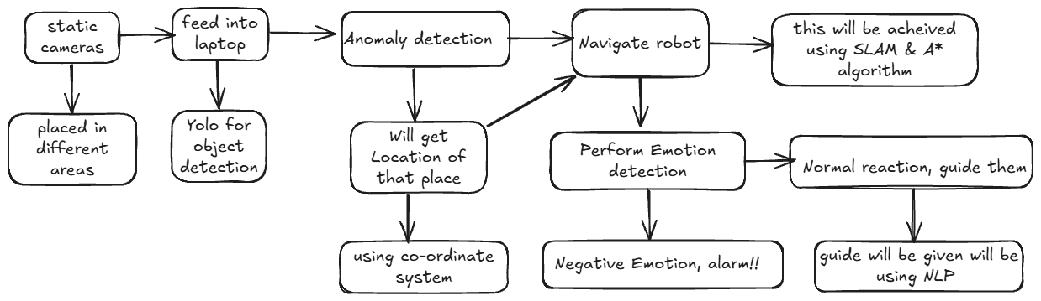
Methodology

Slide 10
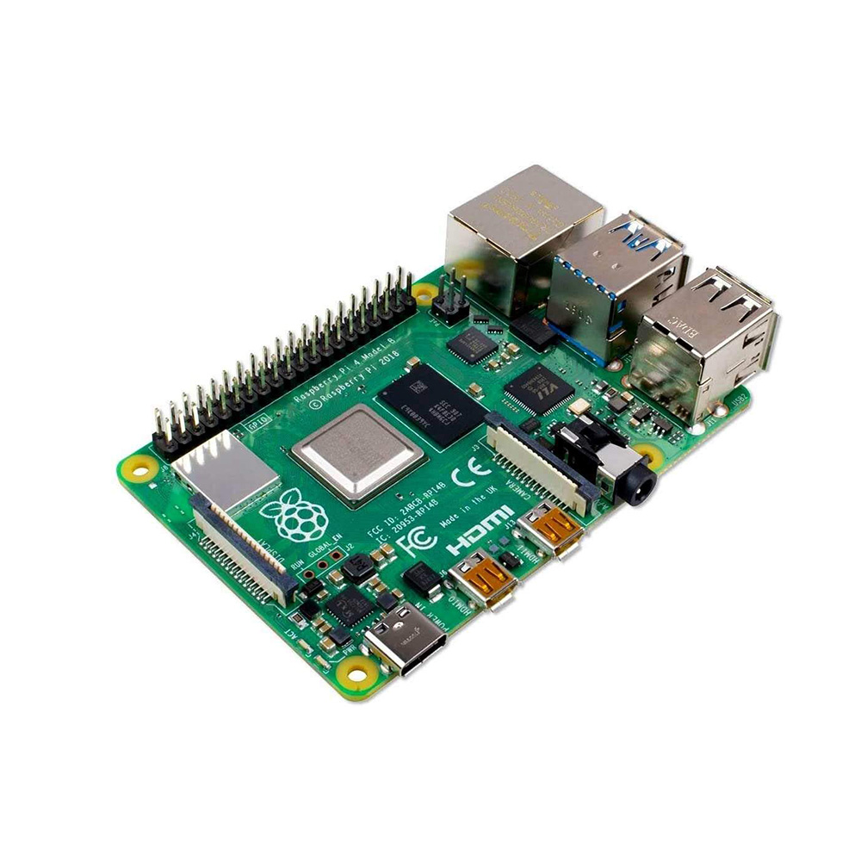
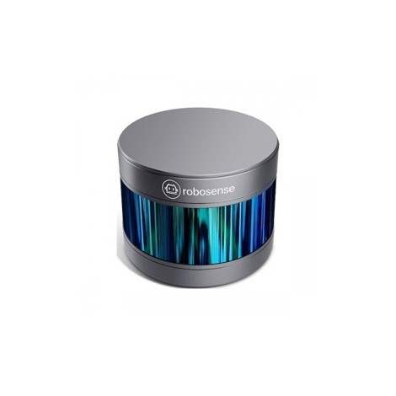
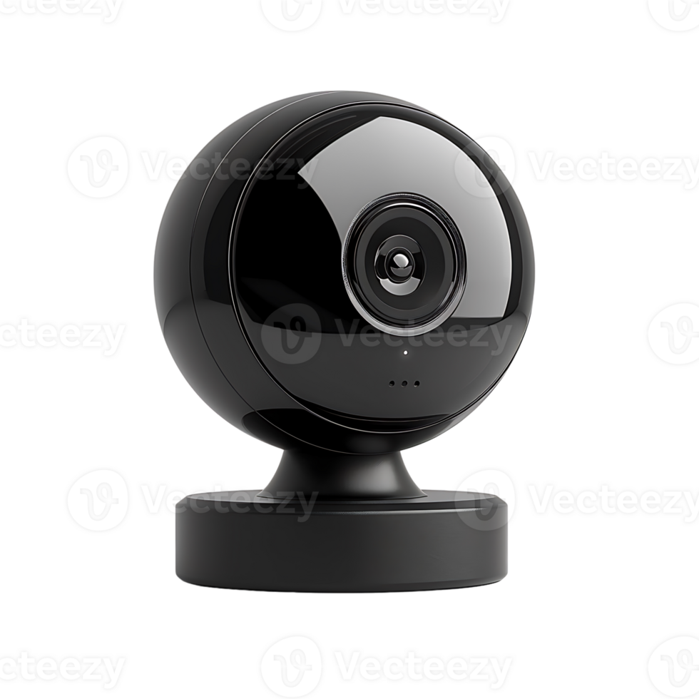
Hardware Requirements
Web Cameras
Raspberry Pi
Lidar sensors

Slide 11
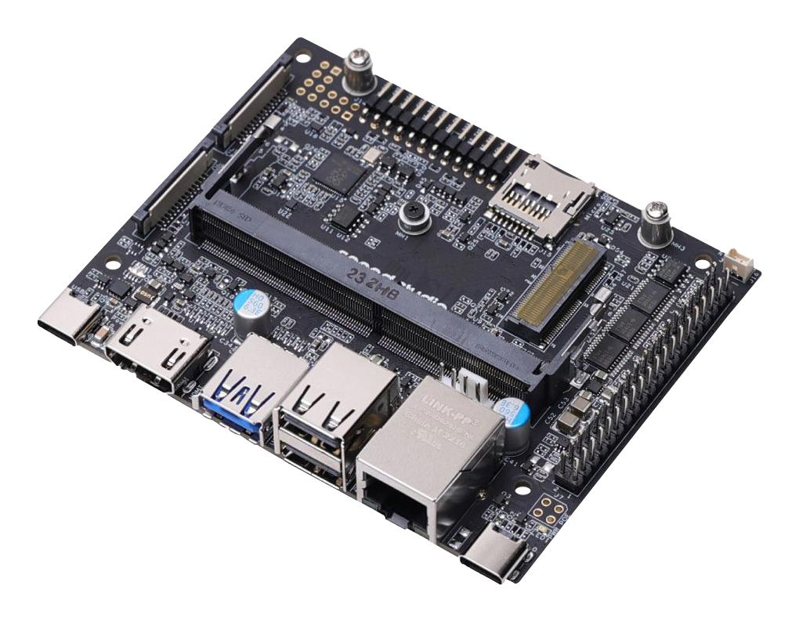
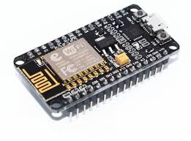
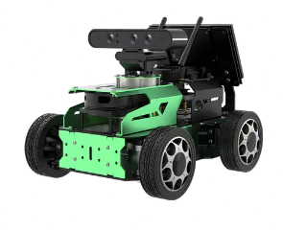
Wifi Module
Surveillance Robot
Jetson Nano

Slide 12
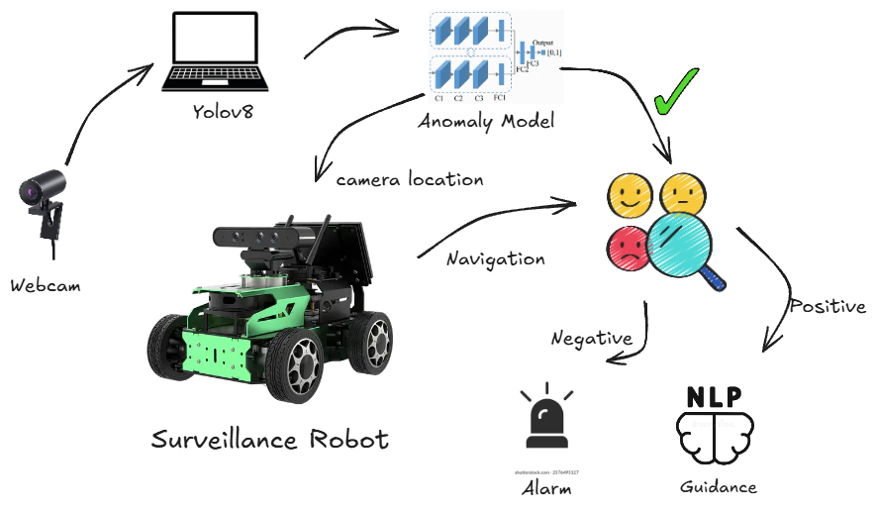
System Architecture

Slide 13
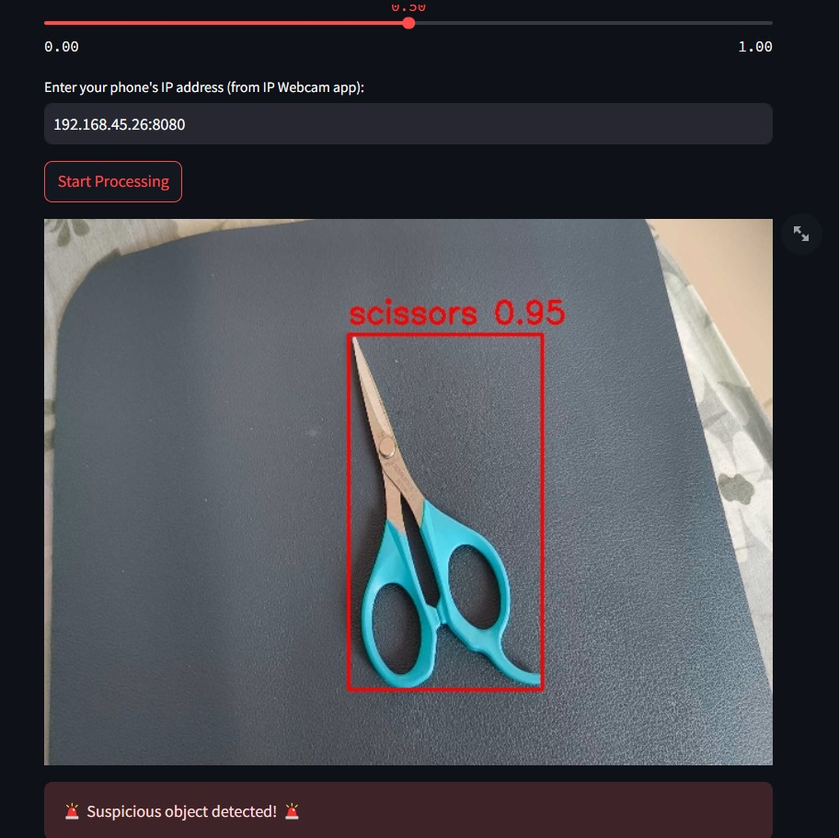
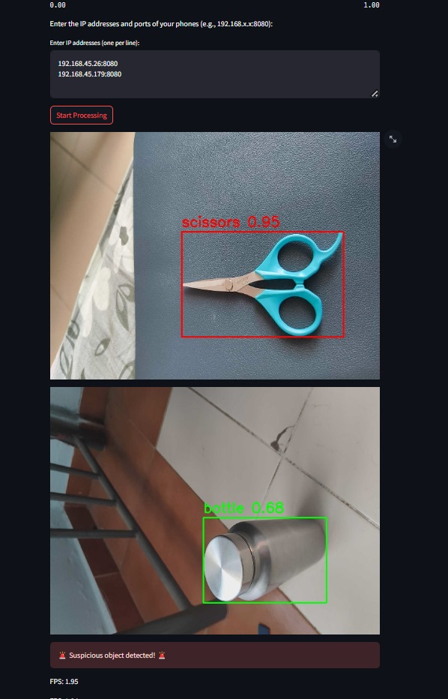
Real-Time Yolo Detection
Using single cam
Using multiple cams

Slide 14
Software Requirements
For Object Detection:-
Yolov8 from Ultralytics
For Navigation of Robot:-
SLAM integrated within Jetpack SDK
For Pathfinding:-
Using A* Algorithm
For Guidance:-
NLP pre-trained models like spacy

Slide 15
A* Algorithm for the Optimal Path-finding
On a map with many obstacles, pathfinding from points A to B can be difficult. A robot, without getting much other direction, will continue until it encounters an obstacle, as in the path-finding.
A* (A-Star) is a graph traversal and path search algorithm that finds the optimal path from a start node to a goal node in a weighted graph
f(n) = g(n) + h(n)
f(n) = total estimated cost of the path through node n
g(n) = actual cost from the start node to n
h(n) = heuristic estimate of the cost from n to the goal

Slide 16
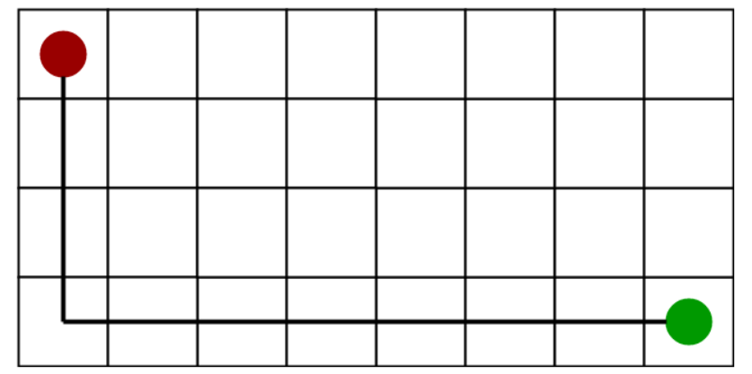
Heuristics
Using a good heuristic is important in determining the performance of A*
We want to be able to select a function h(n) that is less than the cost of reaching our goal.
This method of computing h(n) is called the Manhattan method because it is computed by calculating the total number of squares moved horizontally and vertically to reach the target square from the current square. We ignore diagonal movement and any obstacles that might be in the way.

Slide 17
A* algorithm introduces a heuristic into a regular graph-searching algorithm, essentially planning ahead at each step so a more optimal decision is made.
In the grid above, A* algorithm begins at the start node, and considers all adjacent cells.
Once the list of adjacent cells has been populated, it filters out those which are inaccessible (walls, obstacles, out of bounds).
It then picks the cell with the lowest cost, which is the estimated f(n).
This process is recursively repeated until the shortest path has been found to the target node.

Slide 18


Long Short Term Memory(LSTM)
Definition: LSTMs are advanced RNNs designed to capture long-term dependencies in sequential data.
Difficulty in Capturing Long-Term Dependencies: RNNs often struggle to retain information over long sequences, making it challenging to reference data from earlier time steps when predicting current outputs.
LSTM Architecture:
Forget Gate: Determines which information from the previous cell state should be discarded.
Input Gate: Decides which new information to store in the cell state.
Cell State: Updates the cell state by combining the previous state and the candidate values.
Output Gate: Controls the output based on the cell state.
Dimensionality Constraint: Traditional LSTMs are designed for one-dimensional data, but video frames are two-dimensional, so LSTMs alone may not effectively analyze them.

Slide 19
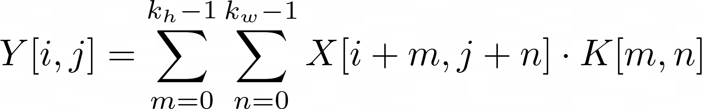
Convolutional Neural Network(CNN)
Convolutional Neural Networks (CNNs) are specialized neural networks designed to process grid-like data structures, such as images.
Key Components of CNNs:
Convolutional Layer: Applies a set of learnable filters (kernels) to the input data to extract local features.
Activation Function: Introduces non-linearity into the model, enabling it to learn complex patterns.
ReLU(x)=max(0,x)
Pooling: Pooling reduces the size of the feature map by summarizing values in a region, typically using the maximum or the average.
Temporal Dependency Handling: While CNNs excel at capturing spatial features, they are not inherently equipped to model temporal dependencies in sequential data, such as video frames.

Slide 20

Convolution LSTM
Purpose: ConvLSTM is designed to process spatiotemporal data by combining convolutional operations with LSTM’s gating mechanisms.
Key Idea: Unlike standard LSTMs (which use matrix multiplications), ConvLSTM replaces these with convolution operations to preserve spatial structure.
Forget Gate: Decides what information to discard from the previous cell state.
Input Gate & Candidate Cell State: Controls the addition of new information to the cell state.
Cell State: Updates the cell state by combining the previous state and the candidate values.
Output Gate & Hidden State: Determines the output based on the updated cell state.

Slide 21
ConvLSTM in our Project
Spatiotemporal Analysis: ConvLSTM processes video frames over time, capturing movement and behavior patterns.
Anomaly Detection: Learns normal street activities and flags deviations as potential anomalies.
YOLO Integration: Works alongside YOLO to track object dynamics across frames for enhanced detection.
Real-Time Alerts: Enables the robot to quickly identify unusual activities and trigger alerts.
Robust Performance: Adapts to varying conditions, ensuring reliable surveillance in diverse environments.

Slide 22
Time Line
Phase | Tasks | Time line
Phase 1: System Design and Setup | Finalize hardware and software components (cameras, Raspberry Pi, LIDAR, motors, etc.). Prepare software stack for anomaly detection (e.g., YOLOv8 setup with TensorFlow). | Week 1 - Week 2
Phase 2: Anomaly Detection and Alert System | Train YOLOv8 for object detection and integrate behaviour analysis for anomaly detection. Implement real-time camera feed processing with OpenCV. Build the alert system to notify via multiple channels (SMS, email, and alarms). | Week 3 - Week 4
Phase 3: Robot Navigation and SLAM Integration | Implement SLAM for real-time mapping and localization using LIDAR or ultrasonic sensors. Develop path-planning algorithms (A* or Dijkstra) for autonomous navigation. Test robot movement in a controlled environment. | Week 5 - Week 6
Phase 4: System Integration | Integrate the anomaly detection system, robot navigation, and alert mechanisms into a unified system. Conduct end-to-end testing in a simulated environment with dynamic obstacles. | Week 7 - Week 8

Slide 23
Thank you

