Slide 1

Vel Tech Rangarajan Dr. Sagunthala R&D Institute of Science and Technology
School of Computing
Department of Computer Science and Engineering
10211CS224 / FULL STACK APPLICATION DEVELOPMENT (JAVA)
PROJECT REVIEW : MILESTONE PROJECT – 1
Date: 03-03-2026
SUBSCRIPTION-BASED MEMBERSHIP ENGINE WITH TIERED LOGIC
SDG: SDG No – SDG Title(Example: SDG 4 – Quality Education)
Presented By:
B.Vishnu vardhan– VTU24685 – Reg.No:23UECS1020
Courses Handling Faculty:
Dr.HAFIZUR RAHMAN
(TTS3985)

Slide 2
INTRODUCTION
Background of the problem : Many universities manage student memberships manually, making it difficult to track subscription status and expiry dates. Manual systems can lead to errors and delays in updating records. Students and administrators may not get accurate information on time. Therefore, a digital system is needed to improve efficiency and accuracy.
Why this project is important : This project automates the membership management process and reduces manual work. It ensures secure storage of student data in a database. The system provides role-based access for students and administrators. It improves transparency and overall efficiency.
Real-world relevance : Subscription systems are widely used in educational institutions and online platforms. Organizations require automated solutions to manage users and renewals. This project reflects real-world web application practices. It helps in understanding practical implementation of secure systems.
Brief overview of the system : The portal is a web-based application built using PHP and MySQL. Students can register, select plans, and view expiry details. Administrators can manage users and extend subscriptions. The system ensures secure login and efficient data handling.
1
2
3
4
5
6
7
8
9

Slide 3
PROBLEM STATEMENT
Problem Statement : In many educational institutions, student membership and subscription services are managed manually or through basic record-keeping systems such as spreadsheets and paper documents. This traditional approach leads to issues like data redundancy, difficulty in tracking subscription expiry dates, delayed updates, and errors in maintaining student records. Administrators may find it challenging to manage multiple membership plans efficiently, and students may not have clear visibility of their subscription status. There is a need for a centralized, automated, and secure system to simplify membership management and improve accuracy.
Solution : To address these challenges, the Student Membership Subscription Portal is proposed as a web-based system that automates the entire membership registration and management process. The portal provides a centralized platform where students can register, select subscription plans, and monitor their membership validity online. Administrators can manage users, update plans, and extend subscription periods efficiently. The system securely stores all data in a MySQL database, reduces manual workload, ensures accurate record maintenance, and provides real-time access to membership information. This solution improves efficiency, transparency, security, and overall institutional management.
1
2
3
4
5
6
7
8
9

Slide 4
OBJECTIVE(S)
To Design and Develop : A centralized web-based Student Membership Subscription Portal to manage student registrations and subscription plans efficiently with real-time data management.
To Implement : Secure student registration, login authentication, and admin subscription management using PHP and MySQL.
To Improve : System efficiency and accuracy by reducing manual paperwork, avoiding duplicate entries, and automating membership tracking.
To Evaluate : The performance of the system based on processing speed, data accuracy, secure access control, and overall user accessibility.
1
2
3
4
5
6
7
8
9

Slide 5
PROPOSED SYSTEM
Description of the Solution : The Student Membership Subscription Portal is a web-based application designed to automate and centralize student subscription management. The system allows administrators to manage student details, subscription plans, validity dates, and membership status. Students can register, log in, and subscribe to available plans through a simple and user-friendly interface. All data is securely stored in a MySQL database, enabling easy tracking, subscription extension, and real-time updates. The system ensures efficient management, reduces manual effort, and provides a structured and reliable platform for handling student memberships.
How It Solves Existing Issues: The proposed system replaces manual and unorganized subscription management with a centralized web-based platform. It eliminates paperwork, reduces duplicate records, ensures accurate data storage, and provides real-time membership updates. Administrators can easily manage subscriptions and monitor expiry dates, while students receive instant confirmation, making the entire process faster and more systematic.
Advantages Over Current Systems : Compared to traditional methods, the proposed system is more efficient, secure, and reliable. It reduces administrative workload, improves data accuracy through database validation, and allows easy management of multiple subscription plans. The portal is scalable, user-friendly, and accessible, ensuring smooth coordination between students and administrators.
1
2
3
4
5
6
7
8
9

Slide 6
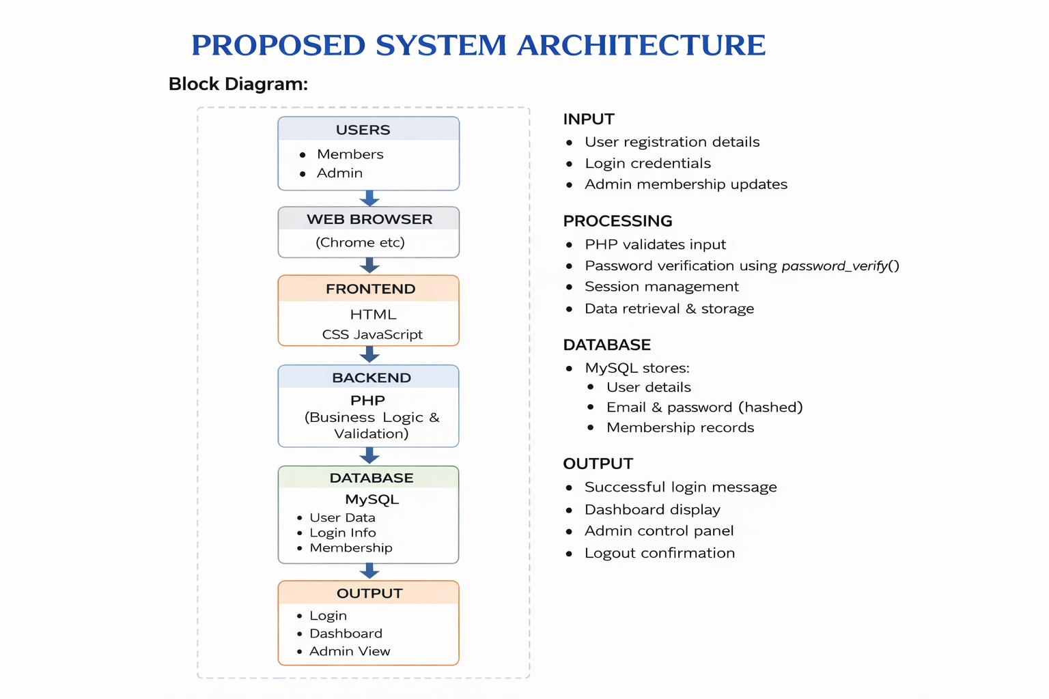
PROPOSED SYSTEM ARCHITECTURE
1
2
3
4
5
6
7
8
9

Slide 7
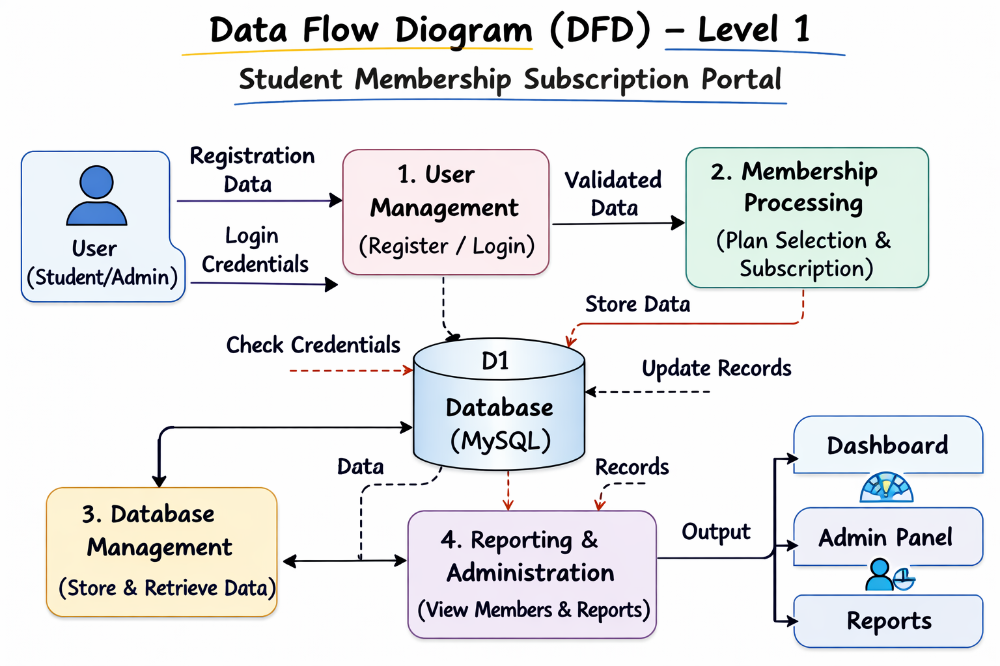
WORKFLOW
1
2
3
4
5
6
7
8
9

Slide 8
TECHNOLOGIES USED
Frontend: HTML5, CSS3, JavaScript (for designing user interface, creating responsive web pages, and performing client-side validation for registration and login forms).
Backend: PHP (for server-side processing, implementing business logic, handling form submissions, managing sessions, authenticating users, and communicating with the database).
Database: MySQL (for storing user account details, encrypted passwords, and membership records securely and efficiently).
Tools: XAMPP (Local Server environment with Apache and MySQL), Visual Studio Code (Code Editor), Web Browser such as Chrome or Edge (for testing and running the application).
Hardware/Software Requirements: Minimum 4GB RAM, Windows 10 or above, Apache Server (via XAMPP), MySQL Database, and a Modern Web Browser for accessing the system.
1
2
3
4
5
6
7
8
9

Slide 9
MODULE DESCRIPTION
Module 1: User Management
Handles user and admin registration, login, and authentication.
Manages user profiles and ensures secure access to the system through password verification and session management.
Module 2: Core Processing
Allows administrators to create, update, delete, and manage membership details such as username, email, membership status, and account information.
Ensures proper organization and control of member records within the system.
Module 3: Database Management
Manages storage and retrieval of user data, membership information, and login credentials while ensuring data integrity and security.
Prevents redundancy and supports efficient data access for system operations.
Module 4: Reporting & Analytics
This module generates detailed reports on registered members, including total users, active memberships, and user details.
It allows administrators to view, filter, and manage member records for analysis. The reporting feature helps in monitoring system usage and supports effective membership management.
1
2
3
4
5
6
7
8
9

Slide 10
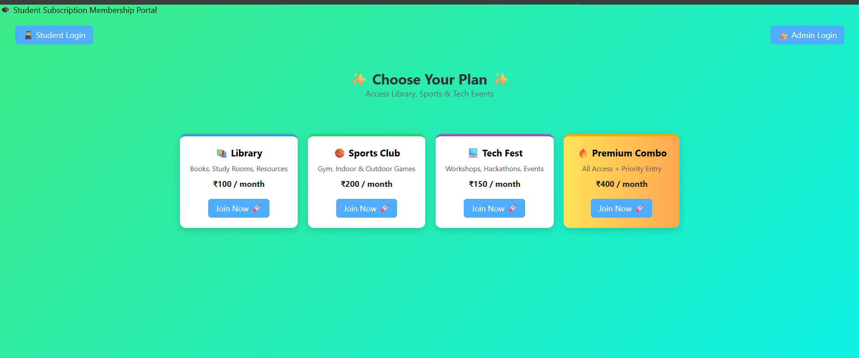
IMPLEMENTATION SCREENSHOTS
Home page : The Home Page is the main entry point of the Student Membership Subscription Portal. It provides a registration form for new users and a login option for existing users.
1
2
3
4
5
6
7
8
9

Slide 11
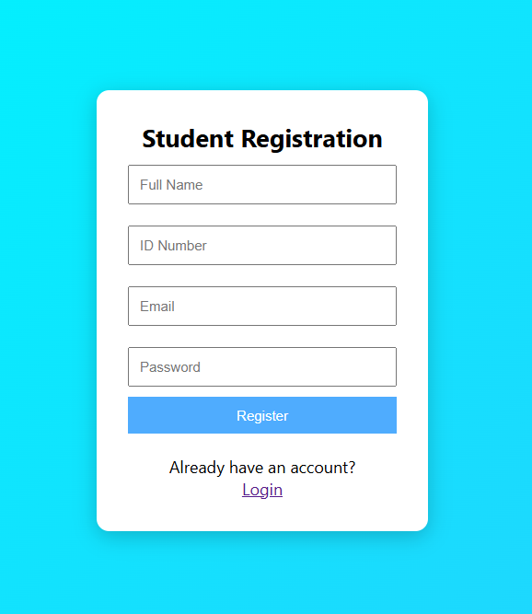
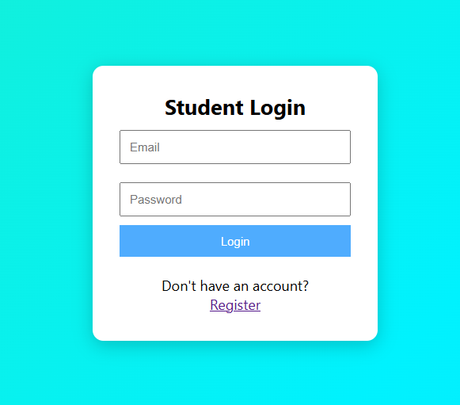
IMPLEMENTATION SCREENSHOTS
Login page : The Login Page allows registered users to enter their email and password to access their account. It verifies the credentials and redirects users to the dashboard upon successful authentication.
1
2
3
4
5
6
7
8(A)
9

Slide 12
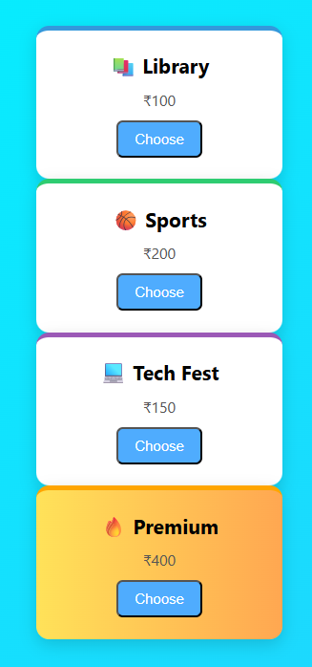
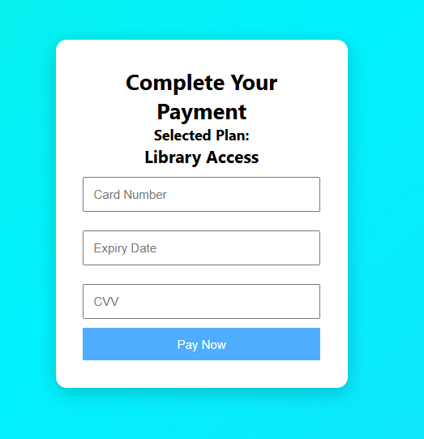
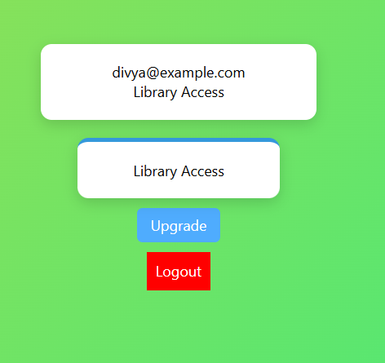
IMPLEMENTATION SCREENSHOTS
Main Module : The Dashboard provides a centralized interface for administrators to view and manage registered students and their subscription details. It displays membership status, plan validity, and allows actions such as extending subscriptions and logout.
1
2
3
4
5
6
7
8(B)
9

Slide 13
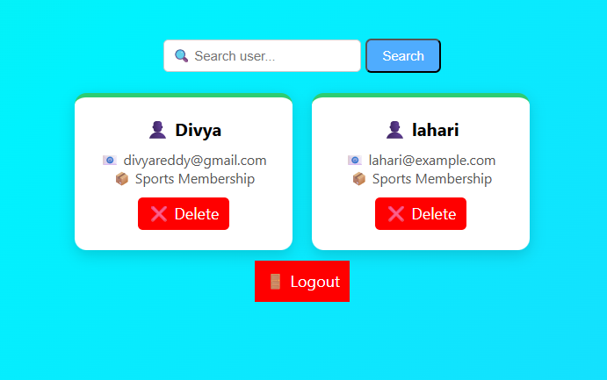
IMPLEMENTATION SCREENSHOTS
OutPage :The Output Page represents the Admin Panel of the Student Subscription Management system. It displays a structured list of registered students including their ID, Name, Email, Subscription Plan, Start Date, Expiry Date, and an option to extend the membership by 30 days. The page also provides a logout option and shows institutional details in the footer for authentication and ownership purposes.
1
2
3
4
5
6
7
8(C)
9

Slide 14
ADVANTAGES & LIMITATIONS
1
ADVANTAGES:
The Student Membership Subscription Portal reduces manual record maintenance and minimizes errors through automated form validation and secure authentication.
It provides centralized data management, real-time updates of membership status, and secure storage of user information using a MySQL database.
The system saves time for administrators, improves efficiency in managing subscriptions, and allows easy monitoring of registered members and membership validity.
LIMITATIONS:
The system depends on internet or local server availability (XAMPP) to function properly.
It may require basic technical knowledge for system maintenance, updates, and database management.
Additionally, without advanced security configurations such as HTTPS and role-based access control, the system could be vulnerable to unauthorized access if not properly secured.
2
3
4
5
6
7
8
9

Slide 15
Thank you

