Slide 1

Team 3
CSYE6200: Concepts Of Object-Oriented Programming
Project Title: ​Library Management System
Gowri Mahadimane Govardhana
Khushi Prakash Gowda
Vishnuvardhan Chennavaram
Niharika Vittal
Rishika Reddy Kotha

Slide 2
Overview
Problem Statement
Flow Diagram
Tech Stack
Implementation and Methodology
Concepts Used
Project Output
Learning Outcomes
Individual Contributions

Slide 3
Problem Statement
The primary objective is to create a Library Management System with user authentication for "Member" and "Librarian" roles. The system allows users to log in and access role-specific functionalities. This includes maintaining a library catalog, borrowing and returning books, managing user accounts, and performing administrative tasks for librarians. The application also provides features for users to register new accounts, track book availability, and manage borrowed items. It employs CSV files for storing user data and follows the Model-View-Controller (MVC) design pattern to separate concerns and improve code maintainability.

Slide 4
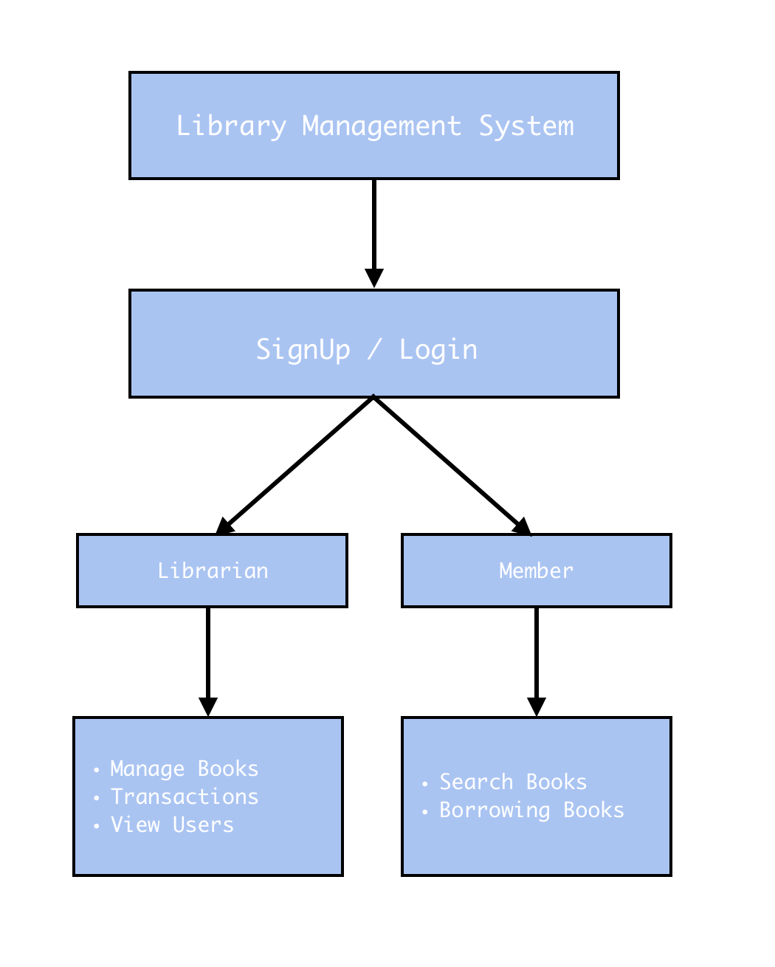
Flow Diagram

Slide 5

Tech-stack
Programming languages: Java.
Tools: Eclipse IDE, NetBeans. IntelliJ Idea and GitHub.
Front-end: Java Swing.
Data storage: CSV files.

Slide 6
Implementation and Methodology
The project’s structure is mainly concentrated on developing using MVC pattern.
In Models, the classes for Books, Users and Borrow were created.
In Views, the main GUI components are built using Java Swing for sign-up, login, user and member panels.
The Controller represents the object storing components such as Array lists and Hash maps, These controller classes can be used for developing API’s when moving into a database. .
The GUI part shows the Login and registration page, and different pages based on the role of the user such as Member and Librarian.
The products and their details are seeded to the application through CSV files by using the file handling operations and functionalities in java and This is defined in a separate Utils package.

Slide 7
Concepts Used
Java classes (BookController, Books, AddBookPanel, etc.,) to organize logical components of the program
CSV File Handling (BufferedReader, FileReader, etc.,) reading from and writing CSV files
Java Collections (ArrayList, List, LinkedHashMap, etc.,) for data storage and manipulation
JPanel: Used for creating user creating user interfaces
Stream API: JButton, JTextField, JLabel, JOptionPane, CardLayout, etc., are used to build the user interface
Encapsulation: In classes with the use of private fileds and public methods
Data Validation: To ensure if all information fields are filled
Lambdas: Define inline implementation for sorting and filtering operations

Slide 8
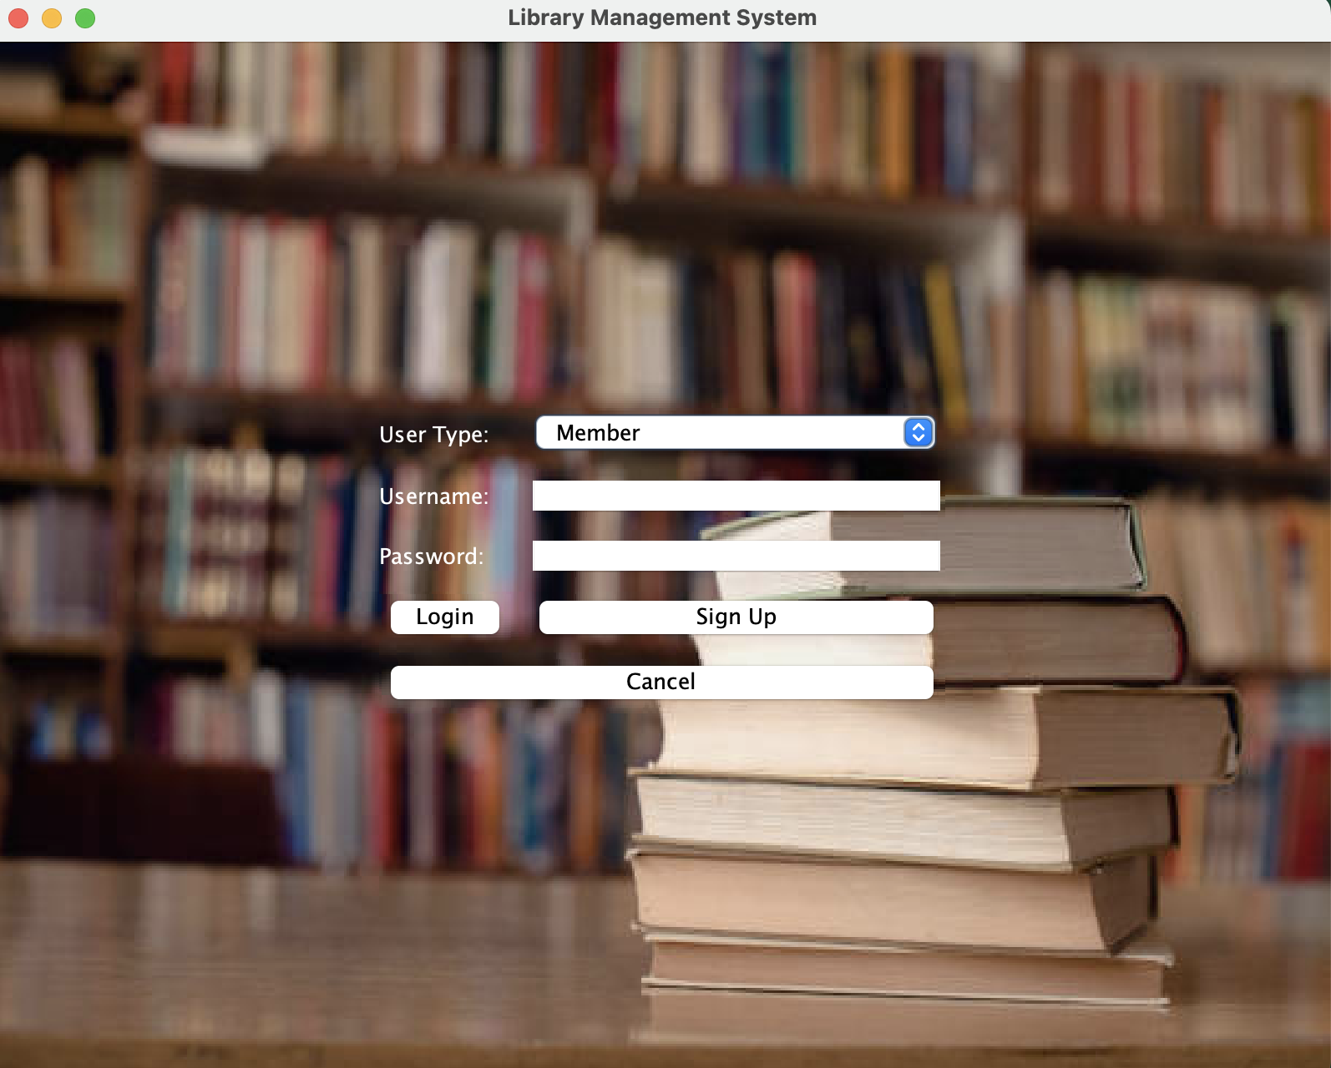
Home Page

Slide 9
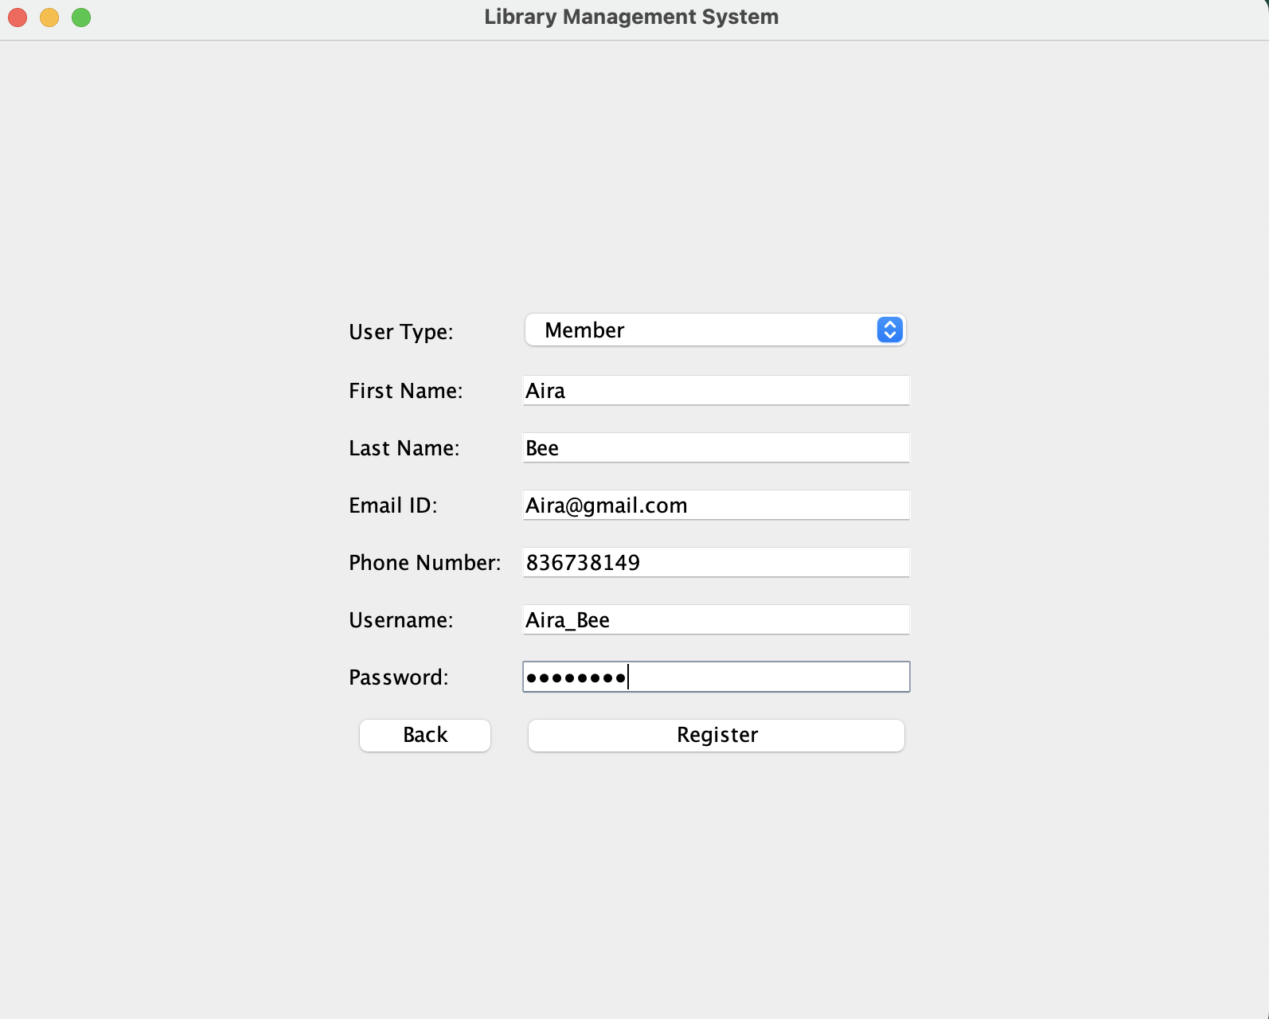
Registration Page

Slide 10
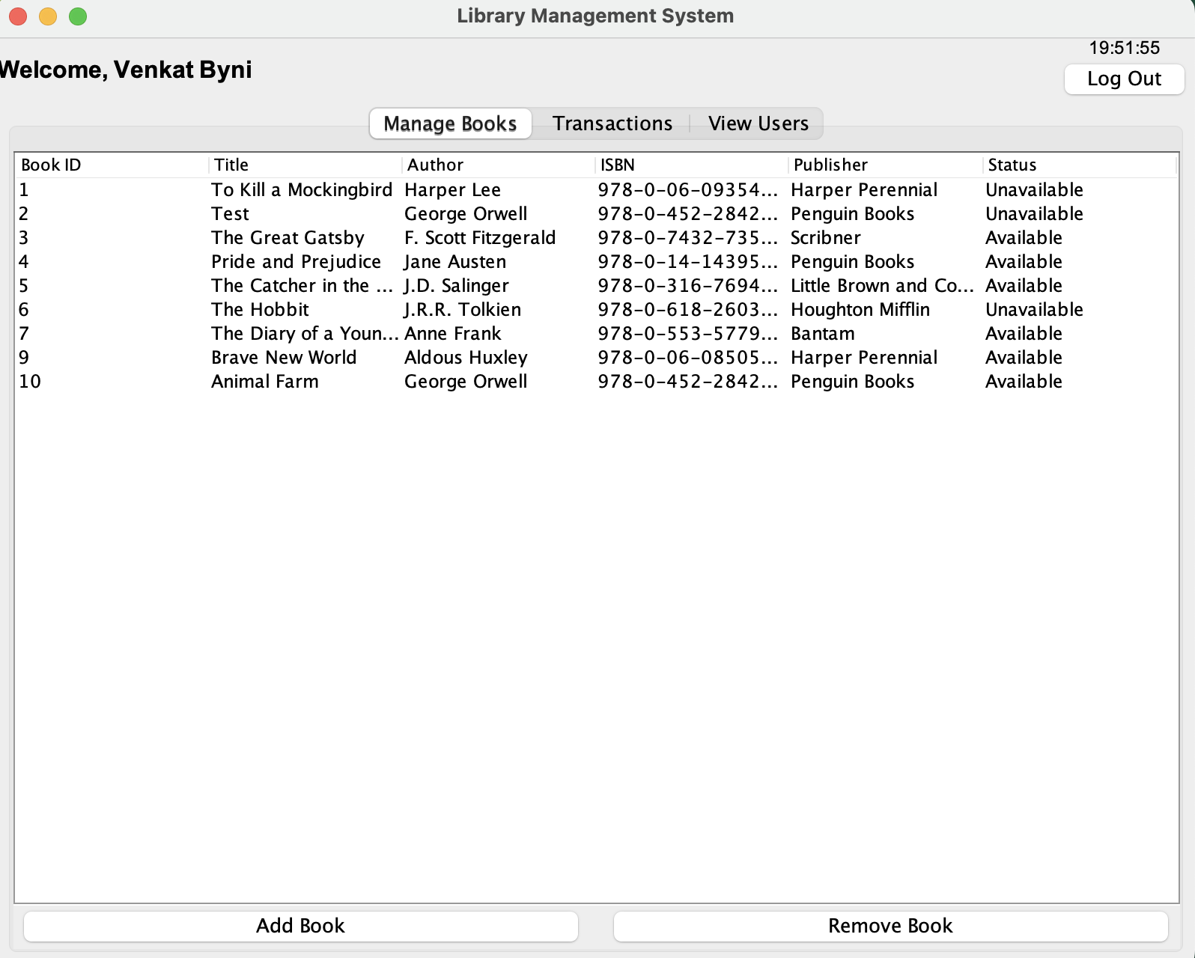
Librarian UI

Slide 11
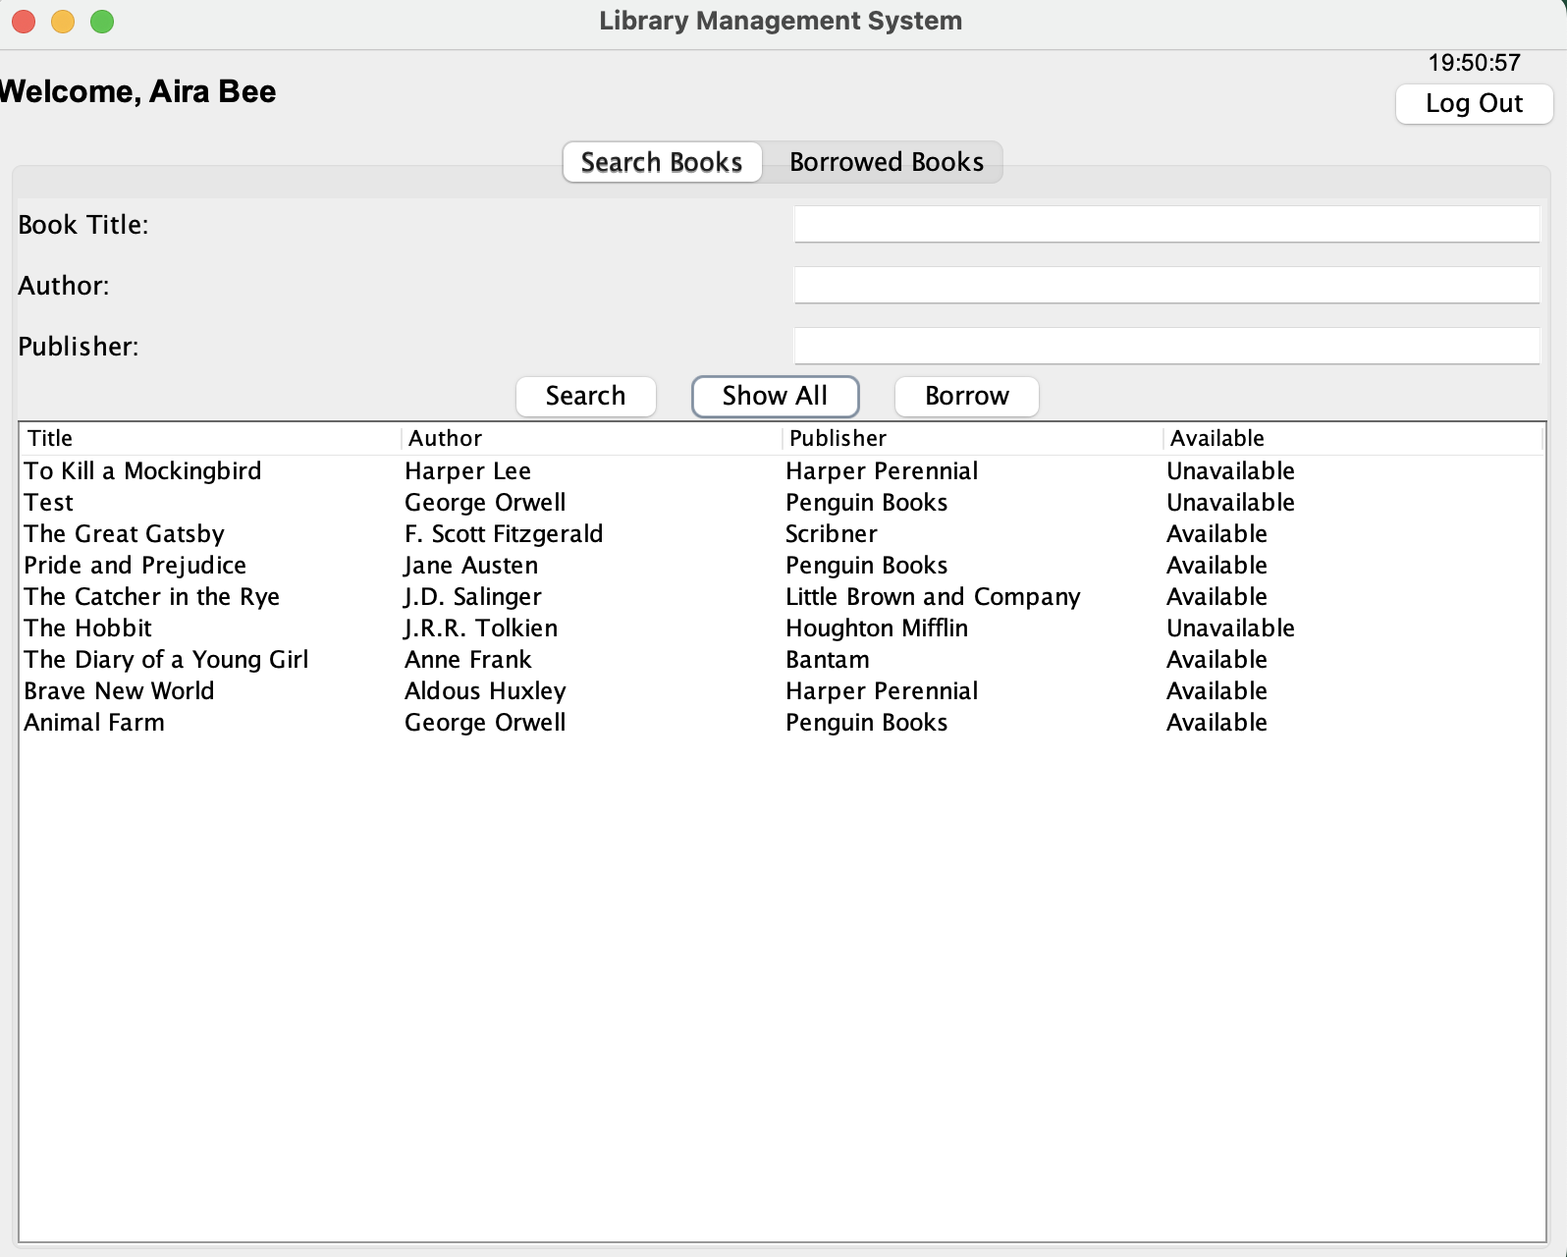
Member UI

Slide 12
Learning Outcomes
Able to understand different Design patterns and MVC architecture along with different object-oriented principles.
Development of a GUI using Java Swing for the library management system.
Handling different exceptions that could occur in the Backend part.
Understanding Java’s File Handling functionalities.
Understanding Entities and their relationship.

Slide 13
Individual Contribution
Gowri Mahadimane Govardhana
→ GUI for Librarian Domain using swing, Controllers
Khushi Prakash Gowda
→ GUI for Member Domain using swing, Validations
Vishnuvardhan Chennavaram
→ GUI for Signup using swing, GUI for Login using swing
Niharika Vittal
→ MVC architecture and modules for Library Domain, Modules for Librarian and Member Domain
Rishika Reddy Kotha
→ Integration of CSV file data using file handling, and exception handling

Slide 14
Thank you !

