Slide 1
Data Analysis on Epidemic Diseases
Team:
Vishnu Vardhan Reddy Manne
Vandith Thotla
Sai Haneesh Tanneru
Sai Jaswanth Gattidi

Slide 2
Table of Contents
Project Introduction
Problems Tackled/Data Analyzed
Motivation/Background
Implementation Environment
Visualization Outputs
To Do List

Slide 3
Project Introduction:
Analyzing the data on epidemic diseases such as Covid-19 and Ebola.
Analysis includes parameters such as death count and confirmed cases.
Obtained the datasets from Kaggle.com.

Slide 4
Problem Tackled/ Data Analyzed:
For Covid-19 we need to keep changing the data set as the data keeps updating.
Many obtained data sets for Covid-19 had data only till February 22.
The datasets we have chosen to do the analysis contains null values so we have to perform exploratory data analysis(EDA) on all the datasets.

Slide 5
Motivation/Background:
This data analysis model can be used to predict and compare the past epidemic diseases with the current Covid-19 epidemic.
This will help us to identify which countries are most effected by the epidemic diseases.
This data analysis will help the public to understand the recovery rate and mortality rate.

Slide 6
Implementation Environment:
Google Colab
Python
Google Cloud

Slide 7
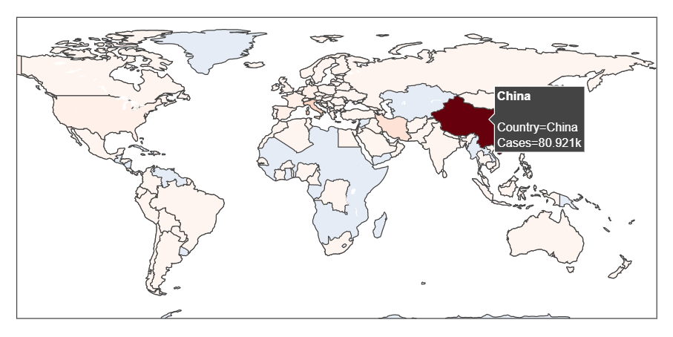
Visualization Outputs/Accomplishments:
COVID-19: Total reported Cases

Slide 8
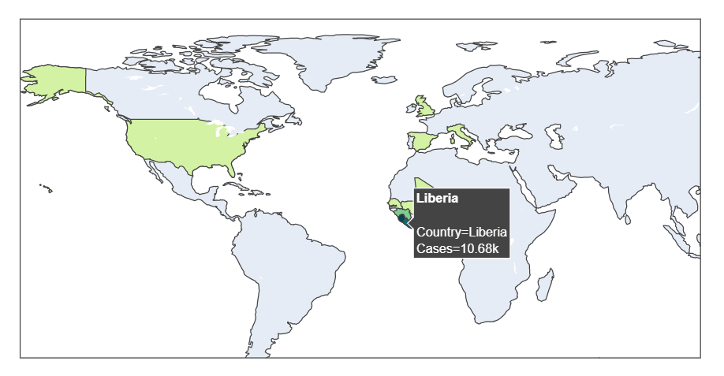
Ebola: Total reported Cases

Slide 9
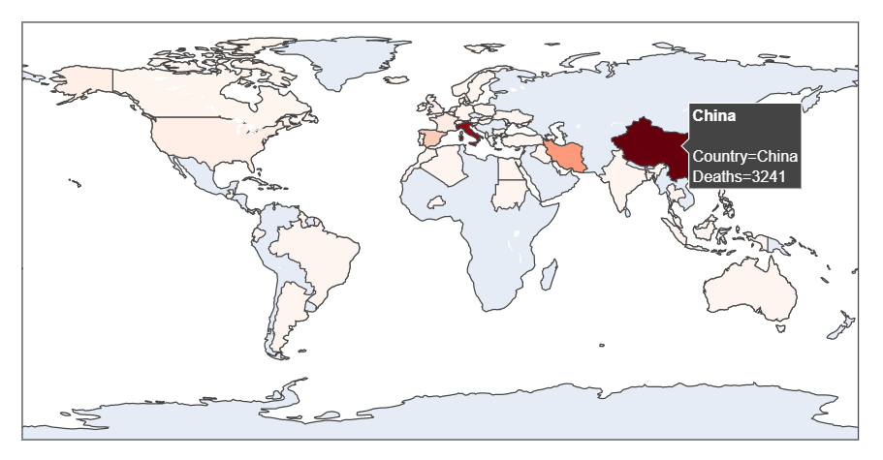
COVID-19: Total death count

Slide 10
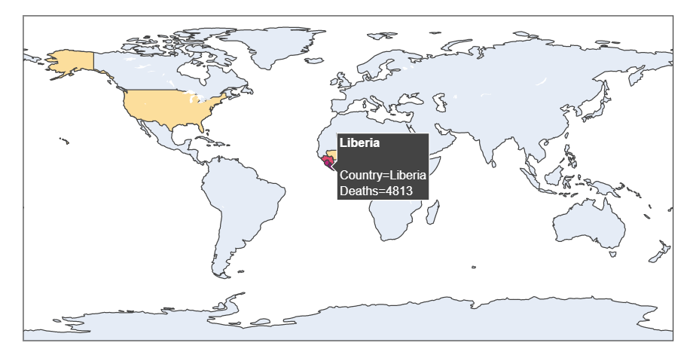
Ebola: Total death count

Slide 11
To Do List:
To collect different data sets on other epidemic diseases like Swine Flu(H1N1), Middle East Respiratory Syndrome.
To compare and visualize all the selected epidemic diseases.
To add more parameters such as recovered cases and mortality rate.
To deploy in Google cloud/Azure cloud.

Slide 12
Trello Board and Github:
Trello Board link:
https://trello.com/b/GGRdqDg3/epidemic-diseases
Github Board link:
https://github.com/vishnuvardhanmanne/Cloud_Computing

Slide 13
References:
www.Kaggle.com

Slide 14
THANK YOU

