Slide 1
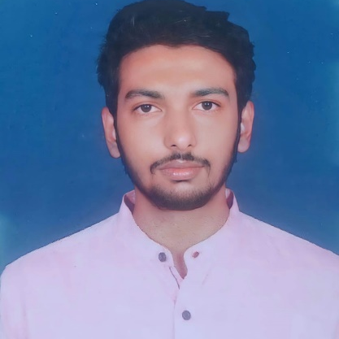

Vishnu Vardhan Reddy
Analyst/Software Engineer
Vel tech university ,B.Tech,
Computer Science & Engg: 2018-2022
Completed AZ900 certification
Skills
Mumbai
maddali-vishnuvarhhan.reddy@capgemini.com
+91 8247684176
A4
C# | Basics, OOPS, Exception Handling ,Arrays ,Collection and Generics, Delegates and Events, File Io and Serialization.
.NET Framework | ADO.NET,ASP.NET with MVC5 and WEB API,Entity Framework
Ado.net | Basics Architecture
Database | SQL
Tools | GIT
UI Technology | HTML5 ,CSS & Angular
Add On Skills | Communication Skills, Team Management, UI Designing (Sketching).
.NET Core Full Stack Developer
Understanding of RDMS concepts using Ms SQL Server.
Practical understanding of C# and SQL concepts using Visual Studio and SQL Server.
Hands on experience in developing applications using .NET Framework, ADO.NET Core, Asp.Net Core.
Understanding of HTML5 , CSS and Angular Cli.
Proficient in creating Single page Web Application in Angular with Authentication with routing.
Trained under iTransform.
Completed Azure fundamentals (AZ-900)
Online Railway Reservation System
Completed case study on Online Railway Reservation System where the users can be able to register and reserve , cancel and get the tickets sent to mail and be downloaded in pdf format where as admins can be able to add the trains, add the seats , update, delete and can view booking history of the users and the users can able to report or view the train status.
Technologies used:
ANGULAR
ASP.NET CORE
Microsoft SQL Server
Video Link : Click
GitHub Link
https://github.com/sdsameer07

