Slide 1
KATI REDDY VISHNU VARDHAN REDDY
Final Project
3/21/2024 Annual Review

Slide 2
PROJECT TITLE
Key Logger and Security
3/21/2024 Annual Review

Slide 3


AGENDA
Introduction
Problem Statement
Project Overview
End Users
Solution and Value Proposition
Demonstrations
Results
3/21/2024 Annual Review

Slide 4

PROBLEM STATEMENT
“Keyloggers pose a significant threat to
cybersecurity, leading to unauthorized
access, identity theft, and financial fraud.”
3/21/2024 Annual Review

Slide 5

PROJECT OVERVIEW
Objective
The primary objective is to develop an in-depth understanding of keyloggers, focusing on their types and the security measures necessary to prevent potential attacks.
Scope
It includes an analysis of various keylogger forms, such as inline devices, wireless interceptors, embedded systems, application-based, kernel-based, form-grabbing, and remote access trojans (RATs).
3/21/2024 Annual Review

Slide 6

WHO ARE THE END USERS?
IT and Cybersecurity Professionals
Business and Organizational Leaders
Legal and Regulatory Bodies
Educational Institutions
General Computer Users
3/21/2024 Annual Review

Slide 7

YOUR SOLUTION AND ITS VALUE PROPOSITION
Solution
Implement a multi-layered security strategy including anti-keylogging software, system scans, and user education.
Value Proposition
Enhanced Security: Reduces data breaches and identity theft.
User Awareness: Educates about keylogging threats.
Compliance: Helps meet data protection regulations.
Innovative Approach: Combines technical measures with user education.
3/21/2024 Annual Review

Slide 8

THE WOW IN YOUR SOLUTION
Real-time demonstration of keylogger functionality.
Ethical emphasis on usage and security measures.
3/21/2024 Annual Review
8

Slide 9
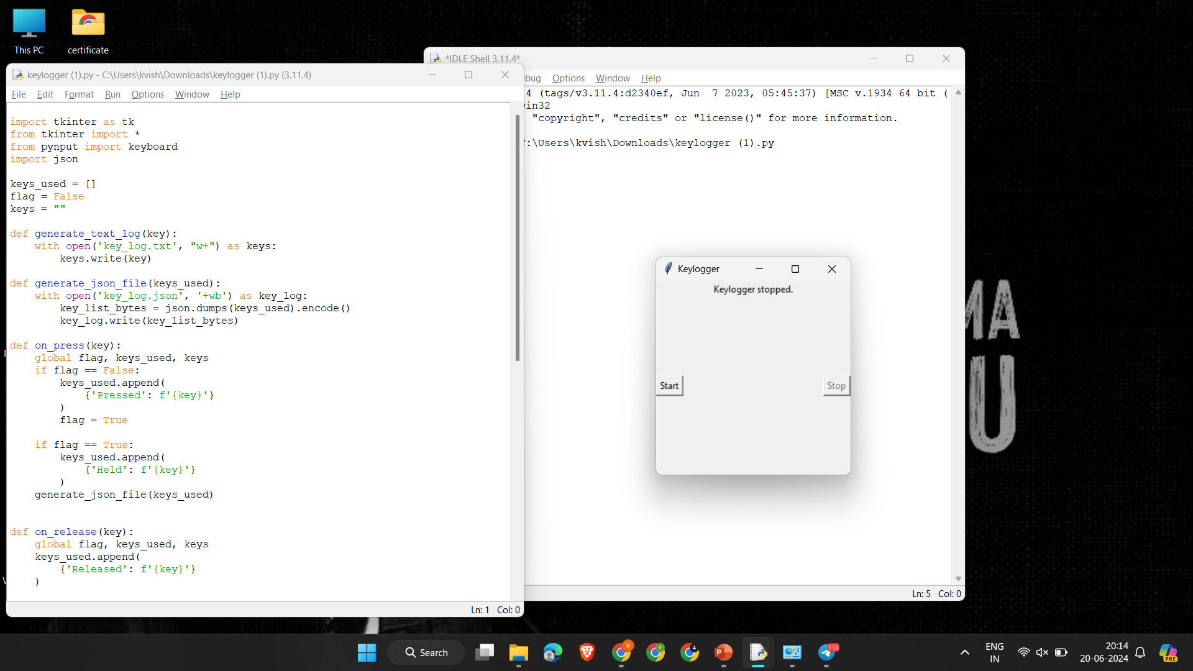
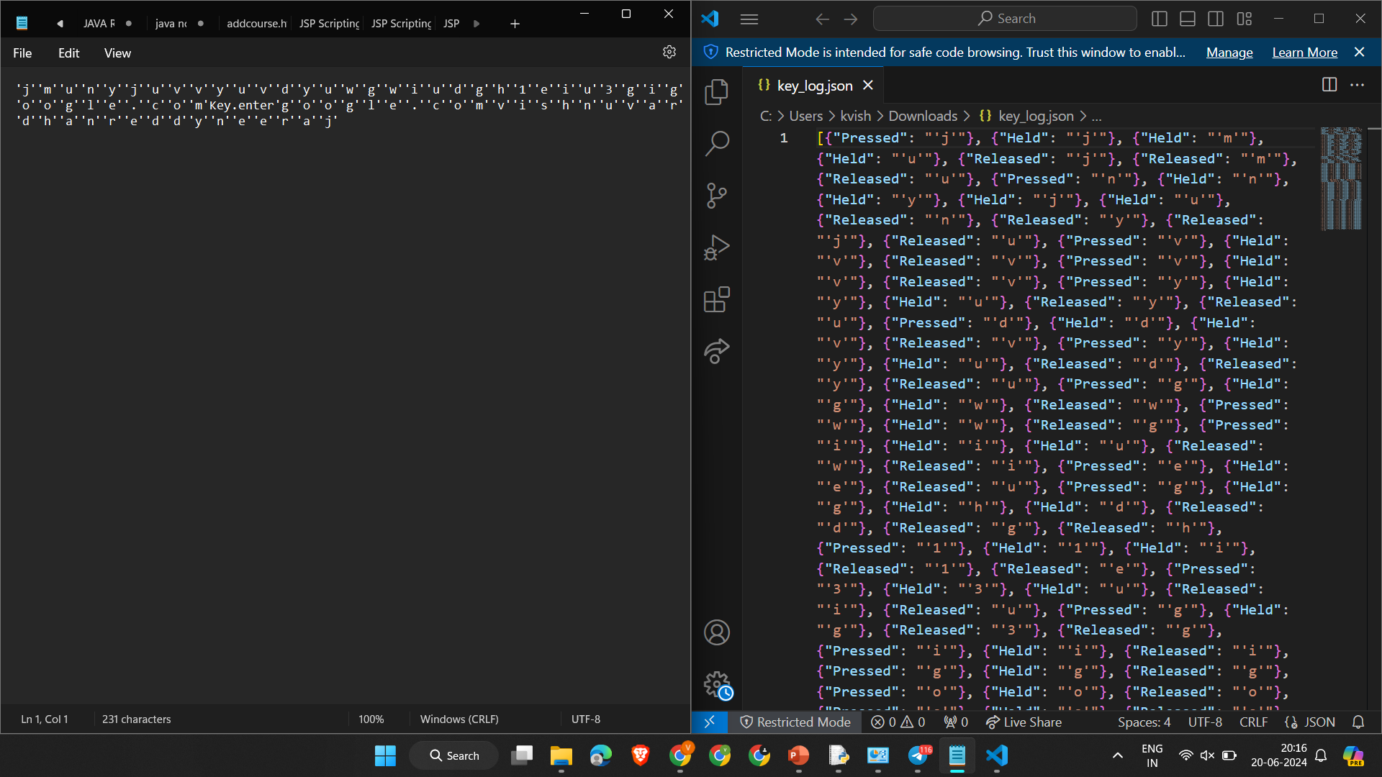
DEMONSTRATION
Teams cam add wireframes
3/21/2024 Annual Review
9

Slide 10
RESULTS
Successfully implemented keylogger capturing keystrokes in real-time.
GUI integration for user-friendly control.
Ethical considerations and security measures highlighted.
3/21/2024 Annual Review
10

Slide 11
Project Link
GitHub Link:
https://github.com/vishnuvardhanreddy48/apssdcproject.git

