Slide 1

DATA ANALYSIS ON
AMCAT Analysis

Slide 2
Problem Statement:
Analyze AMCAT test data to identify candidate performance trends, pinpoint strengths and weaknesses, and explore correlations with job success. Optimize the use of AMCAT scores in the hiring process for more effective candidate selection.
Objective of the Project:
Analyze AMCAT test data to identify candidate performance trends, pinpoint strengths and weaknesses, and explore correlations with job success. Optimize the use of AMCAT scores in the hiring process for more effective candidate selection.

Slide 3
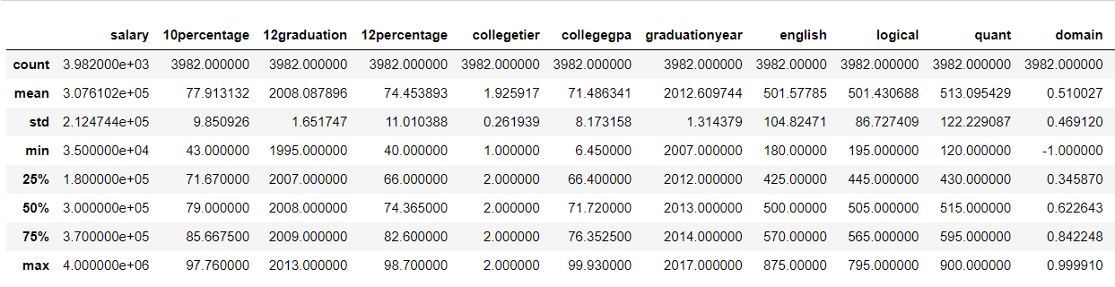
Statistical Analysis(Non-Viz) :

Slide 4
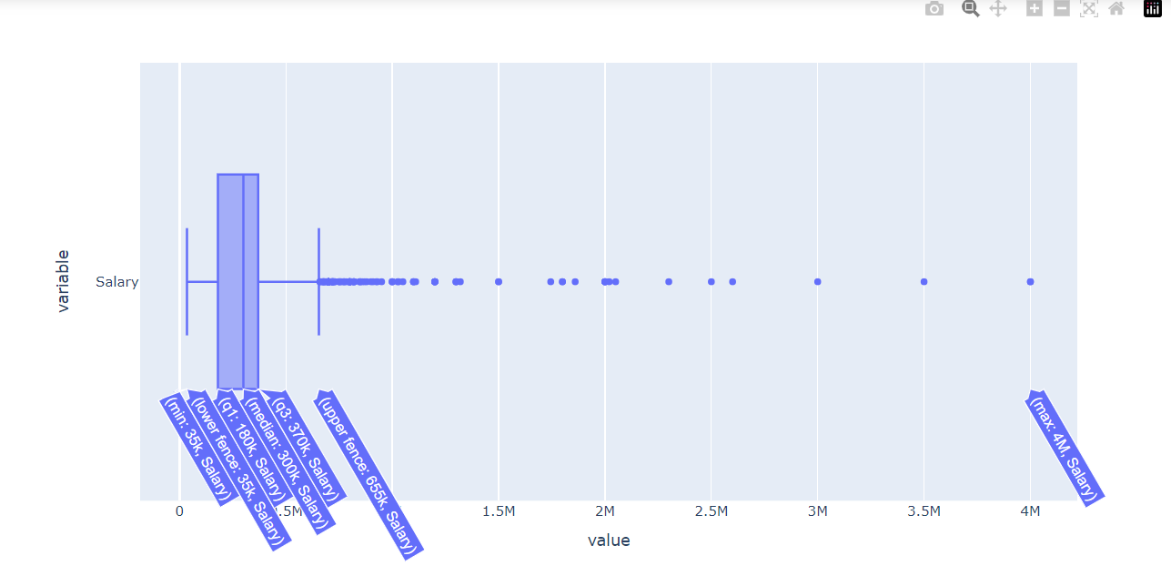
Univariate Analysis :
- Most of the salaries range between 180000 to 370000.
- The highest salary is 4000000

Slide 5
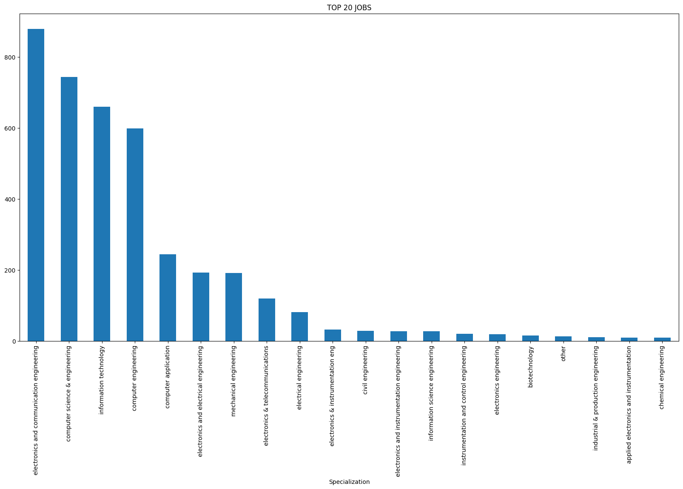
Electronics and communication engineering highest frequency.

Slide 6
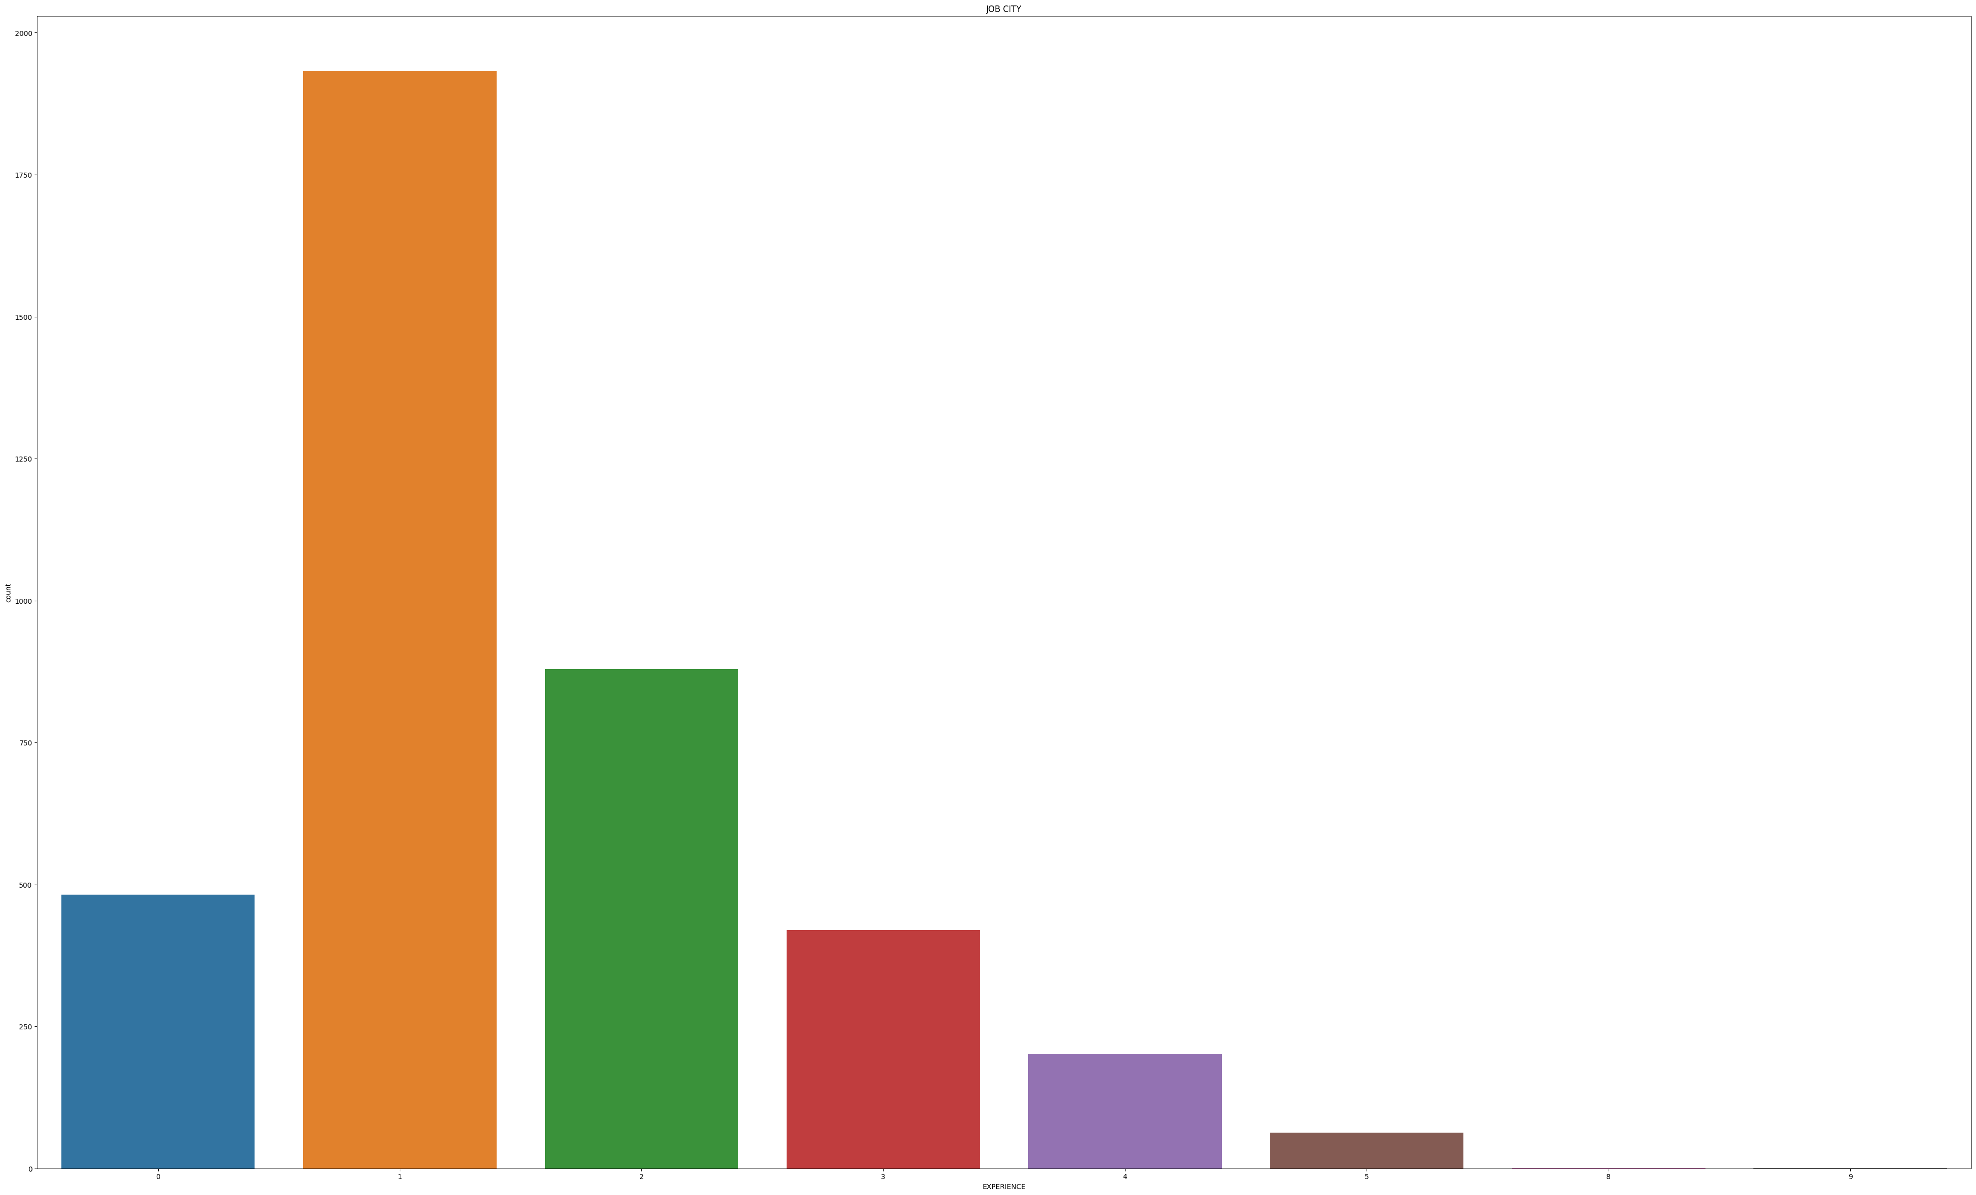
- One year experience employees are more.
- Eight and nine years of experience are less.

Slide 7
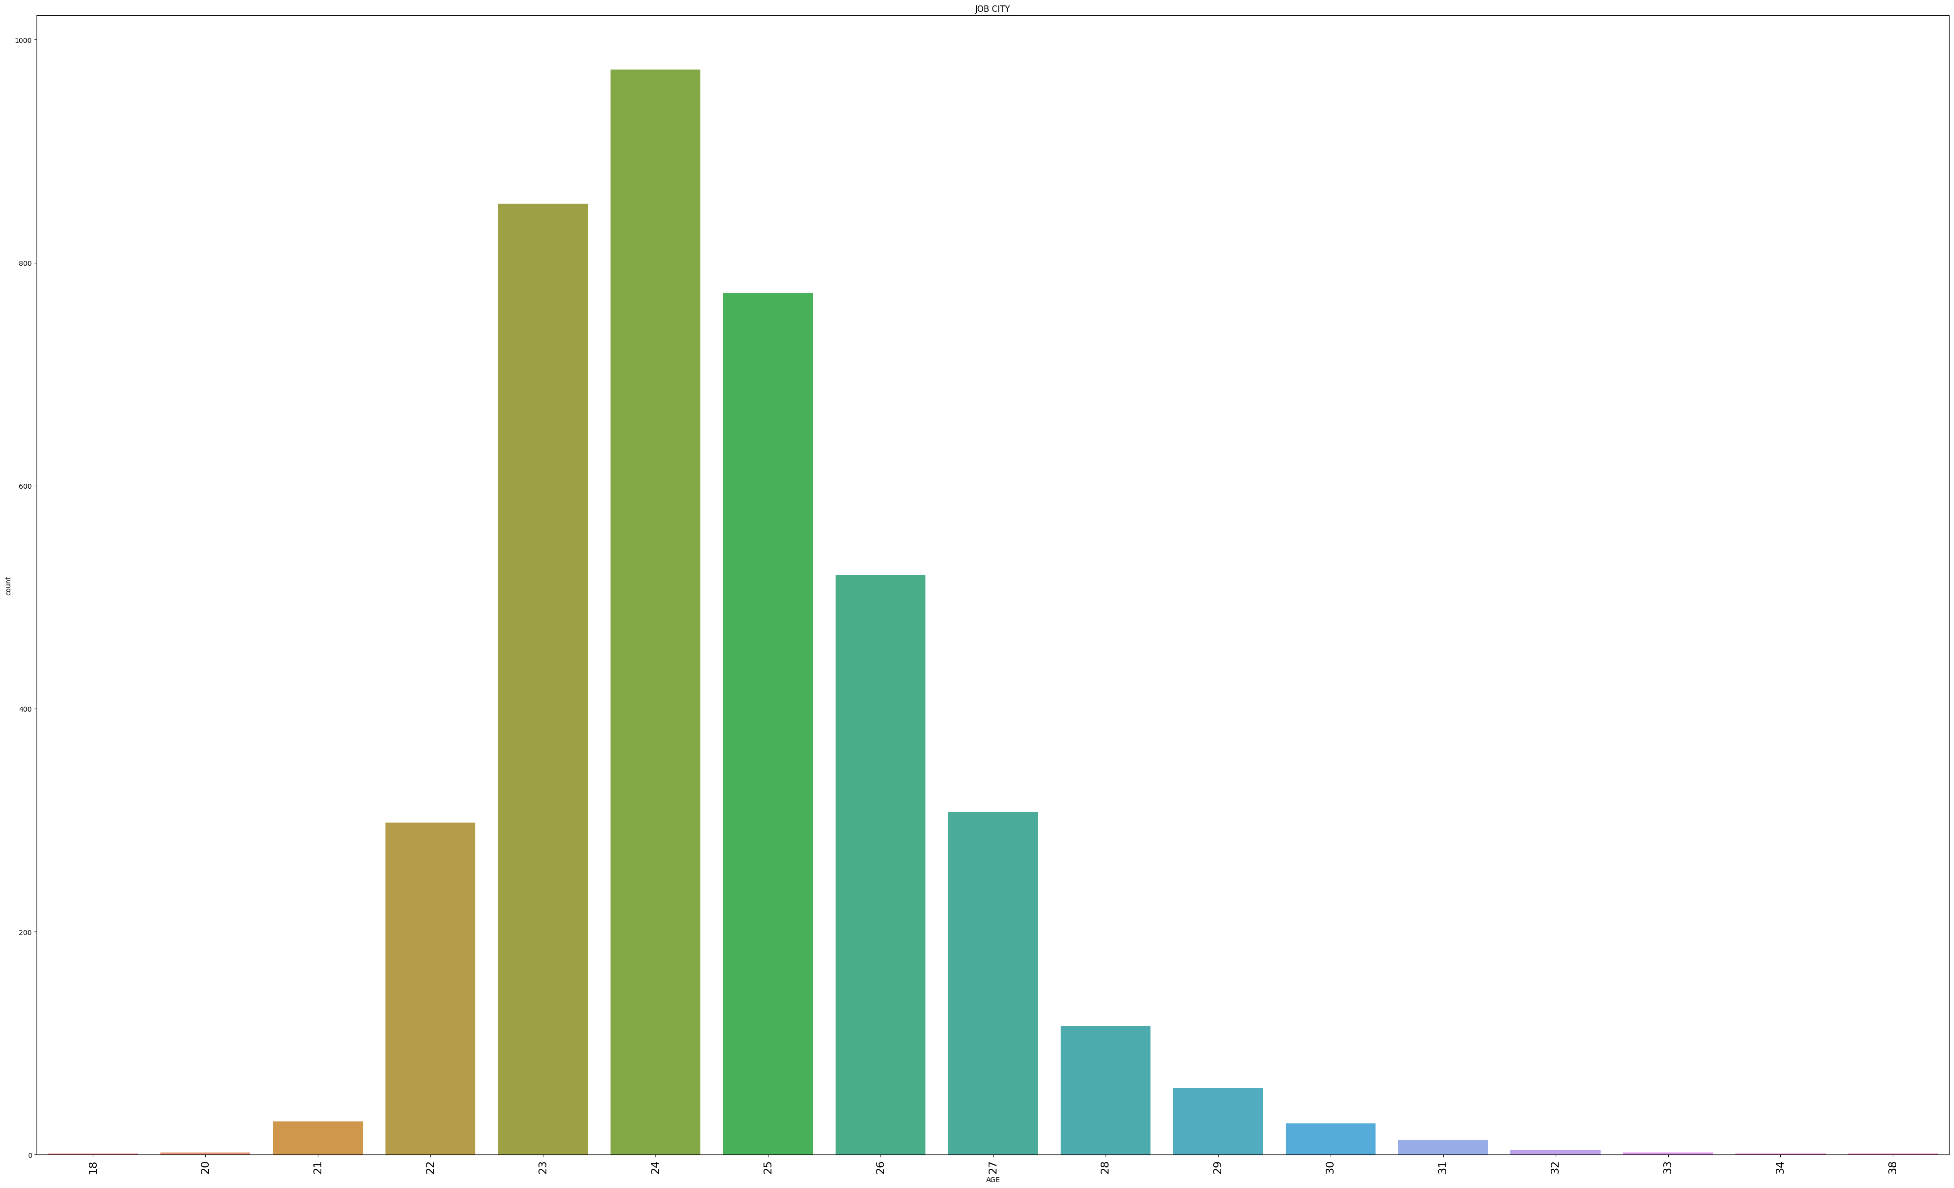
- Most of the ages range between 22 to 27.
- The 24 years of age is more.

Slide 8

THANK YOU

