Slide 1
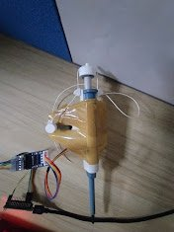
Electronic Pipette
Proof of Concept and Initial Hardware Integration
ka
Prototype v1
Kahaan Padiya

Slide 2
The Problem with Manual Pipetting
😓 Repetitive Strain
📉 Human Variability
Hundreds of pipette strokes per day cause thumb and wrist fatigue, leading to RSI in lab technicians.
Manual force inconsistency introduces volume error. CV of manual pipetting can exceed 1–2% for small volumes.
💸 Cost of Error
⚡ Our Goal
Inaccurate dispensing wastes expensive reagents and can invalidate entire experiment runs.
Build a low-cost electronic pipette using off-the-shelf components to improve consistency.

Slide 3
Hardware Components
01
Arduino Nano
Microcontroller brain. Stores calibration positions in EEPROM, handles serial commands (PREP / ASP / DISP) and jog control.
02
Stepper Motor + Driver
Provides precise angular positioning. The driver board enables control and handles the current requirements of the Stepper.
03
Pulley & String System
Converts rotary Stepper motion into linear plunger travel. String is routed over two force-redirector for smooth, vertical actuation.
04
Web Serial Controller
Browser-based UI (Web Serial API). No app install needed — connect over USB, calibrate endpoints, and run standard pipetting protocol.
05
Future: Pressure Switch
A limit switch at maximum plunger depth will kill the motor, protecting the mechanism and auto-detecting the blowout position.

Slide 4
Operating Protocol
Three Physical buttons on the pipette to control each stage
PREP
ASP
DISP
PREP Button
ASP Button
DISP Button
1. Push to First Stop
2. Aspirate
3. Dispense & Blowout
Press PREP button. Stepper drives plunger to pre-aspirate position and establishes consistent volume baseline before liquid contact.
Press ASP button. Motor retracts plunger to calibrated aspirate depth. Immerse tip first; negative pressure draws liquid in accurately.
Press DISP button. Full plunger travel to second stop — dispenses volume and completes blowout, expelling all residual liquid.

Slide 5
Two Interfaces, Two Roles
LAPTOP · One-Time Calibration
PHYSICAL BUTTONS (V1.1) · Daily Operation
Done once. Saved permanently to EEPROM.
No laptop. Just the pipette.
1
Jog UP / DOWN
PREP
Use ↑↓ buttons to manually position plunger at the desired depth.
Push to 1st Stop
2
Set Open Position (ZERO)
Save the resting / top-of-travel position. Plunger fully retracted.
VS
ASP
3
Save 1st Stop (Aspirate)
Aspirate Liquid
Motor at the exact depth that draws the correct volume into the tip.
4
Save 2nd Stop (Blowout)
DISP
Deepest point : full plunger depression to expel all residual liquid.
Dispense & Blowout
Recalibrate only when needed.
Reads positions from EEPROM at boot. Works standalone.

Slide 6
Precision Comparison: Normal vs Electronic
Manual Pipette
Electronic Pipette (v1)
Readings taken at 520nm
0.47792
0.47687
0.47757
0.54012
0.56028
0.47685
0.47641
0.47592
0.56806
0.54440
Metric | Manual | Electronic
Average | 0.4769 | 0.5532
σ (Sigma) | 0.000733 | 0.01316
3σ | 0.00220 | 0.03948
CV % | 0.154% | 2.379%
3×CV | 0.461% | 7.136%

Slide 7
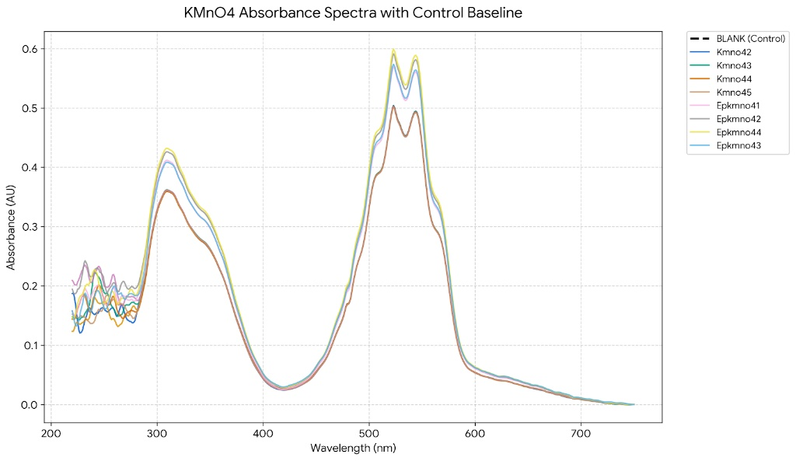
Measurement Spread Visualised

Slide 8
Roadmap & Future Improvements
v1.1
v1.2
Pressure / Limit Switch + control buttons
Auto-Calibration Mode
In Progress
Planned
Mount a microswitch at maximum plunger depth. Arduino kills motor on trigger. Add Buttons to control Prep, aspirate and dispense.
On boot, motor travels to limit switch to find true zero automatically. Calibration saved without manual jog steps.
v2.0
v2.1
Encoder Feedback
Volume Selection UI
Planned
Future
Rotary encoder on Stepper shaft provides closed-loop position control dramatically reduces CV by eliminating string slack error.
Add a volume input to the web controller. Software maps desired µL to encoder ticks for flexible, calibrated aspiration.

Slide 9
Conclusion
A working proof-of-concept in a form factor that costs a fraction of commercial alternatives.
✅ Functional 3-command pipetting protocol over USB Serial
✅ EEPROM-persisted calibration — survives power cycles
✅ Web based browser controller — no install required
📊 CV of 2.38% vs 0.15% manual — improvement path identified
🔧 Pressure switch (v1.1) will fix primary source of error
Built with: Arduino Nano · Stepper Motor · Web Serial API · EEPROM · Open Hardware

