Slide 1
DBMS

Slide 2
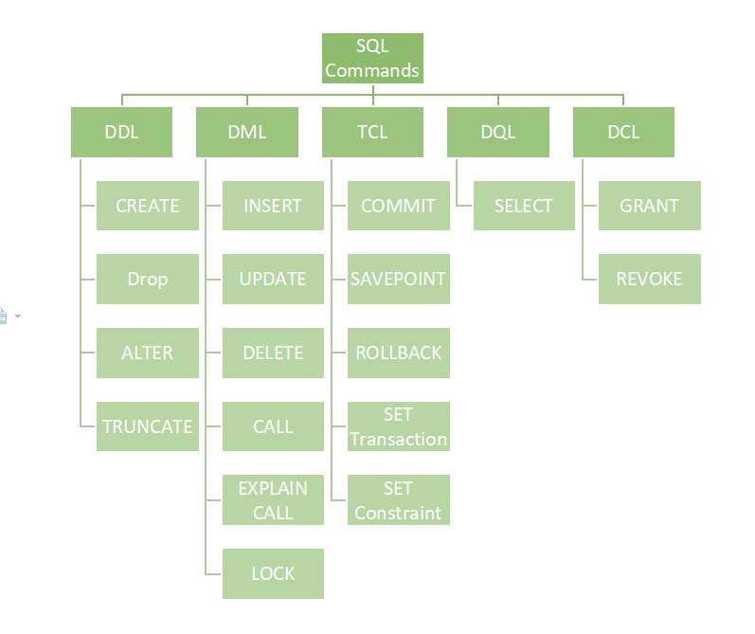

Slide 3
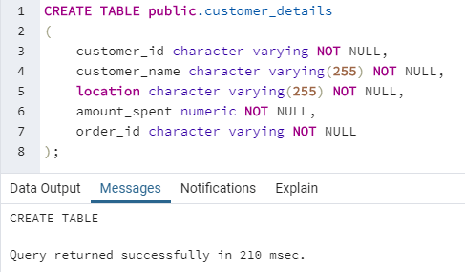
DDL COMMANDS
Data Definition Language actually consists of the SQL commands that can be used to define the database schema.
DDL is a set of SQL commands used to create, modify, and delete database structures but not data.
CREATE
CREATE is a data definition language(DDL) command that is used for creating database objects such as database and database table.
basic syntax:
CREATE DATABASE database_name; -> CREATE DB
CREATE TABLE TABLE_NAME -> CREATE TABLE ( column_name_1 datatype [NULL | NOT NULL], column_name_2 datatype [NULL | NOT NULL], …. column_name_n datatype [NULL | NOT NULL] )

Slide 4
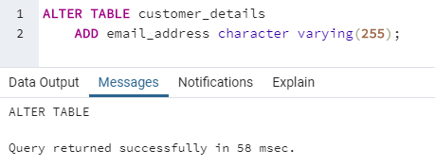
2. ALTER
ALTER command in SQL is used to add, rename or modify, drop/delete columns in an existing database table. It can further be used to add and remove various constraints on an existing database table.
basic syntax:
ALTER TABLE table_name ->ADD A COLUMN TO EXISTING TABLE ADD (Columnname_1 datatype)
OTHER ALTER CMDS ARE…
ALTER TABLE table_name_1 -> rename an existing database table RENAME TO table_new_name;
ALTER TABLE table_name ->deleting existing columns DROP columnname_1 , columnname_2, ...

Slide 5
3. TRUNCATE
TRUNCATE TABLE command is used to remove all the data records from the database table. It deletes all the rows permanently. We cannot perform a rollback operation to undo a TRUNCATE command.
basic syntax:
TRUNCATE TABLE table_name;
4. DROP
DROP TABLE SQL command is used to delete a database object from the database. We can even delete the database using the DROP command. We cannot perform a rollback operation to undo a DROP database/table command.
basic syntax:
DROP DATABASE database_name;
DROP TABLE table_name;

Slide 6
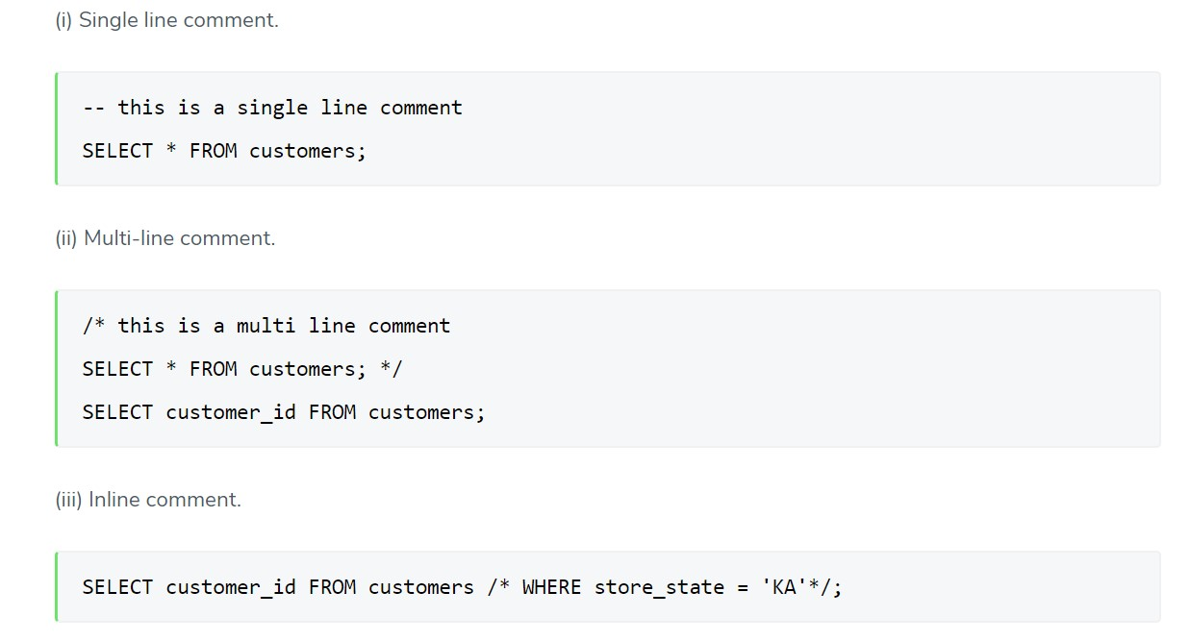
5. COMMENT
Comments in SQL are similar to comments in other programming languages such as Java, C++, Python, etc. They are primarily used to define a code section for easier understanding. Comments can be a single line, multi-line, or even inline types.

Slide 7
DML(Data Manipulation Language):
The SQL commands that deals with the manipulation of data present in the database belong to DML or Data Manipulation Language and this includes most of the SQL statements. It is the component of the SQL statement that controls access to data and to the database.
List of DML commands:
INSERT : It is used to insert data into a table.
basic syntax:
INSERT INTO tablename (column_name_1, column_name_2, column_name_3, ...) VALUES (value1, value2, value3, ...)
UPDATE: It is used to update existing data within a table.
basic syntax:
UPDATE tablename SET column_name_1 = value1, column_name_2 = value2, ... WHERE condition;
DELETE : It is used to delete records from a database table.
basic syntax:
DELETE FROM tablename WHERE condition;

Slide 8
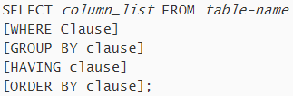

DQL (Data Query Language):
It is a component of SQL statement that allows getting data from the database and imposing order upon it. It includes the SELECT statement. This command allows getting the data out of the database to perform operations with it.
SELECT: This is possibly the most basic SQL command. The select command is used to fetch or retrieve results from a particular table of a database. This is generally followed by specific column names or all column names (by making use of * ).
WHERE: The WHERE clause is one of the most important SQL commands as it is used to retrieve or fetch the specific data that is required for a particular case. This is helpful as it excludes all the irrelevant data.
AND: This is an SQL operator which is used to combine two conditions. For the row to appear in the data result set, both the conditions should be true.

Slide 9




AVG(): This is an aggregate function that is used to return the average value of a particular numeric column.
ORDER BY: This is used along with the select statement to sort the results either in ascending order or descending order. If no argument is given after the ORDER BY clause, it by default takes as the ascending order query.
GROUP BY: this clause in the SQL commands is used to retrieve the data on the basis of some particular grouping related to one or more columns.
HAVING: The HAVING clause is used to filter the data based on one or more group functions. This is quite very similar to using a WHERE clause but this includes the use by a group function.

Slide 10




IN: The IN operator when the comparison of a column is made with multiple values. It is more or less similar to the OR condition.
LIKE: This operator is used to compare between the two conditions and lists down all the rows of a table whose column name matches the pattern specified with the LIKE clause. Wildcard operators such as % are used when you are not sure about the particular pattern.
BETWEEN: As the name suggests, this operator filters the results for a particular set of ranges. The value, in this case, can either be numbers, dates or text.
COUNT(): This is one of the most useful SQL commands which is used to display the count of the total number of rows for all those non-null data. It makes use of the column name as the argument.

Slide 11

LIMIT: The LIMIT clause will help you specify the maximum number of rows that are allowed in the result set.
SQL Join statement is used to combine data or rows from two or more tables based on a common field between them. Different types of Joins are as follows:
INNER JOIN
LEFT JOIN
RIGHT JOIN
FULL JOIN
JOINS

Slide 12
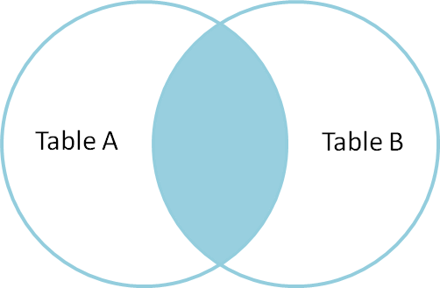
A. INNER JOIN
The INNER JOIN keyword selects all rows from both the tables as long as the condition is satisfied. This keyword will create the result-set by combining all rows from both the tables where the condition satisfies i.e value of the common field will be the same.
SYNTAX:
SELECT table1.column1,table1.column2,table2.column1,....
FROM table1 INNER JOIN table2
ON table1.matching_column = table2.matching_column;
We can also write JOIN instead of INNER JOIN. JOIN is same as INNER JOIN.

Slide 13
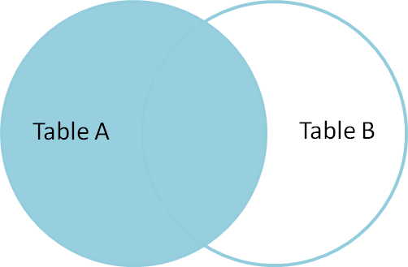
B. LEFT JOIN
This join returns all the rows of the table on the left side of the join and matches rows for the table on the right side of the join. For the rows for which there is no matching row on the right side, the result-set will contain null. LEFT JOIN is also known as LEFT OUTER JOIN.
Syntax:
SELECT table1.column1,table1.column2,table2.column1,....
FROM table1 LEFT JOIN table2
ON table1.matching_column = table2.matching_column;
We can also use LEFT OUTER JOIN instead of LEFT JOIN, both are the same.

Slide 14
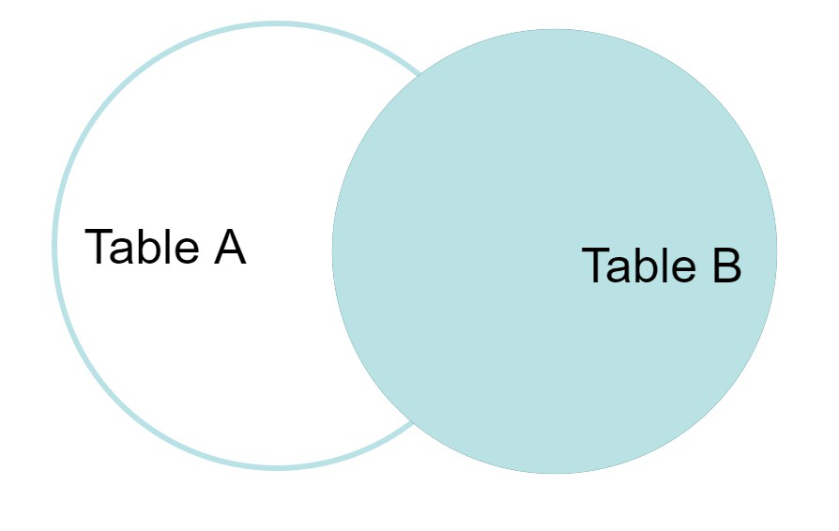
C. RIGHT JOIN
RIGHT JOIN is similar to LEFT JOIN. This join returns all the rows of the table on the right side of the join and matching rows for the table on the left side of the join. For the rows for which there is no matching row on the left side, the result-set will contain null. RIGHT JOIN is also known as RIGHT OUTER JOIN.
Syntax:
SELECT table1.column1,table1.column2,table2.column1,....
FROM table1 RIGHT JOIN table2
ON table1.matching_column = table2.matching_column;
We can also use RIGHT OUTER JOIN instead of RIGHT JOIN, both are the same.

Slide 15
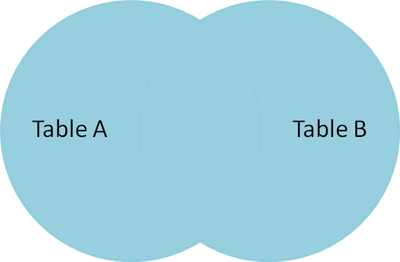
D. FULL JOIN
FULL JOIN creates the result-set by combining results of both LEFT JOIN and RIGHT JOIN. The result-set will contain all the rows from both tables. For the rows for which there is no matching, the result-set will contain NULL values.
SELECT table1.column1,table1.column2,table2.column1,....
FROM table1 FULL JOIN table2
ON table1.matching_column = table2.matching_column;

Slide 16
Natural Join
Natural join is a join that combines two or more common columns between two tables.
Natural join SQL is a join that is similar to the Equi join. The main difference is that the number of columns that are returned in the result set.
The things that need to be taken care in the Natural Join is as below:
We don’t use the ON clause in Natural Join.
The tables which we are using for the Natural join should have one or more identical column name.
The identical column name should be of the same data type.
The main difference between the INNER join and the Natural join is the duplicate column set in the result.
Select * From tablename1 NATURAL JOIN tablename2;

Slide 17
SQL Cross Join
SELECT columnName From X CROSS JOIN Y;
Suppose if we have two tables X & Y with ‘n’ and ‘m’ rows respectively and when we take the Cross join or Cartesian of these two tables, then each row of tables get paired to other and the result set contains n*m rows as the result rows of X*Y Cartesian product.
A SQL Cross JOIN does not include a join condition as of other joins like Inner, Outer, Full, Left or Right Joins. If we use WHERE to Cross Join then it acts like an Inner Join. Other joins function with certain conditions to perform certain different processes to return the result required.

Slide 18
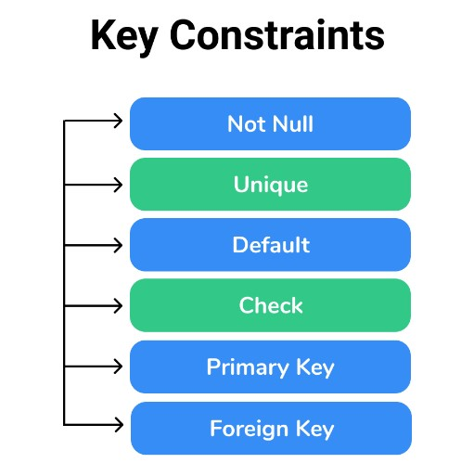
Key Constraints in DBMS
Constraints or nothing but the rules that are to be followed while entering data into columns of the database table
Constraints ensure that data entered by the user into columns must be within the criteria specified by the condition

Slide 19
We have 5 types of key constraints in DBMS
NOT NULL: ensures that the specified column doesn’t contain a NULL value and cannot be applied at table level.
UNIQUE : provides a unique/distinct values to specified columns.
DEFAULT: provides a default value to a column if none is specified.
CHECK :checks for the predefined conditions before inserting the data inside the table.
PRIMARY KEY: it uniquely identifies a row in a table.. f you try to enter duplicate value while inserting in the row you are displayed with an error. Hence primary key will restrict you to maintain unique values and not null values in that particular column.
FOREIGN KEY: ensures referential integrity of the relationship.it is a column or list of columns that points to the primary key column of another table. The main purpose of the foreign key is only those values are allowed in the present table that will match the primary key column of another table.
CREATE TABLE Orders (
OrderID int NOT NULL,
OrderNumber int NOT NULL,
ID int UNIQUE,
PersonID int,
City varchar(255) DEFAULT 'hyderabad’ ,
Age int,
CHECK (Age>=18) ,
PRIMARY KEY (OrderID),
FOREIGN KEY (PersonID) REFERENCES Persons(PersonID)
);

Slide 20
Super Key - Super Key is the superset of primary key. The super key contains a set of attributes, including the primary key, which can uniquely identify any data row in the table.
Composite Key - If any single attribute of a table is not capable of being the key i.e it cannot identify a row uniquely, then we combine two or more attributes to form a key. This is known as a composite key.
Secondary Key - Only one of the candidate keys is selected as the primary key. The rest of them are known as secondary keys.
Candidate Key - The candidate keys in a table are defined as the set of keys that is minimal and can uniquely identify any data row in the table.

Slide 21
Add constraints & Delete constraints
alter table table_name drop constraint “some_name”; -> drop a constraint
Need to know the name of the constraint [may be a primary key constraint, foreign key constraint, check constraint, unique constraint]
alter table table_name alter column ID drop not null; -> drop not null constraint
alter table table_name add constraint “table_name_version_check” check(version between ‘8–1’ and ‘8-z’); -> add check constraint
alter table table_name add constraint “unique_table_name” unique(id); -> add unique constraint
alter table table_name add foreign key (table_name_id) -> add foreign key constraint
references table_name2(table_name2_id)
on update cascade on delete cascade;
alter table table_name add primary key(id); -> add primary key constraint
alter table table_name alter column ID set not null; -> add not null constraint

Slide 22
CASCADE CONSTRAINT
DELETE CASCADE: When we create a foreign key using this option, it deletes the referencing rows in the child table when the referenced row is deleted in the parent table which has a primary key.
ALTER TABLE [Table_name] ADD CONSTRAINT [FK_name] FOREIGN KEY([Column Id])
REFERENCES [Parent_table] ([Parent_column_id])
ON DELETE CASCADE
UPDATE CASCADE: When we create a foreign key using UPDATE CASCADE the referencing rows are updated in the child table when the referenced row is updated in the parent table which has a primary key
ALTER TABLE [Table_name] ADD CONSTRAINT [FK_name] FOREIGN KEY([Column Id])
REFERENCES [Parent_table] ([Parent_column_id])
ON UPDATE CASCADE;
SET NULL
If a delete statement affects rows in a foreign key table, those values will be set to NULL when the primary key record is deleted. If an update statement affects rows in the foreign key table, those rows will be updated with the value NULL after the primary key record has been updated. The foreign key columns affected must allow NULL values.

Slide 23
SET DEFAULT
All the values that make up the foreign key in the rows that are referenced are set to their default value. All foreign key columns in the related table must have default constraints defined on them.
NO ACTION
This is the default action. This specifies that if an update or delete statement affects rows in foreign key tables, the action will be denied and rolled back. An error message will be raised.
ON UPDATE NO ACTION
ALTER TABLE [Table_name] ADD CONSTRAINT [FK_name] FOREIGN KEY([Column Id])
REFERENCES [Parent_table] ([Parent_column_id])
ON DELETE SET NULL
ON UPDATE SET DEFAULT=“0000”;

Slide 24
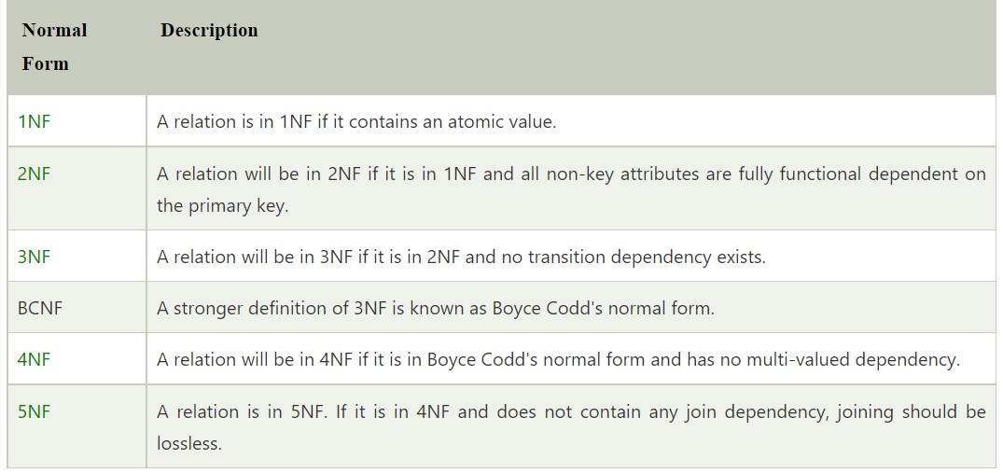
Normalization:
Normalization is used to minimize the redundancy from a relation or set of relations. It is also used to eliminate undesirable characteristics like Insertion, Update, and Deletion Anomalies.
Data modification anomalies can be categorized into three types:
Insertion Anomaly: Insertion Anomaly refers to when one cannot insert a new tuple into a relationship due to lack of data.
Deletion Anomaly: The delete anomaly refers to the situation where the deletion of data results in the unintended loss of some other important data.
Update Anomaly: The update anomaly is when an update of a single data value requires multiple rows of data to be updated.

Slide 25
Types of Entity Relationships in DBMS
One-to-One Relationship
Under One-to-One (1:1) relationship, an instance of entity P is related to instance of entity Q and an instance of entity Q is related to instance of entity P.
One-to-Many Relationship
Under One-to-Many (1:N) relationship, an instance of entity P is related to more than one instance of entity Q and an instance of entity Q is related to more than one instance of entity P.
Many-to-Many Relationship
Under Many-to-Many (N:N) relationship, more than one instance of entity P is related to more than one instance of entity Q. For more than one instance of entity Q is related to more than one instance of entity P.

Slide 26
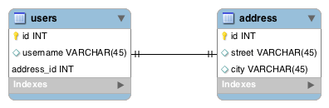
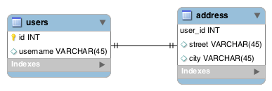
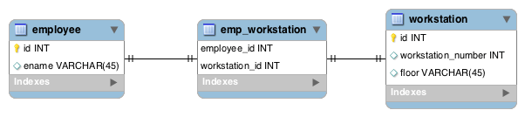
ONE TO ONE :
Modeling With a Foreign Key
Modeling With a Shared Primary Key
Modeling With a Join Table
Reference: https://www.baeldung.com/jpa-one-to-one
@OneToOne(mappedBy = "user", cascade = CascadeType.ALL) @PrimaryKeyJoinColumn private Address address
@OneToOne @MapsId @JoinColumn(name = "user_id") private User user;

Slide 27
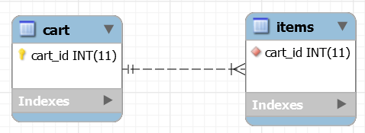
ONE TO MANY:
REF: https://www.baeldung.com/hibernate-one-to-many
@ManyToOne @JoinColumn(name="cart_id", nullable=false) private Cart cart
@OneToMany(mappedBy="cart") private Set<Item> items;

Slide 28

MANY TO MANY:
REF: https://www.baeldung.com/jpa-many-to-many
@ManyToMany
Set<Course> likedCourses;
@ManyToMany Set<Student> likes;
@ManyToMany @JoinTable( name = "course_like", joinColumns = @JoinColumn(name = "student_id"), inverseJoinColumns = @JoinColumn(name = "course_id")) Set<Course> likedCourses;

Slide 29
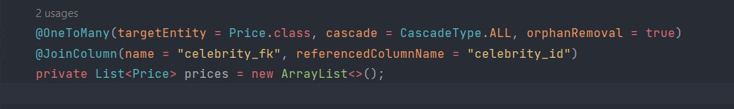
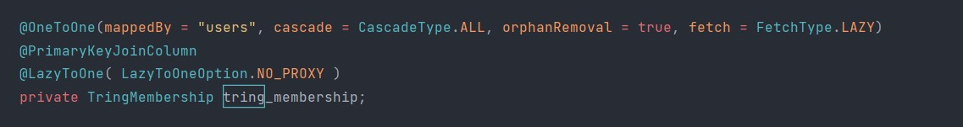
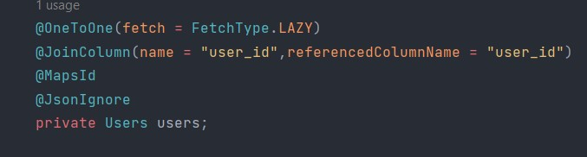
FOR ONE TO MANY RELATIONSHIP:
From parent side (Celebrity)
FOR ONE TO ONE RELATIONSHIP:
From USER CLASS
FROM TRING_MEMBERSHIP CLASS

