Slide 1
DBMS

Slide 2
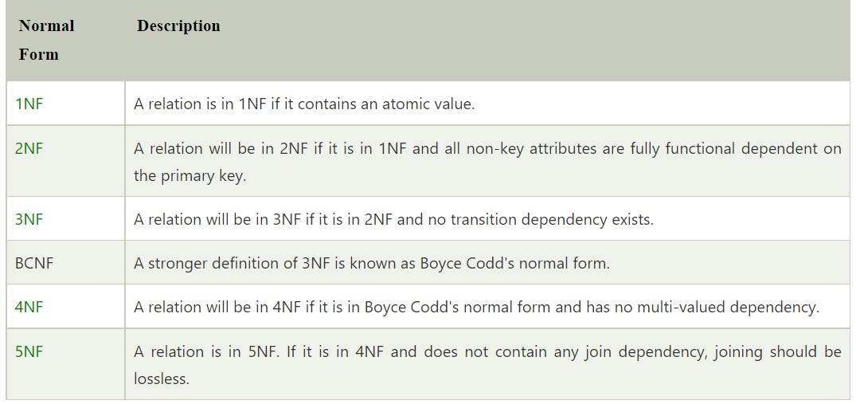
Normalization:
Normalization is used to minimize the redundancy from a relation or set of relations. It is also used to eliminate undesirable characteristics like Insertion, Update, and Deletion Anomalies.
Data modification anomalies can be categorized into three types:
Insertion Anomaly: Insertion Anomaly refers to when one cannot insert a new tuple into a relationship due to lack of data.
Deletion Anomaly: The delete anomaly refers to the situation where the deletion of data results in the unintended loss of some other important data.
Updatation Anomaly: The update anomaly is when an update of a single data value requires multiple rows of data to be updated.

Slide 3
Types of Entity Relationships in DBMS
One-to-One Relationship
Under One-to-One (1:1) relationship, an instance of entity P is related to instance of entity Q and an instance of entity Q is related to instance of entity P.
One-to-Many Relationship
Under One-to-Many (1:N) relationship, an instance of entity P is related to more than one instance of entity Q and an instance of entity Q is related to more than one instance of entity P.
Many-to-Many Relationship
Under Many-to-Many (N:N) relationship, more than one instance of entity P is related to more than one instance of entity Q. For more than one instance of entity Q is related to more than one instance of entity P.

Slide 4
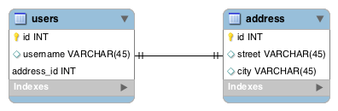
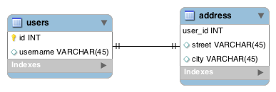
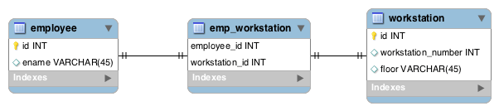
ONE TO ONE :
Modeling With a Foreign Key
Modeling With a Shared Primary Key
Modeling With a Join Table
Reference: https://www.baeldung.com/jpa-one-to-one
@OneToOne(mappedBy = "user", cascade = CascadeType.ALL) @PrimaryKeyJoinColumn private Address address
@OneToOne @MapsId @JoinColumn(name = "user_id") private User user;

Slide 5
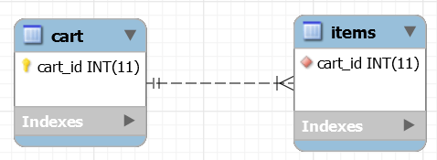
ONE TO MANY:
REF: https://www.baeldung.com/hibernate-one-to-many
@ManyToOne @JoinColumn(name="cart_id", nullable=false) private Cart cart
@OneToMany(mappedBy="cart") private Set<Item> items;

Slide 6

MANY TO MANY:
REF: https://www.baeldung.com/jpa-many-to-many
@ManyToMany
Set<Course> likedCourses;
@ManyToMany Set<Student> likes;
@ManyToMany @JoinTable( name = "course_like", joinColumns = @JoinColumn(name = "student_id"), inverseJoinColumns = @JoinColumn(name = "course_id")) Set<Course> likedCourses;

