Slide 1
JENKINS

Slide 2
Continuous Integration
Jenkins is an open source automation tool written in Java programming language that allows continuous integration.
Set "JENKINS_HOME" environment variable to the new home directory before launching the servlet container.
Set "JENKINS_HOME" system property to the servlet container.
Set JNDI environment entry "JENKINS_HOME" to the new directory
Jenkins dashboard (Home screen)-> Manage Jenkins->
Uncheck the ‘Install automatically’ option -> Add any name for the setting and the location of the MAVEN_HOME -> click on the ‘Save’ button

Slide 3
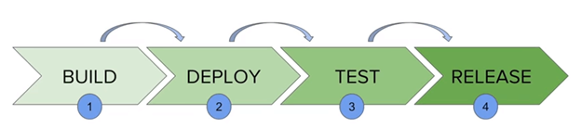
Jenkins Pipeline
In Jenkins, a pipeline is a collection of events or jobs which are interlinked with one another in a sequence.
It is a combination of plugins that support the integration and implementation of continuous delivery pipelines using Jenkins.
Jenkins Pipeline can be defined by a text file called JenkinsFile. You can implement pipeline as code using JenkinsFile, and this can be defined by using a DSL (Domain Specific Language)

Slide 4
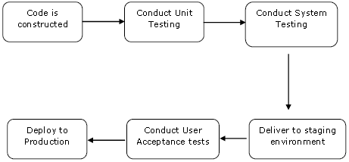
Pipeline: This is the user-defined block, which contains all the processes such as build, test, deploy, etc. it is a group of all the stages in a JenkinsFile.
Pipeline{
}
Node: The node is a machine on which Jenkins runs is called a node. A node block is used in scripted pipeline syntax.
Stage: This block contains a series of steps in a pipeline. i.e., build, test, and deploy processes all come together in a stage.
Generally, a stage block visualizes the Jenkins pipeline process.
Step: A step is a single task that executes a specific process at a defined time. A pipeline involves a series of steps defined
within a stage block.

