Slide 1
THREADS

Slide 2
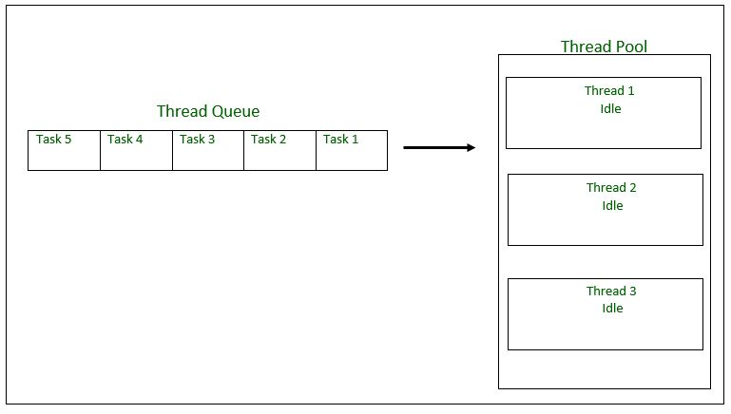
Thread pool:
Created thread pool using Executors.newFixedThreadPool(POOL_SIZE);
Using thread pool, multiple threads were executed according to the pool size.
A thread pool reuses previously created threads to execute current tasks and offers a solution to the problem of thread cycle overhead and resource thrashing.
Java provides the Executor framework which is centered around the Executor interface, its sub-interface –ExecutorService and the class-ThreadPoolExecutor, which implements both of these interfaces.

Slide 3
Steps to be followed:
1. Create a task(Runnable Object) to execute.
2. Create Executor Pool using Executors.
3. Pass tasks to Executor Pool.
4. Shutdown the Executor Pool .
MULTI-THREADING:
Multithreading is a Java feature that allows concurrent execution of two or more parts of a program for maximum utilization of CPU. Each part of such program is called a thread. So, threads are light-weight processes within a process.
Thread Class vs Runnable Interface
If we extend the Thread class, our class cannot extend any other class because Java doesn’t support multiple inheritance. But, if we implement the Runnable interface, our class can still extend other base classes.
We can achieve basic functionality of a thread by extending Thread class because it provides some inbuilt methods like yield(), interrupt() etc. that are not available in Runnable interface.
Using runnable will give you an object that can be shared amongst multiple threads.

Slide 4
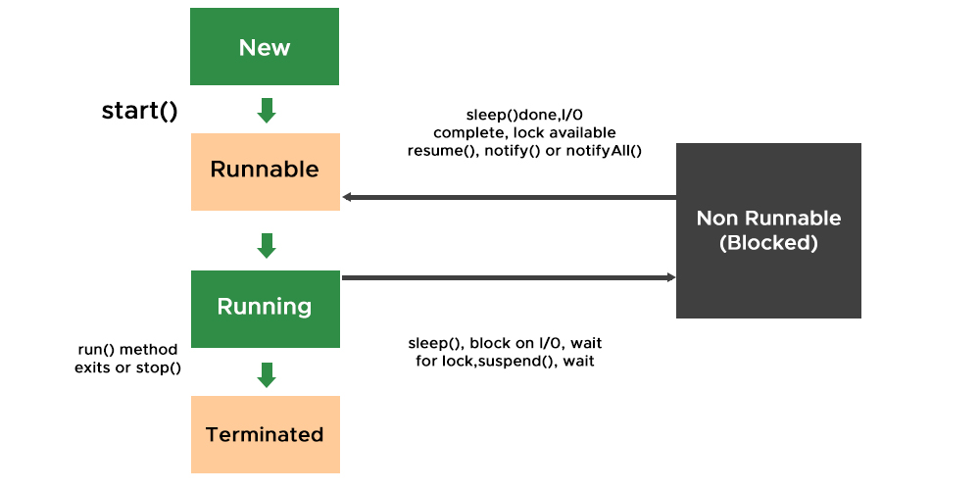
THREAD LIFE CYCLE

