Slide 1
RabbitMQ

Slide 2
RabbitMQ is an open source message broker written in Java.
Point to Point Messaging
The broker sends messages to only one consumer, while the other consumers will wait till they get the messages from the broker. No consumer will get the same message.
Publish/Subscribe
The Broker sends same copy of messages to all the active consumers. This type of communication is also known as Topic based communication.

Slide 3
. we need to connect to it using java client
ConnectionFactory factory = new ConnectionFactory();
factory.setHost("localhost");
Connection connection = factory.newConnection();
Channel channel = connection.createChannel();
factory.setPort(15678);
factory.setUsername(“un");
factory.setPassword("MyPassword");
.PRODUCER:
channel.queueDeclare("products_queue", false, false, false, null);
. Exchange Types:
the different type of exchanges available in rabbitmq->Direct,Fanout,Topic,Headers.
direct exchange will deliver a messages to the queues based on the message routing key.
fanout exchange will route messages to all of the queues that are bound to it.
topic exchange will perform a wildcard match between the routing key and the routing pattern specified in the binding to publish a messages to queue.
headers exchanges will use the message header attributes for routing.
Create Exchange at “Add a new exchange panel” .

Slide 4
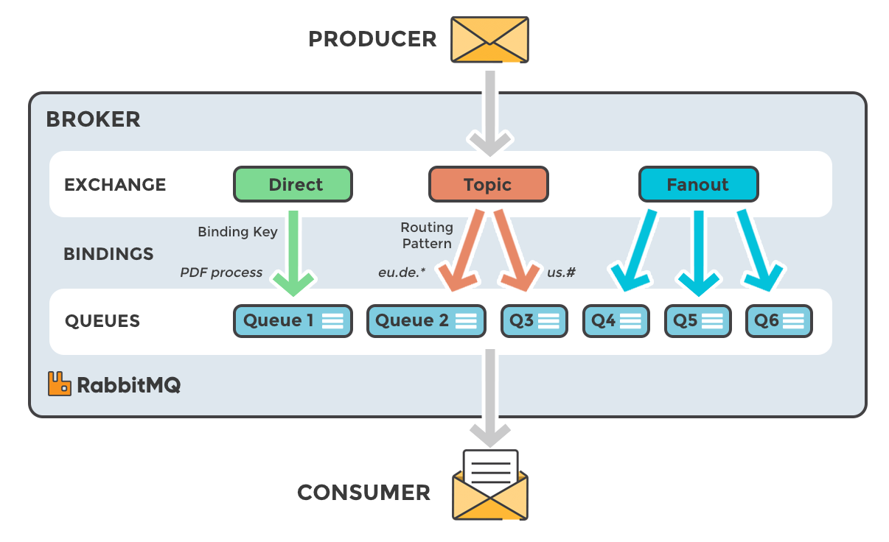

Slide 5
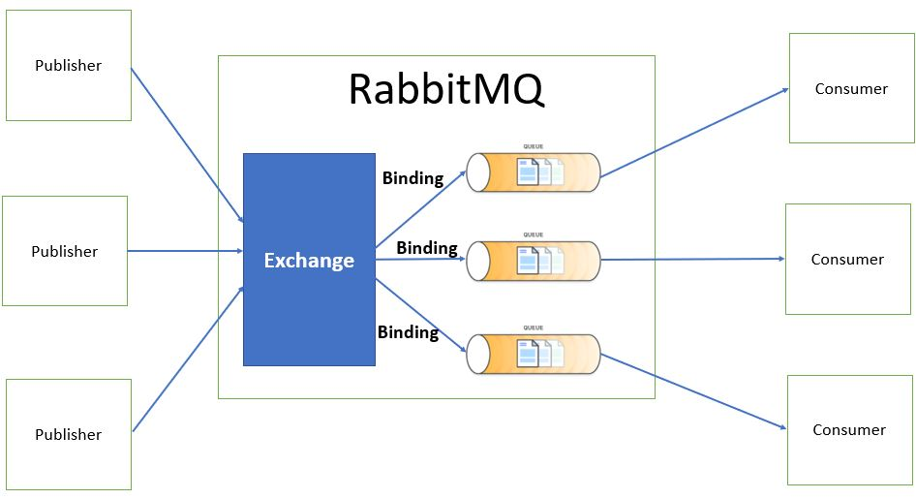

Slide 6
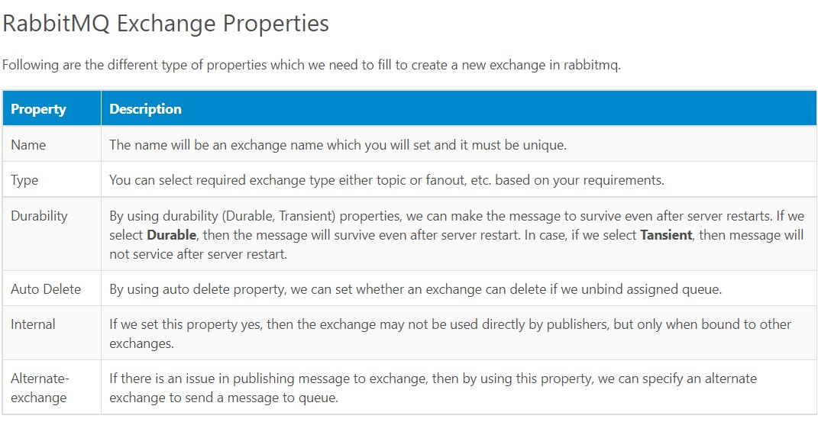

Slide 7
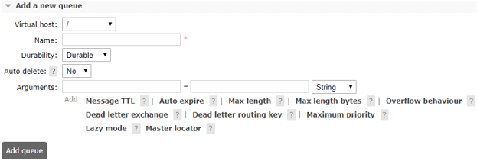
RABBIT TEMPLATE:
RabbitMQ Queues:Queue is a buffer that stores a messages that are sent from the exchanges to queues.
RabbitMQ Bindings (Bind Queue to Exchange):
binding is a connection which is used to configure a relation between a queue and exchange. In simple words we can say, binding is a relationship between an exchange and a queue.
Publish Messages:
we can directly publish messages to queue using web management portal for that we need to login into rabbitmq web.
Read Messages from Queue: -> use negative ack to retain the message in queue.

Slide 8
TEMPLATE AND RABBIT ADMIN CONFIGURATION:
@Bean Queue queue() { return new Queue(queueName, false); }
@Bean DirectExchange exchange() {
return new DirectExchange(exchange);
}
@Bean Binding binding(Queue queue, DirectExchange exchange) {
return BindingBuilder.bind(queue).to(exchange).with(routingkey);
}
@Bean public MessageConverter jsonMessageConverter() {
return new Jackson2JsonMessageConverter();
}
@Bean public AmqpTemplate rabbitTemplate(ConnectionFactory connectionFactory) {
final RabbitTemplate rabbitTemplate = new RabbitTemplate(connectionFactory); rabbitTemplate.setMessageConverter(jsonMessageConverter());
return rabbitTemplate;
}
@Bean public RabbitAdmin admin() { return new RabbitAdmin(connectionFactory()); }

Slide 9
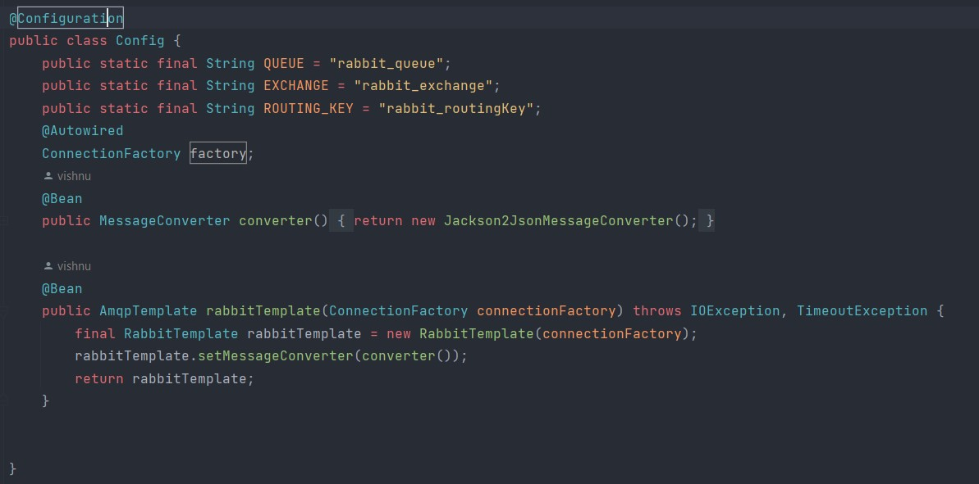
RABBITMQ CONFIGURTION

Slide 10
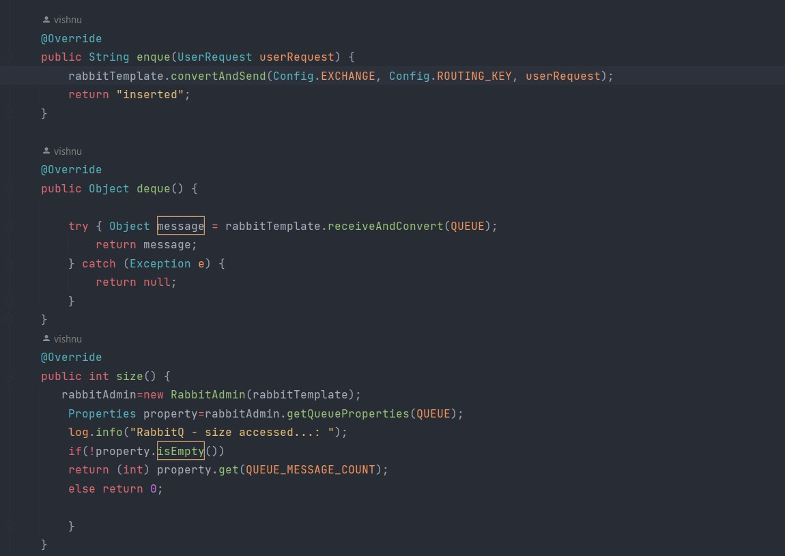
RABBITMQ IMPLEMENTATIONS:

Slide 11
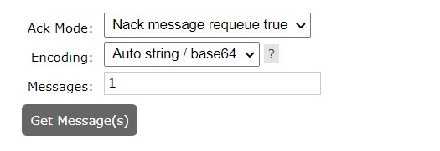
Use Nack message requeue true to read messages without deleting from queue

Slide 12
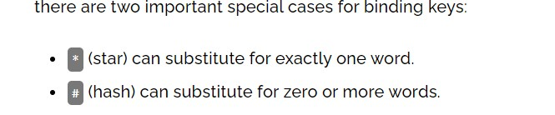
Topic Exchange in AMQP – RabbitMQ
The flow of a message in Topic Exchange
A message Queue binds to an Exchange with a routing key pattern .
A publisher sends a message with a routing key to the Topic Exchange.
The message is passed to the Queue if P matches with K. The routing key matching is decided as discussed below.
The consumer subscribing the Queue receives the message.
Routing pattern matching examples
Routing Key Pattern – It is the routing key pattern that binds a specific Queue with an Exchange.
Valid Routing Key – The message with this key reaches the linked Queue.
Invalid Routing Key – The message with this key does not reach the Queue.

Slide 13
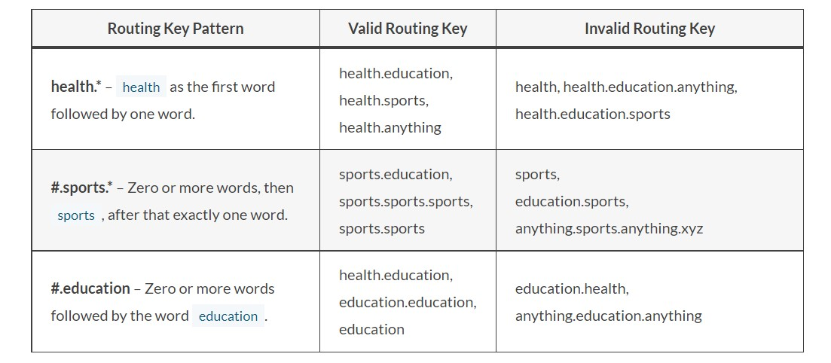

Slide 14
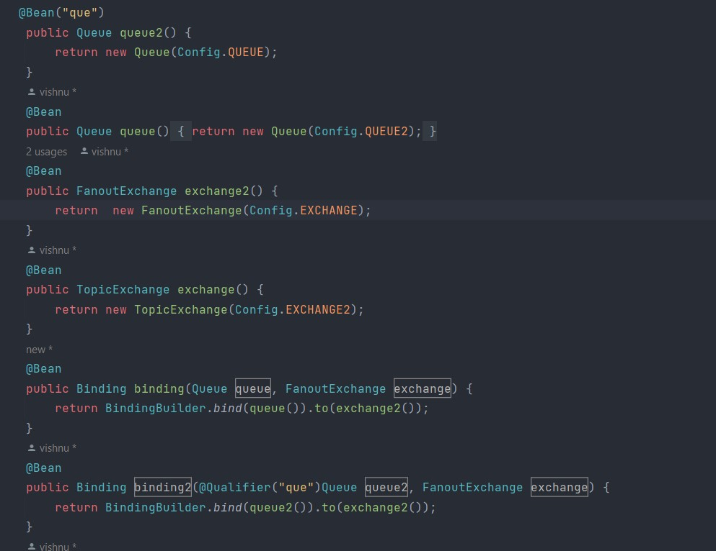
Implementation of Topic Exchange

Slide 15
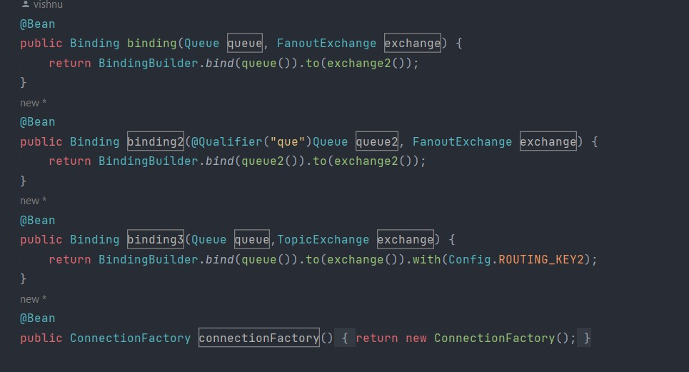

Slide 16
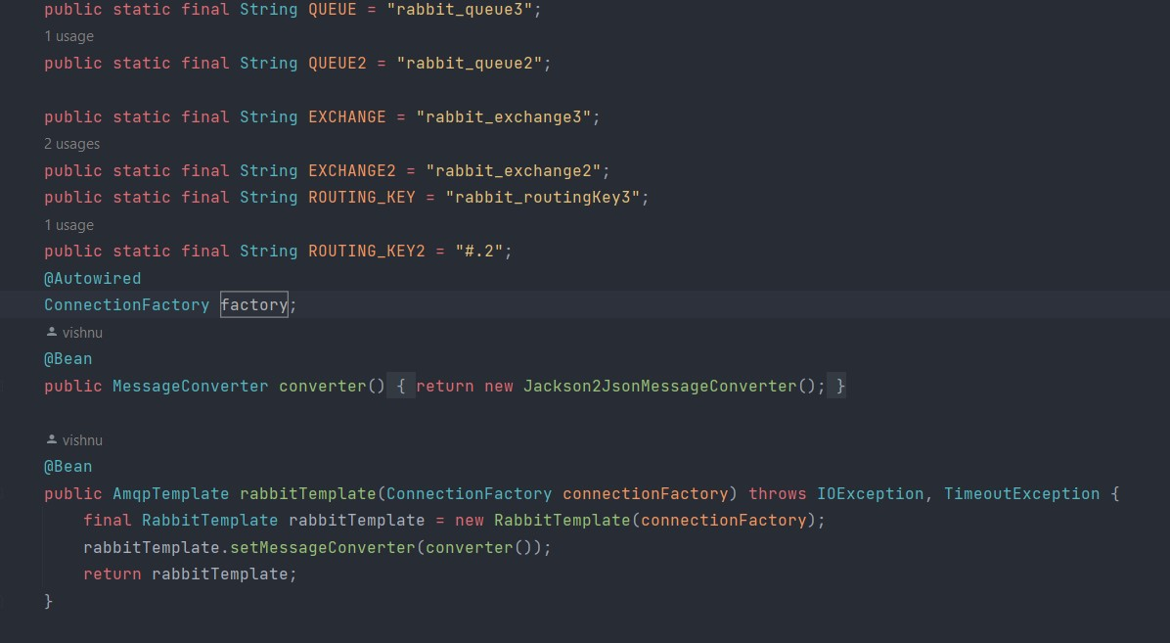
Configuring template:

Slide 17
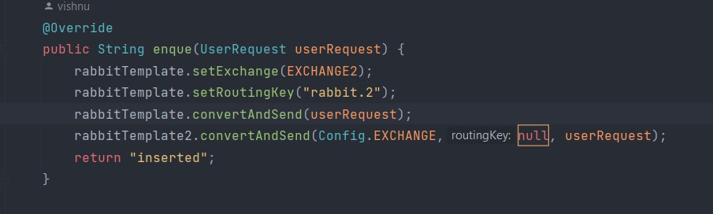
PUBLISHLING THE MSG:

Slide 18
Header Exchange
CONFIG:
@Bean HeadersExchange headerExchange() {
return new HeadersExchange("header-exchange"); }
@Bean Binding marketingBinding(Queue marketingQueue, HeadersExchange headerExchange) {
Return BindingBuilder.bind(marketingQueue).to(headerExchange).where("department").matches("marketing");
}
@Bean Binding financeBinding(Queue financeQueue, HeadersExchange headerExchange) {
return BindingBuilder.bind(financeQueue).to(headerExchange).where("department").matches("finance");
}
PUBLISHER:
MessageProperties messageProperties = new MessageProperties(); messageProperties.setHeader("department", department); MessageConverter messageConverter = new SimpleMessageConverter();
Message message = messageConverter.toMessage(messageData, messageProperties); rabbitTemplate.send(exchange, "", message);

