Slide 1

Heart Disease Detection
Group Member: Ishan Patel, Vishal Patel, Jack Schnair, Zach Sabri, Jonathan Swanson

Slide 2

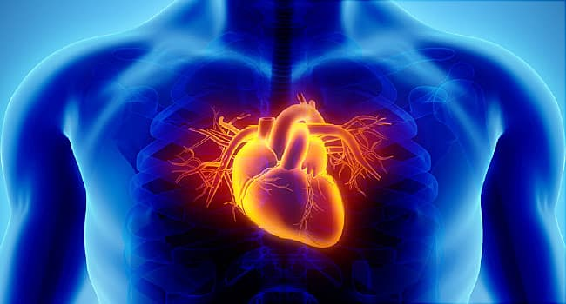
Abstract
Problem: Many people suffer from heart disease. These diseases are caused by different risk factors such as age, cholesterol and sex.
Goal: Use data from Kaggle to detect the level of heart disease that a patient may be suffering from.

Slide 3
Motivation and Significance
Heart disease is most common cause of death in Americans
A person dies every 36 seconds from heart disease
Work will help detect and prevent heart disease
Early detection saves lives
Healthy / recommended lifestyle prevents heart disease

Slide 4
Related Work and Background
Background
Classification of type vs treatment
Heart Disease affects a very large portion of the population
Leading cause of death in certain groups
Related Work
Previous work in image classification
Pytorch
Define our custom model
Test it against pretrained / defined models
Scikit-Learn
Manipulate the data for best practice and results
Nikhil Bora’s “Using Machine Learning to Predict Heart Disease”
Fahmy et al’s work used clinical imaging to predict heart failure

Slide 5
Proposed Work and Methods
Detect different levels of heart disease
Train custom network using Kaggle dataset
Try: ensemble learning, ADAboost, and different model structure
Kaggle dataset has 1000 patient data
13 different features to train network with
Ex: age, sex, chest pain, and other medical information
Use Pytorch and Scikit-Learn in program

Slide 6
Conclusions
We are going to create a model that will give us accurate data to see the level of heart disease our dataset is giving us
We are going to compare this number or percentage we get to the actual number of people suffering from heart disease to see if we are close or not.

