Slide 1

Heart Disease Detection
Group 4: Vishal Patel, Ishan Patel, Jonathan Swanson, Jack Schnair, Zach Sabri

Slide 2
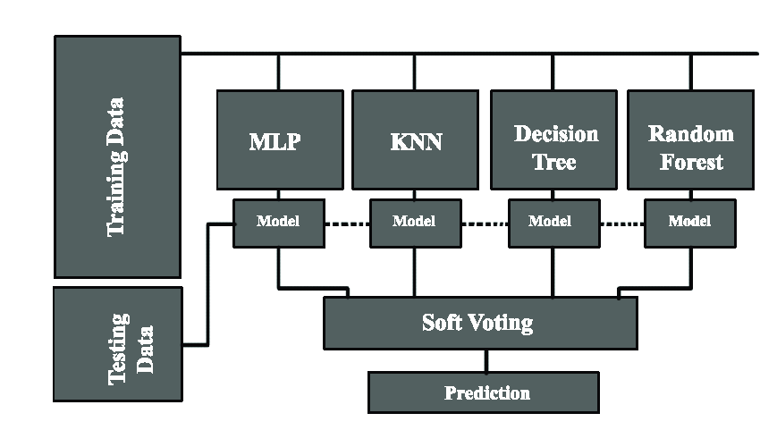
Project Description
Neural network ensemble voting to determine different levels of heart disease (reversible disease, irreversible disease, no disease)
Five ANN models created, one by each team member
Ensemble voting (most common classification determined in array of five models) picks the final classification
In the cases of ties, manually pick the most accurate models vote

Slide 3
Data Source
Data was retrieved from the public Kaggle database
Our decision of target value was changed from the original binary classification of heart disease/no heart disease to the reversible/irreversible/no disease.
We found a severe data imbalance in our new target values and were able to handle it
We used the SMOTE class to handle this severe class imbalance which created pseudo data for all of the underrepresented classes in the dataset

Slide 4
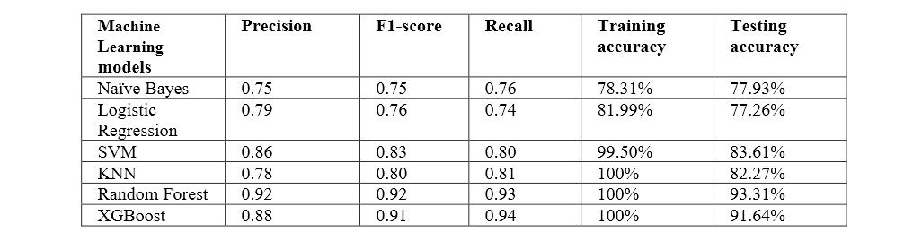
Related Work - Paper 1
Using Machine Learning to Predict Heart Disease by Nikhil Bora
Used numerical patient information to predict heart disease
Used Logistic Regression, Naive Bayes, Support-Vector Machines, KNN
Best performing model was Random Forest

Slide 5
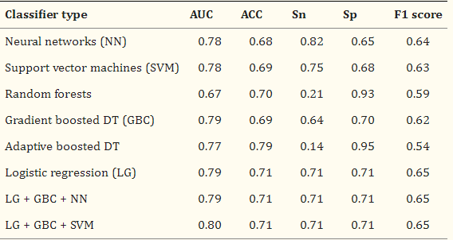
Related Work - Paper 2
Machine Learning for Predicting Heart Failure Progression in Hypertrophic Cardiomyopathy by Ahmed Fahmy, Ethan Rowin, Warren Manning, Martin Maron, and Reza Nezafat
Data from 1427 real patients evaluated from 2001 - 2018
It used:
Logistic Regression
Random Forests
Support-Vector Machines
Gradient Boosted Decision Trees
Adaptive Boosted Decision Trees

Slide 6
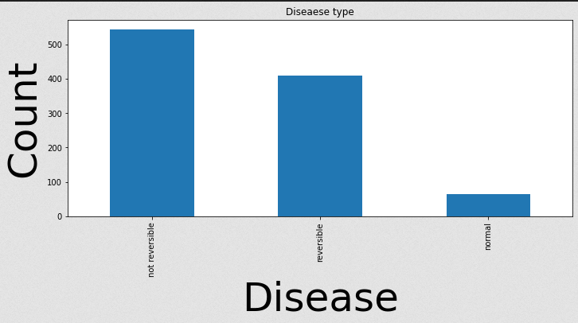
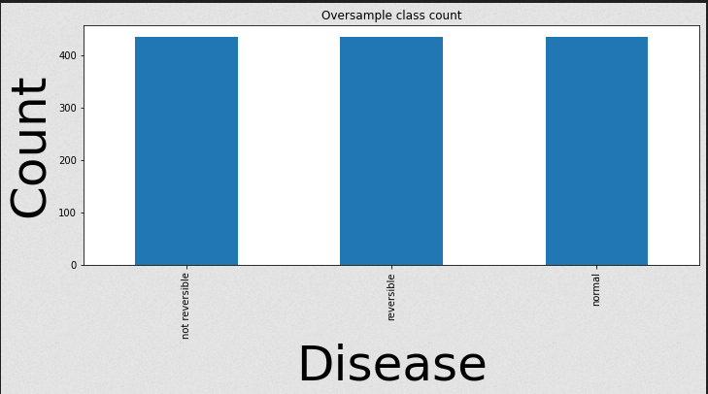
Methodology pt.1
General methods
Used sklearn’s MLP (fully connected ANN) to classify the data
Conducted ensemble voting to get the results of 5 models
Dealing with class imbalance
Stratified our data
Ensures train test split is equally balanced of classes
SMOTE: Synthetic oversampling
Oversamples the minority classes in each dataset
K-Fold Validation
Provides confidence that our models are working properly
Parameter Optimization
GridSearchCV
Original
Oversampled

Slide 7
Methods pt2
Ensemble voting
Entered our results into an array of tuples
The ith tuple contained the votes of all models for the ith set of test data
Obtained the most common vote for each result
Used the most performant model if there was no mode
Our ensemble accuracy was always close to or as performant as our best model
Using different types of models in the ensemble array could lead to better results

Slide 8
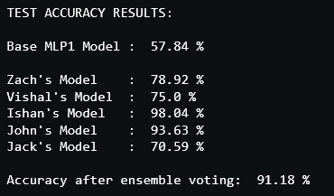
Discussion
Started with base MLP model
Added parameter to make it deeper resulting in higher accuracies
Standardizing (scikit learn) and oversampling (SMOTE) data gave about 3% higher accuracy
Combining multiple models give better accuracy than average
Data shows ensemble learning is more accurate
Could try ensemble learning with different models instead of all MLP models

Slide 9
Team Work
Created 5 models per each team member
Tuned them and integrated each of our files into one file
We created visualization graphs and the structure of our python file overall was done together
We reviewed over the file to make sure all models are yielding correct accuracies

Slide 10

Comparing Results
Nikhil Bora model
Best Accuracy: 93%
Average Accuracy: 84%
Tufts Medical Center
Best Accuracy: 80%
Average Accuracy: 76%
Our model
Ensemble Accuracy: 91%
Average Accuracy: 83%

Slide 11

Conclusion
Our models yielded better accuracy than Tufts medical center by 7% and we were neck in neck with Nikhil Bora. The key point is we were trying to get a close as possible to Nikhil with ensemble voting and our results speak for themselves. We achieved a 91% ensemble accuracy by combining our 5 models into an ensemble array and we achieved the success rate we were looking for.

Slide 12
Future Work
We could take a different approach to this problem by using and coding a completely different architecture for the code to achieve better results. Ensembling different network architectures and trying different sampling techniques can make this project more efficient with better results. This is in theory but these are a few things that can be done to achieve a potential higher accuracy than Nikhil Bora.

