Slide 1


Build a Personalized Online Course Recommender System with Machine Learning
Vishal Purohit
13/07/2025

Slide 2
Outline
Introduction and Background
Exploratory Data Analysis
Content-based Recommender System using Unsupervised Learning
Collaborative-filtering based Recommender System using Supervised learning
Conclusion
Appendix

Slide 3
Introduction
Our company hosts courses on our online platform; however, we currently have no way of recommending new courses to our users.
Our aim is to explore content and collaborative based recommender systems, how they work and to determine which of them performs best with our data.
A secondary aim is to create a prototype app that will demonstrate the recommender system to the management team.
Project hypothesis:
Our data contains 14 genres and all are computer related. As such we believe that course similarity will do better than user similarity since computer related courses generally contain transferable skills. It seems unlikely that the user base will break down into people who only are interested in one computer-based skill.

Slide 4
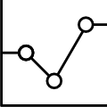
Exploratory Data Analysis

Slide 5
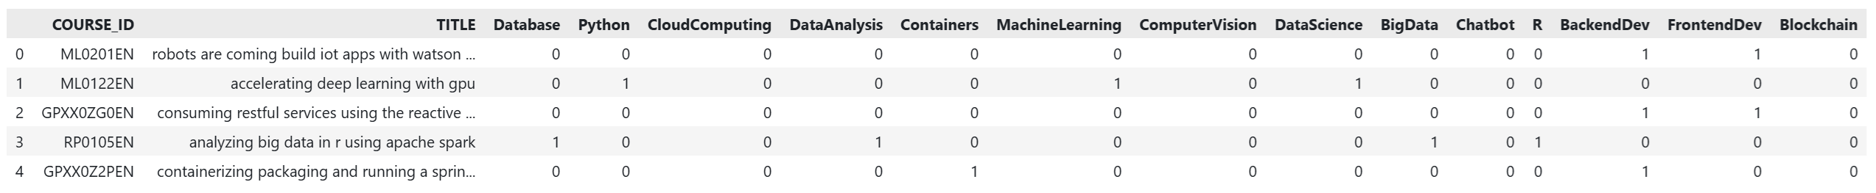
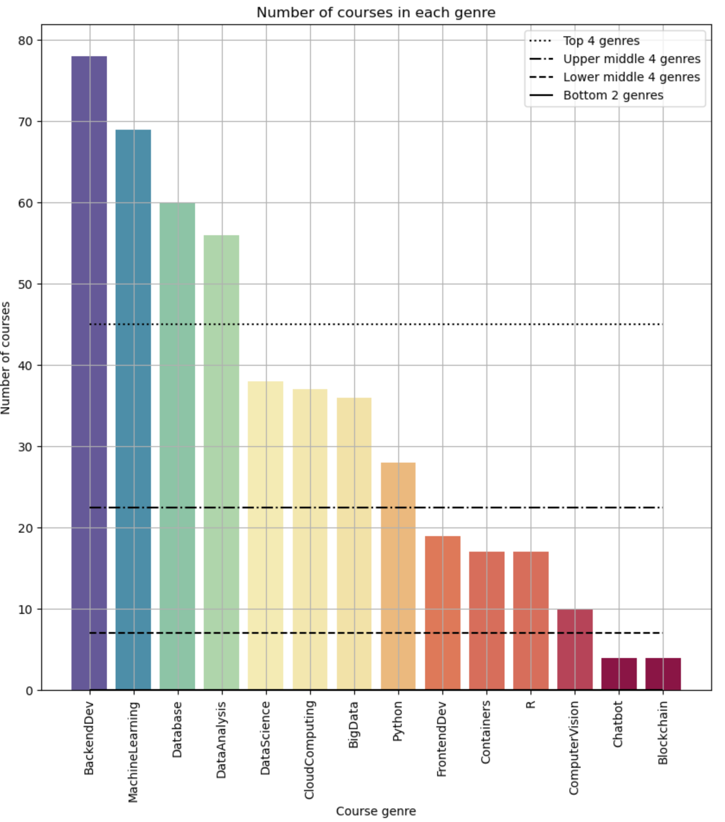
Course counts per genre
Fig 1: Table showing courses and one-hot-encoded genres
Rather than looking at a table full of ones and zeros, we can plot a bar graph showing the number of courses belonging each of our 14 genres.
We note that there appears to be a “staircase” pattern in the graph, where we can loosely group the data into 4 groups.
This could tell us something about demand from employers or student choices at university.
Fig 2: Number of course in each genre
Notes:
Place the barchart of course counts per genre here
Briefly explain the barchart in the slide notes (for peer-review purpose)
A sample bar chart may look like the following:

Slide 6
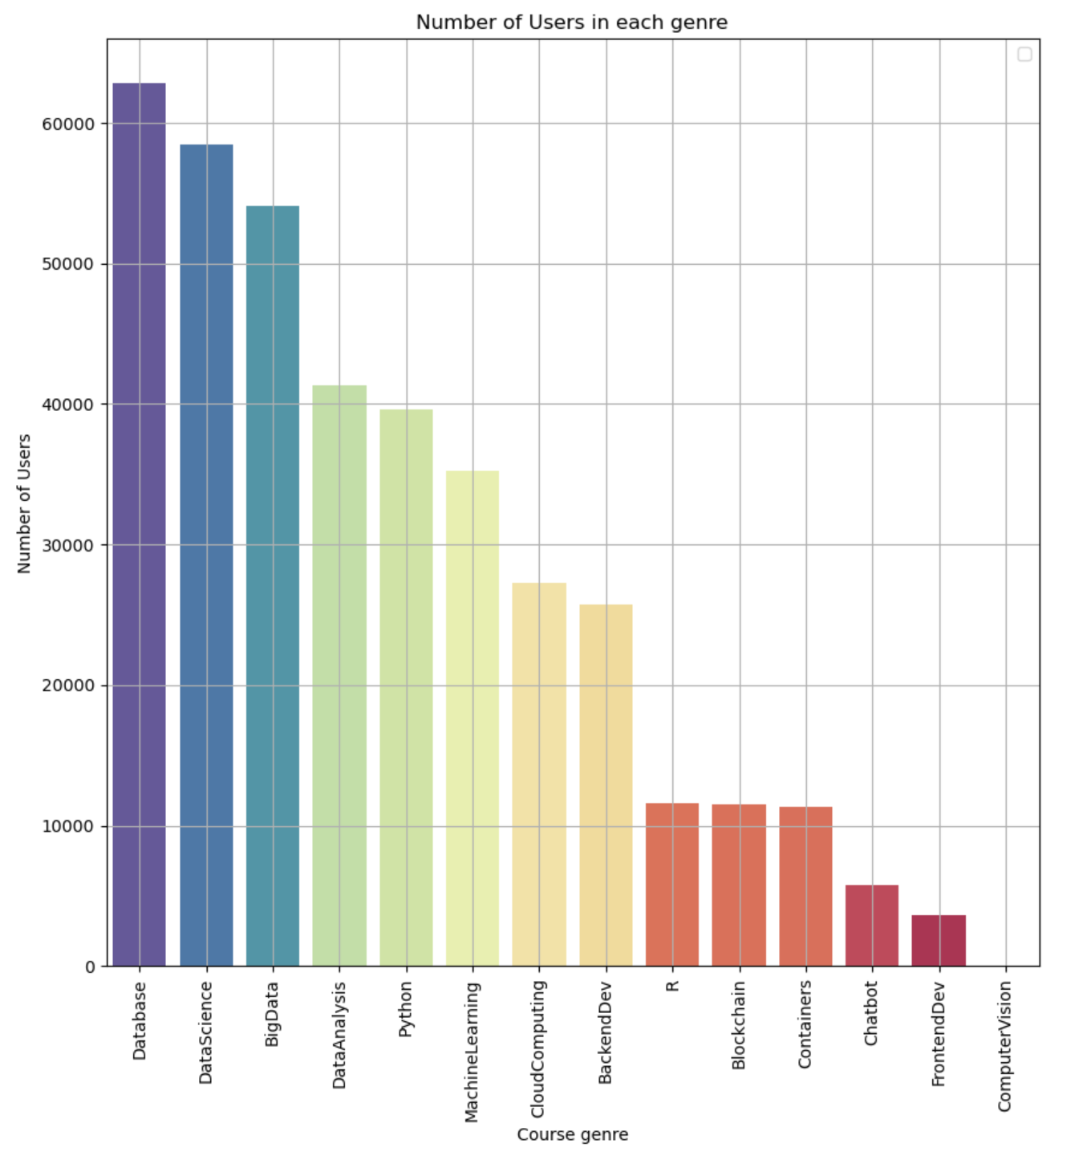
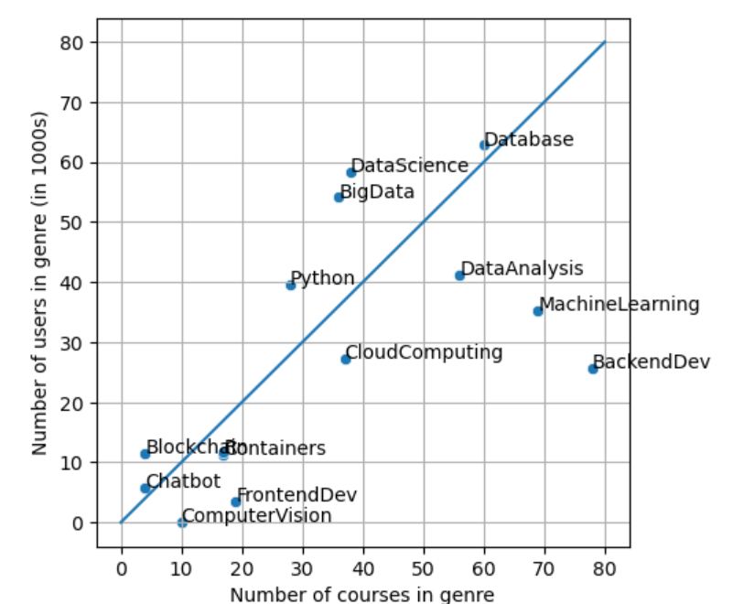
User counts per genre
Since we looked at the number of courses in each genre, let’s look at the number of users enrolled in each genre. We see that this time, “Database” is the most popular genre.
We can plot a graph of the number of users in a genre against the number of courses in a genre. Since it costs us money to host courses on our platform, this graph gives us an idea of which genres are more cost effective than others.
Fig 3: Number of users in each genre
Fig 4: Scatter plot of courses in genres vs users in genres (000s)
Notes:
- Place the histogram showing the enrollment distributions here, e.g., it clearly shows how many users enrolled in just 1 course or how many enrolled 10 courses, etc.
- Briefly explain the histogram in the slide notes (for peer-review purpose)
- A sample histogram may look like the following:

Slide 7
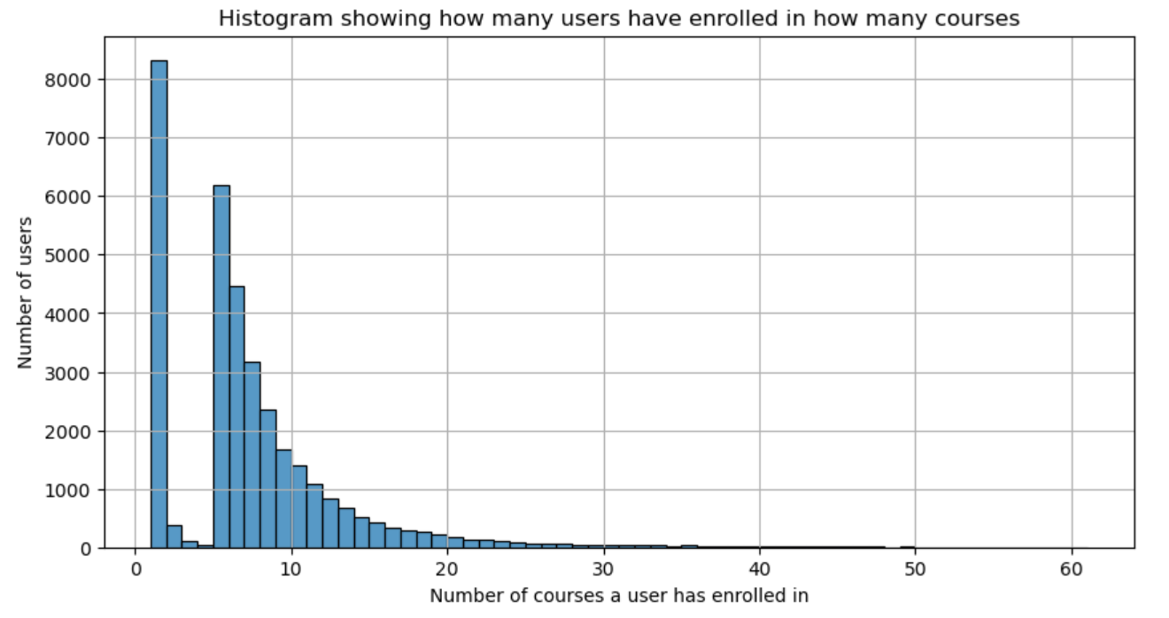
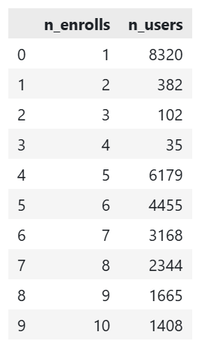
Course enrollment distribution
Now that we have looked at how many courses there are in each genre, we can look at the number of courses that users are enrolled in.
We see that there is a bimodal structure (two peaks). It is possible that there are two types of user.
The beginner: This type could be just trying out the on-line platform, thus having a low number of course enrolls.
The committed: This type could have enjoyed their experience with the platform and has now committed to learning new skills with us.
It might be worth finding out if this conjecture is true from the first group of users and pass this information on to the marketing team so that they can think of ways to retain those users.
Fig 5: Histogram of how many users have enrolled into how many courses
Notes:
- Place the histogram showing the enrollment distributions here, e.g., it clearly shows how many users enrolled in just 1 course or how many enrolled 10 courses, etc.
- Briefly explain the histogram in the slide notes (for peer-review purpose)
- A sample histogram may look like the following:

Slide 8
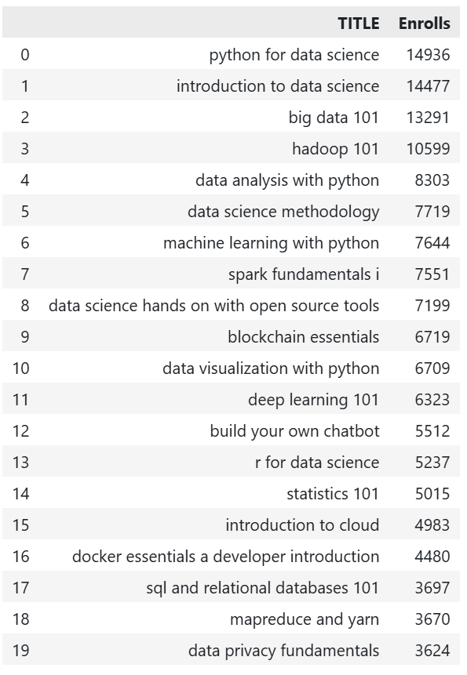
20 most popular courses
If we group our data by course instead of by user, we can see how many users are enrolled in a specific course.
By ordering the resultant table, we can find the most popular courses on our platform.
We clearly see that Data Science and Big Data with related courses on the r-language, statistics, SQL and machine learning are the most popular.
This corroborates what we saw earlier in Fig 4; that Data Science, Big Data and Database has many users.
The top 20 courses account for 63.3% of all users.
The top 53 courses account for 90.4% of all users
Fig 6: Number of users enrolled in each of the top 20 courses
Notes:
List the most popular 20 courses here
Briefly explain the course list in the slide notes (for peer-review purpose)

Slide 9
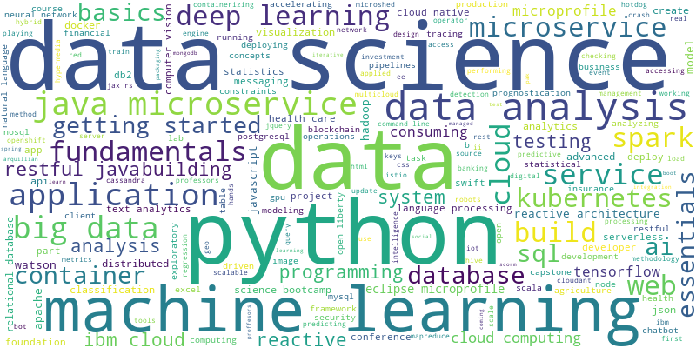
Word cloud of course titles
A way to get a qualitative feel for the data is through a word cloud.
By breaking up the course titles into individual words; we can create a picture, where the size that a word appears in the picture is proportional to the number of times it appears in the titles.
We can see that Data Science, Data, Python and Machine Learning are very big. This means that they are very common words in our course titles.
Fig 7: Word Cloud of Course Titles
Notes:
Place the word cloud (created from course titles) here
Briefly explain the word cloud in the slide note (for peer-review purpose)

Slide 10
Content-based Recommender System using Unsupervised Learning
Cluster2
Cluster1

Slide 11
Flowchart of content-based recommender system using user profile and course genres
Users have taken some courses which they have rated.
Courses belong to different genres.
Combining these data sets, we can create a user profile that says how strongly they like different genres.
We have a list of all the courses on our platform, from which we can subtract the courses the user has already taken, leaving us with courses unknown to the user.
Combining the user profiles with the unknown course genres, we can create a score of how much a user will like the unknown courses based on how much their profile says they like the genres those courses are a part of.
If the score for a course is above a set threshold, we recommend the course to that user.
If not, we do not recommend the course.
User course rating vector
Dot product
Profile Vector
User course genre matrix
Above threshold
Add to recommend list
Dot product
Score
Discard
Below threshold
Unknown course genre matrix
Fig 8: Flowchart of content base recommender system
Notes:
- Plot a flowchart which should clearly illustrate how you implemented the content-based recommender system using user profile vectors and course genre vectors
Briefly explain the flowchart in the slide note
An example flowchart may look like the following:

Slide 12
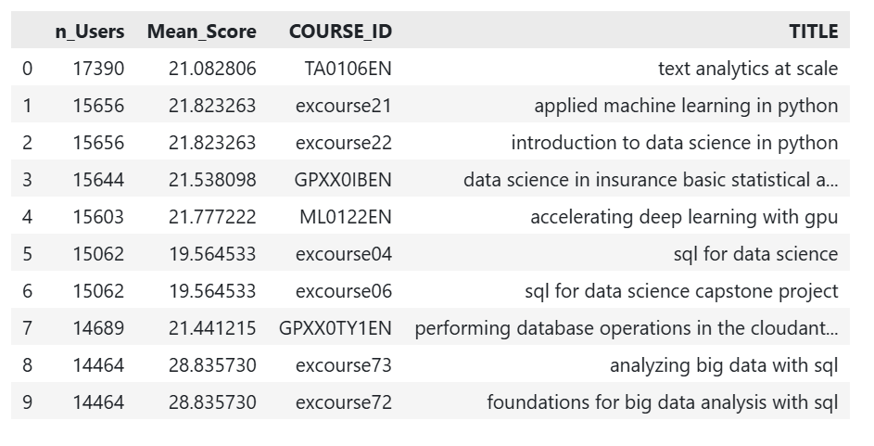
Evaluation results of user profile-based recommender system
The recommendations are based on the dot product of vectors and matrices so there are no hyperparameters in the model. The threshold for recommendation is set at a score of 10.
On average, 44.26 courses have been recommended per user (in the test user dataset) with a median of 33 courses.
However, 27.24% of users have zero recommendations as their scores are too low. While some users were given 267 recommendations.
If we have the resources, perhaps setting the threshold to zero and recommending to the users an ordered list or their own top 10 might be better.
The course recommended to the most people was TA0106EN: Text Analytics at scale. However, we see that it is not the most highly rated course. Excourse72 and Excourse73 have less mass appeal, but are rated more highly.
Fig 9: Table of top 10 courses from user profile-based recommender system
Notes:
Place your hyper-parameter settings, such as recommendation score or course similarity thresholds, etc.
Note: if you have tried multiple hyper-parameters, you may group and show all results in a grouped bar chart
On average, how many new/unseen courses have been recommended per user (in the test user dataset)
What are the most frequently recommended courses? Return the top-10 commonly recommended courses across all users

Slide 13
Flowchart of content-based recommender system using course similarity
Table with Course ID, Word and Number of times seen
Course titles and descriptions
We can break up course titles and their descriptions into individual words.
This can be used to create a dictionary that maps a word to a number and vice versa
Using the dictionary, we can make create a list of how many unique words there are and how many times they appear in a particular course title and description
Small words like “the” and “for” are not helpful is assessing similarity so we can get rid of them to create a table detailing course IDs, the words in them and how many times they appear.
We then create a pivot table with course ID as rows, words as columns and word count as values.
Individual rows form BOW feature vectors, which can be compared to each other using a similarity measure. In this case we used the cosine similarity. Comparing all rows to each other gives a look-up table (similarity matrix) showing how similar course titles and descriptions are to one another.
Courses that users take are then checked against others using the look-up table and if the similarity is above a certain threshold (we chose 0.6), then we add them to the recommendation list.
If they are below the threshold then they are not added.
Tokenization
Pivot
Create token dictionary
BOW feature matrix
BOW feature vector 2
Token dictionary
BOW feature vector 1
Similarity
Create Bag Of Words
Similarity matrix
Bag Of Words
Above threshold
Add to recommend list
Remove stopwords
Discard
Below threshold
Fig 10: Flowchart of course similarity-based recommender system
Notes:
- Plot a flowchart which should clearly illustrate how you implemented the course similarity based recommender system
- Briefly explain the flowchart in the slide note
An example flowchart may look like the following:

Slide 14
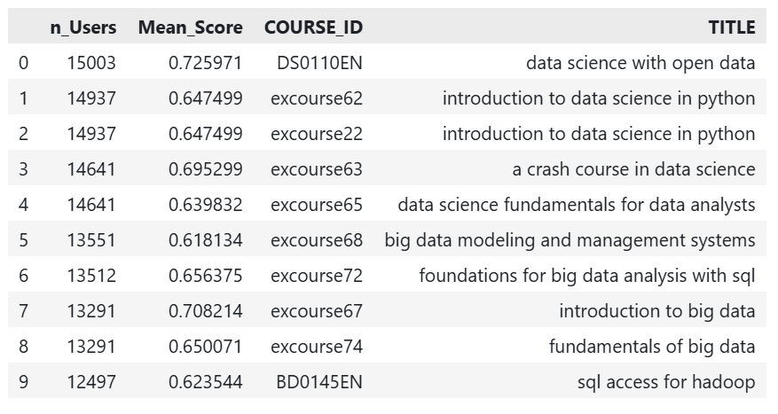
Evaluation results of course similarity based recommender system
The recommendations are based on the similarity scores of profile vectors so there are no hyperparameters in the model. The threshold for recommendation is set at a cosine similarity score of 0.6.
On average, 8.54 courses have been recommended per user (in the test user dataset) with a median of 8 courses.
However, 12.51% of users have zero recommendations as their course similarity scores are too low. While some users were given 30 recommendations.
If we have the resources, perhaps setting the threshold to zero and recommending to the users an ordered list or their own top 10 might be better.
The course recommended to the most people was DS0110EN: Data Science with open data.
Fig 11: Table of top 10 courses from course similarity-based recommender system
Notes:
Place your hyper-parameter settings, such as recommendation score or course similarity thresholds, etc.
Note: if you have tried multiple hyper-parameters, you may group and show all results in a grouped bar chart
On average, how many new/unseen courses have been recommended per user (in the test user dataset)
What are the most frequently recommended courses? Return the top-10 commonly recommended courses across all users

Slide 15
Flowchart of clustering-based recommender system
User profile vectors
Popular courses
Starting from our user profile vectors we need to scale the data, both Principal Component Analysis (PCA) and K-Nearest Neighbours (KNN) use distance metrics, so the data must be on the same scale.
KMeans clustering uses distances between points and consequentially suffers from the curse of dimensionality, so we use PCA to reduce the dimensionality of the dataset. This transforms the genres of our profile vectors into linear combinations of genres.
With our reduced dimensionality dataset, we can perform KMeans clustering, searching of different numbers of clusters (k) to find “good” clusters, which we judge using the elbow method and the silhouette score. This allows us to assign users to different clusters.
Once users and their courses have been clustered, we can look at the most popular courses in each cluster. In this case, we measure popularity by number of enrollments. We set a threshold of 100 to limit results.
Those below 100 enrollments are discarded.
For each user, we can recommend popular courses in their cluster, removing those that the user has already enrolled in.
Scaling
Exclude enrolled
PCA
Add to recommend list
Reduced dimensionality dataset
Gridsearch over k for KMeans
Above popularity threshold
Course clusters
Discard
Get popular courses in each cluster
Below popularity threshold
Fig 12: Flowchart of clustering-based recommender system
Notes:
Plot a flowchart which should clearly illustrate how you performed user profile clustering based recommender system
- Briefly explain the flowchart in the slide note
An example flowchart may look like the following:

Slide 16
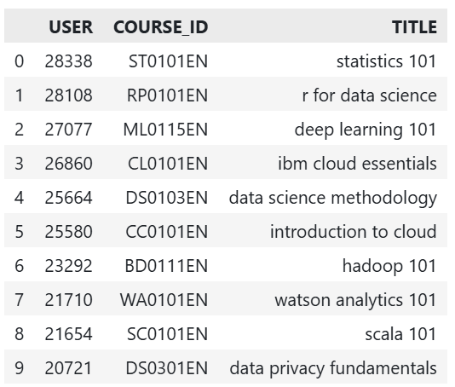
Evaluation results of clustering-based recommender system
We used 9 PCA components, 12 clusters (k=12) and 100 enrollments as the threshold for course popularity.
On average, 26.75 courses have been recommended per user (in the test user dataset) with a median of 30 courses.
Unlike our previous recommender attempts, only 0.62% of users have zero recommendations. We see that there is a cluster (4) that has low numbers of enrollment and that is filtered out by the 100-user enrollment threshold.
If we have the resources, perhaps setting the threshold to zero and recommending to the users an ordered list or their own top 10 might be better.
The course recommended to the most people was ST010EN: Statistics 101. There is no score this time as we are looking popular courses within clusters.
Fig 13: Table of top 10 courses from clustering-based recommender system
Notes:
Place your hyper-parameter settings, such as recommendation score or course similarity thresholds, etc.
Note: if you have tried multiple hyper-parameters, you may group and show all results in a grouped bar chart
On average, how many new/unseen courses have been recommended per user (in the test user dataset)
What are the most frequently recommended courses? Return the top-10 commonly recommended courses across all users

Slide 17
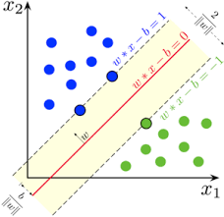
Collaborative-filtering Recommender System using Supervised Learning

Slide 18
Flowchart of KNN based recommender system
Starting with the User-item interaction matrix, which tells you how users rated courses, we encode the users and items by turning them into numbers with a look up dictionary.
The next step depends on the type of collaborative filtering we wish to perform. In our case we found that item-based filtering gave a better root mean squared error (RMSE).
To recommend courses to users, item-based filtering uses the similarity between items (courses). We used the cosine similarity measure.
We go through the list of courses, find the k most similar courses to each of them and how other users rated those similar courses. We then multiply the ratings of the similar courses by how similar we found the courses to be (cosine similarity). The value of k is found by searching over many values and picking the one that minimizes the RMSE.
Using the value of k that we found, we can then calculate the predicted rating for an item by adding up the multiplied user ratings and similarities and then dividing by them by the sum of the similarities.
If the ratings are predicted to be high, we can recommend them
If not, then we don’t recommend them.
User-Item interaction matrix
Label encode users and items
User based
Item based
Similarity between users
K-nearest users’ ratings for item
Similarity between items
User ratings for K-nearest items
Gridsearch over k for KNN
Gridsearch over k for KNN
Rating
Below threshold
Above threshold
Discard
Add to recommend list
Fig 14: Flowchart of KNN-based recommender system
Notes:
Plot a flowchart which should clearly illustrate how you performed KNN based recommender system using course enrollments history
- Briefly explain the flowchart in the slide note
An example flowchart may look like the following:

Slide 19
Flowchart of NMF based recommender system
Non-negative matrix factorization is about breaking up a large matrix into two smaller matrices with latent features. We begin with the User-item interaction matrix, which tells us how users rated different courses.
We then create two new matrices. The first matrix is the User matrix, the rows of which are the users and columns of which represent our latent features. We chose a latent feature size of 100.
The second matrix is the item matrix, the rows of which represent our 100 latent features and the columns of which represent the items (courses).
The dot product (matrix multiplication) of the two matrices relate the users from the first matrix to the items in the second matrix giving us back a predicted rating. At first, this predicted rating will be gibberish, because we haven’t said how the latent features relate to the users or items. That is something we need to find by performing gradient descent over the mean squared error between the true and predicted rating.
Once we have minimized the error, we have our best predictions for the ratings.
If the predicted ratings are high, then we recommend the items (courses) to the users.
If not, them we don’t recommend them.
User-Item Interaction matrix
Create User matrix
Create item matrix
Dot product
Gradient Descent
Not minimised
Not minimised
Minimised
Ratings
Below threshold
Above threshold
Discard
Add to recommend list
Fig 15: Flowchart of NMF-based recommender system
Notes:
- Plot a flowchart which should clearly illustrate how you performed NMF based recommender system
- Briefly explain the flowchart in the slide note
An example flowchart may look like the following:

Slide 20
Flowchart of Neural Network Embedding based recommender system
User-Item Interaction matrix
Much like how NMF used latent features to encode information about how users can be related to items, we are going to create an embedding layer for users and items and use a neural network to predict user ratings.
We create 2 vectors, one for users and one for items (courses)
We then pass each of them into their own embedding layer (which we can control the size of) just like we did for the latent features of NMF
These embedding layers encode information about how the users and items interact and they are fed into a dense layer, which helps account for non-linear relationships.
From here we compute the dot product of the dense layers and send them through a sigmoid function to make sure the predictions come out in a 0 – 1 range. Since the ratings came in the range 3 – 5, we need to multiply the output from the neural network by 2 and then add 3.
Now that we have our predicted ratings, if they are high, we can recommend those courses
If the predicted ratings are low, then we don’t recommend the course to those users.
User vector
Item vector
User embedding
Item embedding
Dense Layer
Dense Layer
Dot product
Sigmoid
Ratings
Below threshold
Above threshold
Discard
Add to recommend list
Fig 16: Flowchart of Neural Network Embedding-based recommender system
Notes:
- Plot a flowchart which should clearly illustrate how you performed Neural Network Embedding based recommender system
- Briefly explain the flowchart in the slide note
An example flowchart may look like the following:

Slide 21
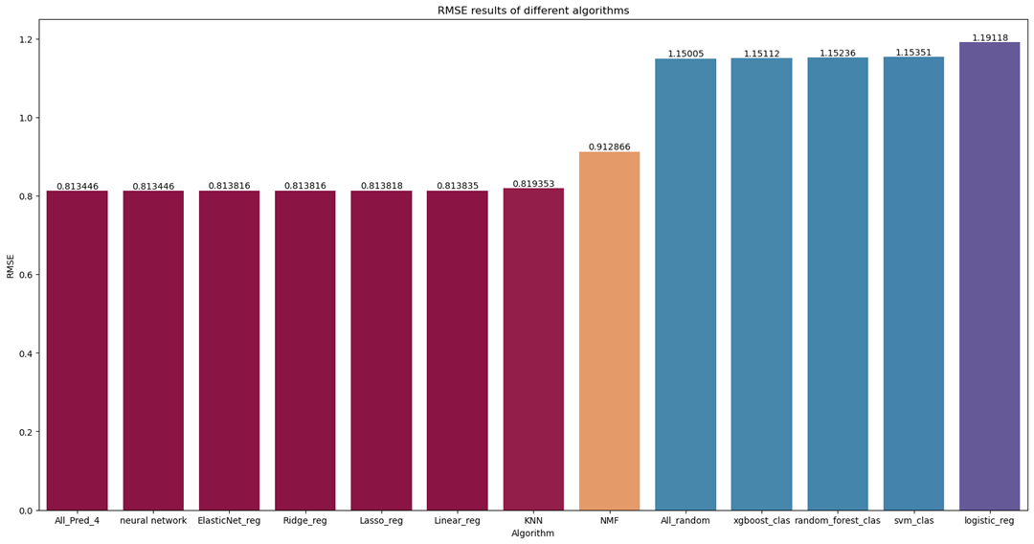
Compare the performance of collaborative-filtering models
Collaborative filtering methods did poorly in our testing. We know that our rating system is between 3 and 5. RMSE is minimized by predicting 4 for all items (courses).
Only the neural network was able to perform the same as predicting all 4s and that was by also predicting all 4s.
Using Machine learning classification algorithms on the embedding weights did very poorly equaling the RMSE for completely random predictions.
Fig 17: Bar chart showing the RMSE for different algorithms for collaborative-filtering recommender systems
Notes:
Plot a barchart visualizing the performance metric (such as RMSE) of different collaborative-filtering models you have built so far
Briefly explain the barchart in the slide note
A sample barchart may look like the following

Slide 22
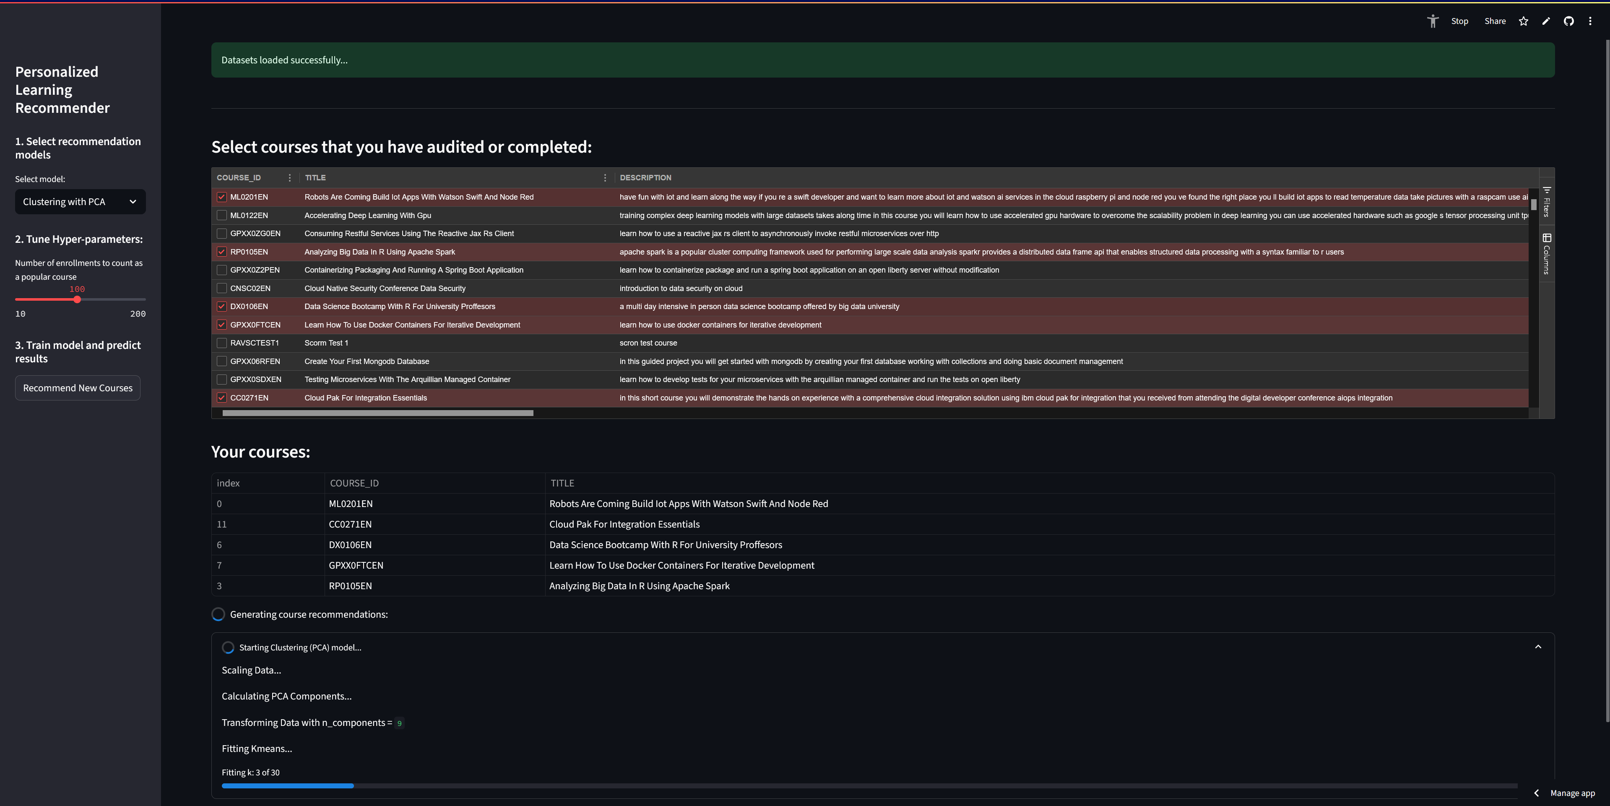
Streamlit course recommender system app (screenshot 1) https://app2-8iudwu6jwezqbwdhtgsh24.streamlit.app/

Slide 23
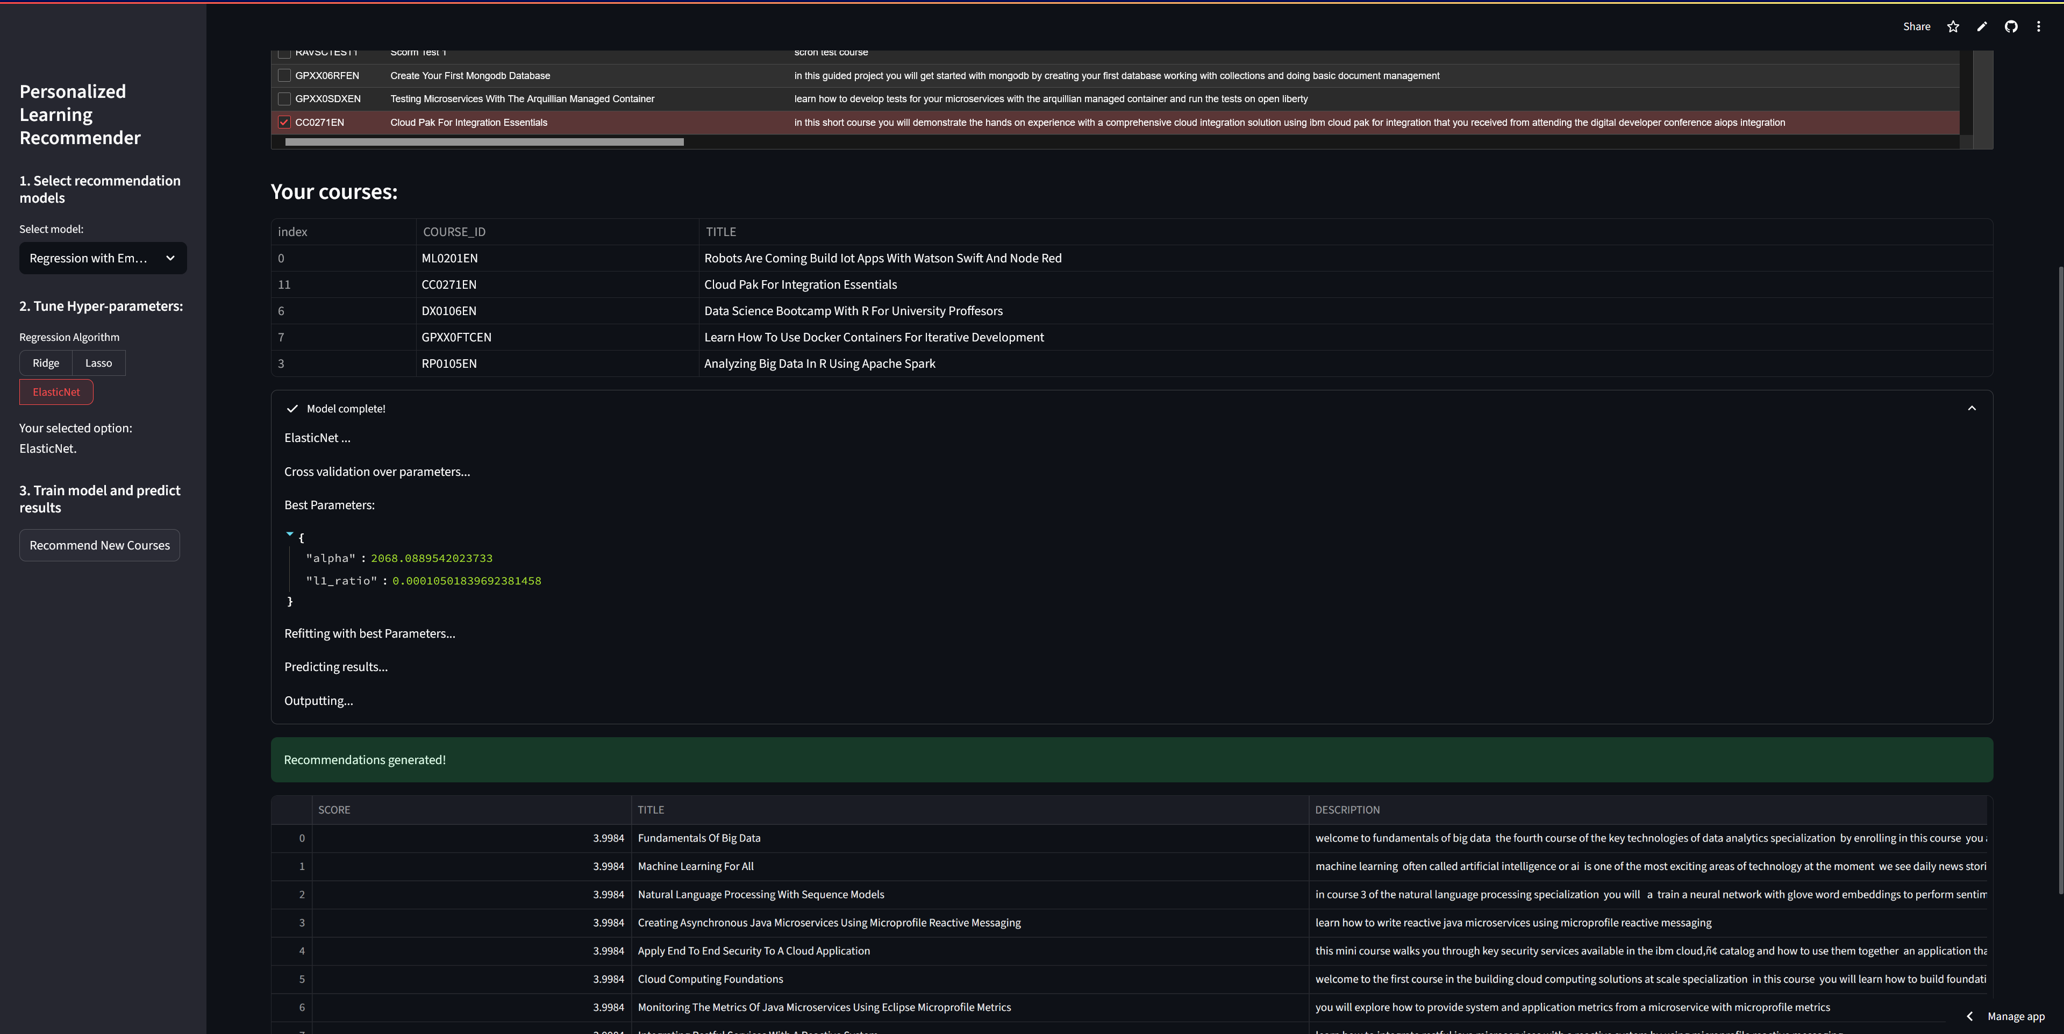
Streamlit course recommender system app (screenshot 2) https://app2-8iudwu6jwezqbwdhtgsh24.streamlit.app/

Slide 24

Conclusions
Content based recommender systems performed better than collaborative-filtering recommender systems for our dataset. As can be seen from Fig 17, the best RMSE is for the neural network model and that predicted all ratings of 4, which is the middle value in a rating system of 3, 4 and 5. We rule these out as candidates for our recommender system.
For the 3 content-based recommenders:
Clustering content-based recommenders have the consideration that some clusters are filtered out for having too few entries, but this can be remedied by adjusting the value of k in KMeans. There is also a scalability issue: as the number of genres on our platform increase, the features in the user profiles will increase. This can be mitigated somewhat by using PCA and while this may become an issue in the future, it only scales as O(n). On the downside, this is a more involved process than the other content-base recommenders.
Course similarity score models have no hyperparameters, but it does require calculating the similarities between all pairs of courses, which scales as O(n^2). However, while the scaling is of a higher order, the calculation does not need to be done unless a new course is added, whereas users will complete courses relatively more often.
User profile recommender systems only rely on dot products, but the profile vectors need to be updated every time a user completes a course so it scales as O(n), which may be more often than new courses are added. In addition, the user profiles may not give as tailored results as course similarities as those models may pick up on specific words in previously taken courses.
We believe that course similarity scores are the best choice for our company.

Slide 25

Appendix
All raw files for this course can be found in the raw files folder:
https://github.com/vishpuro/Streamlit2.git
The streamlit app can be found
https://app2-8iudwu6jwezqbwdhtgsh24.streamlit.app/

