Slide 1
A Study of Different SDN Controllers in a Wireless Environment using Mininet-WiFi
Student’s Name: Vishrut Sundararajan
Course : TELE6400 (SDN), Semester: Fall 2020
Professor’s Name: Prof. Dr. Bhumip KHASNABISH
Presentation Date, Location & Time: 12/15/2020, Virtual, 6pm-9:30pm

Slide 2
Outline
Abstract and Summary
Main Focus of the Project
Survey of Previous works
Distinction of the Current Work
Usefulness of the Current Work
Simulation/Emulation Details
Results
Future works
Q&A and Discussion
References
Background and Other Information

Slide 3
Abstract
The performance of controllers has been extensively studied in numerous wired SDN network simulations.
However, considering wireless networks to be the future of technology, it is imperative that the performance of the standard SDN controllers be studied in greater detail in a wireless network simulation as well.
Here, I propose to use Mininet-WiFi software, for creating and emulating simple wireless network topologies in an SDNized environment.

Slide 4
Summary
In this project, I propose to create various wireless network topologies of different complexities and aim to conduct an analytical study of the performance of different SDN controllers in a wireless environment. Based on the results I get, I will conclude my study by declaring the best SDN controller for a wireless environment.

Slide 5
Main Focus of the Project
We study the performance of different SDN controllers with a single and linear wireless topology.
We analyse the following parameters: Delay, Throughput and Jitter.

Slide 6
Parameters Studied
Delay: The time taken between the packet transmission and the packet reception is known as delay.
Throughput: The amount of data that is successfully transmitted between two end systems is known as throughput.
Jitter: The variation in the delay is known as jitter.

Slide 7
Survey of 5 Previous Similar Works (over last 3 years or so)
Arahunashi et al. [1] conducted an extensive study of the performance of SDN controllers in a wired network environment, using Mininet. They constructed networks of different topologies (ie, linear, tree and mesh), and analysed the performance of the controllers in terms of their delay and throughput in these network simulations.
Fortes et al. [2] introduce the fork called Mininet-WiFi and provide a thorough explanation about its different features.

Slide 8
Survey of 5 Previous Similar Works (over last 3 years or so)
Islam et al. [3] conduct a comprehensive study of the performance of SDN controllers in a wireless network environment, using Mininet-WiFi. They construct a simple linear topology and study the performance parameters of various controllers by analysing their jitter, delay and throughputs.
Juhana et al. [4] study the performance of a Software-Defined Wireless Network. They consider three common network scenarios, and study the delay, jitter and packet loss in the network in each of the scenarios.

Slide 9
Distinction of the Current Work
In this work, I use a simple graphical tool called gnuplot to create the delay and throughput graphs.
Gnuplot is a very simple tool to use, especially in a Linux environment, and this is what made me choose this tool for my project.

Slide 10
Usefulness of the Current Work
This work primarily aims to popularize the Mininet-WiFi fork of Mininet, which would be a useful resource in understanding SDNized wireless networks in greater depth.
By studying the performance of SDNized wireless networks with different controllers, we can have a better understanding of the controllers themselves and how the popular SDN controllers will impact the SDNization of wireless networks.

Slide 11
Simulation/Emulation Details (Environment and Setup)
Environment: Mininet-WiFi version 2.5
OS: Ubuntu 18.04 LTS
Host RAM: 8 GB
VM RAM: 2 GB
Setup Details: I create a single topology with one access point and three stations.
I also create a linear topology with three access points and three stations.

Slide 12
Simulation/Emulation Details (Tools and Monitoring Options)
Controllers used: Ryu, Pox
Parameters monitored: Delay, Throughput, Jitter
Tools used: gnuplot

Slide 13

Environment – Mininet WiFi

Slide 14
Environment – Mininet WiFi
A fork of the Mininet SDN network emulator
Extends Mininet’s functionalities by adding virtualized WiFi stations and access points
Uses standard Linux wireless drivers and the 80211_hwsim wireless emulation driver
Also supports normal Mininet operations

Slide 15
Components in Mininet WiFi
Stations: Any devices that can connect to an access point after successful authentication and authorization. Analogous to hosts in Mininet.
Access Points: These are devices that oversee all the stations that are connected to it. Analogous to switches in Mininet.

Slide 16
Tool Used - Gnuplot
Command-line graphing utility tool designed to operate on various platforms
Objective was to enable scientists and students to easily present mathematical and statistical data in a graphical manner

Slide 17
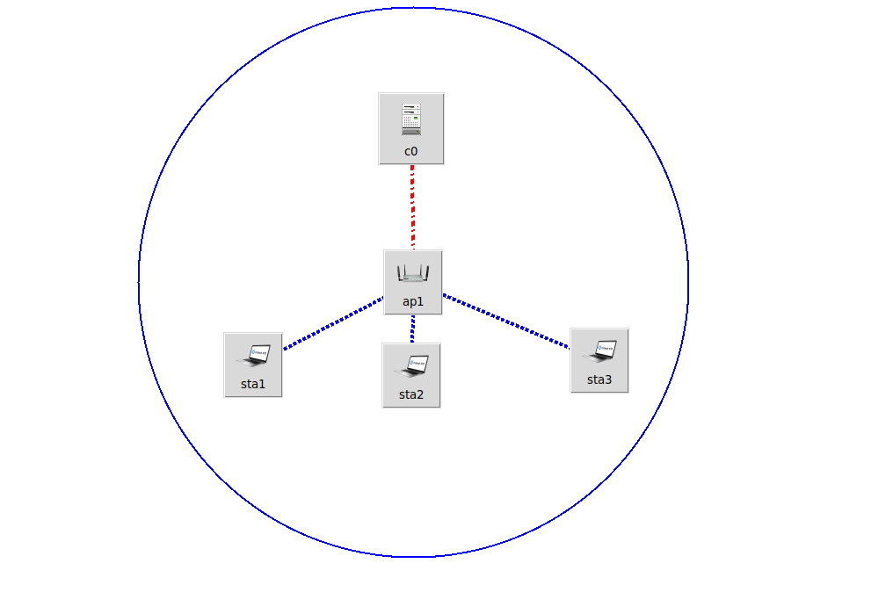
Results
Single Topology structure:

Slide 18
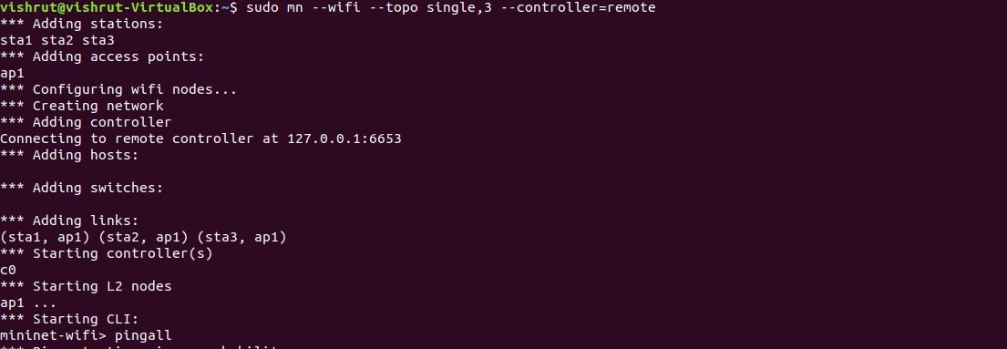
Results
Single topology using Ryu:

Slide 19
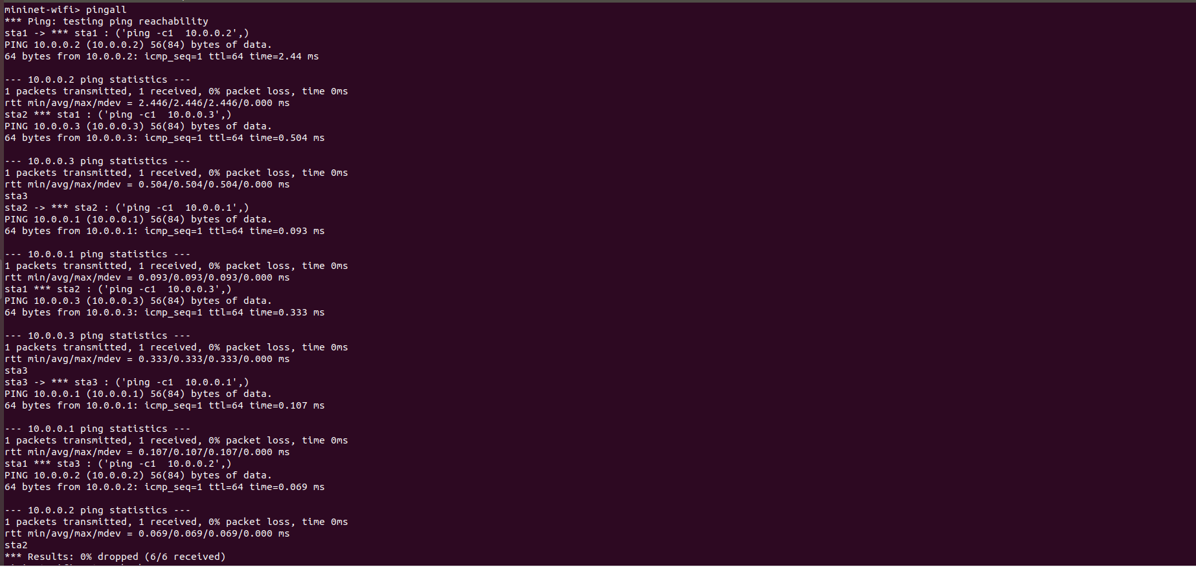
Results
Successful working of topology:

Slide 20
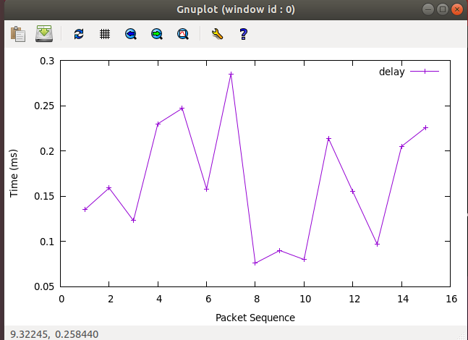
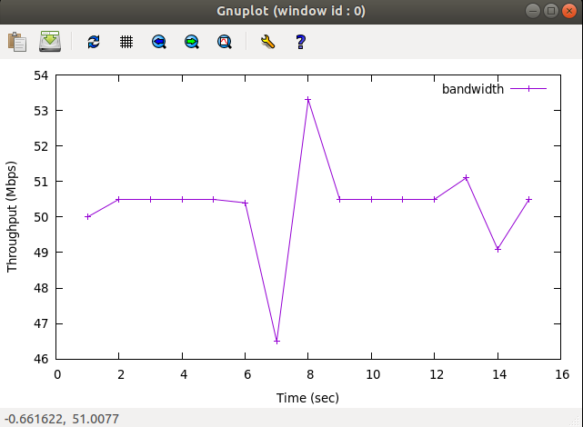
Results
Delay and Throughput graphs for this topology using Ryu:

Slide 21
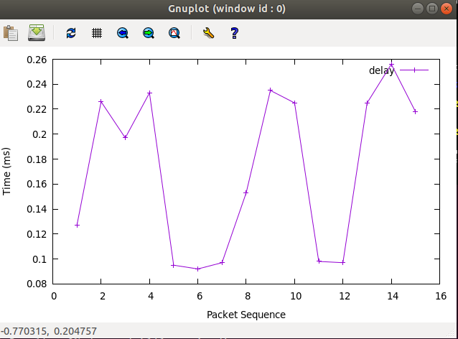
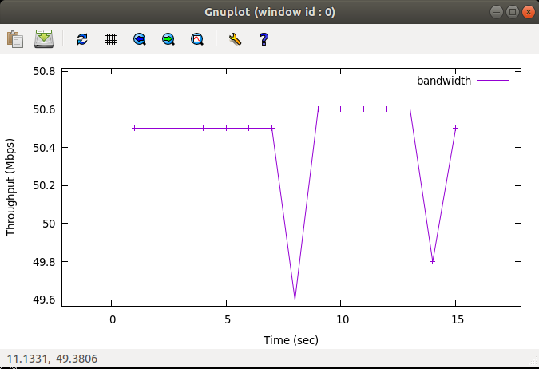
Results
Delay and throughput for this topology using Pox:

Slide 22
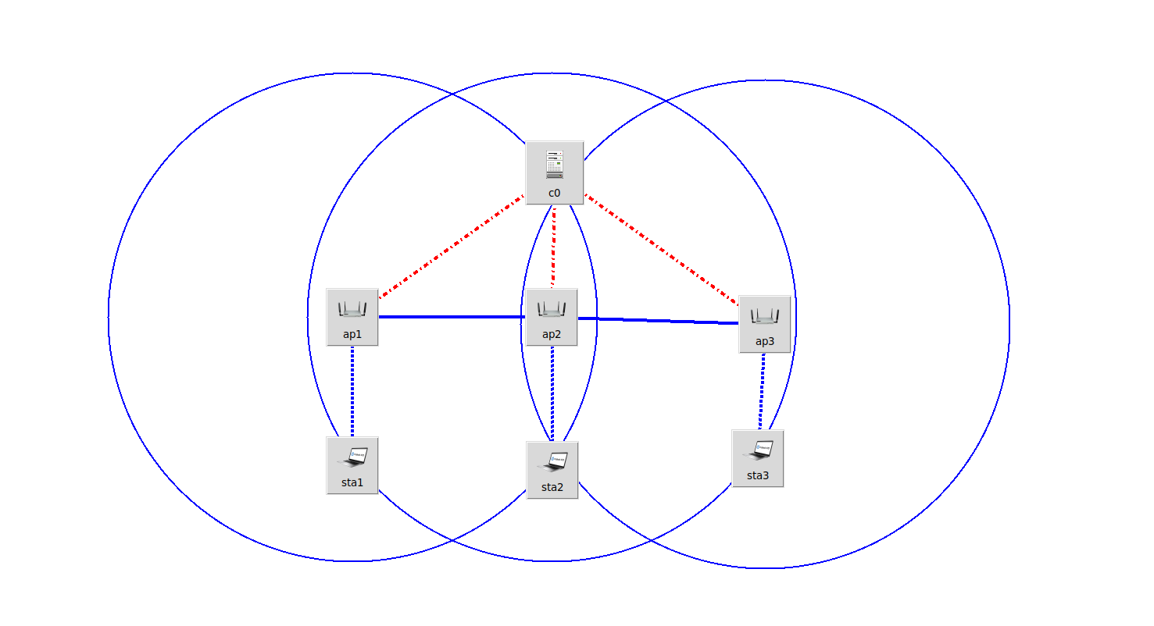
Results
Linear topology structure:

Slide 23
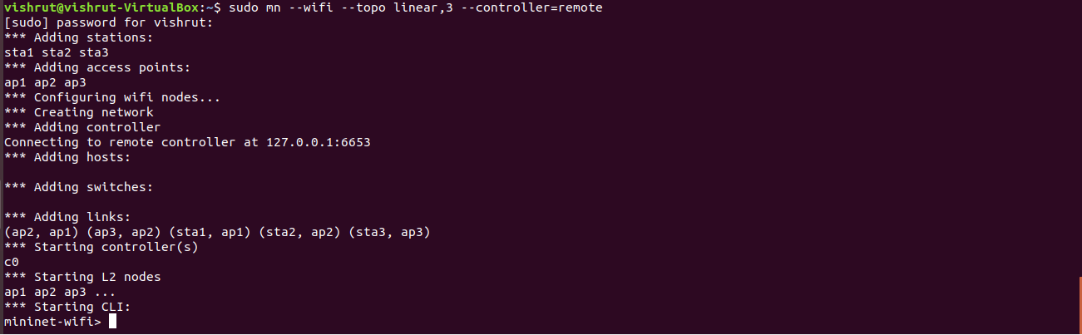
Results
Linear topology with 3 stations and 3 access points:

Slide 24
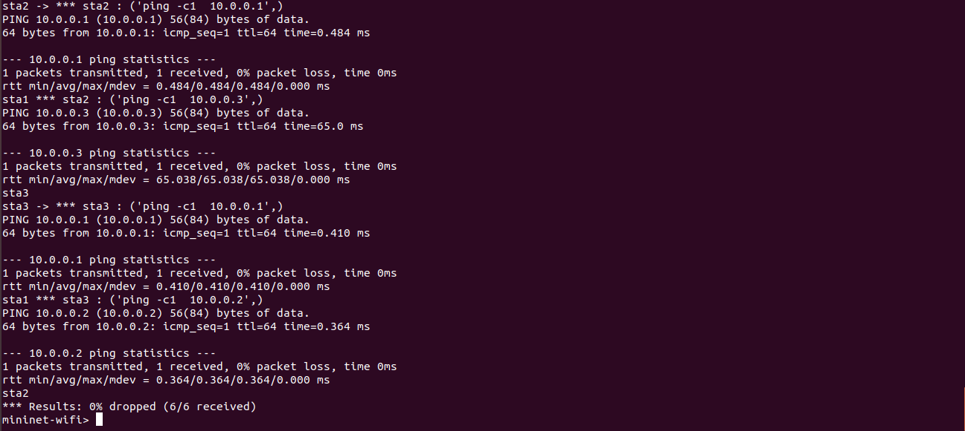
Results
Linear topology working:

Slide 25
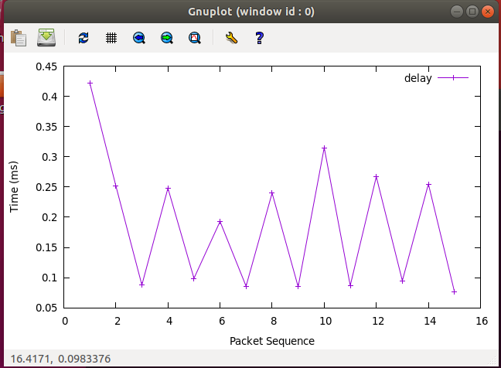
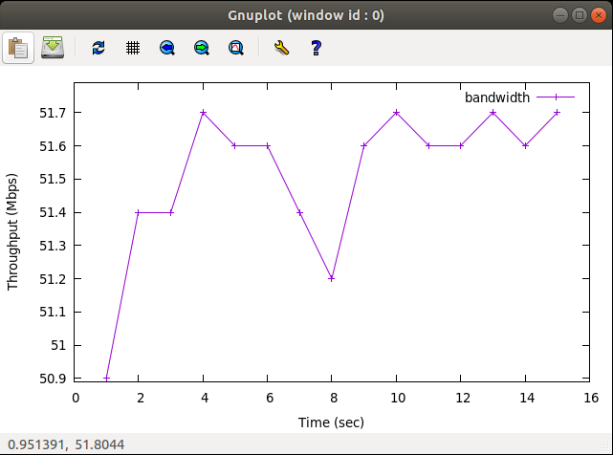
Results
Delay and Throughput graphs for this topology using Ryu:

Slide 26
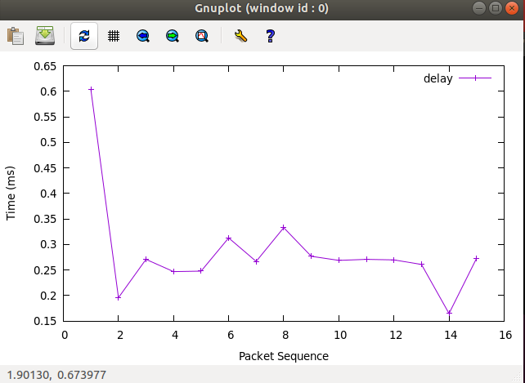
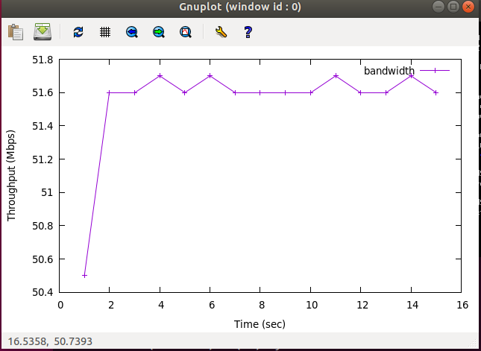
Results
Delay and Throughput graphs for this topology using Pox:

Slide 27
Inference
Delay and throughput values are similar for Ryu and Pox controllers
Pox has less jitter as compared to Ryu
Change in topology has negligible impact on the values of delay, throughput and jitter
From the above results, I would conclude that Pox is the better controller owing to its lower jitter

Slide 28
Future Works
This work can be expanded by including more controllers into the study, like OpenDaylight and Floodlight.
Mininet-WiFi is relatively new, but it has a great potential in the SDNization of wireless networks as its functionality improves with each passing day.

Slide 29
References
1. A. K. Arahunashi, S. Neethu and H. V. Ravish Aradhya, "Performance Analysis of Various SDN Controllers in Mininet Emulator," 2019 4th International Conference on Recent Trends on Electronics, Information, Communication & Technology (RTEICT), Bangalore, India, 2019, pp. 752-756, doi: 10.1109/RTEICT46194.2019.9016693. https://ieeexplore.ieee.org/document/9016693
2. R. R. Fontes, S. Afzal, S. H. B. Brito, M. A. S. Santos and C. E. Rothenberg, "Mininet-WiFi: Emulating software-defined wireless networks," 2015 11th International Conference on Network and Service Management (CNSM), Barcelona, 2015, pp. 384-389, doi: 10.1109/CNSM.2015.7367387. https://ieeexplore.ieee.org/document/7367387

Slide 30
References
3. S. Islam, M. A. Islam Khan, S. Tasnim Shorno, S. Sarker and M. A. Siddik, "Performance Evaluation of SDN Controllers in Wireless Network," 2019 1st International Conference on Advances in Science, Engineering and Robotics Technology (ICASERT), Dhaka, Bangladesh, 2019, pp. 1-5, doi: 10.1109/ICASERT.2019.8934553. https://ieeexplore.ieee.org/document/8934553
4. T. Juhana and F. H. Ilma, "SDN-Based Wireless Network Performance Evaluation," 2019 International Conference on Electrical Engineering and Informatics (ICEEI), Bandung, Indonesia, 2019, pp. 428-433, doi: 10.1109/ICEEI47359.2019.8988878. https://ieeexplore.ieee.org/document/8988878

Slide 31





Q&A and Discussion
Thanks for Your KIND Attention
Discussion

Slide 32
Background and Other Information

Slide 33
Weekly Activities Log
Week No. | List of Tasks (Planned) | Log of Achievements, Errors, and Learning
03 | Finalize project topic and submit project proposal | Submitted project proposal and got approval from instructors.
04 | Collection of papers related to Mininet-WiFi and performance study of controllers | Successfully collected a few quality papers on the topics, and using them as reference material throughout this project.

Slide 34
Weekly Activities Log
Week No. | List of Tasks (Planned) | Log of Achievements, Errors, and Learning
05 | Installation of Mininet-WiFi fork and testing its working without any remote controller | Successfully installed Mininet-WiFi on Ubuntu 18.04 LTS and tested its working with default controller, with the pingall command.
06 | To study the Mininet-WiFi manual in detail and to attempt creating basic topologies in Mininet-WiFi. | Studied the Mininet-WiFi manual to get a better understanding of the Mininet-WiFi fork and tried the basic commands listed in the manual.

Slide 35
Weekly Activities Log
Week No. | List of Tasks (Planned) | Log of Achievements, Errors, and Learning
07 | Test the working of Mininet-WiFi using Ryu | Created a single and linear topology in Mininet-WiFi with Ryu as the remote controller, and successfully tested its working.
08 | Start working on the presentation | Started working on the presentation and added information about my project.

Slide 36
Weekly Activities Log
Week No. | List of Tasks (Planned) | Log of Achievements, Errors, and Learning
09 | Install OpenDaylight and Floodlight controllers to study their performance with Mininet-WiFi. | Faced difficulties in installing OpenDaylight and Floodlight on my Ubuntu VM.
10 | Construct single and linear topologies in Mininet-WiFi and test their working with Pox | Successfully tested their working with Pox controller

Slide 37
Weekly Activities Log
Week No. | List of Tasks (Planned) | Log of Achievements, Errors, and Learning
11 | Study the gnuplot tool and learn how it can be used in my project. | Studied the working of gnuplot and plotted a few rough graphs to get familiar with the tool.
12 | Use gnuplot in tabulating the delay and throughput graphs with both Ryu and Pox controllers. | Plotted the required delay and throughput graphs using gnuplot and added them to the presentation.

Slide 38
Weekly Activities Log
Week No. | List of Tasks (Planned) | Log of Achievements, Errors, and Learning
13 | Collect all information and results obtained so far and proceed with presentation | Successfully included the results I was able to obtain thus far into my project presentation.
14 | Complete all tabulations and finalize project presentation | Completed the final presentation

