Slide 1
DISTRIBUTED REALTIME CHAT
Quick Overview
A containerized realtime chat and collaboration platform with local AI assistance.
PROJECT MEMBERS
Vishrut Bhushan — 2025H1120143P
Prishiv Singh Jamwal — 2025H1120152P
Ajay Badrinath — 2025H1120142P

Slide 2
01 / OVERVIEW
What Distributed Realtime Chat provides
A browser-based collaboration tool backed by gRPC microservices, Docker, and a local LLM.
COMMUNICATION
COLLABORATION
LOCAL INTELLIGENCE
Direct 1-on-1 messaging
Group chats
Realtime sync across browser windows
Presence indicators
File sharing for images and PDFs
Admin controls for groups
Smart reply suggestions
Conversation summaries
Runs through a dedicated local LLM service
Designed for local, repeatable execution with persistent Docker-backed data.

Slide 3
02 / PREREQUISITES
What is needed before starting
The application is intended to be run locally through Docker Compose.
REQUIRED
PROJECT INPUTS
LOCAL ENDPOINTS
Docker Desktop / Docker Engine
Docker Compose
A browser
At least 4 GB RAM recommended for the local LLM
Repository checkout
Internet access for the first image/model build
Ports available: 8000, 50051, 50060
Web UI: http://localhost:8000
App gRPC: localhost:50051
LLM gRPC: localhost:50060
Logs: logs/app.log

Slide 4
03 / QUICK REFERENCE
Start, inspect, and stop
The commands below are the main offline operating steps.
START
LOGS
STOP
Use the platform script:
Windows: scripts\start.ps1
macOS/Linux: scripts/start.sh
File: logs/app.log
Use the platform script:
Windows: scripts\stop.ps1
macOS/Linux: scripts/stop.sh
Web UI: http://localhost:8000

Slide 5
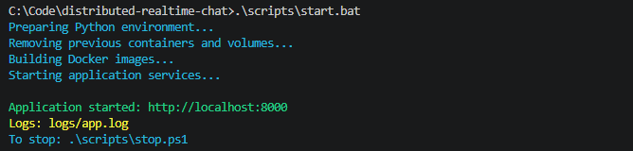
04 / START
Starting & Stopping the application
The start script builds the images and starts the application services. The stop script brings it down.
WHAT THIS SHOWS
The stack reports the web URL, the log location, and the command used to stop the services.

Slide 6
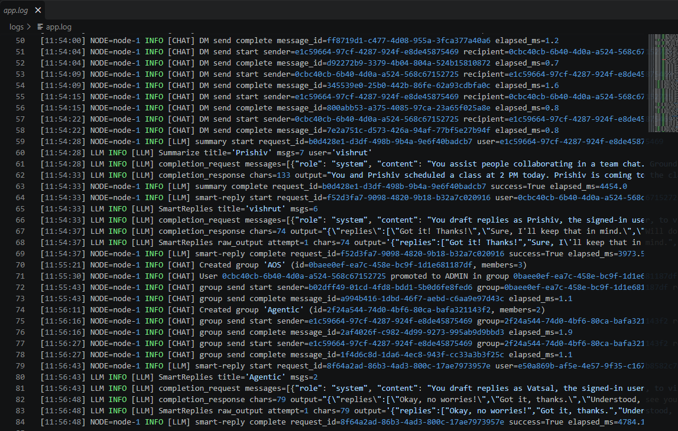
05 / LOGS
Viewing application logs
Operational activity is available in the repository log file.
WHAT THIS SHOWS
Logs show chat sends, group actions, LLM calls, request IDs, elapsed time, and success status.
logs/app.log

Slide 7
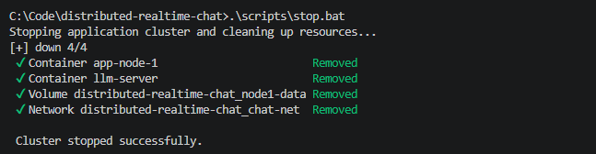
06 / STOP
Stopping the application
The stop script removes the containers and network cleanly.
WHAT THIS SHOWS
A clean stop avoids lingering background processes and makes the next run predictable.

Slide 8
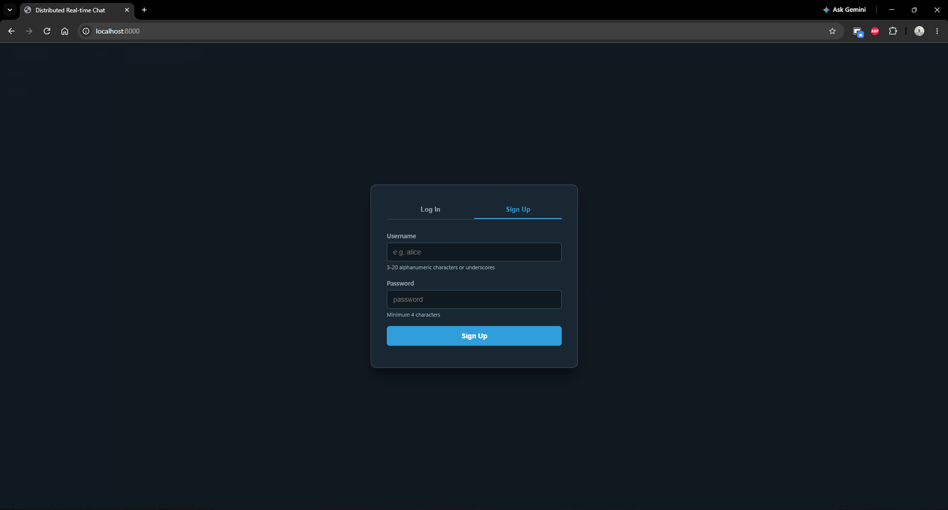
07 / ACCESS
Signup and login
Users create their own accounts; the interface enforces username and password rules.
WHAT THIS SHOWS
The UI shows the username format requirement and minimum password length before a user enters the chat.
Signup form

Slide 9
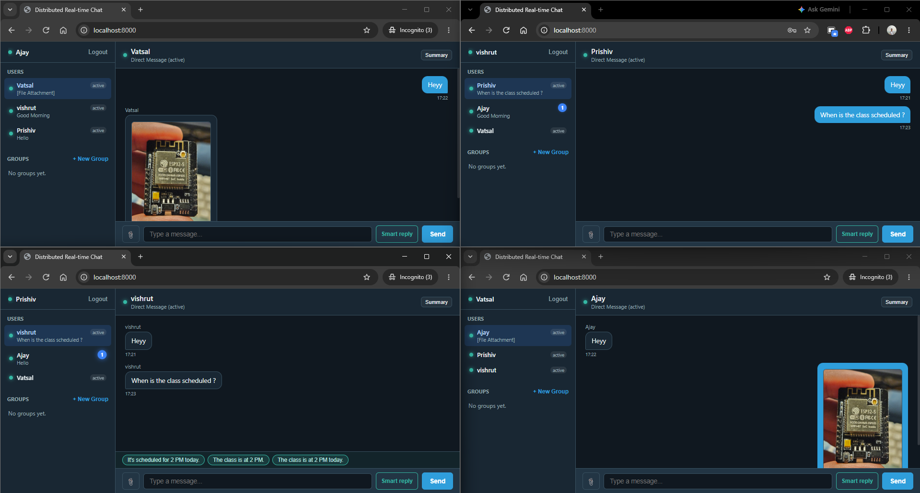
08 / REALTIME MESSAGING
Message passing across four browser windows
A single chat state is visible across multiple independent clients.
WHAT THIS PROVES
Multiple users are logged in.
Messages arrive without a manual refresh in the exact order.
The same conversation state is synchronized across clients.
Four-window screenshot: Ajay, Vishrut, Prishiv, and Vatsal.

Slide 10
09 / FILES
File sharing
Images can be rendered inline in chat, while PDFs are available as downloadable attachments.
WHAT THIS SHOWS
The chat view keeps the file attached to the conversation and makes the shared content visible to recipients.
Inline attachment in chat

Slide 11
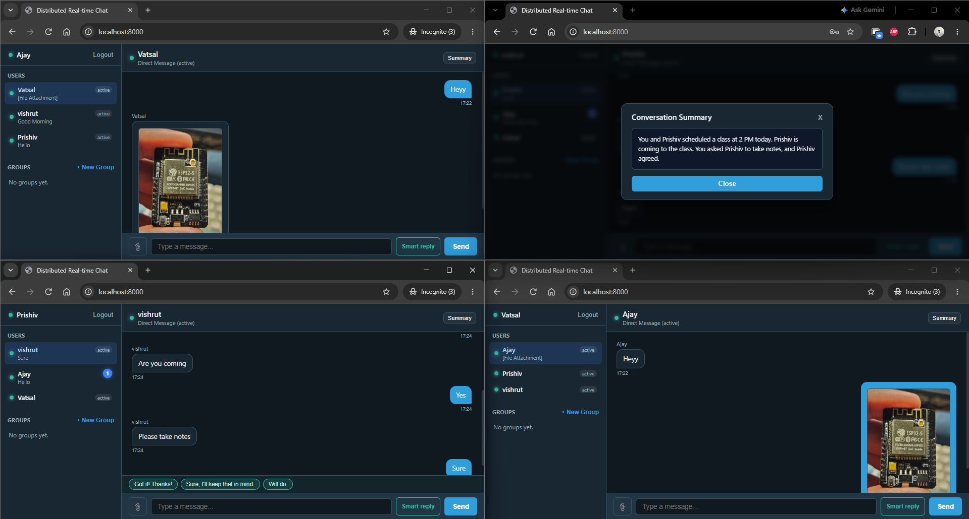
10 / AI
Conversation summaries
The Summary action turns the conversation history into a concise readable recap.
WHAT THIS SHOWS
The summary is generated by the local LLM service and stays within the local deployment.
Conversation Summary modal

Slide 12
11 / AI
Smart replies
The Smart reply action offers short contextual responses based on the current conversation.
WHAT THIS SHOWS
Suggestions appear above the composer and can be selected as quick responses.
Smart reply suggestions

Slide 13
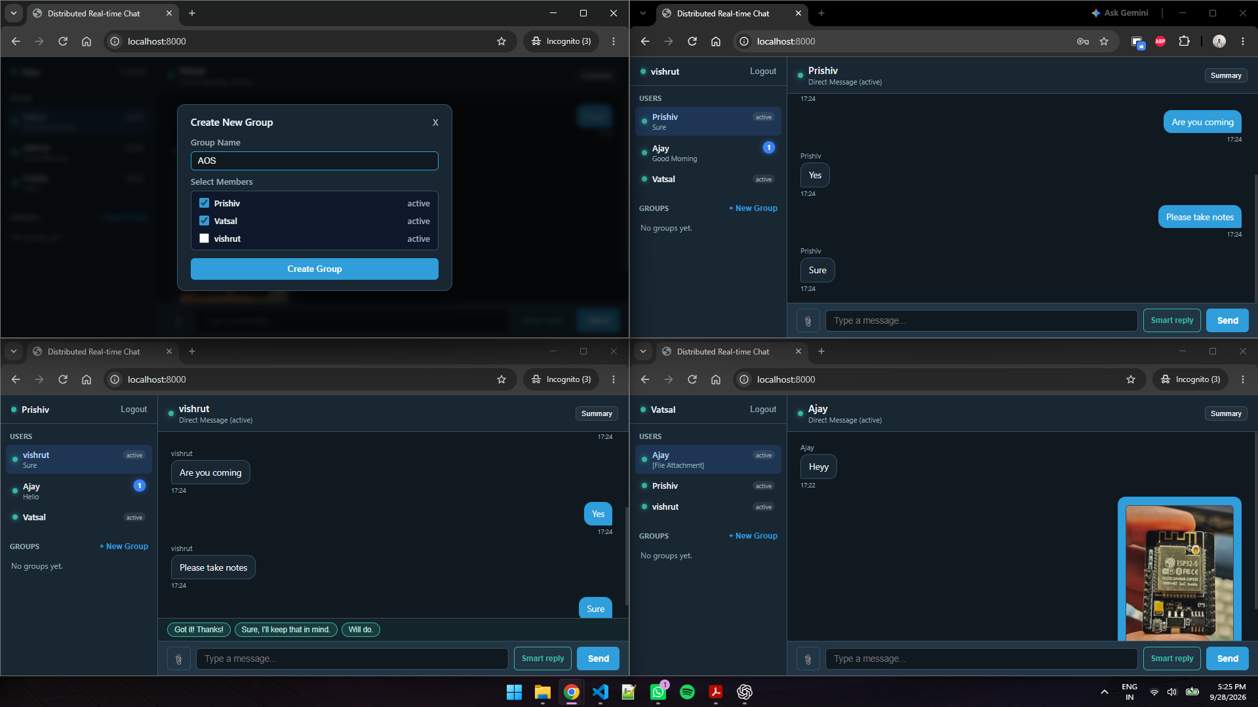
12 / GROUPS
Creating a group
A user can create a named group and select members from the directory.
WHAT THIS SHOWS
The group creator becomes the administrator and the selected users become group members.
Create New Group dialog

Slide 14
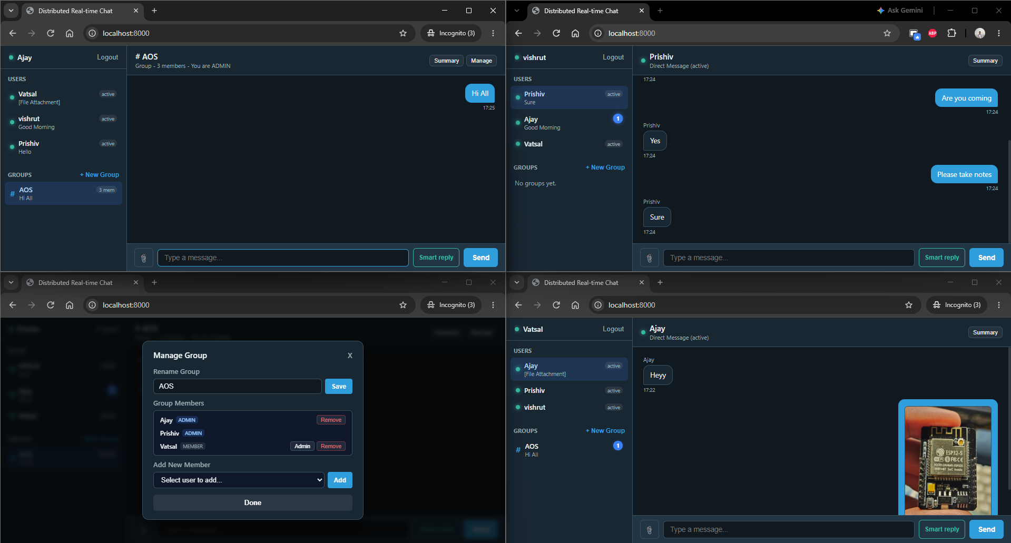
13 / GROUPS
Group chat
Group conversations appear alongside direct conversations in the workspace.
WHAT THIS SHOWS
The group header shows the group name, member count, and the current user’s role.
Group conversation view

Slide 15
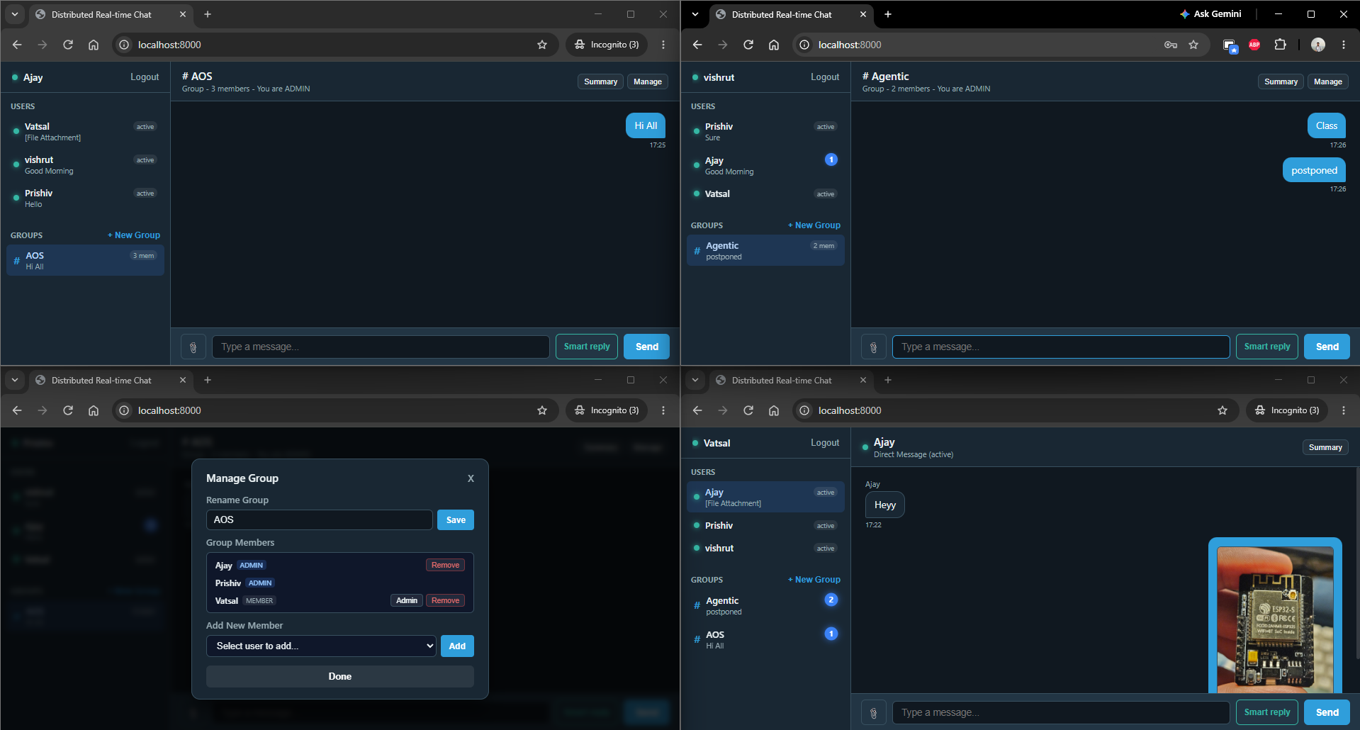
14 / GROUPS
Admin controls
Administrators can rename groups, manage membership, and promote members.
WHAT THIS SHOWS
The management view exposes role-aware actions; non-admin users do not get the same controls.
Manage Group dialog

Slide 16
15 / ARCHITECTURE
How the local deployment is organized
The browser talks to the application node, which coordinates chat, persistence, and AI requests.
BROWSER CLIENT
APPLICATION NODE
LLM SERVER
Responsive single-page web app
JSON/HTTP gateway
Realtime updates through server-sent events
Authentication and presence
Direct and group messaging
SQLite with WAL persistence
File storage
Dedicated container
Qwen 2.5 1.5B quantized model
Smart replies and summaries
CPU fallback supported

