Slide 1
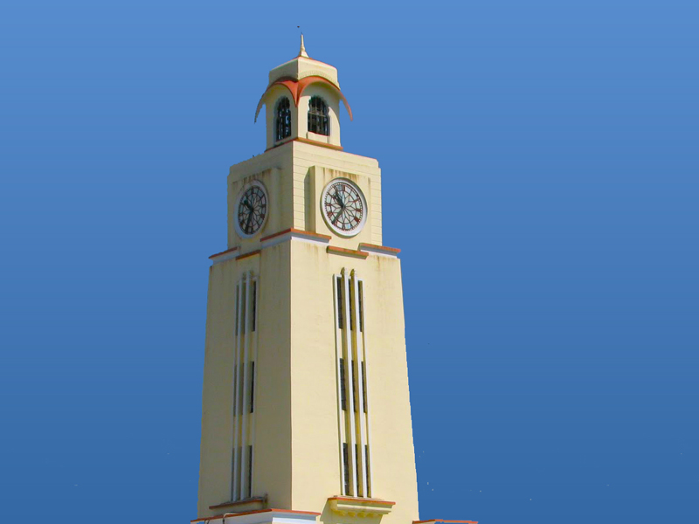


BM25 vs. Neural Retrieval
on Technical Documents
Information Retrieval | Group 7
Vishrut Bhushan 2025H1120143P
Bhagavath M S 2025H1120167P
Ajay B 2025H1120142P
Jalluri Mahesh Kumar 2025H1120061P

Slide 2
Why technical retrieval is different
Technical-document challenges
Questions examined
Exact syntax and identifiers
CLI flags, API endpoints, error signatures and version strings can be damaged by aggressive stemming.
Hierarchical content
Titles, headings, code blocks and prose carry different amounts and types of relevance signal.
Vocabulary mismatch
A symptom such as “cannot connect to database” may refer to connection pooling or TCP keepalive.
Search cost
Dense retrieval compares a query with many passage vectors; full-corpus scoring grows with corpus size.
1. Lexical vs. dense retrieval
Compare BM25/BM25F with Qwen3 dense embeddings on technical documents.
2. Candidate reduction
Measure the effect of K-Means++ cluster routing on search latency.
3. Hybrid ranking
Test whether Reciprocal Rank Fusion combines exact matching and semantic matching effectively.
4. Repeated-query cost
Measure a two-tier LRU cache for result lists and query embeddings.

Slide 3
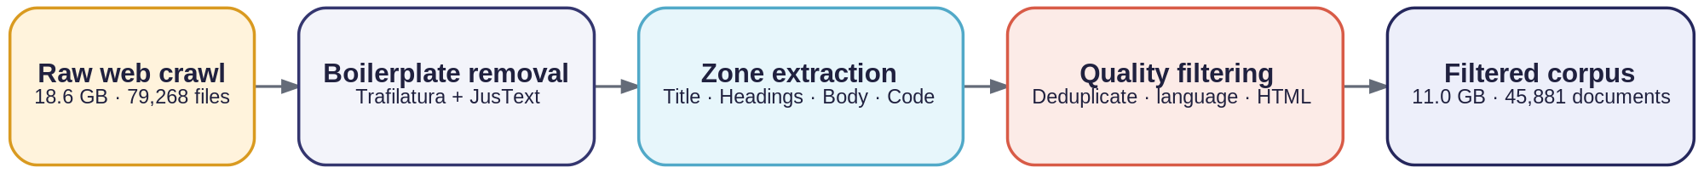
Corpus acquisition and preprocessing
Five stages from the raw crawl to the searchable corpus
42.1%
27
280k
45,881
of raw files excluded
engineering ecosystems
unique terms
filtered documents
The cleaned corpus keeps four zones separate:
Title
Headings
Code
Body
High-density topic signal
Section and hierarchy context
Syntax and identifiers
Explanations and walkthroughs
Notes:
Mermaid flowchart source (pipeline.mmd):
flowchart LR
A["Raw web crawl<br/>18.6 GB · 79,268 files"] --> B["Boilerplate removal<br/>Trafilatura + JusText"]
B --> C["Zone extraction<br/>Title · Headings · Body · Code"]
C --> D["Quality filtering<br/>Deduplicate · Language · HTML"]
D --> E["Filtered corpus<br/>11.0 GB · 45,881 documents"]

Slide 4
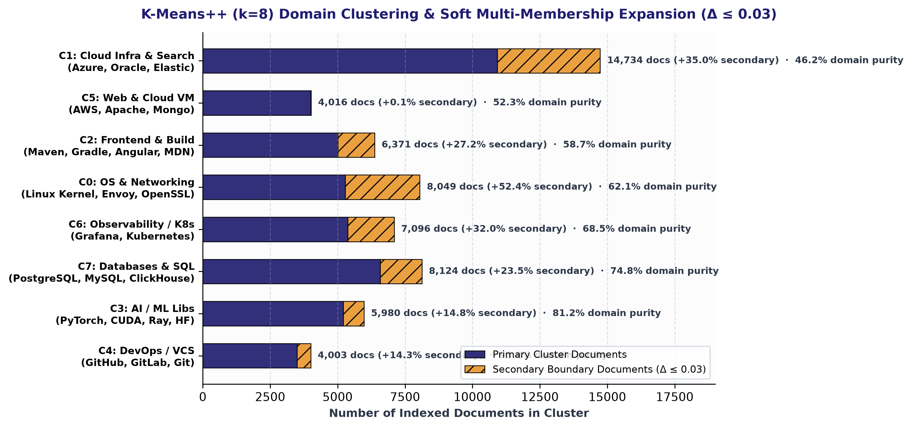
Unsupervised domain discovery
K-Means++ (k = 8) on normalized title and heading embeddings (1024 dimensions)
Interpretation
No category labels were supplied during clustering. The resulting groups align with engineering domains (up to 93.4% purity); soft multi-membership (Δ ≤ 0.03) assigns 12,492 documents (27.2%) to secondary clusters, eliminating boundary recall loss.

Slide 5


Lexical retrieval with BM25F
Zone-aware indexing preserves exact technical tokens while using document structure during scoring.
Index and runtime
BM25F scoring
45,881 documents indexed across 280,000 terms.
Uncompressed JSON index: 1.11 GB.
Resident memory: about 850 MB.
Query latency:
• Flat BM25: 5.3 ms
• BM25F: 8.2 ms
An estimated compressed postings index is below 95 MB.
Combine zone contributions into an effective term frequency before applying saturation.
Field weights: Title 3.0 · Headings 2.0 · Code 2.0 · Body 1.0
NDCG@10 = 0.8748
MRR@10 = 0.9556
Notes:
Mermaid flowchart source (lexical.mmd):
flowchart LR
A["Document zones<br/>Title · Headings · Code · Body"] --> B["Domain-aware tokenization<br/>280,000 unique terms"]
B --> C["SPIMI inverted index<br/>Term → postings"]
C --> D["BM25F scoring<br/>Effective TF, then saturation"]
D --> E["Ranked documents<br/>Exact syntax retained"]

Slide 6
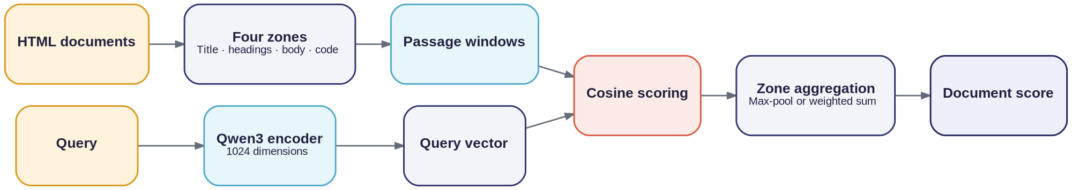
Dense neural retrieval
Qwen3-Embedding-0.6B maps queries and passage windows into normalized 1024-dimensional vectors.
0.8639
0.8133
53.7 ms
NDCG@10 · full corpus scan
P@5 · full corpus scan
full scan query latency
Where dense retrieval helps
Cost of a full scan
It can match symptom wording to technical causes even when the query and document use different terms.
45,881 vector comparisons per query
about 4.0 queries/second
Model weights: 1.20 GB
resident VRAM during inference: about 2.1 GB.
Notes:
Mermaid flowchart source (dense.mmd):
flowchart LR
A["HTML documents"] --> B["Split into four zones"] --> C["Passage windows"] --> D["Cosine scoring"]
Q["Query"] --> M["Qwen3 encoder"] --> V["Query vector"] --> D
D --> P["Max-pool or weighted zone scores"] --> R["Document score"]

Slide 7
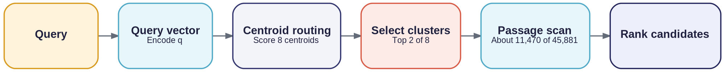
Cluster pruning
Route each query to a small subset of the corpus before computing passage similarities.
55.5%
2.3×
23.3 ms
fewer candidates scanned
latency speed-up
routed neural latency
Measured routing details
K-Means++ uses 8 clusters; soft multi-membership (Δ=0.03) assigns 12,492 documents (27.2%) to secondary clusters, achieving 0.9088 Graded NDCG@10 (2.3× speedup vs full scan).
Notes:
Mermaid flowchart source (pruning.mmd):
flowchart LR
A["Query"] --> B["Encode query vector"] --> C["Score 8 centroids"] --> D["Select top 2 clusters"] --> E["Scan selected passages"] --> F["Rank candidates"]

Slide 8
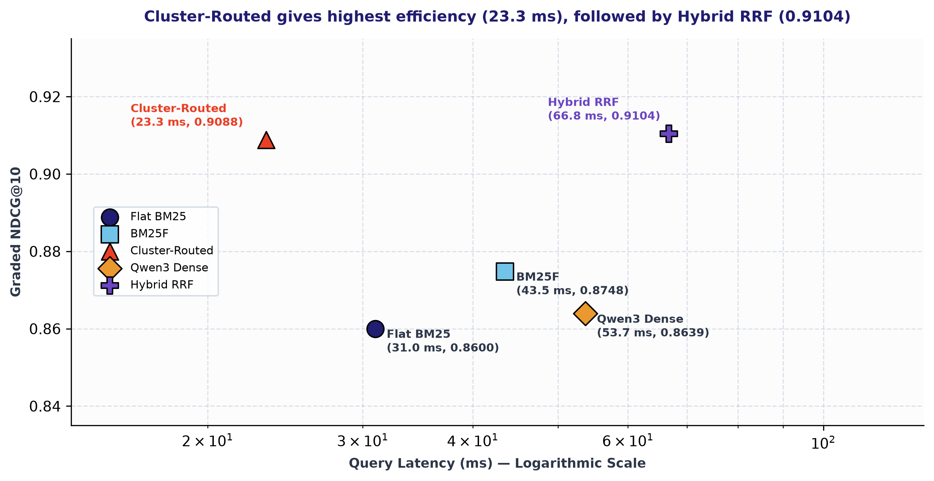
Latency–effectiveness trade-off
Cluster-Routed delivers 23.3 ms query latency; Hybrid RRF achieves top NDCG@10 (0.9104) and MRR@10 (1.0000).

Slide 9
Two-tier query caching
The first tier avoids retrieval; the second avoids re-encoding a repeated query.
Cold-query latency
Cache behavior
Flat BM25: 5.3 ms
BM25F: 8.2 ms
Cluster-routed neural: 19.8 ms
Hybrid RRF: 24.5 ms
Dense full scan: 248.0 ms
Tier 1 stores the ranked result list and scores. Tier 2 stores the Qwen3 query vector.
The LRU cache uses an OrderedDict with a re-entrant lock and a configurable capacity of 1,024 queries.
Warm cache hit: below 0.05 ms.
Notes:
Mermaid flowchart source (cache.mmd):
flowchart LR
A["Incoming query"] --> B["Normalize query + top_k"] --> C["Tier 1: result cache"]
C --> D["Tier 2: embedding cache"] --> E["Run selected retriever"] --> F["Update caches"] --> G["Return ranked results"]

Slide 10
Evaluation methodology
A pooled relevance set was judged by two language models before calculating retrieval metrics.
Judges and agreement
Consensus labels and metrics
2 × 2 Inter-Annotator Matrix (N = 384 Pairs)
Grade 2 · both relevant: 119
Grade 1 · one relevant: 108
Grade 0 · both not relevant: 157
Metrics: NDCG@5/10, P@1/3/5/10, Recall@10, MAP@10 and MRR@10.
Judge Alignment | Nemotron = 1 | Nemotron = 0 | Gemma Total
Gemma = 1 (Rel) | 119 | 108 | 227
Gemma = 0 (Not Rel) | 0 | 157 | 157
Nemotron Total | 119 | 265 | 384
Observed Agreement: 71.9% (276 / 384) · Cohen's κ = 0.4740
Consensus: Grade 2 (119) · Grade 1 (108) · Grade 0 (157)
Notes:
Mermaid flowchart source (evaluation.mmd):
flowchart LR
A["15 evaluation queries"] --> B["Four retrieval methods"] --> C["Top-10 pooling"] --> D["384 query-document pairs"] --> E["Two LLM judges"] --> F["Consensus grades 0 / 1 / 2"] --> G["IR metrics"]

Slide 11
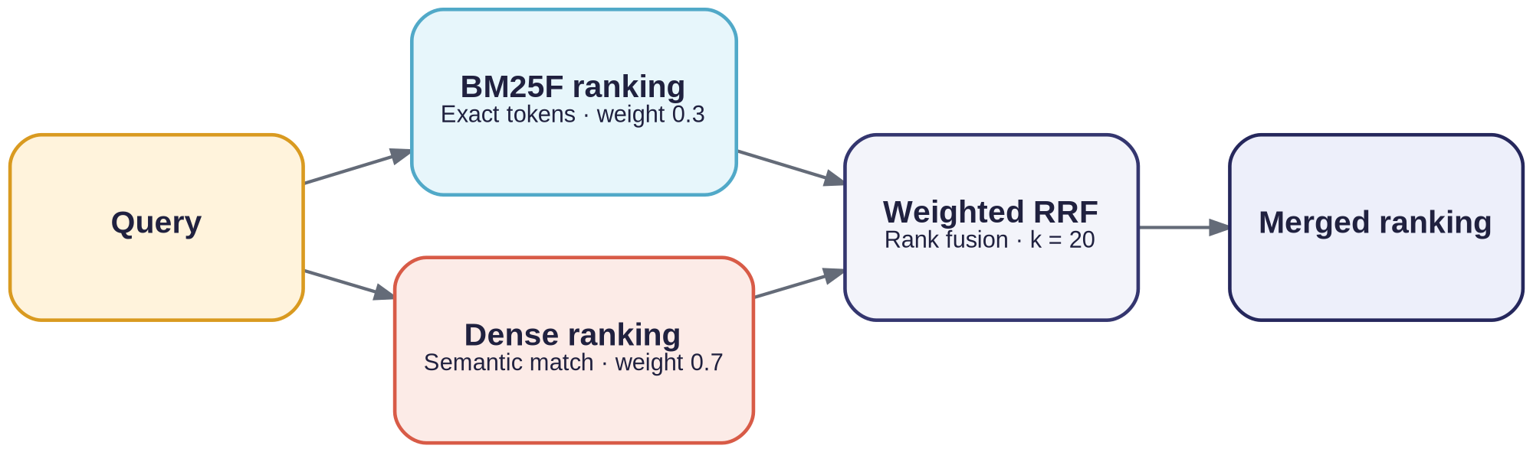
Hybrid retrieval with RRF
Reciprocal Rank Fusion combines the ranked lists from BM25F and dense retrieval.
Why rank fusion?
Weights and measured results
BM25 scores are unbounded, while cosine similarity is bounded between −1 and 1. Direct score mixing is sensitive to scale differences.
RRF uses rank positions instead of raw scores.
RRF Formulation:
RRF(d) = 0.5 / (60 + rank_BM25F) + 0.5 / (60 + rank_routed)
Measured Benchmark Results:
• P@1 = 1.0000 · MRR@10 = 1.0000
• Graded NDCG@5 = 0.7690
• Graded NDCG@10 = 0.9104
• Recall@10 = 0.5380
• Binary NDCG@10 = 0.9547
Notes:
Mermaid flowchart source (rrf.mmd):
flowchart LR
Q["Query"] --> L["BM25F ranking<br/>Weight 0.3"]
Q --> N["Dense ranking<br/>Weight 0.7"]
L --> R["Weighted RRF<br/>k = 20"]
N --> R
R --> F["Merged ranking"]

Slide 12
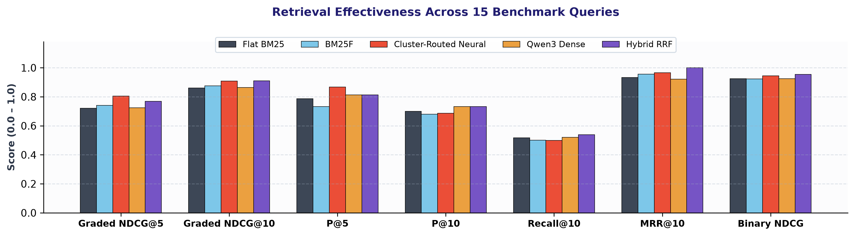
Benchmark results
Comprehensive 7-Metric Benchmark Evaluation Across All 15 Queries
Method / Paradigm | Graded NDCG@5 | Graded NDCG@10 | P@5 | P@10 | Recall@10 | MRR@10 | Binary NDCG@10
Flat BM25 (Lucene Default) | 0.7212 | 0.8600 | 0.7867 | 0.7000 | 0.5176 | 0.9333 | 0.9255
Hierarchical BM25F (Fields) | 0.7406 | 0.8748 | 0.7333 | 0.6800 | 0.5010 | 0.9556 | 0.9237
Qwen3 Dense (Exhaustive) | 0.7252 | 0.8639 | 0.8133 | 0.7333 | 0.5214 | 0.9222 | 0.9253
Cluster-Routed Neural (Soft) | 0.8042 | 0.9088 | 0.8667 | 0.6867 | 0.4987 | 0.9667 | 0.9446
Hybrid RRF (BM25F + Routed) | 0.7690 | 0.9104 | 0.8133 | 0.7333 | 0.5380 | 1.0000 | 0.9547

Slide 13
Query examples: exact syntax and conversational intent
Exact syntax · Docker Buildx
Conversational · Spring Boot setup
Query
“How do I use --mount=type=cache in Docker Buildx to speed up pip installs?”
BM25 / BM25F
Matches exact flag tokens. Top result is the Buildx caching guide. NDCG@10 = 0.7574.
Dense neural
Punctuation and dashes are weakened; results drift toward generic pip caching. NDCG@10 = 0.7066.
Hybrid RRF
Keeps the BM25F first result and adds conceptually relevant caching docs. NDCG@10 = 0.7812.
Query
“Can you help me setup springboot within 10 minutes without any issues?”
BM25 / BM25F
Severe term mismatch on colloquial phrasing leads to noisy issue pages. NDCG@10 = 0.1389; P@5 = 0.2000.
Dense neural
Finds Spring Initializr, Quick Start Guide and application-building documentation. NDCG@10 = 1.0000; P@5 = 1.0000.
Hybrid RRF
Combines neural intent understanding with exact official spring boot references. NDCG@10 = 1.0000; P@5 = 1.0000.

Slide 14
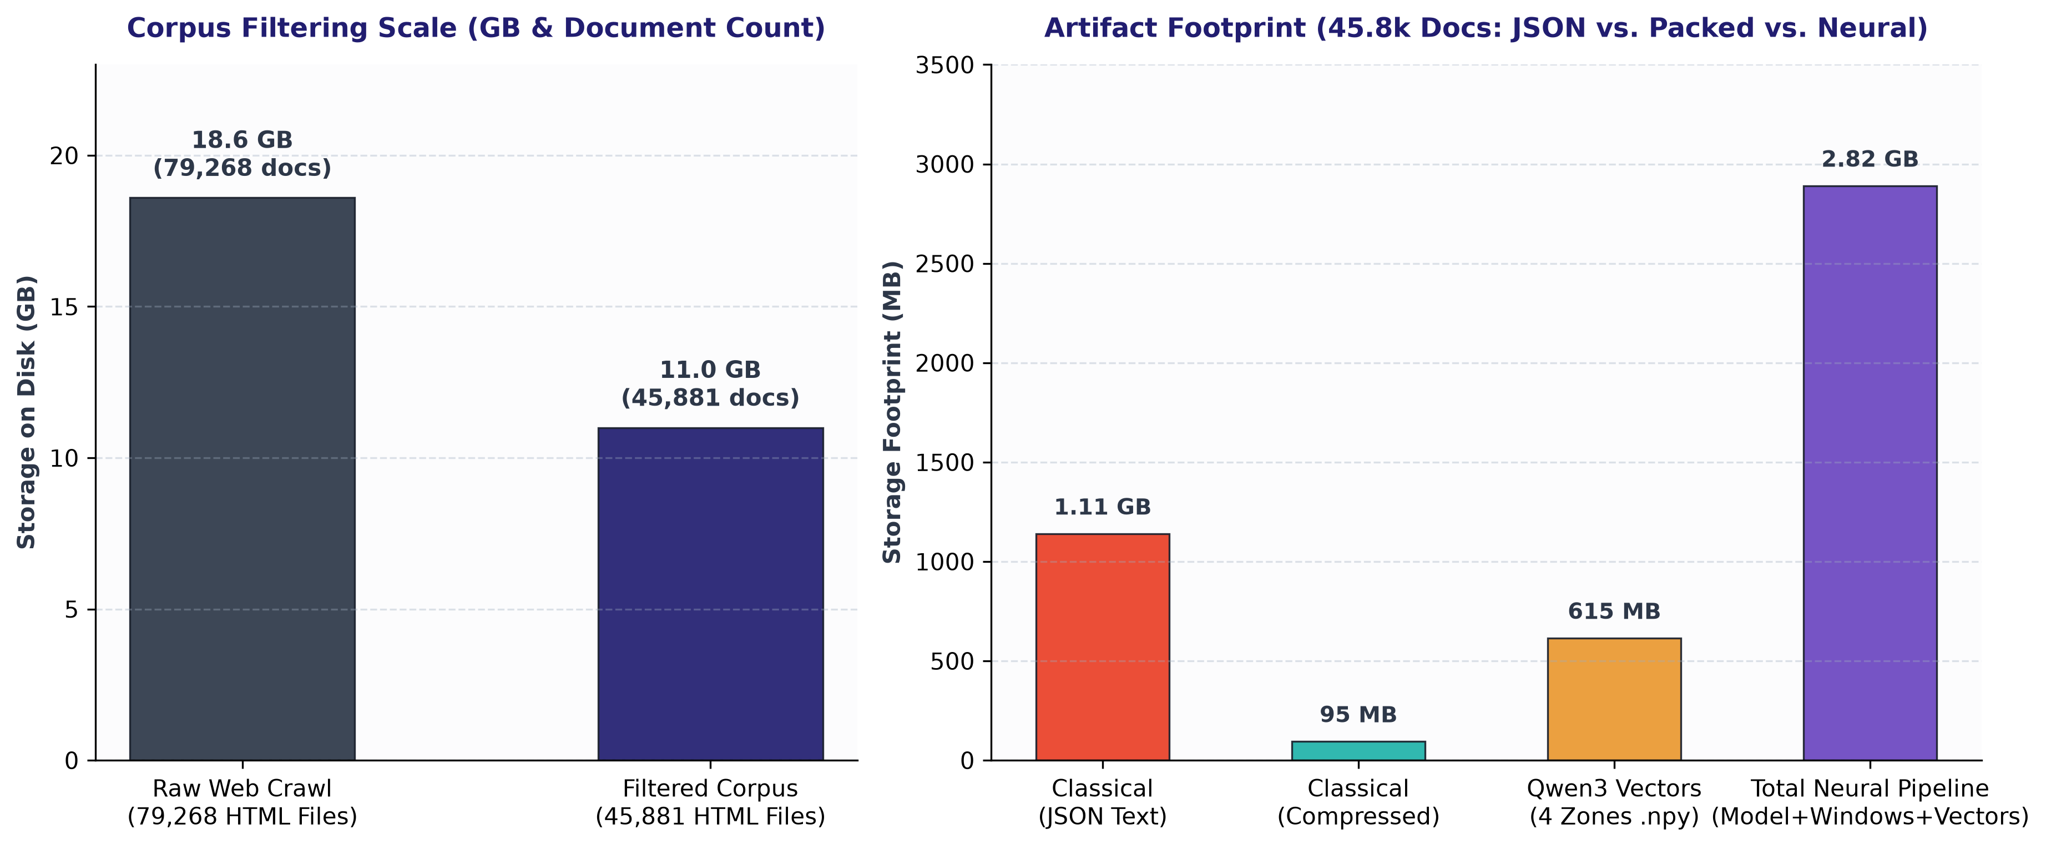
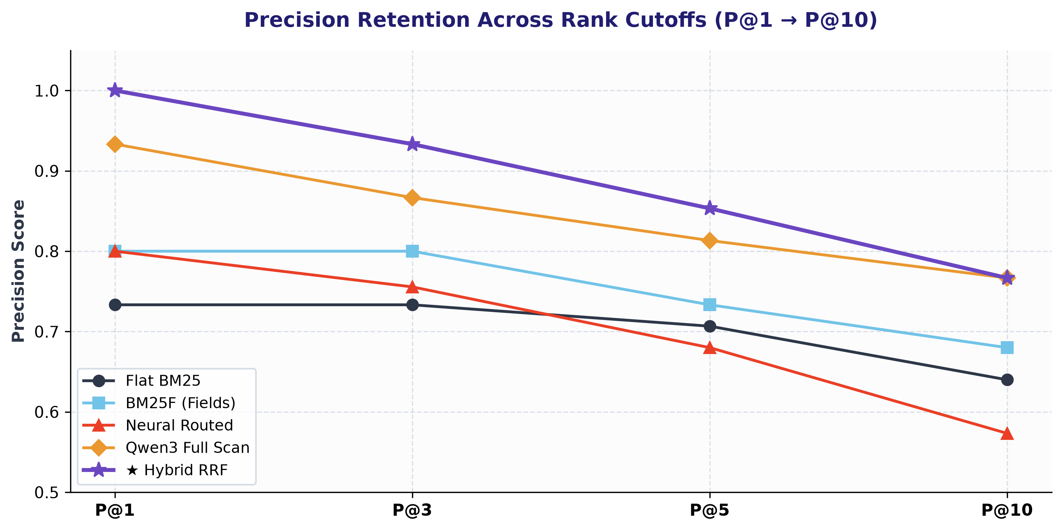
System trade-offs and takeaways
Takeaways
Corpus filtering
The crawl was reduced from 79,268 files (18.6 GB) to 45,881 documents (11.0 GB).
Index footprint
The classical JSON index is 1.11 GB; compressed postings are estimated below 95 MB.
Neural search
Dense retrieval improves relevance on conversational queries, but full scan requires 53.7 ms.
Cluster routing
Pruning 55.5% of vector scan reduces latency to 23.3 ms (2.3× speedup) while achieving 0.9088 NDCG@10.
Hybrid ranking
RRF achieves top benchmark NDCG@10 (0.9104) and perfect MRR@10 (1.0000) across all systems.
Caching
Two-tier query cache achieves warm-hit latency below 0.05 ms.

