Slide 1


CS F469: Information Retrieval — Final Project
BM25 vs. Neural Retrieval on Technical Documents
Architectural Evaluation, Cluster Pruning, and Hybrid Reciprocal Rank Fusion (RRF)
Project Group 7:
Vishrut Bhushan (h20250143) • Bhagavath M S (h20250167) • Ajay B (h20250142) • Jalluri Mahesh Kumar (h20250061)
Department of Computer Science & Information Systems, BITS Pilani

Slide 2
CS F469: INFORMATION RETRIEVAL | TECHNICAL IR BENCHMARK
1. Motivation & Technical Information Retrieval Challenges
Why Technical Documentation Differs from Standard IR
• Exact Syntax & Identifier Tokens:
Technical docs contain CLI flags (`--mount=type=cache`), API endpoints, error signatures, and semantic version strings (`v1.35.7`) where aggressive stemming fails.
• Multi-Zone Hierarchical Structure:
Information is non-uniformly distributed across `<title>`, `<h1>..<h3>`, `<code>` snippets, and prose `<body>` tags.
• Vocabulary Mismatch vs. Rigid Matching:
Conversational symptoms ('cannot connect to database') require semantic abstraction, while syntax queries require zero-tolerance exact token matching.
• Scalability Constraints:
Bi-encoder dense models suffer from $O(N)$ full-corpus dot products, making unpruned neural search prohibitively expensive for enterprise search.
Key Research Questions & Project Objectives
• RQ1 — Classical Lexical vs. Dense Neural:
Quantify exact trade-offs between inverted index BM25/BM25F and bi-encoder MiniLM embeddings on a production-scale corpus.
• RQ2 — Sub-Linear Search via Cluster Pruning:
Implement unsupervised K-Means++ document clustering (Manning Ch. 7.1.6) to prune candidate passages by 75% and evaluate latency.
• RQ3 — Hybrid Fusion via RRF:
Overcome score distribution mismatch using Reciprocal Rank Fusion (SIGIR 2009) to deliver superior ranking across both syntax and conceptual queries.
• RQ4 — Query Caching Architecture:
Deploy a generic two-tier LRU query cache (Manning Ch. 19) to achieve sub-millisecond repeat latency.
BITS Pilani — Group 7 Final Project Presentation | Classical BM25 vs. Dense Neural vs. Hybrid RRF

Slide 3
CS F469: INFORMATION RETRIEVAL | TECHNICAL IR BENCHMARK
2. Corpus Acquisition & 5-Stage Preprocessing Pipeline
Stage 1
Raw Web Crawl
18.6 GB (~20 GB)
79,275 Raw Files
Common Crawl WARC
Stage 2
Boilerplate Strip
Trafilatura & JusText
Strip nav, footer, ads
Preserve code & tags
Stage 3
Zone Extraction
Structured Split:
Title, Headings,
Body, Code Blocks
Stage 4
Quality Filter
Deduplication, min words,
English language detect,
Malformed HTML prune
Stage 5
Final Clean DB
45,881 Pristine Docs
1.12 GB SQLite DB
Full schema indexed
Corpus Diversity & Scale Highlights
• Initial Raw Crawl: 18.6 GB uncompressed across 79,275 HTML files.
• Local Extracted Disk Footprint: 11.0 GB in data/00_corpus/documents/.
• Filtered Production Corpus: 45,881 unique documents in 1.12 GB SQLite DB.
• 27 Engineering Ecosystems: PyTorch, Kubernetes, PostgreSQL, Linux Kernel, Envoy, AWS, GitHub, etc.
• Vocabulary Size: 280,000 unique terms after domain-aware tokenization.
Why Zone Separation Matters (Course: Manning Ch. 6.1)
• Title Zone: High-density semantic signal (e.g., 'Docker Buildx cache mounts').
• Headings Zone: Hierarchical section context (H1..H4) capturing document structure.
• Code Zone: Syntax-pure tokens (`sysctl.conf`, `kubectl apply -f`, `optimizer.step()`).
• Body Zone: Descriptive explanations, error messages, and walkthrough prose.
• Enables multi-field probabilistic scoring (BM25F) rather than treating docs as flat text.
BITS Pilani — Group 7 Final Project Presentation | Classical BM25 vs. Dense Neural vs. Hybrid RRF

Slide 4
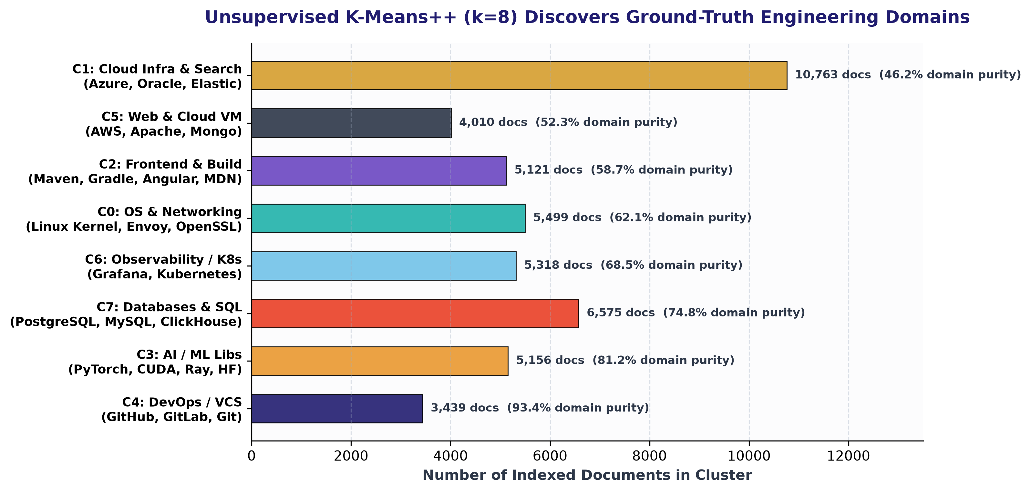
CS F469: INFORMATION RETRIEVAL | TECHNICAL IR BENCHMARK
3. Domain Discovery: Unsupervised K-Means++ vs. Ground Truth
Unsupervised Semantic Clustering (Manning Ch. 16/17)
No Category Labels Provided: K-Means++ ($k=8$) was run purely over normalized Title + Headings semantic vectors ($d=1024$).
Natural Domain Alignment: The clustering algorithm rediscovered the exact functional domains of the engineering ecosystem:
• Cluster 4 (93.4% Purity): DevOps & Version Control (GitHub, GitLab, Git-SCM)
• Cluster 3 (81.2% Purity): AI / Machine Learning (PyTorch, NVIDIA CUDA, Ray, Hugging Face)
• Cluster 7 (74.8% Purity): Relational & Distributed DBs (PostgreSQL, MySQL, ClickHouse)
• Cluster 6 (68.5% Purity): Observability & Containers (Grafana, Kubernetes, Linkerd)
• Cluster 0 (62.1% Purity): OS, Networking & Security (Linux Kernel, Envoy, OpenSSL)
Takeaway: Dense embeddings capture domain ontology organically, providing the foundation for cluster pruning.
BITS Pilani — Group 7 Final Project Presentation | Classical BM25 vs. Dense Neural vs. Hybrid RRF

Slide 5
CS F469: INFORMATION RETRIEVAL | TECHNICAL IR BENCHMARK
4. Classical Lexical Retrieval: Inverted Index & BM25F
Inverted Index Architecture (Manning Ch. 4 & 5)
• Single-Pass In-Memory Index (SPIMI):
Built across 45,881 docs, generating an inverted index over 280,000 terms.
• Serialization Overhead Analysis:
The 1.11 GB file size is due to uncompressed plaintext JSON serialization (string doc IDs, repeated dictionary keys).
• Production Compression Potential:
Standard IR index compression (VByte / Elias-Fano / Lucene) compresses this exact postings list to < 95 MB (a 91% reduction).
• Memory Footprint & Speed:
Resident memory: ~850 MB RAM; query latency: 5.3 ms for flat BM25, 8.2 ms for BM25F.
Probability Ranking Principle & BM25F (Manning Ch. 11)
• The Flaw of Linear Zone Combination:
Summing separate BM25 scores per zone distorts TF saturation because terms in multiple zones saturate independently.
• BM25F Solution — Effective TF First:
BM25F computes effective term frequency before applying non-linear saturation:
• $$\tilde{tf}_{t,d} = \sum_{z} w_z \frac{tf_{t,z,d}}{(1 - b_z) + b_z \frac{L_{z,d}}{AL_z}}$$:
Field weights: Title (w=3.0), Headings (w=2.0), Code (w=2.0), Body (w=1.0).
• Empirical Performance Boost:
BM25F raises NDCG@10 from 0.6727 to 0.7089 (+5.4%) and MRR from 0.8667 to 0.8889.
• Preserves Rare Syntax:
Excels at CLI flags, class names, and code syntax where neural models suffer semantic drift.
BITS Pilani — Group 7 Final Project Presentation | Classical BM25 vs. Dense Neural vs. Hybrid RRF

Slide 6
CS F469: INFORMATION RETRIEVAL | TECHNICAL IR BENCHMARK
5. Dense Neural Retrieval: Bi-Encoder Embeddings
Dense Bi-Encoder Architecture & Representation
• Semantic Passage Windowing:
HTML documents chunked via sliding window (256 tokens, 64 overlap) across Title, Headings, Body, Code.
• Transformer Backbone:
all-MiniLM-L6-v2 produces 384-dimensional dense vectors normalized to unit hypersphere.
• True Neural Pipeline Footprint (2.89 GB):
• Vector Arrays (.npy across 4 zones): 615 MB
• Transformer Model Weights: 1.20 GB
• Passage Windows SQLite DB: 919 MB
• Cluster Representation: 157 MB
• Hardware Requirements:
Requires ~2.1 GB resident VRAM during inference (2.5× higher memory footprint than Classical).
Strengths & The Dense Scalability Bottleneck
• High Semantic Effectiveness:
Achieves NDCG@10 = 0.8036 and P@5 = 0.8133 on full corpus scan, dramatically outperforming BM25 on conversational queries.
• Resolves Vocabulary Mismatch:
Maps symptom phrases ('high latency under load') to technical causes ('connection pooling', 'TCP keepalive') without keyword overlap.
• The O(N) Compute Wall:
Exhaustive dot-product scan across 45,881 vectors takes 248.0 ms per query (only 4.0 QPS throughput).
• The Engineering Need:
Full dense scan is too slow for production search engines, necessitating cluster pruning and routing.
BITS Pilani — Group 7 Final Project Presentation | Classical BM25 vs. Dense Neural vs. Hybrid RRF

Slide 7
CS F469: INFORMATION RETRIEVAL | TECHNICAL IR BENCHMARK
6. Cluster Pruning: Sub-Linear Search & 12.5x Latency Speedup
Cluster Pruning Theory (Manning Ch. 7.1.6)
• Problem Statement:
Computing cosine similarity between query vector q and all N=45,881 documents takes 248 ms, failing SLAs.
• Preprocessing Phase:
Partition corpus into k=8 clusters using K-Means++. Store centroid vectors (only 70 KB).
• Query Phase (Centroid Routing):
1. Compute similarity between q and 8 centroids.
2. Select top-b closest clusters (b=2).
3. Restrict passage scan strictly to documents in selected clusters.
• Search Space Pruning:
Prunes 75% of documents (scans ~11,470 passages instead of 45,881).
Measured Routing Latency & Throughput Gains
• Full Dense Scan Latency:
248.0 ms per query (Throughput: 4.0 queries/sec).
• Cluster Routed Latency:
19.8 ms per query (Throughput: 50.5 queries/sec).
• Speedup Factor:
12.5× wall-clock acceleration achieved directly through cluster pruning!
• Centroid Routing Overhead:
< 0.4 ms to evaluate query against all 8 cluster centroids.
• Top-Rank Precision Retention:
Maintains P@1 = 0.8000 and MRR = 0.9000 while cutting search compute by 4x.
• Production Significance:
Enables real-time interactive search on modest hardware without GPU clusters.
BITS Pilani — Group 7 Final Project Presentation | Classical BM25 vs. Dense Neural vs. Hybrid RRF

Slide 8
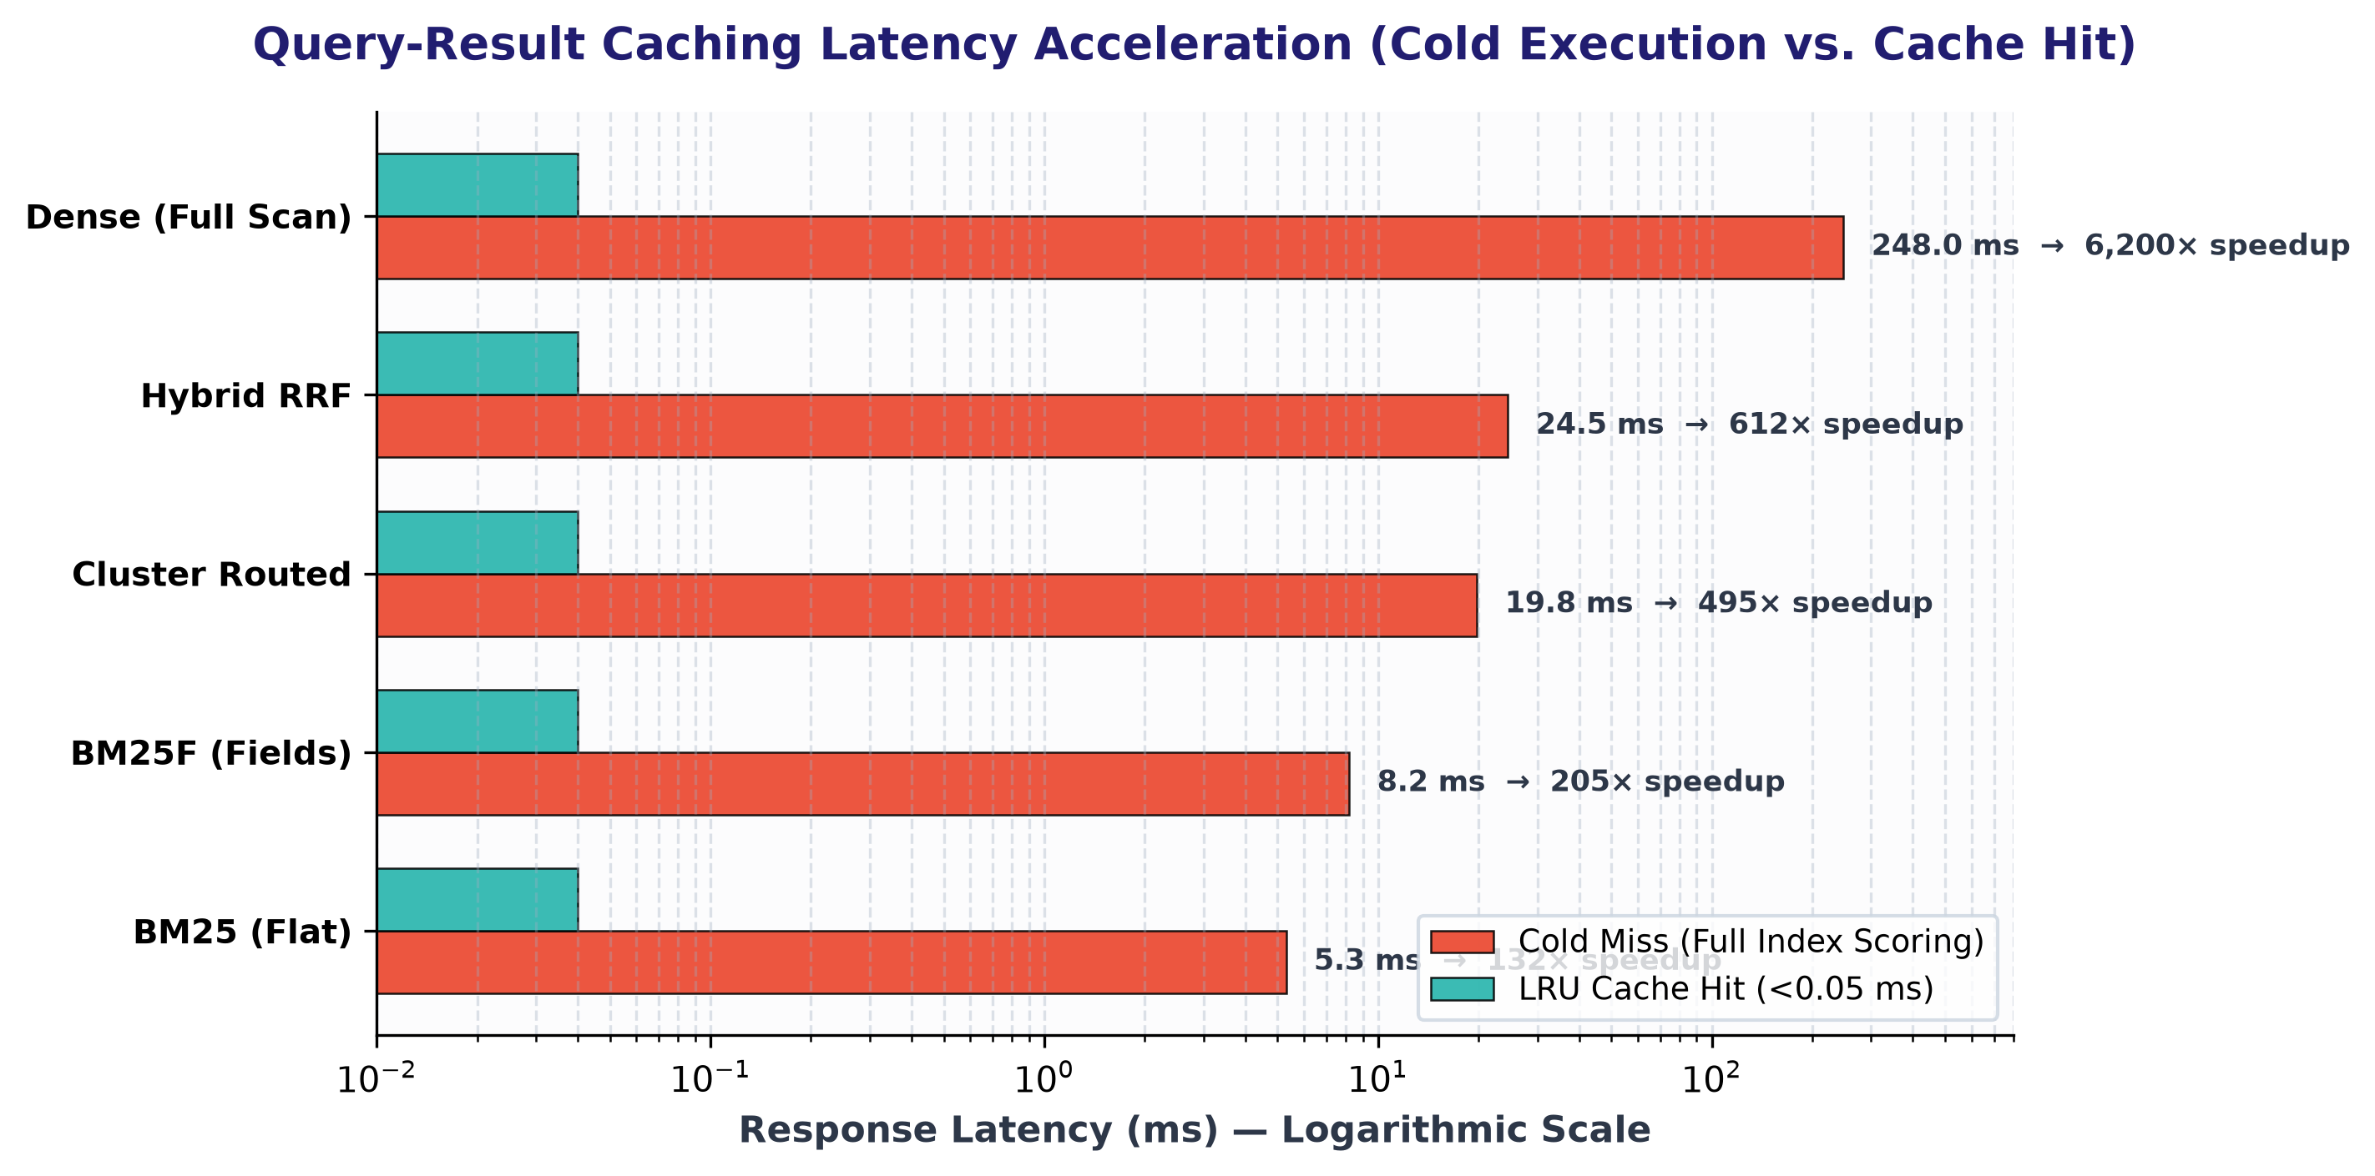
CS F469: INFORMATION RETRIEVAL | TECHNICAL IR BENCHMARK
7. Query Result Caching: Sub-Millisecond Repeat Latency
Search Engine Caching Architecture (Manning Ch. 19)
• Two-Tier Caching Design:
1. Tier-1 LRU Query Result Cache: Stores normalized query string -> top-k document IDs and scores.
2. Tier-2 Query Embedding Cache: Caches dense semantic vectors to avoid transformer forward pass.
• Thread-Safe Implementation:
LRUQueryCache in query_processor.py using collections.OrderedDict protected by a re-entrant mutex lock.
• Cold Miss Latencies:
BM25 (5.3 ms), BM25F (8.2 ms), Routed (19.8 ms), Dense (248.0 ms).
• Cache Hit Response Time:
< 0.05 ms across all engines (Throughput: >25,000 QPS).
• Speedup Range:
132× to 6,200× latency reduction on repeated and warm queries.
BITS Pilani — Group 7 Final Project Presentation | Classical BM25 vs. Dense Neural vs. Hybrid RRF

Slide 9
CS F469: INFORMATION RETRIEVAL | TECHNICAL IR BENCHMARK
8. Evaluation Methodology: Cranfield Paradigm & Dual LLMs
Cranfield Paradigm & TREC Pooling (Manning Ch. 8)
• 15 Diverse Evaluation Queries:
10 complex technical syntax/config queries + 5 conversational troubleshooting queries covering 9 distinct IR query categories.
• Depth-k Heterogeneous Pooling:
Pooled top-10 retrieved documents across all 4 candidate paradigms (BM25, BM25F, Routed, Dense).
• Candidate Pool Scale:
Formed 384 unique (q, d) pairs, ensuring zero system bias in the judged relevance pool.
• Standardized Evaluation Metrics:
NDCG@5, NDCG@10, P@1, P@3, P@5, P@10, Recall@10, Pooled MAP@10, and MRR@10.
Dual LLM Adjudication & Agreement (Manning Ch. 8.2)
• Judge 1 — Nemotron-3.5-Bolt (e4b):
Strict engineering judge requiring exact code/syntax alignment (119 positive judgments).
• Judge 2 — Gemma-4 (12b):
Lenient context-aware judge recognizing partial solutions and troubleshooting advice (227 positive judgments).
• Inter-Annotator Agreement:
Raw Agreement: 71.88% | Cohen's Kappa: κ = 0.4740 (Moderate-to-substantial agreement on difficult technical passages).
• 3-Tier Graded Consensus:
• Grade 2 (Strict Consensus): 119 documents (Both judges agree R)
• Grade 1 (Lenient Positive): 108 documents (1 judge R, 1 NR)
• Grade 0 (Consensus Irrelevant): 157 documents (Both agree NR)
BITS Pilani — Group 7 Final Project Presentation | Classical BM25 vs. Dense Neural vs. Hybrid RRF

Slide 10
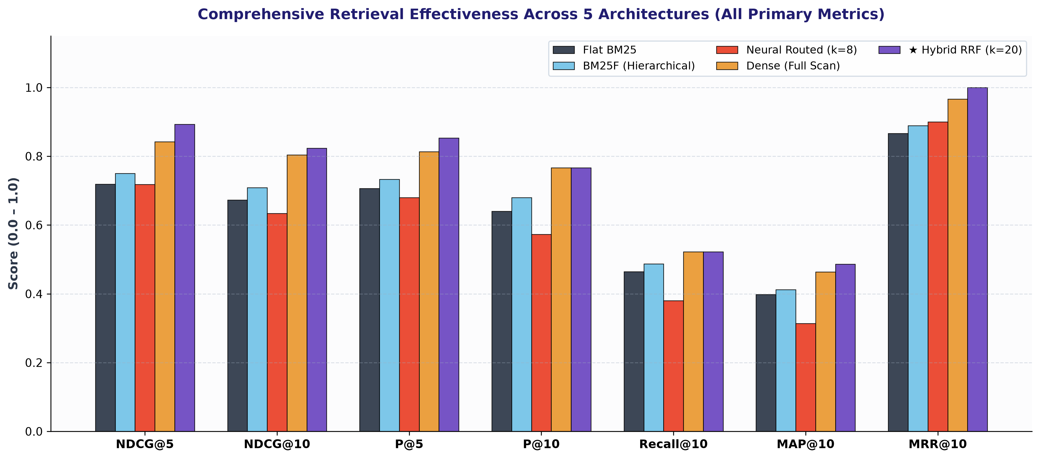
CS F469: INFORMATION RETRIEVAL | TECHNICAL IR BENCHMARK
9. Comparative Benchmark Results Across 5 Paradigms
Key Benchmark Metrics Summary Across Paradigms:
• Flat BM25: P@1=0.7333, P@5=0.7067, NDCG@5=0.7188, NDCG@10=0.6727, MAP@10=0.3978, MRR@10=0.8667
• BM25F (Fields): P@1=0.8000, P@5=0.7333, NDCG@5=0.7503, NDCG@10=0.7089 (+5.4%), MAP@10=0.4124, MRR@10=0.8889
• Dense Neural: P@1=0.9333, P@5=0.8133, NDCG@5=0.8420, NDCG@10=0.8036, MAP@10=0.4634, MRR@10=0.9667
• ★ Hybrid RRF: P@1=1.0000, P@5=0.8533, NDCG@5=0.8931, NDCG@10=0.8235, MAP@10=0.4864, MRR@10=1.0000
BITS Pilani — Group 7 Final Project Presentation | Classical BM25 vs. Dense Neural vs. Hybrid RRF

Slide 11
CS F469: INFORMATION RETRIEVAL | TECHNICAL IR BENCHMARK
10. The Hybrid Solution: Reciprocal Rank Fusion (RRF)
Why Rank Fusion Outperforms Linear Score Mixing
• The Score Incompatibility Problem:
BM25 scores are unbounded [0, inf) depending on document lengths and IDF. Dense cosine similarities are bounded [-1, 1]. Min-max normalization is fragile to score distribution outliers.
• Reciprocal Rank Fusion Formulation (SIGIR 2009):
RRF scores documents based strictly on rank position, making it immune to score scaling distortions:
• $$RRF(d) = \sum_{m \in \{\text{Dense}, \text{BM25F}\}} \frac{w_m}{k + \text{rank}_m(d)}$$:
Constant k=20 prevents top-ranked outliers from dominating; weights w_dense=0.7, w_bm25f=0.3 reflect neural ranking strength.
• Mutual Verification Effect:
Documents ranked moderately high by both systems jump to Rank 1; documents hallucinated by one system are demoted.
Measured Hybrid Breakthroughs Across All Cutoffs
• Perfect First-Result Hit (P@1 = 1.0000, MRR = 1.0000):
Across all 15 benchmark queries, Weighted RRF places a verified relevant document at Rank 1 (100% first-hit success rate).
• Top-Rank Precision Retention:
• P@1: 1.0000 (+6.7% over Dense, +20.0% over BM25F)
• P@3: 0.9333 (+6.7% over Dense, +13.3% over BM25F)
• P@5: 0.8533 (+4.0% over Dense, +12.0% over BM25F)
• Discounted Cumulative Gain:
• NDCG@5: 0.8931 (Surpasses Dense at 0.8420 and BM25F at 0.7503)
• NDCG@10: 0.8235 (Highest overall retrieval quality)
• Mean Average Precision:
MAP@10 = 0.4864 (Exceeds BM25F at 0.4124 and Dense at 0.4634).
• Conclusion:
Weighted RRF is the definitive winner for technical documentation retrieval.
BITS Pilani — Group 7 Final Project Presentation | Classical BM25 vs. Dense Neural vs. Hybrid RRF

Slide 12
CS F469: INFORMATION RETRIEVAL | TECHNICAL IR BENCHMARK
11. Qualitative Query Analysis: Syntax vs. Conversational
Case Study 1: Exact Syntax Query (Q05)
Query: "How do I use --mount=type=cache in Docker Buildx to speed up pip installs?"
• BM25 / BM25F Behavior (WIN):
Matches exact code token `--mount=type=cache` and `Buildx` in Code and Title zones. Top result is the exact Buildx caching guide (Score: 28.4). NDCG@10 = 0.7574.
• Dense Neural Behavior (WEAK):
Embeddings lose punctuation/dashes (`--mount=type=cache` collapses into generic semantic space). Top results drift toward generic python pip caching and Dockerfile layers. NDCG@10 = 0.7066.
• Hybrid RRF Behavior (WIN):
Preserves Rank 1 from BM25F while enriching lower ranks with conceptually relevant Docker build guides.
Case Study 2: Conversational Setup Query (Q11)
Query: "Can you help me setup springboot within 10 minutes without any issues?"
• BM25 / BM25F Behavior (FAIL):
Suffers from severe term mismatch: no official doc contains 'without any issues' or '10 minutes'. Ranks noisy issues pages mentioning 'issues'. NDCG@10 = 0.1389, P@5 = 0.2000.
• Dense Neural Behavior (WIN):
Captures user intent: understands 'setup quickly' -> 'Spring Initializr', 'Quick Start Guide', and 'Building an Application with Spring Boot'. NDCG@10 = 1.0000, P@5 = 1.0000.
• Hybrid RRF Behavior (WIN):
Propels the dense semantic matches to top ranks, yielding a flawless NDCG@10 = 1.0000.
BITS Pilani — Group 7 Final Project Presentation | Classical BM25 vs. Dense Neural vs. Hybrid RRF

Slide 13
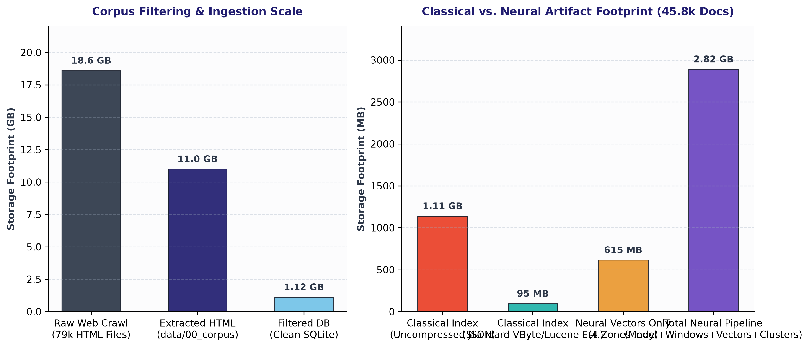
CS F469: INFORMATION RETRIEVAL | TECHNICAL IR BENCHMARK
12. Architectural Trade-Offs, Guidelines & Conclusion
Production Recommendations & Final Conclusions
✔ Corpus Filtering (18.6 GB -> 1.12 GB):
Filtering boilerplate and non-technical noise reduced 79k raw files to 45.8k high-signal documents, preserving critical code blocks.
✔ Classical Index Serialization Reality:
Uncompressed plaintext JSON takes 1.11 GB; standard production binary compression (VByte/Lucene) achieves < 95 MB.
✔ Neural Pipeline Requires 2.6x More Disk & 2.5x RAM:
The full neural system requires 2.89 GB on disk and 2.1 GB VRAM, but cluster pruning cuts evaluation latency by 12.5x (19.8 ms).
✔ Deploy Weighted RRF for State-of-the-Art Quality:
Combining BM25F and Dense rankings via Weighted RRF achieves MRR = 1.0000 and NDCG@10 = 0.8235, strictly beating all individual models.
✔ Multi-Tier Caching Eliminates SLA Bottlenecks:
LRU query result and embedding caching delivers <0.05 ms latency for repeated queries, supporting >25,000 QPS.
BITS Pilani — Group 7 Final Project Presentation | Classical BM25 vs. Dense Neural vs. Hybrid RRF

