Slide 1
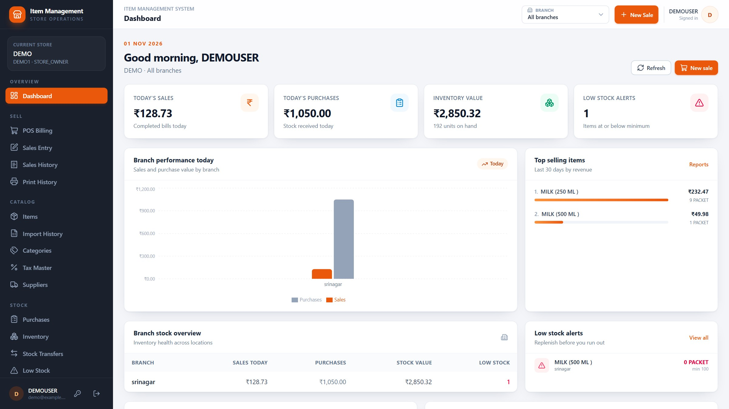
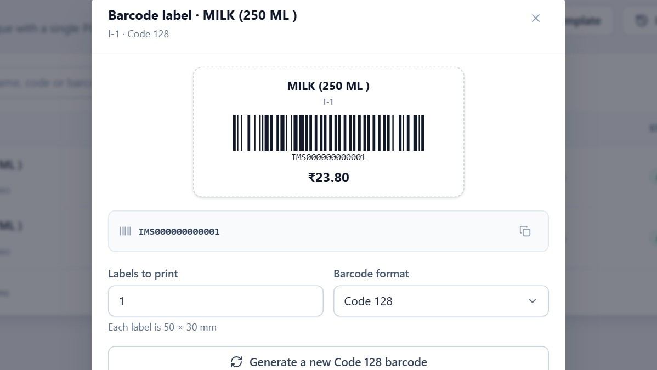
CUSTOMER PRESENTATION · VERSION 1.0.0
Item Management
System
Items, stock, purchases, billing, barcodes and reports — in one place.
Live v1.0.0 · demo store
One click from the item list creates a scannable Code128 label.
Prepared November 2026 · All screens captured from the deployed application with demo data
Notes:
Welcome. This is a complete walkthrough of the Item Management System, version 1.0.0. Everything you are about to see comes from the deployed application, using a demo store rather than any customer's data. I will follow the order a real store works in: sign in, set up people, create items, print and scan barcodes, buy stock, sell, print, and read the reports. Barcodes, printing and GST get the most time because those usually decide whether the system fits your counter. Ask questions at any point; there are speaker notes behind every slide if you present this without me.

Slide 2
AGENDA
Thirteen sections, one business story
Follow the modules in the order a store uses them, or jump to the section you need.
01
Introduction
06
Purchases
10
Reports & GST
Why stores outgrow paper.
Buy stock and record it.
Numbers you can act on.
02
Sign in & dashboard
07
Inventory
11
Platform admin
The first five minutes.
Counts, adjustments, transfers.
Stores and subscriptions.
03
Store & people
08
POS & sales
12
End-to-end
Branches, users and roles.
Bill customers quickly.
A day in the business.
04
Items & masters
09
Printing
13
Benefits & next steps
One catalogue for everything.
Receipts, labels and reports.
What changes for you.
05
Barcodes
Create, print, scan, retrieve.
Every screenshot comes from the live v1.0.0 application with a demo store. No customer data is shown.
Item Management System · Customer Presentation · v1.0.0
02 / 70
Notes:
The deck has thirteen sections. Sections two to eleven walk through the product module by module; twelve ties them into one day of store work; thirteen summarises the business benefits and the limits. If you only have fifteen minutes, I suggest the introduction, barcodes, POS and the GST report — that is the shortest path to understanding the value. The full walkthrough is designed for about forty-five minutes with questions.

Slide 3
SECTION 01
01
1
Item lists and rates drift between notebooks and files
The problem IMS solves
2
Stock is discovered at month-end, not known during the day
Growing stores rarely fail for lack of effort. They struggle because items, stock, bills and reports live in different places.
3
Owners cannot see branches without calling the manager
4
Billing and reporting do not share the same numbers
Item Management System · Customer Presentation · v1.0.0
03 / 70
Notes:
Start with the business problem, not the software. Ask the audience which of these four symptoms they recognise; almost every store recognises at least two. The next slide names the three root causes and shows what changes when all records share one source.

Slide 4
INTRODUCTION
Three problems every growing store knows
Different symptoms, one root cause: records that never meet.
BEFORE
DURING
AFTER
Paper and spreadsheets
Disconnected tools
One shared record
Item lists, rates and stock counts live in notebooks and files. Two people can hold two different truths, and month-end becomes a reconciliation exercise.
Billing, purchasing, labels and reports each keep their own data. A price change has to be repeated three times, and stock still does not match the shelf.
IMS keeps the catalogue, stock ledger, bills and reports on the same data. A purchase, sale or adjustment updates stock immediately for everyone who can see that branch.
One catalogue. One stock ledger. One bill. One set of reports — for every branch.
Item Management System · Customer Presentation · v1.0.0
04 / 70
Notes:
Keep this slide simple and human. Most owners do not want a lecture on databases; they want to hear their own week described. The phrase to land is 'one shared record': every later module is a different view of the same item and the same stock ledger.

Slide 5
INTRODUCTION
Built for owners, managers and counter staff
The same system answers different questions for each person.
OWNER & MANAGER
COUNTER STAFF
See the business, not just the till
Bill quickly with fewer mistakes
• Sales, purchases and stock by branch
• Prices, users and permissions under control
• GST-ready reports without rebuilding spreadsheets
• Branch comparison in one view
• Scan or search instead of typing codes
• Rate, tax and available stock on screen
• Only the modules their role allows
• A clear cart, total and change amount
Common in grocery, dairy, pharmacy, hardware, apparel, electronics and general retail — one branch or many.
Item Management System · Customer Presentation · v1.0.0
05 / 70
Notes:
Split the audience in your head: owners care about control and visibility; counter staff care about speed. IMS does not ask the cashier to understand reports, and it does not ask the owner to stand at the till. Roles decide what each person sees.

Slide 6
INTRODUCTION
Ten modules. One login.
Everything a store needs to buy, stock, sell and report — without switching tools.
01
02
03
04
05
Items & masters
Purchases
Inventory
Transfers
POS billing
Codes, categories, units, tax and rates.
Supplier bills that update stock.
On hand, adjustments, movements.
Move stock between branches.
Scan, discount, tax, payment.
06
07
08
09
10
Sales records
Barcode labels
Printing
Reports & GST
Access & platform
Invoices, cancellations, history.
Code128 labels, 1–100 copies.
Thermal receipts and print history.
Sales, purchases, profit, stock, GST.
Roles, branches, subscriptions.
Item Management System · Customer Presentation · v1.0.0
06 / 70
Notes:
This is the whole product on one page. Notice that every tile is a normal store activity, not a software concept. The order is deliberate: masters feed purchases; purchases and sales feed inventory; inventory feeds reports; roles control who touches each step. We will open nine of these ten modules live during the walkthrough. The platform tile is for the team that runs the service, not for the shop floor.

Slide 7
INTRODUCTION
One store today. A network tomorrow.
Masters stay shared; stock and selling prices stay branch-specific.
PLATFORM ADMINISTRATOR
Stores, subscriptions, platform users
STORE · DEMO1
Catalogue · taxes · suppliers · users · roles
Branch A
Branch B
Branch C
Stock · prices · sales
Stock · prices · sales
Stock · prices · sales
Assigned staff only
Assigned staff only
Assigned staff only
SHARED MASTERS
LOCAL STOCK
SCOPED ACCESS
PLAN LIMIT
One item list, tax set and supplier list for the store.
On-hand quantity and selling price belong to each branch.
A branch user only sees the branches assigned to them.
The subscription sets how many branches the store can run.
Item Management System · Customer Presentation · v1.0.0
07 / 70
Notes:
This is the mental model for everything that follows. The platform administrator creates the store and its subscription. Inside the store, the catalogue, taxes and suppliers are shared, but stock and selling price are held per branch. That is why one item can be low in one shop and healthy in another. Access is scoped to branches, and the subscription decides the maximum number of branches — five in the demo store.

Slide 8
SECTION 02
02
1
Store code, username and password
Sign in, dashboard, access
2
The dashboard and its four headline numbers
The first five minutes: how a person signs in, what they see, and why two people see different things.
3
Branch selection in the header
4
Platform, owner and employee access
Item Management System · Customer Presentation · v1.0.0
08 / 70
Notes:
Now move from theory to the actual product. Keep this section brisk — it is about orientation, not features. The key idea is that the dashboard is personal: it reflects the branches and permissions of the person signed in.

Slide 9
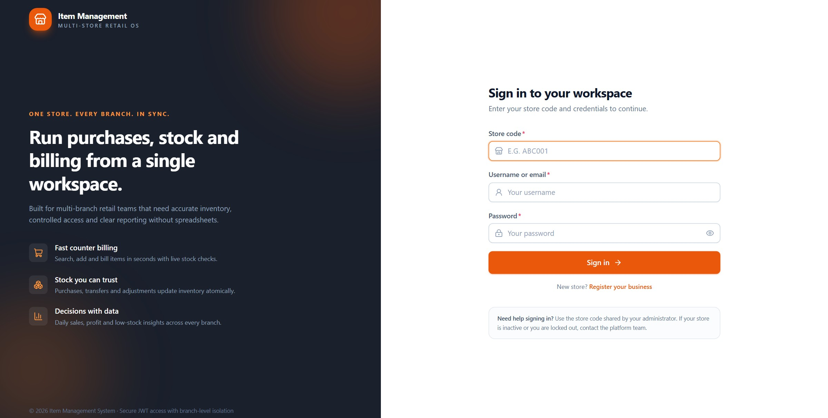
ACCESS
Sign in with a store code, not a shared login
Every person has their own username, password and role — and the session expires after 12 hours.
1
2
3
4
1
Store code
2
Username
3
Password
4
Sign in
Item Management System · Customer Presentation · v1.0.0
09 / 70
Notes:
This is the first screen the team sees. The store code tells IMS which business is signing in; it is not a secret, but it is required alongside the individual username. Nobody shares a login, so every sale, purchase and permission change is tied to a person. The small line under the form reminds staff who to contact if the store is inactive or they are locked out.

Slide 10
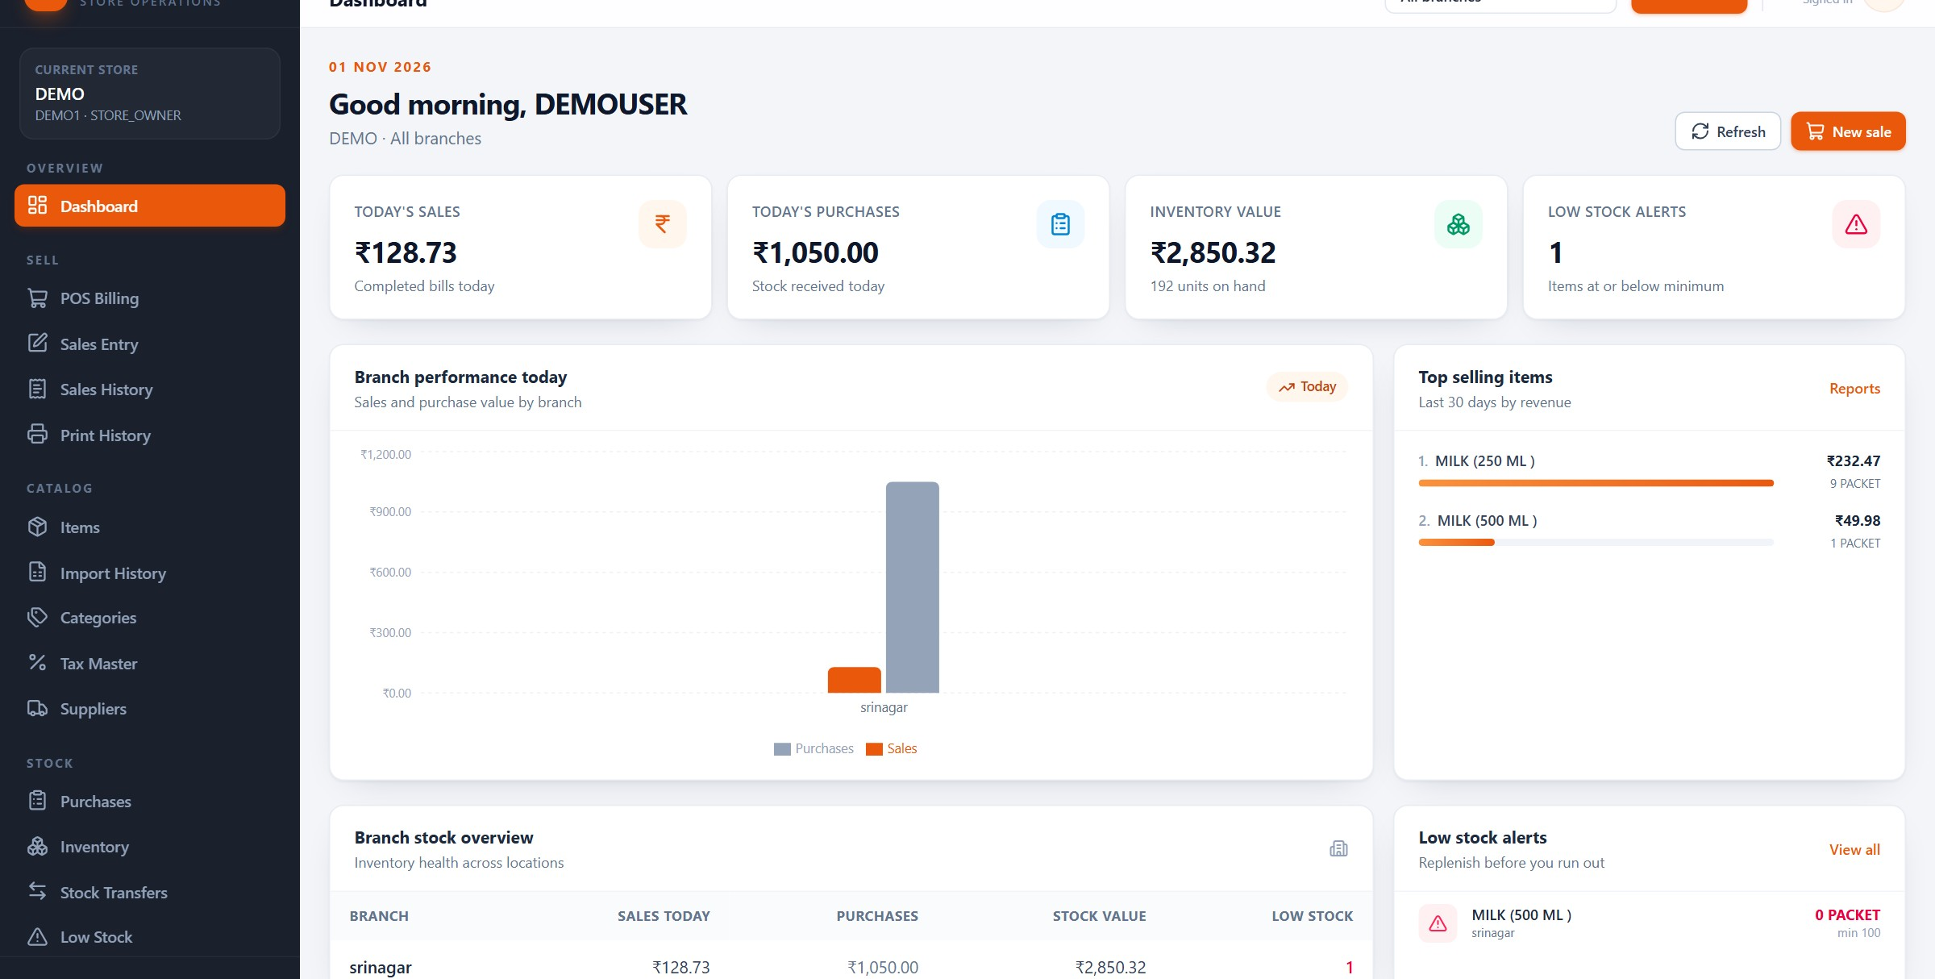
ACCESS
The dashboard answers four questions before coffee
Today's sales, today's purchases, stock value and low-stock alerts — for all branches or the one you choose.
2
1
3
4
1
Today's KPIs
2
Branch filter
3
Top sellers
4
Branch stock
Item Management System · Customer Presentation · v1.0.0
10 / 70
Notes:
After signing in, the owner lands here. The four cards are today's sales, today's purchases, the value of stock on hand and how many items are at or below their minimum. In the demo store the numbers are small because it is a demo: seven bills, 192 units, one low-stock item. Point out the branch selector in the header — changing it changes every number on the page. The bottom table repeats the same figures branch by branch, which is how a multi-branch owner starts the day.

Slide 11
ACCESS
Three levels of access, clearly separated
The platform runs the service; the owner runs the store; employees run the counter.
PLATFORM ADMIN
STORE OWNER
EMPLOYEE
Runs the platform
Runs the store
Runs the counter
Creates stores, manages subscriptions and store login accounts, resets credentials and reads the platform audit trail. Does not open a store's sales, stock or items.
Full control of the catalogue, purchases, sales, inventory, reports, users and roles. Sees every branch unless a role narrows it. Can create custom roles from 30 permissions.
Branch Manager or Branch Staff. Sees assigned branches only, and only the modules and actions allowed by their role — for example billing and stock checks, without settings.
Sessions last 12 hours; five failed attempts lock the account for 15 minutes; first sign-in forces a password change.
Item Management System · Customer Presentation · v1.0.0
11 / 70
Notes:
This is the slide to slow down on if the buyer is worried about staff access. The important sentence is the platform one: the team that hosts the service cannot browse the store's commercial data. Employees are not a single role either — the owner can shape what a cashier, supervisor or branch manager can do.

Slide 12
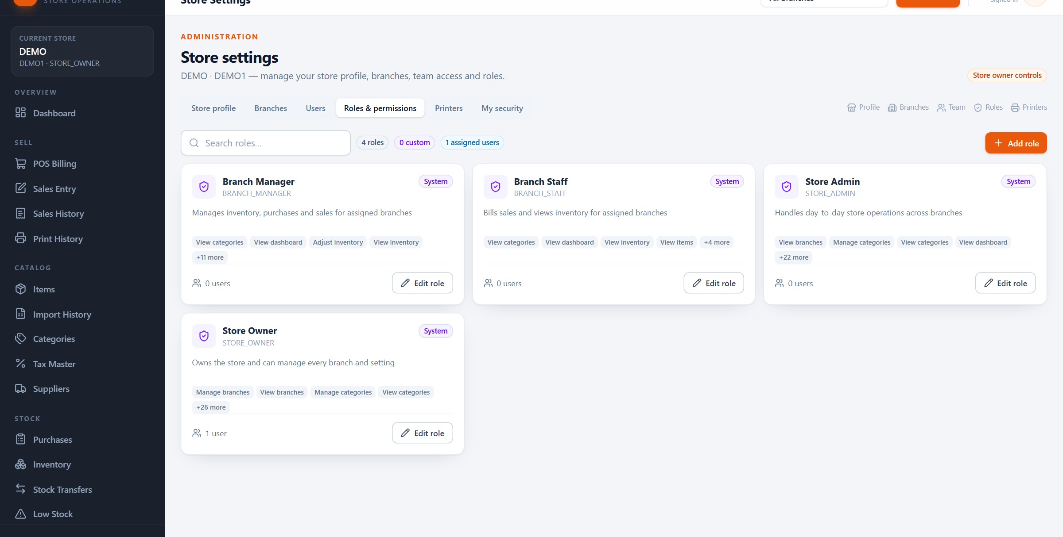
ACCESS
Roles are visible, editable and permission-based
Four system roles ship with IMS; the owner can add custom roles using the same permission set.
System roles and their permission counts
Permissions granted by each role
Add role, top right
Item Management System · Customer Presentation · v1.0.0
12 / 70
Notes:
Settings, Roles and permissions. Each row is a role, its description and the number of permissions it carries. The owner can open a role to see exactly which modules and actions it grants, or create a custom role such as Cashier or Stock Clerk. Permissions are enforced by the server, not just hidden in the interface, so a restricted user cannot reach a module by typing a URL.

Slide 13
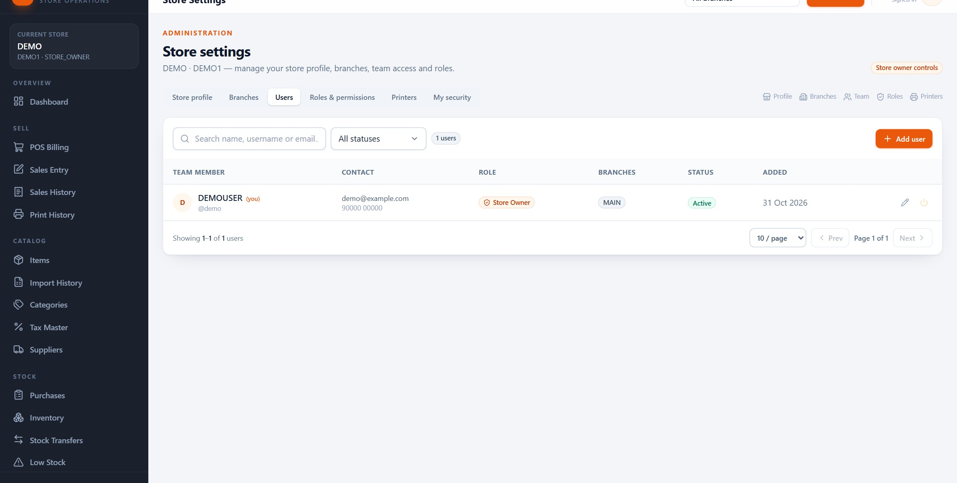
ACCESS
One team list, with role and branch access
Adding a user sets their login, their role and the branches they may work in.
Team members and their role
Branch access per person
Add user from the top right
Item Management System · Customer Presentation · v1.0.0
13 / 70
Notes:
The Users tab is the team roster. Each person has a login, a role and one or more branches. A branch manager assigned to two shops will only see those two in the branch selector. Removing access is a matter of disabling the user or changing the role; the account is not shared with the next hire.

Slide 14
SECTION 03
03
1
Store profile, GSTIN and tax mode
Store, branches and people
2
Branches and the subscription limit
Before the first item is created, the store needs its identity, its locations and its team.
3
Adding a user with the right role
4
How data is kept inside the store
Item Management System · Customer Presentation · v1.0.0
14 / 70
Notes:
Setup is a one-time activity, but it decides how clean the data stays later. Show the profile, then the branch list, then a user. Finish with the data-separation slide, because that is what makes the ownership conversation comfortable.

Slide 15
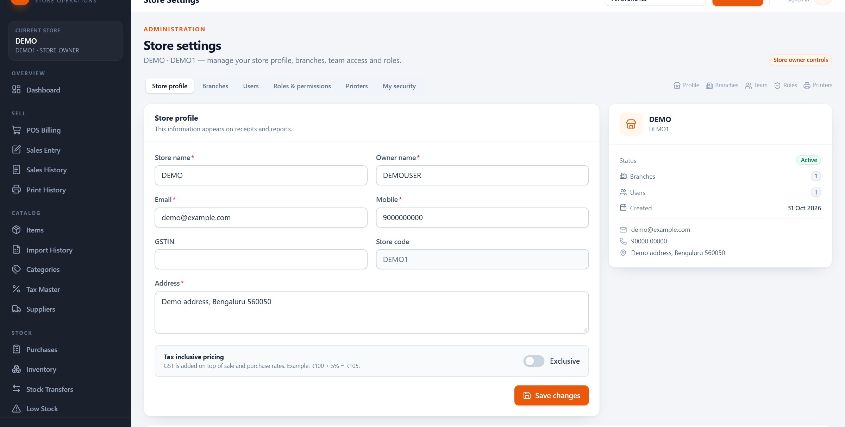
STORE SETUP
The store profile feeds receipts and reports
Name, owner, contact, address, GSTIN and the tax mode apply across the whole store.
3
1
2
1
Store identity
2
Tax mode
3
Subscription
Item Management System · Customer Presentation · v1.0.0
15 / 70
Notes:
This is where the store's legal identity lives. The GSTIN and address appear on receipts and reports; the tax-inclusive switch decides whether catalogue rates already include GST or whether tax is added on top. In the demo it is set to Exclusive, which is why a 25 rupee line becomes 26.25 with five percent GST. At the bottom sits the subscription window and branch allowance, managed by the platform administrator.

Slide 16
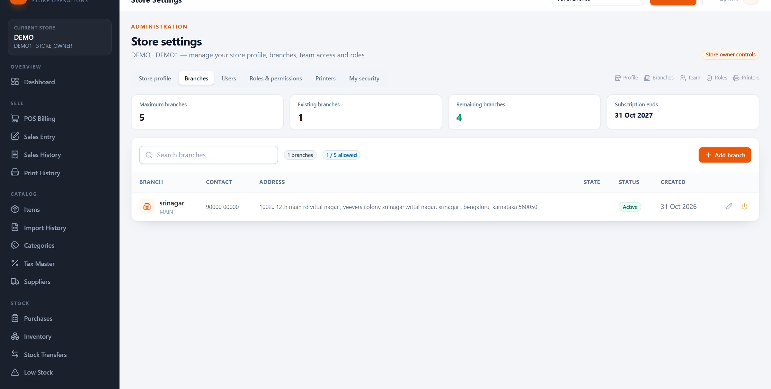
STORE SETUP
Branches are locations, not separate systems
The demo store runs one branch out of a five-branch allowance; each branch keeps its own stock and prices.
Branches and their addresses
1 of 5 branches used
Add branch, top right
Item Management System · Customer Presentation · v1.0.0
16 / 70
Notes:
The branch list is short in the demo — one branch, srinagar, out of five allowed. A branch has a name, a code and an address, and it becomes a stock location: purchases, sales, adjustments and transfers all post against a branch. The branch limit is enforced by the server, so the store cannot quietly exceed its plan by opening the form twice.

Slide 17
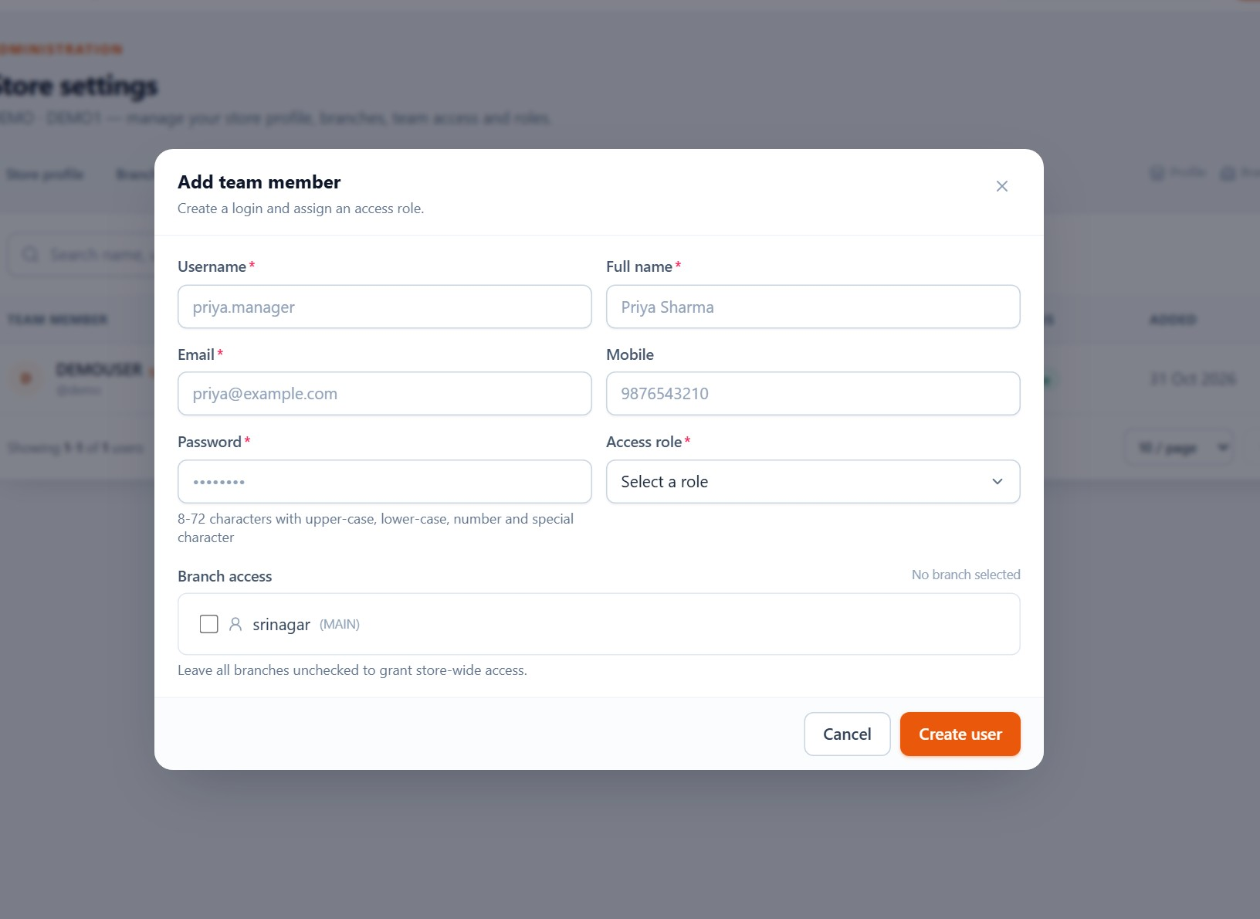
STORE SETUP
Adding a user takes four decisions
Identity, role, branch access, then a password the person must change.
1
Login identity
Full name, username and email for the person — not a shared counter login.
2
Role
Choose a system role or a custom one; the role decides modules and actions.
3
Branch access
Tick the branches this person may work in. Empty means the role decides.
4
First password
The user signs in and is forced to set a new password before working.
Item Management System · Customer Presentation · v1.0.0
17 / 70
Notes:
Open Add user from Settings, Users. The form is short because the role carries most of the policy. The branch list is the second control: a cashier at one shop should not be able to select another. The temporary password is changed at first sign-in, and changing a username or resetting a password invalidates that person's existing sessions.

Slide 18
STORE SETUP
Your data stays inside your store
Separation is built into the data model, not added as a setting.
01
02
03
04
Store isolation
Branch scoping
Server-side checks
Accountability
Every item, sale, purchase and setting belongs to one store. Queries are filtered by the signed-in store before any record is returned.
Stock, prices and sales are held per branch. A user sees only the branches assigned to them, and the branch selector cannot widen that list.
Permissions are checked on every request, not only by hiding buttons. A copied link or a direct API call still hits the same check.
Credential changes are recorded in the platform audit trail, with filters and CSV export. Sign-in sessions expire after 12 hours.
Store owners control their own users and roles. Platform staff never open store business records.
Item Management System · Customer Presentation · v1.0.0
18 / 70
Notes:
This is the answer to 'who can see my numbers?'. The platform administrator manages the store and its subscription, but cannot browse store sales or stock. Within the store, branch assignment narrows what an employee sees. And every permission is enforced on the server, so the UI is a convenience, not the security boundary.

Slide 19
SECTION 04
04
1
Items, codes, units, rates and tax
Items and master data
2
Categories and GST slabs
The catalogue is the foundation: every purchase line, bill, barcode and report points back to an item.
3
Suppliers and item editing
4
Excel import with preview and history
Item Management System · Customer Presentation · v1.0.0
19 / 70
Notes:
Everything downstream depends on this section. Spend time on the difference between the item master rate and branch-level selling price, because that is where most retail systems confuse their users.

Slide 20
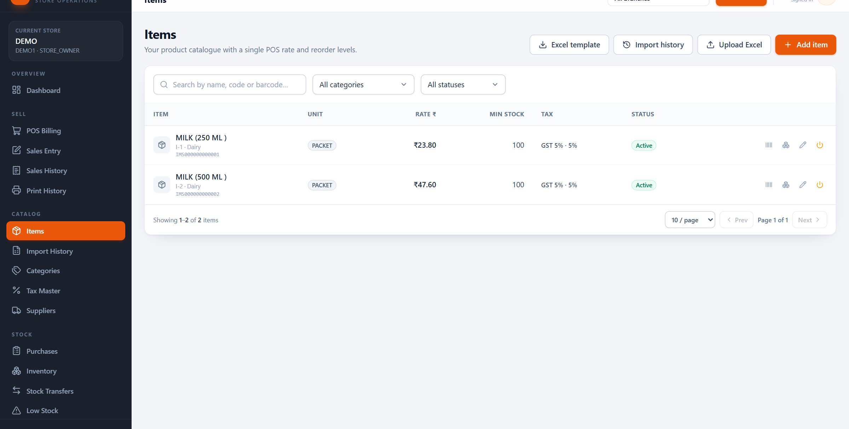
ITEMS
One catalogue, with the details that drive billing
Code, name, unit, master rate, minimum stock, tax and barcode — on one row.
Code & barcode
Master rate
Tax
Item actions
Item Management System · Customer Presentation · v1.0.0
20 / 70
Notes:
The item list is deliberately plain. Each row shows the item code and barcode under the name, the unit, the master rate used by POS, the minimum stock that triggers a low-stock alert, and the tax slab. The icons on the right open branch pricing, the barcode label, editing and activation. This screen is also searchable by name, code or barcode, which is what makes the scanner useful later.

Slide 21
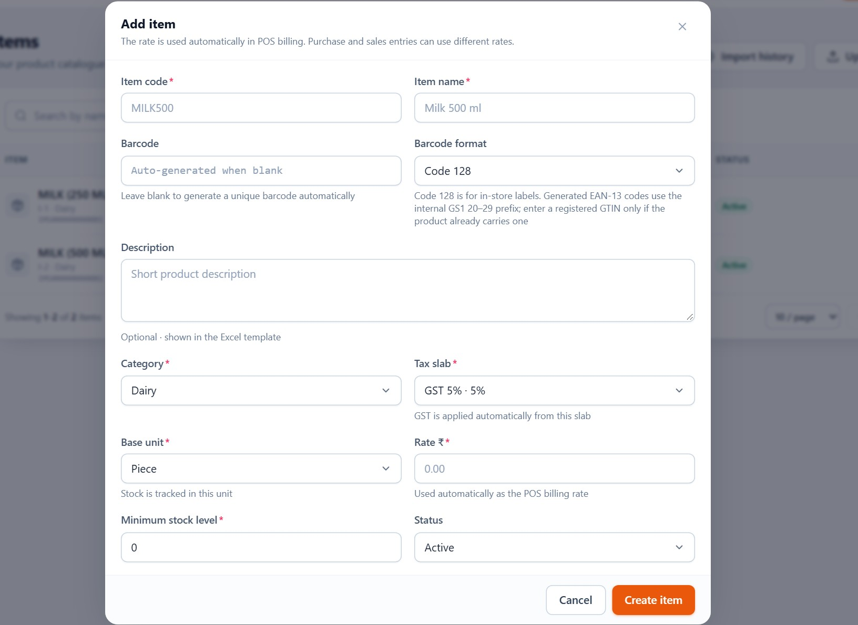
ITEMS
Creating an item is a single short form
Most fields are optional; the name, unit, rate and tax decide how it behaves.
1
Name and code
A human-readable item code; the name is what staff search for.
2
Category and unit
Category groups items in reports; unit drives quantity labels.
3
Rate and tax
The master rate is the POS price; tax comes from the tax master.
4
Description
Optional notes such as pack size, brand or shelf location.
Item Management System · Customer Presentation · v1.0.0
21 / 70
Notes:
Add item. The form asks for the item name, code, category, unit and rate, plus an optional tax and description. In this version there is one master rate per item; if a branch needs a different selling price, that is set in branch pricing rather than by duplicating the item. Saving the item makes it available to purchases, inventory and POS immediately.

Slide 22
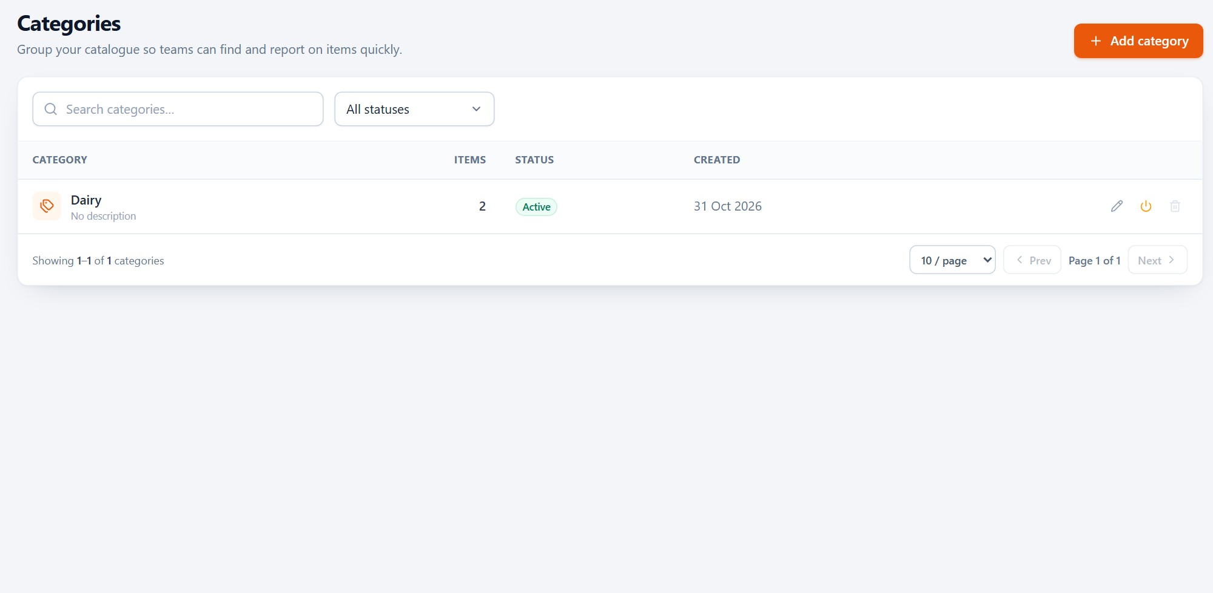
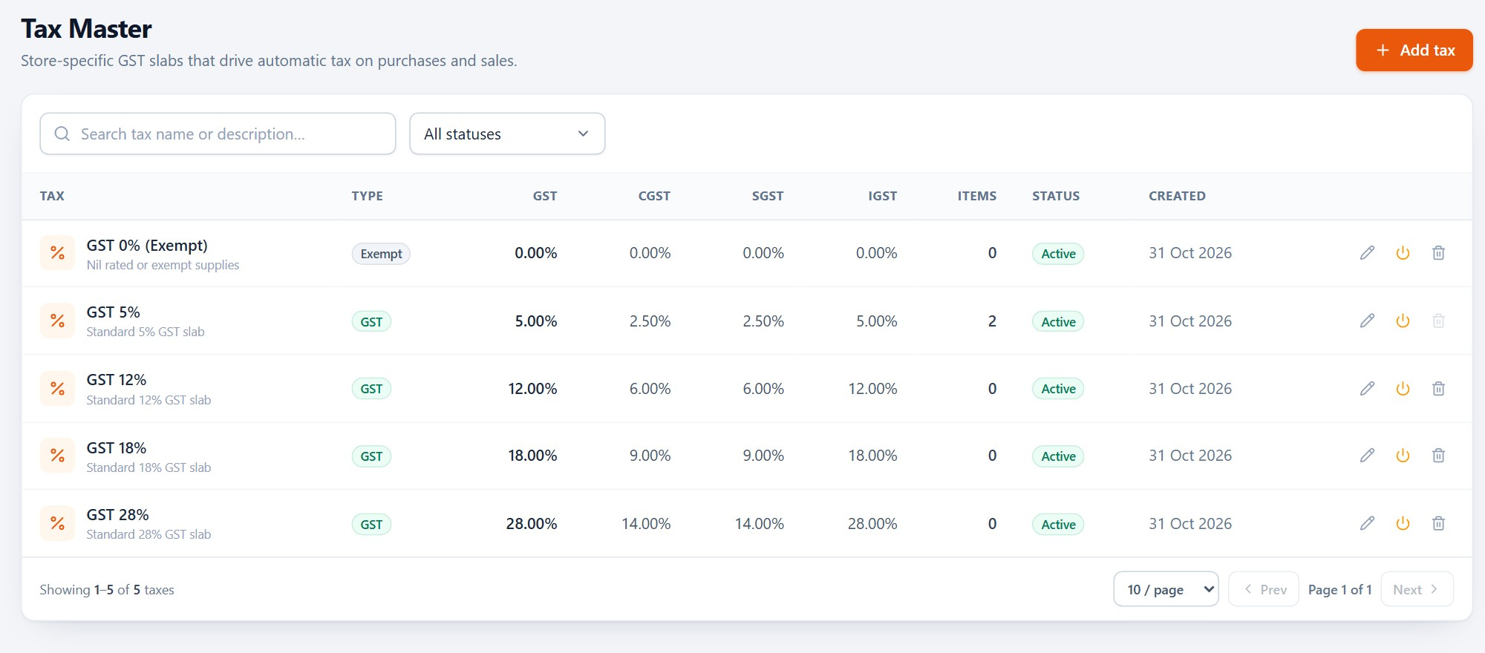
ITEMS
Categories and tax slabs keep the catalogue consistent
Two small masters remove most of the free text — and most of the reporting errors.
Categories
Tax master
Group items once; every item, purchase and report can then be filtered by category. Deleting is blocked while items still use it.
GST slabs of 0, 5, 12, 18 and 28 percent. Each slab carries CGST, SGST and IGST rates, so item setup only needs a name.
Item Management System · Customer Presentation · v1.0.0
22 / 70
Notes:
Two masters, both small on purpose. Categories are how the owner filters a thousand items down to the relevant group. The tax master is where the accounting logic lives: the item simply points at a slab, and IMS derives CGST and SGST for intra-state sales or IGST for inter-state sales. That keeps item setup simple and stops each person inventing their own tax rate.

Slide 23
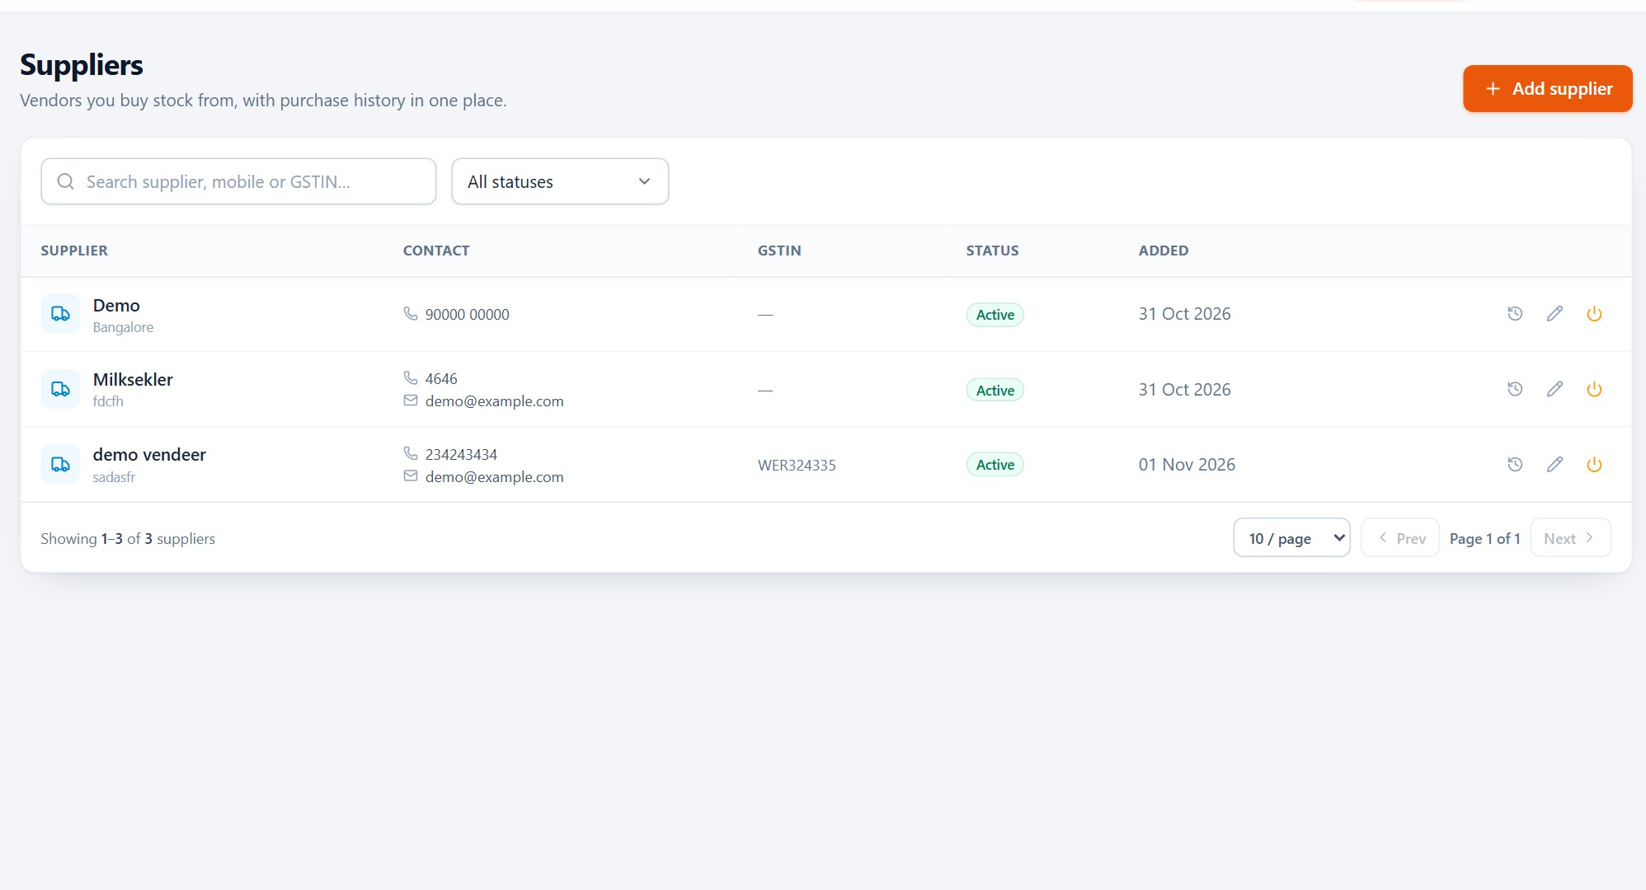
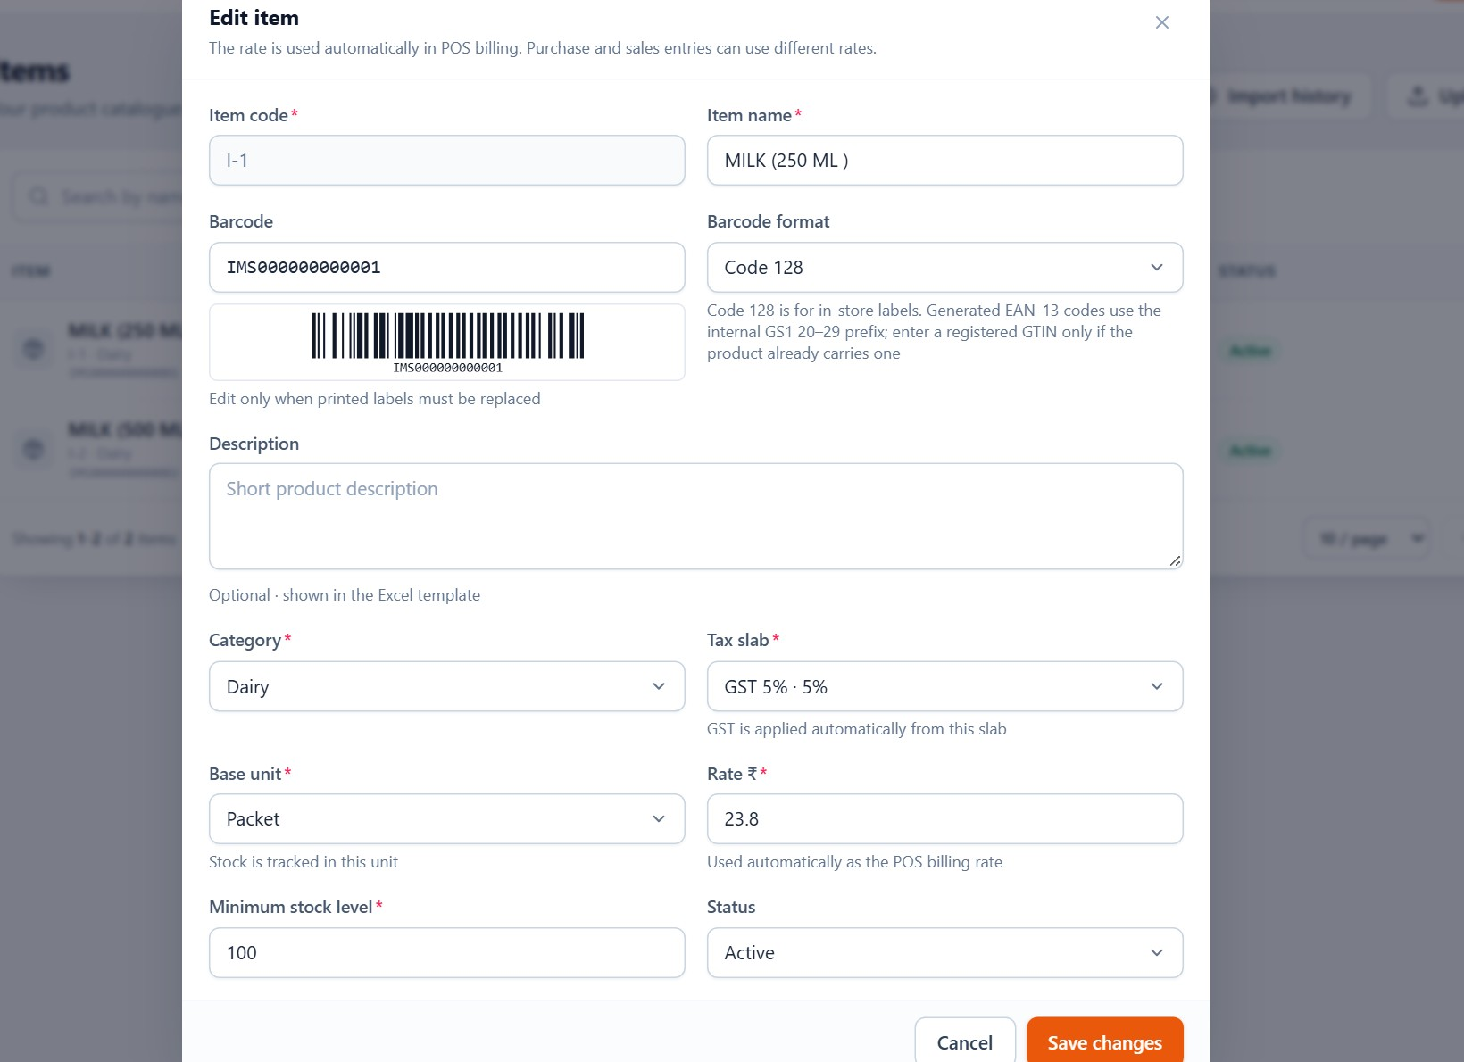
ITEMS
Suppliers and edits — without breaking history
Supplier records feed purchase entry; editing an item updates the master, not past bills.
Suppliers
Item editing
Name, contact and GST details for the businesses you buy from. They appear automatically in the purchase form.
Change name, category, unit, rate or tax. Completed bills keep the rate and tax they were saved with.
Item Management System · Customer Presentation · v1.0.0
23 / 70
Notes:
Suppliers are master data, not typed per bill. The edit form is where an owner changes a rate or tax slab; completed invoices keep the values they were saved with, because tax and rate are snapshotted onto each line. That sounds technical, but the business effect is simple: next month's report still matches last month's bill after a price change.

Slide 24
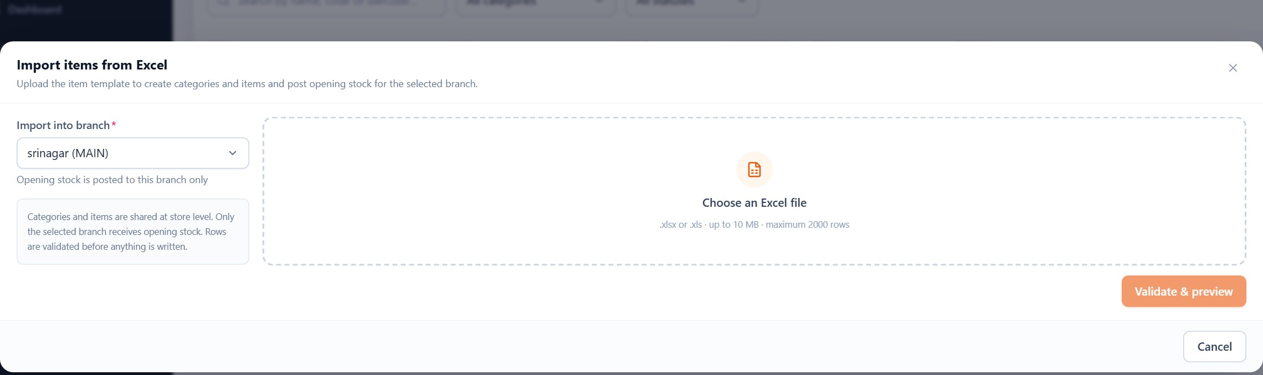
ITEMS
Import an existing catalogue from Excel
Download the template, upload, preview every row, then confirm — nothing is written until you say so.
1
Start from the template
2
Preview first
3
Choose the branch
4
Keep a history
Columns for code, name, category, unit, rate, tax and opening stock.
IMS validates the file and shows what will be created before anything is saved.
Opening stock is posted to the branch selected in the dialog, not to all branches.
Each import is listed with its row counts, so a failed file can be traced.
Excel .xlsx or .xls · up to 2,000 rows per import · the same file cannot be imported twice.
Item Management System · Customer Presentation · v1.0.0
24 / 70
Notes:
The import is for stores that already have a catalogue. The template is a normal Excel file; up to two thousand rows are processed per import. The preview is the important part: categories can be created automatically, and the owner sees exactly what will happen before confirming. Opening stock lands in the chosen branch. The same file cannot be imported twice, which prevents accidental double stock.

Slide 25
ITEMS
Practical example: add a one-litre milk pack
Five decisions, about thirty seconds, and the item is ready for purchase, stock and POS.
1
Category
2
Unit
3
Tax
Create or choose Dairy so the item appears in the dairy filter.
Pick LITER — the unit appears on the bill and in stock reports.
Choose the 5 percent GST slab used for this product.
4
Rate
5
Save & label
Enter the master selling rate used by POS; branch prices can differ later.
Save the item, then open Barcode label to print the first sticker.
Tip: the item code is for people, the barcode is for the scanner. You can keep an existing code such as MILK-1L and still print a scannable IMS barcode for it.
Result: the item is searchable, purchasable, stocked at the selected branch and ready for a barcode label.
Item Management System · Customer Presentation · v1.0.0
25 / 70
Notes:
Walk through this as a real task rather than a feature tour. A new product usually arrives with a rate and a tax slab; the only decisions are category, unit, tax and rate. If the product already has a manufacturer barcode, scan it into the item; if not, IMS generates one when the label is opened. The last step is the bridge into the next section.

Slide 26
SECTION 05
05
1
Create the item, then generate its barcode
Barcode management
2
Print 50 × 30 mm labels, 1 to 100 copies
The feature that changes the counter: create once, print once, scan every time after that.
3
Scan with a USB or Bluetooth scanner
4
Retrieve the item instantly, with no typing
Item Management System · Customer Presentation · v1.0.0
26 / 70
Notes:
This is the section to demonstrate live if possible. The promise is simple: after the first label, nobody types an item code at the counter again. The next slide shows the six-step journey; the slides after it show the label screen and the scan result.

Slide 27
BARCODES
The barcode journey, end to end
Six steps from a new product to a scanned item — the barcode is stored with the item at step three.
1
Create item
2
Generate barcode
3
Save item
Name, unit, rate and tax. No barcode needs to exist yet.
Open the label action; IMS assigns a Code128 code automatically.
The barcode is stored on the item and stays unique inside the store.
4
Print label
5
Scan barcode
6
Retrieve item
50 × 30 mm PNG; choose 1 to 100 copies and print from the browser.
USB or Bluetooth scanner types the code into the scan field.
The item, rate, tax and branch stock appear in the bill.
The barcode is saved with the item, so a lost sticker is a reprint — not a new product record.
Item Management System · Customer Presentation · v1.0.0
27 / 70
Notes:
Say the six steps out loud; this is the workflow the customer will repeat thousands of times. The critical design choice is step three: the barcode belongs to the item and is stored with it, so there is no separate label database to maintain. Reprinting is therefore always possible from the item list, even months later.

Slide 28
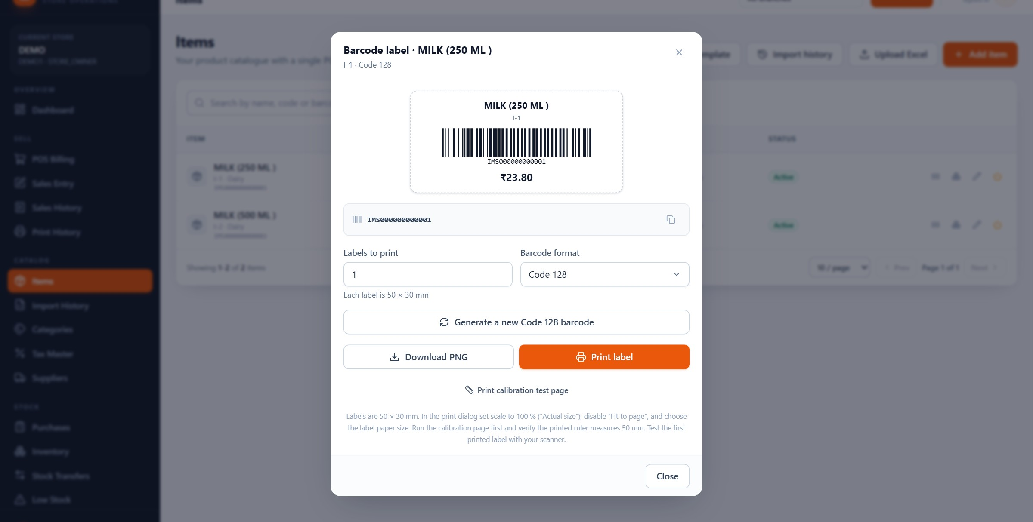
BARCODES
The label screen is the whole label workflow
Preview, size, copies, download and print — one dialog, no design software.
1
2
3
4
1
Barcode value
2
Copies 1–100
3
50 × 30 mm
4
Download / print
Item Management System · Customer Presentation · v1.0.0
28 / 70
Notes:
Open the barcode icon on any item row. The dialog shows the human-readable item, the barcode value and a print-ready preview. The label is fifty by thirty millimetres, the common size for a small retail sticker. Choose how many copies and download the PNG or send it to the browser's print dialog. There is also a calibration control for printers that shift the label slightly.

Slide 29
BARCODES
What is actually stored, and what the scanner sees
Four details that explain why barcode setup stays simple.
01
02
03
04
Generated for you
Unique per store
Internal vs retail
Stored and reprintable
Opening the label assigns a Code128 barcode in the form IMS + ten digits, for example IMS000000000001. No barcode designer is involved.
The store cannot hold two items with the same barcode. The item code remains separate and human-readable, so both can be used in search.
EAN-13 codes with the prefix 20 are reserved for internal labels. A GS1 badge appears only for a genuine external retail GTIN.
The barcode is saved on the item, shown in lists, and can be printed again at any time — including after a sticker is damaged.
Labels are 50 × 30 mm PNG files; print 1–100 copies from the browser — no label software required.
Item Management System · Customer Presentation · v1.0.0
29 / 70
Notes:
The audience often asks whether they need GS1 registration. For in-store labels, no: IMS generates an internal Code128 code, and internal EAN-13 codes use the prefix 20. GS1 matters only when the product must scan in another retailer's system. The barcode is stored with the item, so reprinting is trivial.

Slide 30
BARCODES
Scanning needs hardware, not installation
A USB or Bluetooth scanner behaves like a keyboard. The camera option needs nothing but the browser.
SUPPORTED HARDWARE
WHERE SCANNING WORKS
• USB barcode scanner in keyboard-wedge mode — the most common counter scanner.
• Bluetooth scanner paired as a keyboard (HID); no proprietary driver or SDK.
• Any scanner that types the code and sends Enter; most ship configured this way.
• Phone or webcam as a fallback: the browser camera scans Code128 directly.
• POS billing: scan into the search box and the item joins the cart.
• Manual sales entry: the scan field adds an item line with its tax.
• Item list and search fields accept a code or barcode as text.
• The item is matched inside the signed-in store, then stock is read from the selected branch.
SETUP IN THREE STEPS
Plug in or pair the scanner → click the scan field so the cursor is there → scan a label. If nothing appears, the scanner is usually missing the Enter suffix — enable it in the scanner's configuration barcode.
Item Management System · Customer Presentation · v1.0.0
30 / 70
Notes:
Most barcode scanners in the market are keyboard wedges: to the computer they look like a very fast keyboard. That is why there is no driver, plugin or desktop agent for scanning. The scanner must end the code with Enter, which is the factory default on nearly every model. For a phone, the browser camera is the fallback. The one thing to practise is clicking the scan field first, because the scanner types wherever the cursor is.

Slide 31
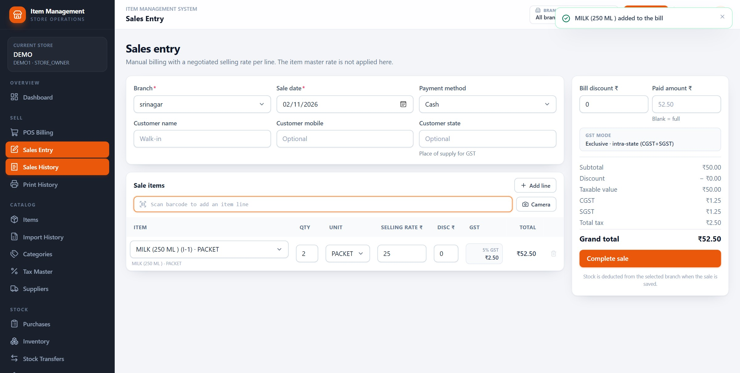
BARCODES
Scan once, and the bill builds itself
The scan filled the item line, applied the 5% tax and calculated the total — no code was typed.
1
3
2
4
1
Scan field
2
Item found
3
Tax applied
4
Total
Item Management System · Customer Presentation · v1.0.0
31 / 70
Notes:
This is the proof. I scanned IMS000000000001 into the sales entry screen; IMS found MILK 250 ML, added the packet unit and the five percent tax, and the toast confirmed the item was added. I then set the quantity to two and the negotiated rate to twenty-five, which gives a total of fifty-two rupees fifty. The bill was not saved — this is a demonstration screen. In POS the rate comes from the item master; in manual sales entry the rate can be negotiated per line.

Slide 32
SECTION 06
06
1
Purchase list with draft, completed, cancelled
Purchase management
2
Supplier, items, quantity, rate and tax
Stock arrives before it can be sold. Purchases are how the system learns what came in, at what cost, from whom.
3
What completion does to stock and cost
4
Cancelling a mistake without losing the record
Item Management System · Customer Presentation · v1.0.0
32 / 70
Notes:
Purchases are the least glamorous module and the one that keeps inventory honest. The key point for the owner is that completing a purchase updates stock and average cost automatically; nobody re-keys the delivery into a stock sheet.

Slide 33
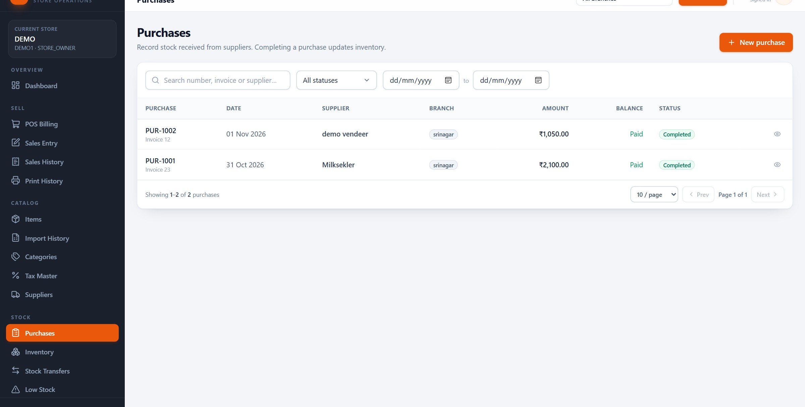
PURCHASES
Every supplier bill in one list
Purchase number, supplier, date, status and total — with a drill-down on every row.
Purchase records
Supplier
Status
Total
Item Management System · Customer Presentation · v1.0.0
33 / 70
Notes:
The purchase list shows the two demo bills: PUR-1001 and PUR-1002. Each row carries the supplier, date, status and total. Drafts can be left open; completed purchases have already moved stock; cancelled ones remain visible for the audit trail. The view action opens the full bill with its lines and tax.

Slide 34
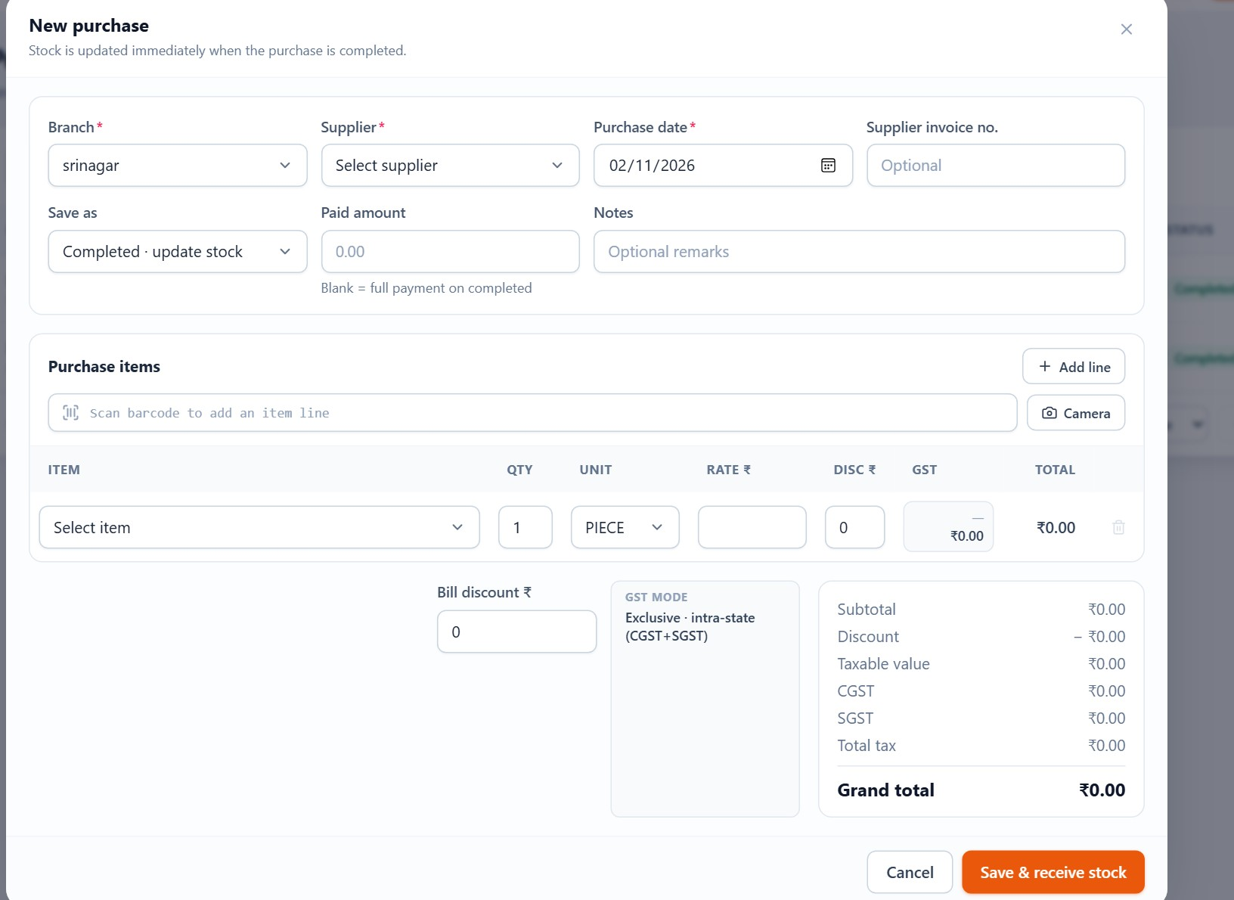
PURCHASES
Raising a purchase is a line-by-line form
Choose the branch and supplier, add items, then save as draft or complete the bill.
1
Branch and supplier
The branch receives the stock; the supplier comes from the supplier master.
2
Item lines
Add each item with quantity, purchase rate and the tax that applies.
3
Totals
IMS calculates line tax, taxable value and the bill total as you type.
4
Draft or complete
A draft can wait; completing posts stock and average cost immediately.
Item Management System · Customer Presentation · v1.0.0
34 / 70
Notes:
New purchase. The branch matters because stock is branch-level: a delivery to srinagar must not appear in another shop. Item selection uses the same catalogue, so descriptions, units and tax defaults are consistent with billing. Save as draft if the invoice is not final; complete it when the stock is physically received.

Slide 35
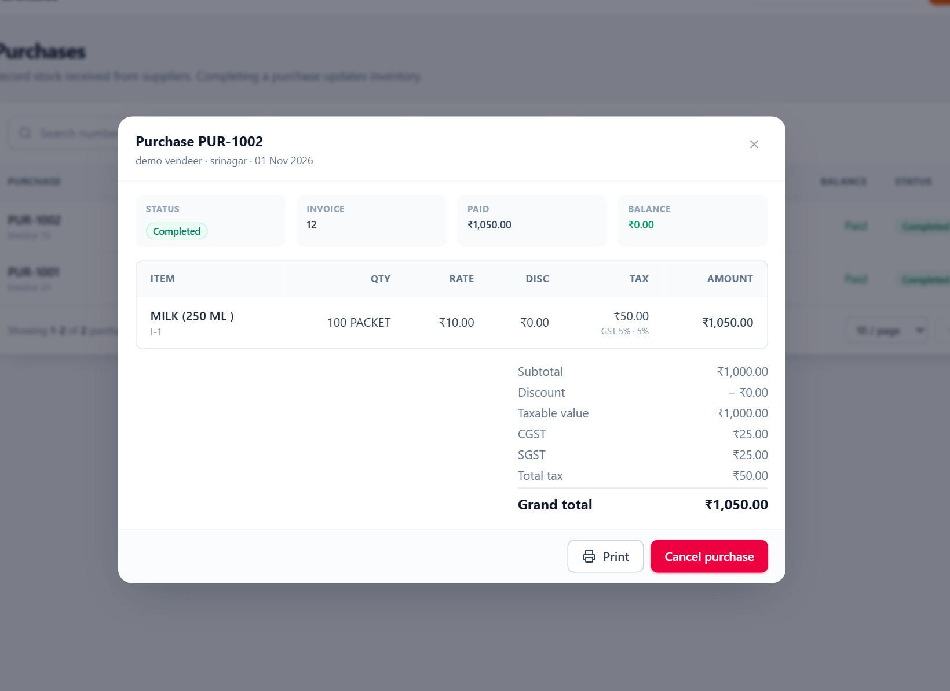
PURCHASES
Completing a purchase changes stock and cost
The record keeps the supplier, lines, tax and total — and reverses cleanly if cancelled.
1
Stock in
Each line increases the quantity on hand at the selected branch.
2
Average cost
The branch's weighted average purchase cost is recalculated for margin reports.
3
Tax snapshot
The rate and tax on the line are stored with the bill, not re-read later.
4
Cancel reverses
Cancelling a completed purchase removes its stock effect and keeps the record.
Item Management System · Customer Presentation · v1.0.0
35 / 70
Notes:
This is PUR-1002, one thousand and fifty rupees for one hundred milk packets. The detail view is the evidence trail: supplier, branch, lines, rates and tax. What the owner should remember is the second point: completing the purchase updates stock and the weighted average cost used by the profit report. If the bill was wrong, cancelling reverses the stock and cost rather than deleting history.

Slide 36
SECTION 07
07
1
Stock on hand, minimum and low-stock status
Inventory management
2
Adjustments with a reason and a record
Stock is the number everyone argues about. IMS keeps one ledger per branch and shows every movement behind the number.
3
Movement history across purchases and sales
4
Transfers between branches, with approvals
Item Management System · Customer Presentation · v1.0.0
36 / 70
Notes:
Inventory is where the barcode and purchase sections pay off, because every scan and every completed purchase writes to this ledger. Emphasise that the on-hand number is not typed; it is calculated from movements.

Slide 37
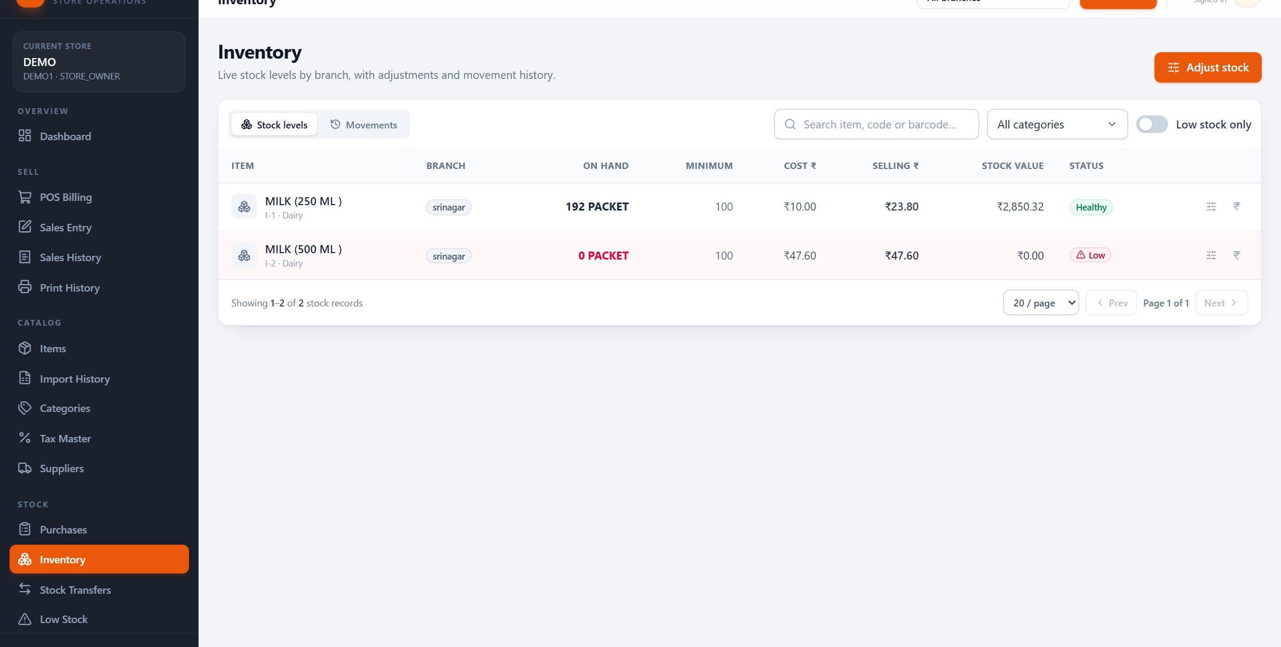
INVENTORY
Stock on hand, branch by branch
The number is calculated from purchases, sales, adjustments and transfers — not maintained by hand.
On hand
Minimum
Status
Actions
Item Management System · Customer Presentation · v1.0.0
37 / 70
Notes:
The inventory list is the branch's shelf in numbers. In the demo, the 250 ml pack has 192 units and the 500 ml pack is at zero and marked low. The minimum column is the reorder point: when on-hand falls to or below it, the item appears on the low-stock list and dashboard. The action icons open adjustment and branch pricing.

Slide 38
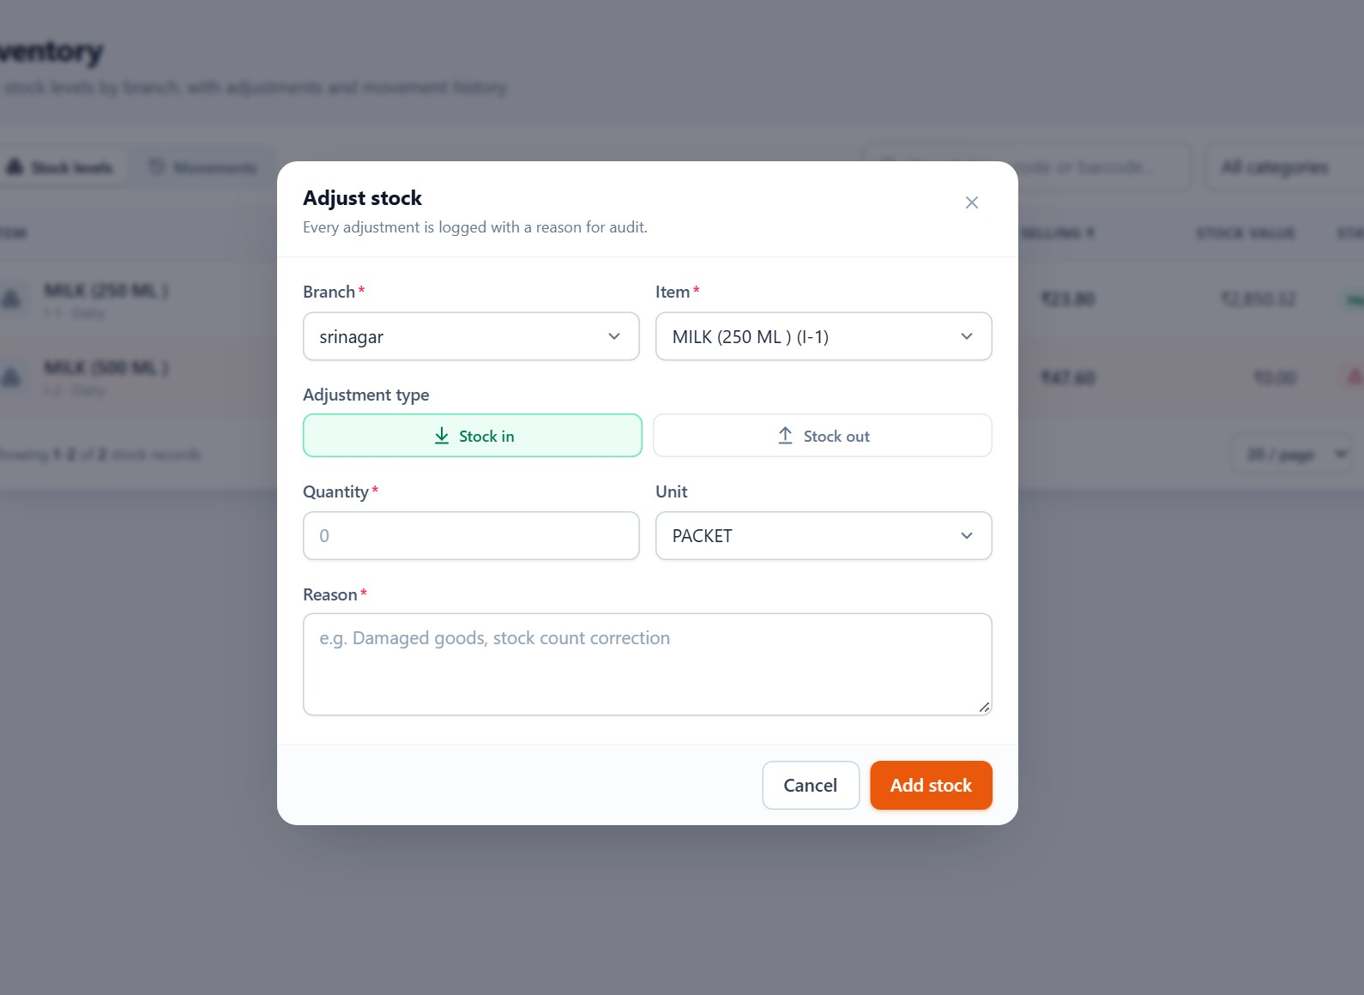
INVENTORY
Adjustments explain the difference
Damaged, expired, counted differently or received without a bill — record the reason, not just the number.
1
Stock in or out
Choose the direction and the quantity; IMS adds or removes it at this branch.
2
Reason required
A short reason turns an unexplained change into an auditable movement.
3
Immediate effect
The on-hand figure and stock value update as soon as the adjustment is saved.
4
Visible in history
Every adjustment appears in the movement ledger with its reference.
Item Management System · Customer Presentation · v1.0.0
38 / 70
Notes:
Adjustment is the honest way to fix stock. The form asks for the item, the branch, whether stock is going in or out, the quantity and a reason. That reason is what makes the movement ledger useful during a stock-take review. Without adjustments, teams tend to edit the quantity directly and the paper trail disappears.

Slide 39
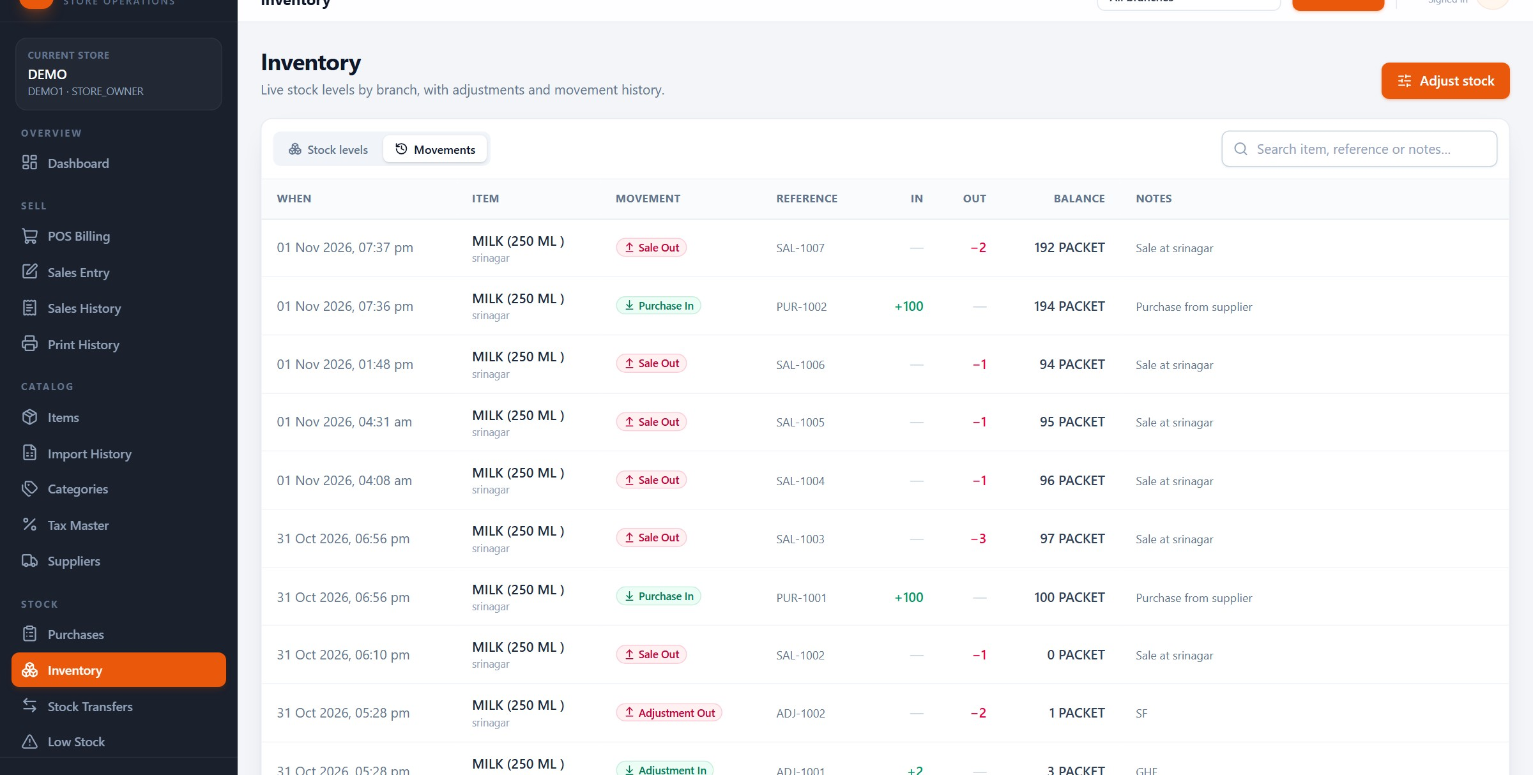
INVENTORY
Every change leaves a movement
Purchases, sales, adjustments and transfers in one chronological ledger.
Movement ledger
Reference
Quantity
Balance
Item Management System · Customer Presentation · v1.0.0
39 / 70
Notes:
Movements are the audit trail behind the stock number. Each row records what changed, when, at which branch, and which document caused it — a purchase, a sale, an adjustment or a transfer. If the shelf and the system disagree, this is where the investigation starts: the ledger shows the last known quantities and the document behind each change.

Slide 40
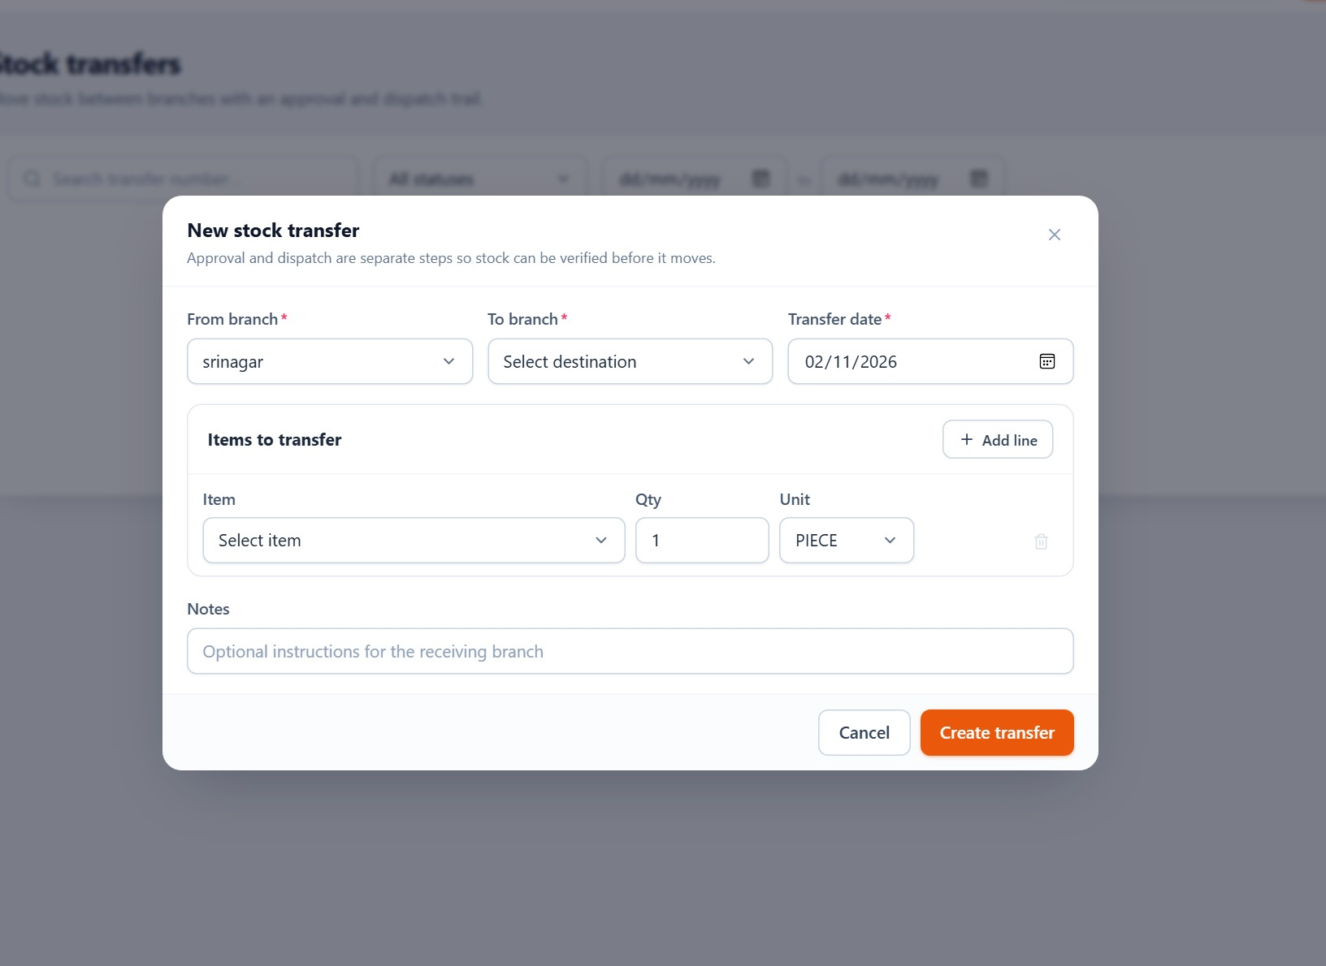
INVENTORY
Transfers move stock with approval, not by editing two branches
A four-stage flow keeps the sending and receiving branches honest.
1
Pending
A branch requests stock from another branch; quantities are recorded but not moved.
2
Approved
A user with approval permission accepts the request. Stock is still untouched.
3
Dispatched
Stock leaves the source branch — this step cannot be undone.
4
Received
The destination confirms arrival and the stock becomes available there.
Item Management System · Customer Presentation · v1.0.0
40 / 70
Notes:
Transfers exist because a multi-branch store should not sell stock twice. The request records the items, but nothing moves until approval. Dispatch removes stock from the source and is irreversible; receipt adds it to the destination. Approval and dispatch use different permissions, so a branch manager can request without being able to send. Rejected and cancelled requests stay in the list. Stock is not reserved while a request is pending.

Slide 41
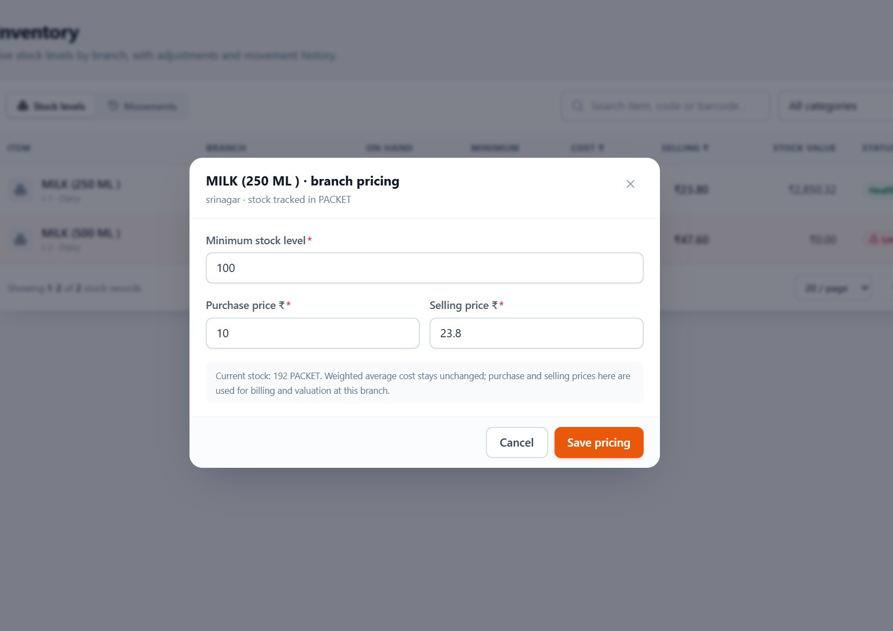
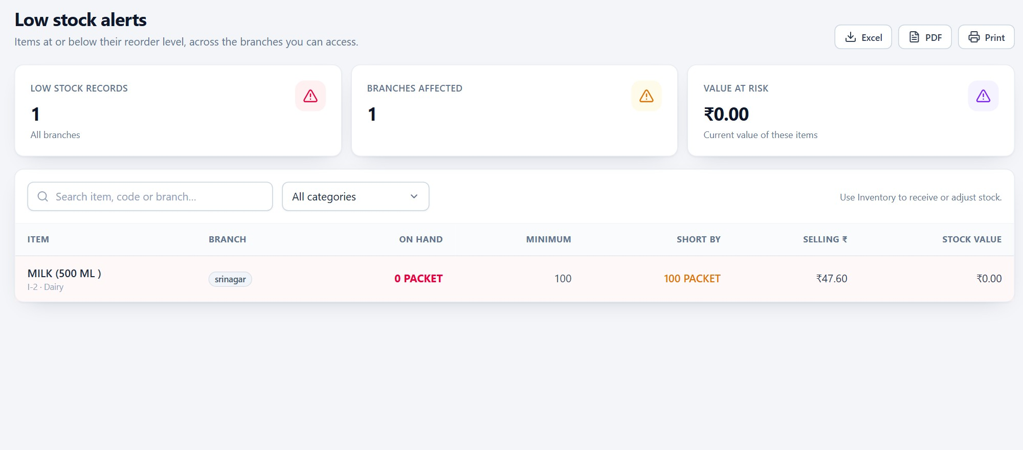
INVENTORY
Low stock and branch pricing — two views of the same shelf
Reorder before the shelf empties; price per branch without duplicating the item.
Low stock
Branch pricing
One list of items at or below their minimum, with the branch and quantity. The dashboard alert links here.
Minimum, purchase and selling price per branch. The master rate stays the POS default.
Item Management System · Customer Presentation · v1.0.0
41 / 70
Notes:
Two related ideas. Low stock is a working list, not a report you run at month-end; it is what the purchasing person checks before placing an order. Branch pricing is how one catalogue serves shops with different local prices. The master rate is still the POS default; branch pricing overrides it where the business needs to.

Slide 42
SECTION 08
08
1
POS billing with item cards and scan
POS and sales
2
Quantities, discounts, tax and four payment labels
The counter is where the system earns its keep: scan, confirm quantity, take payment, print, move on.
3
Completing a sale and finding it later
4
What cancellation does to stock
Item Management System · Customer Presentation · v1.0.0
42 / 70
Notes:
Now the busiest screen in the store. Keep the pace up: show POS, add items, take payment, then move to sales history. The owner will watch the cashier's hands, not the slides.

Slide 43
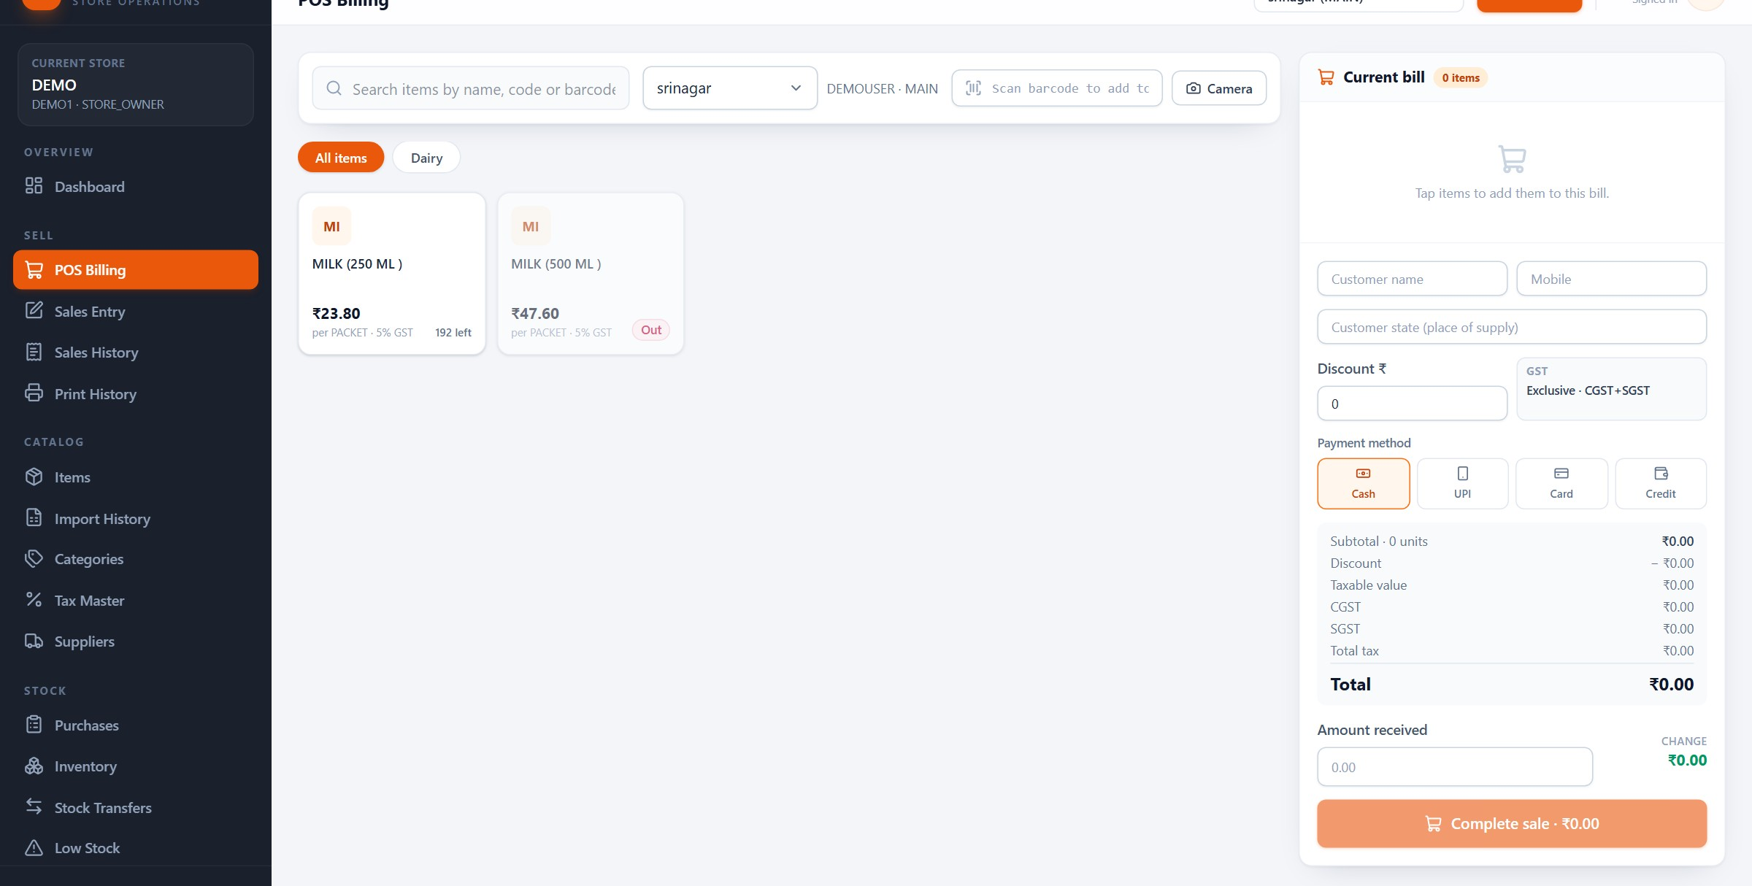
POS
POS is built for speed at the counter
Search or scan, tap an item, adjust quantity, take payment — all on one screen.
1
2
4
3
1
Search or scan
2
Categories
3
Item cards
4
Current bill
Item Management System · Customer Presentation · v1.0.0
43 / 70
Notes:
POS Billing. The left side is the catalogue: a search box that accepts a name, code or barcode, category filters and item cards showing the master rate and the stock left at this branch. The right side is the bill. The branch selector at the top decides which stock is being sold. A cashier can work this screen with a scanner and almost no typing.

Slide 44
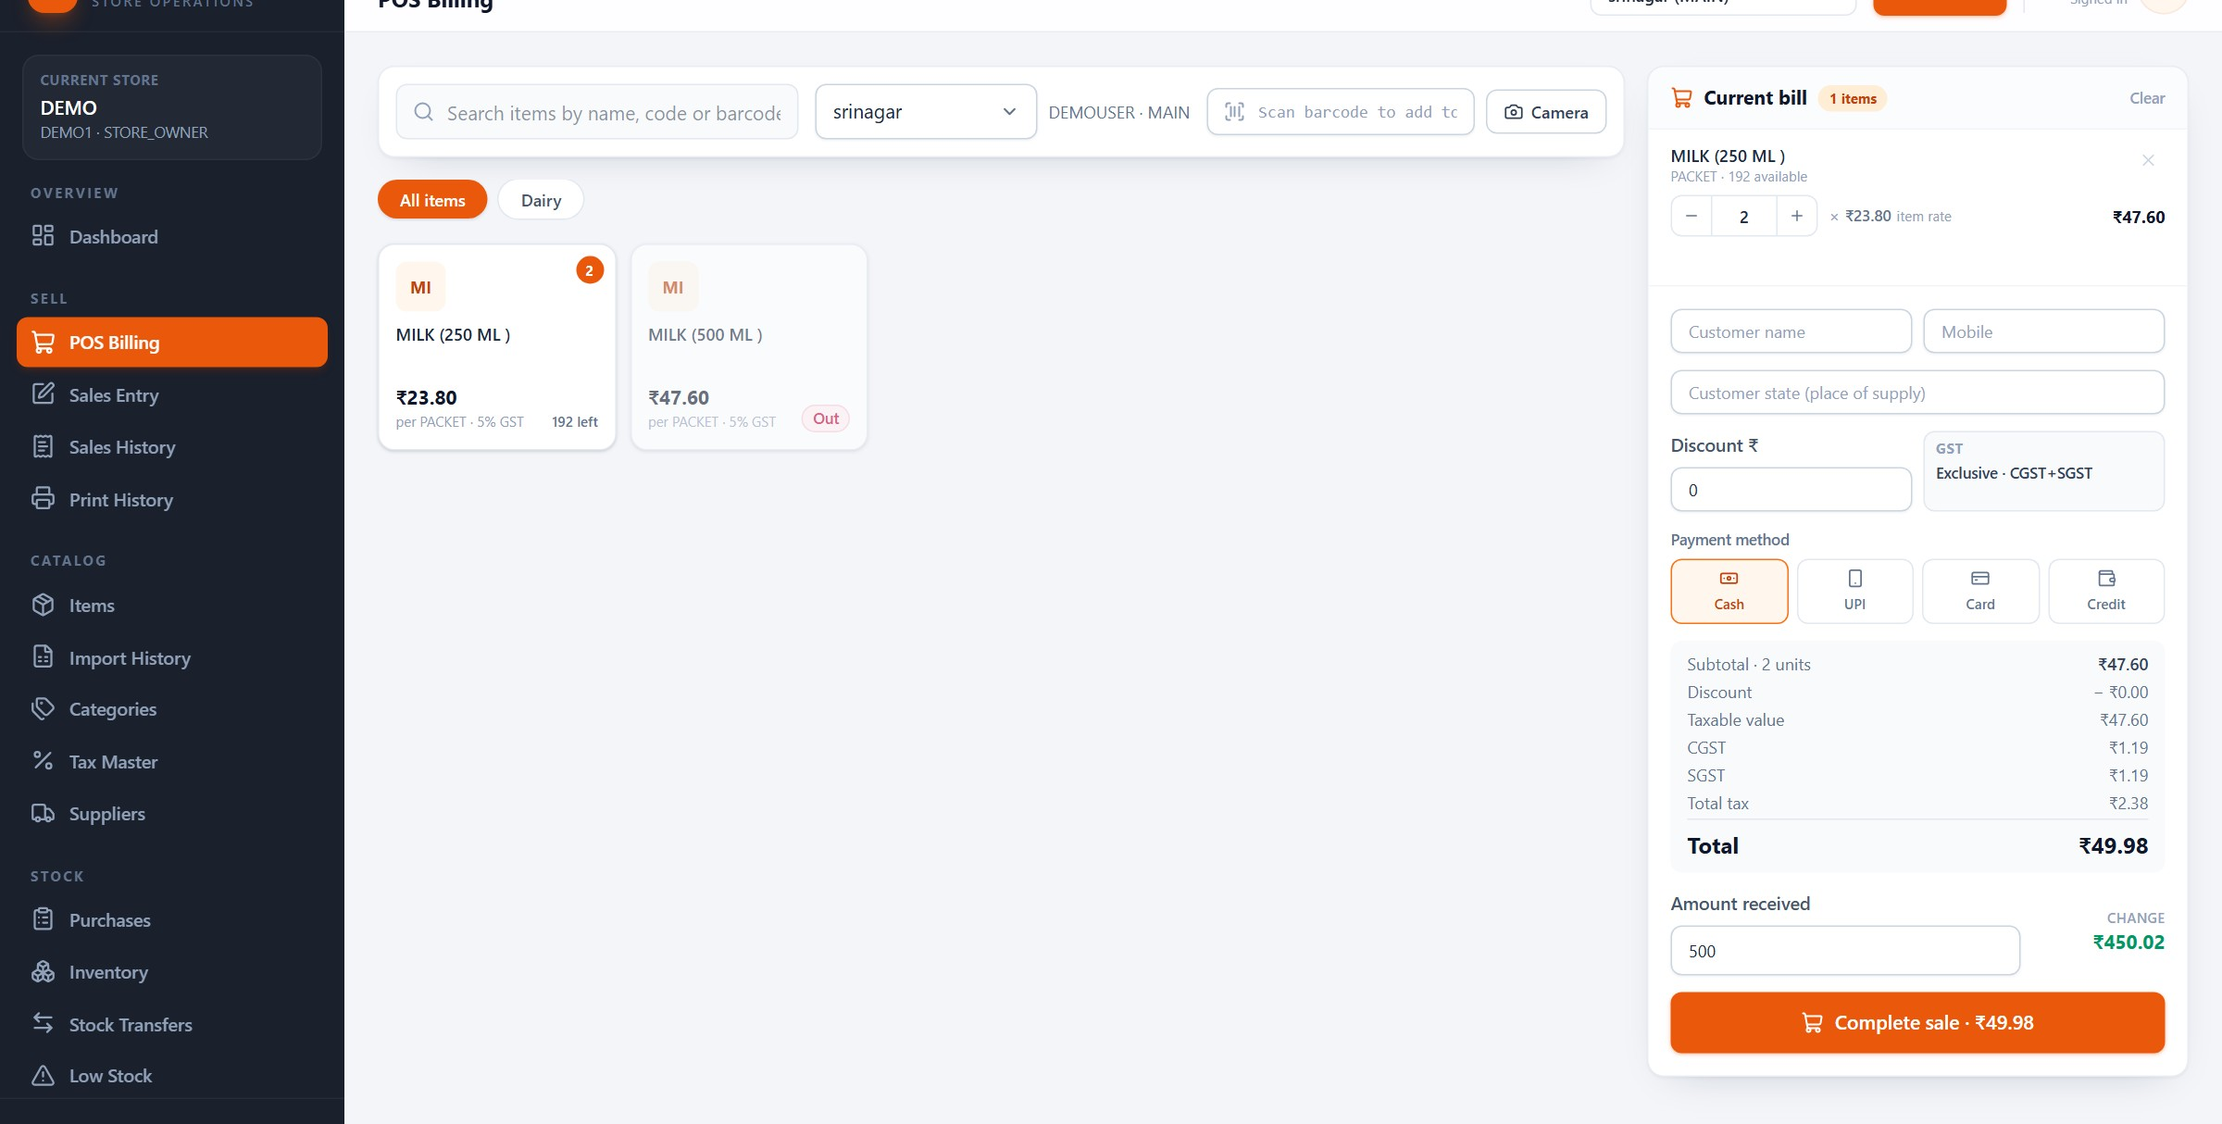
POS
The cart shows every number before the customer pays
Quantity, discount, tax, payment method, amount received and change — in one column.
1
2
3
4
5
1
Quantity
2
Discount
3
Payment
4
Totals
5
Change
Item Management System · Customer Presentation · v1.0.0
44 / 70
Notes:
This cart has two 250 ml packs at 23 rupees 80, with five percent GST, giving 49 rupees 98. The cashier can change quantity, apply a bill discount, pick Cash, UPI, Card or Credit, and type the amount received; the change updates automatically. The sale in this screenshot was not completed, so no stock was deducted and no bill number was created.

Slide 45
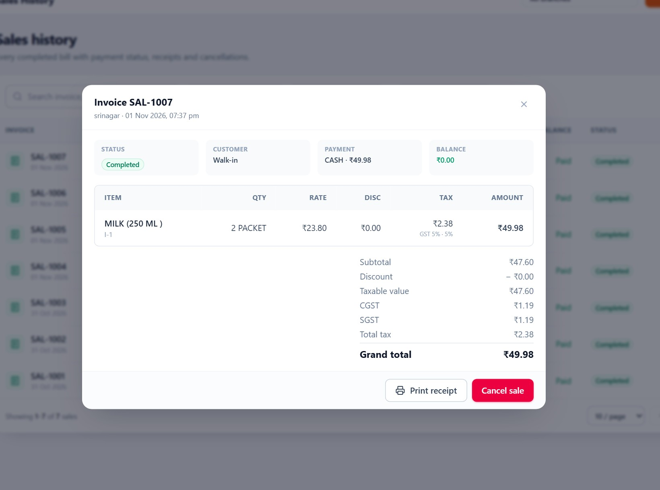
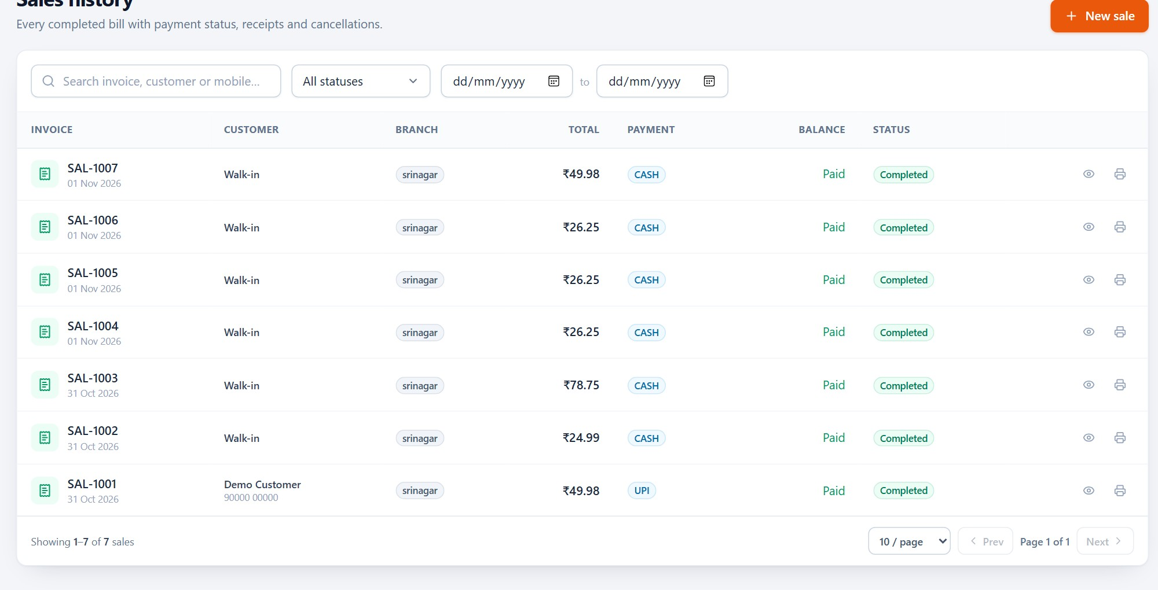
SALES
Every bill can be found, reopened and reprinted
Sales history keeps the header; the invoice keeps the lines, tax and payment.
Sales history
Invoice detail
Bill number, date, customer, payment, total and status. Seven demo bills, all completed.
Line items, tax split and payment — the same data used for the receipt and the GST report.
Item Management System · Customer Presentation · v1.0.0
45 / 70
Notes:
Sales history is the owner's and accountant's view. Each bill carries a SAL- number, the branch, payment method and total. Opening a bill shows the exact lines and tax that were stored at the time of sale. This is also the screen used to reprint a receipt from the browser, and the source of the sales and GST reports.

Slide 46
SALES
What completing a sale actually does
Four writes happen together; the customer sees only the receipt.
01
02
03
04
Stock moves
A bill is numbered
Tax is snapshotted
Cancel restores
The quantity sold is deducted from the selected branch immediately. The cart cannot sell more than the branch holds.
IMS assigns a SAL- invoice number and stores the branch, cashier, customer and payment method for later lookup.
Rate and tax are stored on each line, so later price or slab changes cannot rewrite old bills or reports.
Cancelling a completed sale returns the stock and keeps the record marked cancelled — it does not delete history.
Limits in v1.0.0: no returns or credit notes, no receivables tracking, no accounting ledger.
Item Management System · Customer Presentation · v1.0.0
46 / 70
Notes:
This is the answer to 'what if the power goes or the cashier makes a mistake?'. Completion is atomic: stock, invoice and tax are written together. A cancelled bill is kept, not deleted, and its stock goes back. Be explicit that this version has no returns or credit notes, and that the Credit payment label does not track receivables — that is a deliberate scope decision, covered again at the end.

Slide 47
SECTION 09
09
1
Thermal receipts through a local bridge
Printing
2
Barcode labels and reports through the browser
A receipt that appears without extra clicks, a label that sticks, a report on paper when the accountant asks.
3
Print history, reprints and failures
4
What must be configured before the first print
Item Management System · Customer Presentation · v1.0.0
47 / 70
Notes:
Printing is the area where customer expectations are highest and physical reality matters most. Be precise about what was tested: the jobs, the bridge and the history were exercised; a physical printer was not available in the demo store.

Slide 48
PRINTING
From bill to paper, in six steps
The same flow for an automatic receipt and a manual reprint.
1
Choose print option
2
Use a configured printer
3
Generate content
Complete a sale with auto-print on, or press Print on a saved bill.
The store's device, paper width and purpose are already stored.
IMS builds the receipt from the saved bill — not from the screen.
4
Send the job
5
Printer processes
6
Printed output
The browser sends it to the local bridge on the counter machine or phone.
The bridge forwards the job to the printer's IP and port.
The job is marked printed; failures stay visible for a reprint.
The receipt content comes from the saved bill, so a reprint months later shows the same lines and totals.
Item Management System · Customer Presentation · v1.0.0
48 / 70
Notes:
Walk the six steps slowly, because this is where 'cloud' printing usually becomes confusing. The browser does not talk to the printer directly. It sends a job to a small bridge running on the local network, and the bridge forwards it to the printer. That is why the bridge must be installed once on the counter machine or Android device.

Slide 49
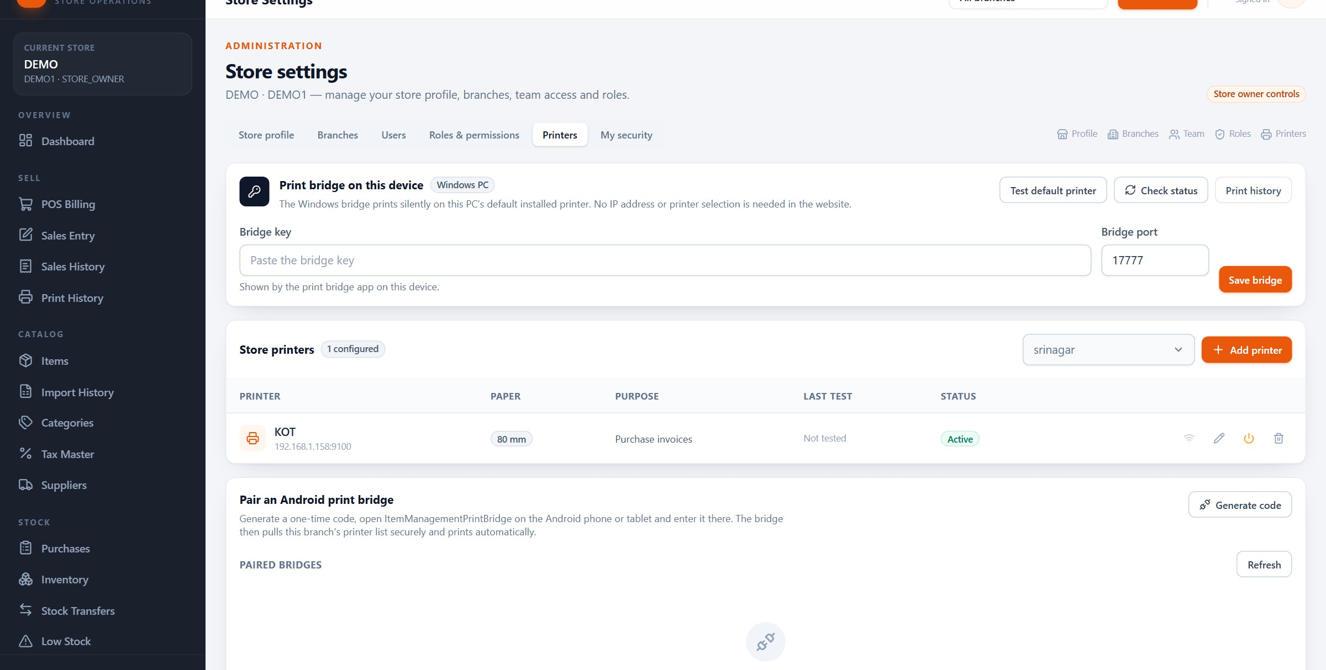
PRINTING
Printers are configured once, per store
Name, network address, paper width, purpose and the bridge that will deliver the job.
Windows bridge, counter PC
Network printer per branch
80 mm thermal paper
Not physically tested
Item Management System · Customer Presentation · v1.0.0
49 / 70
Notes:
Settings, Printers. The demo store has one eighty-millimetre thermal printer at 192.168.1.158 on port 9100, used for purchase invoices, marked Active but Not tested — that label is honest, because no physical printer was connected in this environment. The same page shows the Android pairing section for a phone-based bridge. A printer is only usable after it is saved and the bridge is running.

Slide 50
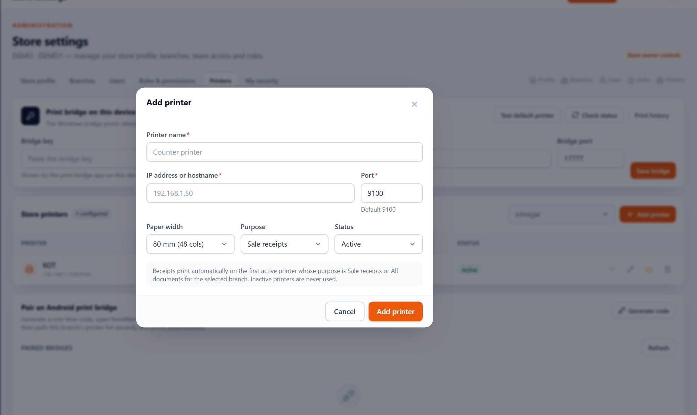
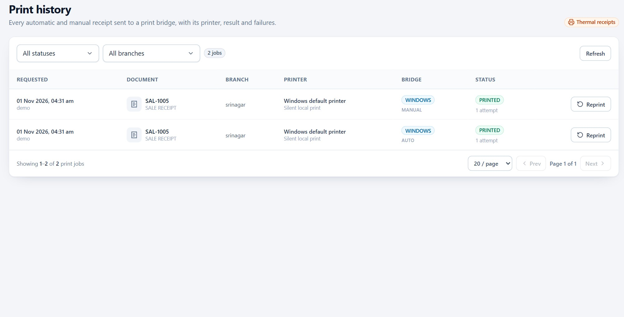
PRINTING
Adding a printer, and watching the queue
Configuration takes one form; the history tells you what actually happened.
Add printer
Print history
Name, connection type, IP and port (9100 for a network thermal printer), paper width and purpose.
Automatic and manual jobs with status. A reprint creates a new manual job instead of hiding the failure.
Item Management System · Customer Presentation · v1.0.0
50 / 70
Notes:
The form is short because most thermal printers use the same network pattern: an IP address and port 9100. Paper width is either 58 or 80 millimetres. The history is the operational screen: auto jobs from completed sales and manual reprints sit together, with status. If a job fails, there is no silent retry; the person sees it and reprints deliberately.

Slide 51
PRINTING
Three print paths, one consistent result
Different documents leave the system in different ways — and that is intentional.
RECEIPTS
LABELS
REPORTS
Through the bridge
Through the browser
Through the browser
Sale receipts are sent as jobs to the local bridge (Windows on port 17777, Android on 17778), then to the thermal printer. The bridge pairs with a code valid for ten minutes.
Barcode labels are generated as a 50 × 30 mm PNG and printed from the browser's print dialog. No bridge or drivers are involved.
Sales, purchase, stock and GST reports export to Excel or PDF, or print directly from the browser. Exports are generated on the client, not on the server.
Before the first receipt: install the bridge, add the printer, pair the device, then send a test receipt.
Item Management System · Customer Presentation · v1.0.0
51 / 70
Notes:
Customers often assume everything prints the same way. Receipts need the bridge because a thermal printer does not understand a web page. Labels and reports are ordinary browser prints. The practical consequence: the bridge only matters for receipts, and it must be on the same network as the printer.

Slide 52
PRINTING
When a receipt does not appear, check these five things
Most failures are network or pairing problems, not software faults.
1
Bridge running
The Windows service or Android app is open and shows as paired.
WHAT WE CAN HONESTLY SAY
• The job pipeline, bridge pairing, statuses and reprint flow were exercised in testing.
• No physical printer was connected in the demo store, so paper output is not claimed as tested here.
• There is no automatic retry: a failed job stays failed until someone reprints it.
• Receipts are thermal sale receipts; A4 invoice printing is done from the browser.
• The Android application is a print bridge, not a mobile version of the store app.
2
Same network
The counter machine and the printer are on the same local network.
3
Printer address
IP and port 9100 are correct; the printer answers on that address.
4
Paper width
58 mm or 80 mm matches the physical roll, or the layout will clip.
5
Pairing code
The ten-minute code has not expired; re-pair if it has.
Item Management System · Customer Presentation · v1.0.0
52 / 70
Notes:
Be candid here; it builds trust. The system creates and tracks print jobs, the bridge pairs and forwards them, and the history records success or failure. What we could not do in this environment is connect a real thermal printer, so the demo printer is marked 'Not tested'. On site, the first step of installation is a test receipt. Also repeat that the Android app is a bridge for printing, not a mobile store application.

Slide 53
SECTION 10
10
1
Sales, purchases, profit, stock movement
Reports and GST
2
GST summary with CGST, SGST and IGST
Reports should answer a question, not just display a table. IMS ships eight views with the same filters.
3
Branch performance, store summary, low stock
4
Date range, branch, category and item filters
Item Management System · Customer Presentation · v1.0.0
53 / 70
Notes:
The report section is where the owner decides whether the system is worth paying for. Do not read every table; ask which question they need answered, then show the report that answers it. GST needs a clear boundary: calculation and reporting, not filing.

Slide 54
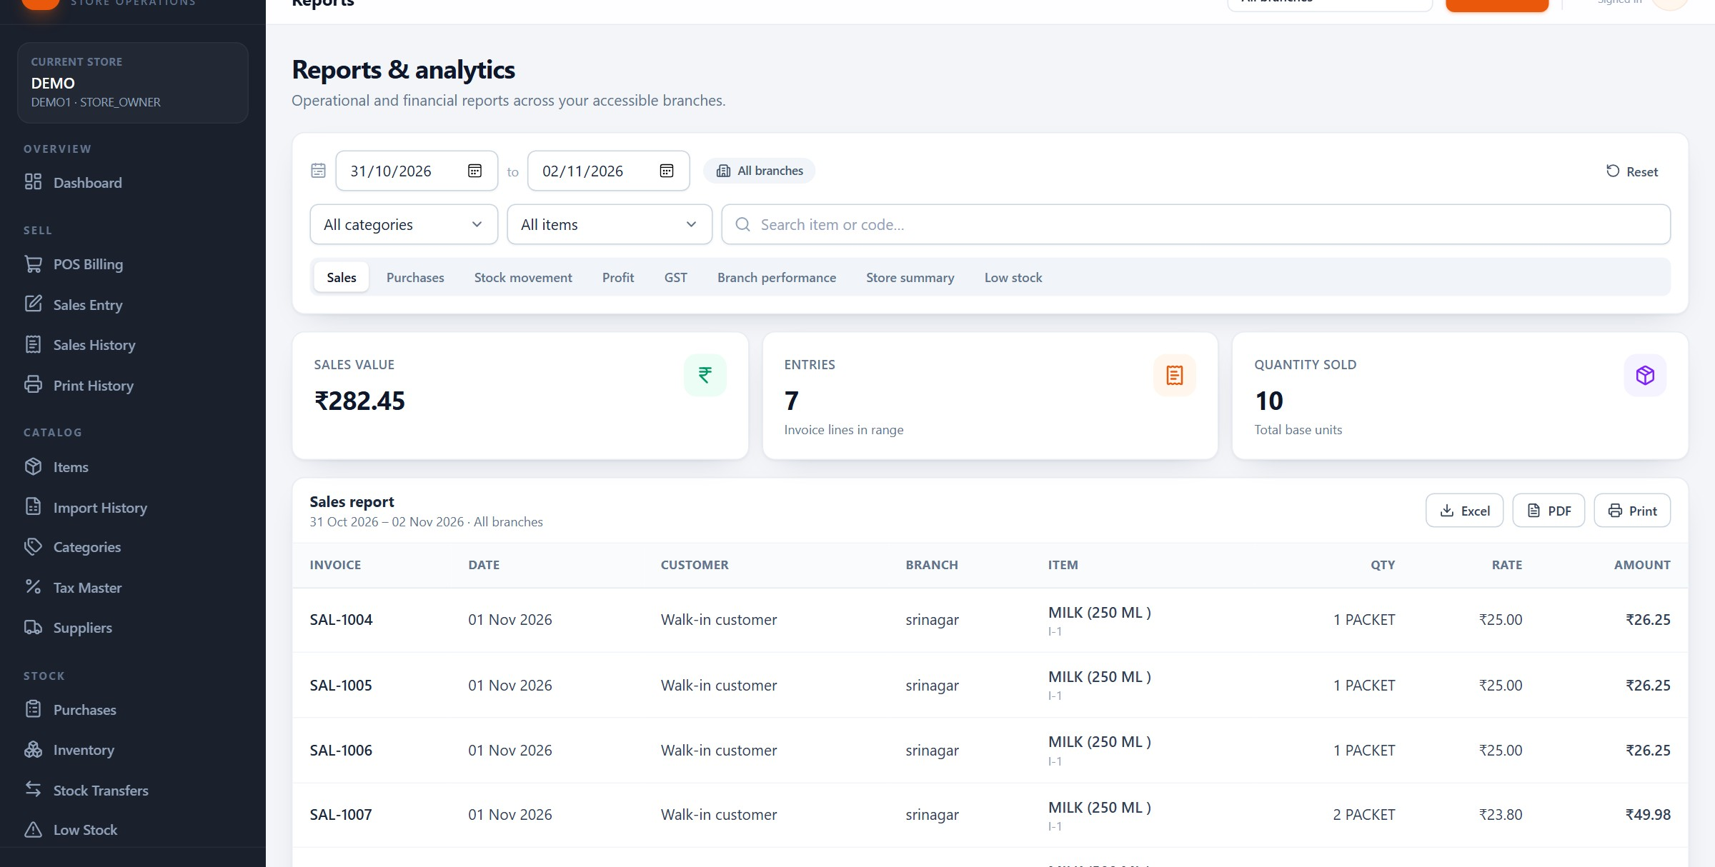
REPORTS
Eight reports, one set of filters
Choose a date range, a branch and optional category or item — every tab uses the same context.
Date range
Branch
Report tabs
Export
Item Management System · Customer Presentation · v1.0.0
54 / 70
Notes:
Reports and analytics. The filter bar is shared: date range, branch, category and item search. The tabs across the middle switch between sales, purchases, stock movement, profit, GST, branch performance, store summary and low stock. Because the filters are shared, an owner can compare the same week across branches without rebuilding the query each time.

Slide 55
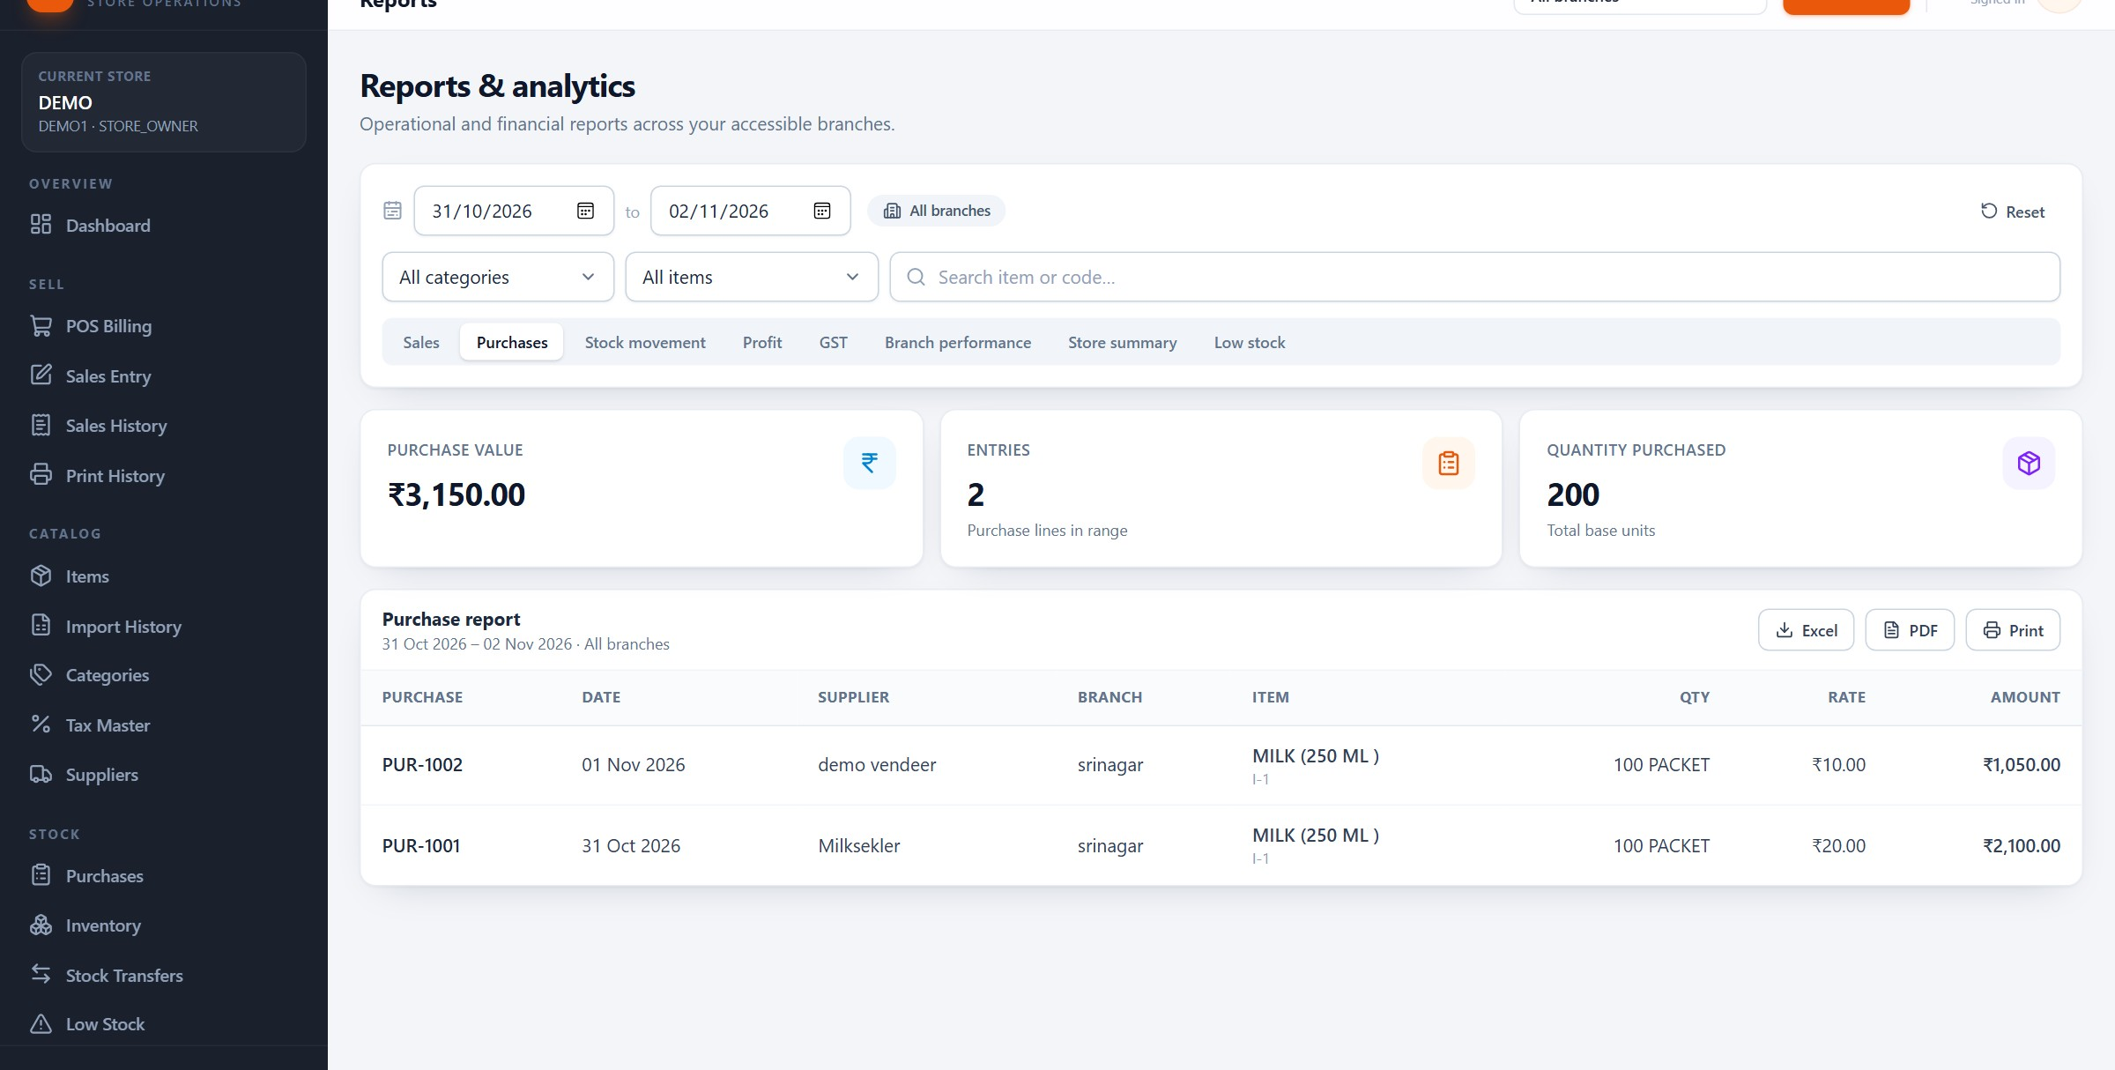
REPORTS
A purchase report the accountant can use
Value, line count, quantity and the underlying bills — exportable to Excel or PDF.
Purchase value
Entry count
Quantity
Export
Item Management System · Customer Presentation · v1.0.0
55 / 70
Notes:
The purchases tab over a two-day range: three thousand one hundred and fifty rupees across two bills and two hundred packets. The table below is the evidence: bill number, date, supplier, branch, item, quantity, rate and amount. This is the view an accountant asks for at GST time, and it exports to Excel or PDF without a server-side report run.

Slide 56
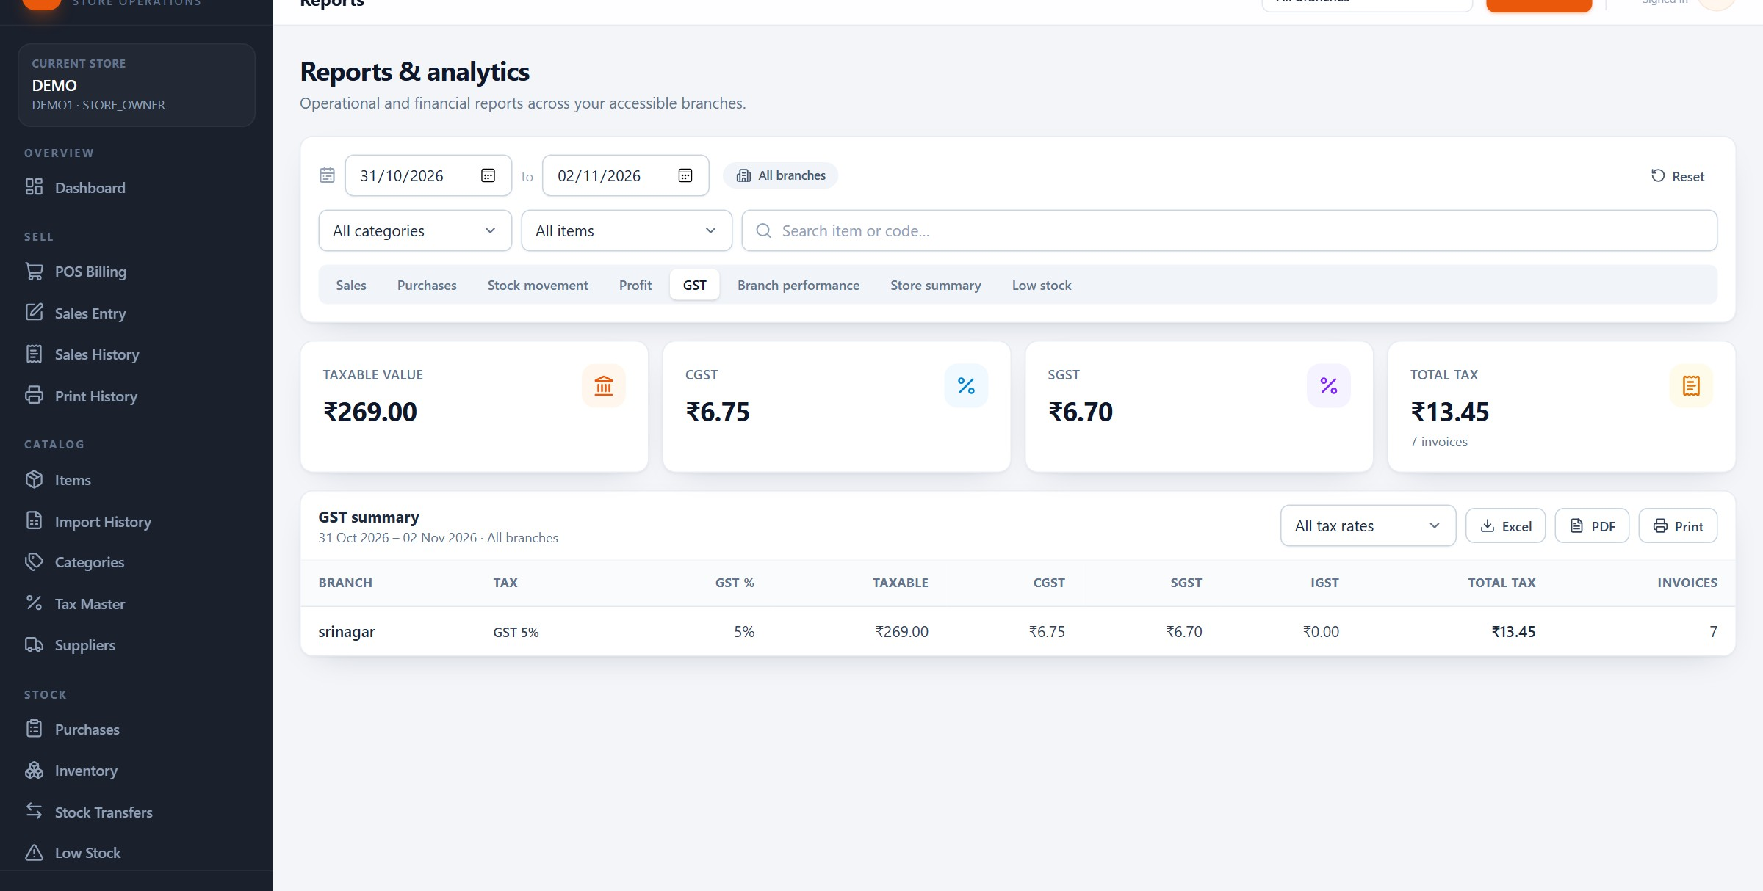
REPORTS
GST, calculated from the same lines that made the bill
Taxable value, CGST, SGST and invoice count for the selected period and branch.
Taxable value
CGST / SGST
Total tax
Invoice count
Item Management System · Customer Presentation · v1.0.0
56 / 70
Notes:
The GST report for the demo store: taxable value of 269 rupees, CGST of 6 rupees 75, SGST of 6 rupees 70 and total tax of 13 rupees 45 across seven invoices. The small difference between CGST and SGST comes from rounding on individual lines. This is an intra-state view, which is why the tax is split in two. For an inter-state customer, the same logic produces IGST instead.

Slide 57
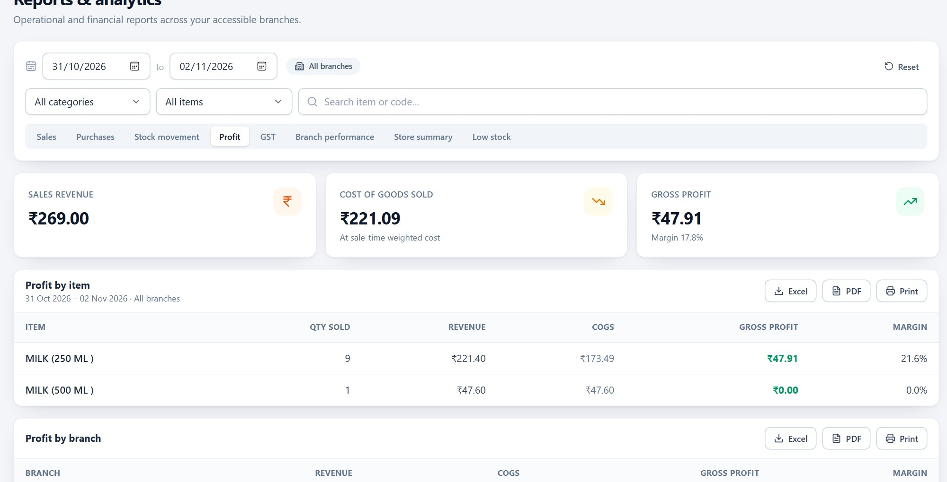
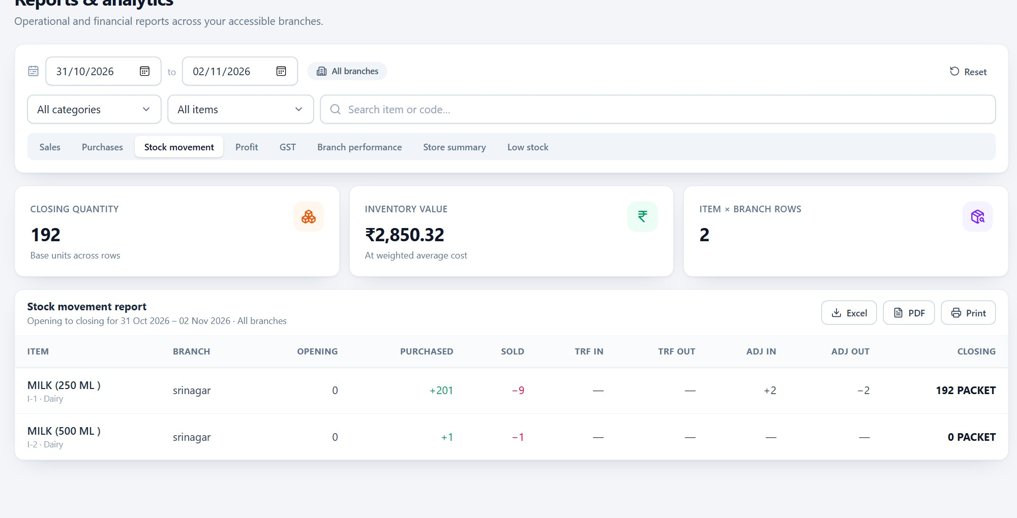
REPORTS
Profit and stock movement — the two questions owners ask most
What did we earn, and where did the stock go?
Profit
Stock movement
Revenue, cost of goods sold and gross margin for the period. Demo: 269 rupees revenue, 221.09 cost, 47.91 gross.
Opening, in, out and closing quantities with value. Demo: 192 units closing, 2,850.32 rupees value.
Item Management System · Customer Presentation · v1.0.0
57 / 70
Notes:
Profit is gross margin, not accounting profit: revenue minus the weighted average cost of what was sold. It is the number a shop owner can act on. Stock movement answers the second question: what came in, what went out, and what value is left on the shelf. Both use the same filters as every other report.

Slide 58
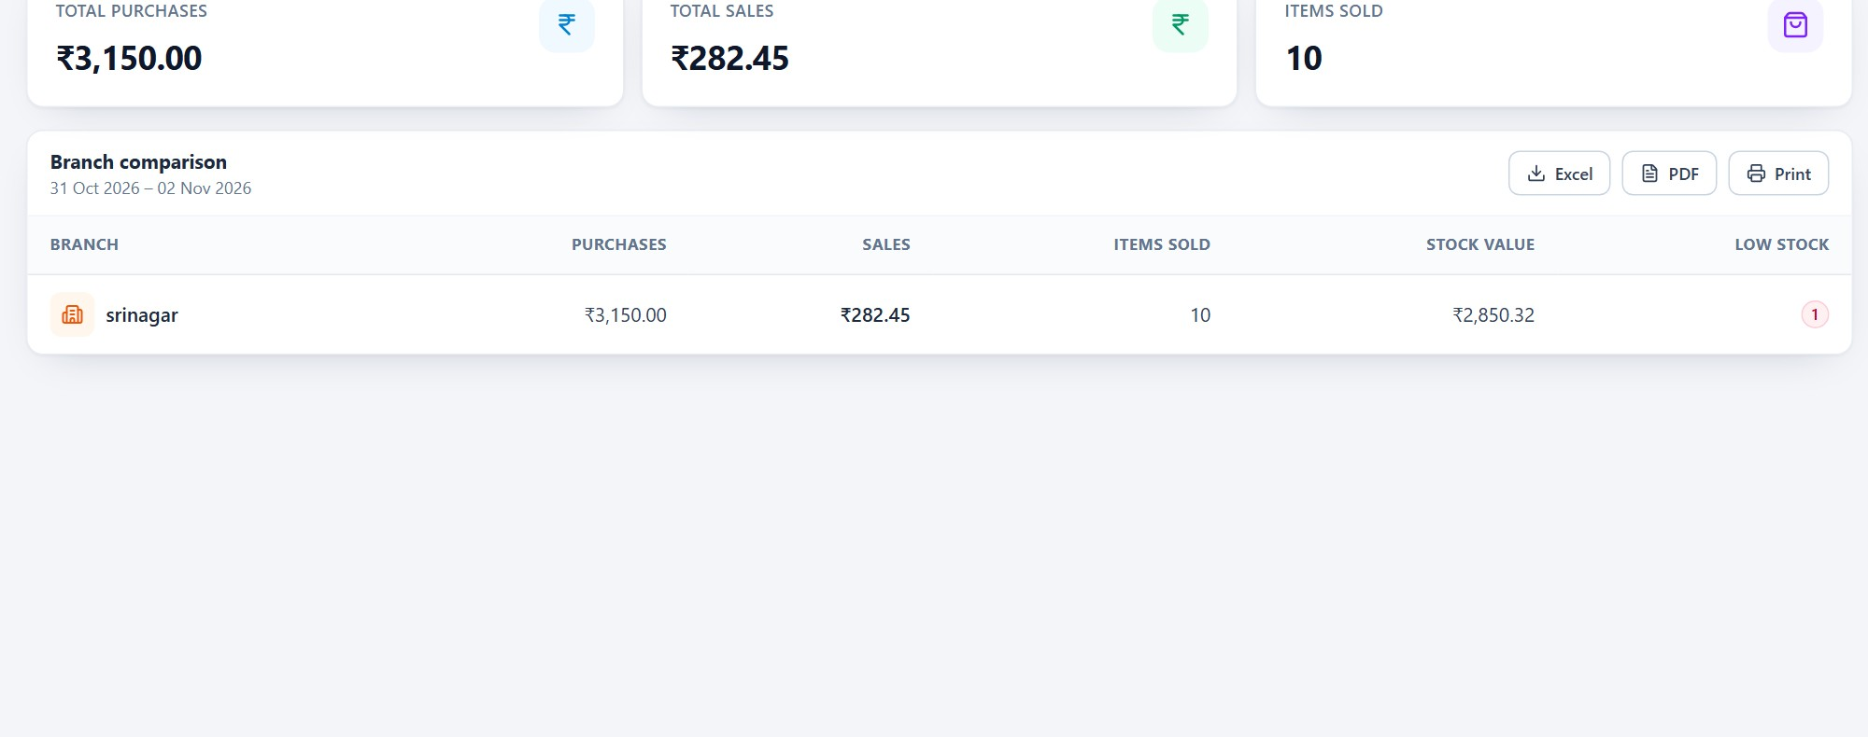
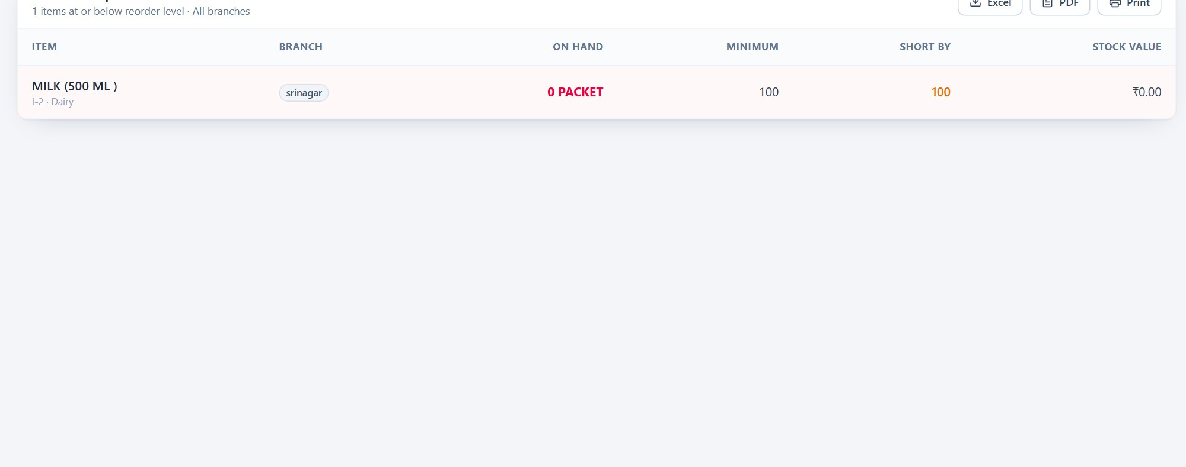
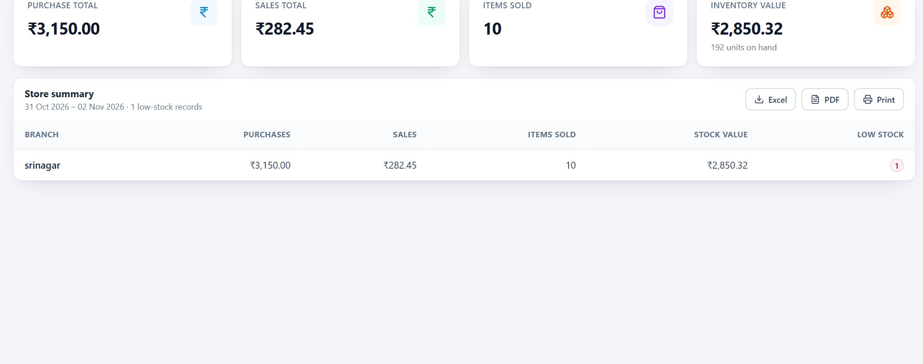
REPORTS
Branch performance, low stock and the store summary
Three views for the weekly review: compare locations, act on shortages, see the whole store.
Branch performance
Low stock
Store summary
Sales and purchases per branch. The demo branch shows 282.45 in sales against 3,150 in purchases.
Items at or below minimum with quantity and branch — the buying list for tomorrow.
One roll-up of sales, purchases, tax and stock value for the whole store.
Item Management System · Customer Presentation · v1.0.0
58 / 70
Notes:
The three reports to schedule for a Monday review. Branch performance shows where stock and attention should go. Low stock is the practical order list. Store summary is the one-page answer for an owner who wants totals, not detail. All three export in the same way.

Slide 59
REPORTS
GST in plain English
Four rules explain every number in the report.
01
02
Exclusive or inclusive
Intra or inter-state
The store setting decides whether an item rate already contains GST. Switching it changes how rates are entered, not the tax logic.
A customer state equal to the store state splits tax into CGST and SGST. A different state produces IGST.
03
04
Line-level snapshots
One report, one period
Tax is calculated and stored per line, so mixed slabs on one bill and later edits cannot corrupt history.
The GST report covers sales for the chosen dates and branches — the figures an accountant needs to reconcile.
REPORTS, NOT FILING
IMS calculates and reports GST; it does not file returns, issue e-invoices or e-way bills, or maintain HSN codes. Missing customer state is treated as intra-state.
Item Management System · Customer Presentation · v1.0.0
59 / 70
Notes:
Explain GST through the bill, not through tax law. A line has a rate and a slab; IMS calculates the tax, decides whether it is intra-state or inter-state, and stores the split. The report simply aggregates those stored lines. Then draw the boundary clearly: this is calculation and reporting. IMS does not file returns, generate e-invoices or e-way bills, or maintain HSN codes.

Slide 60
SECTION 11
11
1
Store list, status and onboarding
Platform administration
2
Store login accounts and credentials
The service behind the stores: onboarding, subscriptions, store accounts and the audit trail.
3
Subscription window and branch limit
4
Who can see what — platform vs store
Item Management System · Customer Presentation · v1.0.0
60 / 70
Notes:
This section is mainly for the buyer, not the cashier. It answers 'who runs this, and what can they see?'. Keep repeating that the platform team manages access and billing, not store commercial data.

Slide 61
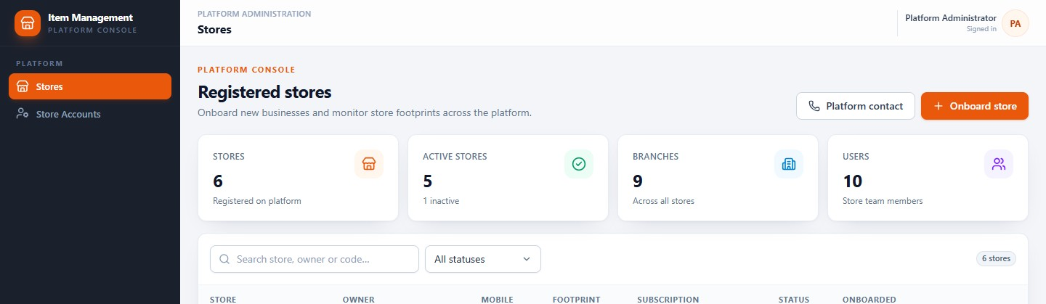
PLATFORM
Every store, its status and its plan
The platform administrator sees the service at a glance — aggregate counts, not store sales.
STORE LIST
SEARCH & FILTER
ONBOARD
Registered stores with status, subscription and branch counts.
Find a store by name or code before changing anything.
Create a store, set its plan and its first owner account.
AGGREGATE VIEW
The demo platform shows six stores, five active, nine branches and ten store users. Those are counts, not a way into any store's records.
Item Management System · Customer Presentation · v1.0.0
61 / 70
Notes:
This is the platform administrator's home. The cards summarise the service: how many stores, how many are active, how many branches and how many store users. The list below is for onboarding and support: status, plan and branch allowance. The important boundary is at the bottom — these are counts. The platform team cannot open a store's sales, stock or items from here.

Slide 62
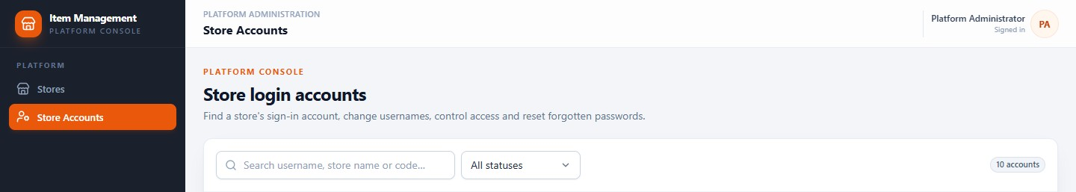
PLATFORM
Store login accounts, managed without shared passwords
Reset a password, change a username, disable an account — every action leaves a trace.
ACCOUNT LIST
RESET
CHANGE OR DISABLE
One row per store login, with its store and current state.
A temporary password is issued and must be changed at next sign-in.
Username changes and resets invalidate the person's existing sessions.
WHY IT MATTERS
There is no shared owner password and no self-service reset in v1.0.0. The platform team issues a temporary credential, the store user changes it immediately, and old sessions stop working.
Item Management System · Customer Presentation · v1.0.0
62 / 70
Notes:
Store login accounts are managed centrally because a locked-out owner cannot fix it alone. A reset issues a temporary password; the person is forced to change it at the next sign-in, and any session using the old credential is invalidated. The screen also records when credentials were last changed. Self-service password reset and MFA are not part of this version, which is worth stating openly.

Slide 63
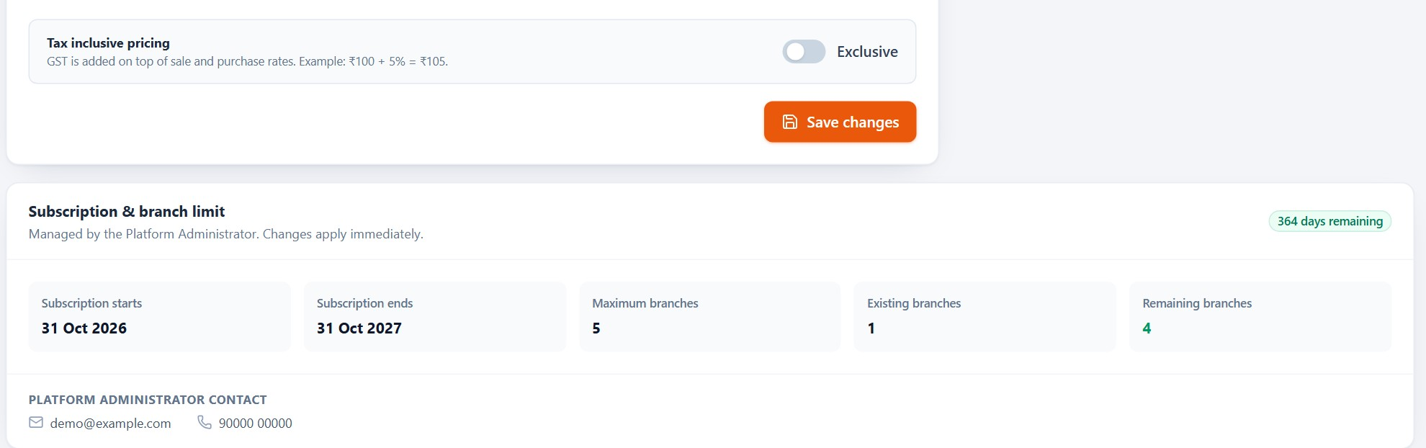
PLATFORM
The subscription controls time and branch count
Both are enforced by the server, not by the honour system.
1
Active window
2
Branch allowance
3
Expiry behaviour
4
Renewal
A start and end date; the demo store has 364 days remaining on a one-year term.
The plan allows up to five branches and the store currently uses one.
When the window ends, business actions are blocked until the platform renews it.
Renewal is handled by the platform administrator; there is no self-serve checkout.
Expired or over-limit stores are refused by the server; renewal is a platform action, not a card payment in the app.
Item Management System · Customer Presentation · v1.0.0
63 / 70
Notes:
The subscription panel is deliberately boring: start date, end date, days remaining and the branch allowance. The server enforces both. When the window expires, the store can sign in but business actions are blocked until renewal; when the branch limit is reached, the add-branch action is refused. Renewal is a conversation with the platform team, not a card payment in the app.

Slide 64
SECTION 12
12
1
Setup once, operate daily
The complete business workflow
2
The same item and stock ledger across modules
One loop connects setup, buying, stock, selling, printing and reporting — every day.
3
A realistic day with demo numbers
4
Where owners and staff touch the loop
Item Management System · Customer Presentation · v1.0.0
64 / 70
Notes:
Bring the modules back together. The point of this section is that the customer is not buying nine separate screens; they are buying one loop that closes every evening.

Slide 65
WORKFLOW
One loop, every working day
Each step feeds the next, and the last step feeds tomorrow.
1
2
3
4
Set up
Add items
Buy stock
Receive
Store, branches, users, taxes.
Catalogue, rates, labels.
Supplier, quantities, cost.
Stock and average cost update.
5
6
7
8
Sell
Print
Review
Adjust
Scan, bill, payment, receipt.
Receipt, label or report.
Sales, profit, GST, stock.
Low stock, transfer, reorder.
The loop closes: what you sell changes stock, what stock needs changes tomorrow's purchase, and what you purchase changes the cost used in tomorrow's profit report.
Item Management System · Customer Presentation · v1.0.0
65 / 70
Notes:
This is the whole product on one diagram. Setup happens once. The daily loop is buy, receive, sell, print and review; the review feeds the next purchase. Nothing here is a separate database: the purchase that updates stock is the same stock the POS reduces, and the same stock the report values. If the audience remembers one slide from the deck, make it this one.

Slide 66
WORKFLOW
A day in a store using IMS
Illustrative times, with the demo store's real numbers where they exist.
08:30
12:30
20:30
Open and bill
Lunch rush
Close and review
Cashier signs in, selects the branch, scans the first customer's items. Stock and tax are checked as the cart is built.
Two 250 ml packs at 23.80 sell for 49.98 including 2.38 tax. Receipt printed or browser-printed.
Owner checks sales, profit, stock value and today's GST total; the next purchase list is ready.
1
2
3
4
5
10:15
18:00
Delivery arrives
Shelf check
Owner completes the purchase: supplier, 100 packets at 10 rupees, 5% tax. Stock and average cost update.
Low-stock list shows the 500 ml pack at zero. A transfer request or purchase is raised for tomorrow.
The example uses the demo store's rates; a real day would also include adjustments, cancellations and a branch transfer.
Item Management System · Customer Presentation · v1.0.0
66 / 70
Notes:
Use this slide as a story rather than a screen tour. Morning billing, a delivery, lunch, a shelf check and an evening review. Every number on the slide either comes from the demo store or is a simple illustration. The goal is to show that the owner's evening review takes minutes because the day's work already wrote the data.

Slide 67
SECTION 13
13
1
Eight practical benefits
Benefits and next steps
2
The honest scope of v1.0.0
What changes for the business, what this version deliberately does not do, and how to start.
3
A simple path to the first live day
Item Management System · Customer Presentation · v1.0.0
67 / 70
Notes:
End on business outcomes, not features. The limits slide is not a weakness; it prevents disappointment and shows the product is mature enough to state its boundaries.

Slide 68
BENEFITS
Eight things that change on day one
Most of the value comes from removing duplicate work, not from adding screens.
01
02
03
04
One catalogue
Visible stock
Barcode speed
Purchase control
Every bill, purchase and report uses the same item master.
On-hand quantity per branch, updated by the work itself.
Scan instead of typing; no code memorisation at the counter.
Supplier bills update stock and average cost automatically.
05
06
07
08
Branch clarity
Role-based access
Organised records
Printing & reports
Compare locations and price locally without duplicating items.
People see the modules and branches their role allows.
Bills, movements and imports remain searchable and auditable.
Receipts, labels and eight reports from one system.
Item Management System · Customer Presentation · v1.0.0
68 / 70
Notes:
Summarise, do not re-demo. The strongest three for most stores are visible stock, barcode speed and purchase control, because together they remove the daily re-keying. Branch clarity and role-based access matter more as the business grows. The last two are about trust: records you can find again, and documents you can print.

Slide 69
SCOPE
What v1.0.0 does — and does not — do
Stated plainly, so there are no surprises after go-live.
NOT IN THIS VERSION
WORKS WITH LIMITS
BY DESIGN
• Offline billing or a mobile store app
• MFA, SSO or self-service password reset
• Returns, credit notes and receivables
• Accounting ledger or bank reconciliation
• GST filing, e-invoicing, e-way bills, HSN
• Automatic retry of failed print jobs
• Deleting stores, items, users or branches
• Report exports run in the browser, not on the server.
• Very large Excel imports may hit the web host's upload limit.
• Some malformed API calls return a generic server error.
• A physical thermal printer was not tested in this demo environment.
• The Android app is a print bridge only.
• Platform staff cannot browse store sales, stock or items.
• Stores and accounts are disabled, not deleted.
• Subscription renewal is handled by the platform team.
• Tax is snapshotted on every line for auditability.
• Stock is branch-level; masters are store-level.
If a capability is not on this page, ask before assuming it exists. The next step is a short discovery call to map these boundaries to your process.
Item Management System · Customer Presentation · v1.0.0
69 / 70
Notes:
Do not rush this slide. Every item here has been verified against the deployed build. Being explicit protects the customer: a pharmacy that needs batch expiry, or a wholesaler that needs credit notes, should know now rather than in month two. The right side is not a limitation list; it explains deliberate design choices such as branch-level stock and platform separation.

Slide 70
NEXT STEPS
Start with one store.
Grow to many.
WHAT YOU ARE LOOKING AT
Item Management System v1.0.0
Deployed and verified
October–November 2026
The fastest path is a guided setup with your real catalogue, one branch and one trained cashier — then add the second location when the first runs cleanly.
01
Discovery
Screens in this deck: 53 captures from the live application, plus platform views and interface states. Demo data only.
Walk through your items, tax setup and daily process.
02
Setup
Store, branch, users, tax master and catalogue import.
03
First day
Train the counter team, print labels, run a parallel day.
Item Management System · Customer Presentation · November 2026
70 / 70
Notes:
Close on the sequence, not on a feature. One store, one branch, one cashier trained, then expand. The three next steps are deliberately small so the first live day is low risk. Thank the audience and open the floor; the most useful next conversation is usually about their catalogue and tax setup, because those two decisions shape everything else.

