Slide 1

Report Submission: Group 2 (ML A2) CO-327 -Sourabh 2K18/CO/355 -Vishruth Khare 2k18/CO/393 Submitted to: -Ms. Juhi Jain
FAKE NEWS DETECTION using Machine Learning

Slide 2

⧫ Fake news encapsulates pieces of news that may be hoaxes and is generally spread through social media and other online media.
⧫ This is often done to further or impose certain ideas and is often achieved with political agendas.
⧫ With so much false information, consumers are skeptical and it erodes the trust they should have in the media.
Motivation

Slide 3
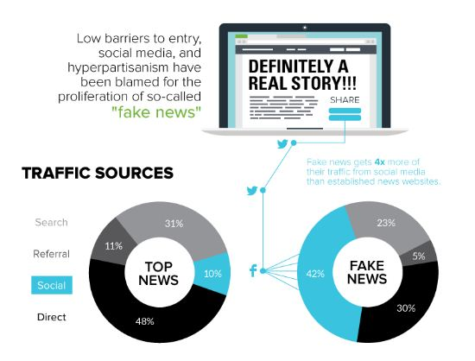
Sources of
Fake News

Slide 4
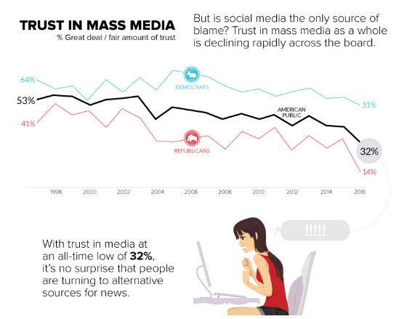
Do you trust
Mass Media ?

Slide 5
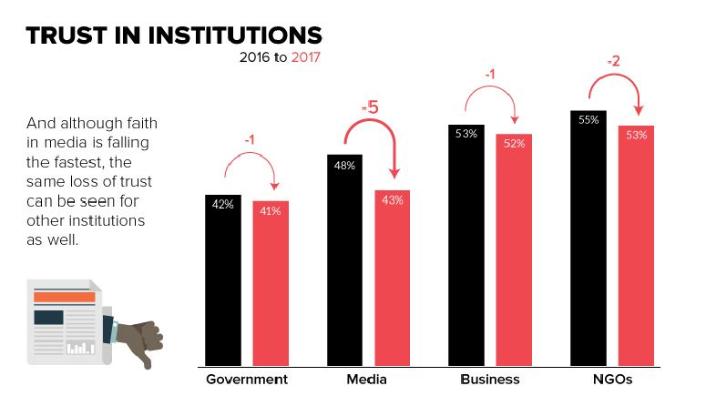
Trust in
Institutions

Slide 6

Problem
Statement
Develop a machine learning
program to identify fake/unreliable
news based on content acquired.

Slide 7
Knowledge Based Detection
Word
Embedding (Response Based)
Techniques
Style Based Detection
Stance based detection
Detection
Methods

Slide 8
Response based technique takes into consideration
the collected responses on tweets/posts to determine
the credibility of the news . Implementation of the same
was carried out in five sub phases:
1) Selecting the dataset and preprocessing it.
2) Choosing relevant features for classification
and Training the Model
3) Evaluation of different model performance
based on extracted features
4) Improving performance
5) Discussion and Presentation of results
Response
Based
Detection

Slide 9
Not all articles are visual so image processing would not work, so virtual detection would fail.
It is not possible to fact check each news as the genuine news might not have been published yet. So knowledge based detection would not work.
There is possibility that Fake news can appear in a well-written article. So style based detection would fail.
Why Response
Based
Detection ?

Slide 10
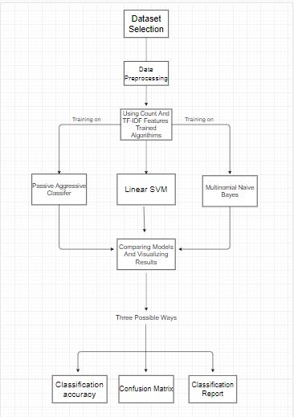
Workflow

Slide 11
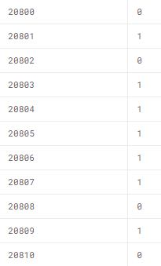
The dataset used for the project was downloaded from https://www.kaggle.com/c/fake-news/data
train.csv: A full training dataset with the following attributes:
id: unique id for a news article
title: the title of a news article
author: author of the news article
text: the text of the article; could be incomplete
label: a label that marks the article as potentially unreliable
1: unreliable
0: reliable
Dataset

Slide 12
Stop-Words Removal
Tokenization
Lemmatization
Removal of punctuations
Conversion to Lower Case
Text
Preparation

Slide 13
Word
Embedding
Count Vector
TF-IDF
Vector
Feature
Generation
Text Data
is often
Processed to
Generate
Features like

Slide 14
Count Vector is a matrix notation
of the dataset, in which rows
represent the documents in the
corpus, columns represent a term
from the corpus, and cells
represent the count of that
particular term in a particular
document .
Count Vector
As Feature

Slide 15


TF stands for Term Frequency: It calculates how frequently
a term appears in a document.
TF-IDF
Vector as
Feature
IDF stands for Inverse Document Frequency: A word is not of
much use if it is present in all the documents
TF-IDF – Term Frequency-Inverse Document Frequency

Slide 16
The
Algorithm
This section deals with training the classifier.
Different classifiers were investigated to predict
the class of the text. We explored specifically three
different machine-learning algorithms
→ Multinomial Naïve Bayes
→Passive Aggressive Classifier
→Linear Support Vector machines

Slide 17
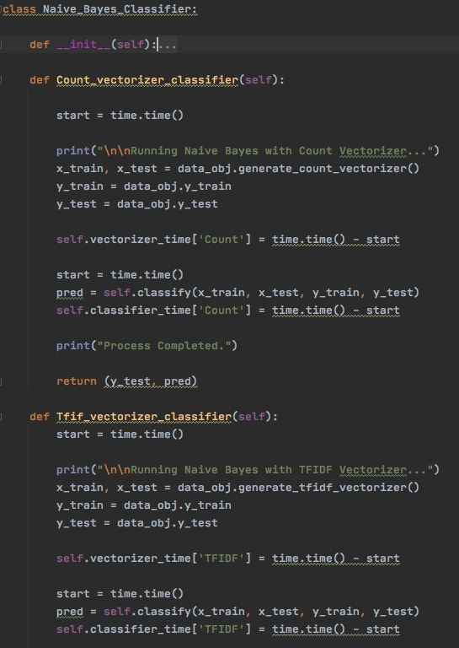

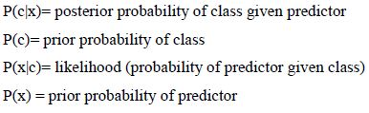
This classification technique is based on Bayes theorem, which assumes that the presence of a particular feature in a class is
independent of the presence of any other feature.
Naïve Bayes

Slide 18
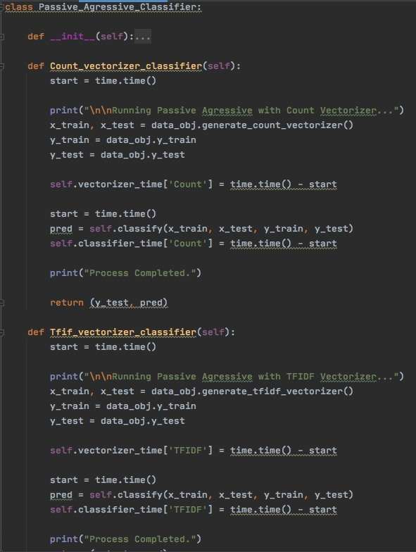
The Passive Aggressive Algorithm is an online algorithm; ideal for classifying massive streams of data (e.g. twitter).
It is easy to implement and very fast.
It works by taking an example, learning from it and then throwing it away.
Passive
Aggressive
Classifier

Slide 19
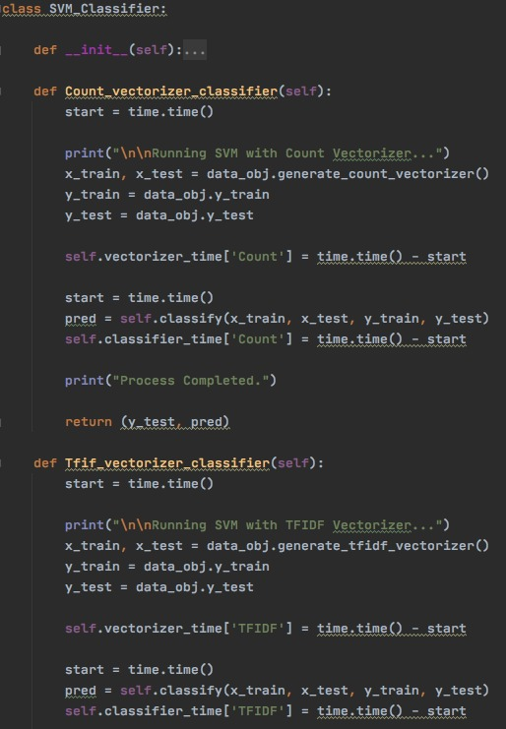
In this algorithm, each data item is plotted as a point in
n-dimensional space (n is the number of features).
Values of each feature are the value of each co-ordinate. It specifically
extracts a best possible hyper-plane or a set of hyper-planes in a high dimensional space that segregates two classes.
Linear kernel was used for SVM in this work.
Linear Support
Vector Machine

Slide 20
Metrics to
Access
Performance
We have explored some of the most significant metrics
by which a machine learning model performance
is measured. These metrics measures how well
our model is able to classify or evaluate predictions.
Classification
Accuracy
Confusion
Matrix
Classification
Report
Sensitivity, Precision, Specificity

Slide 21

It is the most common evaluation metric for classification problems. It is defined as the number of correct predication as against the number of total predictions. However, this metric alone cannot give enough information to decide whether the model is a good one or not. It is suitable when there are equal numbers of observation in every class.
Classification
Accuracy

Slide 22
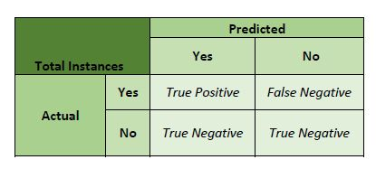
It is also known as Error matrix, which is a table representation that shows the performance of the model. It is special kind of Contingency table having two dimensions- “actual”, labeled on x-axis and “predicted” on y-axis. The cells of the table are the number of predictions made by the algorithm.
Confusion
Matrix

Slide 23



Precision: Precision is the ratio of correctly predicted positive instances
to the total predicted positive instances. High precision means low False Positive rate
Classification
Report
Recall (Sensitivity): Recall is the ratio of correctly predicted positive instances to the all instances in actual class - Yes.
F1-Score: It is the weighted average of Precision and Recall.
Therefore, it takes into consideration both false positives and false negatives .

Slide 24

Result and
Analysis
Experiments were performed using the above algorithms using Vector features- Count Vectors and Tf-Idf vectors at Word level and N gram-level. Accuracy was noted for all models.
We applied text classification on the articles body in two different publicly available datasets

Slide 25
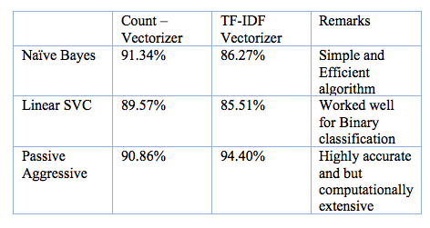
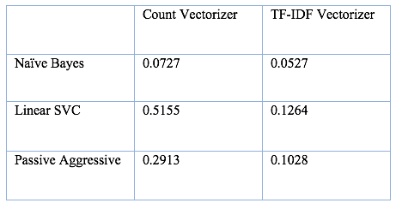
Classification
Accuracy and
Inference
Classification
Accuracy and
Classifier
Time
Classifier
Time

Slide 26
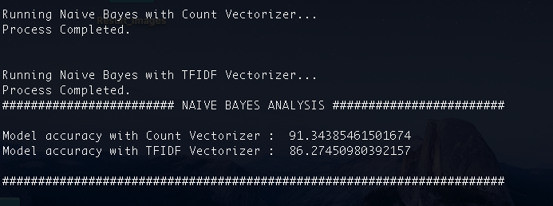
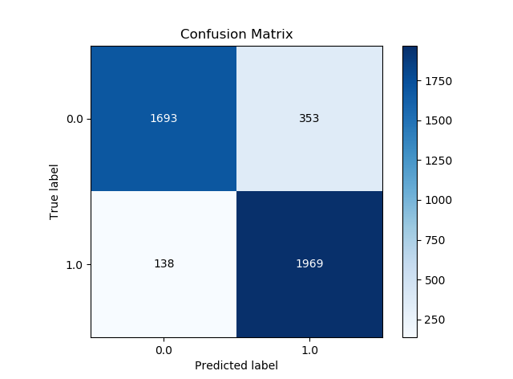
Classification
Report for
Naïve Bayes
Precision: 0.84
Sensitivity: 0.90
Specificity: 0.83

Slide 27
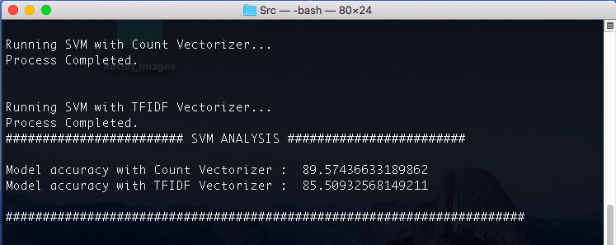
Classification
Report for
Linear SVM
Using TF-IDF
Precision: 0.89
Sensitivity: 0.88
Specificity: 0.90

Slide 28
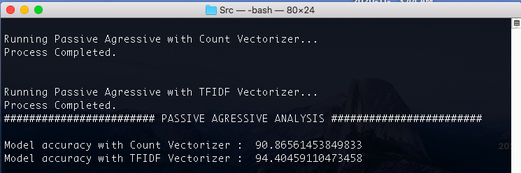
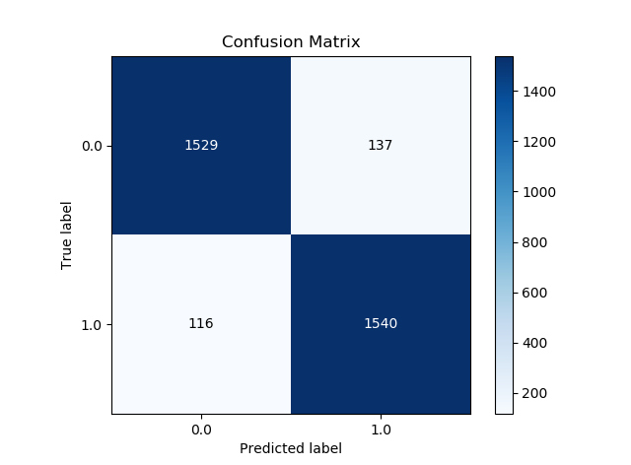
Classification
Report for
PAC using
TF-IDF
Precision: 0.86
Sensitivity: 0.92
Specificity: 0.86

Slide 29
Dissemination of Fake news on social media is very fast and therefore this method, can serve as a basic building block for Fake news detection.
With highest classification accuracy of 93.2% and sensitivity of 92%, LV-SVMwith Tf-Idf vector served as a better model as compared to others.
Conclusion
In addition, gathering real news that almost appears as Fake news will improve the training of the model.
More linguistic based features can be applied on responses to determine the news veracity.

Slide 30
Emilio Ferrara, Onur Varol, Clayton Davis, FilippoMenczer, and Alessandro Flammini. The rise of social bots. Communications of the ACM, 59(7):96{104, 2016.
Carlos Merlo (2017), "Millonario negocio FAKE NEWS", Univision Noticias
Chang, Juju; Lefferman, Jake; Pedersen, Claire; Martz, Geoff (November 29, 2016). "When Fake News Stories Make Real News Headlines". Nightline. ABC News.
https://www.cjr.org/analysis/facebook-rohingya-myanmar-fake-news.php
https://blog.paperspace.com/fake-news-detection/
Eni Mustafaraj and Panagiotis Takis Metaxas. The fake news spreading plague: Was it preventable? arXiv preprint arXiv:1703.06988, 2017.
Niall J Conroy, Victoria L Rubin, and Yimin Chen. Automatic deception detection: Methods for finding fake news. Proceedings of the Association for Information Science and Technology.
References

Slide 31
What Next?
Adding more data to the dataset will test the consistency of the performance thereby increasing trust of users on the system.
By exploring more social media features in our experiments, and combining them we can create an effective and reliable system for detecting Fake news.

