Slide 1

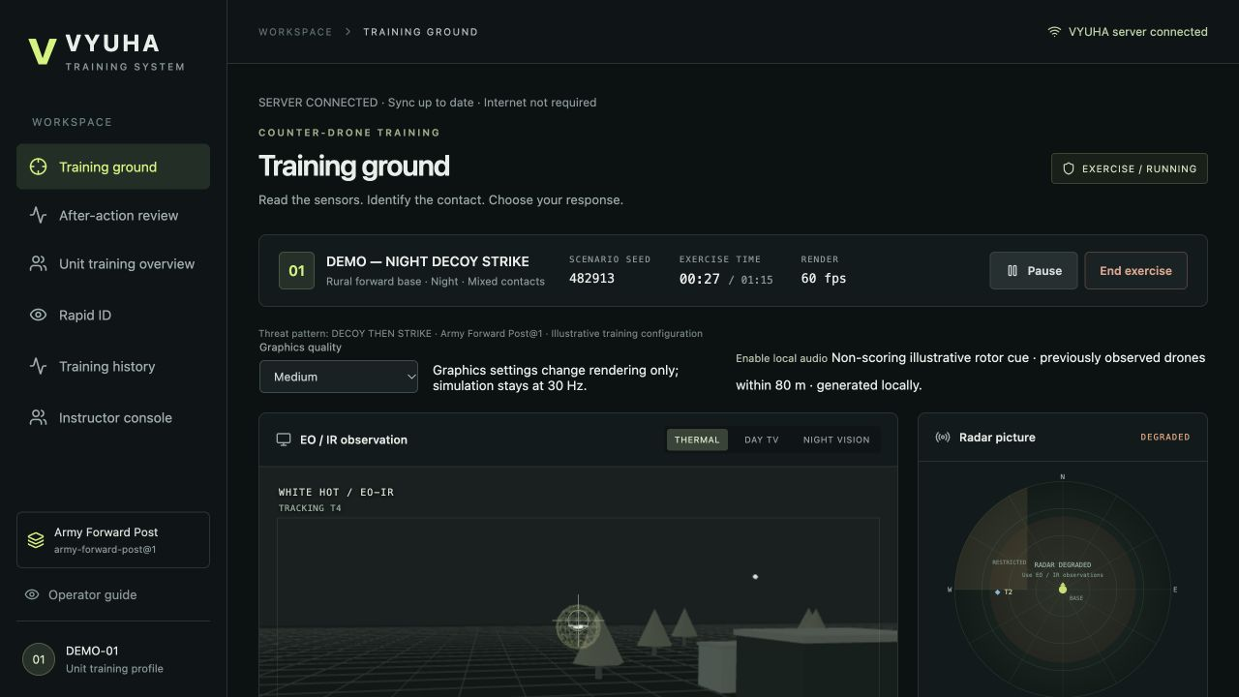
SMART INDIA HACKATHON 2026
TITLE PAGE
VYUHA
Adaptive counter-drone decision training
Train. Explain. Adapt. Repeat.
Problem Statement ID – SIH26247
Problem Statement Title –
AI-Enabled Drone & Counter-Drone
Threat Simulation Trainer
Theme – Robotics and Drones
PS Category – Software
Team ID – 185350
Team Name (Registered on portal) – WhiteList&0
Notes:
Registered metadata supplied by the user: Software, Team ID185350, WhiteList&0. College and member names omitted at explicit request. Official PS: https://sih.gov.in/sih2026PS . The page visually renders the first word as Al-Enabled; AI-Enabled follows the problem meaning and supplied plan. Demonstration screenshot uses a synthetic DEMO-01 identity, not operational soldiers. Runtime models are illustrative.

Slide 2
IDEA TITLE
WhiteList&0
Proposed Solution (Describe your Idea/Solution/Prototype)
Detailed explanation of the proposed solution
A local laptop serves repeatable mixed-contact drills; verified decisions feed
explainable review, persistent skill profiles and the next adaptive exercise.
How it addresses the problem
PS requirement | Working VYUHA capability
Recognise / classify / respond | Tactical drills + separate Rapid ID
Scoring / after-action review | Server reconstruction + Ghost + Time Machine
Adjust difficulty | Four-skill Beta Director; heuristic difficulty
Conditions / terrain | Day/night, sensor degradation, urban/rural
Single / swarm / unit training | Five Red Force patterns + local LAN Unit Mode
Innovation and uniqueness of the solution
One traceable loop: issued scenario → decisions → verified AAR → profile → next drill.
Notes:
Capability statuses and scopes: docs/feature-manifest.json. VALIDATED means listed prototype checks, not operational certification. Recorded practice, synthetic learner evidence and evaluation tooling are EXPERIMENTAL; local audio IMPLEMENTED; crew/live feeds/VR/rain/production identity/calibrated military signatures DEFERRED. No learning efficacy or real doctrine claim.

Slide 3
TECHNICAL APPROACH
WhiteList&0
Technologies to be used (e.g. programming languages, frameworks, hardware)
React + TypeScript + Three.js · Web Worker · Python/FastAPI · SQLite + IndexedDB
Methodology and process for implementation (Flow Charts/Images/ working prototype)
Trainee browser
30 Hz Worker
Local FastAPI
Observe, classify, respond
Seeded sensors + Red Force
Validate + reconstruct score
Profile + Director
Ghost + Time Machine
Local SQLite
4 Beta skills → next drill
Explain facts; replay decisions
Sessions + outcome ledger
Detect | Classify | Prioritise | Engage
25 points | 25 points | 15 points | 35 points
Notes:
Arrow loop shows browser actions → deterministic Worker → local authoritative server → persisted sessions/outcomes → review → profile/next recommendation. Ghost deterministic rules, no LLM. Advanced prioritisation = auditable pair agreement × engagement coverage; original Night Watch preserves historical timely-resolution node. Early end preserves disclosed75s scoring projection; available evidence is distinct from ground truth. Sources: https://developer.mozilla.org/en-US/docs/Web/API/Web_Workers_API/Using_web_workers ; https://fastapi.tiangolo.com/tutorial/static-files/ ; https://arxiv.org/abs/1707.02038 . Local implementation is authoritative for the specific design, rather than these references proving efficacy.

Slide 4
FEASIBILITY AND VIABILITY
WhiteList&0
Analysis of the feasibility of the idea
134 backend · 44 frontend · 312 parity checkpoints · 22 local assets
Physical multi-device LAN training was validated. Runtime assets and services are hosted locally;
dedicated WAN-disconnected physical validation remains pending.
M1 Air / 8 GB: median 60 FPS at 8–200
contacts, fixed Medium, 20-second runs.
Six simulated clients / 18 completions
over loopback; physical Mac + Android LAN.
Potential challenges and risks
Trusted LAN, no production authentication.
Illustrative laws; no human efficacy study.
Strategies for overcoming these challenges
Local assets, queued recovery, backup/restore;
Tactical 2D and recorded-demo fallbacks.
Physical WAN-off/LAN-on: NOT PERFORMED BEFORE SUBMISSION
Reason: Required physical/network setup unavailable during final validation window.
Notes:
Final regression receipt docs/qa-stage7/regression.json:134/44/312/build22assets. Existing Starlette/httpx and large Three.js chunk warnings remain. Performance is prior Stage6 measured evidence carried into a source-compatible release; no simulation/scoring changes. Six-client loopback median/p95ms completion83.32/176.74; dashboard113.74/393.21. M1andAndroid20-second bounded tests are not sustained certification; AndroidAutoenabled. Dedicated physical WAN-off/LAN-on validation was not completed before submission. Multi-device LAN operation, local asset serving, process-outage recovery and queued-event resynchronization were validated separately. Exception not failed architecture and not waiver of other checks.

Slide 5
IMPACT AND BENEFITS
WhiteList&0
Potential impact on the target audience
Repeat mixed-contact decisions safely.
Review the evidence behind each mistake.
Select the next drill from saved outcomes.
SIMULATED ONLY · not human efficacy
Metric | Director | Random
Reached specified threshold | 8 / 50 | 5 / 50
Median sessions, reached only | 21.5 | 28
Mean final hidden probability | 73.43% | 73.15%
Benefits of the solution (social, economic, environmental, etc.)
Intended: accessible repetition on unit laptops
and traceable instructor review. Cost savings
and field-performance transfer are unmeasured.
50 paired profiles per policy × 30 sessions.
Abstract Bernoulli learning law, uncalibrated;
no human learners or tactical physics.
Human efficacy has not been measured.
Next: subject-matter calibration and a consented pre/post pilot. Evaluation tooling is experimental.
Notes:
Experiment source: docs/qa-stage6/experiment-config.json, experiment-results.json and full trajectories. Production Thompson selector/template/RedForce vs uniform random focus/template; sameBeta difficulty rule, paired seeds/initial hidden probabilities/uniforms and common abstract focused learning law. Hidden competence distinct from reportedBetaestimates. No human efficacy claim, causal operational claim or statistically established superiority. Table rounds mean values to2decimalpercent. Canonical feature manifest marks experiment/evaluation EXPERIMENTAL and formalhumanfieldstudy DEFERRED.

Slide 6
RESEARCH AND REFERENCES
WhiteList&0
Details / Links of the reference and research work
Official problem statement and 2026 submission template
sih.gov.in/sih2026PS · sih.gov.in/letters/2026/SIH2026-IDEA-Presentation-Format.pptx
Russo et al. — A Tutorial on Thompson Sampling (2018)
arxiv.org/abs/1707.02038 · Method reference; does not validate VYUHA training efficacy.
Implementation references
developer.mozilla.org/en-US/docs/Web/API/Web_Workers_API/Using_web_workers
fastapi.tiangolo.com/tutorial/static-files/
Reproducible product evidence
FINAL-VALIDATION.md · release-evidence.json · feature-manifest.json
Private repository: github.com/vishruthvayu/vyuha-sih26247 · source package supplied separately.
DEFERRED: calibrated signatures · human/field evaluation · production identity · live feeds · crew · VR · rain
Notes:
Sources checked3Oct2026: https://sih.gov.in/sih2026PS ; https://sih.gov.in/letters/2026/SIH2026-IDEA-Presentation-Format.pptx ; https://arxiv.org/abs/1707.02038 ; https://developer.mozilla.org/en-US/docs/Web/API/Web_Workers_API/Using_web_workers ; https://fastapi.tiangolo.com/tutorial/static-files/ . Repo is private as requested; independent review uses supplied source/evidence archive. Portal upload format PDF,max6slidesincltitle per officialtemplate. User target4Oct; livePSpage says5Oct,olderpublicguidelinePDF30Sept. Deadline discrepancy is retained in claim audit; do not treat olderPDFdate as current.

