Slide 1
SIH26247
VYUHA
Drone & counter-drone
threat simulation trainer
Repeatable practice on a laptop,
with a debrief for every decision
WhiteList&0
Notes:
Product: VYUHA. Team: WhiteList&0. The college name has not been supplied. Problem statement source: user-provided SIH26247 text. The product is a working prototype with illustrative training values.

Slide 2
Proposed Solution
A complete practice loop for mixed drone contacts
Problem requirement | Working prototype
Scripted and generated scenarios | 75-second drill, new seeds, two skill focuses
Detection, classification and response | Working sensor cues and decision controls
Decision-tree scoring | Server replay with a transparent 100-point rubric
Individual and unit AAR | Replay, reference responses and saved session history
Urban terrain and mixed contacts now. Rural terrain and VR follow the prototype.
WhiteList&0 SIH26247 2/6
Notes:
Requirements follow the user-supplied SIH26247 statement. Scripted generation currently varies bearings by seed and adds a no-RF contact in response-focused scenarios. Full procedural diversity, calibrated difficulty and anti-rote filtering are planned. The AAR replay is 2D tactical, not a 3D replay.

Slide 3
Technical Approach
Browser simulation
Local scoring server
Session storage
30 Hz worker
Three.js observation view
FastAPI replay
Validated action log
SQLite on the laptop
IndexedDB on the device
Scenario seed and trainee decisions reproduce the exercise
Detect | Classify | Timely response | Engage
25 points | 25 points | 15 points | 35 points
Detection time starts at the first working-sensor observation.
A non-hostile engagement fails the session.
WhiteList&0 SIH26247 3/6
Notes:
The Python server reconstructs sensor observations and response outcomes from its stored scenario and action log. Regression tests compare the browser and Python engines across three seeds and multiple replay checkpoints. The 15-point node currently rewards resolution before impact, not Kendall-tau prioritization. Logs are reproducible but cannot be claimed tamper-proof. Sources: https://r3f.docs.pmnd.rs/getting-started/installation ; https://fastapi.tiangolo.com/tutorial/static-files/ ; https://developer.mozilla.org/en-US/docs/Web/API/Web_Workers_API/Using_web_workers ; https://developer.mozilla.org/en-US/docs/Web/API/IndexedDB_API

Slide 4
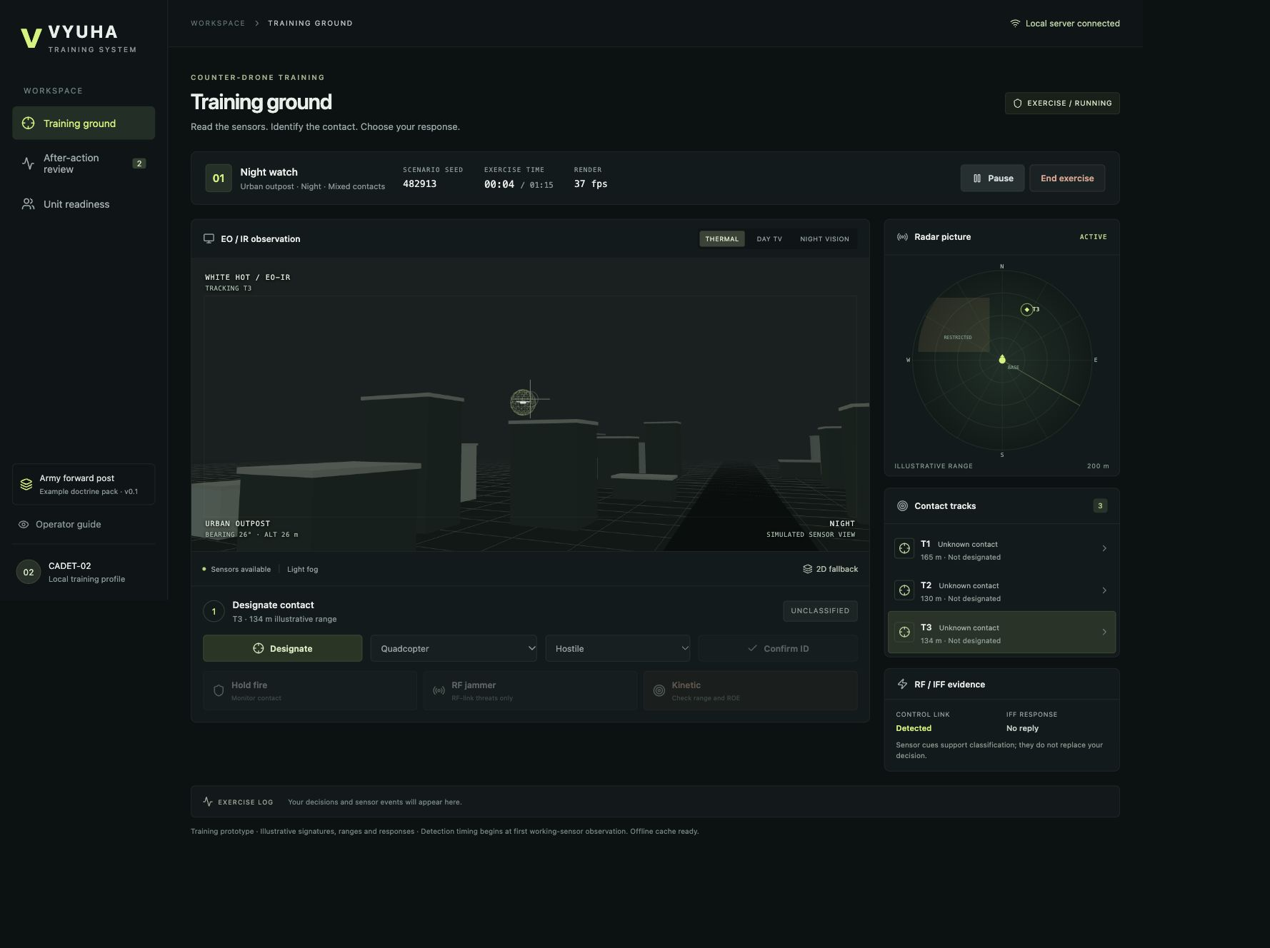
Feasibility & Viability
Local demonstration
The same laptop serves the app
and scores the exercise.
The browser keeps session records
and restores unfinished practice.
2D tactical fallback supports
classification and response practice.
Sensor and effector values are illustrative. Hardware performance still needs team-laptop testing.
WhiteList&0 SIH26247 4/6
Notes:
Screenshot: actual local prototype built in this chat. Local offline reload should be rehearsed on the presentation browser after the cache-ready indicator appears. LAN access and role-based accounts are not implemented. Docker configuration is provided; a container build is not yet verified on this machine.

Slide 5
Impact & Benefits
Practice reveals the decisions
that need another repetition
A trainee reviews when a contact became visible,
how they classified it, and why a response worked.
An instructor sees actual session history
and two observed skill scores for each trainee.
Validation before operational use
Subject-matter review, laptop benchmarks and a trainee pilot.
Training efficacy remains a hypothesis until measured.
WhiteList&0 SIH26247 5/6
Notes:
These are intended training benefits, not measured military outcomes. The current prototype stores pseudonymous trainee IDs. It has no pilot data, real radar signatures, real readiness thresholds or claims of improved operational performance. The two-skill director uses Beta profiles and seeded Thompson sampling to choose recognition or response practice. A simulated-learner efficacy experiment is future work and would need explicit simulated-evidence labeling.

Slide 6
Research & References
Problem requirements
SIH26247 statement supplied by the team
3D interface
React Three Fiber installation documentation
Local API and application serving
FastAPI static-files documentation
Background simulation and device storage
MDN Web Workers and IndexedDB documentation
All example signatures and response rules require subject-matter validation.
WhiteList&0 SIH26247 6/6
Notes:
Sources: user-supplied SIH26247 statement in the attached pasted context; https://r3f.docs.pmnd.rs/getting-started/installation ; https://fastapi.tiangolo.com/tutorial/static-files/ ; https://developer.mozilla.org/en-US/docs/Web/API/Web_Workers_API/Using_web_workers ; https://developer.mozilla.org/en-US/docs/Web/API/IndexedDB_API . The deck follows the six headings in the team plan, not a verified current official SIH template.

