Slide 1
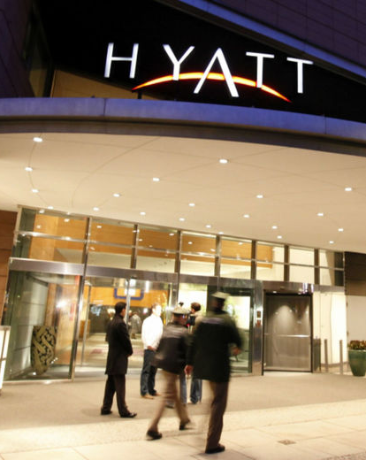
HYATT GROUP DATA ANALYSIS
IST 687
By Vishwanath Hegde
Notes:
To change the image on this slide, select the picture and delete it. Then click the Pictures icon in the placeholder to insert your own image.

Slide 2
Business Questions
Which Hyatt brands are not performing well?
What are the demographics of Hyatt guests in California?
Which amenities and facilities most strongly influence net promoter score for customers in California?

Slide 3
Approach
Data Selection
Downloaded March, July & December 2014 data
Data Cleaning
Removed all rows where NPS type was NULL
Data Visualization
Modelling Techniques
Use of descriptive statistics and recommendations based on the data observed
Use of inferential statistics and recommendations based on the data observed

Slide 4
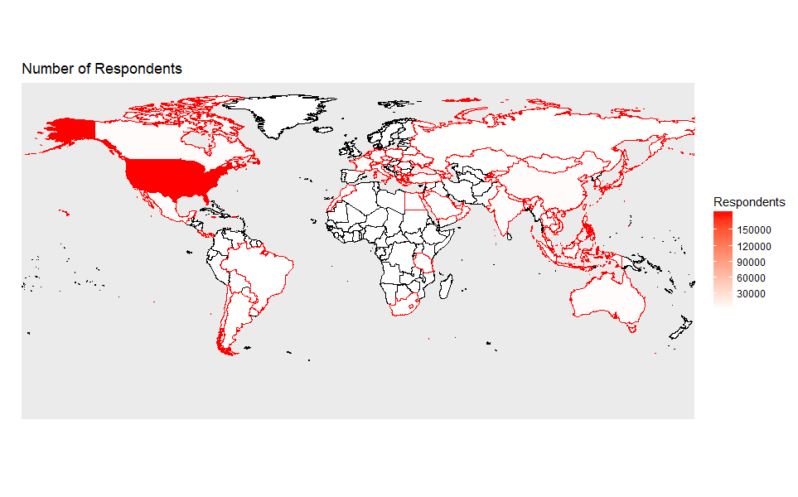
Map of Respondents Worldwide
USA has the highest number of Respondents

Slide 5
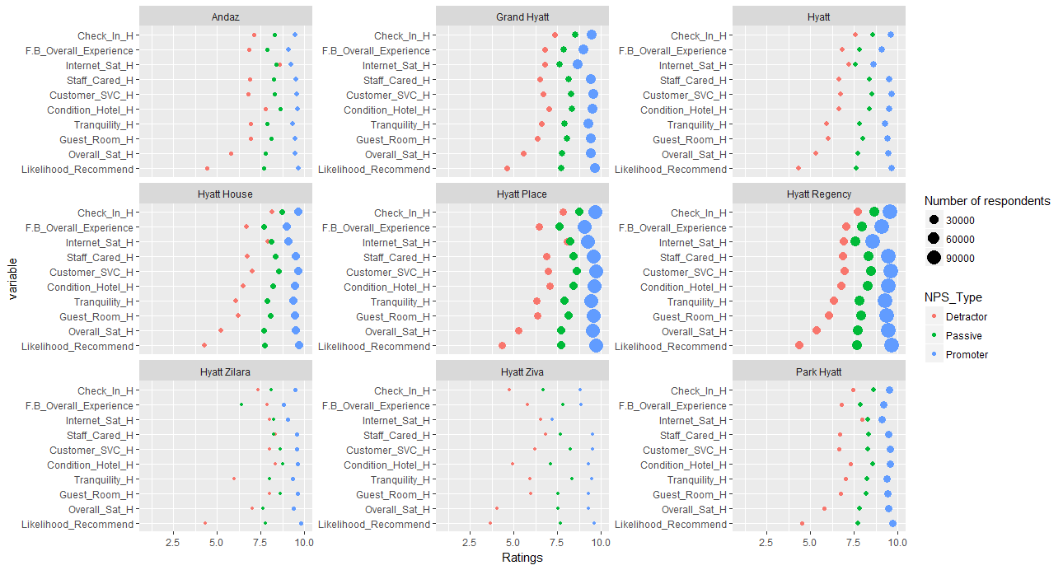
Overview of Average Ratings Based on Brands

Slide 6
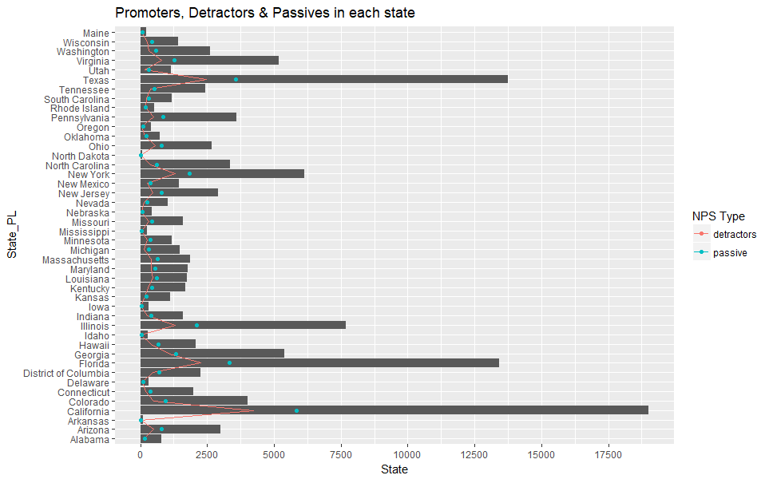
Statewise Distribution of Promoters, Detractors & Passives
California has the highest number of promoters and detractors
North Dakota has the lowest number of promoters and detractors
Opportunity lies in converting passives to promoters and reducing the number of detractors

Slide 7
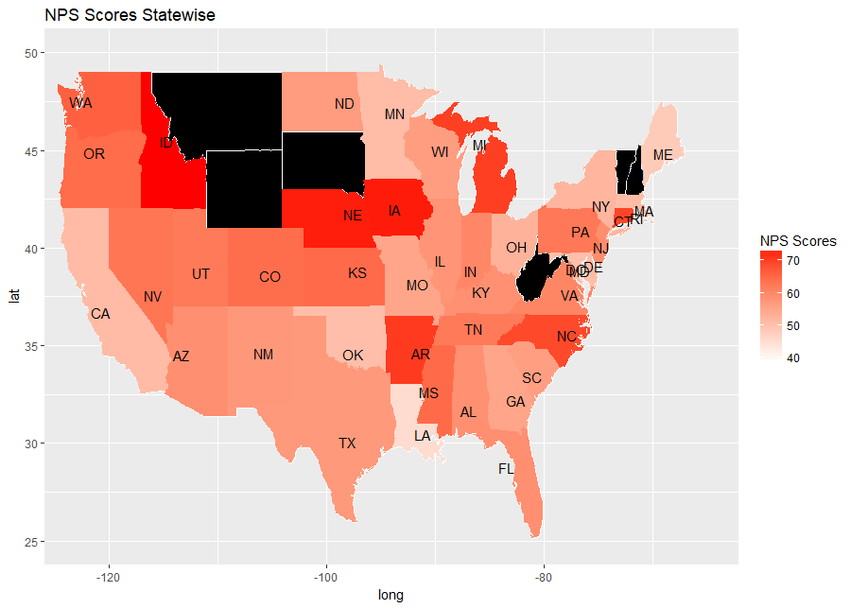
Overview of NPS Statewide
Nebraska, Idaho and Iowa have very high NPS scores
Texas, New Mexico and California have medium NPS scores
Louisiana, maine and Rhode island have the lowest NPS scores

Slide 8
FOCUS ON CALIFORNIA

Slide 9
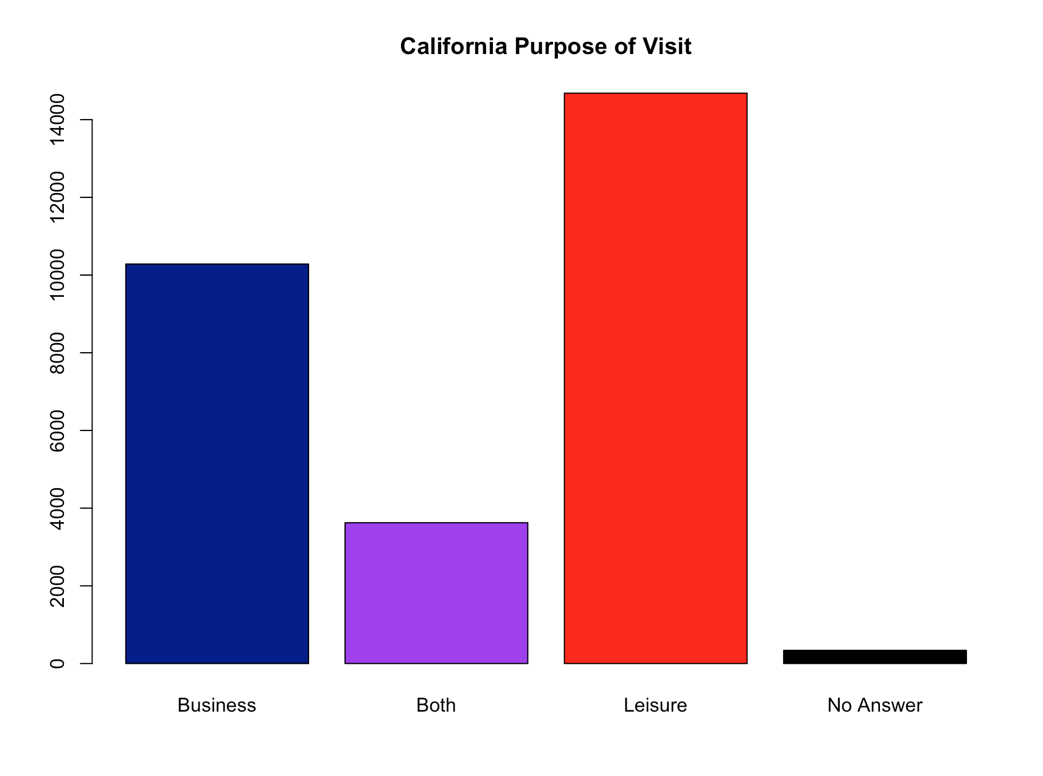
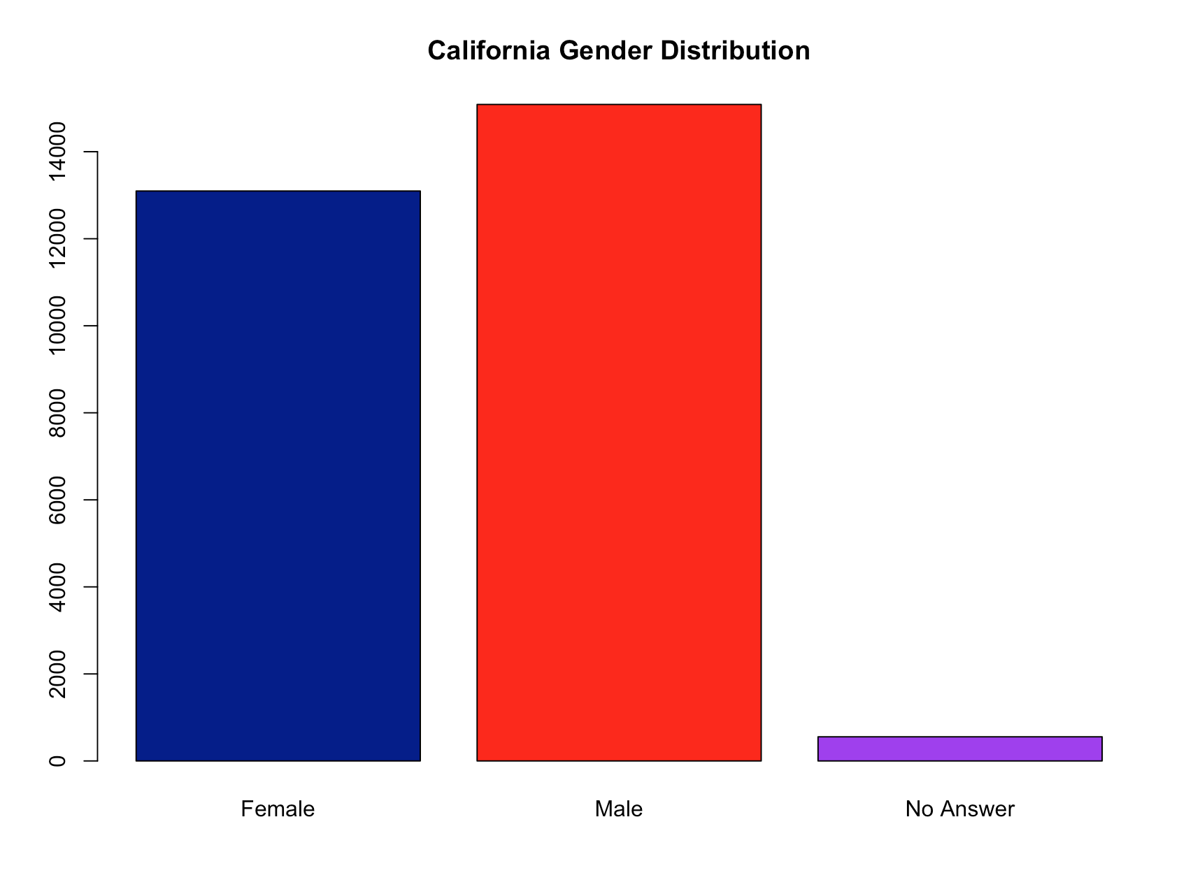
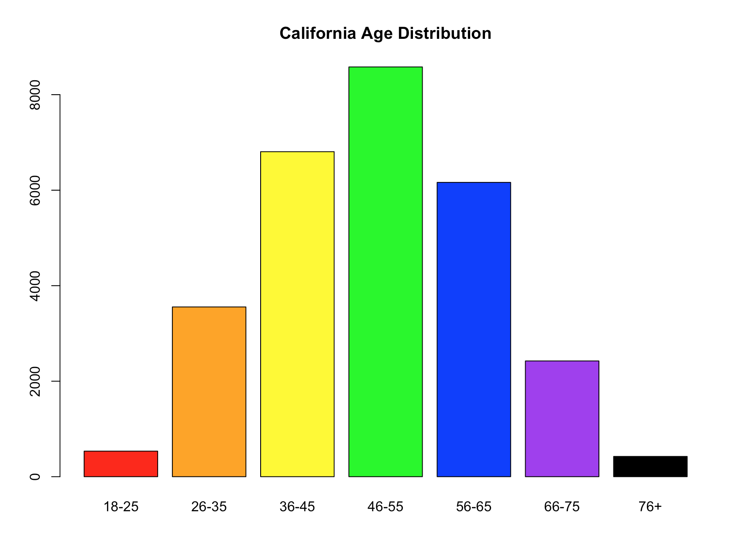
Overview of California (March, July & December )
More customers visited Hyatt hotels for leisure than for business
Hotels had more male visitors than females
More people in the age group 46-55 visited Hyatt hotels

Slide 10
MODELING TECHNIQUES

Slide 11
Models
The following modeling techniques were utilized
Support Vector Machines
Association Rules Mining
Correlation modeling
Linear Modeling
Random Forest algorithm

Slide 12
Support Vector Machine
Developed models to predict whether a customer was a Promoter, Detractor or Passive based on satisfaction ratings and facilities present
The model produced the highest accuracy of 83% when the following factors were considered
Guest Room Satisfaction
Hotel Condition
Customer Service
Overall Satisfaction
Tranquility
Staff Cared
When considering whether facilities were present or not out model had a maximum accuracy of only 20%
This suggests that the presence of facilities is not very important when determining if a customer is a Promoter, Detractor or Passive

Slide 13
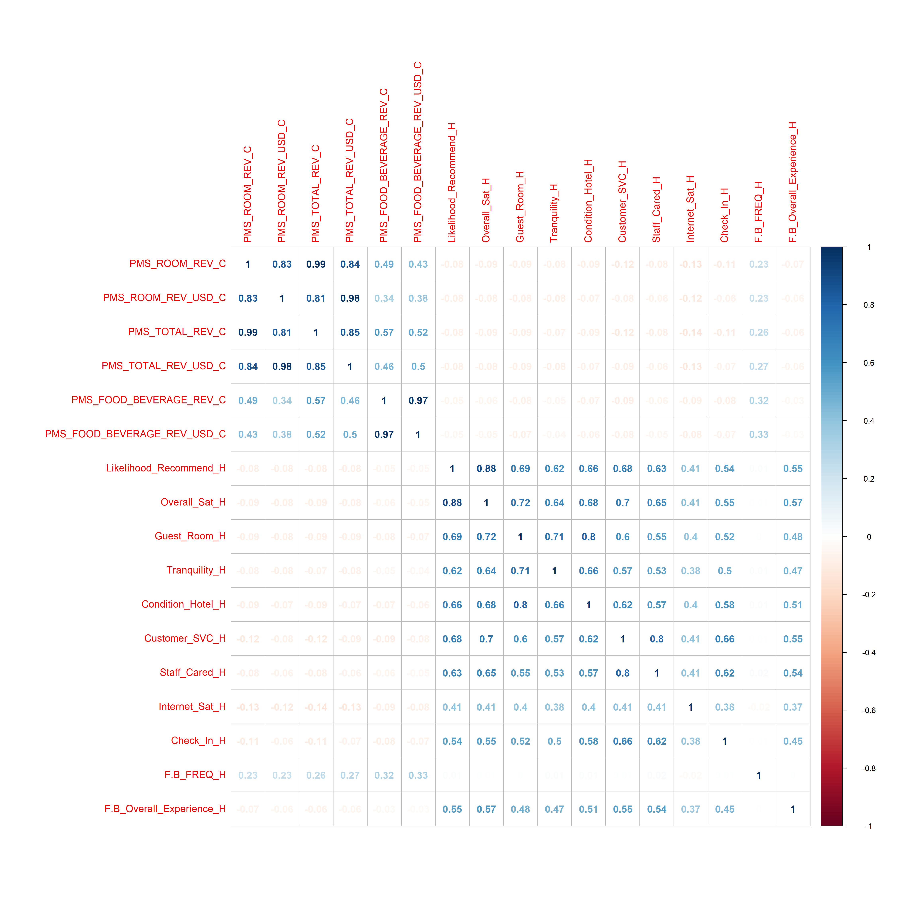
Correlation Modelling
Staff Cared ratings is highly correlated to customer service ratings
Guest Room ratings is highly correlated to tranquility and hotel condition

Slide 14
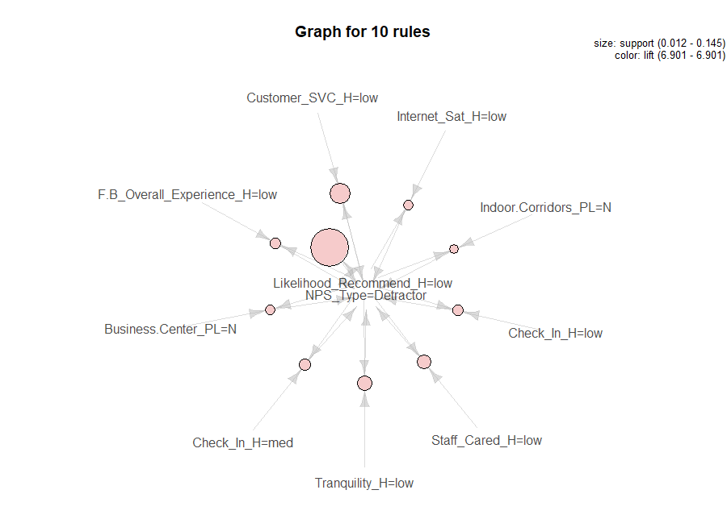
Association Rules Mining
Found out which attributes frequently occur with the word detractor
A person is likely to become detractor when he rates the hotel low on:
customer service
internet satisfaction
staff care
check in service
food & beverage service
The non availability of a business center and indoor was frequently associated with detractor

Slide 15
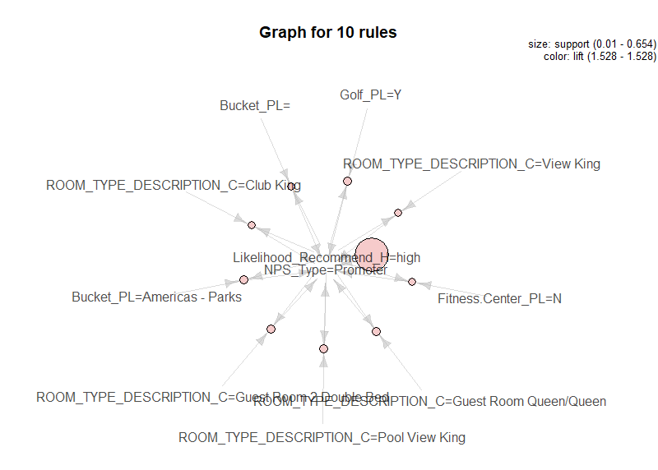
Association Rules Mining
Found out which attributes frequently occur with the word promoter
A person is likely to become promoter when he stays on club king, view king, guest room queen, guest room double bed or pool view king

Slide 16
Recommendations
Improve hotel conditions, tranquility and guest room experience of Hyatt Ziva hotels
Provide staff training seminars to improve both customer service and staff care ratings
Put up noise reducing barriers in guest rooms to improve both tranquility and guest room ratings
Focus on upgrading wifi services to help improve the satisfaction of users in California
Provide more rooms with queen/king beds or rooms with scenic views (consider improving landscaping)

Slide 17

THANK YOU

