Slide 1
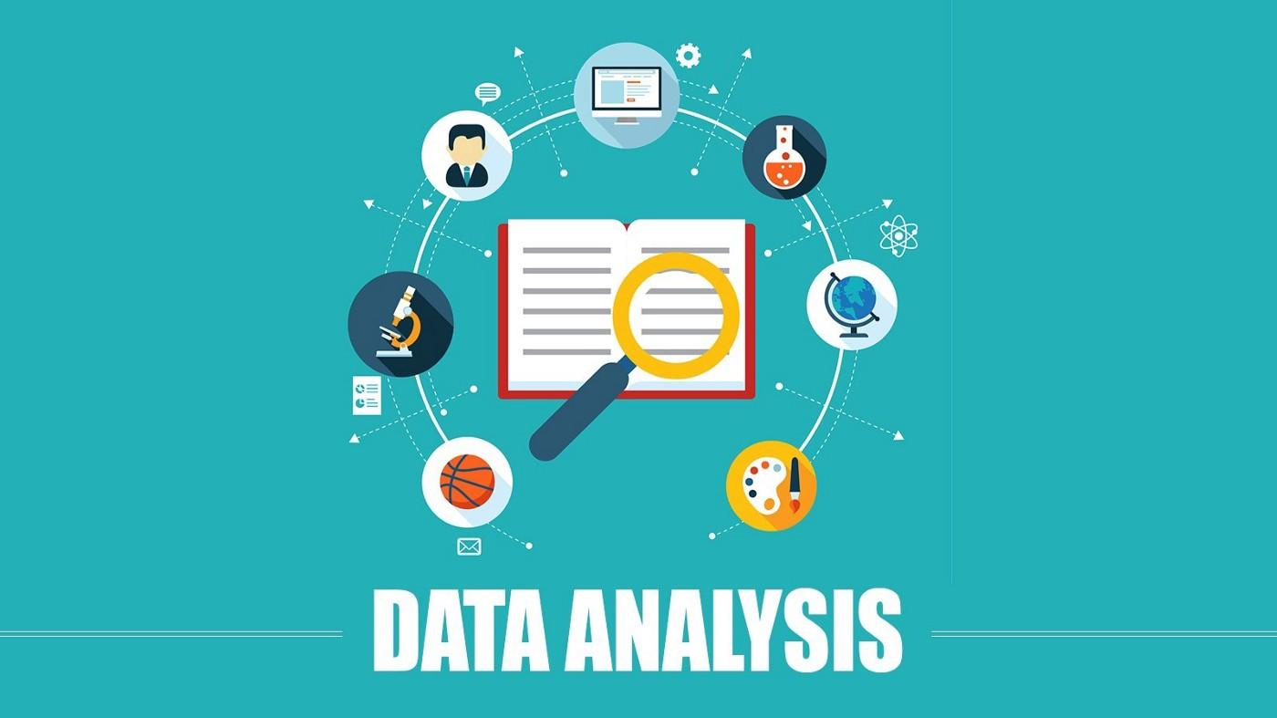
Google Play Store Analysis
Class Project Progress Report
Sai Manoj Kalasani - FH55174
Komal Prakash Londhe - AY10453
Viswas Kalyanam - RN49734

Slide 2
Project update
Dataset: https://www.kaggle.com/gauthamp10/google-playstore-apps?select=Google-Playstore.csv
It is an updated dataset with more than 2.3 million records of 600K applications and size of 673MB.
It contains 23 features: App Name, App Id, Category, Rating, Rating Count, Installs, Minimum Installs, Maximum Installs, Free, Price, Currency, Size, Minimum Android, Developer Id, Developer Website, Developer Email, Released, Privacy Policy, Last Updated, Content Rating, Ad-Supported, In-app purchases, Editor Choice.

Slide 3
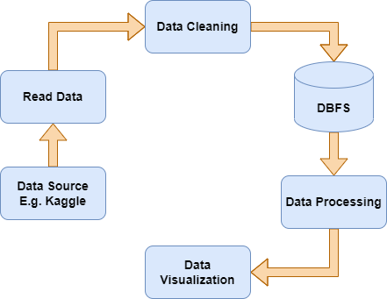
Proposed Methodology
1. Data Cleaning
2. Final Data set uploading
3. Data Processing in spark
4. Execute MongoDB query in
Spark
5. Visualizing outcomes using
draw.io

Slide 4
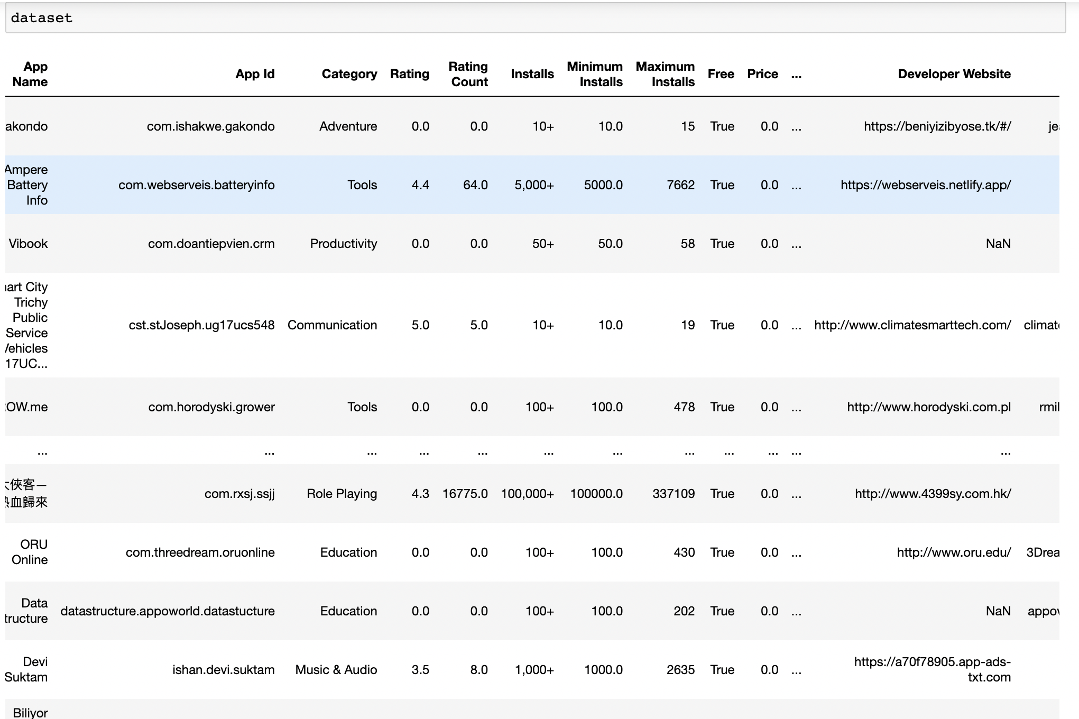
Data Cleaning: Though, it is a highly usable and updated dataset, it contains some unwanted data, like data with other languages, and few of them has application names as ‘0’, hence they are removed.
Completed Phases

Slide 5
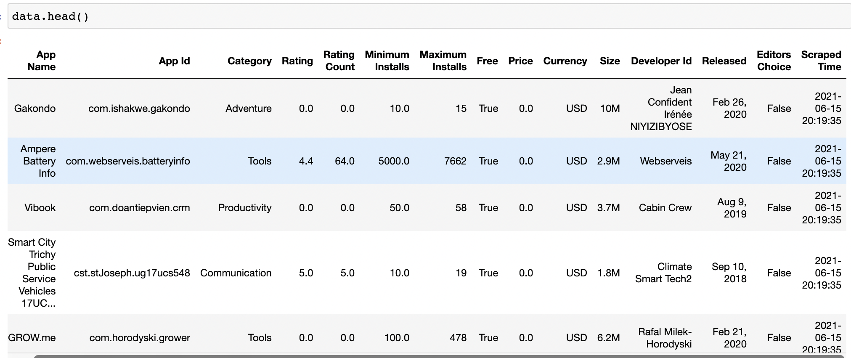
Final Dataset Uploading: The Cleaned data is processed with Spark Using Pyspark.

Slide 6
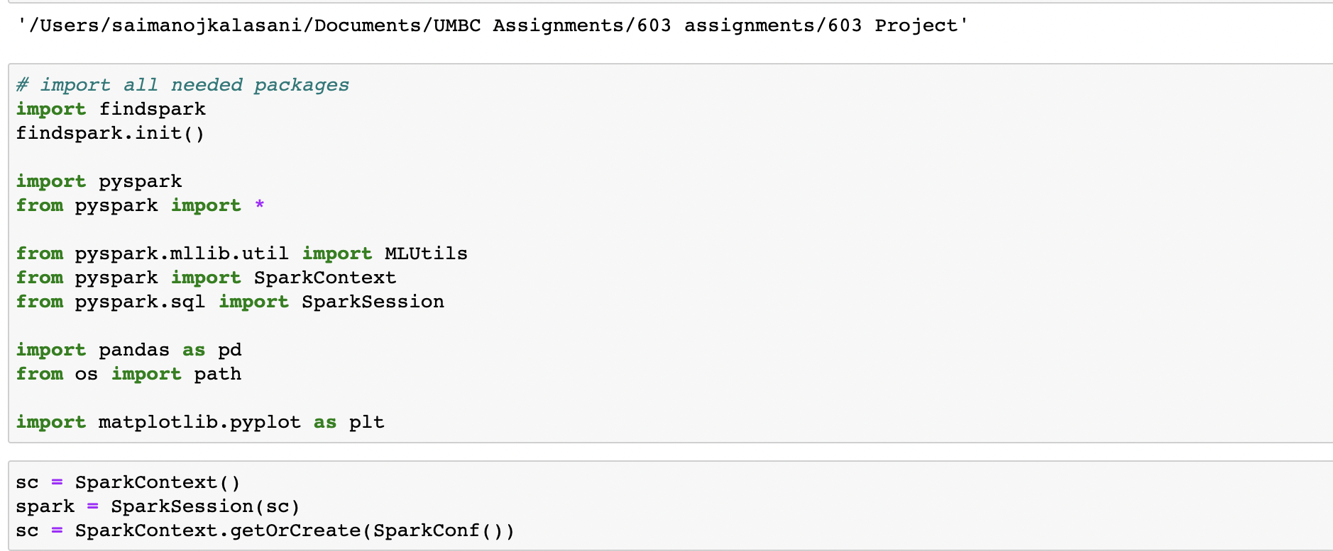
Data Processing in spark :Started a spark session to run queries.

Slide 7
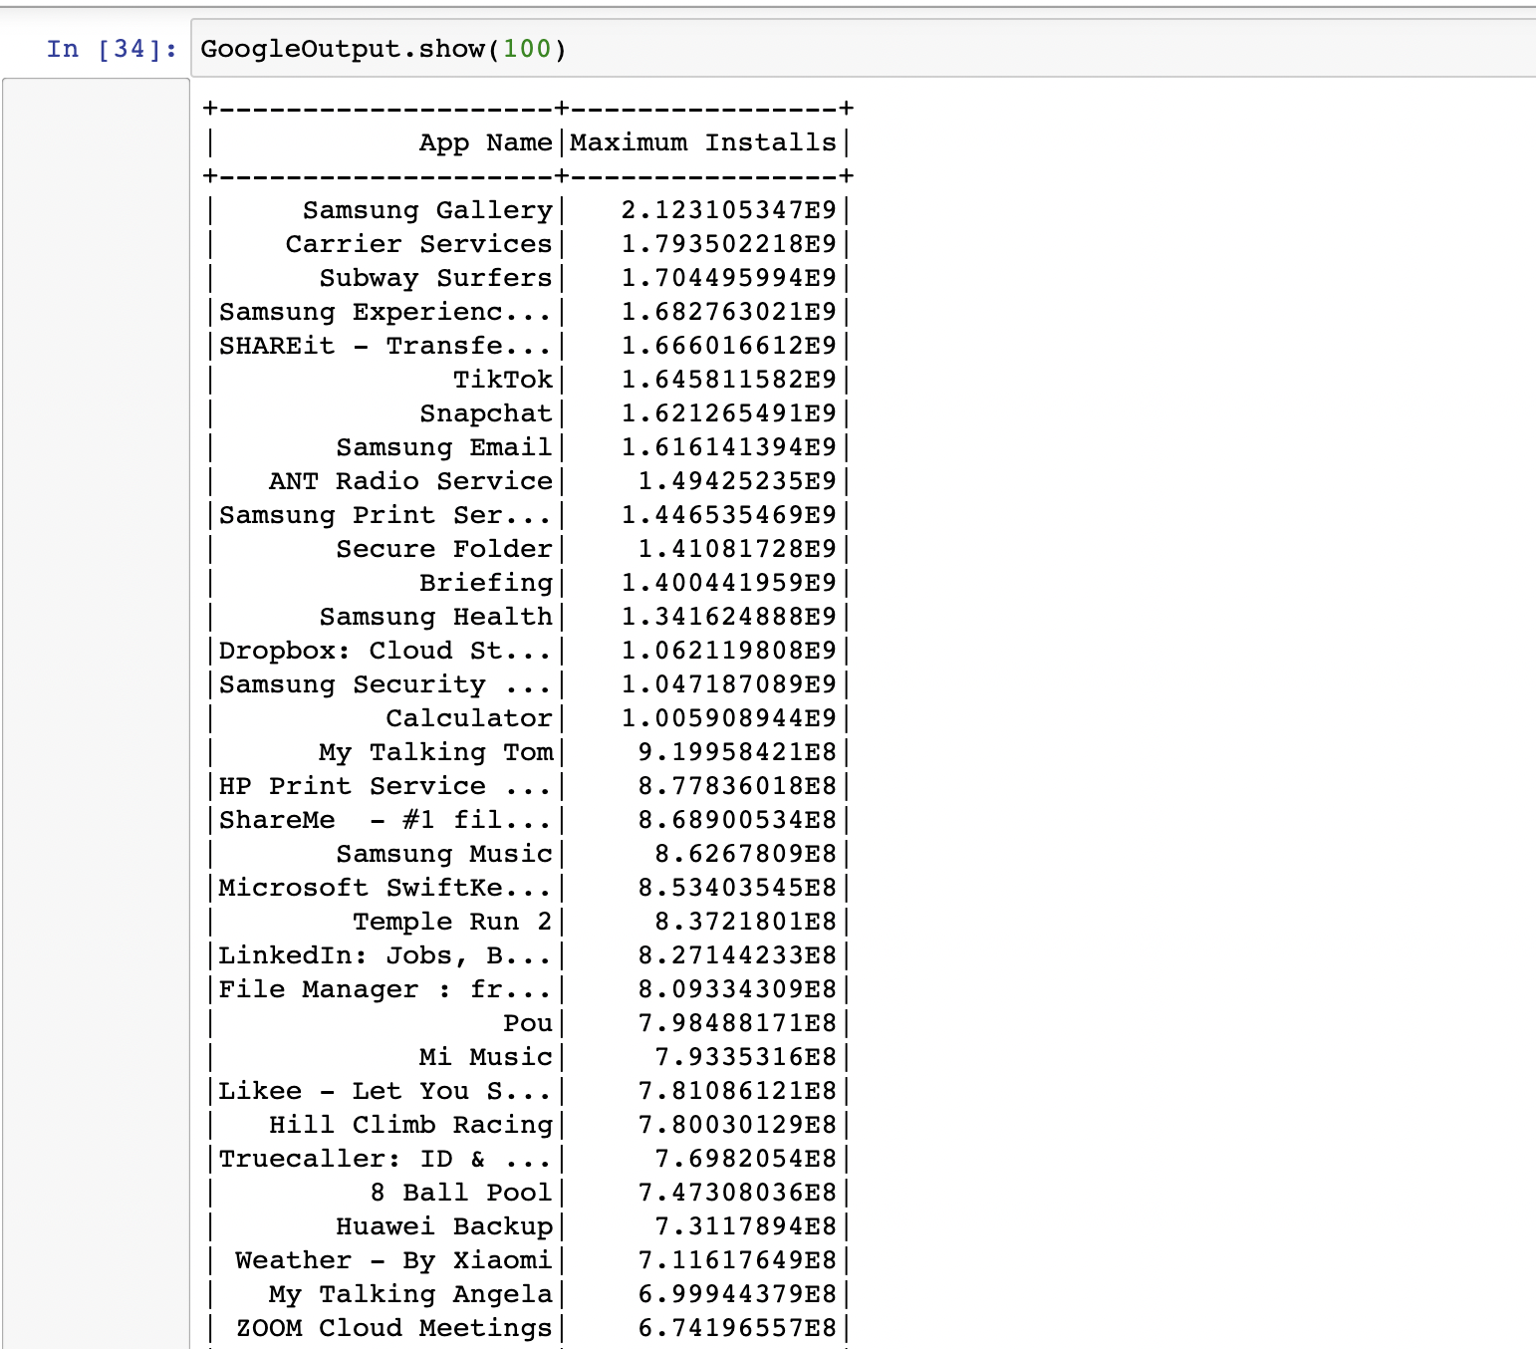
In-Progress Tasks
Completed the first task
using the query and got the list of top
100 most downloaded apps.

Slide 8
Working On
Remaining 4 tasks.
Word cloud generation based on installations
Using bar graphs
- find main category of apps downloaded per year
- find the best developer based
Donut chart for the top 5 most rated apps

Slide 9
Expectations:
I expect to complete the project with all the proposed details and tasks and going to achieve all the expected results.
I expect to implement modelling with word2vec and the machine learning sentiment classifier and try to get user reviews chart.
I expect to get all the visualizations.

Slide 10
References:
Chile, A. (2019). Analysis of Google Play Store Application. International Journal for Research in Applied Science and Engineering Technology, 7(6), 2362–2368. https://doi.org/10.22214/ijraset.2019.6398
Mahmood, A. (2019). Identifying the influence of various factor of apps on google play apps ratings. Journal of Data, Information and Management, 2(1), 15–23. https://doi.org/10.1007/s42488-019-00015-w
ICFAI Tech, Hyderabad & ICFAI Tech, Hyderabad, Telangana, India. (2020, December 12). Google Play Store Apps- Data Analysis and Ratings Prediction. Https://Www.Irjet.Net/Archive. https://www.irjet.net/archives/V7/i12/IRJET-V7I1248.pdf
Mokarizadeh, S. (2013, May 8). SCITEPRESS - SCIENCE AND TECHNOLOGY PUBLICATIONS. Https://Www.Scitepress.Org/. https://www.scitepress.org/Papers/2013/45020/

Slide 11


