Slide 1
BOSTON CITY CRIME INCIDENT REPORTS
DATA-602
Project Overview
Viswas Kalyanam (RN49734)

Slide 2
CHAPTERS
Dataset description.
Aim of the project.
Data Cleaning & Removing Null Values.
Exploratory Data Analysis (EDA).
Modeling, Feature Engineering & Evaluation.

Slide 3
Dataset Description
Dataset had been extracted from the crime incident reports of Boston Police Department "Analyze Boston".
Dataset consists of Boston city’s crime incident reports in the year 2021.
This dataset contains 70,000 rows and 18 columns.
Which goes through the crimes committed based on the hour of the day and crimes are categorized into several categories for a better understanding of the dataset.
The main objective of the project is to anticipate when crimes will take place based on the kind of offense committed and the Hour of day.
Implementing the EDA on the required columns which gives an in-depth analysis of each, and every column considered in the dataset.

Slide 4
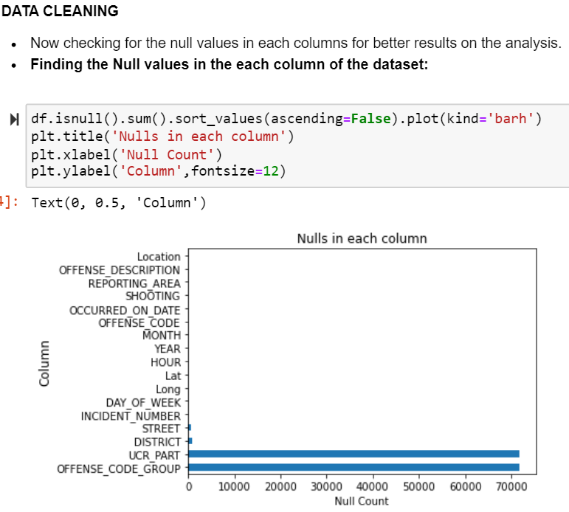
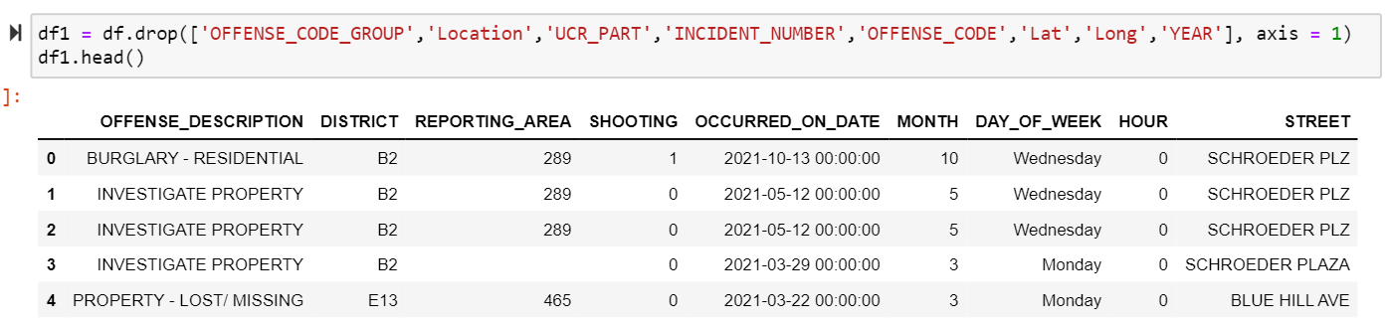
Data cleaning
This includes dropping the columns in the dataset which are not suitable for future analysis.
In this dataset we have two columns that consist of null values in the whole column.

Slide 5
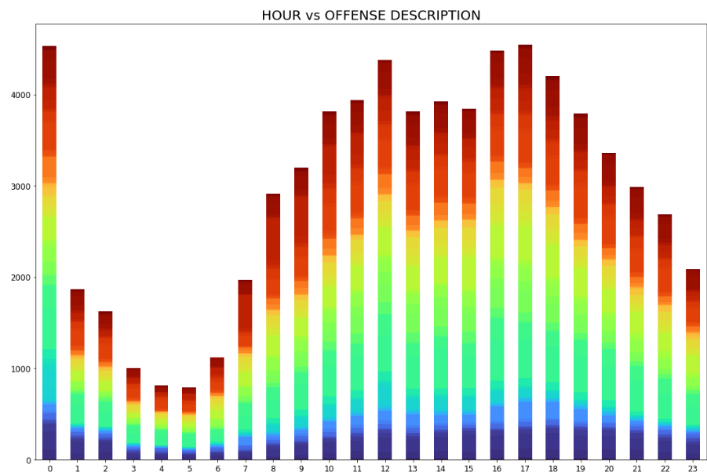
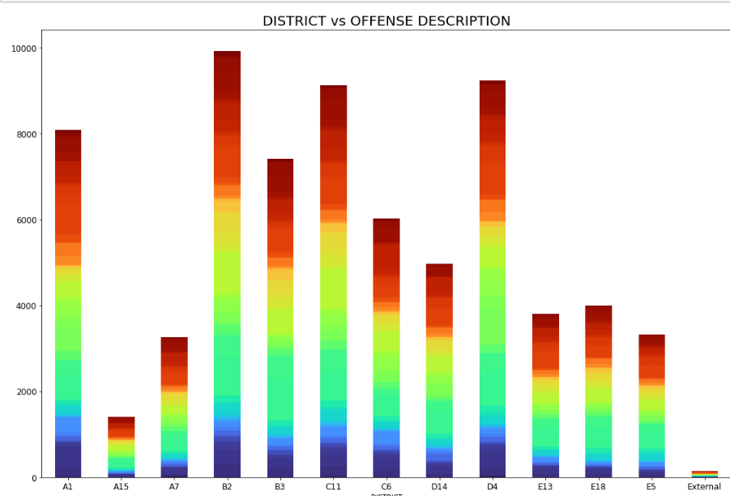
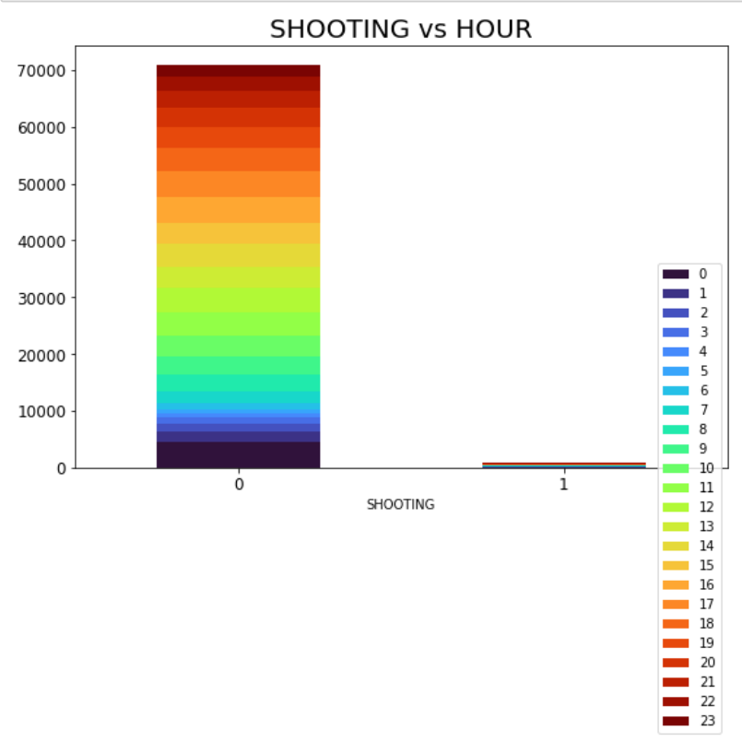
Exploratory Data Analysis
Now coming to the EDA part, we are performing distribution on the columns which are having some interesting characteristics shown up.
HOUR vs OFFENSE DESCRIPTION: Most of the offenses took place in the '0' & '17' hours at midnight and Evening, respectively. (Figure:1)
DISTRICT vs OFFENSE DESCRIPTION: Considering the 'DISTRICT' & 'OFFENSE_DESCRIPTION' in the dataset, most of the offenses are taken place in the 'B2' District. (Figure:2)
SHOOTING vs HOUR: Most of the shootings are taking place at 12:00 AM midnight. To be precise at '0' Hours in the morning. Shootings are less involved in the offenses and most of them were handled without shooting. (Figure:3)

Slide 6
Modeling
Which consists of pipeline construction and feature engineering techniques.
Dataset consists of four categorical variables, three numerical variables, and one target variable which is ‘HOUR’.
‘HOUR’ is categorized into three types day, night & midnight, which will be easier for the analysis.
Most of the time the crimes are taking place from 0 to >6 those are midnight.

Slide 7
Handling null values & splitting the dataset.
Null values exist in the dataset.
By simple Imputer approach, we will fill the null values with the most frequently appearing values in every column, respectively.
Numerical values are filled by using simple_imputer(strategy = ‘median’).
Categorical values are filled by using simple_imputer(strategy = ‘most_frequent’).
By splitting the datasets into two categories testing & Training.
Considering the 'HOUR' Column in the dataset, We have created a new column which is 'Time of day'.

Slide 8
Types of models used for data analysis
Logistic Regression
Decision Tree
KNN - Classifier

Slide 9
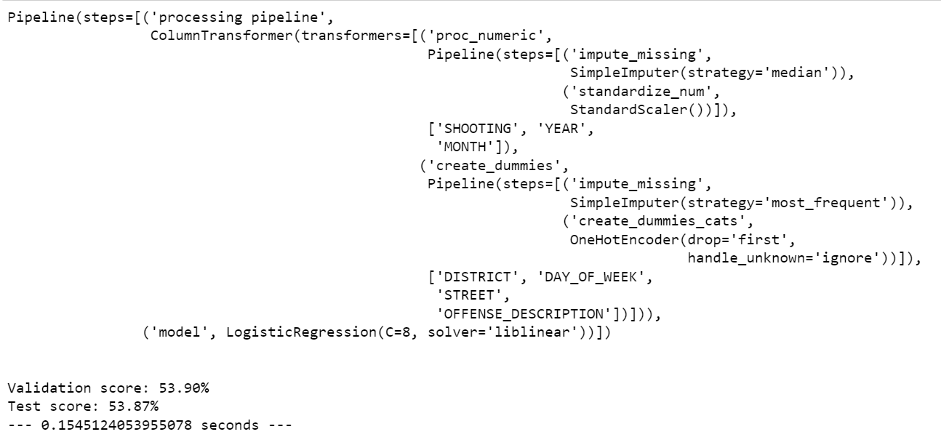
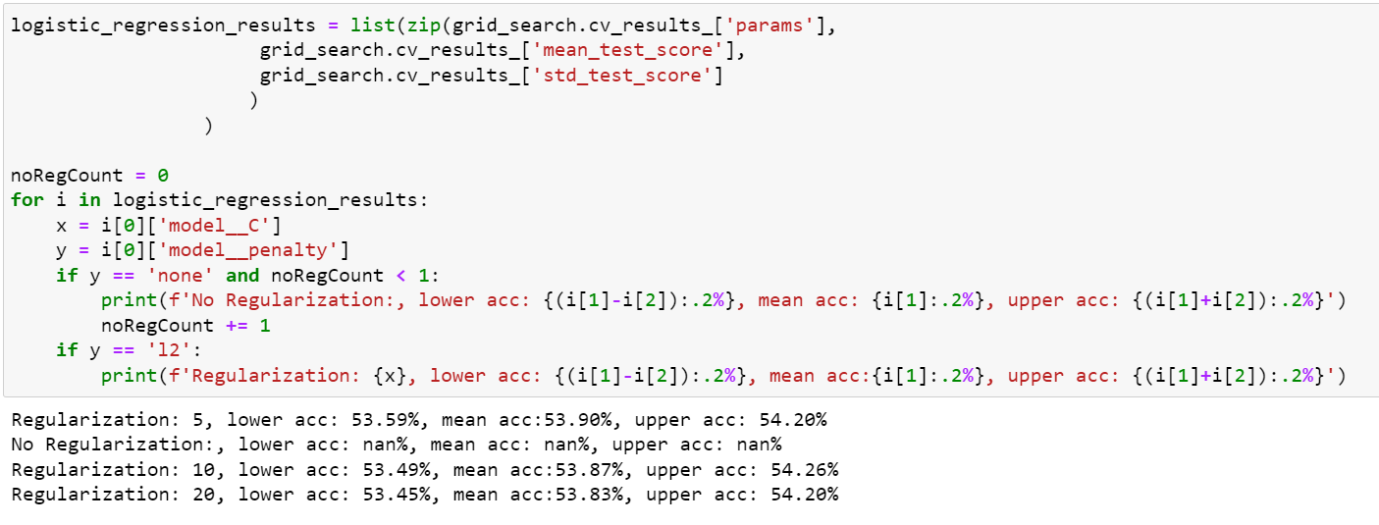
Logistic regression
These figures show the validation scores and test scores.
By performing hyperparameter search for better parameters and implementing them in the LR pipeline.

Slide 10
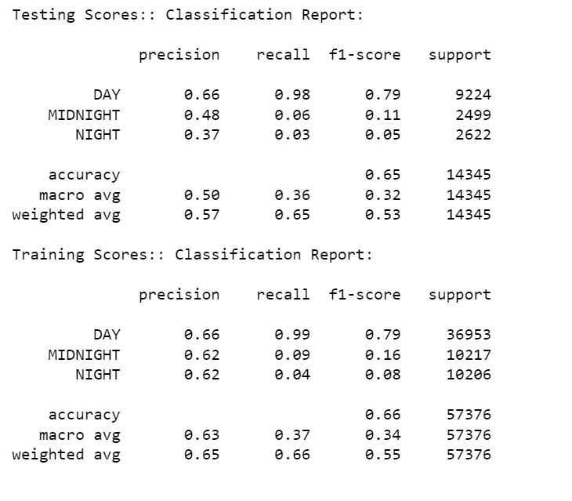
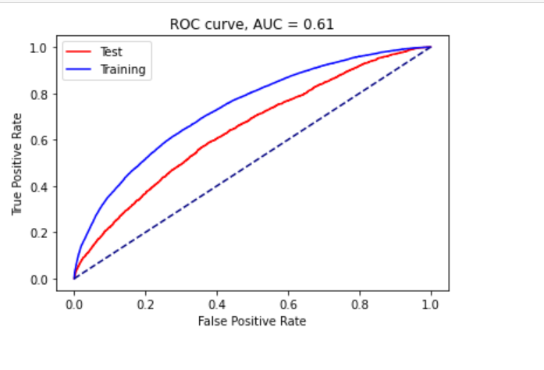
These are the Testing scores of logistic regression.
Accuracy is 66%
Performing ROC curve and getting the Area under curve values for the model.
AUC is 61%

Slide 11
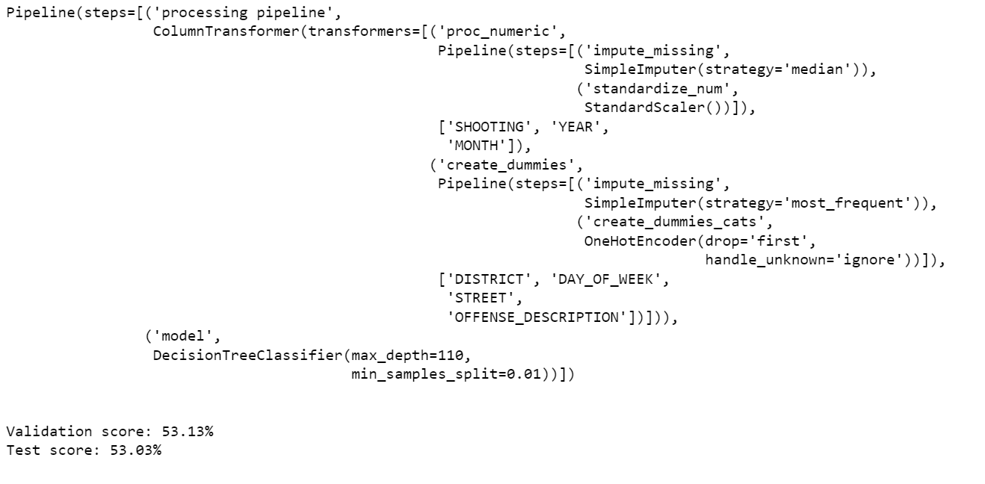
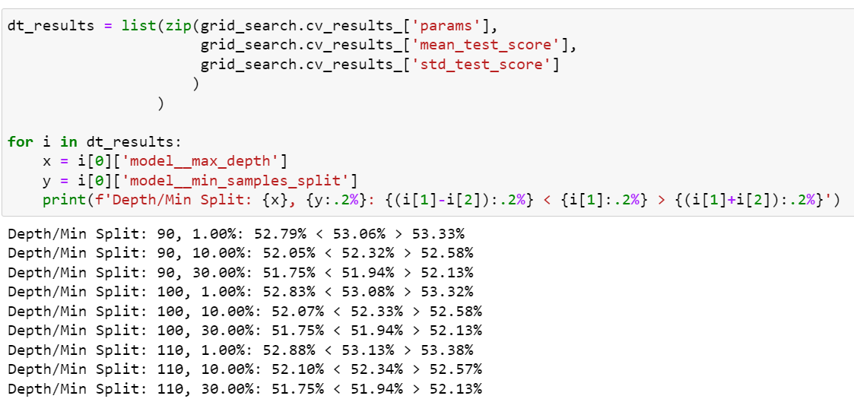

DECISION TREE
These figures show the
validation scores (53.13%) and test scores (53.03%).
By performing hyperparameter search for better parameters and implementing them in the LR pipeline.

Slide 12
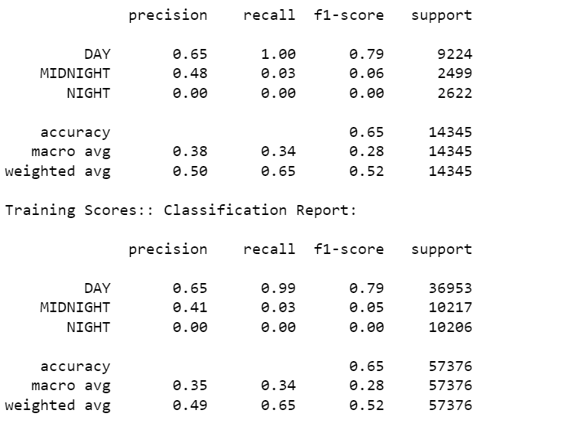
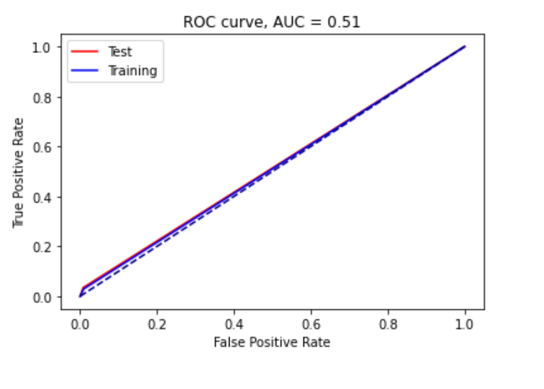
These are the Testing scores of the decision tree.
Accuracy = 65%
Performing ROC curve and getting the Area under curve values for the model.
AUC is 51%

Slide 13
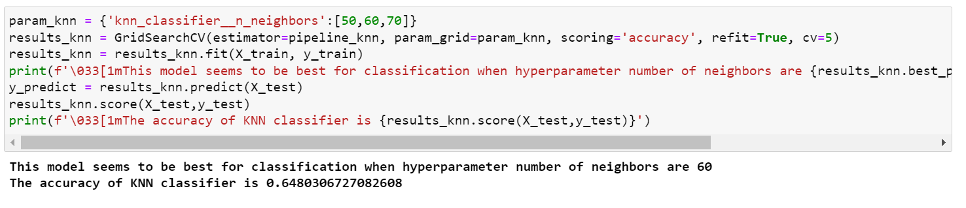
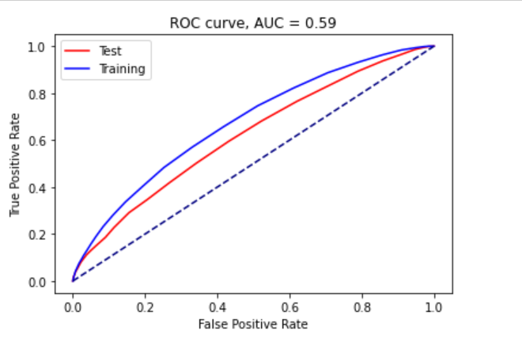
KNN- CLASSIFIER
These are the Testing scores of the decision tree.
Performing ROC curve and getting the Area under curve values for the model.
AUC IS 59%

Slide 14
CONCLUSION
Considering the three machine learning models, the Decision tree model shows the highest accuracy even though compared with the remaining models they are similar in their accuracy. Accuracy can be increased by using better modeling techniques.

