Slide 1
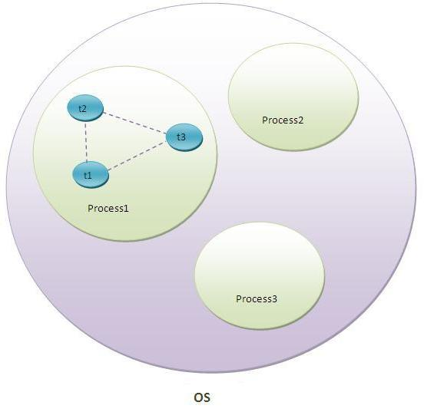
What is Multithreading?
Multitasking:-
Process-based Multitasking(Multiprocessing)
Thread-based Multitasking(Multithreading)

Slide 2
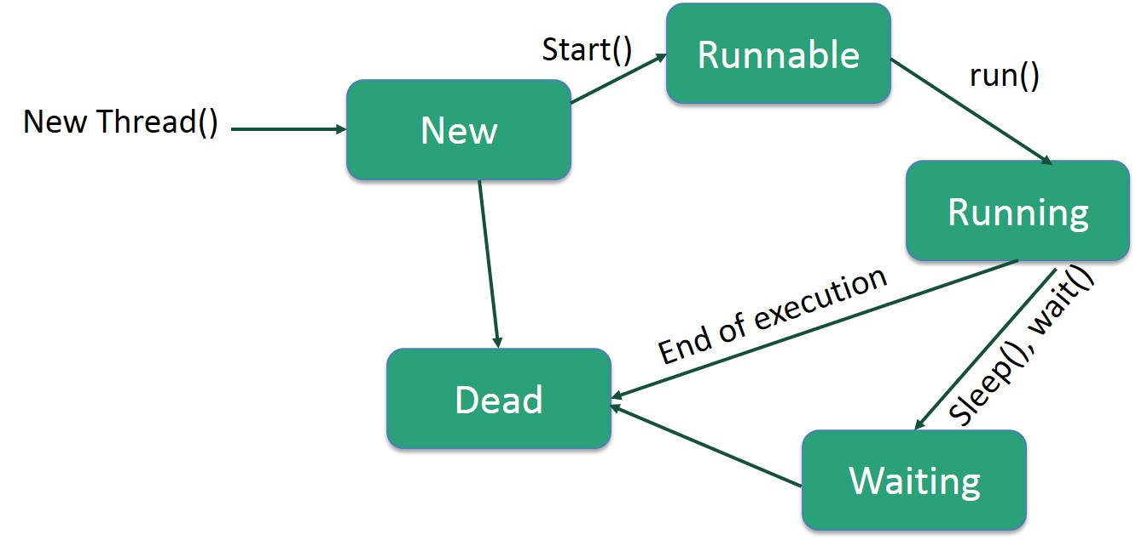
Thread Lifecycle
Thread State:-
New
Runnable
Running
Non-Runnable (Blocked)
Terminated

Slide 3
How to create thread?
There are two ways to create a thread:
By extending Thread class
By implementing Runnable interface.
class Multi extends Thread{
public void run(){
System.out.println("thread is running...");
}
public static void main(String args[]){
Multi t1=new Multi();
t1.start();
}
}
Output:-
thread is running...

Slide 4
By implementing Runnable interface.
class Multi3 implements Runnable{
public void run(){
System.out.println("thread is running...");
}
public static void main(String args[]){
Multi3 m1=new Multi3();
Thread t1 =new Thread(m1);
t1.start();
}
}
Output:-
thread is running...

Slide 5
The join() method
The join() method waits for a thread to die.
class TestJoinMethod extends Thread{
public void run(){
for(int i=1;i<=5;i++){
try{
Thread.sleep(500);
}catch(Exception e){System.out.println(e);}
System.out.println(i);
}
}
public static void main(String args[]){
TestJoinMethod t1=new TestJoinMethod();
TestJoinMethod t2=new TestJoinMethod();
TestJoinMethod t3=new TestJoinMethod();
t1.start();
try{
t1.join();
}catch(Exception e){System.out.println(e);}
t2.start();
t3.start();
}
}
Output:-
1
2
3
4
5
1
2
3
4
5
1
2
3
4
5

Slide 6
getName(),setName(String) and getId() method:
public String getName()
public void setName(String name)
public long getId()
class TestName extends Thread{
public void run(){
System.out.println("running...");
}
public static void main(String args[]){
TestName t1=new TestName();
TestName t2=new TestName();
System.out.println("Name of t1:"+t1.getName());
System.out.println("Name of t2:"+t2.getName());
System.out.println("id of t1:"+t1.getId());
t1.start();
t2.start();
t1.setName(“John");
System.out.println("After changing name of t1:"+t1.getName();
}
}
Output:-
Name of t1:Thread-0
Name of t2:Thread-1
id of t1:8
running...
After changing name of t1:John
running...

Slide 7
Priority of a Thread (Thread Priority):
public static int MIN_PRIORITY
public static int NORM_PRIORITY
public static int MAX_PRIORIT
public class ThreadPriority extends Thread{
public void run(){
System.out.println("running…");
}
public static void main(String args[]){
ThreadPriority m1=new ThreadPriority();
ThreadPriority m2=new ThreadPriority();
m1.setPriority(MIN_PRIORITY); //1
m2.setPriority(MAX_PRIORITY); //10
m1.start();
m2.start();
System.out.println("running thread name is:"+m1.getName());
System.out.println("running thread priority of M1 is:"+m1.getPriority());
System.out.println("running thread priority of M2 is:"+m2.getPriority());
}
}
Output:-
Running…
Running…
running thread name is:Thread-0
running thread priority of M1 is:1
running thread priority of M2 is:10

Slide 8
Commonly used methods of Thread class
public void run(): is used to perform action for a thread.
public void start(): starts the execution of the thread.JVM calls the run() method on the thread.
public void sleep(long miliseconds): Causes the currently executing thread to sleep (temporarily
cease execution) for the specified number of milliseconds.
public void join(): waits for a thread to die.
public void join(long miliseconds): waits for a thread to die for the specified miliseconds
.
public int getPriority(): returns the priority of the thread.
public int setPriority(int priority): changes the priority of the thread.
public String getName(): returns the name of the thread.
public void setName(String name): changes the name of the thread.
public Thread currentThread(): returns the reference of currently executing thread.
public int getId(): returns the id of the thread.
public Thread.State getState(): returns the state of the thread.
public boolean isAlive(): tests if the thread is alive.
public void yield(): causes the currently executing thread object to temporarily pause and allow other threads to execute.
public void suspend(): is used to suspend the thread(depricated).
public void resume(): is used to resume the suspended thread(depricated).
public void stop(): is used to stop the thread(depricated).

