Slide 1
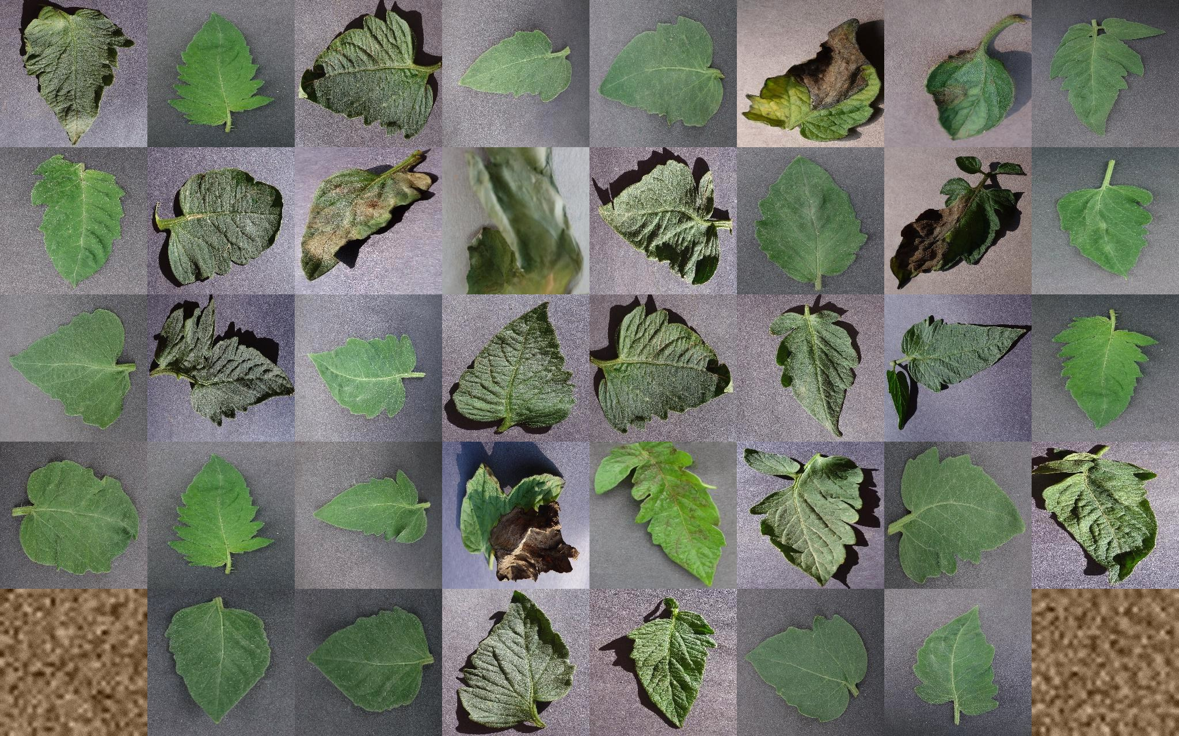
AGRISENTINEL
AUTONOMOUS FIELD HEALTH
PROTOTYPE FIELD MOSAIC
AAROH AI/ML HACKATHON
From image to verified field action.
Hybrid crop disease detection that combines local EfficientNet speed with whole-image vision reasoning — then verifies every recommendation before it reaches a farmer.
40
+
2
=
1
HYBRID DETECTION
RAG + VERIFIER
EN + HI BRIEF
inspection tiles
independent views
verified decision
LOCAL CNN
VISION LLM
TEAM OWNERSHIP
maps where
checks what
DEV A · VISHAL
DEV B · KHUSHI
Backend • ML • Agents
Frontend • UI • Demo
Notes:
Open with the reframe: AgriSentinel is not another leaf-classification app. It turns one field image into a verified decision. Introduce Vishal as Dev A for backend, ML, and agents, and Khushi as Dev B for frontend, UI, and the demo experience. Then preview the hybrid idea: the local CNN maps where disease may be, while an independent vision model checks what the whole image actually shows.

Slide 2
AGRISENTINEL
PROBLEM
02
AUTONOMOUS FIELD HEALTH
The real problem is detection-to-action latency
A disease label is useful only if it becomes a timely, targeted, and safe field decision.
01
02
03
04
Late detection
Look-alike symptoms
No spread intelligence
Unsafe next step
Only a fraction of the field is inspected; infection can spread before it is noticed.
Blight, spots, stress, and deficiencies can be confused from a single close-up.
A label does not reveal affected area, clusters, direction, or likely impact.
Generic advice can invent a chemical or dosage without evidence or a veto.
OUR REFRAME
Do not stop at “What disease is this?” Answer “Where is it, how serious is it, and what can safely happen next?”
AAROH AI/ML HACKATHON • DEV A: VISHAL • DEV B: KHUSHI
Notes:
The problem is not simply identifying a leaf. Today the chain breaks at four places: symptoms are detected late, look-alike diseases cause uncertainty, no one measures spread, and generic advice can be unsafe. AgriSentinel is designed around the full detection-to-action delay.

Slide 3
AGRISENTINEL
SOLUTION
03
AUTONOMOUS FIELD HEALTH
One upload. One autonomous path to action.
The farmer sees the field evidence, the system’s reasoning, and a plan only after verification.
1
2
3
4
5
UPLOAD
INSPECT
FUSE
VERIFY
ACT
Drone or phone field image
8 × 5 tile heatmap
Local + whole-image views
Grounding, dosage, allowlist
Schedule + farmer brief
Infection map
Spread intelligence
Verified plan
Farmer action
Progressive tile heatmap with confidence escalation
% affected, clusters, direction, yield-risk estimate
Source-backed treatment with PASS / REWRITE / BLOCK
Day-by-day schedule, cost band, rescan, EN / HI brief
The architecture changes control flow — not just wording.
AAROH AI/ML HACKATHON • DEV A: VISHAL • DEV B: KHUSHI
Notes:
Walk left to right. The user uploads once. The system tiles the image, fuses two independent visual reads, verifies the grounded plan, and produces an action schedule. The key product outcomes are visible: heatmap, spread, verified guidance, and a plain-language brief.

Slide 4
AGRISENTINEL
DIFFERENTIATOR
04
AUTONOMOUS FIELD HEALTH
Hybrid detection: local speed + global context
EfficientNet-B0 and a vision LLM inspect the same image independently before a policy-driven fusion step.
FIELD IMAGE
EfficientNet-B0
Image
Local ONNX model 40 tile predictions Maps WHERE
Drone / phone field capture
Decision Fusion Agent
Final diagnosis
RAG → Verify → Plan
Reconciles crop, disease, visible symptoms, and disagreement policy
Disease + confidence CNN spatial map preserved
Grounded treatment Veto before action
Vision LLM
Gemini / GPT-4.1 Whole-image reasoning Checks WHAT
Why hybrid?
Tile-level precision without losing the whole-field context that can expose a confidently wrong local diagnosis.
AAROH AI/ML HACKATHON • DEV A: VISHAL • DEV B: KHUSHI
Notes:
This is the new hybrid detection path. EfficientNet-B0 runs locally over forty tiles and is excellent at spatial localisation. A configurable vision LLM — Gemini today, or GPT-4.1 through the same role — reads the whole image without seeing the CNN answer. The Decision Fusion Agent reconciles them before RAG, verification, and planning.

Slide 5
AGRISENTINEL
FUSION LOGIC
05
AUTONOMOUS FIELD HEALTH
Disagreement becomes a safety signal
The fusion layer preserves evidence and changes the outcome only when the independent views justify it.
AGREE
DISEASE MISMATCH
HEALTHY CONFLICT
Same disease / healthy result
Both see disease; names differ
Vision sees clean; CNN sees ≥20% affected
Keep the CNN’s spatial heatmap and move forward with higher trust.
When vision is confident and crop-scoped, relabel infected tiles while preserving where the CNN found them.
Keep the heatmap as evidence, mark the diagnosis contested, and withhold treatment advice.
PASS FORWARD
FUSE THE NAME
REFUSE TO SPRAY
Graceful fallback
If the vision API is unavailable, the event is logged and the local offline pipeline continues — no crash, no hidden state.
AAROH AI/ML HACKATHON • DEV A: VISHAL • DEV B: KHUSHI
Notes:
The fusion policy has three important branches. Agreement passes forward. A disease-name mismatch can fuse the label while keeping the CNN’s tile map. But a clean-versus-infected conflict is fundamentally different: the system marks the result contested and refuses to recommend spraying. If the vision API is unavailable, the local pipeline continues and the event log makes that visible.

Slide 6
AGRISENTINEL
SYSTEM ARCHITECTURE
06
AUTONOMOUS FIELD HEALTH
Architecture: pixels to a verified decision
The browser, API, agents, models, knowledge, and safety boundary stay decoupled through one shared RunState.
React console
FastAPI
SUPERVISED INTELLIGENCE
Field capture
Upload • heatmap agent timeline brief + Advisor
POST run • GET state SSE events • chat
Orchestrator
PERCEPTION
FUSION
GROUND
Drone / phone JPEG or PNG
Scout • Observer Diagnose • 2nd opinion
Consensus • Spread map + severity
TF-IDF RAG 10 curated documents
Owns order, gates, branches, and the verify-redraft loop
READ / WRITE
SAFETY
ACTION
SSE EVENTS + FINAL STATE
Verifier → PASS REWRITE / BLOCK
Planner • Reporter EN / HI brief
SHARED STATE + REALTIME
Live scan
Immutable contract-shaped RunState
Offline replay
events[] is replayed over SSE; SQLite + uploads persist completed runs
ONNX Runtime • Vision LLM • TF-IDF retrieval • allowlist + dose rules
Same event consumer
CONTROL PRINCIPLE
Agents never call each other; they read and write RunState, while the Orchestrator alone decides what runs next.
AAROH AI/ML HACKATHON • DEV A: VISHAL • DEV B: KHUSHI
Notes:
Read this from left to right. The React console uploads the field image to FastAPI, which starts a background run and returns the run ID immediately. The Orchestrator is the only component that controls sequence, confidence escalation, and the verifier rewrite loop. Every specialised agent reads and writes the shared RunState; the browser receives the same event history over SSE. ONNX inference remains local, while the whole-image Observer and optional language-model work can use a hosted provider. SQLite and uploaded images make finished runs recoverable. The offline demo replays the same events into the same frontend consumer.

Slide 7
AGRISENTINEL
AGENT SYSTEM
07
AUTONOMOUS FIELD HEALTH
Eleven visible agents, one controlled execution trace
Ten specialised agents share one event-sourced RunState; the Orchestrator alone controls sequence and branching.
PERCEPTION
FIELD INTELLIGENCE
SAFETY + ACTION
1
Scout
tile + filter
1
Spread Analyst
% + clusters + direction
1
Verifier
PASS / REWRITE / BLOCK
2
Observer
whole-image vision
2
Action Planner
schedule + cost
3
Diagnostician
EfficientNet-B0
2
RAG Agronomist
source-grounded draft
4
Second Opinion
TTA under 0.75
3
Reporter
farmer brief EN / HI
5
Consensus
decision fusion
ORCHESTRATOR
Shared RunState + SSE events → live agent timeline
AAROH AI/ML HACKATHON • DEV A: VISHAL • DEV B: KHUSHI
Notes:
There are eleven visible nodes including the Orchestrator. The multi-agent design is justified by different tools and different failure modes. Perception agents operate on pixels, the spread agent performs deterministic spatial analysis, the agronomist retrieves sources, and the verifier has veto power. All mutations and branches appear in one event stream, so judges can see what ran instead of trusting an architecture claim.

Slide 8
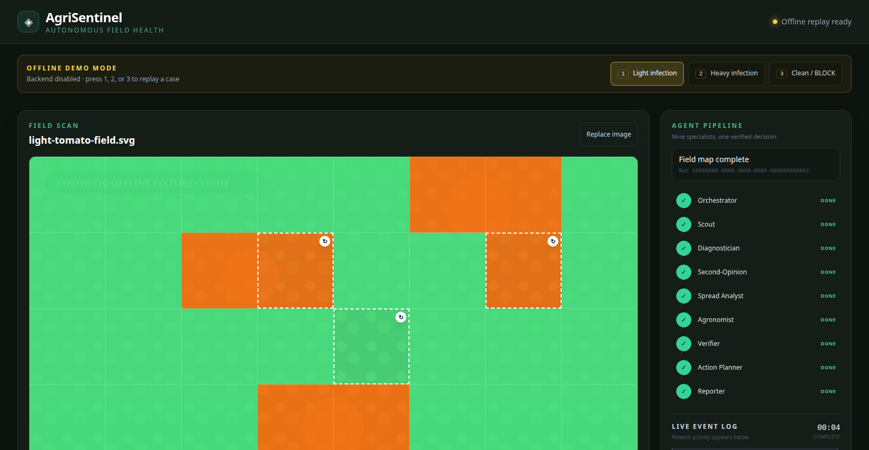
AGRISENTINEL
PRODUCT
08
AUTONOMOUS FIELD HEALTH
The full decision is visible in one console
This screenshot is the running React interface in offline replay mode, using the same event consumer as the live API.
18.4%
FIELD AFFECTED
3
INFECTION CLUSTERS
NE
SPREAD DIRECTION
7/7
CLAIMS GROUNDED
Same UI: live SSE or offline replay
AAROH AI/ML HACKATHON • DEV A: VISHAL • DEV B: KHUSHI
Notes:
This is the actual dashboard. Point out the progressive heatmap, spread cards, live agent pipeline, grounded treatment plan, and action schedule. The numbers shown are from the prepared light-infection demo case. Offline replay is deliberate demo insurance: it feeds the same frontend event consumer as the live SSE backend.

Slide 9
AGRISENTINEL
ADVISOR CHATBOT
09
AUTONOMOUS FIELD HEALTH
A run-grounded Advisor — not a generic chatbot
A stateless, run-scoped Advisor sits inside the Farmer Brief and inherits the Verifier’s safety decision.
1 Ask
2 Bind
3 Retrieve
4 Answer
INSIDE THE FARMER BRIEF
Question + recent browser transcript
Load completed RunState read-only
Disease-scoped + general practice
LLM when online; extractive fallback
ASK ABOUT THIS FIELD
Can I spray before rain?
POST /api/run/{run_id}/chat
5 Verify each sentence
6 Return a typed outcome
Avoid spraying if rain is expected within four hours; the application may wash off.
No chat state is written back to the frozen run contract.
Recompute citation • drop unsupported text • reject unsafe chemical or dose
answer • sources • grounded • refused • provider
1 SOURCE • P2
BLOCK / contested → advice withheld
SAFETY INHERITANCE
If the scan was BLOCKED or the models disagree, the Advisor never retrieves or calls a model—it explains the refusal and directs the farmer to an extension officer.
AAROH AI/ML HACKATHON • DEV A: VISHAL • DEV B: KHUSHI
Notes:
The Advisor appears inside the Farmer Brief after a completed live run. The browser posts the question and a bounded recent transcript to a run-scoped endpoint. The server loads that RunState read-only, retrieves disease-specific and crop-agnostic passages from the same ten-document corpus, and asks the language model only when available. Every returned sentence is attributed again against the evidence, and the same chemical allowlist and dosage checks used by the Verifier are applied. If the model is unavailable, the closest extractive passage is returned with honest framing. If the run was blocked or contested, the Advisor never reaches retrieval or the network; it explains why advice was withheld.

Slide 10
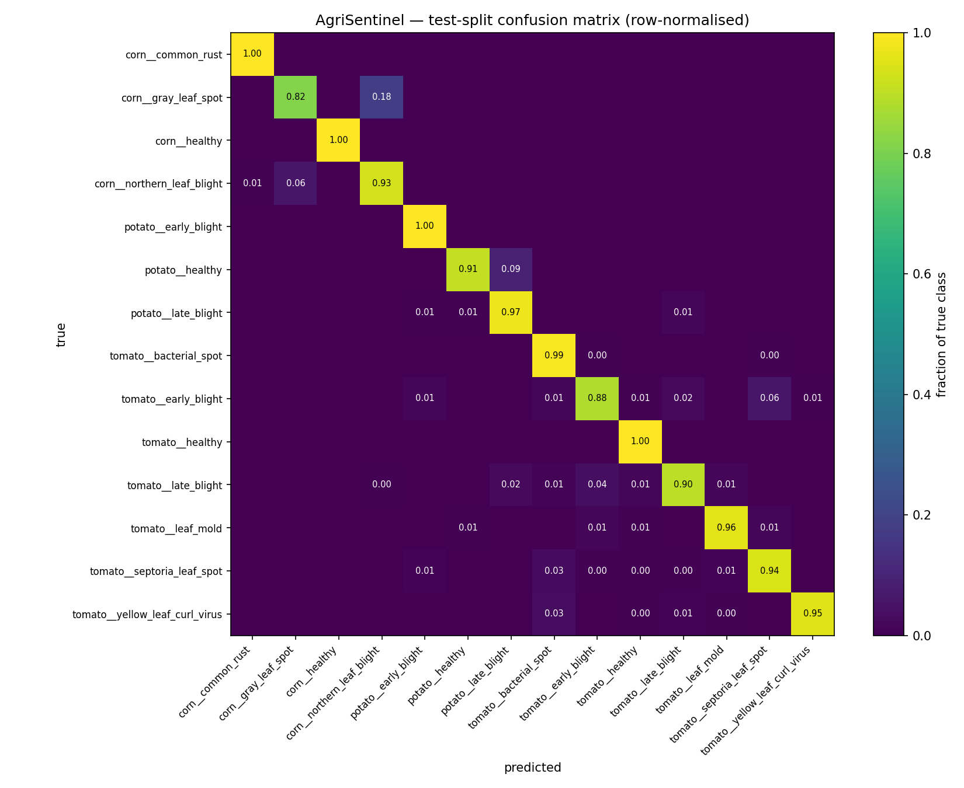
AGRISENTINEL
EVIDENCE
10
AUTONOMOUS FIELD HEALTH
Measured performance, not presentation claims
Results below come from committed artifacts and a 2,399-image, 14-class PlantVillage test split.
95.6%
94.7%
TEST ACCURACY
MACRO-F1
clean test split
+2.6 pp vs scratch
99.3%
6.5 ms
CONFIDENT ACCURACY
CPU / TILE
confidence ≥ 0.75
ONNX Runtime mean
0.46 s
91.1%
OFFLINE SCAN
MOSAIC TILE ACCURACY
median end to end
labelled synthetic grid
EfficientNet-B0 confusion matrix • 14 classes
Sources: ml/artifacts/metrics.json, latency.md, pipeline_scan.md, baseline_comparison.md
AAROH AI/ML HACKATHON • DEV A: VISHAL • DEV B: KHUSHI
Notes:
State the evidence boundary before the numbers: these are PlantVillage test-split and labelled synthetic-mosaic results, not real-field accuracy. The fine-tuned EfficientNet reaches 95.6 percent accuracy and 94.7 percent macro-F1. ONNX CPU inference averages 6.5 milliseconds per tile, and the entire offline pipeline has a 0.46-second median.

Slide 11
AGRISENTINEL
VALIDATION
11
AUTONOMOUS FIELD HEALTH
The lab-to-field gap is real — so we expose it
Image degradation alone costs 9.0 accuracy points and more than doubles the escalation load.
15.8% → 35.9%
Clean test
95.6%
tiles escalated below 0.75 confidence
Mild simulation
92.8%
EVIDENCE BOUNDARY
Field simulation
86.6%
Original real-field benchmark: not collected yet
Next: 30–50 untouched phone photos with provenance, then report the measured gap even if it is large.
Accuracy under progressively harder image conditions
Source: ml/artifacts/lab_vs_field.json • simulated “field” changes quality, not scene composition
AAROH AI/ML HACKATHON • DEV A: VISHAL • DEV B: KHUSHI
Notes:
This is the honesty slide. Under simulated field degradation, accuracy falls from 95.6 to 86.6 percent and escalation rises from 15.8 to 35.9 percent. That simulation still does not add real clutter, overlapping leaves, soil, or camera variation, so it is not a substitute for original field photos. The next validation step is explicit.

Slide 12
AGRISENTINEL
SAFETY
12
AUTONOMOUS FIELD HEALTH
Refusal is a successful product outcome
The Verifier can revise or stop treatment advice while still returning the field evidence and diagnosis context.
PASS
ADVERSARIAL TEST
RAG treatment draft
Verifier
Show plan
Every sentence carries a retrieved source marker
Grounding • allowlist • dosage sanity
10
crafted attacks
REWRITE
Regenerate / strip
2 landed
2 caught
0 leaked to the farmer
BLOCK
Withhold treatment
Small-sample counts — not a claimed universal rate.
BLOCK means no dosage, schedule, cost, or rescan prescription — only the evidence, reason, and a safe referral.
Source: ml/artifacts/block_rate.md • 10 attacks, 2 reached the plan, both were blocked
AAROH AI/ML HACKATHON • DEV A: VISHAL • DEV B: KHUSHI
Notes:
The verifier is a real control boundary. It checks whether claims are supported, whether chemicals are allowlisted, and whether dosage formats and ranges are sane. In the prepared adversarial test, ten attacks were attempted, two reached the plan, both were caught, and zero leaked. Call these counts, not a universal safety rate.

Slide 13
AGRISENTINEL
EXECUTION
13
AUTONOMOUS FIELD HEALTH
Two developers. One contract. One integrated demo.
Dev A and Dev B worked in parallel against the same RunState and endpoint contract.
DEV A • VISHAL
DEV B • KHUSHI
SHARED INTEGRATION BOUNDARY
AI Systems + Backend
Product UI + Demo
CONTRACT
Frozen RunState JSON schema
Model training + ONNX inference
React console + responsive field UX
TRANSPORT
POST / GET / SSE / health / chat
Orchestration, agents, RAG, safety
Heatmap, agent timeline, safety UI
DEV A
Publishes state + ordered events
FastAPI, SSE, storage, evaluation
Offline replay, brief, Advisor experience
DEV B
Renders live or replay identically
Integration rule
Dev A owns the system behind the contract; Dev B owns every user interaction in front of it.
AAROH AI/ML HACKATHON • DEV A: VISHAL • DEV B: KHUSHI
Notes:
Vishal is Dev A and owns the backend, model pipeline, orchestration, agents, retrieval, verifier, Advisor, and evaluation evidence. Khushi is Dev B and owns the React product experience: upload, heatmap, activity timeline, safety states, farmer brief, Advisor UI, responsive behaviour, and demo replay. The frozen RunState and endpoint contract let both developers work in parallel and made final integration predictable.

Slide 14
AGRISENTINEL
VISION
14
AUTONOMOUS FIELD HEALTH
AgriSentinel turns uncertainty into a safer field decision.
PROTOTYPE SCOPE
Tomato • Potato • Corn
14 disease / healthy classes
Not just “what disease?” — but where it is, how serious it may be, and whether the next action is evidence-backed enough to show.
NEXT VALIDATION
Real-field benchmark
SEE
Hybrid detection combines local spatial precision with whole-image context.
30–50 original photos • crop/device calibration • regional agronomy review
VERIFY
RAG grounding and a hard veto stop unsupported treatment from shipping.
THANK YOU
ACT
The farmer gets a field map, schedule, cost band, and EN / HI brief.
Dev A: Vishal
Dev B: Khushi
Aaroh AI/ML Hackathon
AAROH AI/ML HACKATHON • DEV A: VISHAL • DEV B: KHUSHI
Notes:
Close with three words: see, verify, act. AgriSentinel combines two visual perspectives, turns evidence into an auditable decision, and knows when to refuse. The immediate next step is not more features; it is the real-field benchmark and calibration needed to earn deployment trust. Thank the judges.

