Slide 1

Stock Quant
Shubham SaurabH
Seth Smithson
Costas Vogiatzis
Time series analysis
Indiana university
Spring 2023

Slide 2


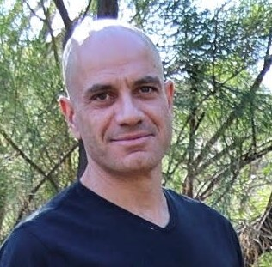
Team
Seth Smithson
sesmit@iu.edu
Shubham Saurabh
ssaurab@iu.edu
Costas Vogiatzis
cvogiatz@iu.edu

Slide 3
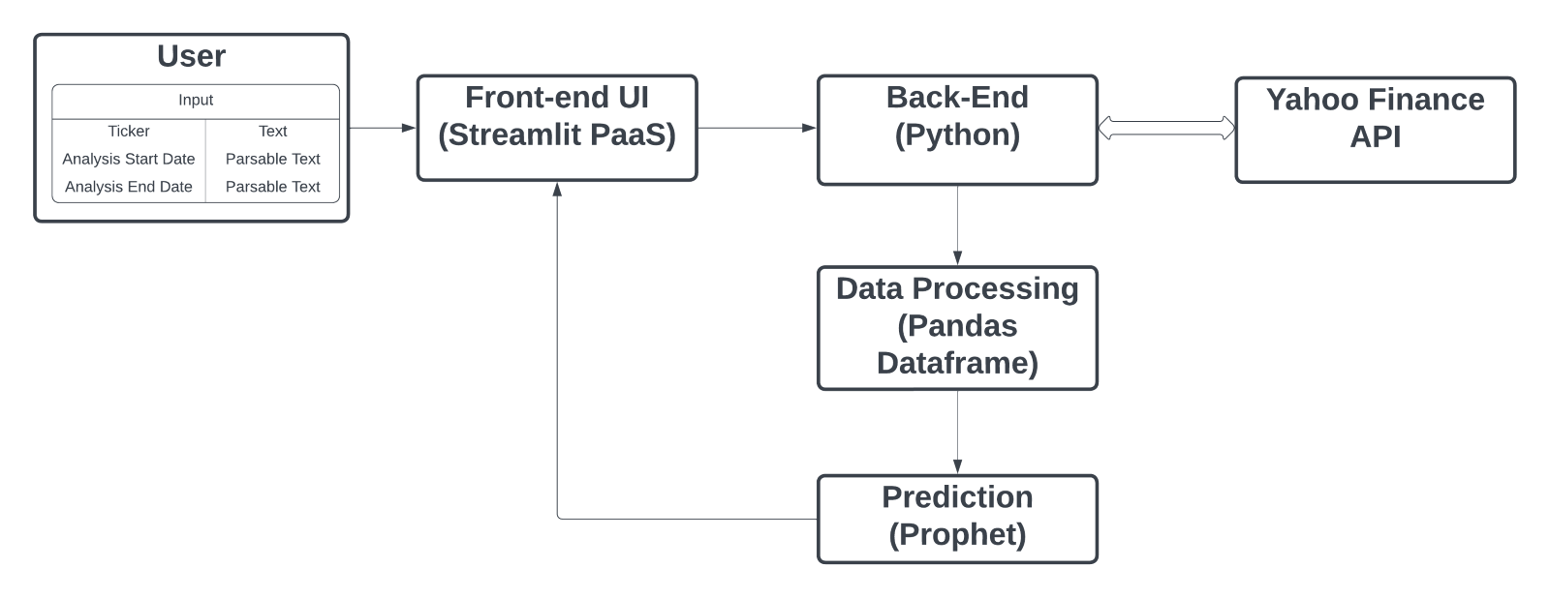
Application Architecture
Notes:
The User interacts with the Streamlit Front-end UI and selects the Ticker and Date range using Streamlit’s built-in widgets.
The Front-end communicates with the Python Back-end.
Python Back-end fetches stock data from the Yahoo Finance API.
The Yahoo Finance API is used as the primary data source, with data fetched directly and stored in a Pandas dataframe and processed on-the-fly.
The dataframe is loaded into the Prophet machine learning algorithm, which generates predictions which are then displayed in the Front-End UI for the user to examine.

Slide 4
Let’s see the app!
https://vishubham-tsa-final-project-01-stock-quant-knvhvh.streamlit.app/

Slide 5
Conclusions
Interactive and intuitive web app
Simplifies stock analysis for individual investors
Combines power of Streamlit, Prophet, Plotly and Pandas

