Slide 1

Infosys Digital Makeathon
Team NOOBS

Slide 2
Problem Statement: Facial Recognition Based Entry in Classrooms + Activity Tracking of Classes

Slide 3
Database of Student Information
[Cloud Hosted]
[MongoDB]
Camera Inside the Classroom
Camera at Entry Point
Record Student Activity
Record Attendance
Send Activity Status
ML Model
[OpenCV, Tensorflow]
And Custom-Made Haar Cascade
Teacher’s Dashboard
[ReactJS, ExpressJS, NodeJS]
Send Attendance Data
Send Enrollment Data
GUI For Enrollment
[PyQT5 and CSS]
Technical Design

Slide 4
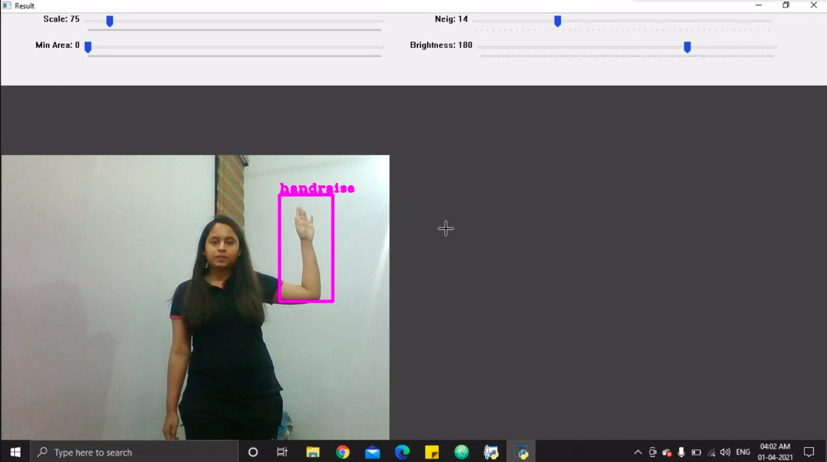

Slide 5
Main Features: ¤ The teacher can access the attendance in one place. ¤ End-semester attendance calculation can be done easily – no more registers to be checked. ¤ ‘Shortage of Attendance’ notifications can be noticed easily. ¤ Provides activity tracking to help judge engagement of students in class. ¤ Promotes peer empowerment and team building. ¤ The university/college authorities can use the activity data of each classroom to track the effectiveness of the teacher’s lessons. More activity means that the teacher is succeeding in keeping the class engaged.

Slide 6
Benefits:
Saves time by automating attendance.
Alerts about attendance shortage in advance.
Simplifies the job of the teacher.
In-class monitoring ensures students participate more in class and teachers work harder to keep class engaged.
Internal assessment based on class performance can be done easily.
Student data can be updated anytime by easy to use GUI.

Slide 7
Assumptions:
Camera inside class is calibrated to the room specification.
Only Admin can add and remove data.

Slide 8
Future Scope:
Facial Recognition use cases are limitless but in our use case especially for education the future work is to not only detect the attendance but also students activity. For now we are detecting activating for hand raising later on it can also be implemented for talking detection or fight detection or any other bad as well as good activity while will really be helpful for monitoring students behavior, analyze it and taking important steps to improve the same.
Another future use case is examination proctoring as well.

